Slide 1
Increasing Pump Use in Patients with Diabetes at Cook Children’s Endocrinology and Diabetes Clinic
Stephanie Ogburn RN, BSN, CDCES, Christin Morell RN, BSN, Candice Williams NP, CDCES,, Susan Hsieh MD, Mouhammad Alwazeer MD, Luke Cielonko DO

Slide 2
Cook Children’s T1D Exchange Collaborative Key Diagram Driver

Slide 3
Background
There is evidence that insulin pump use in youth contributes to moderate improvement inAa1c, decreased hypoglycemia, decreased DKA risk, as well as decreased risk of complications when compared with MDI. Additionally, evidence suggests the use of automated insulin delivery systems (AIDs) reduces A1C, improves TIR, lowers risk of exercise-related hypoglycemia, and reduces diabetes burden, therefore contributing to psychosocial benefits.
Recommendation of insulin pump therapy being the main mode of insulin delivery in pediatric patients with Type 1 Diabetes under the age of 7
At baseline insulin pump use at Cook Children’s is 38%

Slide 4
Objective
The objective of this project is to increase pump use by 15% by July 2023, with a secondary objective to decrease the time of pump interest to pump start to less than 100 days at the Cook Children’s Endocrinology and Diabetes Clinic by the end of the year

Slide 5
Methods
PDSA 1
Group pump training and group PFU
4 patients
PDSA 2
Group pump training and group PFU
6 patients
PDSA 3
Phone PFU, 2 calls
4 patients
PDSA 4
Phone PFU, 1 call
5 patients

Slide 6
Fishbone
Notes:
Provider bias

Slide 7
Pump Process

Slide 8
PDSA 1
AIM Shorten timeframe from pump interest to pump follow up
Intervention:
Group pump training with pump company trainer
Group pump follow up with Cook diabetes educator and provider
Barriers encountered:
Classroom space
Insurance
Provider availability

Slide 9
PDSA 2
Intervention:
Group pump training with pump company trainer
Group pump follow up with Cook diabetes educator and provider
Barriers
Classroom space
Insurance
Provider availability

Slide 10
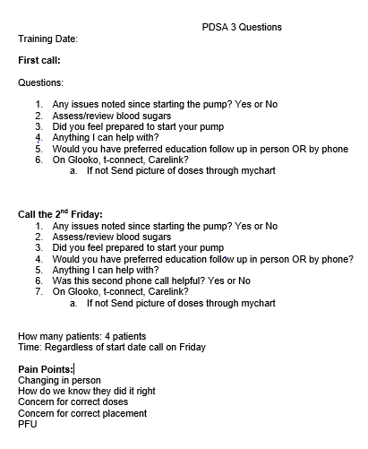
PDSA 3
Intervention:
Pump training by pump company trainer
Diabetes educator contacts with family the Friday following training as well as the next Friday (2 calls
Barriers:
Pump Trainer availability

Slide 11
PDSA 3 Results

Slide 12
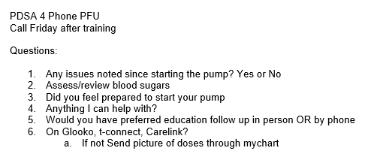
PDSA 4
Pump training by pump company trainer
Diabetes educator contact with family the Friday following training

Slide 13
PDSA 4 Results

Slide 14
Discussion
Outliers
Family rescheduling pump class due to family schedule conflict
Family unsure of which pump they wanted (waited over 1 year to decide)
Insurance issues

Slide 15
Next Steps
Increase phone PFU patients to see sustainability of diabetes educators making Friday phone PFU calls
Determine specific day of the week for pump trainings with pump company trainers
Module based pump class allowing multiple languages and improved patient experience
Provider initiating conversation on pump use
Redo provider bias survey

Slide 16
Cook Children’s Endocrinology & Diabetes
POPULATION (BASED ON 2022 DATA)
Total Patient <18yo with T1D and 2 or more visits per year : 1,010 (Female 502 and Male 508) (~2000 total)
Newly diagnosed annually: ~300
Payor Mix: 37% Medicaid
OUR TEAM
Doctors: 14 (12 FTE)
Nurse Practitioners: 3 (all are CDEs)
Diabetes RN/CDCEs: 11 (9.2 FTE)
Registered Dieticians: 4 (3 FTE)
Clinical Therapists: 3 (2 FTE)
Social Worker: 1
Child Life Specialist: 2 (inpatient and outpatient)

Slide 17
References
ElSayed NA, Aleppo G, Aroda VR, et al., American Diabetes Association. 7. Diabetes technology: Standards of Care in Diabetes—2023. Diabetes Care 2023;46(Suppl. 1):S111–S127

Slide 18
Thank You
Contact
Stephanie Ogburn
stephanie.ogburn@cookchildrens.org
cookchildrens.org

