Slide 1
T1DX T2D Project Kick-Off
February 6, 2023

Slide 2
Agenda
Introduction
T2D Pilot Overview
Participating sites
Timeline
AIM
Understand the expectation
Deliverables
Questions

Slide 3
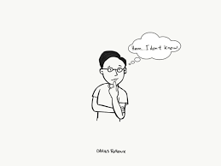
Introduction
Why are you interested in this project?
Notes:
Brief overview of previously shared tools (what they were, when you use them, and where to find them on Trello)

Slide 4
Overview of the 2021-2022 pilot

Slide 5
Introduce 2 pilot clinics
SUNY
PI: Marisa Desimone, MD. Clinical focus: adult endocrinology
N pts 3,363
Providers: 7 MDs
Type: adult endocrine practice
Stanford
PI: Sandra Tsai, MD. Clinical focus: Preventive Cardiology & Internal Medicine
N pts 3,049
Providers: 30 MDs
Type: adult primary care practice

Slide 6
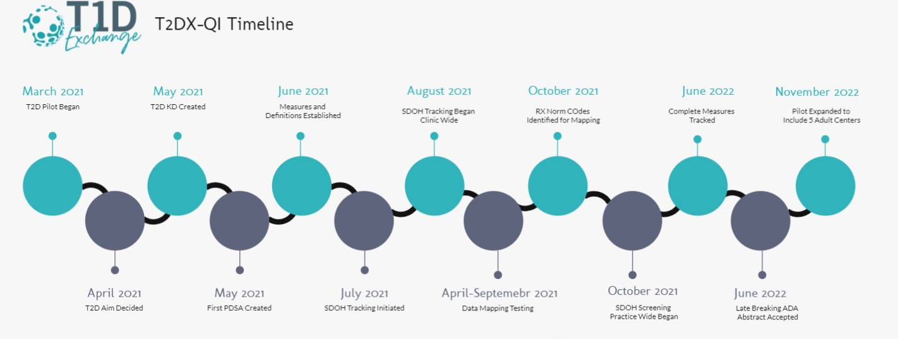
Notes:
Add to Establishment paper
Revise- call out KDD- deid center names
Extend to 2023- extend to 5 centers

Slide 8
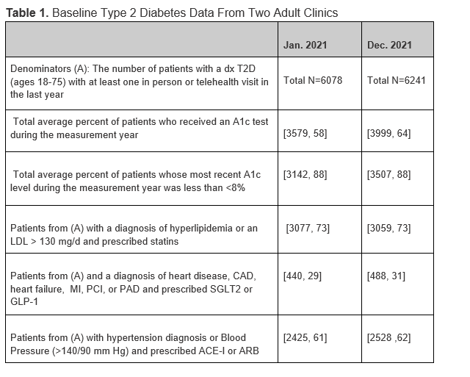

Slide 9
Achieving A1c results through CGM interventions
Notes:
Multi-Clinic Quality Improvement Initiative Increases Continuous Glucose Monitoring Use Among Adolescents and Young Adults With Type 1 Diabetes | Clinical Diabetes | American Diabetes Association (diabetesjournals.org)

Slide 10
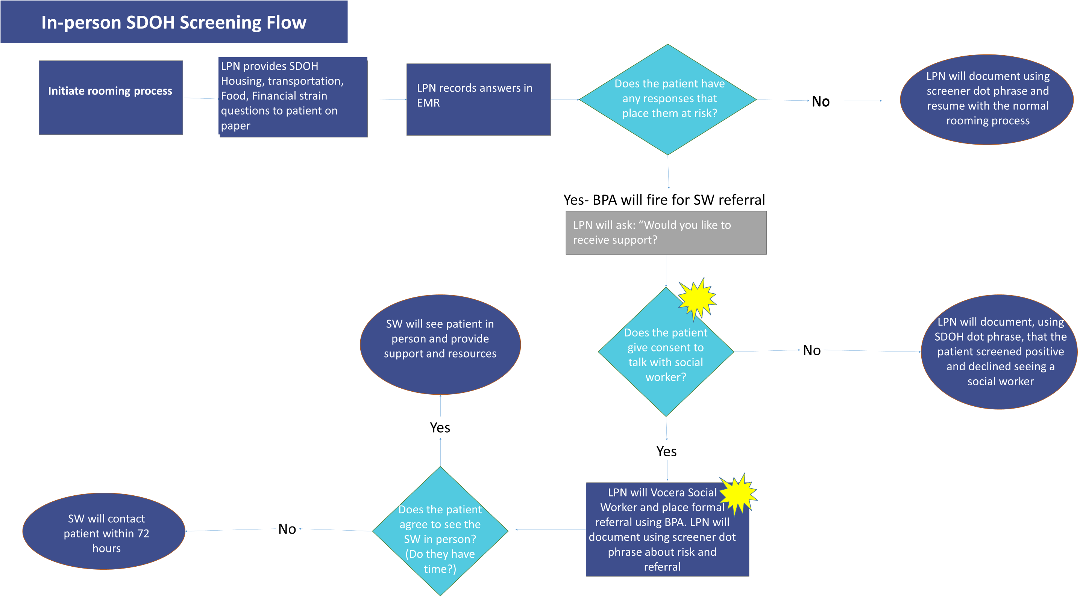
Social Determinants of Health Screener Workflow

Slide 11
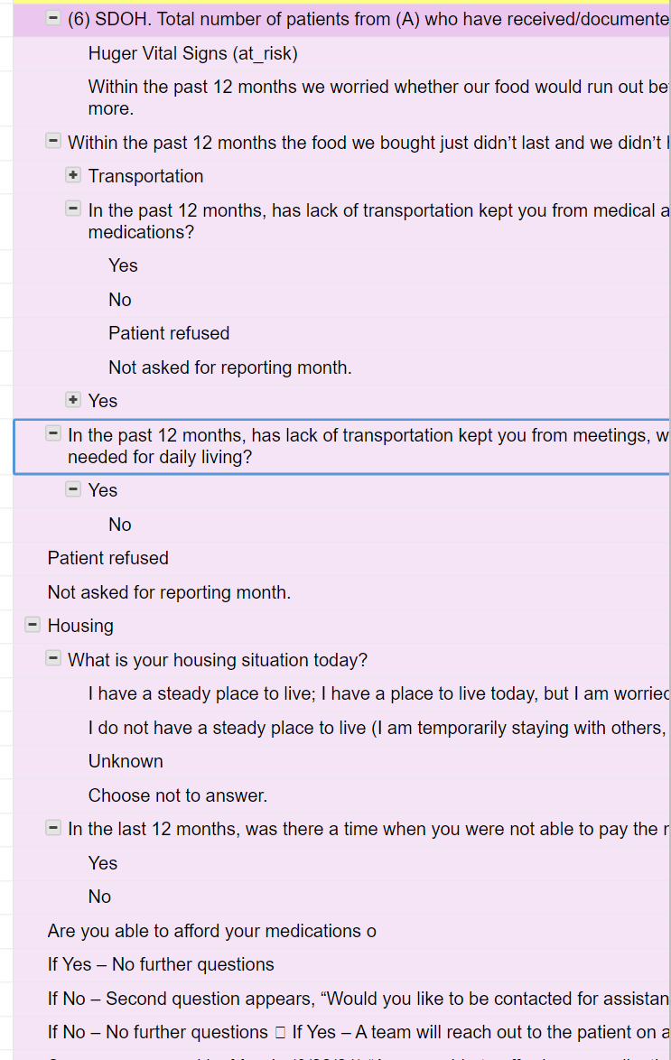
Addressing Inequities and SDOH

Slide 12
Results
Improved team capacity, tracked changes, and make improvements in T2D care in two clinics
Prescribing rates of Sodium-glucose Cotransporter-2 (SGLT2) and Glucagon-like peptide-1 (GLP-1) receptor agonists increased by 18%
Depression screening increased by 34%.
The two clinics began SDOH screening in August 2021 and screened 6,515 patients in the first seven months of the intervention.

Slide 13
Plans for 2023-2025

Slide 14
Participating Sites

Slide 15
Timeline | Expectations
January 2023 –July 2023 (6 months) | All participating sites will report project baseline data using the smart sheet. All participating sites will review their existing data.
February/March 2023 | Hold Kick off meeting/Plan recurring monthly meeting Each site will identify champions for the QI project, including at least one patient/parent who identifies as Black or Hispanic Introduce the Equity 10 step Framework program to clinics. Develop measures set related to race/ethnicity and device use.
April 2023 | Teams map out current process and annotate pain points in the process. Teams will share process map at meeting in April
May 2023 | Team will perform a fishbone activity/ create KDD

Slide 16
Timeline | Expectations
June 2023 –June 2025 | Use PDSA Cycles to test interventions starting with one provider and scaling across the clinic. Weekly/bi-weekly Plan-Do-Study-Act Cycles. Each team will have the opportunity to complete at least 20 PDSA cycles.
June 2025- December 2025 | Each center will present projects at conference calls and learning sessions. Develop a type 2 Diabetes Pilot Change Package that supports new QI strategies and interventions to improve equitable care in diabetes practices. Submit T2D Health Equity abstract to the ADA Scientific Sessions. Draft T2D Health Equity manuscript intended for 2025 publication.

Slide 17
Project Expectations

Slide 18
T1D Exchange Equity Framework:
Ebekozien OA, Ori Odugbesan et al Equitable Post COVID-19 Care: A Practical Framework to integrate Health Equity in Diabetes Management. Journal of Clinical Outcomes and Management Nov 2020 https://doi:10.12788/jcom.0025

Slide 20
Provider states patient would benefit from CGM
1
Route note to education pool or individual educator
2
3
4
Script is signed for CGM
Where is script sent?
DME pharmacy requests: notes, insurance information
Is more info needed?
DME Pharmacy
No
one.
5
Approval given, patient called by DME pharmacy to relay cost information, sensor sent out
Local Pharmacy
Yes
Was this supposed to go to local pharm?
8
No
Approval given, patient called by pharmacy to relay cost information, sensor sent out
Yes
Denial
Needs to be sent to DME Pharmacy
6
New information including updated information sent to DME
Was Rx approved?
Yes
No
7
Approval given, patient called by DME pharmacy to relay cost information, sensor sent out
Requests: notes, insurance information
Example of Site Process and Pain Points for CGM
call

Slide 21
Baseline data shared in Feb 2023 for reporting
Clinic Name | BMC | UPMC | SUNY | Stanford | Wash U | U Miami
Denominator | 4350 | 9641 | 3193 | 3000 | 4437 | 3500
Public Insurance | 3045 (70%) | 5396 (56%) | 2427 (76%) | 1000 (33%) | 2584 (58%) | 1950 (58%)
White pop | 2080 (48%) | 7915 (82%) | 2267 (70%) | 1200 (40%) | 3378 (76%) | 2450 (70%)*
Hispanic pop | 780 (18%) | 96 (<1%) | 148 (<1%) | 600 (20%) | 84 (<1%) | 2100 (60%)
CGM use | n/a* | 3085 (32%) | 1013 (32%) | 1000 (33%) | 861 (19%) | n/a
A1c | 3900 (90%) | 8574 (90%) | 2207 (69%) | 2600 (87%) | 2428 (58%) | 3500 (100%)
Mean A1c | 8.7% | 7.8% | 7.9% | 8.0% | 8.7% | 7.5%
A1c below 8% | n/a | 6127 (71%) | 1351 (61%) | 1200 (46%) | 944 (38%) | 2275 (65%)

Slide 22
CGM Uptake Key Driver Diagram
Outcomes/Aim
Key Drivers
Change Ideas
Increase 10% utilization of continuous glucose monitors (CGM) for people with T2D by 10/31/24. Demonstrate reduction in CGM disparities by 3%
Support patients starting CGM
Support patients starting CGM during new visits and annual visits.
Coach and educate patients on effective CGM use
Educate patients on CGM use.
Follow up with patients who express an interest.
Identify inequitable processes
Redesign workflows to ask patients about their interest in CGM and address barriers. Re-offer CGM as appropriate.
Use ten step equity framework
Provide CGM training for patients in clinic, through telehealth, and online.
Provide CGM training for clinical staff.
Train and educate clinical teams on CGM
Create tools in EMR to facilitate insurance and vendor approval. Navigate and mitigate hurdles with patients.
Partner with vendors and payors to support equitable device access

Slide 23
Improve Cardiovascular Health Key Driver Diagram
Outcomes/Aim
Key Drivers
Change Ideas
Increase prescription for cardioprotective medication by 10%, demonstrate a reduction in disparities by 3%.

Slide 24
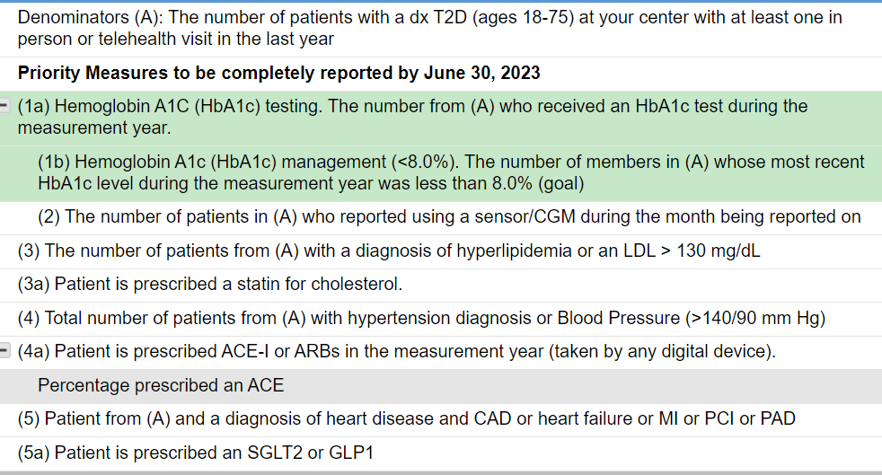
Measures
Notes:
I stuck in if useful- maybe better to just have live screen showing to allow edits in real time

