Slide 1
Clinical Leadership
2/10/2023

Slide 2
Agenda
Welcome and Introductions
Clinical Interest Survey
Annual Survey Review
Review Yearly Questions
Discuss 2023 proposed topics
Member Website Q&A Discussion
Teplizumab
Saline education when starting pumps

Slide 3
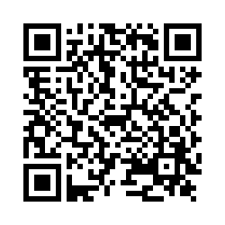
Clinical Interest Survey
If you have not filled out the Clinical Interest survey, please use this link or scan the QR code. This helps us identify the topics you are interested in for publications.

Slide 4
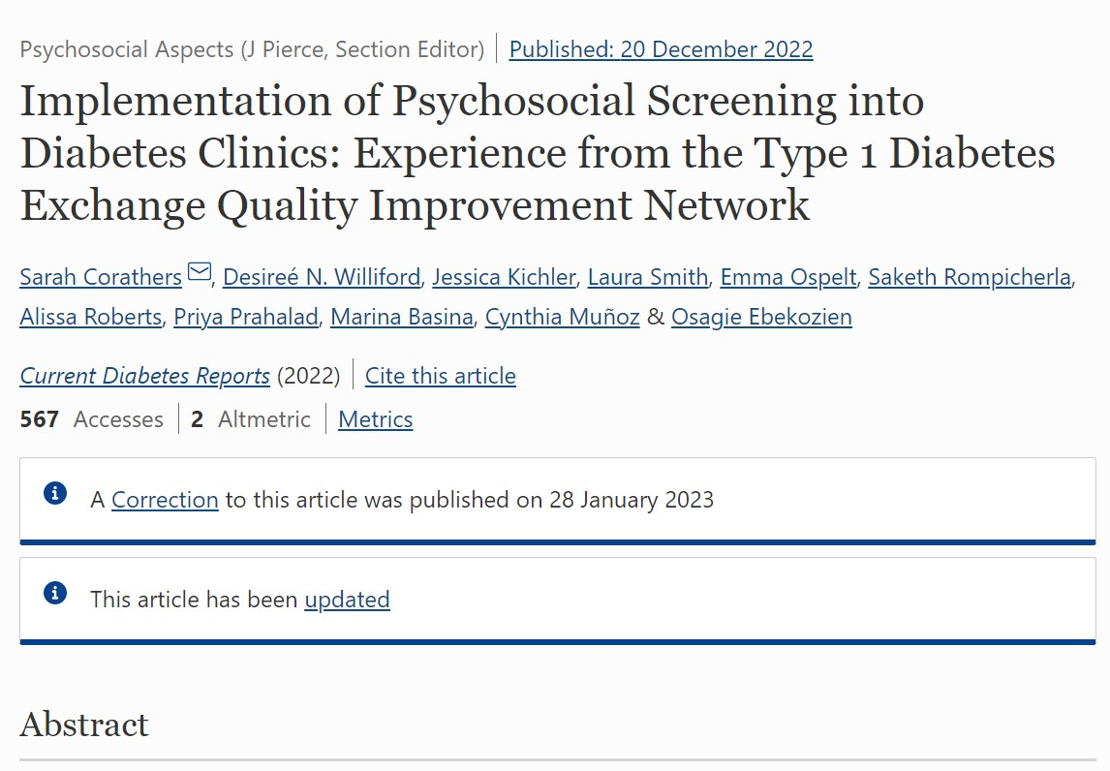
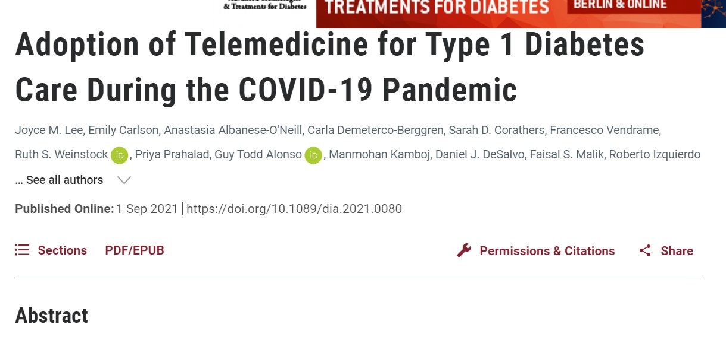
2021 Annual Clinic Survey Outputs
Two publications on psychosocial screening and telemedicine were a direct result of the 2021 Annual Clinic Survey data

Slide 5
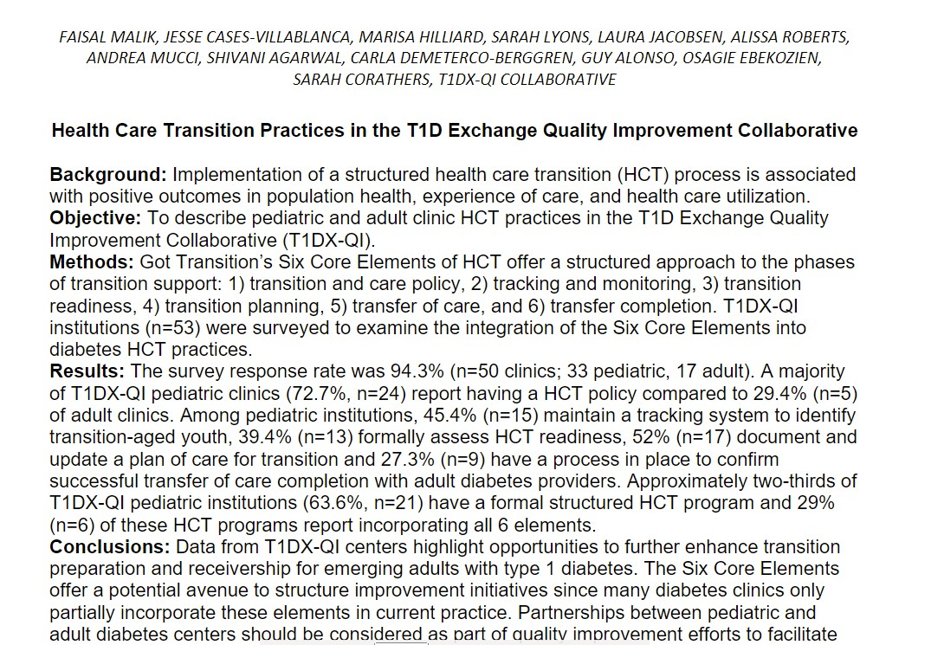
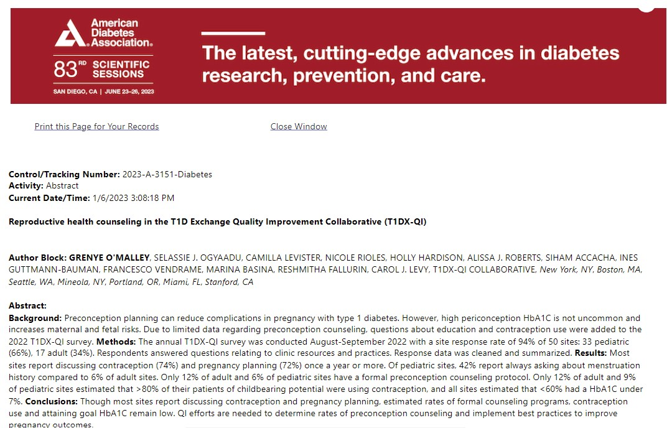
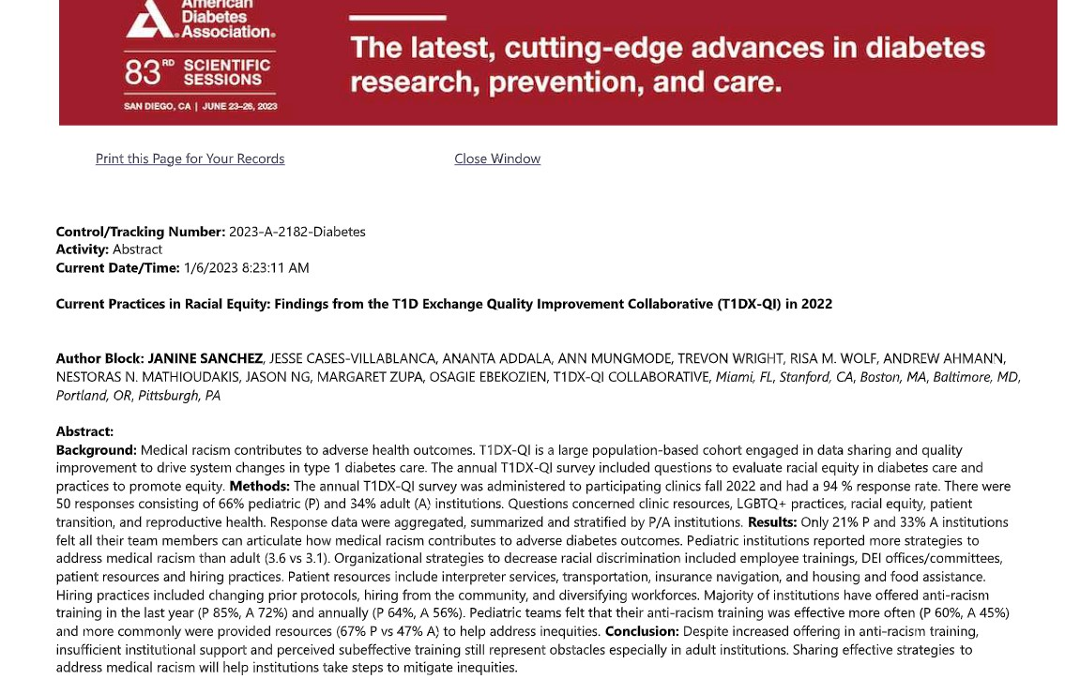
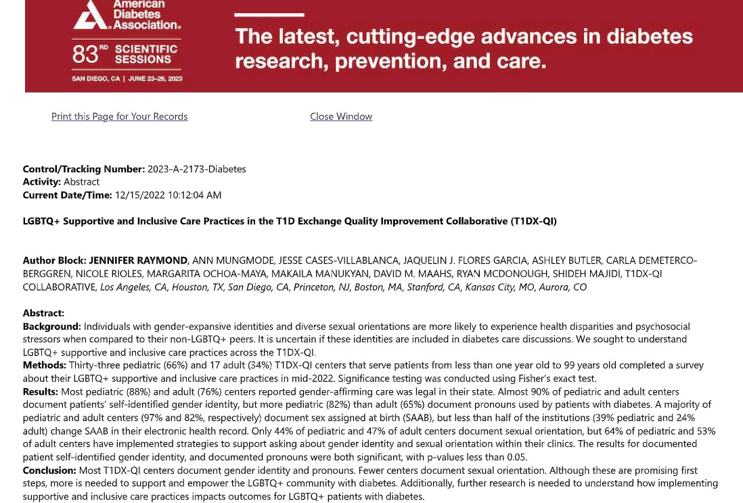
2022 Annual Clinic Survey Outputs
4 abstract were submitted to ADA and will be submitted as manuscripts as a result of 2022 Annual Clinic Survey data.

Slide 6
2023 Annual Clinic Survey
Yearly Questions on:
Clinic Staffing and Structure
T1D and T2D patient numbers
FTE
Proposed Topics:
Cannabis Use
Diabetes Education Documentation
Open Discussion for 2 more topics

Slide 7
Member Website Questions on Tepilzumab
Question:
What are centers doing for weekend infusions?
Has anyone successfully treated someone with TZield in the clinical setting?
Name: Daniel DeSalvo, MD
Clinic: Texas Children’s Hosptial
Adult or Pediatric Population: Both
Question:
We are wondering what other clinics have procedures in place with the new announcement of Teplizumab.
Name: Grace Nelson, MD
Clinic: Le Bonheur Children’s Hospital
Adult or Pediatric Population: Both

Slide 8
Member Website Questions on Saline Pump Education
Question:
Does your clinic use saline education when initiating insulin pumps? Or have you eliminated this from your practice?
Name: Olivia Docter, BSN, RN, CDCES
Clinic: Barbara Davis Center
Adult or Pediatric Population: Both

