Slide 1
SUNY Upstate Medical University
Dr. Rachel Hopkins
Dr. Ruth Weinstock
Margaret Greenfield, PTA, MS, CHES
Emilie Hess, MS

Slide 2
Equity Project KDD (CGM)
Change Ideas
Equity/unconscious bias training
Aim
Primary Drivers
Accessibility to translated materials
Have CDE/SW work with Black and NHB patients to address SDOH
Utilize community outreach staff to help families with some of the more difficult steps
Disparity Advocacy
Translator available in clinic
Live interpreters for CGM starts and follow ups
A. Participating Centers will collaboratively reduce the Inequities in CGM Use between Non-Hispanic White and Hispanic T1D Patients from 10% to 5% by June 2022 B. Participating Centers will collaboratively reduce the Inequities in CGM Use between Non-Hispanic White and Non-Hispanic Black T1D Patients from 10% to 5% by June 2022
Provider & Team Bias
Equity/SDOH
Handouts from companies in other languages
Device data reviews and interpretation, staff troubleshoot device for patients who need it
Create CGM peer support groups for Blacks and NHB patients
SDOH screening at every visit
Education/Training
Discuss CGM regularly at appointments
Provide education on basic criteria for insurance (Medicaid vs Private)
Have CGM education visible in waiting rooms
Decrease time between obtaining CGM and receiving CGM education
Utilize Patient advocates to help talk with technology hesitant families
Force function/automatization
Provider training
Technology
Tracking insurance forms/refills/initial starts
Create process for CGM start based on insurance type
Improve/standardize workflow for insurance coverage
Provide contact information for device reps/patient support
Lessen insurance requirements that make it so hard to get technology
Standardize criteria for prescription
Force function/automatization
Policies/Insurance
Access
Require patients to provide logs at initiation
Standardize communication for staff and device companies
FAQ education sheet
Use EPIC flow sheet identify barriers
“CGM champion” to help follow up with family
Nurse training/outreach
Communication/
Shared decision
Provide alternative contact options for families to call clinic: Email, iConnect message
Best practice alert reminder
Barrier assessment survey
More time with CDE and make introduction to technology a bigger part of initial education
Equity Framework
Utilize PDSA cycles to test small changes and scale up

Slide 3
Patient is requesting supplies.
Patient is interested in, or is exploring, CGM options
Patient meets with float OR provider will send chart to front desk and front desk will schedule appointment
DCES will discuss CGM options and benefits
Does the patient decide they want CGM
Patient has decided they want CGM, including which model.
Yes
No
In Wrap Up tab, “send chart upon closing” to Pump/CGM/CMN pool with message
In Wrap Up tab, “send chart upon closing” to Pump/CGM/CMN pool with message
DCES working in the pool will reach out to patient to initiate order either through DME or local pharmacy depending on insurance
DCES will document using .joscgminterestwithouttrial that the patient isn’t interested at this time
DCES working in the pool will reach out to patient to initiate order either through DME or local pharmacy depending on insurance
LPN working in pool will process.
Clerical Staff will reach out 3 weeks after order is placed to schedule education visit
When the DCES completes the DME form, the CGM will be added to med list and route note to Clerical Team to follow up
Has the patient received CGM?
No
Yes
Schedule patient for training unless they decline
Clerical Staff will message to Joslin Adult Education Team and DCES will reach out to company
Yes
No

Slide 4
Schedule patient for training unless they decline
No
DCES will document using .joscgmtraininginitial stating patient requests to self-start
Yes
DCES trains (telemed or in-person) and patient connect to clinic for downloads
DCES will document using .joscgmtraininginitial stating put in med list, connected to clinic, follow-up scheduled
No
Schedule patient for a follow-up visit to answer questions and go more into depth unless they decline
DCES will schedule a one- month follow-up visit with the patient during the first training
Yes
DCES will document using .joscgmtraininginitial stating patient is not interest in follow-up

Slide 5
PDSA #1.A (DME reports):
Act:
Need to ensure weekly reports are being sent by the DME company
Need a better process with our education team on how the report will be used to schedule an education visit for CGM training
Aim/Plan: Increase communication with DME companies (regarding information needed to obtain CGM, make us aware of which patients placed an order themselves and who received the CGM.) Weekly reports from DME companies will help to decrease the time it take patients to receive CGM once ordered and assist us in follow up education and overall CGM uptake.
Study:
Company sent us weekly reports on 10/4, 10/11, 10/25, 11/16
4 patients followed via weekly reports, 2 received assistance/education, 1 has an education visit scheduled, 1 had no education visit yet
Do: Determine if 1 DME company’s weekly reports from Oct 4th-Nov 16th are assisting the education team and providers in the above aim.

Slide 6
PDSA#1.B
Act:
Need follow up with DME companies that are not sending weekly reports
Need a better process with clinical and clerical staff on how the report will be used to schedule an education visit for CGM training
Working on a process with our education and clerical teams on how the report will be used to schedule an education visit for CGM training
Aim/Plan: Increase communication with DME companies (regarding information needed to obtain CGM, make us aware of which patients placed an order themselves and who received the CGM.) Weekly reports from DME companies will help to decrease the time it take patients to receive CGM once ordered and assist us in follow up education and overall CGM uptake.
Study: Since 12/13
3 out of 5 DME companies are providing new vs refill information
DME1: using new vs refill, 2 out of 4 reports
DME2: not using new vs refill, 1 out of 4 reports
DME3: using new vs refill, 4 out of 4 reports
DME4: not using new vs refill, 1 out of 4
DME5: using new vs refill, 1 out of 4
Do:
Week of 12/13 DME companies start reporting to us whether order is a refill or new CGM/sensor to help our education team use the reports to determine whether an appointment for CGM training is necessary

Slide 7
DME reports are placed in the DME Weekly Report folder in the shared drive by Karen
RD will look at the columns: “Product” “New” & “Delivered/shipped” in the DME reports from each company
The RD will chart review to determine if the patient has already received education or requires an appointment with DCES
Did the patient receive CGM training and follow up?
Are they linked to the clinic?
Yes
Yes
No
No
The RD will call the patient a second time to schedule an education visit. If no response, use smartphrase JOSDCESmissedyouletter and a letter will be mailed.
RD will call the patient for education appointment
Is the correct CGM on the med list?
Yes
No
Did the patient answer?
The RD will communicate with the patient regarding the need for an appointment.
If no response, a second call will be made by the RD.
No
Does the patient use MyChart?
Yes
No
Add CGM to the medication list
Yes
Did the patient answer the second call?
Did the CGM training occur via telemed at the time of the call?
Document in an encounter to state:
The patient has received CGM training
The patient is linked to the clinic
The medication list has been updated.
Yes
The patient will receive a letter using smartphrase JOSDCESmissedyouletter via MyChart and snail mail
Yes
Schedule an appointment
No
No
Notes:
Lesson Learned:
PDSA Cycle #1 Paused

Slide 8
PDSA # 2.A (Pools):
Act: Re-train specific staff that are not following the process. Continue to monitor.
Aim/Plan: Decrease time between obtaining CGM and Receiving CGM Education
Study: 70% of the time, the process is being followed. When it is not followed it is because staff is sending to the wrong pool or to multiple pools then duplicating work for the education staff.
Do: Monitor if the CGM process created is being followed.

Slide 9
PDSA# 2.B: CGM Pool
Act: Dedicate more time to our Pump/CGM/CMN Call Pool
Aim/Plan: Decrease time between obtaining CGM and Receiving CGM Education
Study: 94% of the time, the process is being followed. When it is not followed it is because staff is sending to the wrong pool or to multiple pools then duplicating work for the education staff
Do: RE-train specific staff and continue to monitor if the CGM process created is being followed.

Slide 10
PDSA 2.C: Pool Numbers
Act: Continue to have dedicated time for Pump/CGM/CMN pool. Have a back up RN dedicated to the pools if Sara is out.
Aim/Plan: Decrease time between obtaining CGM and Receiving CGM Education
Study: Call pool numbers
Did they decrease? Yes!
Do: Last cycle we realized how we have room for improvement in our Pump/CGM/CMN Call Pool. An RN now has 2 half days (M&F) dedicated time to Pump/CGM/CMN pool. This started on 3/4
Notes:
Lesson Learned: We needed to change our CGM process and have more than just the educators involved. Our process now includes Clerical and Clinical Staff.

Slide 11
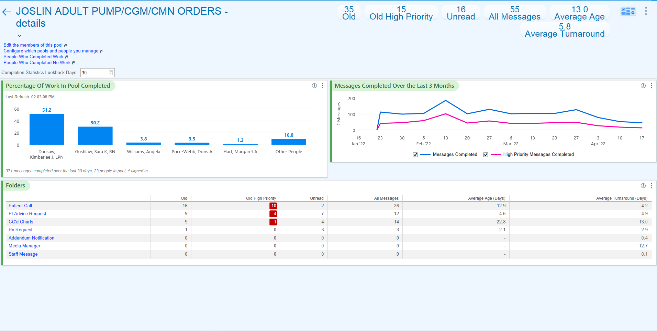

Slide 12
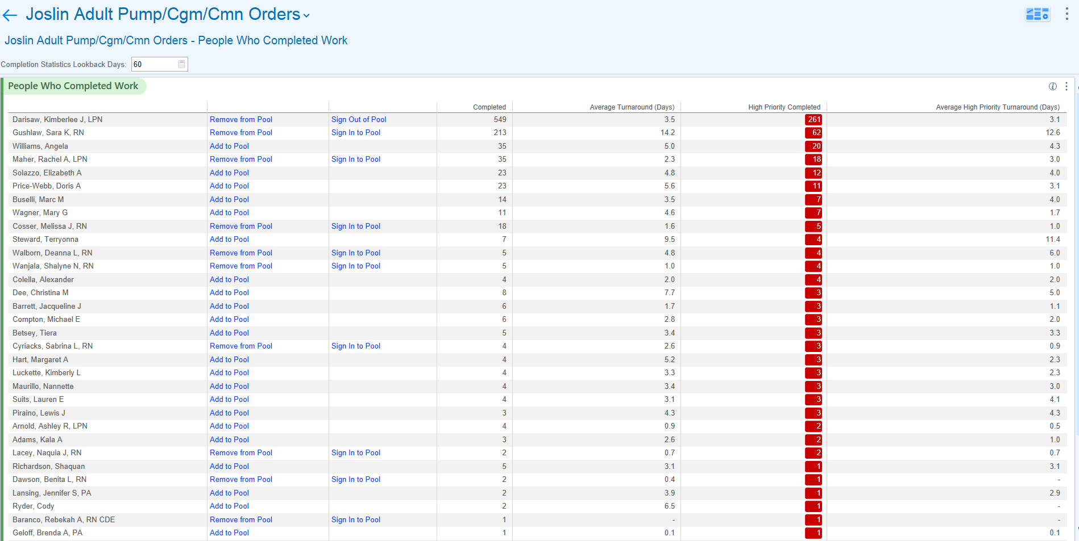
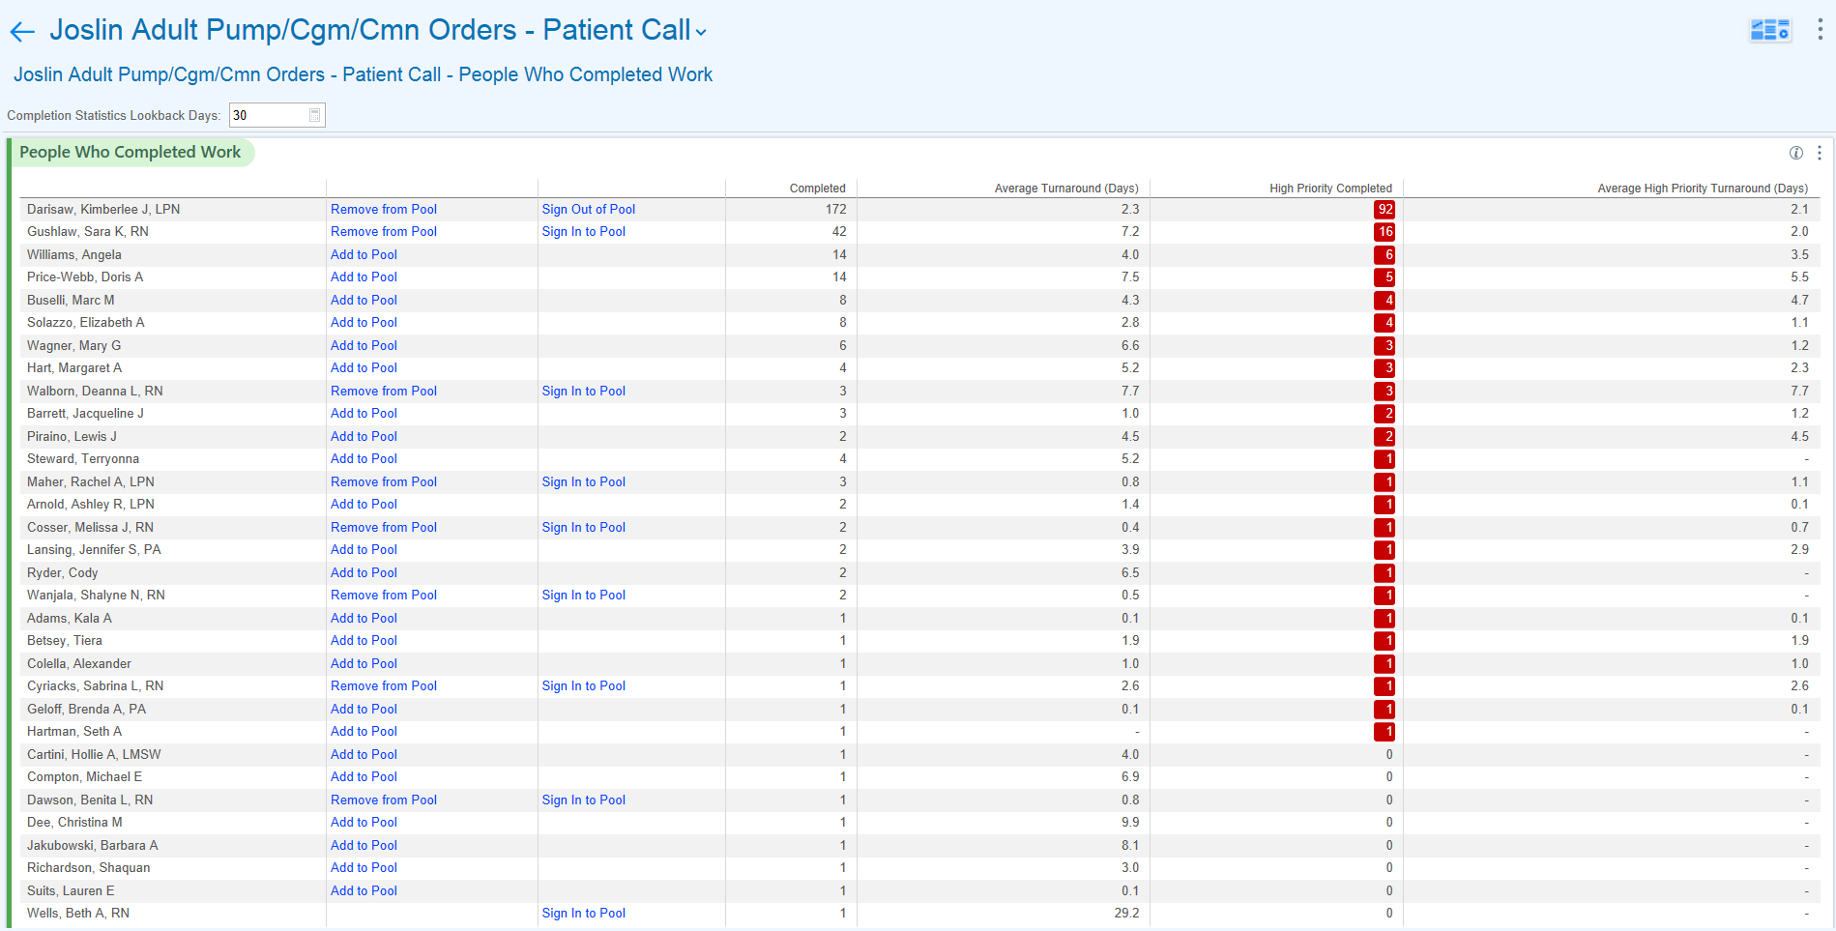

Slide 13
PDSA # 2.D: Front Desk
Aim/Plan: Decrease time between obtaining CGM and Receiving CGM Education
Act: Determine if the front desk staff communicating with patient will decrease the no show rate (next slide)
Study:
92 education visits were scheduled by the front desk from June 17th to July 20th
89 out of 114 education visits were billable
40 education visits since July 5th (All staff was fully trained by July 5th)
Do: Have Front Desk staff dedicated for scheduling CGM Interest/Discussion Patients.

Slide 14
Front Desk Intervention – No Show Appts in Tableau
211 appts
278 appts
Notes:
April and May Numbers (5/16/22 to 7/1/22) vs July and August Numbers (7/5/22 to 8/19/22) Number of

Slide 15
PDSA 2.E: Joslin Template Pool
Act: Obtain feedback from two staff members; create a cheat sheet for questions that patients might ask
Aim/Plan: Decrease time between obtaining CGM and Receiving CGM Education
Study:
Increase in appointments and decrease in missed opportunities. The two staff members have been schedule training with all the patients who needed it since July 26th
Do: Clerical Staff reaching out to schedule education training. 2 staff members will use the Joslin Template Pool to call patients who need education 3 weeks after order is placed

Slide 17
PDSA #3.a: FAQ Sheet
Act: Develop educational materials for patients that will assist in CGM education and the CGM process. This will increase overall CGM uptake.
Act: Add topics suggested and test with 2 patients who do not have CGM and have been prescribed CGM.
Study: Met with 2 patient advocates who provided feedback on the educational materials. They gave great suggestions and additional topics to cover. See FAQ/tips and tricks
Do: Create a Frequency Asked Question Sheet for CGMs.

Slide 20
PDSA #3.b:
Act: Create a letters via mychart - Send out letters to patients two weeks before appointment to discuss CGM at appointment
Act: Develop educational materials for patients that will assist in CGM education and the CGM process. This will increase overall CGM uptake.
Study: 10 patients have given feedback
Do: When the educator calls/follow-up to see if the patient has any questions about their CGM, asking if the FAQ was hopefully or something that would've been helpful

Slide 21
FAQ Sheet Survey Results
Questions | Responses
Did you read the sheet? | Yes – everyone said they read the sheet No
Was it helpful? | Yes (comment: reinforced tips, good for new cgm users, easy to read) No (comment: already knew everything on the sheet)
Is there anything they would change on the FAQ to relay to other patients? | Most of the patients said no
Do they have any tidbits worth adding? | Add overpatches Tip: Dexcom gives overpatches for free when you request. They don’t come with the sensor. Libre doesn’t provide overpatches but they are available from Amazon or people can use Tegaderm from a pharmacy
Notes:
Final Draft

Slide 22
PDSA #4
Act: Create a resource sheet that every patient can have
Plan: Incorporate SDOH Screening
Study:
See next two slides
Do:
SDOH screening at every visit

Slide 23
Adult Clinic
Adults Clinic | 8/10/22 – 6/2/22
Total Patients screened (n, %) T1D T2D Other Endo | 7730 1822 3252 2656
Total patients at risk (n, %) T1D T2D Other Endo | 1116 286 568 262
SW referrals for positive screening (n, %) | 323
Notes:
Encounter Level

Slide 24
Peds Clinic
Peds Clinic | 8/10/22 – 6/2/22
Total Patients screened (n, %) T1D T2D Other Endo | 3110 1293 164 1619
Total patients at risk (n, %) T1D T2D Other Endo | 339 154 30 154
SW referrals for positive screening (n, %) | 84
Notes:
Encounter Level

Slide 25
PDSA #5
Act: Work with IMT to make generic smart phrase trackable. We will be able to track the following:- on med list, connected to clinic, follow-up visit
Plan: Improve Device Data Review and Interpretation
Study: In Progress
Do: Create a generic smart phrase for all educators

Slide 27
PDSA# 5.b: Follow-Up with Advance Features
Act: Continue to track how many follow-ups, who needs to be scheduled, and who declined follow-up
Plan: Improve Device Data Review and Interpretation
Study: We started with 0 (July) follow-ups on the educators schedule; they now have 8 to 9 follow-up trainings schedule per week
Do: Troubleshoot which patients need additional help and call within 2 weeks of initial education visit or 4 week follow-up

Slide 28
Our Data – June and July numbers**
Notes:
June 2022: 22/25 NH Blacks and 247/310 NH Whites
Denominator: Number of patients with T1D who had an appointment in the last 12 months by race
Numerator: Number from Denominator who reported using a CGM during the reported month by race
Insurance Change: November and April

Slide 29
Joslin Patients with Type 1 Diabetes seen in last 2 years Report
August 2020 to August 2021 | August 2021 to May 2022
NH White – 42% were not on CGM | NH White – 22% not on CGM
NH Blacks – 64% were not on CGM | NH Blacks – 29% not on CGM
Notes:
Give details on what you are seeing with the report
We aren't able to see if the patient is in progress within this report
Out of 50 patients over half were found to be in progress of getting a CGM

Slide 30
Last 6 months on CGM vs not on CGM
NH Blacks | NH Whites
Total: 162 On CGM: 125 = 77% Mean A1c: 9.76 | Total: 2027 On CGM: 1682 = 82.9% Mean A1c: 8.36
Not on CGM: 37 Mean A1c: 9.38 | Not on CGM: 345 Mean A1c: 8.1

