Slide 1
Improving Data Uploads at Stanford Adult Endocrinology Clinic
Jacob Less, BS; Marina Basina, MD

Slide 2



Stanford University Adult Endocrinology Clinic
Division of Endocrinology, Gerontology, and Metabolism
Multidisciplinary Team Members
16 Attending Physicians
5 Endocrinology Fellows
3 Nurse Practitioners (2 PNP-BC/CDCES, 1ANP-BC
5 Certified Diabetes Educators
1 Nutritionist
1 Psychologist
Clinic Contacts
Site PI: Marina Basina, MD
Site Coordinator: Jacob Less, BS
Volume
1600-1700 established T1D patients
35-45 new/newly diagnosed T1D patients (est. from 2020)

Slide 3
Problem Statement
Many patients were being seen virtually via Telehealth/Telemedicine Visits
For these visits, we started to notice that recent BG, CGM and/or insulin pump data was not being uploaded prior to the visit
This meant that a significant amount of the patient encounter was directed to troubleshooting data upload, actually uploading the data, or having no data to review
There is no established telehealth/virtual protocol for the support staff to follow in regards to sending pre-visit messages, following up with pre-visit phone calls, uploading DM technology, or reporting that data was successfully uploaded to the provider prior to the start of the patient encounter.

Slide 4
Aim Statement
Increase the amount of successful pre-visit DM technology uploads for patient blood glucose by 15% over 3 months (from 65.5% to 80%).

Slide 5
Chart Review:
Encounter Breakdown
Patient Diagnoses
Interpreter Services***
Total Patients | 87
Video | 78
NPV* | 5
Telephone | 4
Type 1** | 49
Type 2 | 35
Type 3c | 1
MODY 2 | 1
CF Related | 1
Vietnamese | 3
Russian | 3
Cantonese | 2
Spanish | 2
Arabic | 1
*NPV were also video, but have been reported separately
**Three had Type 1 LADA
***Listed on chart as either ”preferred language” or ”needs interpreter”
Notes:
Old Slide

Slide 6
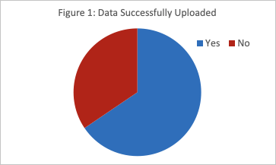
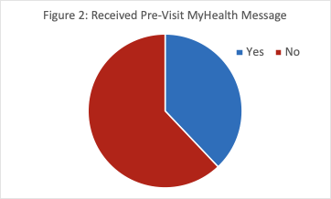
Baseline Data Uploads
(N = 87) [11/30/20 - 12/11/20]
34.5%
65.5%
62%
38%
Figure 1: 57/87 (65.5%) patient encounters during this period had data successfully uploaded prior to the visit.
Of these 57 that uploaded: 19 received pre-visit message (33.3%) and 38 did not (66.67% uploaded without pre-visit initiation)
Of the 30 Encounters with data not uploaded: 14 Encounters took ~“1-5” minutes & 16 Encounters took ~“6-10” minutes of the visit time for technology troubleshooting (attempting to upload data, trying to read off data, trying to login)
This is ~110-230 minutes in a 2 week period alone of technology troubleshooting
Figure 2: 33/87 (38%) patients received a pre-visit message with instructions on how to upload data
Notes:
Old Slide

Slide 7
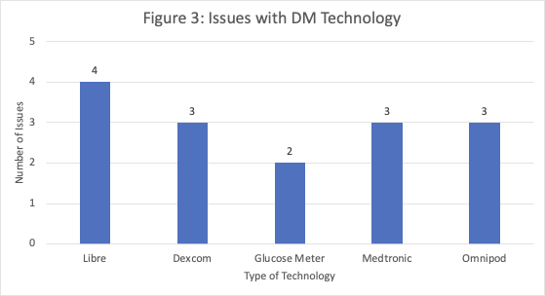
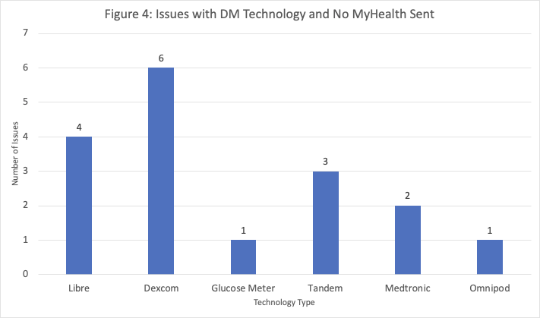
Pre-Visit Msg/Call Sent & Data Not Uploaded (n = 14)
Pre-Visit Msg/Call Not Sent & Data Not Uploaded (n = 16)
Figure 3: Breakdown of DM technology from these 14 patient encounters
Three “sent” MyHealth messages were not read
Figure 4: Breakdown of DM technology from these 16 patient encounters
Notes:
30 patients without successful data upload
Represent with a pie chart? Of this 30, how many received MHMs

Slide 8
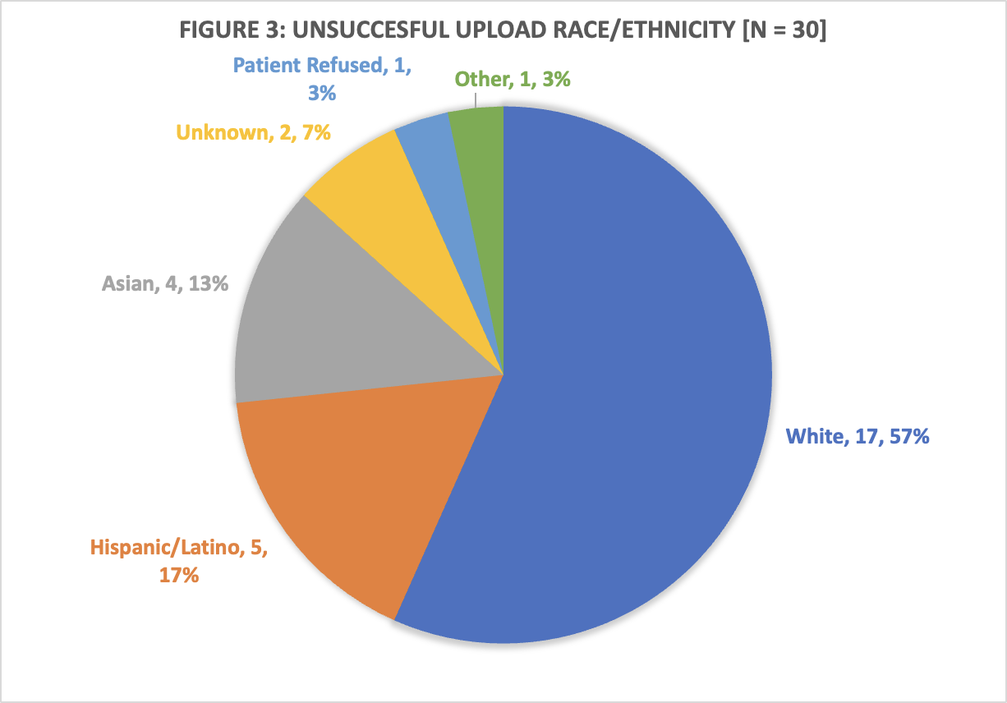
Reanalyzed Data
Race/Ethnicity
Total Patients | 87
Black/ African American | 2
Hispanic/ Latino | 12
Asian | 14
White | 45
Other | 14

Slide 9
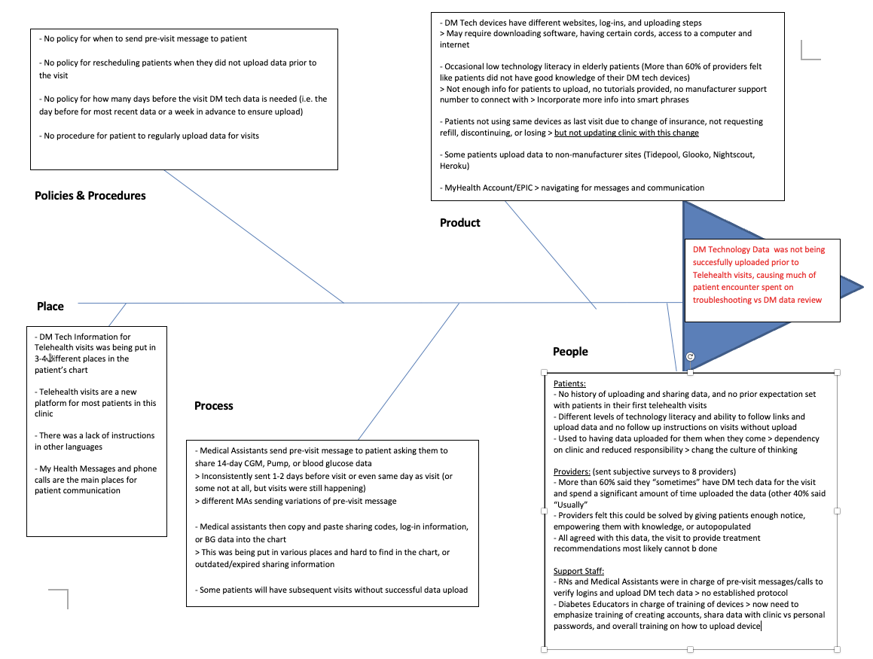
Fishbone: Cause and Effect Diagram

Slide 10
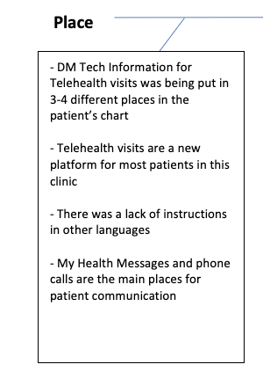
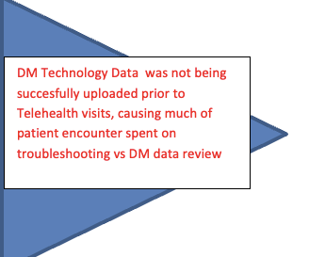
Fishbone: Cause and Effect Diagram

Slide 11
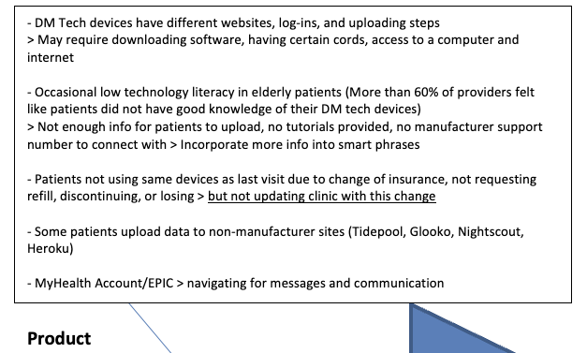
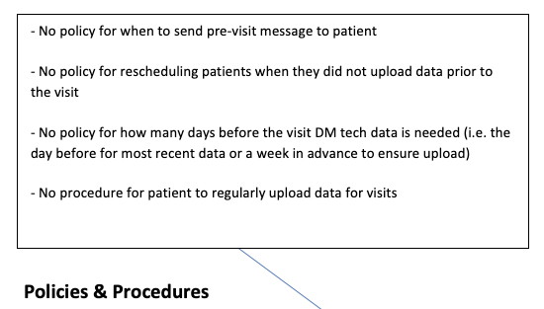
Fishbone: Cause and Effect Diagram

Slide 12
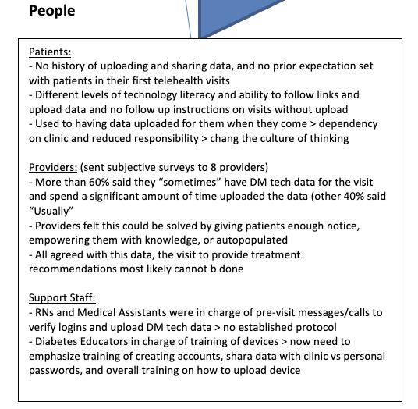
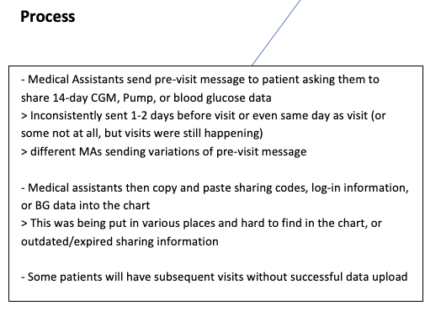
Fishbone: Cause and Effect Diagram
Standardize chart location for pre-visit update -> Utilize blue sticky to indicate pre-visit data uploaded, type of DM tech, last A1c and where in chart (e.g. results review, care everywhere, media, telephone encounter etc.)

Slide 13
Takeaways/Influence fr. Baseline Data T1DX & Meeting
Reasons for unsuccessful data upload and pre-visit msg/call sent
  Patients were not expecting call -> Set expectations at end of each visit (“you will receive pre-visit msg/call & this many days before appt”)
Look back at prior visit and identify if data was successfully uploaded
  If not -> have staff spend more time with this patient in pre-visit phase. This can be a period of intervention via phone call
Pre-charting information/demographic information may be outdated or assumed to be up to date
  Standardize chart location for pre-visit update -> Utilize blue sticky to indicate pre-visit data uploaded, type of DM tech, last A1c and where in chart (results review, care everywhere, media, telephone encounter etc.)
Pre-visit message info is not including enough info, assumed device is incorrect
  Collect more information on DM tech tutorials/support -> ask patients to follow up with tech change, incorporate more into smart phrase (youtube videos, links to manufacturer support)

Slide 14




Change Idea: Proposed Workflow
1. Update sticky with CGM/Pump/Other meter/none
2. Indicate date of recent A1c and chart location
3. Indicate if patient is sharing data
4. Check last note to see had data uploaded
STEP 1 For Staff: - Pre-visit: Check Blue Sticky for most recent DM Tech Info (2 days before if possible)
1. Call patient and walk them through the instructions for their specific device.
2. See if interpreter services are needed.
3. If unable to upload, provide them with manufacturer support links found in smart phrase
STEP 1A For Staff:
- If data not successfully uploaded at last visit
- If data uploaded, skip
*From baseline data this should only be around 1-2 patients/day
Notes:
From last slide: if patients having subsequent visits without data upload

Slide 15
Proposed Workflow
STEP 2 For Staff: - Send pre-visit message two days before Tele Visit if possible (Fri., send on Mon.) - Cont. calling day of for check-in
1. Use smart phrase: .DMPREVISITMSG
2. Follow the “for staff” instructions, type in “.UPLOAD” and choose appropriate device(s) [there is an option for .UPLOADFINGERSTICK]
3. Fill in any other *** as needed
STEP 3 For Provider/Scribe:
- At end of visit, create AVS to set future telehealth visit expectations on receiving instructions
1. Use smart phrase: .DMAVSTELE 2. Fill in “.UPLOAD” and choose appropriate device(s) [there is an option for .UPLOADFINGERSTICK] 3. Fill in any other ***

Slide 16
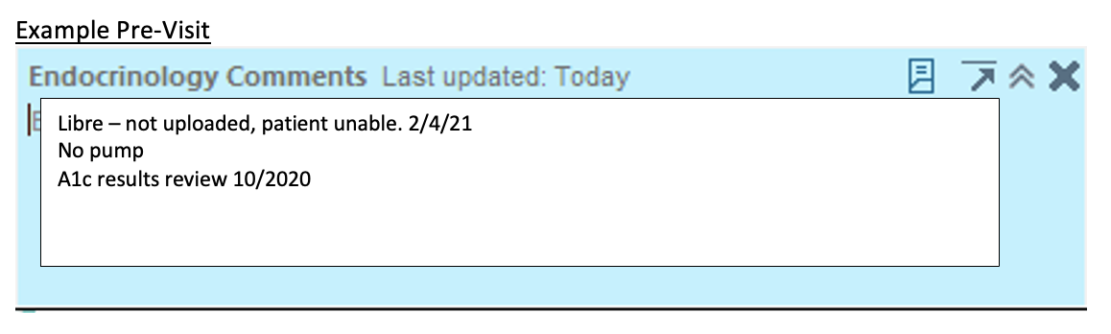
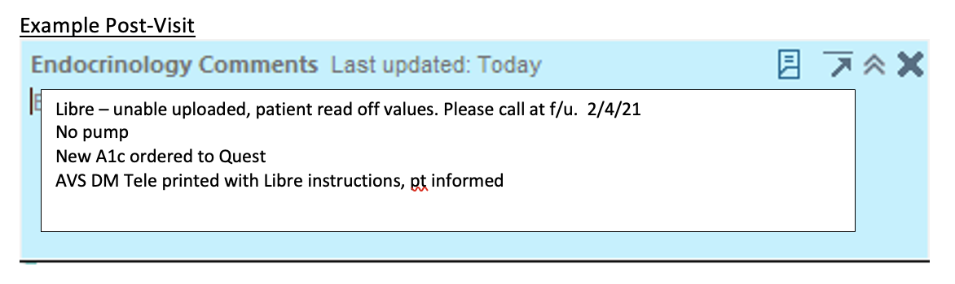
Proposed Workflow
STEP 4 For Provider/Scribe (maybe Staff): - After the visit: Update blue sticky to support staff and provider at next follow up
1. Indicate if data was successfully updated and any notes for future visits
2. Update patient DM technology (type of device, passwords, share codes)
3. If new labs ordered, indicate where so can call for and find easier at next follow up

Slide 17
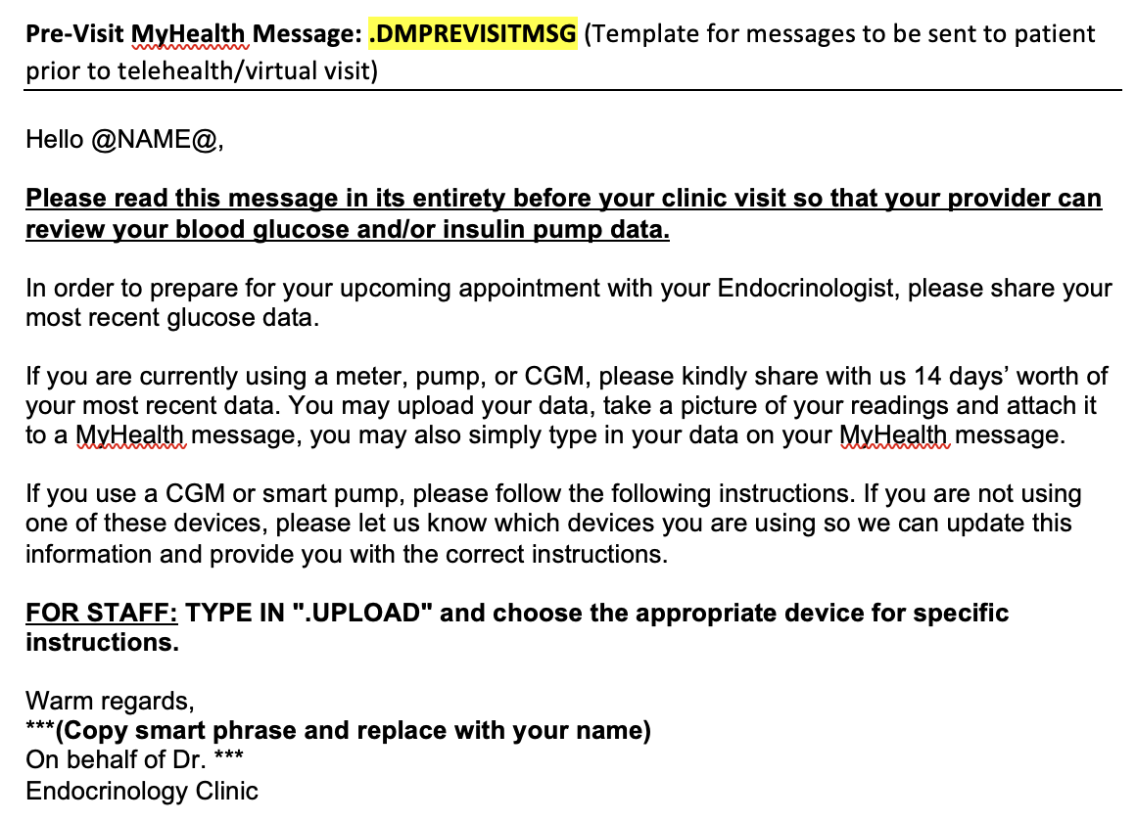
DM Pre-Visit Message Template & Smartphrases
CGM/Meter Smartphrases
.UPLOADDEXCOM
.UPLOADLIBRE
.UPLOADGLOOKO (w/ comptaible meter)
.UPLOADFINGERSTICK
Insulin Pump Smartphrases
.UPLOADTANDEM
.UPLOADMEDTRONIC
.UPLOADOMNIPOD
Notes:
The device specific smart phrases have step by step instructions by device, phone numbers to manufacturer customer support, and links to youtube videos walking through steps

Slide 18
After Visit Summary Tele Smartphrase
Patients were not expecting call -> Set expectations at end of each visit (“you will receive pre-visit msg/call & this many days before appt”)
Medication changes:
***
Labs:
Get laboratory testing done in {DMLABTESTING:45470} (Today, in 1 week, in 2 weeks, in 3 weeks, in 1 month, in 2 months, in 3 months, in 6 months, in ***)
To make your next visit go smoothly, please read this message in its entirety.
Before your next visit, be on the lookout for a pre-visit MyHealth message that should arrive 1-2 days before your appointment. If you don't have a MyHealth account, you can create one here: https://myhealth.stanfordhealthcare.org/#/
  This will come provide you instructions on how to upload your blood glucose data
If you would prefer a phone call instead of a MyHealth message please let us know 1-2 days before your visit so we can make sure to call you
Our goal is to have your recent data successfully uploaded so a majority of the visit can be spent on reviewing data and providing recommendations as needed
For your device, these are a copy of the instructions you will receive before your visit:
  .UPLOAD (insert DM tech)

Slide 19
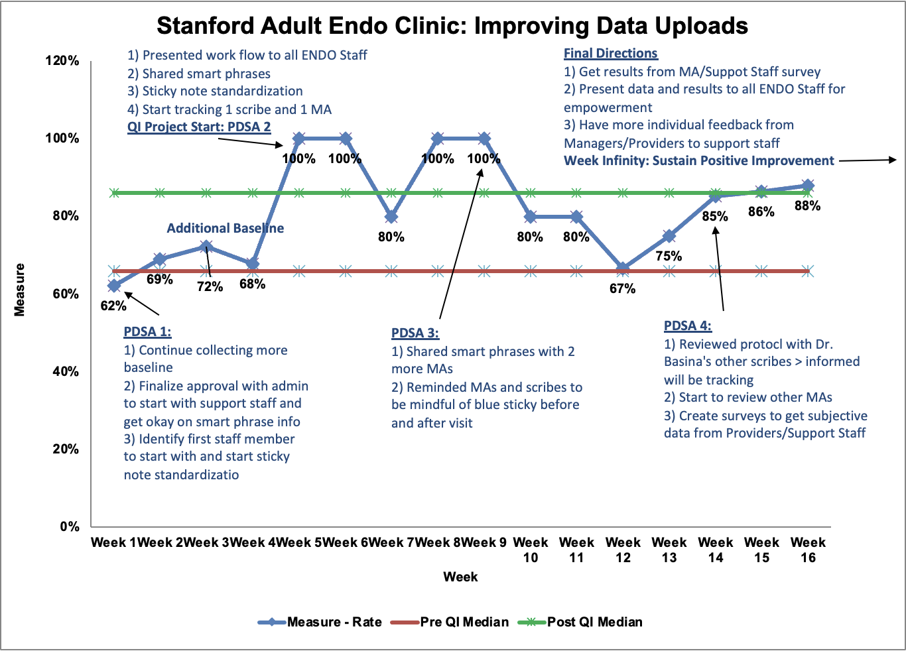
Run-Chart
Notes:
Reviewed week 15 to see if we are sustaining this and we currently are
Add a slide on future directions:
During the initial pump/CGM training > trainer expectations how to upload, setting up the account with them
Walking them through how to do it
Ideally everything that connected with the clinic > sharing > use their own passwords which are being changed (significant time)
Sharing with all of the clinic > up to staff
Waiting room before the visit > check to see if the data was pulled
Identifying staff where something wasn’t happened > showing staff positive reinforcement and reminders when not done

Slide 20
PDSA Cycle 1 (Week 1)
PDSA Cycle 1 : Test the new protocol change that includes implementing new templates using blue sticky note
Plan: On Thursday during Jacob’s scribing shift, implement all changes with all DM patients. Even with patients Jacob not scribing for, will update blue sticky with information.
Predict:
Uploads: 70% successful
Do: All the implementation was successful
Study:
Uploads: 67% successful (6/9)
  3 unsuccessful: 1 lost meter, 1 sent wrong image in pre-visit message, 1 NPV from recent admission sent BG trend (no specific values)
Act: : Continue collecting baseline data. Finalize approval with administration to start with support staff > smart phrases, looking back at prior visits
Focus on which staff will start with this method--identify one staff member. Continue to discuss changes and perceived effectiveness

Slide 21
PDSA Cycle 2 (Weeks 5-8)
PDSA Cycle 2 : Test the new protocol change that includes implementing new smart phrase, templates, and looking back at prior visit data in pre-visit phase
Plan: On Thursday during Jacob’s scribing shift, implement all changes with all DM patients. Even with patients Jacob not scribing for, will update blue sticky with information.
Predict:
Uploads: 75% successful
Pre-Visit Smartphrase Utilized (when appropriate): 50%
Pre and Post-Visit Blue Sticky Update: 100%
New AVS template will be utilized when appropriate
Do: All the implementation was successful
Study:
Uploads: 95% successful (20/21)
  Week 7: From blue sticky “Fora: Unable to dictate due to difficulties understanding pt. Informed to keep log and send via mhm prior visit.” Patient reported BG ranges during the visit
Pre-Visit Smartphrase Utilized (when appropriate): 70%
Pre-Visit Blue Sticky Update: 81%
Post-Visit Blue Sticky Update: 76%
Act: Shared smart phrases with two more MAs, be more mindful to fill out blue sticky after visit, encourage MAS to utilize pre-visit smartphrase and abd to fill out blue sticky before visit

Slide 22
PDSA Cycle 3 (Weeks 9-13)
PDSA Cycle 3 : Shared smart phrases with two more MAs, be mindful to fill out blue sticky before and after visit and utilize pre-visit smartphrase with detailed instructions
Plan: On Thursday during Jacob’s scribing shift, implement all changes with all DM patients.
Predict:
Uploads: 90% successful
Pre-Visit Smartphrase Utilized (when appropriate): 80%
Pre-Visit Blue Sticky Update: 80%
Post-Visit Blue Sticky Update: 80%
New AVS template will be utilized when appropriate
Do: All the implementation was successful

Slide 23
PDSA Cycle 3 (Weeks 9-13)
Study:
Uploads: 76.5% successful (26/34). Of the 8 that did not upload:
  Week 10 (1): Pre-Visit message sent and read, not followed up by call
  Week 11 (2):
    1 patient no pre-visit message sent and discovered not regularly checking BG
    1 patient pre-visit message sent and read but no f/u call
  Week 12 (4):
    2 patients did not read MHM, not followed up by calls until day of visit
    1 not using CGM and did not inform clinic
    1 patient responded could not upload data but will share login during visit
  Week 13 (1): 1 patient ran out of Libre CGM sensors and not yet gotten refill,not checking with other meter
Pre-Visit Smartphrase Utilized (when appropriate): 100%
Pre-Visit Blue Sticky Update: 79%
Post-Visit Blue Sticky Update: 61%
Act: Reviewed protocol with scribes and told them I would be tracking changes in April, start reviewing other MAs to track their progress for recommendations, create survey with ENDO fellow to get subjective data on Providers/Support Staff

Slide 24
PDSA Cycle 4 (Weeks 14-15)
PDSA Cycle 4: Act: Reviewed protocol with scribes and told them I would be tracking changes in April, start reviewing other MAs to track their progress for recommendations, create survey with ENDO fellow to get subjective data on Providers/Support Staff
Plan: On all Dr. Basina’s scribes shifts, should already be implementing protocol and now we will collect data, as well as other MAs use of smart phrases. Jacob will work with Endo Fellow, Dr. Kaplan, to create and distribute subjective surveys.
Predict:
Uploads: 85% successful
Pre-Visit Smartphrase Utilized (when appropriate): 100%
Pre-Visit Blue Sticky Update: 85%
Post-Visit Blue Sticky Update: 80%
New AVS template will be utilized when appropriate
Do: All the implementation was successful
Notes:
Explain the scale up to other scribes

Slide 25
PDSA Cycle 4 (Weeks 14-15)
Study:
Uploads: 87.5% successful (56/64). Of the 8 that did not upload:
Week 14 (4):
  1 did not read MHM and did not answer f/u call
  1 just got new glucometer and never taught how to upload
  1 uploaded Dexcom but not yet create Nightscout account for Omnipod
  1 f/u call and patient said he would upload Dexcom but didn’t
Week 15 (4):
  1 NPV using Dexcom (receiver and not phone trouble uploading data) and Omnipod EROS (unsure how to upload)
  1 recently received Libre CGM but not yet started using only checking fasting BGs
  1 not checking BGs but provided estimated range during visit
  1 received pre-visit MHM and left voicemail to upload > had expired transmitter for Dexcom CGM
Pre-Visit Smartphrase Utilized (when appropriate): 94.5%
Pre-Visit Blue Sticky Update: 87.5%
Post-Visit Blue Sticky Update: 89%
Act: Get data from MA/support staff surveys, present data and results to all ENDO staff, have more 1-1 feedback from providers/managers to staff
Notes:
Explain the scale up to other scribes

Slide 26
Run-Chart
Week 16: 44/50
Notes:
Reviewed week 16 to see if we are sustaining this and we currently are

Slide 27
Lessons Learned
QI projects require a lot of baseline knowledge (e.g. factors involved, how to implement with given resources) > what are the needs of the clinic, patients, and providers
These projects take a while and require constant and regular review to implement changes > Really see dips in progress when assessment is not active
It takes a lot of effort upfront to develop and implement a protocol > change can be hard due to implicit/explicit resistance
Collaborative sharing of success/failures works as I took many influences from the previous Champions Meetings
Education and knowledge is key for all involved
Notes:
Reviewed week 15 to see if we are sustaining this and we currently are
Add a slide on future directions:
During the initial pump/CGM training > trainer expectations how to upload, setting up the account with them
Walking them through how to do it
Ideally everything that connected with the clinic > sharing > use their own passwords which are being changed (significant time)
Sharing with all of the clinic > up to staff
Waiting room before the visit > check to see if the data was pulled
Identifying staff where something wasn’t happened > showing staff positive reinforcement and reminders when not done

