Slide 1
Improving Depression Screening in patients with Type 1 Diabetes Mellitus
Sheila Dennehy, RN, MSN, CDCES, Lori Benzoni MPH,
Ulka Kothari, MD, Danielle Alessio, LCSW, Siham Accacha, MD
Department of Pediatric Endocrinology, NYU Long Island School of Medicine, Mineola, NY

Slide 2
NYU Langone Hospital – Long Island
Clinic | Multidisciplinary Team Members | Volume & Medicaid | Contact Names
NYU Langone Hospital – Long Island | 7 Attending Physicians 2 Endocrinology Fellows 3 RN CDCES 1.8 Registered Dietician/Nutritionists CDCES 2 Nurse Practitioners (1 with CDCES) 1 Social Worker | -850-900 established T1D patients receiving ongoing care at 2 locations - 40-50 Newly diagnosed T1D patients seen annually - Estimated in past 1 year Medicaid–15% Commercial Insurance-85% - LCSW services free of charge for patients/families - 4 active supports groups - Annual FREE Spring Conference for patients and families | Site PI Siham Accacha, MD Siham.Accacha@nyulangone.org Site Coordinators Sheila Dennehy, RN, MSN, CDCES Sheila.Dennehy@nyulangone.org Lori Benzoni, MPH Lori.Benzoni@nyulangone.org
Notes:
5 physicians are seeing diabetes patients

Slide 3
Introduction
Depression is one of the most common mental illnesses in the pediatric population, particularly amongst adolescents.
Longitudinal studies of community samples of children and adolescents suggest an average age of onset between 11 and 14 years old.
In 2019, about 15.5% of adolescents (age 12-17) experienced at least one major depressive episode and 18.8% reported seriously considering a suicide attempt.
Youth with type 1 diabetes (T1D) have significantly higher rates of depression over the general population and having depression may impact the management of diabetes.
Despite its high prevalence, depression is widely undertreated in this population: about 40% of pediatric patients with this disorder are not treated.
Olfson M, Blanco C, Wang S, et al. JAMA Psychiatry 2014; 71:81.
O'Connor BC, et al. JAMA Pediatr. 2016 Apr;170(4):373-80.
Notes:
Longitudinal studies of community samples of children and adolescents suggest an average age of onset between 11 and 14 years for MDD and depressive disorder (DD
Having diabetes may increase the likelihood of developing depressive symptoms, and having depression may impact the management of diabetes.

Slide 4
PHQ-9 and PHQ-9A
Quality improvements efforts to improve screening with the Patient Health Questionnaire 9 (PHQ-9) in adolescent and adult populations are widespread, particularly in primary care settings.
Identifying depression in specialty care is difficult unless standardized screening and diagnosis tools are used along with a formal diagnostic process.
The Patient Health Questionnaire 9 for Adolescents (PHQ-9A) is a widely used, validated tool used to monitor and measure the severity of depression. The instrument consists of nine questions about depression symptoms during the past 2 weeks followed by a single question that assesses associated impairment; the resulting scores are used to determine depression severity and range from 0 to 27.
A score of 10 or above has a sensitivity of 89% and a specificity of 77% for major depression.
Bitsko RH, Claussen AH, Lichtstein J, Black LJ 2013 – 2019 MMWR, 2022 / 71(Suppl-2);1–42.
Notes:
Patient Health Questionnaire (PHQ-9) to measure depression symptoms (60). The PHQ-9 screening instrument consists of nine questions about depression symptoms during the past 2 weeks followed by a single question that assesses associated impairment; the resulting scores are used to determine depression severity and range from 0 to 27.

Slide 5
Purpose Method
To improve recognition of adolescent depression in patients, with T1D, ages 11-17yo, through implementation of standardized annual screening for depression using PHQ-9A from baseline of 0% to 75% by December of 2022.
A multidisciplinary team of physicians, RN, CDCES, medical assistants, and social worker was created.
Many PDSA cycles were conducted for education, folder for resources, written algorithm.

Slide 6
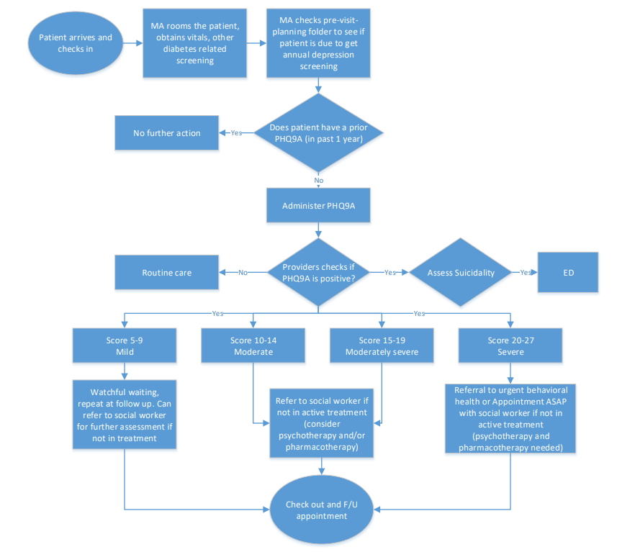
Daily workflow

Slide 7
PDSA Cycles

Slide 8
Department of Pediatric Endocrinology, NYU Long Island School of Medicine, Mineola, NY

Slide 12
Flowchart and referral materials
Notes:
After the implementation of our flowchart and referral materials that were provided to our providers, we had a strong increase in # of patients screened.

Slide 14
Flowchart and referral materials
Notes:
This graph shows our data for the entire year of 2022. Our goal of 75% has been met. As you can see there are two months August and November that some patients were missed for screening. This could have been the MA forgetting to distribute the screening to patient as well as the provider not reminding them to do so. You can see here our median went from 28-68 after 4 months of working on the project. This was a true multidisciplinary approach!

Slide 15
Results
Systematic processes and multiple PDSA cycles led to increase in the number of patients screened for depression.
Many patients with elevated scores were noted to already be connected with a mental health provider and receiving therapies/ medications.
Depression was noted in the chart as a co-morbidity, in these patients with type 1 diabetes, allowing focus on whole person care in addition to diabetes alone.
Making changes in EMR facilitated better recognition of patients due for an annual screening.

Slide 16
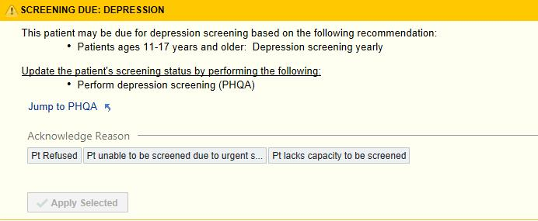
Looking forward:
Hardwire processes- have the MA’s/Providers assess if a patient is due for screening
Feb: Go-live with an alert that patient is due for annual depression screening
Education of new staff includes education on screening for depression
Ongoing feedback to the team on depression screening metrics and addressing barriers

Slide 17
Conclusions
Multidisciplinary approach to chronic disease management is key to improving patient outcomes.
Co-location of mental health provider helps facilitate timely screening, referral and follow up for patients with depression.
EMR can aid in provider decision support about patients who are due for screening.
Social worker helped create a list of community based providers for timely referral of newly diagnosed patients.
Tracking data and ongoing PDSA cycles helped initiate and improve screening for depression in adolescent patients with type 1 diabetes.

Slide 18
References
1.Bitsko RH, Claussen AH, Lichtstein J, Black LJ. Surveillance of Children’s Mental Health – United States, 2013 – 2019 MMWR, 2022 / 71(Suppl-2);1–42.
2.Olfson M, Blanco C, Wang S, et al. National trends in the mental health care of children, adolescents, and adults by office-based physicians. JAMA Psychiatry 2014; 71:81.
3.O'Connor BC, Lewandowski RE, Rodriguez S, Tinoco A, Gardner W, Hoagwood K, Scholle SH. Usual Care for Adolescent Depression From Symptom Identification Through Treatment Initiation. JAMA Pediatr. 2016 Apr;170(4):373-80.
4.Merikangas KR, Nakamura EF, Kessler RC. Epidemiology of mental disorders in children and adolescents. Dialogues Clin Neurosci. 2009;11(1):7-20.
5.Kroenke K, Spitzer RL, Williams JB. The PHQ-9: validity of a brief depression severity measure. J Gen Intern Med. 2001;16(9):606-613.

Slide 19
Our Next Project…

Slide 20
Questions?

