Slide 1
Increasing Hybrid-Closed Loop Pump Usage Lessons Learned in year one…
Elizabeth Brouillard RD, CDCES
Boston Medical Center
QI Champion for T1D Exchange

Slide 2
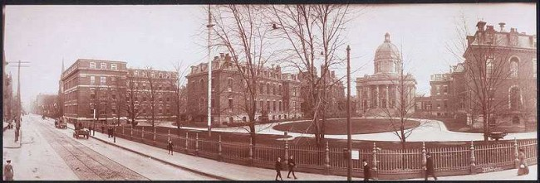
Boston Medical Center
Boston City Hospital was opened in 1864 and was the first municipal hospital established in the United States
1996 Boston University School of Medicine merged with Boston City Hospital to create Boston Medical Center
MISSION: Care for all people, regardless of their ability to pay. Provide exceptional care, without exception
Seventy percent of BMC patients are low-income families, elders, people with disabilities, minorities, and immigrants
30% do not speak English as a first language
65% are Boston residents, concentrated in neighborhoods with the greatest level of health disparities

Slide 3
Baseline Facts
A1c is high and disproportionately so in minorities
Limited DSME skills and nutritional literacy in our T1D population
Limited access to technology trainers
Poor transition for emerging adults moving up from pediatrics

Slide 4
A1C Discrepancies seen in 2015
 | Overall | 18-25 years old | 26-49 years old | >50 years old
Public | 9.4 | 11.2 | 8.9 | 8.4
Private | 8.6 | 9.6 | 8.4 | 7.6
 | HgbA1c, All Ages
White | 8.3
Black | 10.5
Hispanic | 9.3
Asian | 8.4
Other | 8.2

Slide 5
Improvement in A1C with technology 2015
 | HgbA1c Prior to Intervention | HgbA1c Following intervention | Percent change
Pump users n=17 | 7.9 | 7.4 | -0.5%
CGM users n=16 | 8.3 | 7.4 | -0.9%
 | Overall (n=126) | 18-25 years old (n=33) | 26-49 years old (n=73) | >50 years old (n=20)
Number of patients on pump + CGM | 20 (15.8%) | 5 (15.2%) | 9 (12.3%) | 6 (30%)
HgbA1c, mean for pump + CGM | 7.5 | 7.9 | 7.4 | 7.2

Slide 6
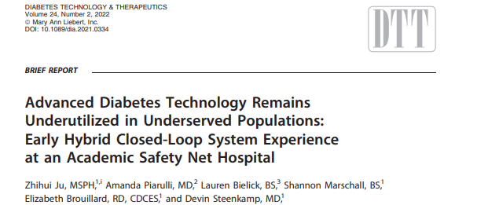
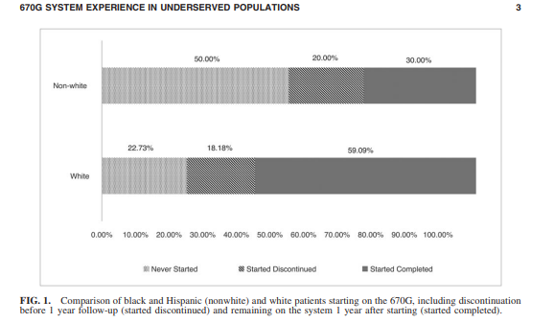
32 patients prescribed 670G
69% female
69% white
56% with advanced degrees
94% commercially insured
84% experienced pump users

Slide 7
How do we increase HCL system among non-white patients

Slide 8
Problem: Under-utilization of Hybrid Closed Loop Systems in T1D patients Aim statement: BMC will improve HCL use by 30% among those with an A1C >8.5% in one year

Slide 10
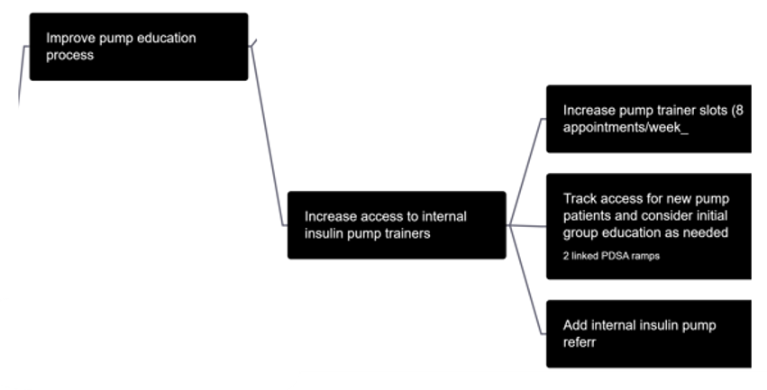
Improving Access and scheduling

Slide 11
PDSA - Improving Access to pump education
Plan | Create more availability for 2 pump trainers to see referred patients
Do | Add blocked time for both pump trainers for new visits
Study | 13 referred with average access = 6.3 weeks
Act | One trainer increased hours to full time from part time
Plan | Create more availability for 2 pump trainers to see referred patients
Do | Both pump trainers now only scheduled with diabetes patients
Study | 11 referred with average access = 7 weeks
Act | Start to see initial patients in group settings
Plan | Create more availability for 2 pump trainers to see referred patients
Do | One trainer increased hours to full time from part time
Study | 15 referred with average access = 6.9 weeks
Act | Both pump trainers now only scheduled with diabetes patients
Plan | Create more availability for 2 pump trainers to see referred patients
Do | Start to see initial patients in group settings (Intro to Pump and Carb Counting)
Study | 33 referred with average access = 4.48 weeks
Act | Now look at access for follow up after group and block schedule for pump start

Slide 12
PDSA – Improving scheduling Process
Plan | Have clinic staff schedule all pump visits
Do | Track pump visit requests through Epic message
Study | 0 out of 4 appointments scheduled correctly
Act | Practice manager provided education on scheduling pump visit
Plan | Have clinic staff schedule all pump visits
Do | All schedulers received training on scheduling pump visit
Study | All 28 appointments booked correctly 10 appointments booked by CDCES (Omnipod5 LMR)
Act | Create Referral for scheduled work que
Plan | Have clinic staff schedule all pump visits
Do | Create Referral for scheduled work que
Study | 41 out of 44 referrals booked correctly 3 appointments booked by CDCES
Act | Continue to track scheduling now focused on scheduling follow up visits after group visit

Slide 13
Increasing pump education referrals

Slide 14
PDSA – Increasing number of patients referred to pump program
Plan | Create Best Practice Advisory
Do | Request BPA to alert all providers of patients with T1D to considered putting in pump education referral
Study | After putting in request IT told BPA not a critical alert
Act | Encourage providers to refer patients to pump program through Diabetes journal club
Plan | Increase referrals to pump education by educating providers on pump benefits
Do | Sent out diabetes technology chapter from ADA book
Study | Increase in the number of providers referring to pump education by 3
Act | Increase number of providers by presenting T1D exchange QI project at Grand Rounds
Plan | Increase referrals to pump education by educating providers on pump benefits
Do | Increase number of providers by presenting T1D exchange QI project at Grand Rounds
Study | Increase in the number of providers referring to pump education by 7
Act | Review percentage of patients referred actually starting on insulin pumps

Slide 15
Total Referred = 17

Slide 16
Total Referred = 29

Slide 17
Total referred = 44

Slide 18
Continued efforts

Slide 19
Results
Total referred patients | 91
Referred patients with A1C >8.5 | 37
Patients started on HCL pump | 31
Patients started on HCL with A1C >8.5 | 11
Declined pump | 4
Lost to follow up * Only 3 started pump education | 20
Still in pump education process | 36

Slide 20
Ethnicity of all Referred patients

Slide 21
Ethnicity of patients started on pumps

Slide 22
Ethnicity of patients lost to follow up

Slide 23
Insurance of all referred patients

Slide 24
Insurance of patients on pumps

Slide 25
Insurance of patients lost to follow up

Slide 26
Average A1C at Time of Referral

Slide 27
Total referrals by Provider

Slide 28
Percent of referrals started on Pump

Slide 29
What’s Next
Increase the percentage of referred patients starting on HCL systems
Reduce barriers for obtaining and maintaining pump supplies
Continue to improve ongoing access for pump education follow up and pump start
Improve access to ophthalmology for dilated eye exams prior to insulin pump start

Slide 30
T1D Exchange QI Team at BMC
Providers
Kathryn Fantasia MD
Devin Steenkamp MD
Catherine Sullivan MD
Howard Wolpert MD
Pump Educators/ CDCES
Corinne Aia RD, CDCES
Liz Brouillard RD, CDCES
Research Coordinator
Astrid Atakov Castillo

