Slide 1
Comprehensive Psychosocial Screening program in A Pediatric Diabetes Clinic
Alan Delamater, PhD
Professor of Pediatrics and Psychology
University of Miami miller school of medicine

Slide 2
Disclosures
I have no conflicts or disclosures to declare.

Slide 3
objectives
Describe psychosocial screening protocol and results from UM Pediatric Diabetes Clinic
Discuss medical providers’ perspectives on psychosocial screening
Discuss adolescent and mother perspectives on psychological involvement in routine diabetes care
Review results of a quality improvement initiative in the UM Pediatric Diabetes Clinic during COVID-19

Slide 4
Background
Type 1 diabetes is the most common endocrine disorder affecting children and its incidence is increasing world-wide—over 200,000 youth in US currently
Most youth with type 1 diabetes do not meet glycemic control targets—over 70% have HbA1c above 7%
Using insulin pumps and continuous glucose monitoring helps to improve glycemic control—but does not guarantee successful outcomes
Regimen adherence problems are common—even with technology use (failure to utilize CGM results, inaccurate carb counting, omission of bolus or under-dosing insulin)
Greater risks for suboptimal regimen adherence and glycemic control—associated with a number of demographic, psychological, and psychosocial factors

Slide 5
A1c over time: 2010-2012 vs. 2016-2018 in T1DX
17% of youth and 21% of young adults achieve glycemic target
A1c increased over time in adolescents
57% pump use increases to 63%
7% CGM increases to 30%
Despite technological advances, glycemic control remains elusive goal
Foster et al., T1D Exchange Clinical Network, Diab Tech and Therapeutics, 2019

Slide 6
SEARCH study: diabetes care, 2022

Slide 7
What Accounts for suboptimal Outcomes?
Kids don’t understand the importance of good glycemic control for preventing future problems.
They are disorganized, forgetful, or they have psychological problems.
Their families are disorganized and chaotic and just not involved.
Their parents are over-involved and argue too much with them about diabetes.
They are more interested in having fun with peers and/or doing well at school—they’re just not motivated about diabetes care.
Health care teams don’t know how to work effectively with kids to help them achieve better self-management and glycemic control.

Slide 8
Questions
Why is non-adherence so common and optimal glycemic control so difficult to achieve for most patients?
How do we motivate patients to do better at diabetes self-management and improve glycemic control?

Slide 9
Ecological Model of Predictors of Glycemic Control
Medical System
Characteristics
Health
insurance
Parent, Family, & Social
Factors
Peer relations and support
Parental regimen
knowledge
Child
Characteristics
Age, gender; diabetes duration
Racial and ethnic status
Child Glycemic
Control
Parental psychological status
SMBG &
Insulin
Adherence
Family SES;
Single or 2-parent home
Dietary skills and adherence
Relationship
with doctor
School
Health
Policies
Neuro-cognitive and psychological
Physical Activity
Family organization and routines
Parental
monitoring and support
Parent-child conflict
Contacts with health care team
Notes:
9

Slide 10
Importance of Psychological Factors
Youth with diabetes have high rates of psychological disorders such as depression, anxiety, and eating disorders
Diabetes distress is common
These problems can interfere with successful diabetes management and adversely impact quality of life.

Slide 11
Importance of Family Factors
Family conflict is associated with decreased regimen adherence and poor glycemic control
Supportive parental behaviors, clear communication, shared responsibilities, monitoring regimen behaviors, and structured routines are associated with better regimen adherence and glycemic control

Slide 12
ISPAD Guidelines for Psychological Care (Ped Diab, 2018, 2022)
Include professionals with expertise in mental and behavioral health within the interdisciplinary health care team
Assessment of adjustment to and understanding of diabetes management
Identification of psychosocial adjustment and quality of life problems should be conducted at planned intervals
Assessment of general and diabetes-specific family functioning
Evidence-based psychosocial interventions should be provided for patients and families exhibiting conflict, behavioral or psychiatric difficulties, or adherence problems affecting glycemic control
Preventive interventions at key developmental times

Slide 13
Purpose of Study
This study reports on the results of universal, comprehensive psychosocial screening in a pediatric diabetes clinic with integrated behavioral health care provided by a psychologist.

Slide 14
Screening Process
Focus on youth with diabetes 12 years and older
Over a one-year period, prior to regular outpatient clinic visit, youth were screened for depression and suicidal risk, anxiety, life satisfaction, diabetes stress, disordered eating, family conflict, regimen adherence, and motivation for adherence.
Screeners were completed by youth on tablets in the waiting room before the appointment and immediately scored and a report generated.
If patients scored above a pre-determined cutoff on any measure, the psychology team conducted a consultation and developed a follow-up plan.
Those who did not screen positive were re-screened one year later.
Parents also completed brief screeners for their child.

Slide 15
Youth Screening Measures
PHQ-9: depression and suicidal risk
GAD-7: anxiety
Multi-dimensional Student Life Satisfaction Scale (6 items)
Diabetes Stress Scale (10 items)
Blood Glucose Monitoring Stress (2 items)
Eating Disorders Questionnaire (7 items)
Diabetes Family Conflict Scale (4 items)
Diabetes Self-Management Profile-SR (2 items regarding insulin use)
Intrinsic Motivation Inventory for Diabetes Management (2 items)

Slide 16
Depression (PHQ-9)

Slide 17
Suicide risk (PHQ-9)

Slide 18
anxiety (gad-7)

Slide 19
Results
280 youth 12 and older (M age=14.9 years, 56% female, 86% with type 1 diabetes) completed the psychosocial screener over a 12-month period (May 2018-April 2019)
Screening rate = 83.1% of eligible youth
The screening protocol was completed in an average of 12 minutes, then immediately scored and the report reviewed by the team
10 months after screening program initiated, psychological consultations increased by 25% (n = 181 pre-screening vs. 226 post-screening)
232 with type 1 included for analyses

Slide 20
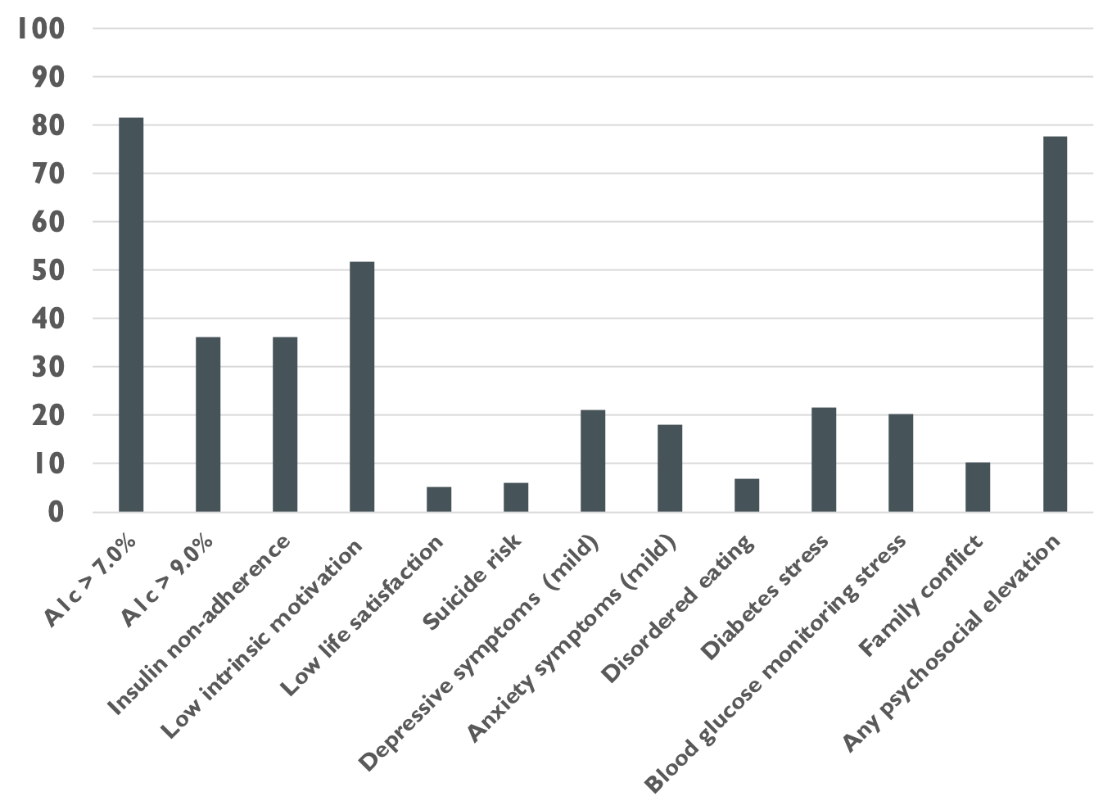
% Screening Positive

Slide 21
A1C and Psychosocial Factors
A1c correlated positively with:
Suicide risk*
Anxiety*
Disordered eating**
Diabetes stress***
Blood glucose monitoring stress**
Family conflict***
Total number of elevations***
A1c correlated negatively with intrinsic motivation** and life satisfaction**
Youth with A1c ≥ 7.0% more likely to screen positive for insulin non-adherence**
*p<.05, **p<.01, ***p<.001

Slide 22
Low intrinsic motivation*
Insulin
Non-Adherence***
Low life satisfaction*
Youth with A1c ≥ 9.0%
were significantly more likely to screen positive for psychosocial factors
Family Conflict**
Suicide risk***
Diabetes Stress***
Disordered Eating**
Blood Glucose Monitoring Stress*
*p<.05, **p<.01, ***p<.001

Slide 23
Insulin Non-Adherence & Psychosocial Factors
Insulin non-adherence correlated positively with:
Suicide risk*
Depressive symptoms**
Anxiety**
Diabetes stress***
Blood glucose monitoring stress**
Family conflict***
Total number of elevations***
Negatively with intrinsic motivation***
*p<.05, **p<.01, ***p<.001

Slide 24
Low intrinsic motivation**
Youth screening positive for insulin non-adherence were more likely to screen positive for other psychosocial factors
Family Conflict*
Depressive symptoms*
Anxiety*
Diabetes Stress*
*p<.05, **p<.01, ***p<.001

Slide 25
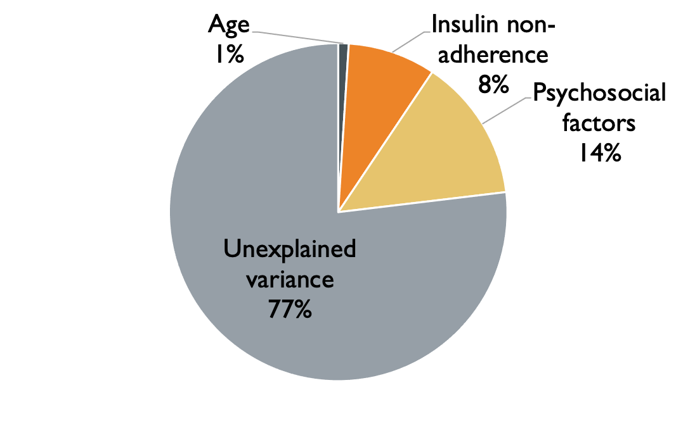
Results
Hierarchical linear regression indicated that, as a group, psychosocial factors account for a significant portion of variation in A1c (F (8, 221) = 6.68, p < .001).
In final model, some factors uniquely accounted for variance in A1c:
Insulin non-adherence (𝜷 = .18, p < .01)
Disordered eating (𝜷 = .15, p < .05)
Diabetes stress (𝜷 = .26, p < .01)
Family conflict (𝜷 = .16, p < .05)
Variation in A1c

Slide 26
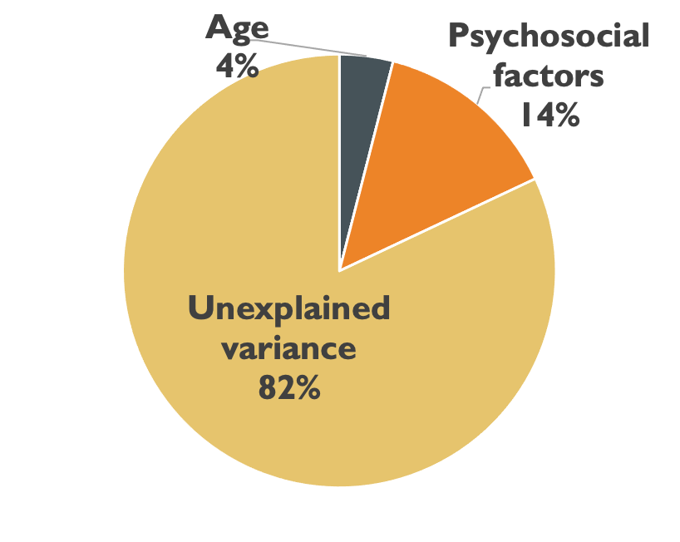
Results
Psychosocial factors also accounted for a significant portion of variation in insulin non-adherence (F (8, 222) = 5.43, p < .001).
In final model, some factors uniquely accounted for variance in insulin non-adherence
Age (𝜷 = .17, p < .01)
Intrinsic motivation (𝜷 = -.14, p < .05)
Family conflict (𝜷 = .20, p < .01)
Variation in insulin non-adherence

Slide 27
Intrinsic Motivation in Youth with Diabetes: Role of family conflict
Having good blood sugar control is very important to me, a priority in my life.
Better treatment adherence¹
Intrinsic Motivation
Better glycemic control¹
I feel confident in being able to manage my diabetes so that my blood sugar is in good control.
However, low intrinsic motivation is common
Our clinic asked adolescents (12+) to report on intrinsic motivation as part a routine screening program
51.7% reported at-risk levels of low motivation
¹Delamater et al. (2017). Intrinsic motivation in ethnic minority youth with type 1 diabetes. Children's Health Care, 46(3), 215-229.
²Brodar et al. (2021). Comprehensive psychosocial screening in a pediatric diabetes clinic. Pediatric Diabetes. Advance online publication.
Notes:
Intrinsic motivation describes the importance an individual ascribes to a particular activity as well as their confidence in carrying out that activity. In youth with diabetes, intrinsic motivation is associated with better treatment adherence and better glycemic control. However, low intrinsic motivation is extremely common in this population.

Slide 28
FAMILY CONFLICT
Common among youth with diabetes¹
10.3% clinically elevated on family conflict screening measure²
Disagreements related to responsibility for diabetes management tasks, communication style, parental monitoring of diabetes¹
Associated with poorer adherence behaviors and suboptimal glycemic control³
Youth with more family conflict report lower intrinsic motivation to manage their diabetes²
¹Delamater et al. (2018). Psychological care of children and adolescents with type 1 diabetes. Pediatric diabetes.
²Brodar et al. (2021). Comprehensive psychosocial screening in a pediatric diabetes clinic. Pediatric Diabetes. Advance online publication.
³Hsin et al. (2010). Adherence and glycemic control among Hispanic youth with type 1 diabetes: Role of family involvement and acculturation. Journal of Pediatric Psychology, 35(2), 156-166.
Notes:
Family conflict is also extremely common among youth with diabetes. In our clinic’s screening program, we found that 10.3% of youth reported clinically elevated levels of family conflict. Family conflict has been linked to poorer adherence and worse glycemic control. We also found that more family conflict was associated with lower intrinsic motivation to manage diabetes.

Slide 29
study aims
Aim 1: Examine relationship between intrinsic motivation and (1) insulin non-adherence and (2) glycemic control.
Aim 2: Assess family conflict as moderator of these relationships.
Intrinsic Motivation
Adherence to Insulin Regimen
Family Conflict
Intrinsic Motivation
Glycemic Control
Notes:
The current study aimed to examine the relationships between intrinsic motivation, insulin non-adherence, and glycemic control, and to assess whether family conflict moderated these relationships.

Slide 30
study methods
Procedures
Youth completed a psychosocial screener prior to their outpatient clinic visit, including measures of IM and family conflict, as well as depression, anxiety, diabetes stress, and life satisfaction⁴
Pearson correlations and hierarchical linear regression analyses, controlling for sex and diabetes type, examined relationships between variables
Participants
263 adolescents with diabetes (age range=12-18 years, M=15.4 years; 53.6% female; 87.8% type 1)
Measures
Intrinsic motivation: 2 items from Intrinsic Motivation Inventory for Diabetes Management¹
Family conflict: 4 items from Diabetes Family Conflict Scale²
Insulin non-adherence: 2 items from Diabetes Self-Management Profile³
Glycemic control: Glycosylated hemoglobin A1c obtained from medical charts
¹Delamater et al. (2017). Intrinsic motivation in ethnic minority youth with type 1 diabetes. Children's Health Care, 46(3), 215-229.
²Hood et al. (2007). Updated and revised diabetes family conflict scale. Diabetes Care 2007;30(7):1764-69
³Wysocki et al. (2012). Validation of a self‐report version of the diabetes self‐management profile. Pediatric diabetes 2012;13(5):438-43
⁴Brodar et al. (2021). Comprehensive psychosocial screening in a pediatric diabetes clinic. Pediatric Diabetes. Advance online publication.
Notes:
Participants included 263 adolescents with diabetes who completed a psychosocial screener as part of routine clinical care in an outpatient endocrinology clinic. We used Pearson correlations and hierarchical linear regression to assess relationships between variables. We controlled for sex and diabetes type based on preliminary analyses.

Slide 31
Results
Greater intrinsic motivation (IM) was associated with less family conflict (r = -.21, p<.01), less insulin non-adherence (r = -.23, p < .001), and lower A1c (r = -.19, p<.01), as well as less depression, anxiety, diabetes stress, and greater life satisfaction (all p’s<.05)
Moderation analyses for insulin non-adherence
Interaction between family conflict and IM was significant (t = -.21, p < .05)
Low family conflict → IM negatively correlated with insulin non-adherence (t = -2.99, p < .01)
High family conflict → non-significant relationship between IM and insulin non-adherence (t = .06, p > .05)
Moderation analyses for A1c
Interaction between family conflict and intrinsic motivation was not significant
However, both were uniquely associated with A1c
Intrinsic motivation, t = -2.18, p < .05
Family conflict, t = 3.73, p < .001
Notes:
We found that more intrinsic motivation was associated with less family conflict, better insulin adherence, lower A1c, and better emotional functioning. Regression analyses indicated that family conflict moderated the relationship between intrinsic motivation and insulin non-adherence, such that at low levels of family conflict, intrinsic motivation was significantly associated with better adherence, but at high levels of family conflict, there was no relationship between intrinsic motivation and adherence. In the analyses with glycemic control, we did not find similar evidence of moderation, but intrinsic motivation and family conflict both emerged as unique predictors of glycemic control.

Slide 32
Discussion
These findings indicate that comprehensive psychosocial screening can be integrated into routine clinical care.
A high percentage of youth screen positive for psychological problems and family conflict.
The association of these problems with poorer glycemic control and insulin misuse supports the need for routine psychosocial screening so that these youth can be identified and provided appropriate interventions.
Interventions to address adherence issues in this population should incorporate a family systems perspective
More research needed to validate some of the screening tools.

Slide 33
Discussion of family conflict
Family conflict presents a major barrier to diabetes management, even in youth who report feeling intrinsically motivated to manage their condition.
These study findings provide further support for the importance of intrinsic motivation in diabetes management, particularly in the context of family conflict.
Interventions to address adherence issues in this population should incorporate a family-based approach to reduce conflict, improve communication about diabetes management tasks, negotiate parental involvement and monitoring, and promote collaborative teamwork.
The results also suggest that interventions to increase intrinsic motivation may be helpful.
The current study findings are limited by the cross-sectional study design; future studies on the role of intrinsic motivation in diabetes management should incorporate prospective study designs.
Notes:
Our findings suggest that intrinsic motivation is an important factor in diabetes management for youth. However, in the context of family conflict, even youth who are motivated to manage their diabetes face significant challenges to meet glycemic goals. As such, interventions to address adherence issues in this population should incorporate a family systems perspective.

Slide 34
Medical Providers’ Perspectives on Psycholological Screening

Slide 35
Medical Providers’ Perspectives
Qualitative interviews conducted with all 7 providers in diabetes clinic involved with screening (2 CDEs, 2 fellows, 3 attendings)
Overall, providers reported positive experience with screening
Primary advantages: Screener identifies problems that would have gone unnoticed, supports treatment planning, encourages empathy, brings problem to caregivers’ awareness
Challenges/drawbacks: patients may “slip through cracks” on busy clinic days, youth may not answer honestly/accurately
Suggestions for improvement included better communication about which youth need screening, more training/education related to screening procedures for all staff, better inclusion of CDEs & fellows in process

Slide 36
ADD QUOTES
Screener identifies problems that may have previously gone unnoticed
“There's a lot of things that it detects that we never detected so we can address. I think it’s standard of care now with diabetes care. I don't even think it's optional because now it’s so important.”
Screener helps pinpoint source of suboptimal glycemic control
“It’s really nice when we know [the screening results] before we go into the visit because then it helps you assess the medical part.”
“If certain screening results are concerning, I would say, okay, let’s try to work that out first. Because that will tell me that’s more like compliance, not the actual [insulin] dosing stuff.”
Screener might alter focus of visit, treatment plan
Sometimes it picks up on why they may not be doing something.. . . So, I’m making a plan, but it’s not a realistic plan because it is not what they are capable of doing at that time. I need to know that. So then, okay, I have to shift gears and make a different plan.

Slide 37
ADD QUOTES
Screener encourages providers to express empathy
“It changes the whole interaction . . . you’re more careful of what to say and how to say it. You’re not just there blind, talking and not knowing what’s going on.”
Screener allows providers to help patients gain insight into their difficulties with self-management
“Someone with depression, I would be pointing out to them that they probably feel down or low, they don’t want to do anything, and that’s not their fault. You know, it’s because of this mental health issue.”
Screener brings awareness of problem to attention of caregiver
I think also to be able to sometimes convince parents, listen, they are not scoring well on this, and this is actually something you have to take care of. It’s not just an optional thing . . . If you can deal with these diabetes-related mental issues, obviously it’s going to make the diabetes care better. So, on top of just mental issues improving, the diabetes improves.

Slide 38
Adolescent and Mother Perspectives on Psychosocial Screening

Slide 39
Study sample and procedures
Mean age of adolescents was 15.1 years (12-19 years)
61.5% White/Hispanic; 15.4% White/non-Hispanic; 23.1% Black (Hispanic/non-Hispanic)
77% of mothers had college degree or higher
Qualitative interviews with 13 adolescent-mother dyads were conducted via zoom and recorded
Youth and mothers interviewed separately
Thematic analysis of transcripts

Slide 40
Interview guide addressed four issues
1) the role medical providers should play in identifying and addressing psychosocial concerns;
2) barriers to discussing psychosocial concerns during visits;
3) reactions to routine psychosocial screening procedures and consultations with the psychology team in their diabetes clinic;
4) accessing mental health services outside of the diabetes clinic.

Slide 41
Results: medical provider’s role in mental health

Slide 42
Results: Barriers to discussing mental health
Not considering mental health as part of routine diabetes care--Normalizing mental health as a routine part of care
Too many people in the room, not having privacy--Limiting the number of “extra” people in the room (e.g., trainees)
Providers being too rushed, not interested in non-medical aspects, being judgmental--Taking the time to listen, and being calm and nonjudgmental
Past negative interactions with providers--Positive relationships with clinic providers would increase comfort with disclosing mental health concerns.

Slide 43
Reactions to routine screening
Overall, very positive views of the clinic's routine psychosocial screening procedures—Identify kids who need more support, feel valued and cared for
Adolescents liked the screener because it provided an option to disclose concerns non-verbally
Concern that some questions are scary--Kids who had not previously had depressive or suicidal thoughts might suddenly think they are experiencing those symptoms due to “over-thinking it”
Concerns that teens may not answer honestly or not understand the questions
Adolescents suggested talking about the screener first to build rapport and promote comfort and trust
Mothers suggested having them complete screeners about their kids and themselves, reviewing the results of the screening during the visit, regardless of whether the adolescent screens positive, and adding questions about diabetes knowledge

Slide 44
Reactions to interactions with psychologists
Both adolescents and mothers expressed highly positive views on consultations with the clinic's psychology team
Mothers felt the psychology consultations did not occur frequently enough and wanted the team to provide more regular therapy sessions
Recommended that endocrinologists verbally offer psychology consultations to patients at every diabetes clinic visit, and continue to offer psychology telehealth consultations
Both also wanted the psychology team to give families the opportunity to have the parent and teen meet with psychology separately from one another.

Slide 45
Accessing mental health services outside of the clinic
Adolescents and mothers emphasized the importance of professional mental health services for helping families to navigate the emotional side of diabetes
Mothers were willing to seek mental health services outside of the clinic if recommended to do so by their endocrinologist or the psychology team because they believed that physical and mental health are strongly connected
However, some noted they would be unlikely to seek mental health services because they felt that mental health providers do not understand diabetes: “I find it very tiring to go to a generic psychologist and have to spend the first sessions teaching them what diabetes is”

Slide 46
Accessing mental health services outside of the clinic
Even parents who were willing to seek services noted significant barriers to doing so, including difficulty finding a mental health provider, financial and insurance issues, transportation, finding time in busy schedules for appointments, and stigma around seeking mental health support
Mothers recommended that physicians should educate families about the benefits of therapy and connect diabetes and mental health from the very beginning of a child's treatment to normalize seeking mental health services.

Slide 47
discussion
Families want their medical providers to address mental health concerns as part of routine diabetes care
Psychosocial screening is accepted and valued by youth and their mothers, allowing youth to disclose concerns they may not feel comfortable verbalizing
There are some important barriers that need to be addressed
Screening should include psychoeducation, knowledge checks, and parent reports
Offering regular psychology consultations helps meet clinical needs
Families need help connecting to psychological care outside the clinic

Slide 48
Telehealth during covid-19: QI initiative

Slide 49
Quality Improvement Initiative
Our team identified declining psychosocial screener completion and psychology consultation rates as primary challenges following a shift to telehealth
We utilized the Plan-Do-Study-Act (PDSA) quality improvement framework to improve screening and consultation rates
Screening and consultation rates dropped initially, but recovered to nearly pre-pandemic levels following three PDSA intervention cycles
During implementation, challenges arose related to the feasibility of patient interactions, interdisciplinary collaboration, patient engagement, and ethical issues.

Slide 50
PDSA: Psychological Screening and consultation
Cycle 1: March 2020: Psychology team emails caregiver a time-limited link to the screener; MD and CDE refers family to psychology who contacts caregiver via phone to schedule a telehealth visit requiring additional consent
Cycle 2: April 2020: to address insufficient screening responses: psychology team calls caregiver in morning and HCT given list of patients to be screened so they can remind caregiver about screener if not done; psychology team sent an email with mental health resources and psychology team contact information to the clinic’s caregiver listserv
Cycle 3: May 2020: EHR update allowed virtual visits with Zoom integrated in Epic; virtual warm handoff in which MDs emailed psychology to join the medical visit; in June 2020 screening used generic links emailed several days prior to outpatient visit that did not expire
Notes:
time

Slide 51
screening and consultation rates over time

Slide 52
Lessons learned
Clinics shifting psychology consultation-liaison services to telehealth should prioritize interdisciplinary communication, elicit perspectives from all clinic professionals, leverage the electronic health record, and develop procedures for warm handoffs and navigating ethical issues.

Slide 53
Leveraging the EHR: 6 habits
Checks glucose at least 4 times/day or uses CGM
Gives at least 3 insulin boluses per day
Uses insulin pump
Delivers boluses before meals
Reviewed glucose data since last clinic visit
Has changed insulin doses since the last clinic visit.
For every 1-unit increase in total habit score, there was a mean (SE) 0.6% (0.05) decrease in HbA1c among all participants and a mean (SE) 2.86% (0.71) increase in TIR among those who used CGMs
Only 8.7% performed all 6 habits

Slide 54
Psychosocial screening in T1DX
Corathers et al. (2022) at ADA:
Of 25 pediatric centers, 96% use one tool, 79% use two or more
Of 8 adult centers, 43% use one or more tools
Most common screen is for depression in 96% of pediatric and 38% of adult centers
About 40% of pediatric centers screen for transition to adult care and social determinants of health and 25% screen for anxiety or diabetes distress
Adult centers also screen for SDOH (38%) but less so for diabetes distress, health literacy or adherence (10%)
Common challenges include time constraints, workflow integration, and how best to follow up on positive screens

Slide 55
Summary
Barriers to Achieving Good Glycemic Control
Barriers to Youth Receiving Behavioral Health Care
Integrated Behavioral Health Care

Slide 56
Barriers to Achieving optimal Glycemic Control
Stress, anxiety, depression
Family conflict about diabetes management
Low motivation
Regimen adherence problems (BG checks and utilization of data, omission or underdosing of insulin, lack of attention or accuracy with regard to carbs)
Lack of integration of behavioral and medical care
New intervention approaches needed to address these barriers and help youth achieve glycemic targets

Slide 57
Barriers to Youth Receiving Behavioral Health Care
Attitudes and stigma
Financial barriers, inconvenience and distance, and long wait times
Insurance coverage
In many states in the US, mental and behavioral health services provided by Medicaid HMOs with very poor reimbursement, effectively excluding licensed psychologists from participation
Most youth—particularly lower income and ethnic minority youth--do not receive evidence-based behavioral interventions to improve diabetes management.

Slide 58
Integrated Behavioral Health Care
Integrated behavioral health care can overcome common barriers related to access of mental/behavioral health care for pediatric patients.
Research has demonstrated behavioral interventions reduced medical utilization and DKA hospitalizations for youth with poorly controlled diabetes (e.g., Ellis et al., 2005, Diab Care; Ellis et al., 2008, Diab Care).
Integrated psychology services in the diabetes clinic improves glycemic control and reduces costs (Caccavale et al., 2020, J Clin Psych in Med Settings).
More research is needed to demonstrate cost effectiveness of integrated behavioral health care for youth with type 1 diabetes.

Slide 59
Research Team
Eileen Davis, PhD
Kaitlyn Brodar, MS, MPH
Lolly Starr-Glass, PsyD
Courtney Lynn, PhD
Joyce Liu, PhD
Janine Sanchez, MD
Luiza Mali, PhD
Annette La Greca, PhD
Alan Delamater, PhD

Slide 60
Thanks for your attention

