Slide 1
Clinical Leadership Updates
G. Todd Alonso, MD (Pediatric co-chair)
Devin Steenkamp, MBChB (Adult co-chair)
11/8/22

Slide 2
Committee highlights – high level accomplishemnts
Clinical Leadership
Data Science – What data are we collecting and how?
Data Governance – How do we use these data?
Publications Committee – What scientific products can we publish?

Slide 3
Purpose of Clinical Leadership Committee
Review progress against strategic goals
Advise on clinical directions and partnerships
Recommend new Co-PIs for special project
Discuss new grant ideas and sustainability plans

Slide 4
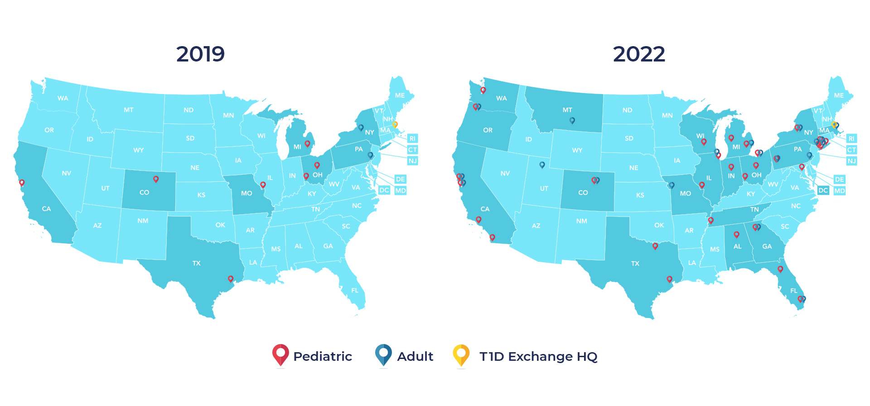
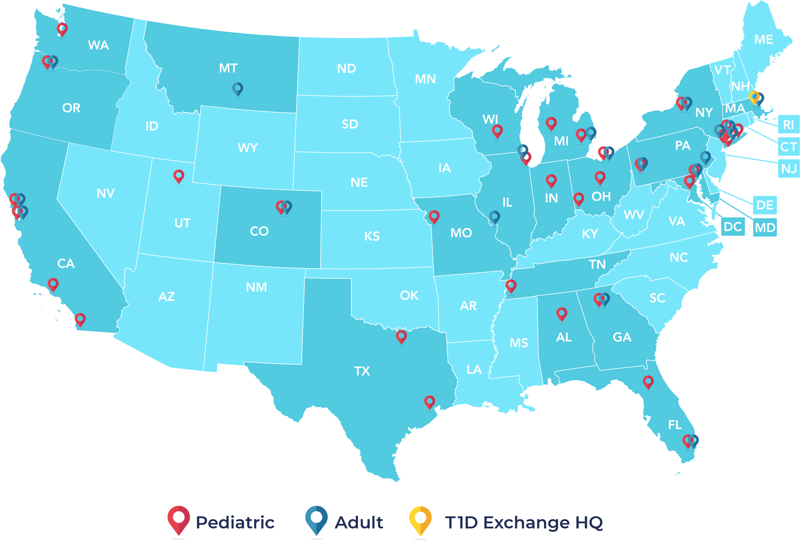
T1DX-QI now includes 52 data-sharing diabetes centers

Slide 5
Clinical leadership
Big questions from the PIs:
How do we leverage the power of the Collaborative for improved care?
How do we do QI between centers? What is the benefit?

Slide 6
Clinical leadership
This collaborative is about collaboration
We need continuous connection
How can we learn from one another?
Our teams all look different and have different capacities for improvement

Slide 7
Our challenges to you
1. Take home at least one intervention idea from this meeting
2. Find at least one QI topic to discuss with another clinic
3. Help us develop:
Methods for continuous connection that avoid flooding your inbox
A sharing space for good ideas
Our recommendations:
Central, T1D Exchange resources
Transition of care toolkits
Exercise and diabetes education
Diabetes technology overview documents

