Slide 1
State of the T1DX-QI 2022
Osagie Ebekozien MD, MPH, CPHQ
Chief Medical Officer

Slide 2
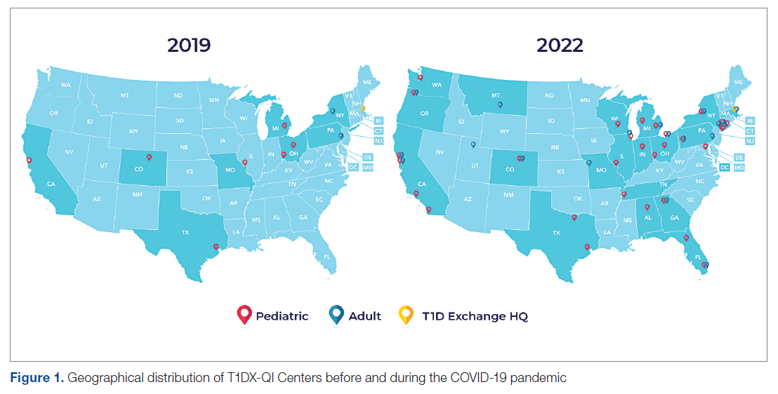
T1DX-QI now 52 Centers strong serving 80,000+ lives
Mungmode, A. H et al Diabetes Population Health Innovations in the Age of COVID-19: Insights From the T1D Exchange Quality Improvement Collaborative. J Clin Outcomes Manag, 29(5), 185-192. https://doi.org/10.12788/jcom/0109

Slide 3
Welcome 6 New T1DX-QI Pediatric Centers in 2022

Slide 4
Welcome 7 New Adult T1DX-QI Centers in 2022

Slide 5
T1DX-QI Population Health Improvement Framework
eg: Test changes in the clinic to improve
outcomes for high risk patients
Design
and Improve
Clinical Processes
(QI)
Co-Design with
Partners and
People with
Diabetes
eg: Identify top drivers for
high risk patients
eg: Identify high risk patients
for follow up
Analyze Data
for QI Policy
Insights
Use QI Portal
for Population
Health Management
Priya Prahalad et al. T1D Exchange Quality Improvement Collaborative: Accelerating Change through Benchmarking and Improvement Science for People with Type 1 Diabetes. Journal of Diabetes. November 2021

Slide 6
T1DX-QI Value Questions
Do we have the right kind of data to drive real-world improvements?
Are we making the best decisions based on available data?
What insights can we generate from available data?
How can we improve clinical and population health outcomes?
Are outcomes equitable?
Priya Prahalad et al. T1D Exchange Quality Improvement Collaborative: Accelerating Change through Benchmarking and Improvement Science for People with Type 1 Diabetes. Journal of Diabetes. November 2021

Slide 7
1. Collect the right kind of data to drive real-world improvements

Slide 8
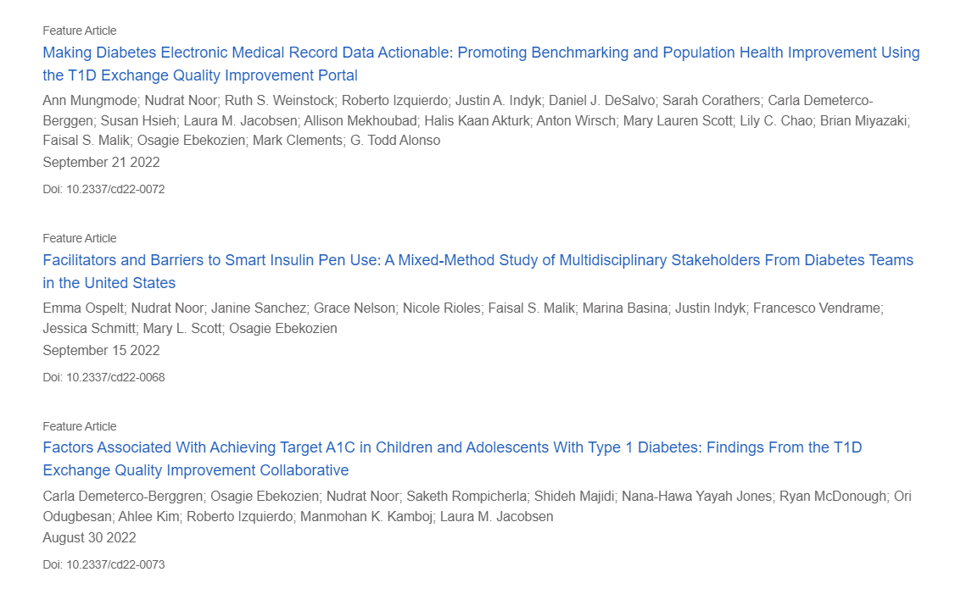
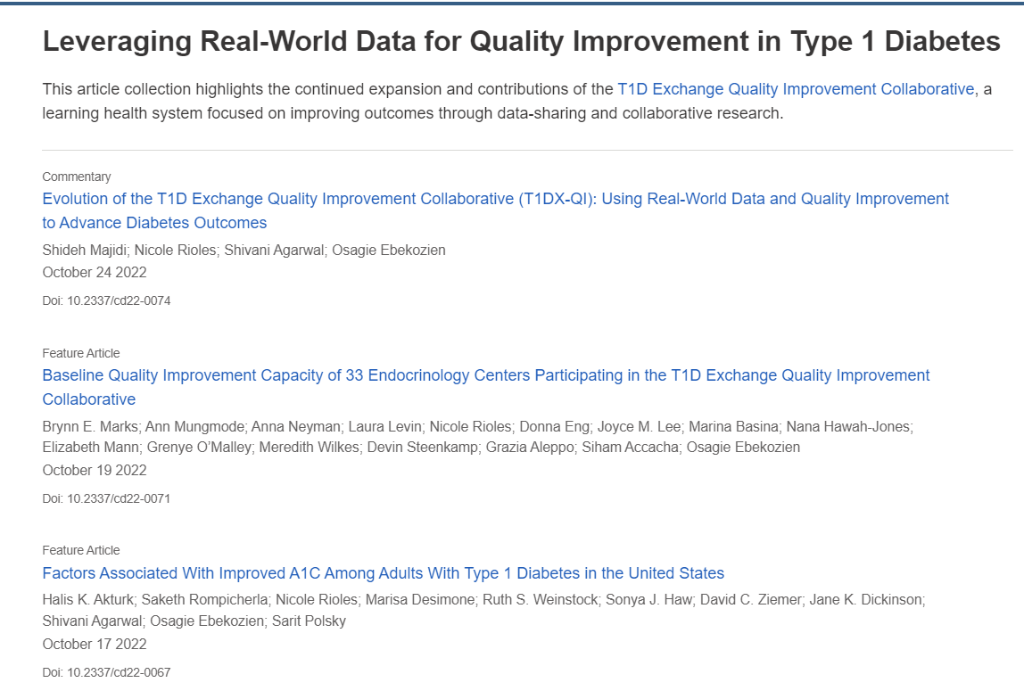
T1DX-QI Clinical Diabetes 2022 Special Issue

Slide 9
T1DX-QI leading the way in Real World Data
Upgraded the EMR data specifications to version 3 (October 2022)
Increased de-identified EMR database from 38,000+ to 58,000+ in 2022 (52% Increase).
Completed data mapping for 16 centers in 2022, increased number of mapped centers to 27 (145% Increase).
Support ad hoc data collection including qualitative studies and 7 special population health projects.

Slide 10
T1Dx QI EMR T1D Mapped Data Distribution (N=54,145)
 |  | >6 yrs N=1734 | 6-13 yrs N=13573 | 13-18 yrs N=19690 | 19-26 yrs N=12531 | 26-50 yrs N=4660 | 50-65 yrs N=1386 | >=65 yrs N=563
 |  | n (n (%)) | n (%) | n (%) | n (%) | n (%) | n (%) | N (%)
Male sex | 28,134 (52) | 928 (54) | 6917 (51) | 10438 (53) | 6542 (52) | 2324 (50) | 699 (50) | 280 (50)
Race/Ethnicity NH white NH Black Hispanic Other | 30,933 (58) 5,503 (11) 5,459 (10) 11,425 (21) | 945 (55) 149 (9) 163 (10) 435 (26) | 7169 (54) 1438 (11) 1365 (10) 3294 (25) | 10888 (56) 2178 (11) 2048 (11) 4234 (22) | 7509 (61) 1143 (9) 1477 (12) 2288 (18) | 3055 (65) 417 (19) 352 (8) 817 (18) | 953 (69) 148 (11) 43 (3) 241 (17) | 409 (73) 30 (5) 10 (2) 114 (20)
Insurance ª Private Public | 26,156 (58) 16,308 (36) | 837 (54) 580 (39) | 6424 (54) 4587 (39) | 9597 (55) 6652 (38) | 6247 (63) 3148 (32) | 2430 (73) 836 (25) | 561 (69) 248 (31) | 55(18) 255 (82)
HbA1c (Mean[SD]) | 8.7 [2.1] | 8.3 [1.6] | 8.5 [1.9] | 9.0 [2.3] | 8.9 [2.1] | 8.0 [1.8] | 8.0 [1.6] | 7.5 [1.2]
HbA1c Median (IQR) | 8.2 [2.6] | 8.1 [2.0] | 8.1 [2.2] | 8.5 [3.1] | 8.4 [2.7] | 7.6 [2.1] | 7.6 [1.9] | 7.4 [1.4]
CGM use ^{b} | 30,561 (56) | 1065 (61) | 8201 (60) | 10794 (55) | 6132 (49) | 3172 (68) | 845 (61) | 347 (62)
Pump use ^{b} | 27,035 (50) | 740 (43) | 6778 (50) | 9358 (48) | 6372 (51) | 2846 (61) | 724 (52) | 289 (51)
ª Missing data, column totals may not add up to 100%; ^{b} Device information available on a subset of the population
Unpublished data, presented at ADA Scientific Conference and publication in 2022

Slide 11
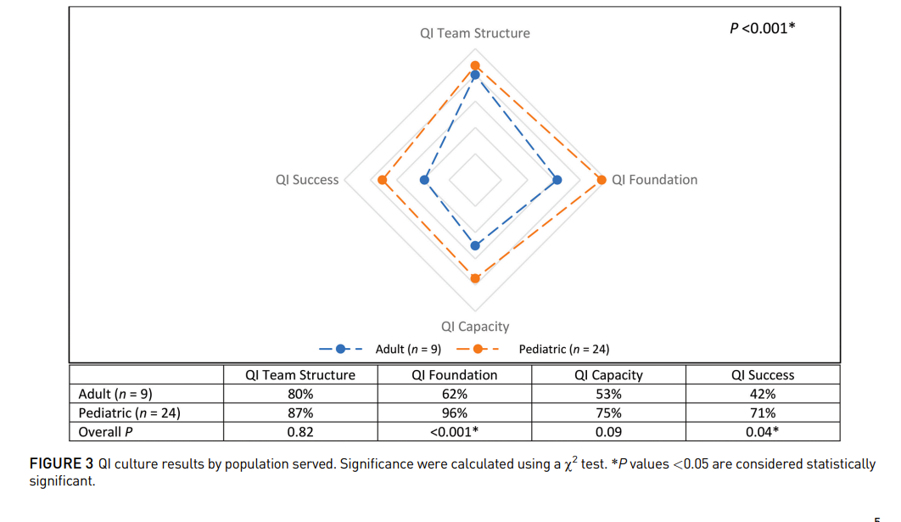
Data on QI Culture and Capacity
Brynn M, Mungmode A at al Baseline Quality Improvement Capacity of 33 Endocrinology Centers Participating in the T1D Exchange Quality Improvement Collaborative. Clinical Diabetes 2022

Slide 12
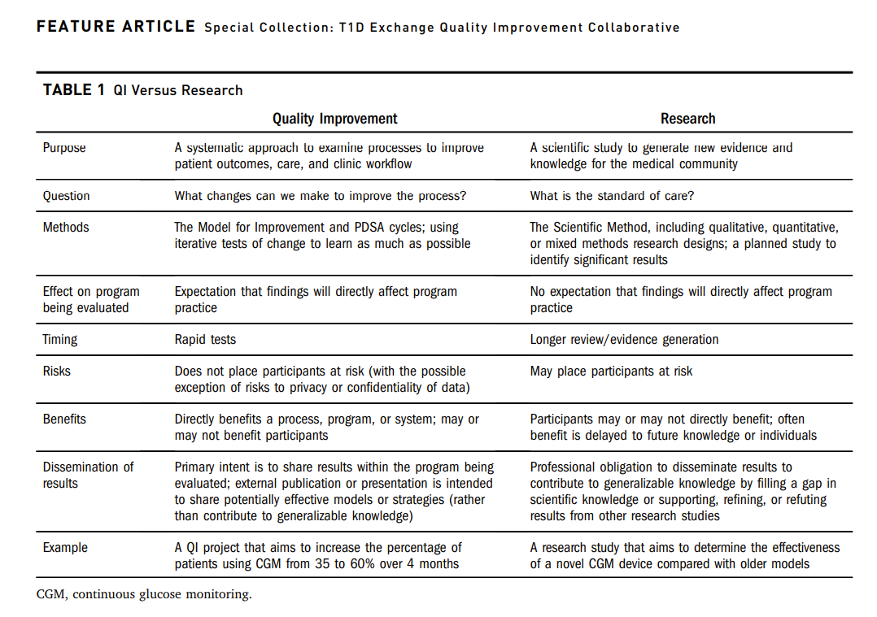
Using QI Principles to scale knowledge
Brynn M, Mungmode A at al Baseline Quality Improvement Capacity of 33 Endocrinology Centers Participating in the T1D Exchange Quality Improvement Collaborative. Clinical Diabetes 2022

Slide 13
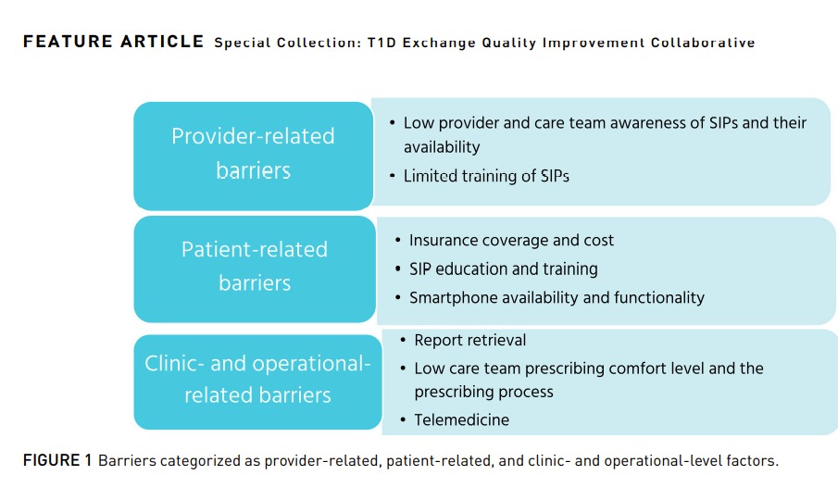
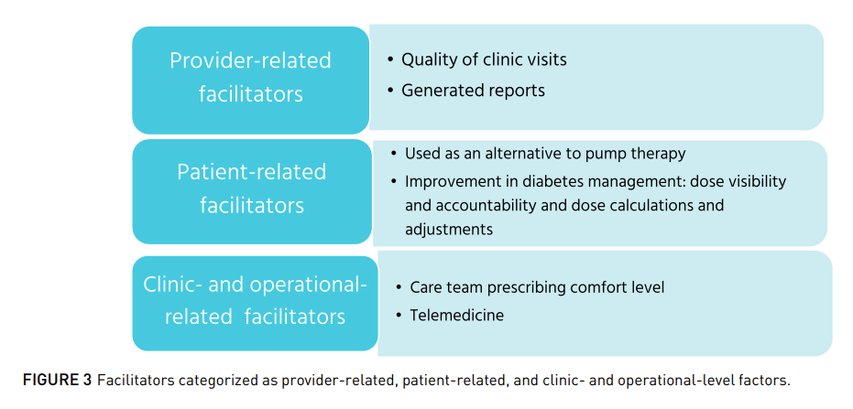
Embraced Qualitative Real-World Data
Ospelt E, Nudrat N. at al Facilitators and Barriers to Smart Insulin Pen Use: A Mixed Method Study of Multidisciplinary Stakeholders from Diabetes Teams in the United States. Clinical Diabetes 2022

Slide 14
2. Use data to make best the decisions for the population of people with type 1 diabetes

Slide 15
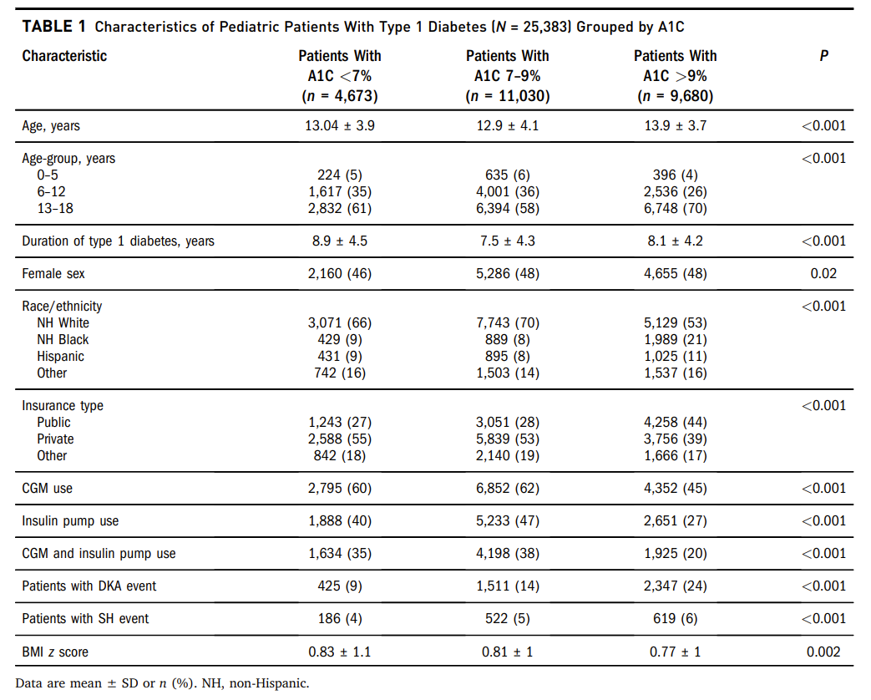
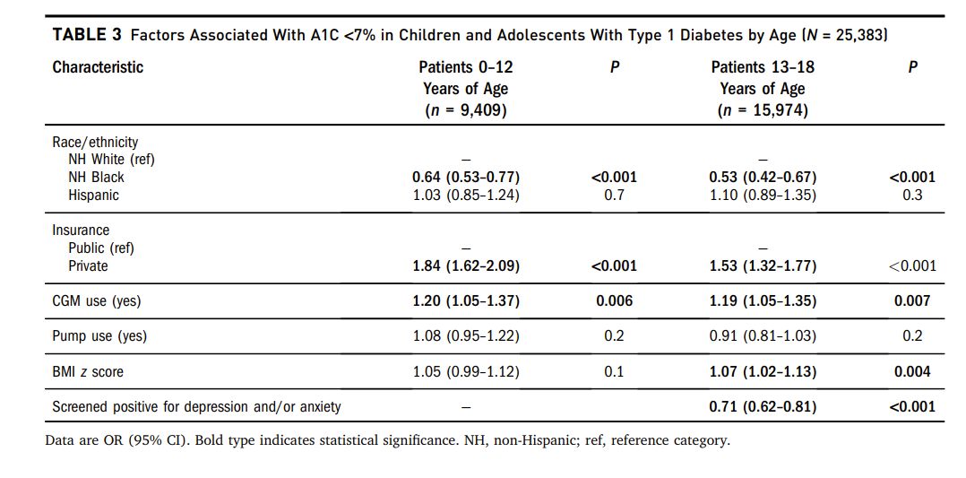
Achieving A1c Target in Pediatric Cohort
Demeterco-Bergren C, Ebekozien O at al Factors Associated with Achieving Target A1C in Children and Adolescents with Type 1 Diabetes: Findings from T1D Exchange Quality Improvement Collaborative. Clinical Diabetes 2022

Slide 16
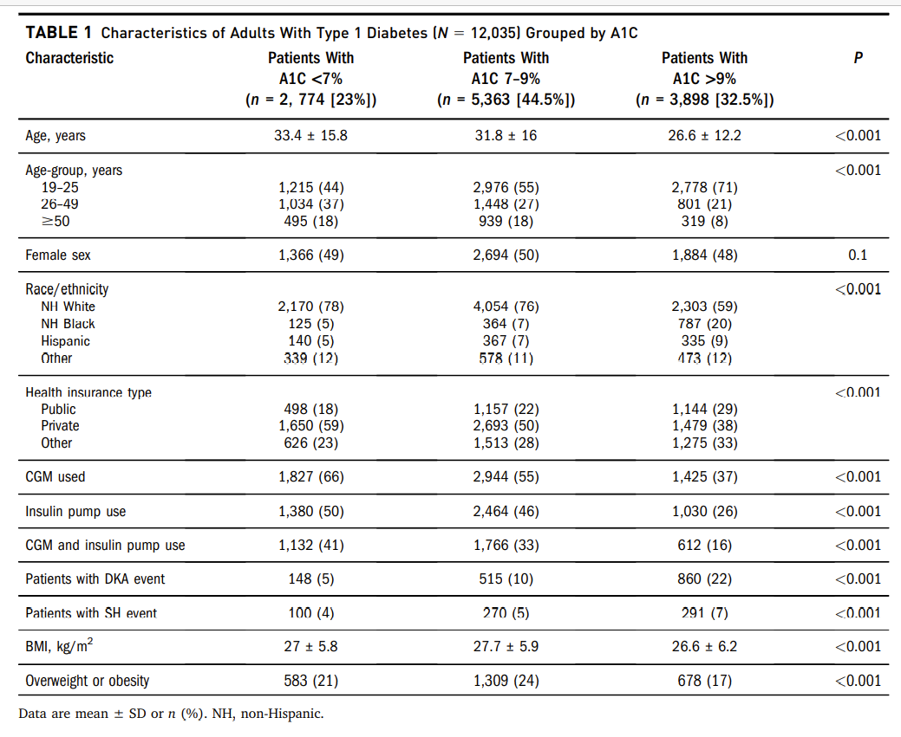
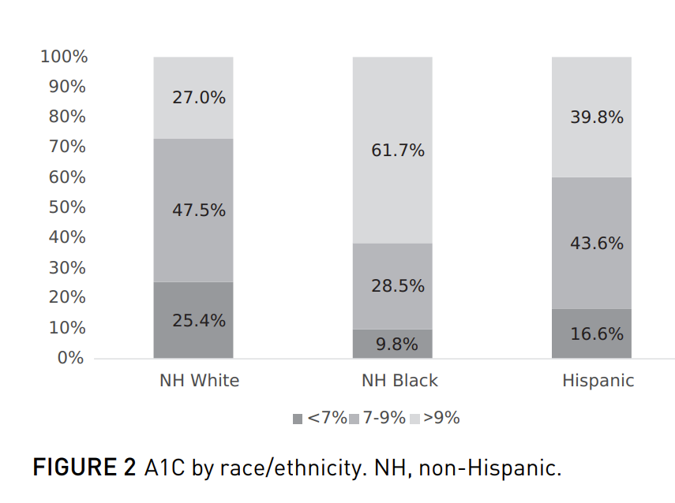
Achieving Target A1c in Adult Cohort
Halis A, Rompicherla S at al Factors Associated with Improved A1C among Adults with Type 1 Diabetes. Clinical Diabetes 2022

Slide 17
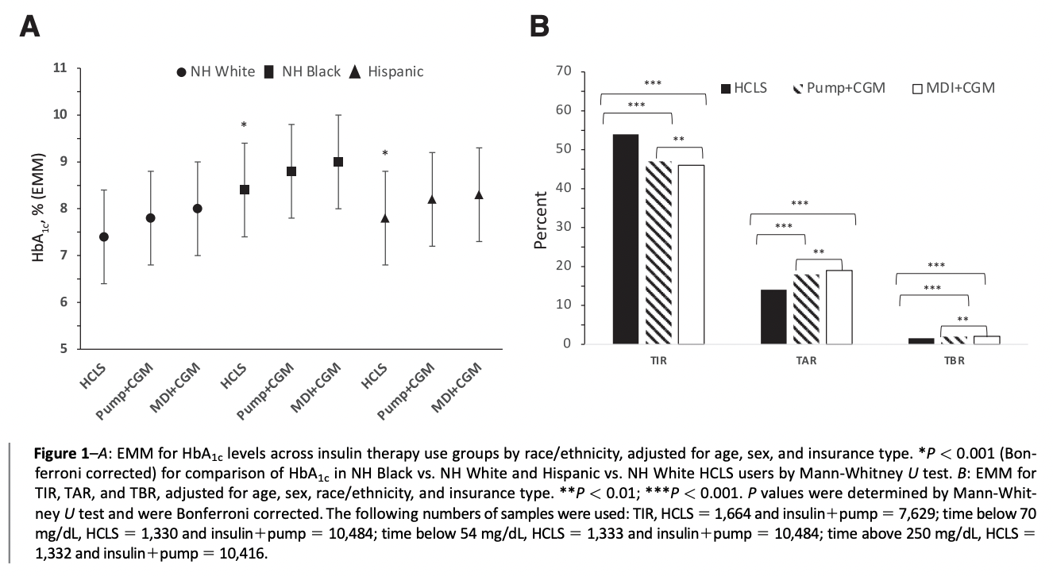
Building evidence for emerging technologies

Slide 18
3. How can we improve clinical and T1D population health outcomes?

Slide 19
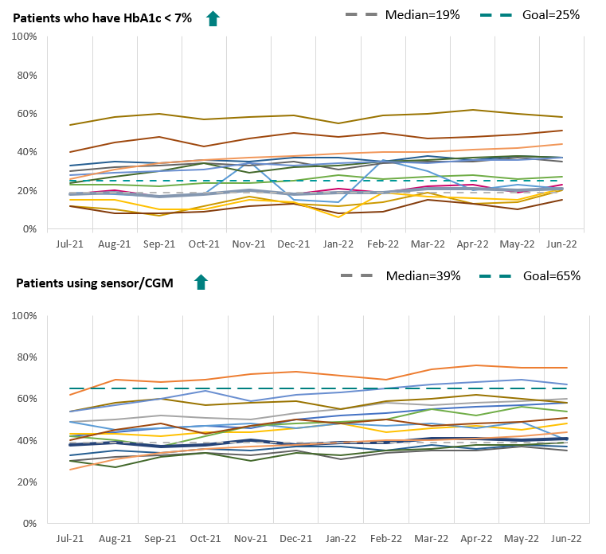
QI benchmarking with T1DX-QI Portal
Innovative EMR-based data platform
Access and chart local center data.
Benchmark against other T1DX-QI centers on key T1D metrics.
View case studies and change packages for QI inspiration.
Rank metric performance in the network for advocacy.
Mungmode A. Making Diabetes Electronic Medical Record Data Actionable: Promoting Benchmarking and Population Health Improvement Using the T1D Exchange QI Portal. Clinical Diabetes 2022

Slide 20
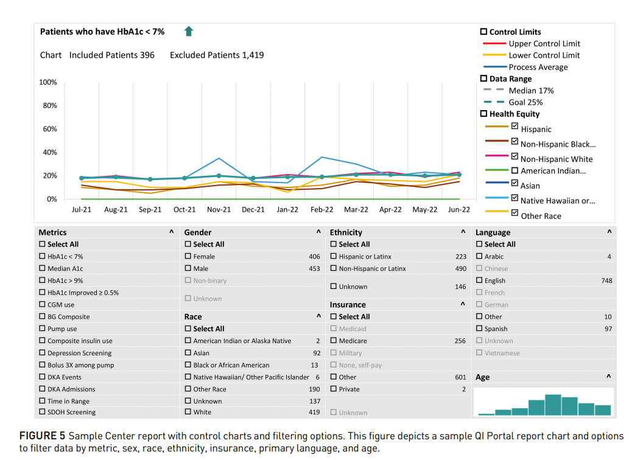
Expanded features of the data benchmarking QI Portal
Mungmode A. Making Diabetes Electronic Medical Record Data Actionable: Promoting Benchmarking and Population Health Improvement Using the T1D Exchange QI Portal. Clinical Diabetes 2022

Slide 21
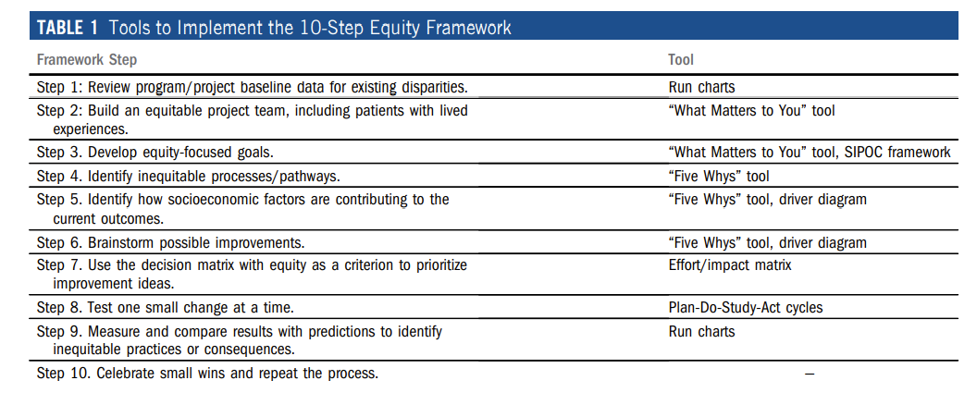
Developed templates of Practical QI Tools
Ebekozien OA, et al Achieving Equity in Diabetes Research: Borrowing from the Field of Quality Improvement Using A Practical Framework
and Improvement Tools. Diabetes Spectrum 2022

Slide 22
Driving positive outcomes for the T1D Population?

Slide 23
63% of Adult QI Measures improved in 2022

Slide 24
58% of Pediatric QI Measures improved in 2022

Slide 25
Learning and Sharing
18 Manuscripts accepted/published so far in 2022.
25 Abstracts accepted/presented at 5 international conferences ADA, ATTD, ISPAD, NCQA, ADCES.
Published papers have received recognition including “Most Cited”, “Most Read”, “Featured Paper”, “Top 10% of cited Papers”.
36 Abstracts presented at the T1DX-QI Learning Session in Miami, FL. Abstracts published in Journal of Diabetes.

Slide 26
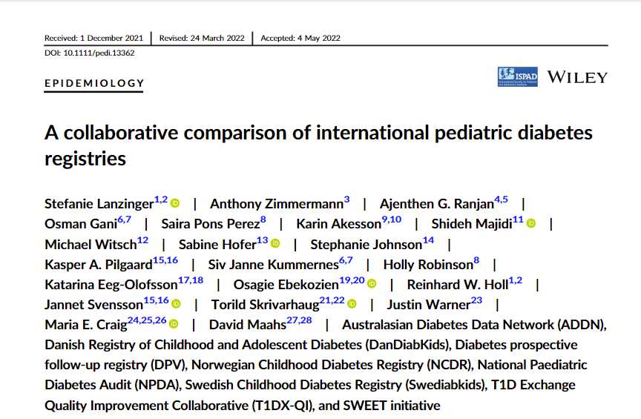
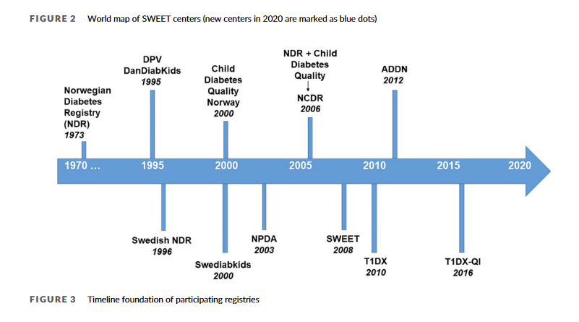
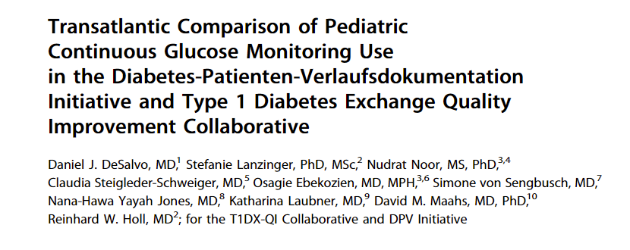
Learning from International Collaborations

Slide 27
Can we make outcomes equitable?

Slide 28
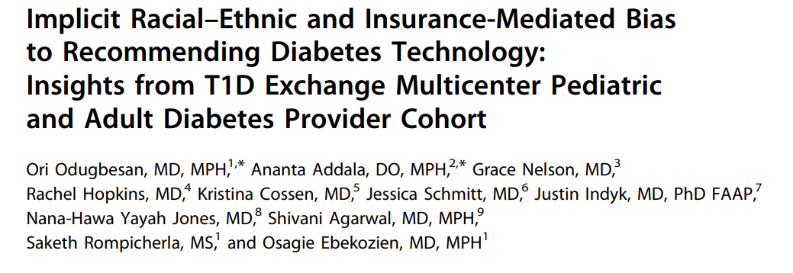
Data to understand Implicit Bias role in Health Equity
Providers rank race/ethnicity low but insurance high, as important in recommending CGM
Odugbesan, O., Addala, A., Nelson, G., Hopkins, R., Cossen, K., Schmitt, J., Indyk, J., Jones, N. Y., Agarwal, S., Rompicherla, S., & Ebekozien, O. (2022). Implicit Racial-Ethnic and Insurance-Mediated Bias to Recommending Diabetes Technology: Insights from T1D Exchange Multicenter Pediatric and Adult Diabetes Provider Cohort. Diabetes technology & therapeutics, 24(9), 619–627. https://doi.org/10.1089/dia.2022.0042

Slide 29
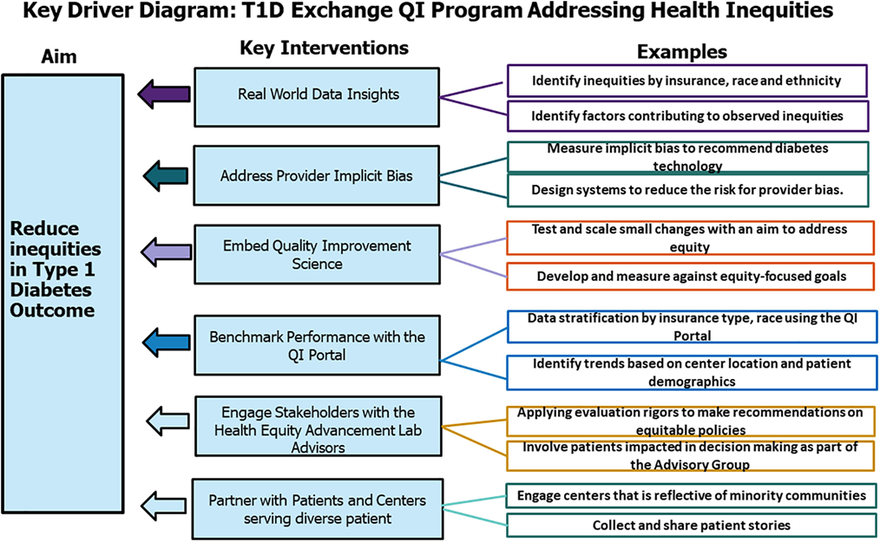
T1DX-QI Health Equity Approaches
Ebekozien O Diabetes Addressing type 1 diabetes health inequities in the United States: Approaches from the T1D Exchange QI Collaborative; Journal of Diabetes 2021:https://doi.org/0.1111/1753-0407.13235

Slide 30
Results: Significant reduction in CGM Use disparities
The median CGM Use increased by 7% in Non-Hispanic White (NHW), 12% in Non-Hispanic Black (NHB), and 15% in Hispanic patients.
The disparity in CGM Use between NHW and Hispanic patient reduced by 11% and by 5% between NHW and NHB. Both trends were statistically significant with P value of <0.001
Unpublished data, manuscript in progress

Slide 31
2022 Special Projects
Health Equity Advancement Lab (HEAL)
Health Equity QI Project Expansion
Smart/Connected Pen QI Project
Fear of Hypoglycemia Adult Centers Study
T1D antibodies Screening Qualitative Studies
CGM Real World Studies
T2D Pilot QI Initiative

Slide 32
QI Collaborative Clinic Engagement & Governance
T1DX-QI
300+ members
Clinical Leadership
60 members
Publications Committee
25 members
Data Science
12 members
Data Governance
18 members
Patient/Parent Advisory
15 members
Health Equity (HEAL)
23 members

Slide 33
2022-2024 Co-Chairs – Thank you
Clinical Leadership Co-Chairs
Devin Steenkamp (Adult)
G. Todd Alonso (Pediatrics)
Data Science Co-Chairs
Joyce Lee (Pediatrics)
Marina Basina (Adult)
International Collaboration Chair
David Maahs
Data Governance Co-Chairs
Daniel DeSalvo (Pediatrics)
Carol Levy (Adult)
Publications Co-Chairs
Shideh Majidi (Pediatrics)
Shivani Agarwal (Adult)

Slide 34
2022 T1DX-QI Industry/Special Projects
T1D Antibody Screening Provider Qualitative Assessment
Ultra Rapid Insulin CME (MannKind)
Connected/Smart Pen Health Equity QI Project funded (Eli Lilly)
Real World CGM Data Study (Dexcom)
Diabetes Devices Health Equity QI Project (Medtronic)
Fear of Hypoglycemia (Eli Lilly)

Slide 35
Industry very satisfied with past projects, overall satisfaction score of 4.8/5

Slide 36
Proud of our 2022 Accomplishments

Slide 37
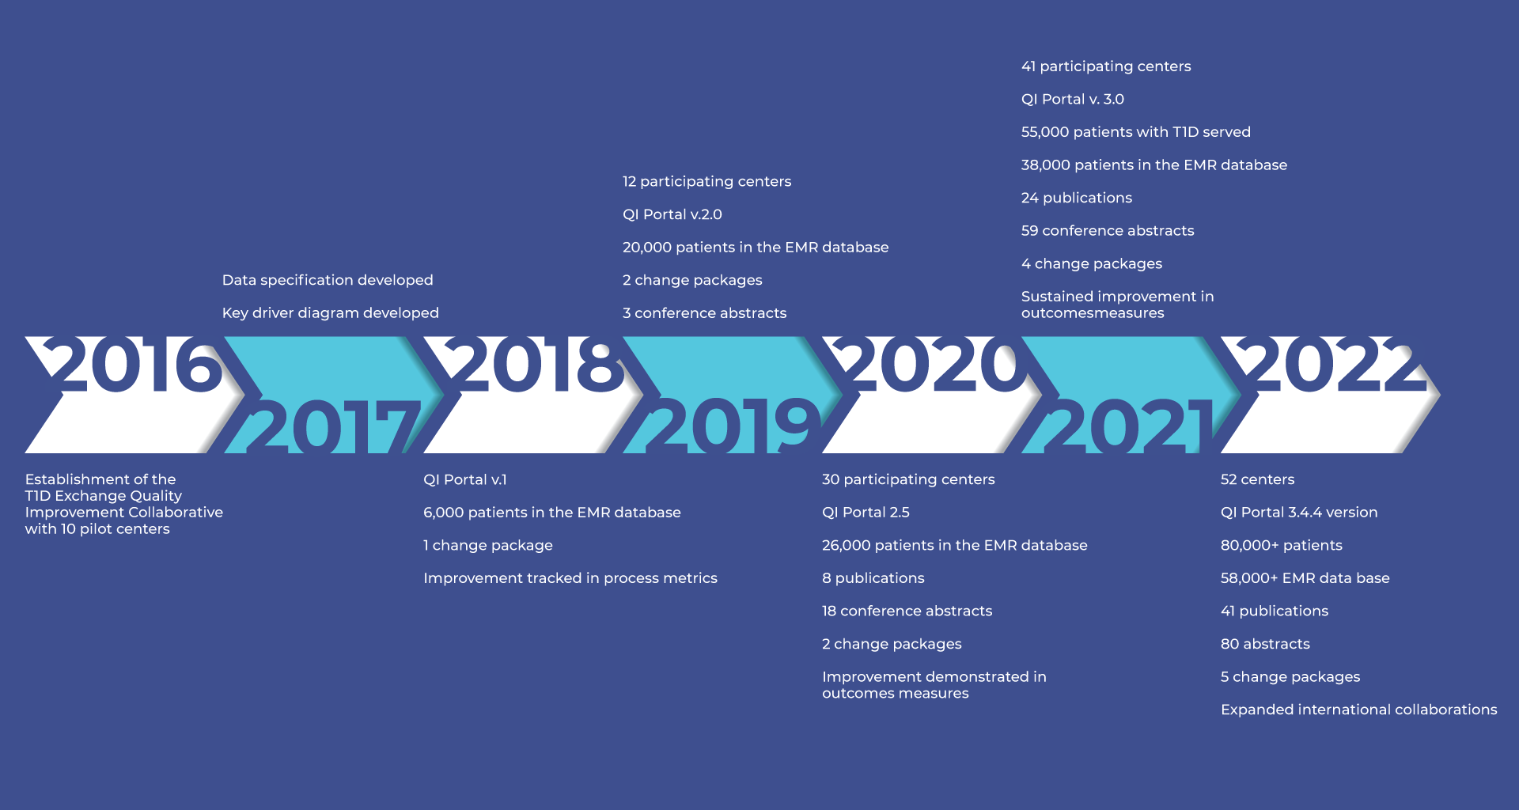
Our Journey continues
Figure shared with permission by T1D Exchange Boston.
Notes:
Add 2022 infographic

Slide 38
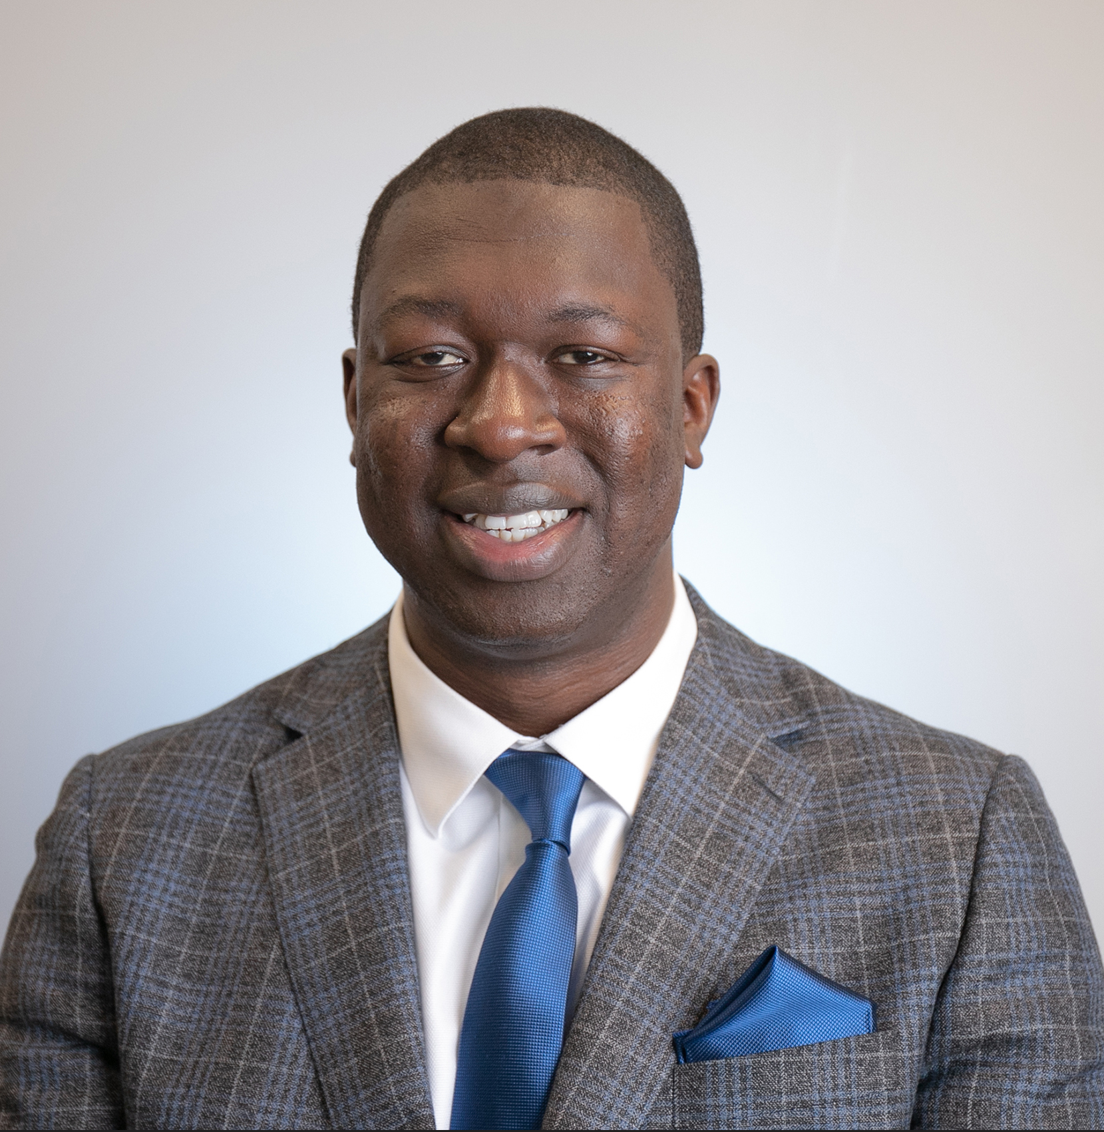
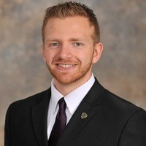
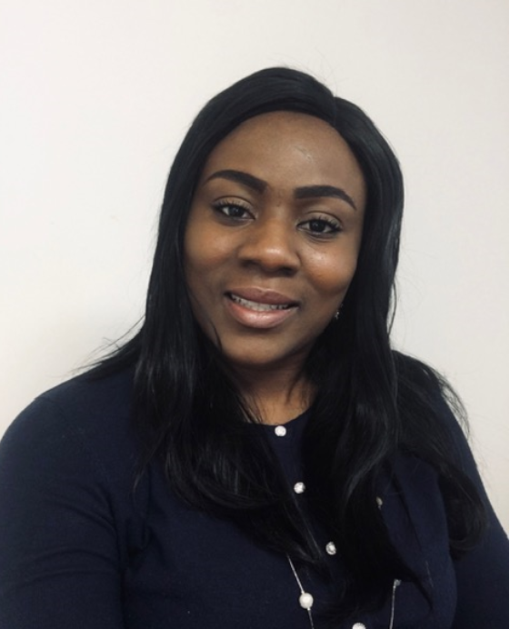
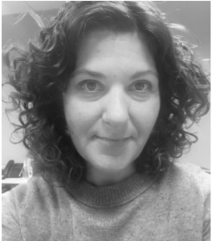
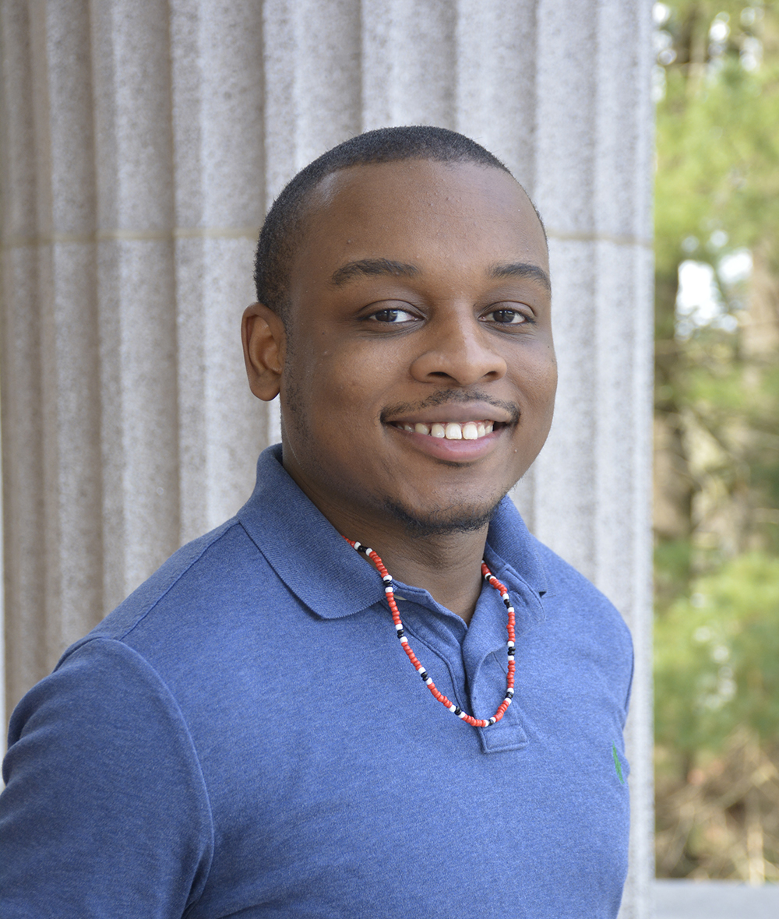
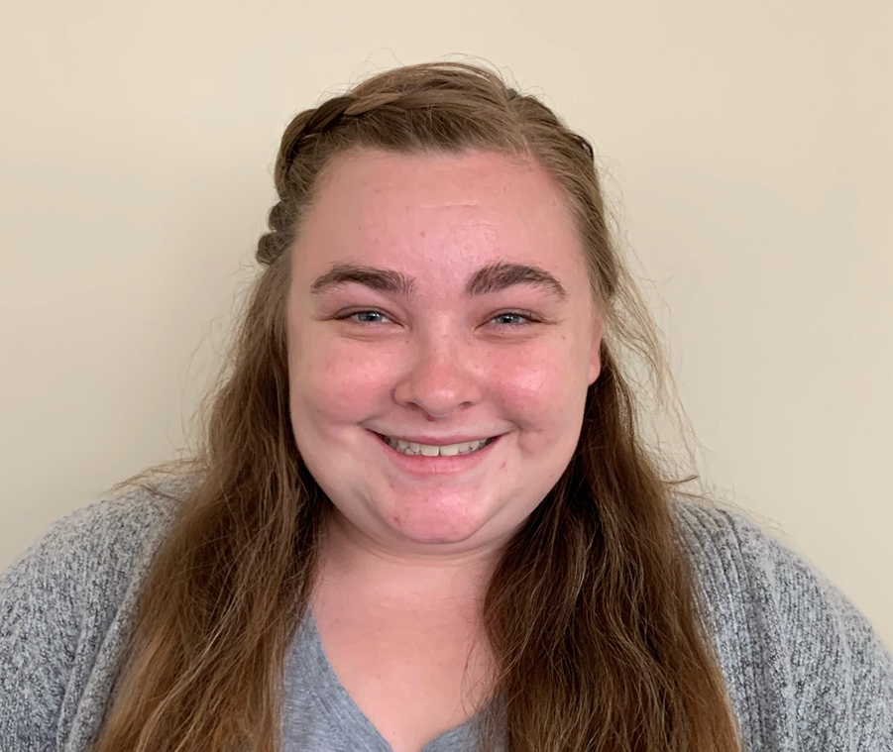
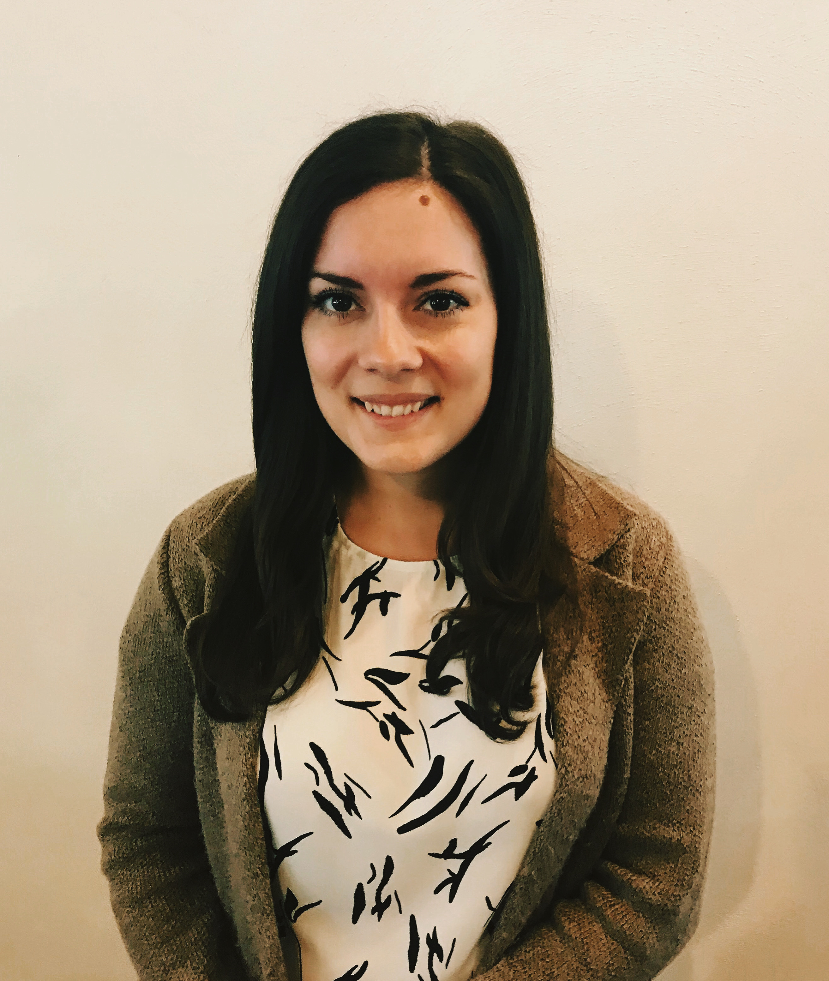
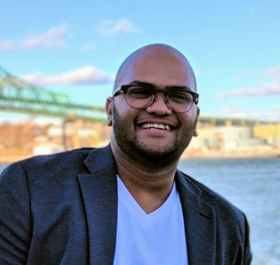
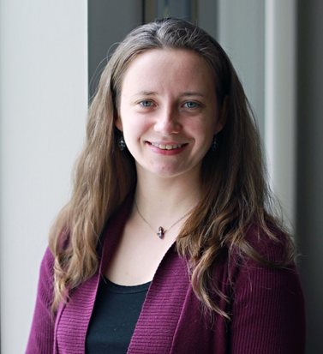
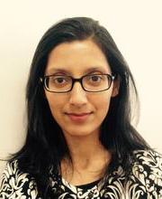
Coordinating Center QI Team
Data Integration Manager
Jesse Cases-Villablanca, MS, MPA
Associate Director of QI & Health Equity
Ori Odugbesan, MD, MPH, CPHQ
Senior Director of Clinical
Partnerships
Nicole Rioles, MA
Senior QI Analyst
Trevon Wright, MHA
Chief Medical Officer
Osagie Ebekozien, MD, MPH, CPHQ
QI Coordinator,
Holly Hardison, BS
QI Analyst,
Emma Ospelt, MPH
Population Health Analyst,
Saketh Rompicherla, MS
Senior QI Consultant
Don Buckingham, Sr. MBOE, CPHQ, CSSBB
Over 110 years of combined QI experience across the team!
QI Program Manager,
Ann Mungmode, MPH, CPHQ
Associate Director of Population Health,
Nudrat Noor, PhD
Data Integration Manager
Anton Wirsch, MS

Slide 39
We are excited for 2023
Expanding our Impact
Build QI Capacity for new centers
Implement revised Pediatric and Adult QI Metrics
Scale Health Equity programs
Expand Psychosocial care and behavioral support
Apply for competitive funding opportunities
Expand and Sustain QI Capacity for existing centers
Type 2 Diabetes Adult Collaborative Expansion
State and Federal Advocacy with QI results and real-world data
Increase impact on national measures
Trusted source for QI, Implementation, Health and Real World data

Slide 40
Many thanks to all T1DX-QI Sponsors/Supporters including Dexcom, Eli Lilly Diabetes, Medtronic Diabetes, Abbott Diabetes, Vertex, MannKind, Janssen, Clinical Diabetes, Journal of Diabetes, Children with Diabetes
Grateful to The Leona M. and Harry B. Helmsley Charitable Trust for their steadfast support of T1D Exchange and their unwavering vision and commitment to improving outcomes for those living with T1D.

Slide 41
One T1DX-QI Family

