Slide 1
Improving Back-up Planning in the Event of Pump Failure
NOVEMBER 7, 2022
T1DX-QI Learning Session

Slide 2
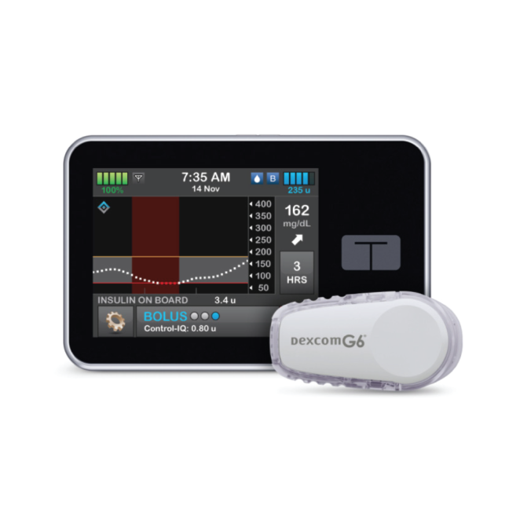
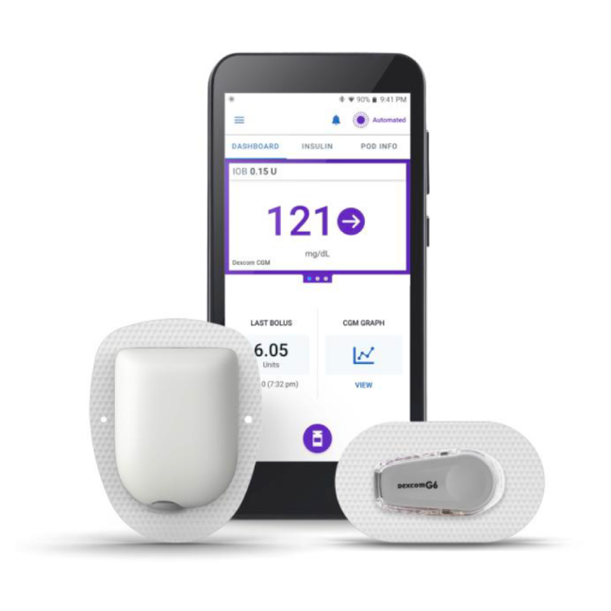
Background & Problem Statement
Use of diabetes technological devices, including insulin pumps and continuous glucose monitors, is associated with improvements in glycemic trends.¹⁻³
Device use has become standard of care and pump users should receive education on device complications with back-up plans in case of device failure.^{4,5}
A majority of DKA admissions among pump users could be prevented with troubleshooting guidelines and targeted DKA prevention education.⁶
Over the prior 18 months, only 54% of pump users with T1D in our outpatient diabetes clinic had an active long-acting insulin prescription to use in the event of pump failure.
7

Slide 3
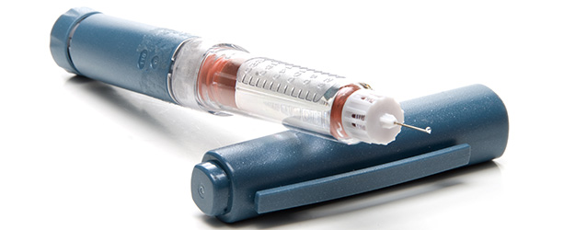
Aim
Improve percentage of active long-acting insulin prescriptions for pump users seen each month from 54% to 61% within 10 months.

Slide 4
Key Drivers & Interventions
Key Drivers
Interventions
Health Literacy/
Education & Support
Multidisciplinary team meetings to define the problem, agree on metrics/goals, & solicit ideas from clinic for process changes
In case of pump failure, *patient name*’s long-acting insulin dose is *** units once every 24 hours. Give it immediately once you realize the pump is not delivering insulin to prevent ketone accumulation. When you’re ready to restart the pump, restart 24 hours after the last long-acting dose or run a temp basal at 0% until 24 hours after the long-acting insulin was given
Use of Data
Standardized language in printed after visit summary to prompt providers to give long-acting insulin dose instructions
Insulin Therapy

Slide 5
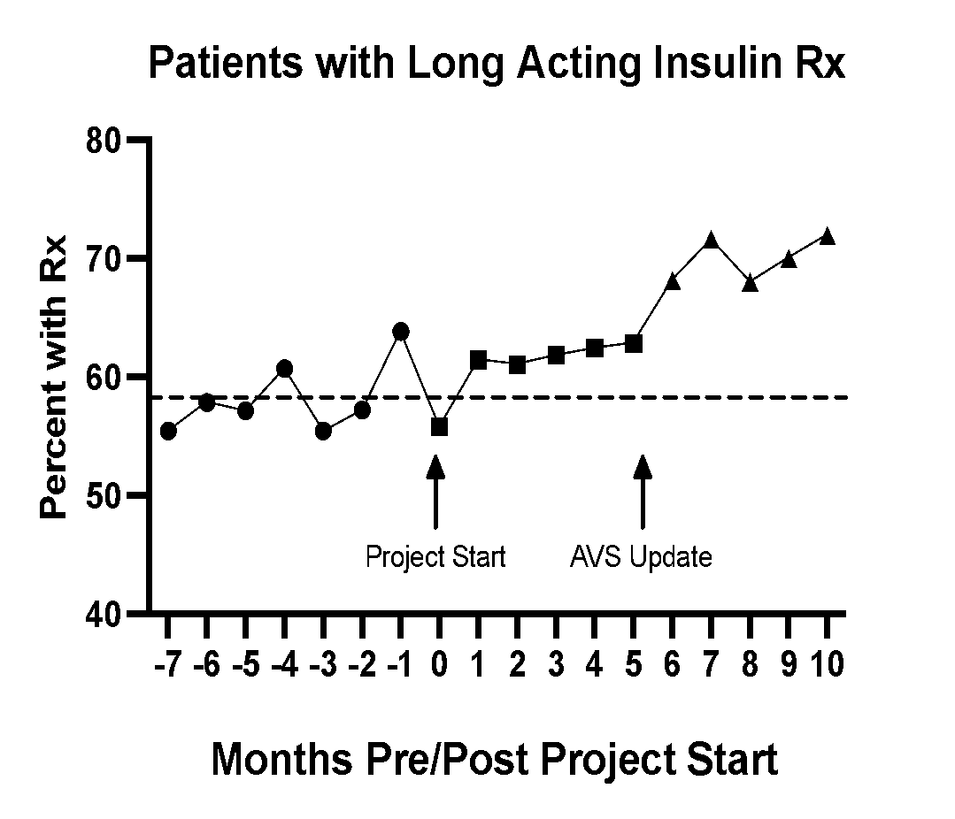
Project Results/ Performance:
Increases in provider prescribing during clinic visits were noted both during planning phase and following intervention with AVS update.

Slide 6
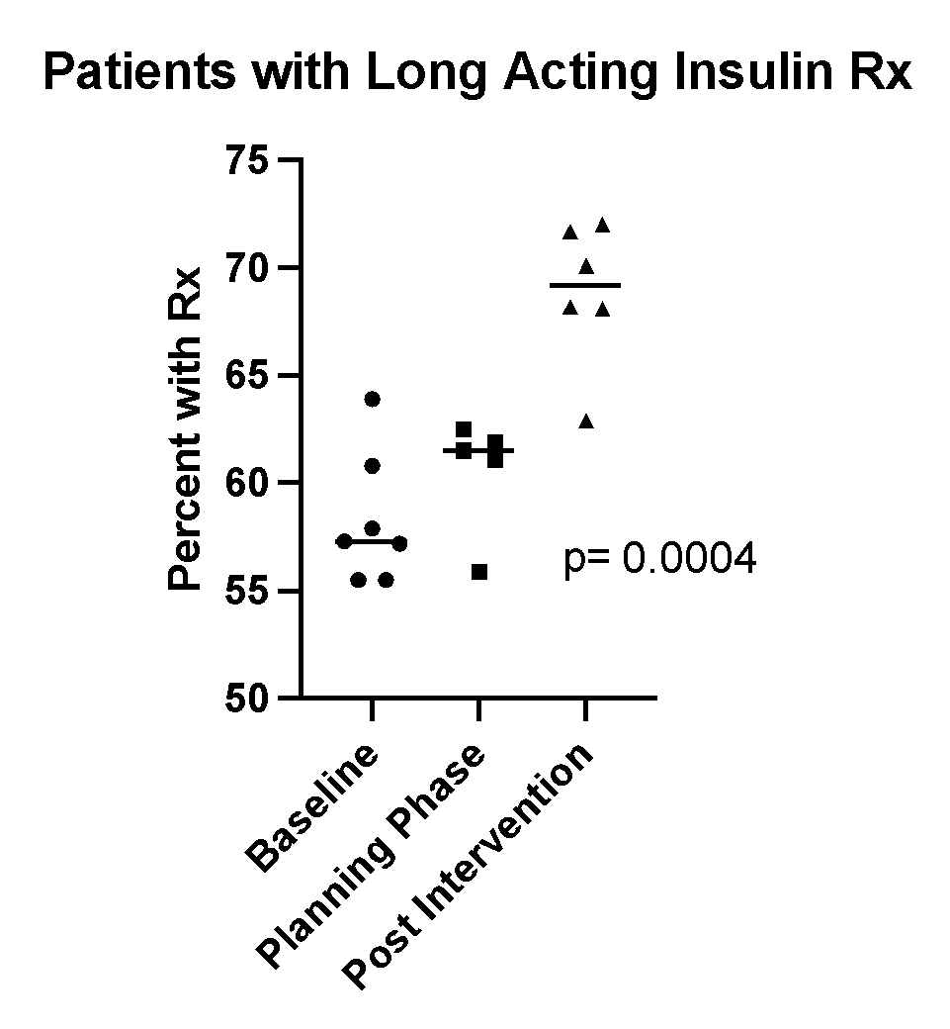
Project Results/ Performance:
Changes over time were statistically significant between the three phases.

Slide 7
Challenges/ Barriers:
If the patient had not been prescribed long-acting insulin for an extended period (> 12 months), the prescription renewal process required more time and manual entry from the clinic team.
Currently, outside of initial pump education sessions, pump failure and DKA prevention counseling is not a standard practice at our center.

Slide 8
Next Steps
Develop and implement a pump failure action plan to assist in utilizing prescribed long-acting insulin

Slide 9
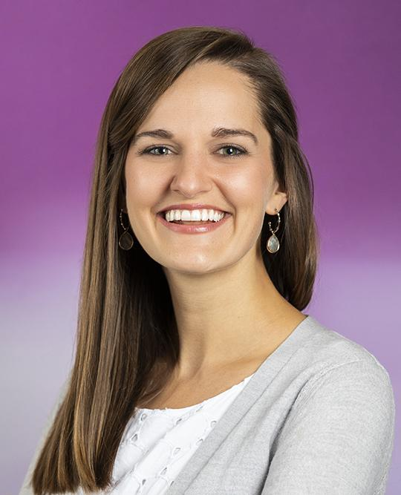
Meet the Team!
Dr. Victoria Elliott
Dr. Meghan E. Pauley
Dr. Erin Finn
Dr. Anna Valentine
Dr. Lauren Waterman
Fellow
Fellow
Fellow
Fellow
Fellow
Dr. Rachel Sewell
Dr. Jennifer Barker
Dr. Todd Alonzo
Olivia Docter
Fellow
Barbara Davis Center Faculty
Barbara Davis Center Faculty
QI Coordinator

Slide 10
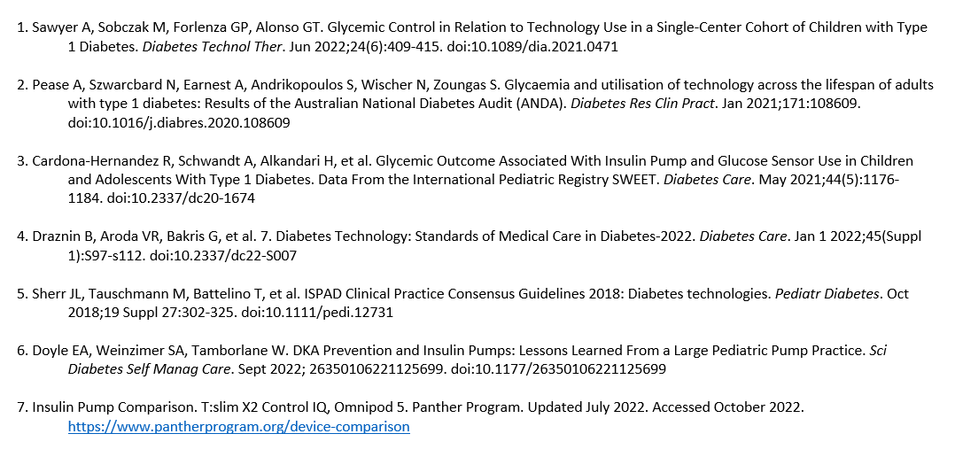
References

Slide 11
Questions?

Slide 12
Standardizing insulin pump therapy initiation in children with Type 1 diabetes
Mili Vakharia APRN, FNP-C, CDCES, Sarah Lyons, MD, Don Buckingham, MBOE, CPHQ, Daniel DeSalvo, MD, Rona Sonabend, MD, and Grace Kim, MD
Division of Pediatric Diabetes and Endocrinology
Baylor College of Medicine/Texas Children’s Hospital Houston, Texas, USA 77030
T1D Exchange Collaborative, November 7-8th, 2022

Slide 13
Burning Platform
Underutilization of insulin pumps at our institution
General prescribing barriers
Lack of standardized process for insulin pump starts

Slide 14
A model for improvement
Smart AIM
By summer of 2022, increase insulin pump use in new onset T1D patients, less than 1 year from diagnosis, by 5% at Texas Children’s Hospital The Woodlands
Keep me safe (Safe)
Provide me with the right care (effective)
Help me stay well
Global AIM
Patient
Standardize the insulin pump initiation process with goals related to safety, effectiveness, and patient-centered care
Treat me with respect (equitable, patient centered)
Help me navigate my care (Timely, Efficient)

Slide 15
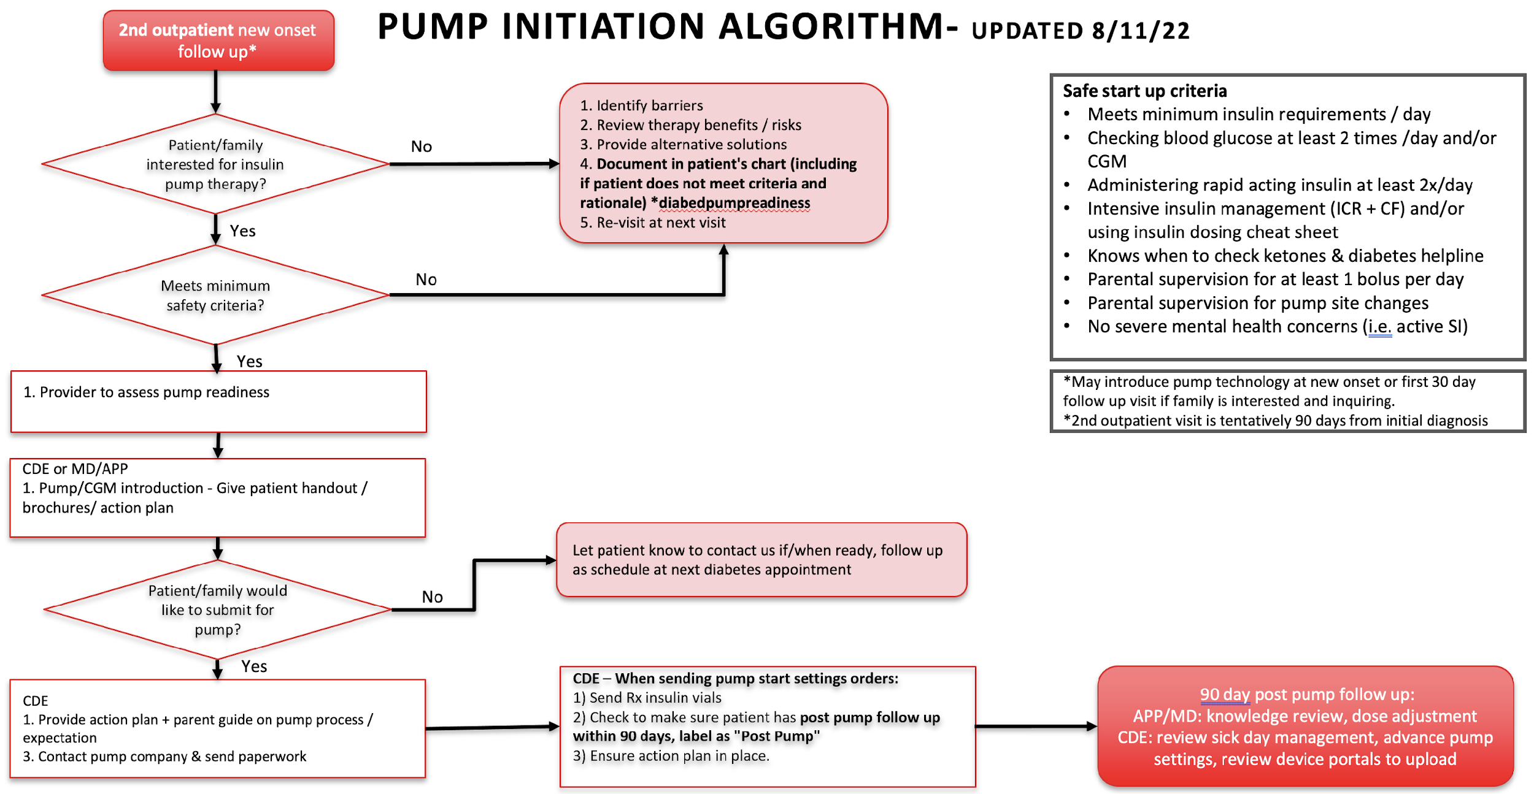
New Pump Initiation Process

Slide 16
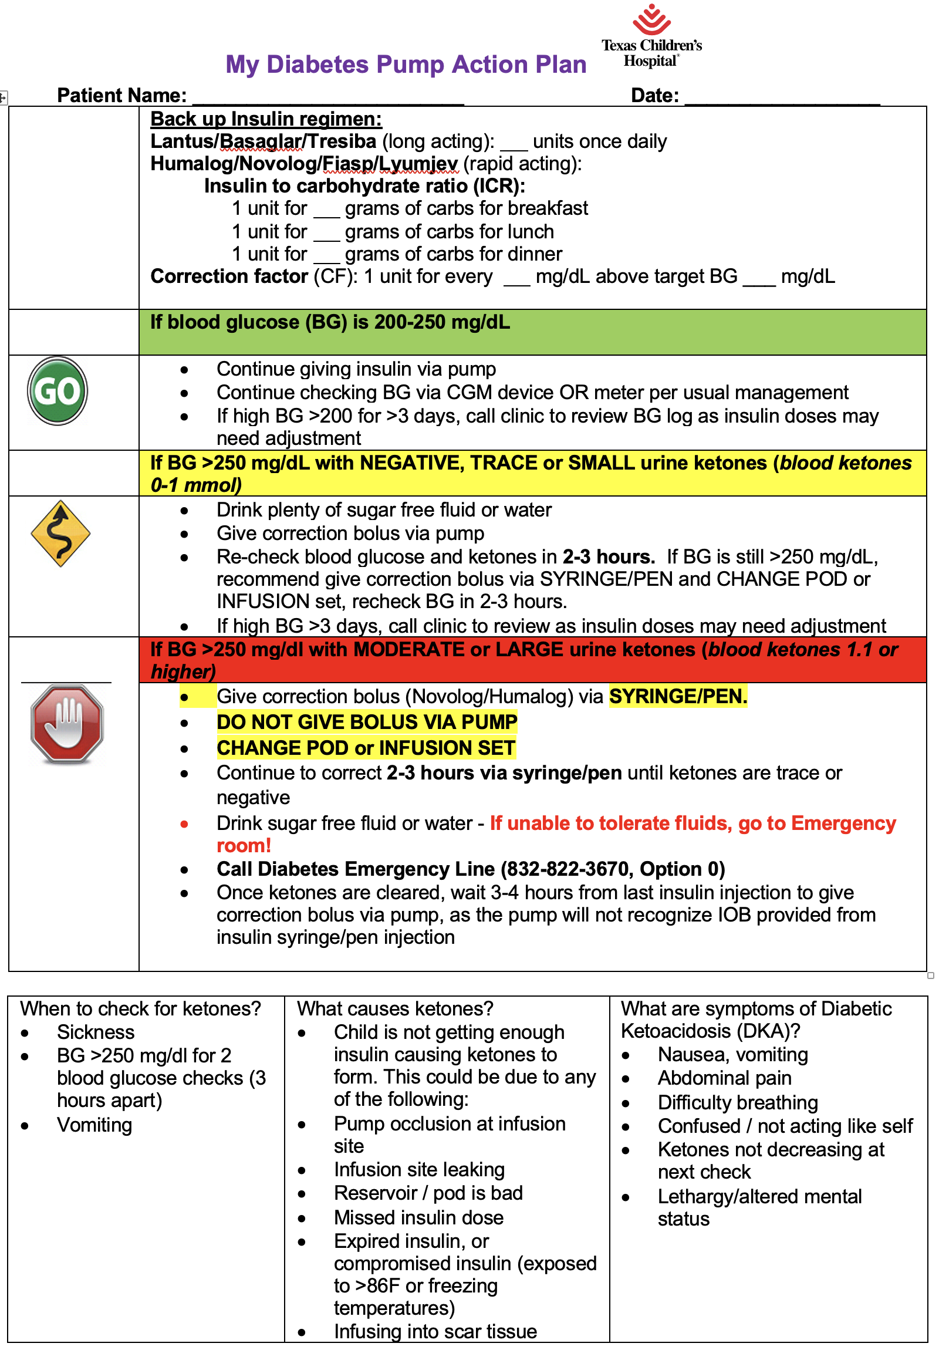
Insulin Pump Action Plan

Slide 17
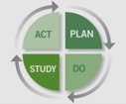
METHODS
P: Educated providers and diabetes educators and about the new onset pump initiation protocol, safe start criteria, pump action plan and pre- and post- pump visit checklist
D: Jan 2021
S: Increase percent initially
A: Adopt
PDSA 1:
P: Implemented the new process of early introduction of pump technology and education to patients/families
D: Spring 2021
S: Clinically better to wait until second follow up at 90 days post diagnosis
A: Adapt- instead of introducing at 30 days post diagnosis, to introduce at 90 day
PDSA 2:
P: Scheduled and labeled post-pump follow up visit with provider and diabetes educator
D: Summer 2021
S: Initially increased percent
A: Adopt
PDSA 3:
P: Greatly simplified the process, action plan, reminding providers, diabetes educators about process
D: Fall 2021
S: Increased percent
A: Adopt
PDSA 4:

Slide 18
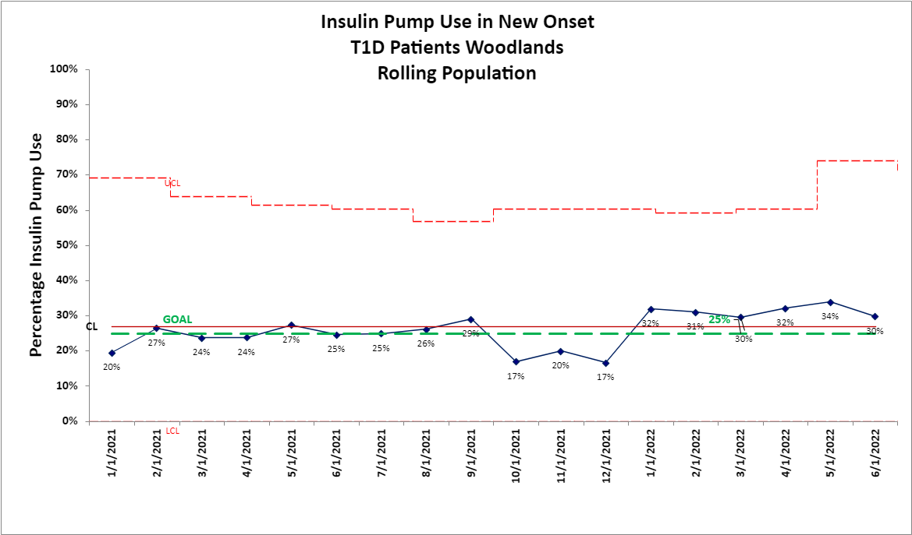
Results
PDSA1
PDSA2
PDSA3
PDSA4

Slide 19
Conclusion
Early standardized and multidisciplinary education facilitates a structured way to increase the uptake of insulin pump use in patients with T1D
Reduce healthcare disparity via elimination of unconscious provider prescribing biases
Plan to spread to additional campuses

Slide 20
Special Acknowledgements: TCH Team "DiabEndo"
Certified Diabetes Care & Education Specialists
Ambulatory Leaders
Physicians/Advance Practice Providers
Patients & Families
Psychologists
Medical Assistants
Social Workers
Ambulatory Service Representatives

Slide 21
References
DeSalvo DJ, Miller KM, Hermann JM, Maahs DM, Hofer SE, Clements MA, Lilienthal E, Sherr JL, Tauschmann M, Holl RW; T1D Exchange and DPV Registries. Continuous glucose monitoring and glycemic control among youth with type 1 diabetes: International comparison from the T1D Exchange and DPV Initiative. Pediatr Diabetes. 2018 Nov;19(7):1271-1275. doi: 10.1111/pedi.12711. Epub 2018 Jul 1. PMID: 29923262; PMCID: PMC6175652.
Desrochers, H.R., Schultz, A.T., & Laffel, L.M. (2020). Use of Diabetes Technology in children: Role of Structured Education for Young People with Diabetes and Families. Endocrinology Metabolism Clinical North America, 49(1). 19-35: doi:10.1016/j.ecl.2019.11.001.
Lipman, T. H., Willi, S. M., Lai, C. W., Smith, J. A., Patil, O., & Hawkes, C. P. (2020). Insulin Pump Use in Children with Type 1 Diabetes: Over a Decade of Disparities. Journal of pediatric nursing, 55, 110–115. https://doi.org/10.1016/j.pedn.2020.08.007
Sherr, J.L., Tauschmann, M., Battelio, T., Bock de M., Forlenza, G., Roman, R., Hood, K.K., & Maahs, D.M. (2018). ISPAD Clinical Practice Consensus Guidelines 2018: Diabetes Technologies. Pediatric Diabetes, 19(27): 302-325.
Walker, A. F., Hood, K. K., Gurka, M. J., Filipp, S. L., Anez-Zabala, C., Cuttriss, N., Haller, M. J., Roque, X., Naranjo, D., Aulisio, G., Addala, A., Konopack, J., Westen, S., Yabut, K., Mercado, E., Look, S., Fitzgerald, B., Maizel, J., & Maahs, D. M. (2021). Barriers to Technology Use and Endocrinology Care for Underserved Communities with Type 1 Diabetes. Diabetes care, 44(7), 1480–1490. https://doi.org/10.2337/dc20-2753

Slide 22
In Sync with Diabetes: Increasing Remote Upload of Insulin Pump Data among Children with Type 1 Diabetes
Andrew R. Lavik, MD, PhD; Sonia Priscila Rodas Márquez MD; Amy Grant, DNP, RN, CPN; Monica Gumz, MA; Tammy DiMuzio, MS, RN, CDCES; Sarah D. Corathers, MD; Allison Deisinger, RD, LD, CDCES; Karishma Tilton, APRN, CNP; Kimberly Keppler, MSN, RN, CDCES; and Gail Patten, MSN, RN, CCM
Department of Pediatrics, Division of Endocrinology; Cincinnati Children’s Hospital Medical Center Cincinnati, OH, USA

Slide 23
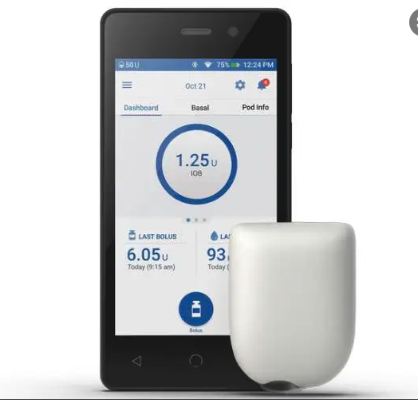
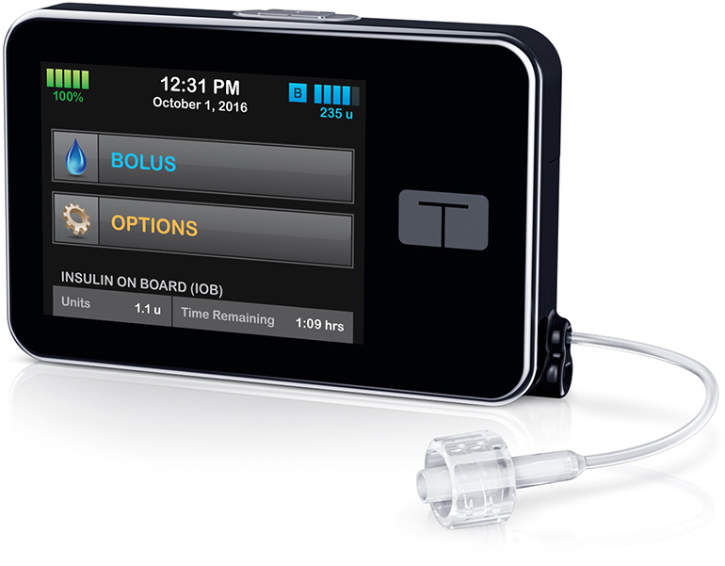
Background
Insulin pump data upload is crucial for pediatric type 1 diabetes (T1D) care delivery
Data upload by staff requires significant time, extends visit length, and cannot be performed at telemedicine visits
Tools for remote data upload exist but are underutilized
(https://www.medgadget.com/)
(www.janzmedicalsupply.com/)
(www.adwdiabetes.com/)
Notes:
Might be helpful to put in information about our total population and what percentage of patients are on pump or CGM.

Slide 24
SMART Aim
To increase the percentage of insulin pumps uploaded prior to T1D clinic visit at our institution from 15% to 30% by June 30, 2022.
(https://www.medgadget.com/)
(www.janzmedicalsupply.com/)
(www.adwdiabetes.com/)

Slide 25
Methods
Team: clinicians, educators, parents, QI specialists
understand the baseline state of pump uploading in our diabetes center
develop a key driver diagram reflecting our theory
conduct Plan-Do-Study-Act cycles targeting key drivers

Slide 26
Key Driver Diagram
Global Aim
Key Drivers
Interventions (LOR #)
Partner with patients/families to support diabetes care and self-management during and between visits to optimize outcomes.
Adequate assistance for patient/family uploading barriers & needs
Kiosk/room in clinic for device uploading (LOR 2)
“Diabetes Pantry” in clinic for device/uploading needs (LOR 2)
Effective educational resources for families and patients
Providing video/job aid tutorials to patients/families for uploading (LOR 1)
SMART Aim
Email to families prior to clinic visit– uploading expectation and instructions (LOR 1)
Clear uploading expectations for families and staff
Increase the percentage of insulin pumps that are uploaded prior to the start of the visit from 15% to 30% by June 30, 2022
Reinforcement during clinic visits of the benefits and importance of uploading (LOR 1)
Empowered, engaged, and motivated patient/families
Device and uploading education for staff/providers (LOR 1)
Knowledgeable, engaged, and motivated staff/providers
Reward/Incentives for patients/families (LOR 1)
Population
Type 1 Diabetes Patients with insulin pumps seen in CCHMC Diabetes Center
Reward/Incentives for staff (LOR 1)
Proper assessment for patient/family uploading barriers/needs
Asking about barriers when pt/family doesn’t upload prior to clinic appt (LOR 2)
Legend
Note: LOR # = Level of Reliability Number, e.g., LOR 1
Potential intervention
Active intervention
Adopted/Abandoned intervention
Notes:
Highlight big things:---in a later slide
This is change in status quo
This is hard to do in some cases—many steps
This can take some time
This tupically is done by patient
BUT ONLY NEED ONE TIME!

Slide 27
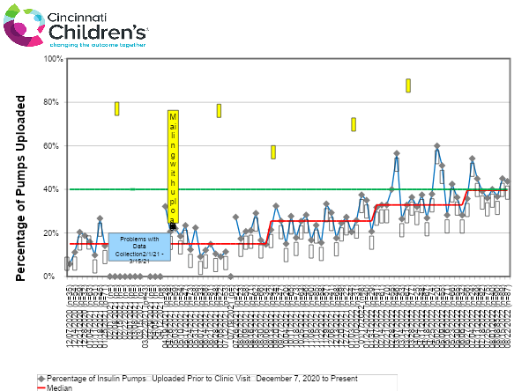

Slide 28
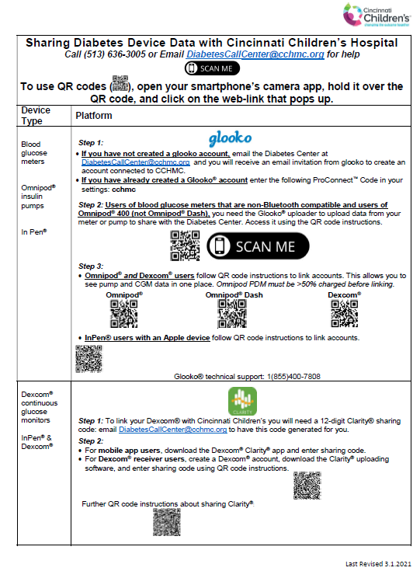
Mailer:

Slide 29
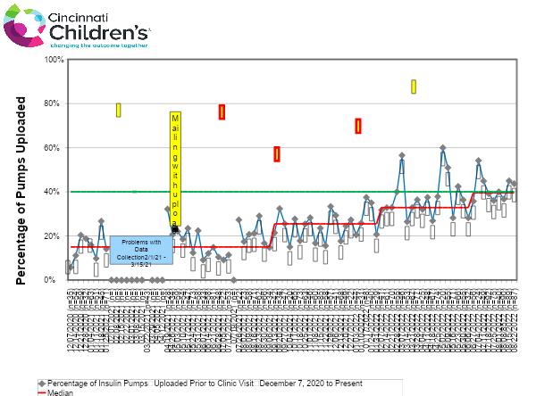
Result: 25% increase in percentage of insulin pumps uploaded prior to visit

Slide 30
Conclusions:
25% increase in pre-clinic pump uploads and counting =
over 50 more patients per month with pump data uploaded pre-clinic
Future Directions:
Ongoing interventions
Assess and address gaps
Impact on clinic cycle time
Remote monitoring
Device data integration into EMR
AI-guided modifications

Slide 31
Thank you!
Notes:
Consider photo

Slide 32
Pediatric Type 1 Diabetes Technology Use: Hispanic Caregiver’s Perspective.
Mariaester Makacio-Morillo, MD¹; Lisandra Hernandez, APRN, CDE¹, MPH; Janine Sanchez, MD¹
¹University of Miami Miller School of Medicine, Miami, FL
Jackson Health System

Slide 33
Background
Studies have shown that Hispanics have low use of insulin pumps and CGM when compared with white subjects¹.
Racial disparities in technology use and diabetes outcomes persist regardless of insurance status.
Our aim was to obtain a better understanding of barriers that keep people from using advanced technology and prevent health disparities.
¹ Willi SM, Miller KM, DiMeglio LA, et al. Racial-ethnic disparities in management and outcomes among children with type 1 diabetes. Pediatrics. 2015;135(3):424-434. doi:10.1542/peds.2014-1774

Slide 34
Methods
We completed semi-structured interviews and 2 focus group with a sample group of Hispanic parents of T1D patients.
All interviews were conducted by a 3rd year pediatric endocrinology fellow.

Slide 35
Methods
Four topic areas were the focus of the interview: sensor usage, pump vs smart pen vs MDI, training via video conference vs in-person visits, and suggestions to improve care.
The interviews were transcribed, annotated, and analyzed for common themes.
We compared the results to study we did with Black parents.

Slide 36
Results
We gathered data from 9 Hispanic parents of T1D patients.
The interview format was chosen by parents:
22% individual interview
11% interview via email
66% focus group
All preferred interviews in Spanish

Slide 37
Results
We gathered data from 9 Hispanic parents of T1D patients.
100% of the patients were using a sensor regularly ( 66% in the Black population)
33% were using an insulin pump (57% in the black population)
55% using a smart pen (32% in the black population)
1 parent reported using neither pump or smart pen

Slide 38
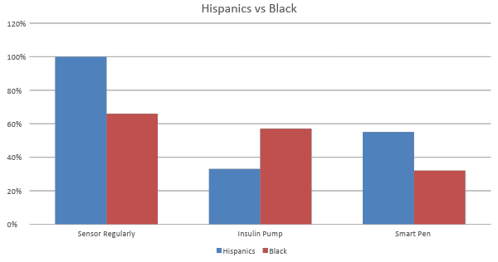
Results

Slide 39
Results
Key barriers to technology use reported included:
Fear of doing something wrong at the beginning
Difficulty understanding how the pump worked at the beginning
Difficulty with initial telemedicine training during COVID
Insurance problems including language barrier and refills.

Slide 40
Conclusions
The focus group is a patient centered initiative to help to understand barriers and discuss ways to increase technology usage. It is also useful to share other patient recommendations for treatment.
Overall, when compared to out black focus group we received similar results: they are satisfied with technology and felt it increased their understanding of diabetes.

Slide 41
Conclusions
Insurance continues to play a limiting role.
The study also taught us tools for organizing focus meetings for different patient populations to increase patient participation and input.
More studies are needed to increase understanding of our population and increase device use.

Slide 42
Thank you!

