Slide 1
Publication Committee
11/8/22

Slide 2
2022 Publication Committee in Review: Process
Dr. Majidi and Dr. Agarwal new Co-Chairs of Committee
6 new members joined the Publication Committee
New publication submission form
Improved publication process

Slide 3
2022 Publication Committee in Review: Outputs
5 article Clinical Diabetes special feature
36 clinics represented in 2022 published articles
4 oral and 3 poster presentations at ATTD
2 oral and 11 poster presentations at ADA
1oral and 2 poster presentations at ISPAD
36 abstract presentations at November Learning Session
17 articles published

Slide 4
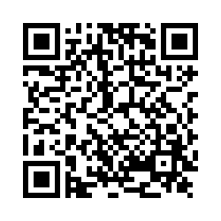
Publication Proposal
Mapped sites have access to all mapped data
Non-mapped sites have access to aggregate smart sheet data
Access the publication policy
Please scan this QR code to access the publication proposal survey

Slide 5
Clinic Representation in Q1- October 26th 2022 Manuscripts
Adult:
Upstate University Hospital (9)
Albert Einstein College of Medicine, NY (5)
Barbara Davis Center, CO (6)
Boston Medical Center, MA (2)
Grady Memorial Hospital, GA (2)
Stanford (2)
Mt Sinai, NY (2)
NYU Langone, NY (1)
Northwestern (1)
University of Miami (1)

Slide 6
Clinic Representation in Q1- October 26th 2022 Manuscripts
Pediatrics:
Cincinnati Children’s, OH (8)
Nationwide Children’s, OH (7)
Rady Children’s Hospital, CA (5)
Barbara Davis Center, CO (5)
Children’s National, D.C. (5)
Texas Children’s Hospital, TX (5)
Children’s Mercy Kansas City, MO (4)
University of Alabama Birmingham, AL (4)
NYU Langone, NY (4)
Stanford Children’s Health Lucille Packard, CA (4)
Le Bonheur Children’s Hospital (3)
Lurie Children’s Hospital (3)
Mt. Sinai, NY (3)
University of Florida Health, FL (3)
University of Michigan C.S Mott Children’s Hospital, MI (3)
Children’s Hospital of Los Angeles (2)
Seattle Children’s Hospital (2)
University of Miami (2)
University of Wisconsin (2)
Children’s Healthcare of Atlanta (1)
Cohen Children’s Northwell, NY (1)
Cook Children’s Hospital (1)
Helen DeVos (1)
Indiana University School of Medicine, IN (1)
NYU Langone, Long Island (1)
University of California San Francisco (1)
Upstate University Hospital, NY (1)
Weill Cornell Medicine, NY (1)

Slide 7
First/Senior author writs and submits draft to Coordinating Center
QI Publication Process
Aim: Manuscript writing process is completed in less than 120 days
Coordinating Center and First author selects co- author based on data, clinical interest, publication history
First/Senior Author submits proposal to Coordinating Center
Coordinating Center analyst discuss with First/Senior author analysis plan
Coordinating Center reviews request
Coordinating Center shares data package with First/Senior author
Journal accepts edits from authors
Coordinating Center returns to co-authors for revisions
Journal Accepts Manuscript
yes
First/Senior authors reviews, address feedback returns to coordinating center
no
First and Senior author reviews and edits journal comments
Coordinating Center or Frist/Senior author submits to journal
First/Senior author address feedback from Publication Committee
Coordinating Center selects 3 main reviewers from Publications Committee
Journal reviews manuscript
Last revised 7/11/22

Slide 8
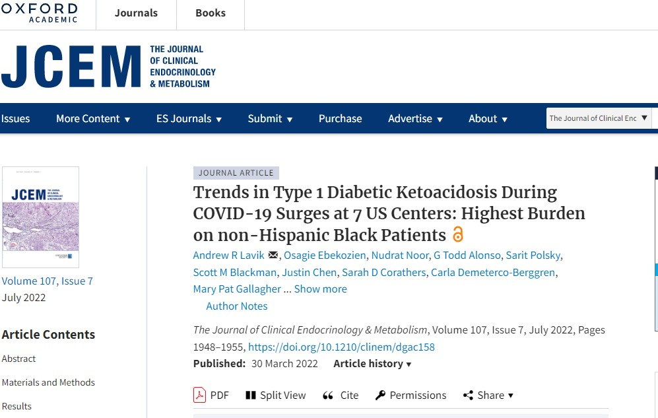
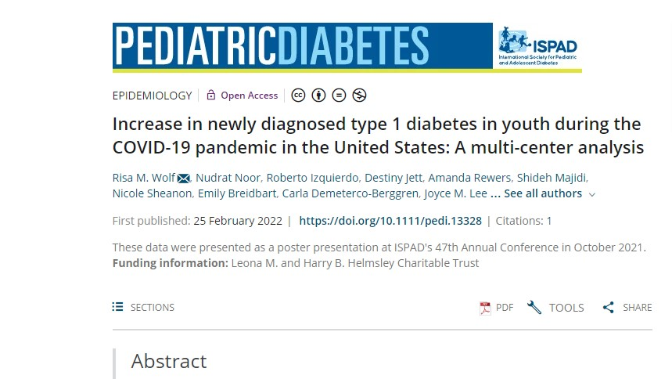
Q1 Published Manuscripts

Slide 9
Q2 Published Manuscript

Slide 10
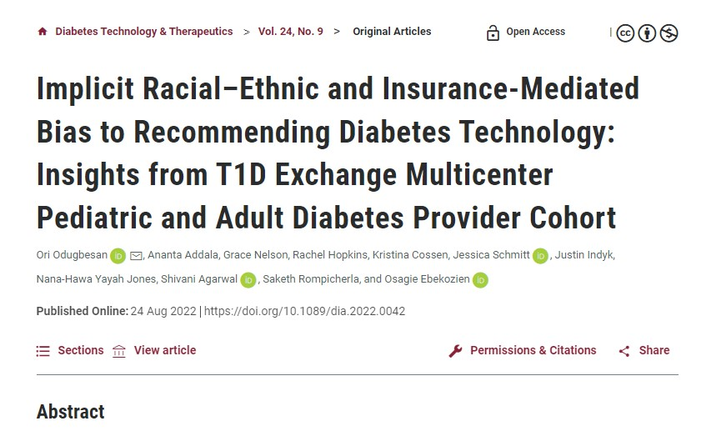
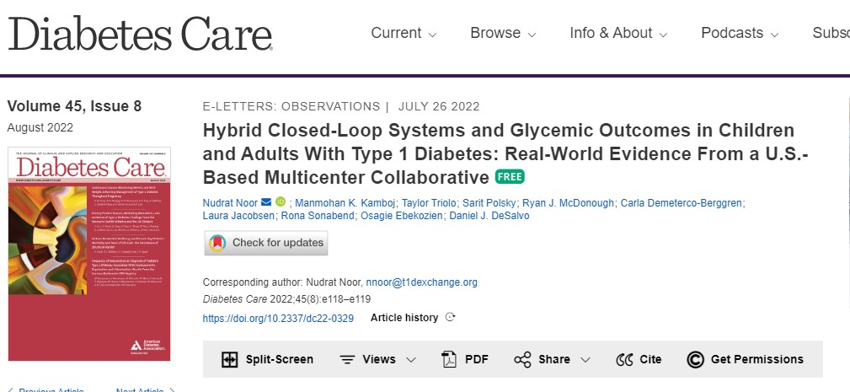
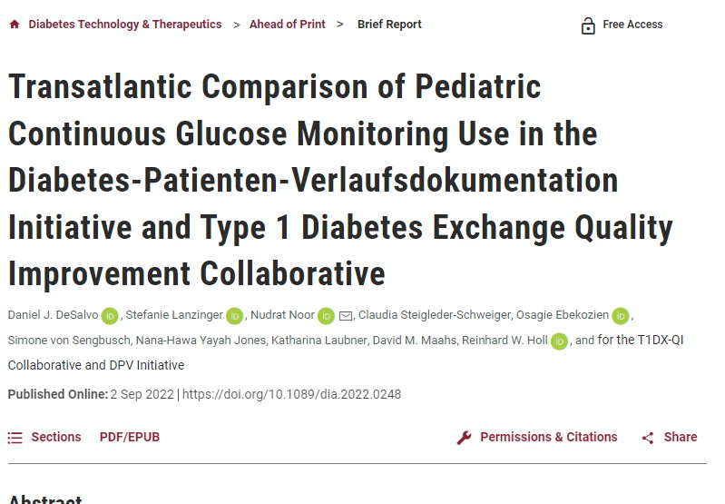
Q3 Published Manuscripts

Slide 11
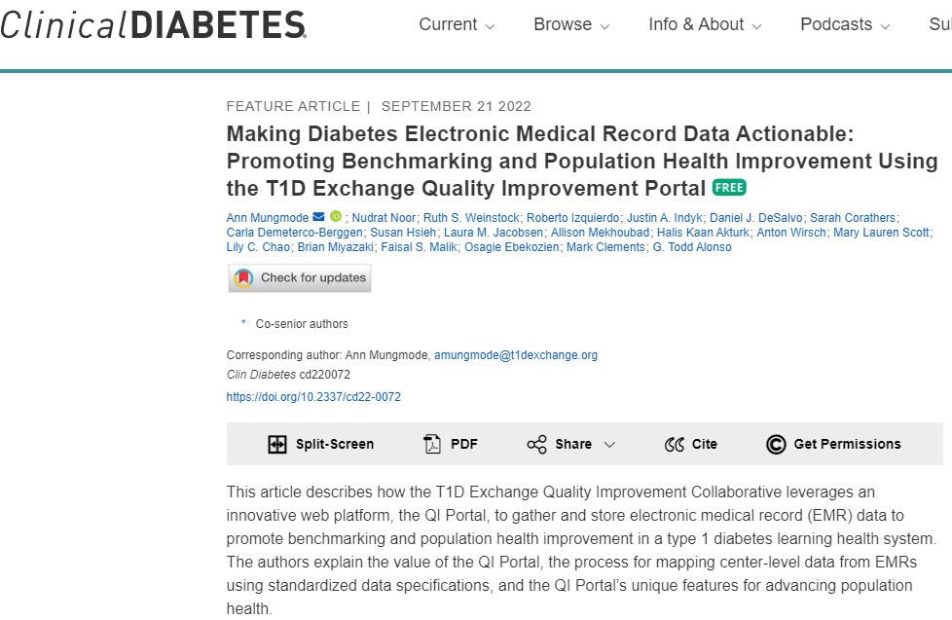
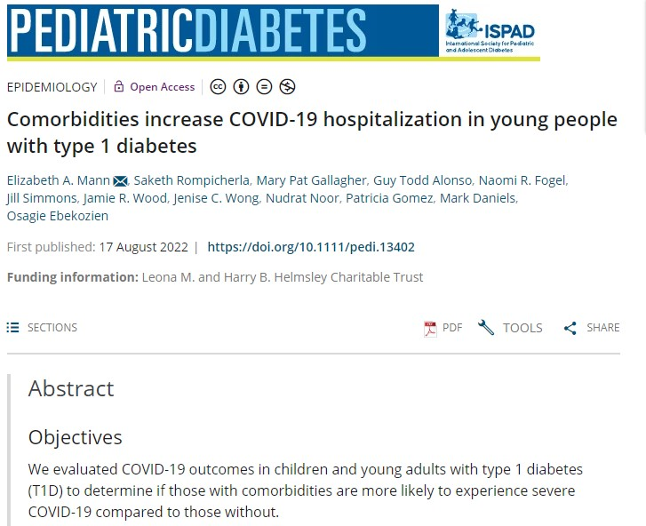
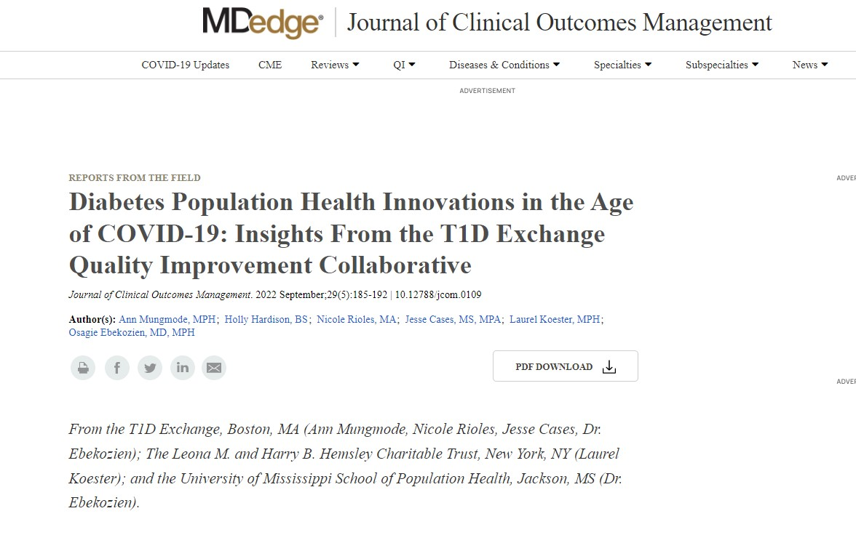
Q3 Manuscripts continued

Slide 12
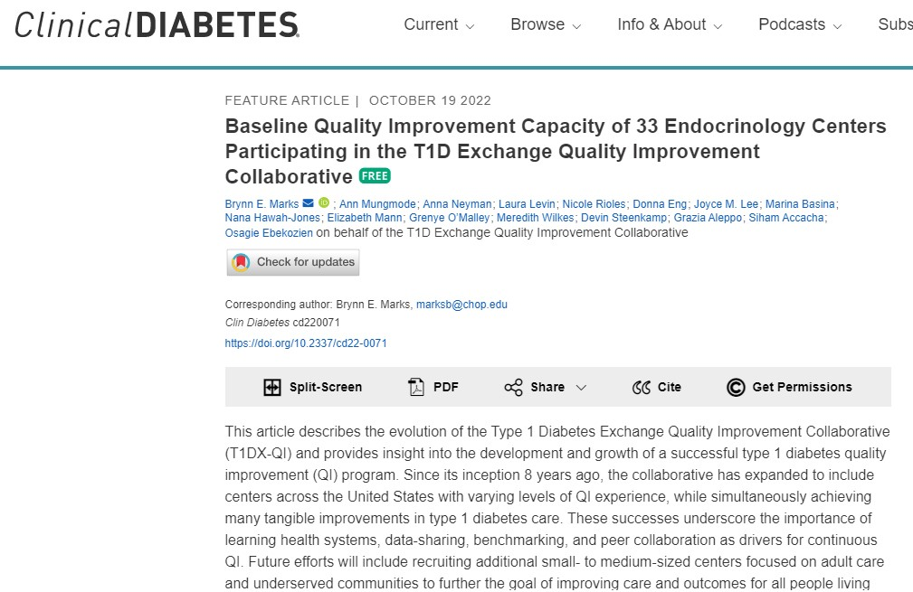
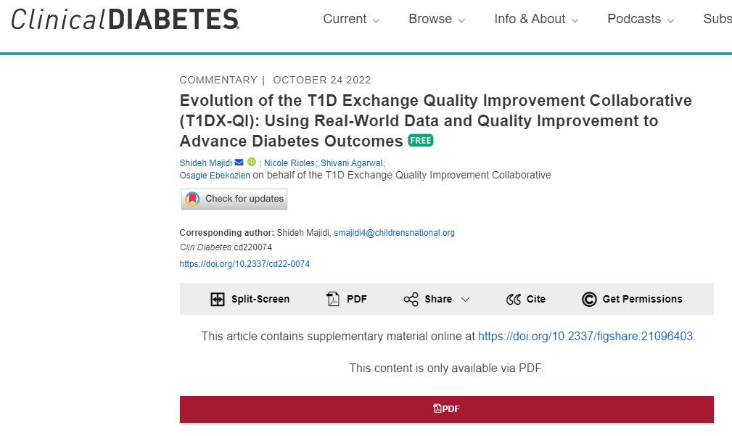
Q4 Manuscripts

Slide 13
Common Clinic Writing Interests

Slide 14
Questions, Comments, Issues, Concerns
If you have any ideas, improvements or modifications you would like to see implemented in the publication process, committee workflow or target journals, please email:
Shivani Agarwal shivani.agarwal@einsteinmed.edu
Shideh Majidi smajidi4@childrensnational.org
QI qi@t1dexchange.org
Thank you!

