Slide 1
Towards risk-based management of type 1 diabetes (T1D): Developing a population health dashboard based on performing diabetes self-management habits
Craig Vandervelden, PhD; Brent Lockee, BS; Susana R. Patton, PhD ABPP CDE; Ryan McDonough, DO; Joyce M Lee, MD, MPH; Mark Clements, MD, PhD

Slide 2
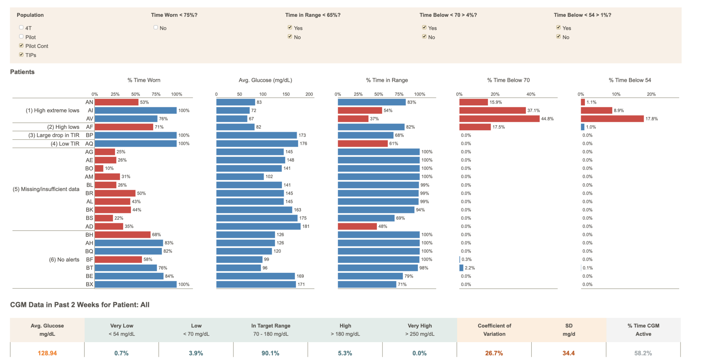
Motivation: Improving T1D Outcomes with population-health dashboards
Stanford’s Tide dashboard:
Algorithm-enabled, population-level health dashboards for T1D patients was associated with
Improved time in range (TIR)
Reduced provider time spent per patient, leading to increased clinic capacity
D. Scheinker et al., JMIR Diabetes, 2022; 7(2):e27284

Slide 3
The “Six Habits”
J. M. Lee et al., JAMA Netw Open. 2022; 5(1):e220001
Population:
All patients (N = 4728)
with a clinic visit from 01/01/21 – present day.
Six self-management habits where performance is associated with improved (i) HbA1c and (ii) Time in range.
Habit | Definition | Data Source
1 | Checks BG ≥ 4x/day if not on CGM OR uses CGM. | Device data (IP) > EMR (IP = In progress)
2 | Gives ≥ 3 rapid-acting boluses/day. | Device data > EMR
3 | Uses insulin pump. | Device data (IP) > EMR
4 | Delivers boluses before meals. | EMR
5 | Reviewed glucose data for patterns at least once since last clinic visit. | EMR
6 | Changed insulin doses at least once since the last clinic visit. | EMR
7 | Eats a healthy diet. | EMR
Objective:
i) Create an interactive population health management tool that displays data related to “the 6 habits” for providers
ii) Incorporate new habits which align with the seven pillars of diabetes self-management

Slide 4
Methodology: The D-Data Dock
Build reusable processes.
Data on all habits already present. Refreshes weekly.
Set rules on how to count habit performance
How far to look back?
EHR? Device data?
Handling multiple results.
Rapidly create and deploy Six Habits dashboard in < 1 mo.
Ingestion:
EHR
Device
RedCap
Geocoding
Garmin
Partners
CSV, JSON, API, Cosmos DB, etc.
Map similar sources to common schema
Azure Data Pipeline
Interactive dashboards:
Tide
T1DE Metrics
Data Lake:
Storage
Delta tables
Databricks:
Clean/Validate
Extract, transform, Load
Mapping
Machine Learning
Visualizations
Six Habits
Six Habits
Research/Quality Improvement:
Remote patient monitoring
Predictive ML models:
DKA Risk
ΔA1c
TIR
Azure Serving

Slide 5
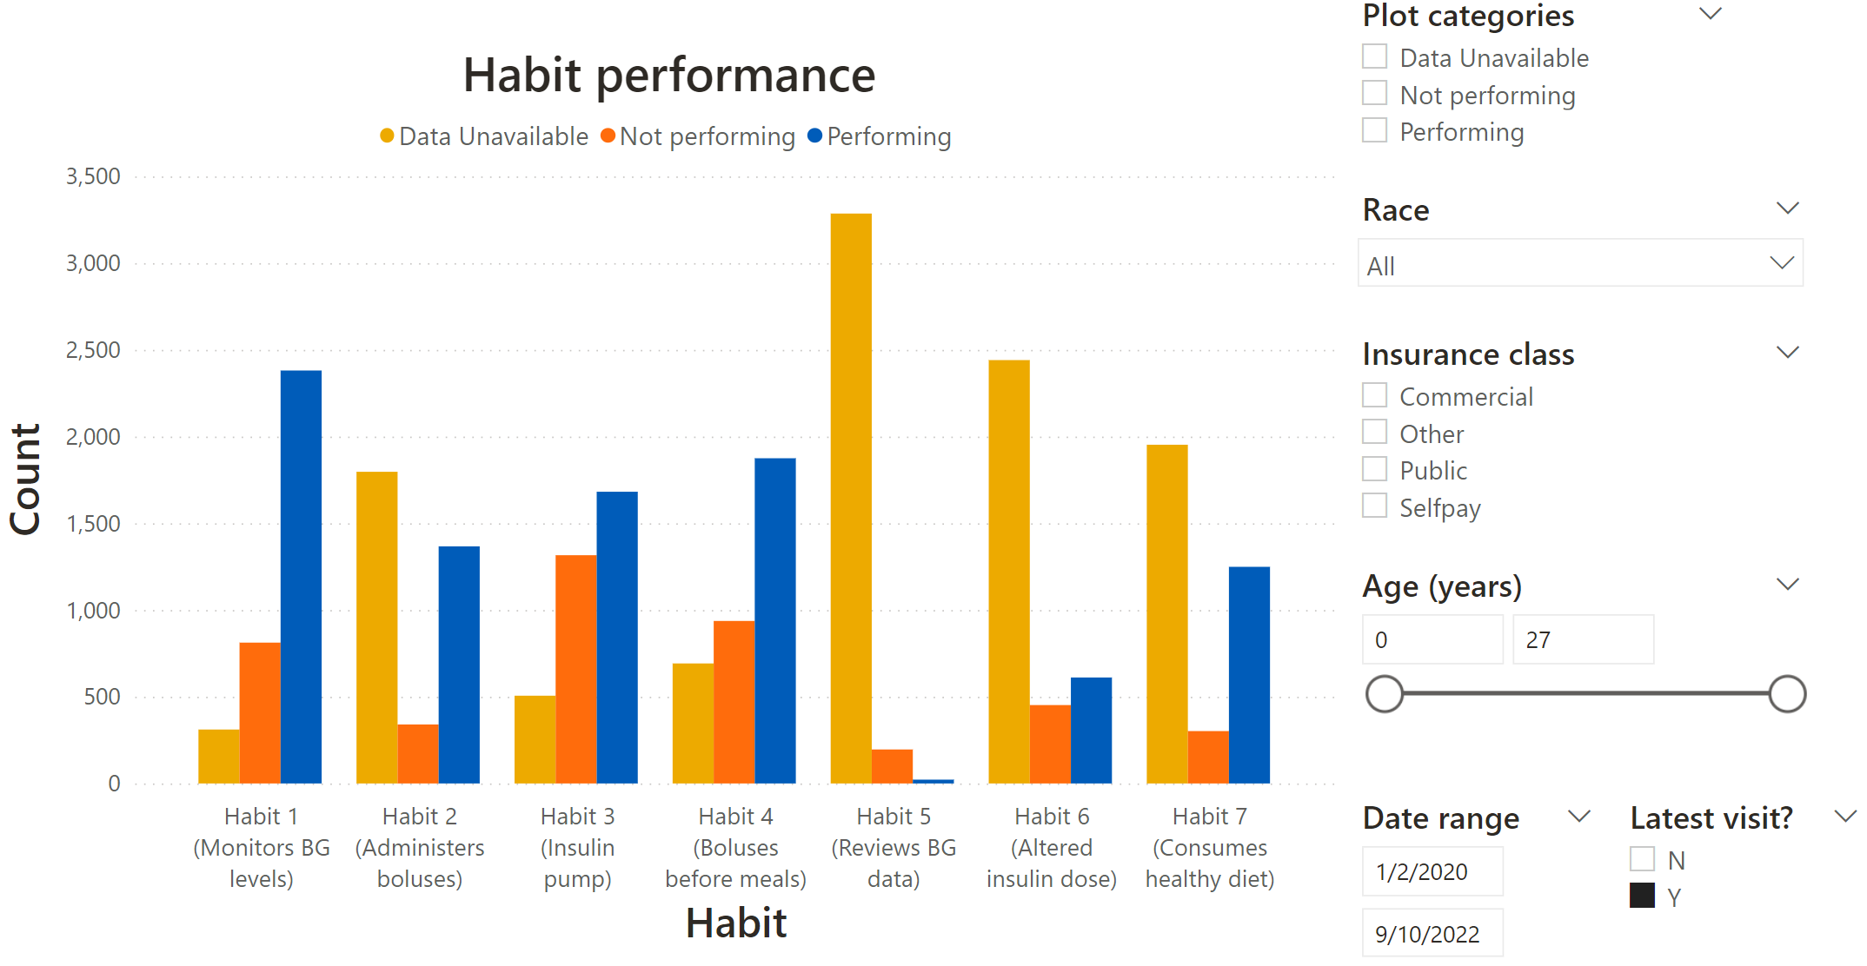
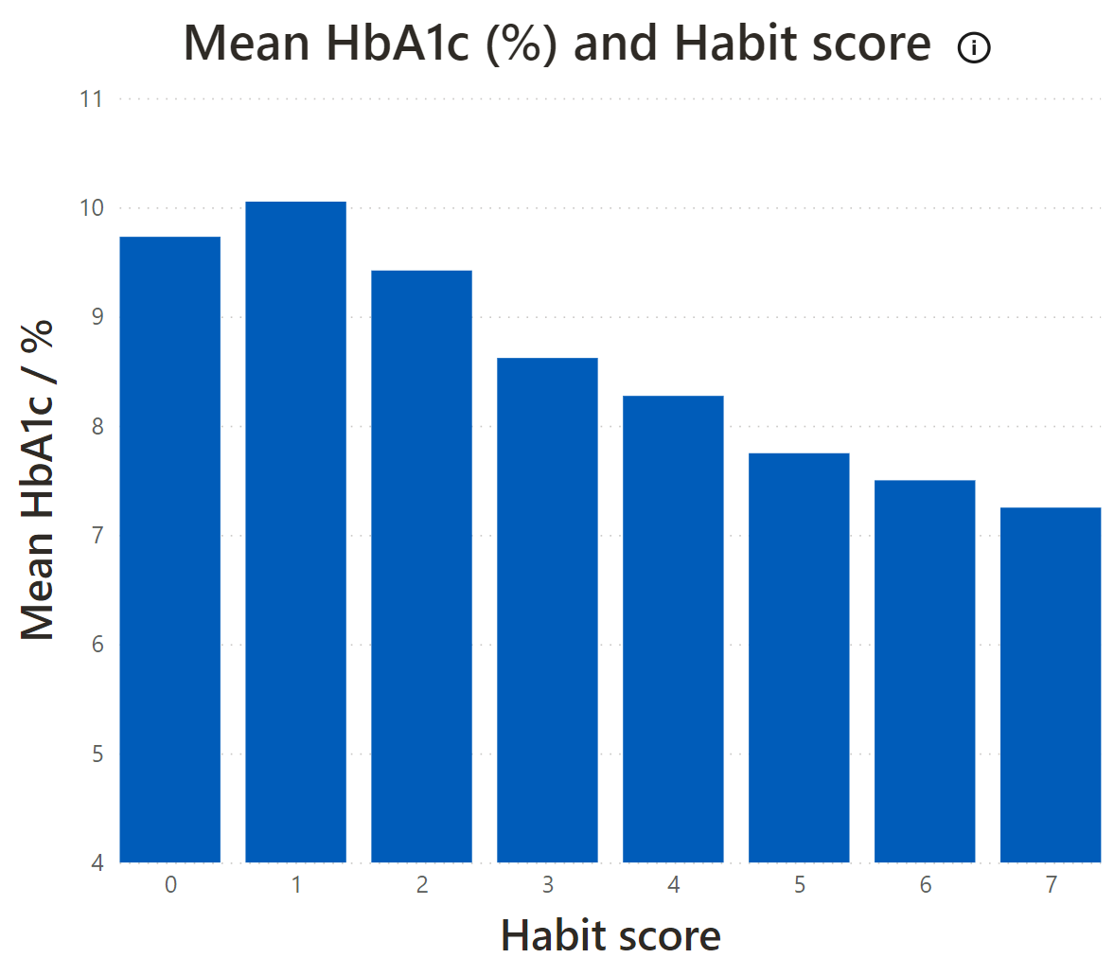
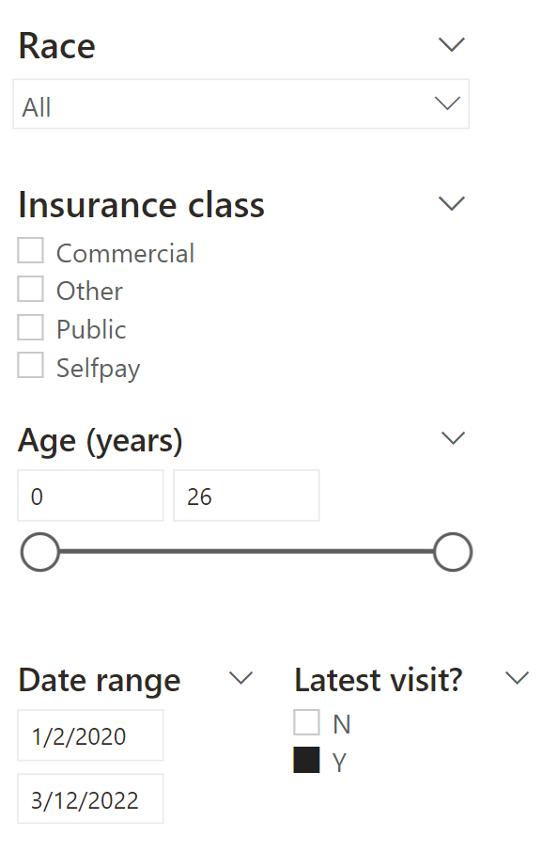
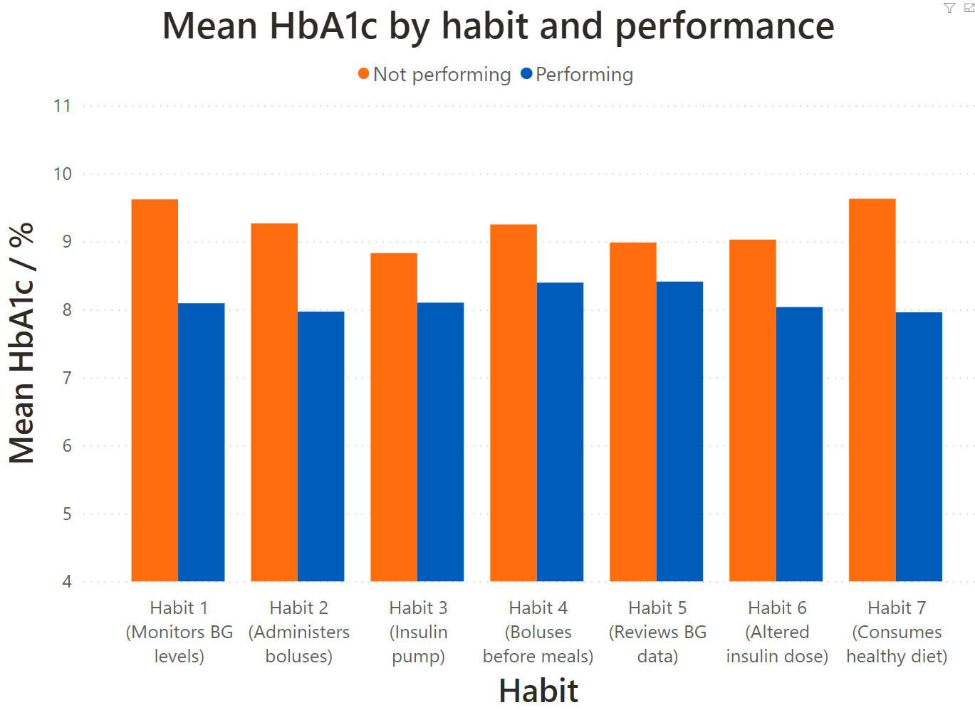
The “Six Habits” population health dashboard
Monitor habit performance
Mean HbA1c ~1.5% lower!
User-definable populations
(Sum of all followed habits)

Slide 6
Proposing new habits
The 7 pillars of diabetes self-care
Healthy eating
Being
active
Monitoring
Taking medication
Problem solving
Reducing Risk
Healthy coping
Habit 7
(Healthy diet)
Habit 8
(Active lifestyle)
Habit 1
(Uses CGM)
Habit 2
(Rapid acting boluses)
New habits
Habit 5
(Reviewed BG data)
Habit 3
(Uses insulin pump)
D Tomky et al., Diabetes Educ. 2008; 34:445–449
Habit 6
(Altered insulin dose)
Habit 4
(Bolus before meals)

Slide 7
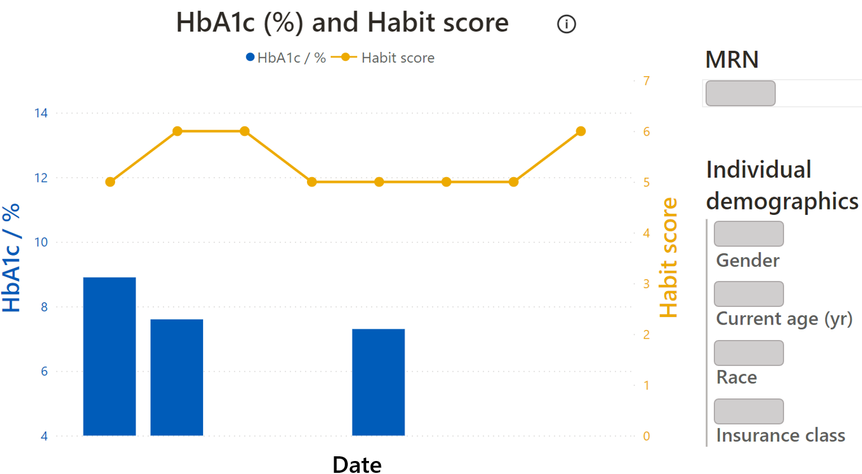
Conclusions and future work
Individual-level habit performance
The six habits dashboard gives a population-level view for habit performance for a diabetes center.
Habit performance and habit score is strongly associated with glycemic outcomes
Dashboard shows which specific habits lead to the largest glycemic outcome improvements on average.
Interventions based on habit (non-) performance
Person A:
{performing},
{not perf.},
{current interventions}
Recommendation
algorithm
Recommend interventions, ranked by impact/burden.

Slide 8


Acknowledgements
Role | Name
Executive Lead | Mark Clements
Project Coordinator | Emily DeWit
Diabetes Educator | Katie Noland
Project Assistant 1 | Britaney Spartz
Project Assistant 2 | Jude E/An Hoang
QI Clinical Champion | Ryan McDonough
Psych Grad Resrch Asst 1 | Alex Monzon
Data Scientist | Brent Lockee
Data Scientist | Mitchell Barnes
Data Scientist | Craig Vandervelden
Statistician | David Williams
Data Science Advisor | Mark Hoffman
Bioethics Lead | Brian Carter
Formative Research Lead | Emily Hurley
Innovation Advisor 1 | Krista Nelson
Innovation Advisor 2 | Sallie Guezuraga
Senior Software Architect | Kevin Power
Software Architect | Harpreet Gill
Advisory Committee Chair | Sanjeev Mehta, Joslin
Director, Intervention Dev. | Susana Patton, Nemours
www.risingT1De.org

Slide 10


Creation of a Diabetes Data Dock to Integrate, Improve, and Analyze Diverse Data Sources and Facilitate Continuous Learning and Improvement
Brent Lockee, BS;
Mitchell Barnes, BS; Craig Vandervelden, Ph.D;
Emily Dewit, MS;
Mark C. Clements MD, Ph.D

Slide 11



No conflicts to disclose

Slide 12
The diverse goals of member diabetes centers face data integration and management challenges.
Introduction
EMR
Periodic Operational Reporting
Device Vendor 1
Mapped T1D Exchange Output
Device Vendor 2
Survey and Intake
Risk-based Initiative
Single-use processes and pipelines

Slide 13
Design and create a cloud data infrastructure with highly reusable, general processes that support diverse goals.
Objective
EMR
Periodic Operational Reporting
Diabetes Data Dock
Device Vendor 1
Mapped T1D Exchange Output
Device Vendor 2
Survey and Intake
Risk-based Initiative

Slide 14
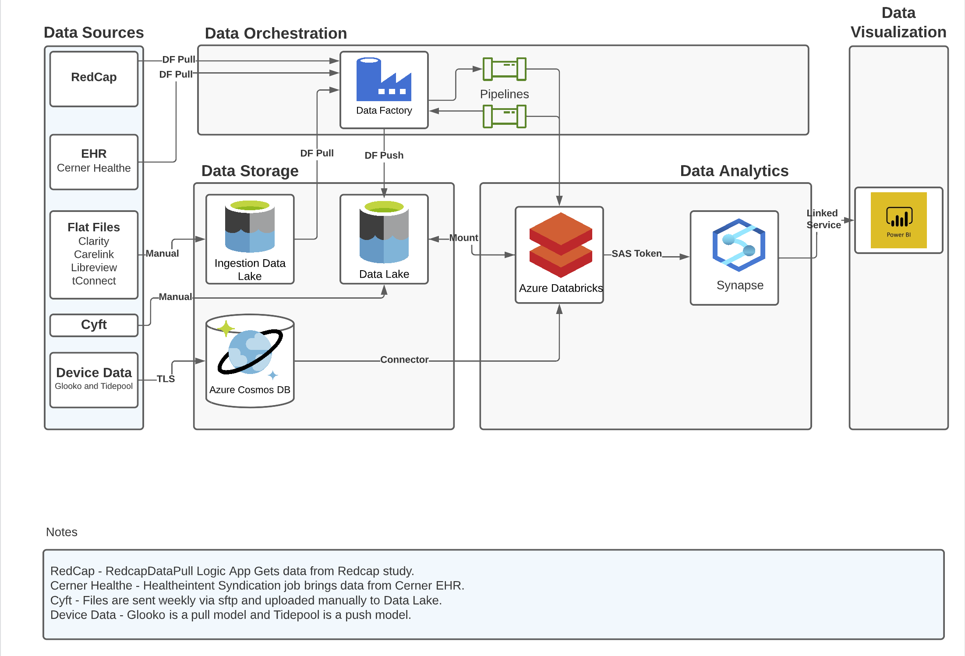
Methods
Storage
Compute
Serve
Publish and Use

Slide 15
Methods
How we met the challenges of diabetes data
Volume, variety, and velocity: Microsoft cloud-based tools are built to handle these
Veracity: Multi-hop architecture with data validation
Reporting
Power BI Dashboard
CSV
JSON
Cosmos DB
API connection
Reporting
Processed
Mapped
Reporting
Database reporting access for advanced users
Outgoing connections to partners
Stored using original, incoming format in a Gen 2 Data Lake
Organized by vendor – nearly identical to input format.
Organized by domain – common schema across vendors. Filtered and cleaned. For EHR data, de-identification features added.
Built to serve end users with specific use case(s) in mind. Calculated variables added and data aggregated as needed.

Slide 16
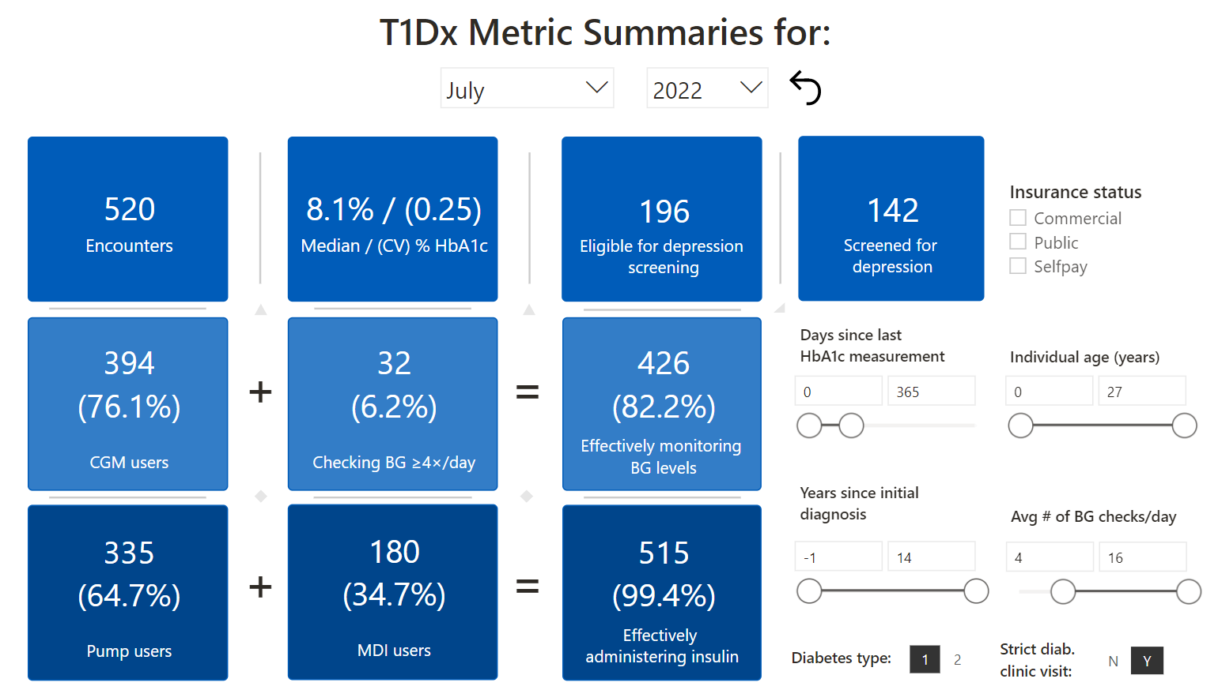
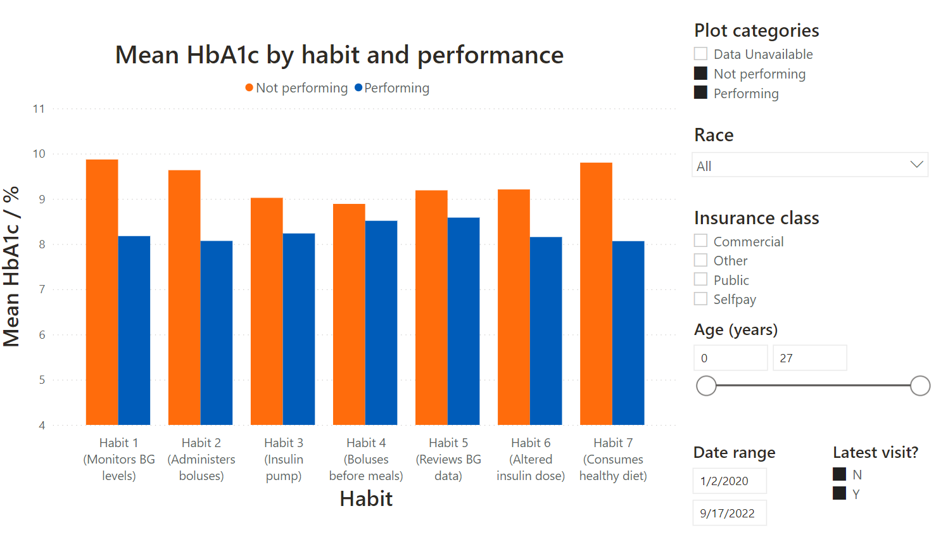
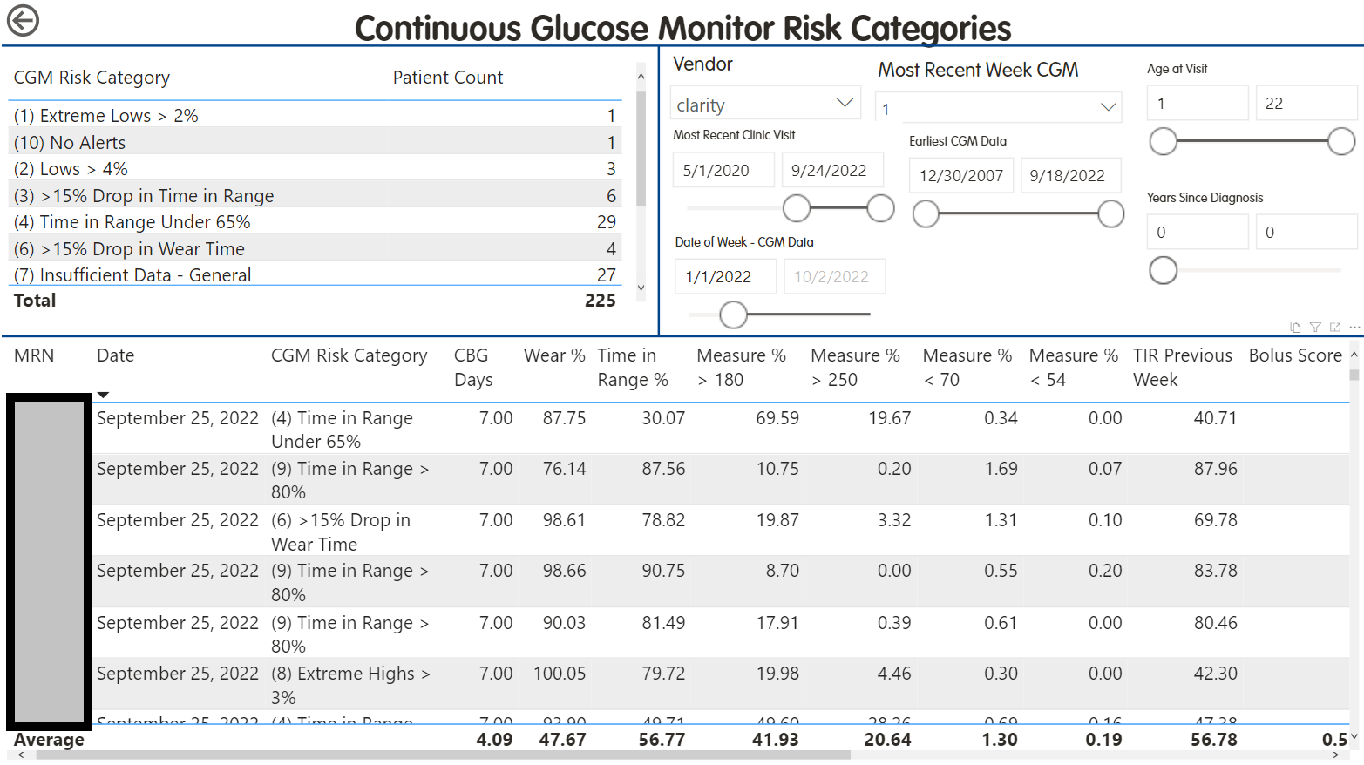
Results
Mapping medical record data to T1D Exchange + interactive visuals
D-Data Dock up and running – allows our team to focus on risk prediction, novel risk biomarkers, and population health dashboards
Implementation of Six Habits framework from Dr. Lee, University of Michigan
Implementation of T1De Dashboard from Dr. Scheinker, Stanford
EMR
Periodic Operational Reporting
Device Vendor 1
Output to Mapped T1D Exchange Output
Device Vendor 2
Survey and Intake
Risk-based Initiative

Slide 17
Conclusion
The D-Data Dock:
Replicable
Scalable
Ready for adoption at additional diabetes centers
Exploring multiple implementation strategies balancing flexibility and ease of use

Slide 18
Acknowledgements
Role | Name
Executive Lead | Mark Clements
Project Coordinator | Emily DeWit
Diabetes Educator | Katie Noland
Project Assistant 1 | Britaney Spartz
Project Assistant 2 | Jude E/An Hoang
QI Clinical Champion | Ryan McDonough
Psych Grad Resrch Asst 1 | Alex Monzon
Data Scientist | Brent Lockee
Data Scientist | Mitchell Barnes
Data Scientist | Craig Vandervelden
Statistician | David Williams
Data Science Advisor | Mark Hoffman
Bioethics Lead | Brian Carter
Formative Research Lead | Emily Hurley
Innovation Advisor 1 | Krista Nelson
Innovation Advisor 2 | Sallie Guezuraga
Senior Software Architect | Kevin Power
Software Architect | Harpreet Gill
Advisory Committee Chair | Sanjeev Mehta, Joslin
Director, Intervention Dev. | Susana Patton, Nemours
www.risingT1De.org

Slide 19


COPYRIGHT© 2021 RISING T1DE ALLIANCE ALL RIGHTS RESERVED.

Slide 20


The Role of Certified Diabetes Care and Education Specialists in the Development of the 4T Program:
J. Leverenz¹, B. Leverenz², P. Sagan¹, A. Martinez-Singh¹, B. Conrad¹, A. Chmielewki¹, J. Senaldi¹, N. Alramahi², L. Heckard²,
D. Mitchell², D. Scheinker³, P. Prahalad^{,1}, David M. Maahs^{1,4}
¹Stanford Children's, Pediatric Department of Endocrinology, Stanford, CA, U.S.; ²Stanford University, Division of Pediatric Endocrinology, Stanford, CA, U.S., ³Department Management
Science and Engineering, Stanford, CA, Stanford University, Stanford, CA, U.S., ⁴Diabetes Research Center, Stanford, CA, U.S.
Contact information: jleverenz@stanfordchildrens.org

Slide 21

Presenter Introduction
Jeannine Leverenz MS, RN, CDCES
Speaker’s Honoraria:
None
Disclosures:
None

Slide 22


The 4T Program (Teamwork, Targets, Technology, and Tight control) at Stanford Children's aimed to intensify new onset type 1 diabetes (T1D) education
In the Pilot 4T Study, HbA1c improved by 0.5% at 12-months compared to historic controls. Certified diabetes care and education specialists (CDCES) were key to the development and implementation of the program
Our aim is to describe the role of CDCES in the development and implementation of the 4T Program at Stanford Children’s Diabetes Clinic

Slide 23

Youth with new onset T1D start continuous glucose monitoring (CGM) the first month of T1D diagnosis and CDCES review CGM data weekly
CDCES (n=10) send family secure electronic health record-based messaging for
education and dose adjustments
Plan, Do, Study, Act (PDSA) cycles were utilized to determine the best workflow for the CDCES and handouts for the families
All CDCES received an email with a link to an anonymous 6-question RedCap survey to assess their experiences with the study and for families to develop a scalable process for CGM review

Slide 24
Table 1: Participant Characteristics
Participants | (n=135)
Age at TID diagnosis, median (Q1-Q3), years | 9.7 (6.8,12.7)
Sex (M/F) | M = 71 / F = 64
Insurance Type | 77% Private / 23% Public
English | 117 (86.7%)
Spanish | 18 (13.3%)
HbA1c (%) at T1D Diagnosis, mean (SD) | 12.2 (2.1)
Participants | (n=135)
Non-Hispanic White, n (%) | 50 (37%)
Hispanic | 25 (18.5%)
Asian/Pacific Islander, n (%) | 17 (12.6%)
Other | 11 (8.1%)
Unknown | 32 (23.7%)

Slide 25
During the 4T pilot study, a total of 135 youth were started on CGM
The team developed a workflow for CGM initiation, follow up, and education as
well as handouts for patients
The CDCES team reviewed the CGM tracings of a subset of participants (n = 89) and helped co-develop a population health dashboard to facilitate CGM data review. CDCES input helped engineering colleagues define a workflow

Slide 26
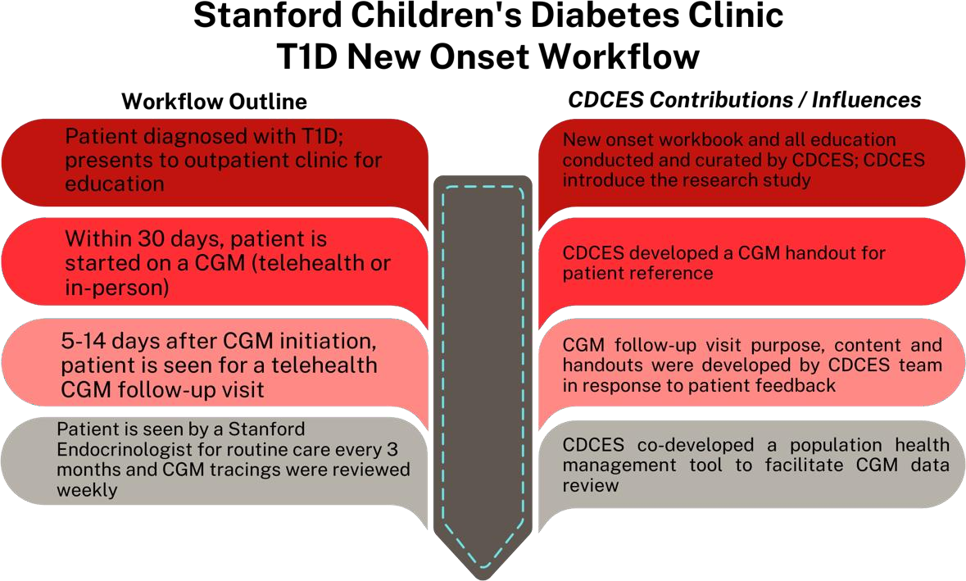
Figure 1: An outline of the patient workflow for new onset patients with T1D at Stanford Children's Diabetes Clinic

Slide 27
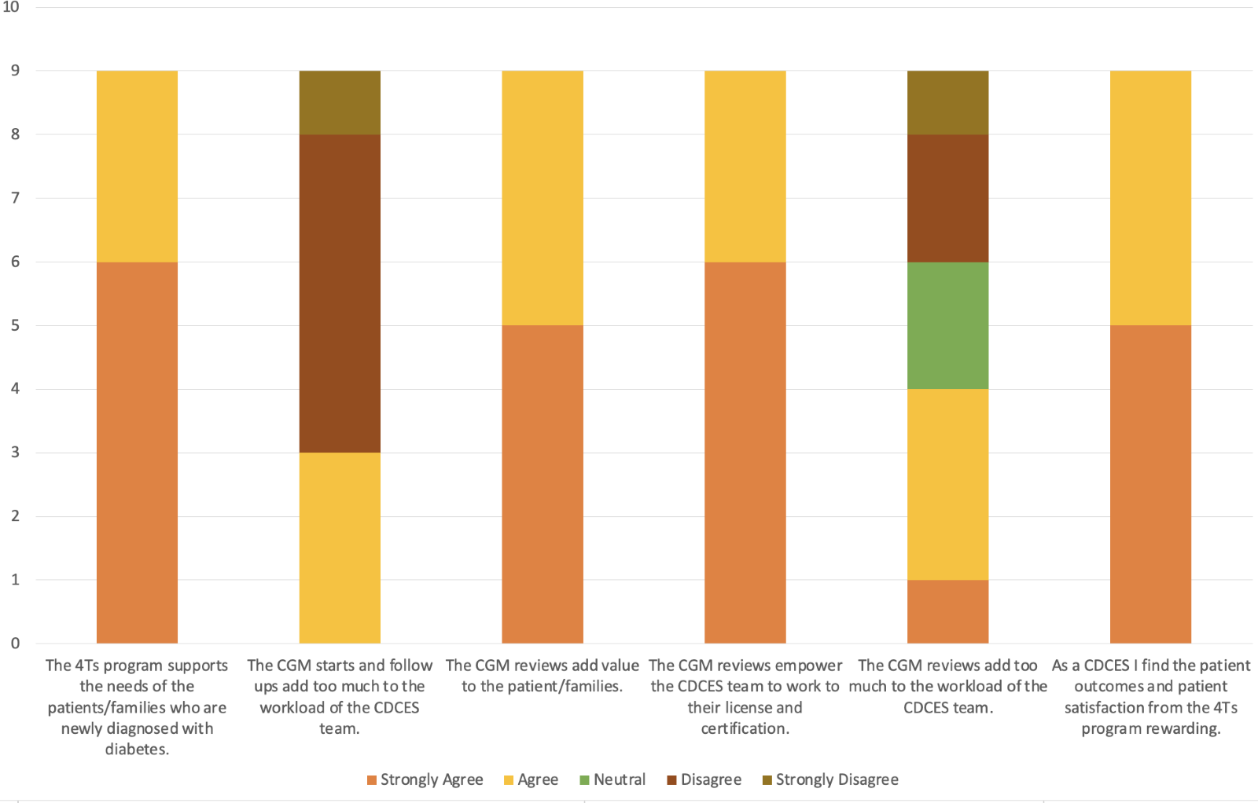
- The survey was completed by 90% of CDCES
- Some CDCES (n=3) felt that the process of starting CGM on all patients with new onset T1D and a 1-week follow up added burden to their workload. Another 44% (n=4) felt that weekly CGM reviews added to the workload of the CDCES
Figure 2: CDCES responses to the survey questions

Slide 28
- While the 4T Program added to the CDCES workload, they all felt that the program was beneficial to patients and families and rewarding for the CDCES team
- Incorporating CDCES perspectives into program development can lead to
successful program continuity and increased job satisfaction
CDCES teams should play an essential role in program development for the care of youth with T1D

Slide 29










Acknowledgements: Teamwork, Targets, Technology and
Tight Control in Newly Diagnosed Pediatric T1D: 4T Study
David Maahs , MD, PhD
Staff Scientist:
Systems Utilization Research for Stanford Medicine (SURF):
Informatics:
Franziska Bishop, MS, CDCES
Ryan Pei, MS
Esli Osmanlliu, MD
Annie Chang, BS
Paul Dupenloup, MS
Natalie Pageler, MD
Simrat Ghuman, PhD
Michelle Wiedmann, BS
Connor Brown, BS
Brendan Watkins, MBA
Glenn Loving, MS
Priya Prahalad, MD, PhD
Coordinators:
Ana Cortes, BS
Nora Arrizon-Ruiz
Erica Pang, BS
Dom Mitchell, BS
Andrea Bonilla Ospina, BA
Rachel Tam, BA
Ilenia Balistreri, BS
Alondra Loyola, BS
Noor Alramahi, BA
Liz Heckard, BS
Eliana Frank, BS (CRM)
David Scheinker, PhD
Quantitative Sciences Unit (QSU):
Victoria Ding, MS
Rebecca Gardner, MS
Victor Ritter, PhD
Blake Shaw, MS
Collaborators:
York University:
Manisha Desai, PhD
T1D Working Group (Statistics):
Michael Riddell, PhD
Korey Hood, PhD
Emily Fox, PhD
Carlos Guestrin, PhD
Johannes Ferstad, MS
Ransalu Senanayake, PhD
Juan Langlois, MS
Alex Wang, MS
Joseph Futoma, PhD
Matthew Levine, PhD
Arpita Singhal, BS
Yujin Jeong, BS
Matthew MacKay, MS
Children’s Mercy:
Mark Clements, MD, PhD
Avinash Kollu, MS
Clinical Staff:
Ananta Addala, DO
Jeannine Leverenz, RN, CDCES
Piper Sagan, RN, CDCES
Anjoli Martinez-Singh, RD, CDCES
Annette Chmielewski, RD, CDCES
Barry Conrad, RD, CDCES
Kim Clash, NP
Julie Senaldi, RN, CDCES
Erin Hodgson, RD, CDCES
Molly Tanenbaum, PhD
Funding:
Helmsley Charitable Trust
ISPAD-JDRF Research Fellowship
R18DK122422
SDRC
LPCH Auxiliaries
Ramesh Johari, PhD
Dessi Zaharieva, PhD, CDCES
– PI of exercise study
Diana Naranjo, PhD

Slide 30


Nuances of Socioeconomic Status and Health Insurance Associations with HbA1c in Adults with Type 1 Diabetes
Caitlin S. Kelly, PhD; Huyen Nguyen, PhD; Katherine S. Chapman, BA; Megan E. Peter, PhD; Kelsie LaFerriere, BA; Julia Ravelson, BA; & Wendy A. Wolf, PhD

Slide 31
Background
Lower socioeconomic status is associated with higher HbA1c in adults with T1D^{1,2}
  Markers of socioeconomic status include individual markers, such as:
    Personal income, educational attainment, insurance type
  Past research has examined SES factors in isolation or as a single score
  Limited distinction between income-based insurance (e.g., Medicaid) and age-based insurance (i.e., Medicare)
Individual markers of lower SES occur in a broader context and community markers of SES may contribute to personal health outcomes
  Examples: rural youth with T1D face greater healthcare barriers³; neighborhood differences in healthcare outcomes⁴
¹Sutherland et al., 2020; ²Miller et al., 2020; ³Stumetz et al., 2016; ⁴Faramand et al., 2022

Slide 32
Current Study Overview
Aims
  What factors are associated with HbA1c after accounting for the others?
    Examined concurrent associations of demographics, diabetes characteristics, residential characteristics, and insurance with HbA1c
  Does insurance type change the relationship between community income and HbA1c?
    Explored moderating role of health insurance type (e.g., Medicaid) in the relationship between average county-level income and HbA1c
Sample and Measure
Participants (n = 9,027) completed baseline survey of the T1D Exchange Online Registry¹
Variables included:
  Demographics (race, ethnicity, age, gender)
  Diabetes technology use (pump use, CGM use)
  SES (income, education)
  Residential area (zip code)
      Median county level income
      Residential area characteristics (‘metro’ vs. ‘non-metro’ areas)
  Health insurance type
¹Participants completed the questionnaire between June. 2019-June 2022 and must have had an HbA1c level reported within the past 12 months of completing the survey

Slide 33
Sample Characteristics (n = 9,027)
T1D Exchange Registry participants are predominately higher SES, NH-white diabetes technology users
  But there is variability in insurance, residential area, and income
Diabetes Characteristics | Mean (SD) | Frequency (%)
HbA1c | 7.33 (1.63)
Pump Use (Yes) |  | 6393 (70.8%)
CGM Use (Yes) |  | 7530 (83.4%)
Demographics | Mean (SD) | Frequency (%)
Age | 42.3 (14.5)
Gender (female) |  | 6936 (76.8%)
Race (non-white)¹ |  | 697 (7.7%)
Ethnicity (Hispanic/Latino) |  | 469 (5.2%)
Income (≤ $50,000) |  | 2748 (30.4%)
Education (High School or Less) |  | 752 (8.3%)
Zip Code Characteristics | Mean (SD) | Frequency (%)
Residential Area (Nonmetro) ² |  | 1309 (14.5%)
County Median Income³ | 7.71 (2.85)
Health Insurance Type | Mean (SD) | Frequency (%)
Medicaid |  | 836 (9.3%)
Medicare |  | 848 (9.4%)
No health insurance (No HI) |  | 167 (1.9%)
Private⁴ |  | 7176 (79.5%)
¹Participants self-identified as Black/African American (n = 178, 2.0%), Asian (n = 72, 0.8%), Native American/Native Alaskan (n = 36, 0.4%), Native Hawaiian or Pacific Islander (n = 9, 0.1%), or mixed race (n = 402, 4.5%) and were collapsed into a single category, as individual group sizes were small.
²Nonmetro was defined as having a population less than 20,000.
³County median income in measurement units of $10,000; thus, the median is $77,100. Counties with median income of $250,000+ was capped at $250,000.
⁴Private insurance included participants who reported having insurance through the Affordable Care Act Marketplace.

Slide 34
Concurrent Associations with HbA1c
What factors are associated with HbA1c after accounting for the others?
  Used hierarchical linear models and found all variables statistically significant after accounting for the others, except for:
      Ethnicity: no relationship to HbA1c (B = .10, SE = .08, p = .20)
      Medicare: no relationship to HbA1c (B = -.03, SE = .06, p = .61)
      Non-metro residence: no relationship to HbA1c (B = .09, SE = .05, p = .07)
Lower HbA1c | B (SE)
Pump Use | -.51 (.04)
CGM Use | -.65 (.05)
Age | -.01 (.001)
Income | -.08 (.01)
Education | -.16 (.01)
Median County Income | -.06 (.02)
Higher HbA1c | B (SE)
Female Gender | .12 (.04)
Non-white Race | .21 (.06)
Medicaid Insurance | .24 (.06)
No Health Insurance | .41 (.12)
Note. Final model (all significant variables) explained 14.4% of the variance in HbA1c.

Slide 35
Nuances of Concurrent Associations with HbA1c
While many individual characteristics and some community factors may be uniquely related to HbA1c, consider the magnitude of the effects.
  Diabetes technology had the largest estimated impact on lower HbA1c (B_{pump} = .51, B_{CGM} = -.65)
  Having Medicaid (B = .24) or no health insurance (B = .41) had moderate-to-large associations with higher HbA1c
  Despite use of a composite score for race as ‘non-white’, racial identity also had a moderate association with HbA1c (B = .24)
    As a small portion of our sample identifying as any one race (individual groups ranged from 0.1 to 4.5%), we were unable to explore more specific differences
Community-level aspects of SES (median income, population) had mixed associations with HbA1c.
  Average of median county income was inversely associated with HbA1c
    Lower income, higher HbA1c (B = .06) but small magnitude
  No association between HbA1c and living in a less populated area

Slide 36
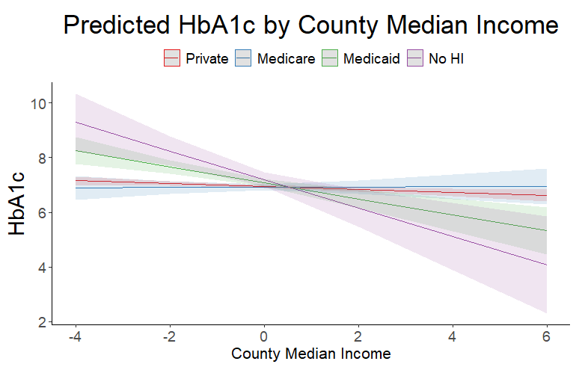
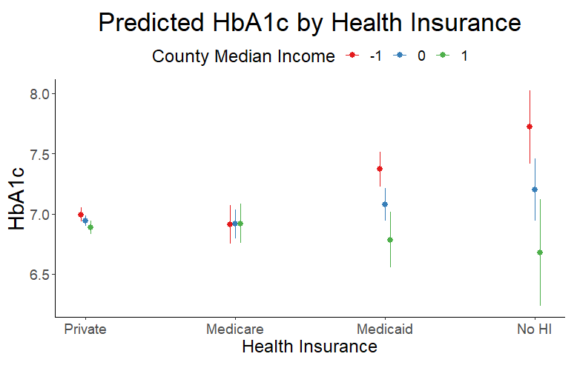
Moderated Associations by Insurance Type
Is the association between living in a lower vs. higher income and HbA1c different by insurance type?
Note. Simple slope tests revealed significant slope and moderate estimates for Medicaid (est. = .29, SE = .07, t = -4.30, p < .001) and No Health Insurance (est. = -0.52, SE = .04, t = 3.69, p < .001). Private insurance also had a significant slope, but magnitude was too small to interpret (est. = -.05). Simple slope for Medicare recipients was not significant (est. = .00, SE = .05, t = .08, p = .94).
Second graph illustrates differences at the mean of median income and +/-1 SD.

Slide 37
Discussion of Moderated Associations
Participants on Medicaid and those with no insurance had a steeper slope compared to those with private insurance, suggesting those with Medicaid or no insurance may be more sensitive to county-level income.
  But impact may be felt more in lower income counties
    In lower and ‘average’ median income counties, these participants had higher HbA1c
      Statistically significant at and below the mean of county income
    In much higher median income counties also had lower HbA1c
      Statistically significant at +2.25 SDs above the mean of county income
  Results suggest that – in addition to personal resources – county-level resources may have disparate impact on health outcomes for adults with T1D

Slide 38
Conclusions and Implications
Limitations
Despite large sample size overall, some group sizes were small
Definitions of ‘metro’ vs. ‘non-metro’ (population < 20,000)
Limitations of cross-sectional design and sample generalizability
Conclusions
Magnitude of estimate on HbA1c is greater for some factors (e.g., in our sample, CGM use, pump use, health insurance type (Medicaid, no insurance), and race)
    Consistent with research in health inequities and T1D which shows these factors (e.g., race, lack of technology use) are often compounded⁵
    Suggests future research to increase technology use, target services to those with Medicaid/no insurance, and understand the needs of and barriers faced by people of color may be especially impactful
County-level median income may serve as a proxy for community resources
  Further exploration in community resources may help explain inequities in HbA1c in low-income individuals on Medicaid and those with no insurance
⁵Majidi et al., 2021

Slide 39
References
Sutherland, M. W., Ma, X., Reboussin, B. A., Mendoza, J. A., Bell, B. A., Kahkoska, A. R., ... & Liese, A. D. (2020). Socioeconomic position is associated with glycemic control in youth and young adults with type 1 diabetes. Pediatric diabetes, 21(8), 1412-1420. https://doi.org/10.1111/pedi.13112
Miller, K. M., Beck, R. W., Foster, N. C., Maahs, D. M., & T1D Exchange. (2020). HbA1c levels in type 1 diabetes from early childhood to older adults: a deeper dive into the influence of technology and socioeconomic status on HbA1c in the T1D exchange clinic registry findings. Diabetes Technology & Therapeutics, 22(9), 645-650. https://doi.org/10.1089/dia.2019.0393
Stumetz, K. S., Joyce, P., Mitrovich, C., & Early, K. B. (2016). Quality of care in rural youth with type 1 diabetes: a cross-sectional pilot assessment. BMJ Open Diabetes Research and Care, 4(1), e000300. doi: 10.1136/bmjdrc-2016-000300
Farahmand, B., Dehghani, M., Vafamand, N., Mirzaee, A., Boostani, R., & Pieper, J. K. (2022). Robust nonlinear control of blood glucose in diabetic patients subject to model uncertainties. ISA transactions. https://doi.org/10.1016/j.isatra.2022.07.009
Majidi, S., Ebekozien, O., Noor, N., Lyons, S. K., McDonough, R., Gandhi, K., ... & Jones, N. H. Y. (2021). Inequities in health outcomes in children and adults with type 1 diabetes: data from the T1D Exchange Quality Improvement Collaborative. Clinical Diabetes, 39(3), 278-283. https://doi.org/10.2337/cd21-0028

