Slide 1
Improving Mental Health Screening at Stanford Adult Endocrinology Clinic
Deene Mohandas, BA; Jacob Less, BS; Marina Basina, MD

Slide 2
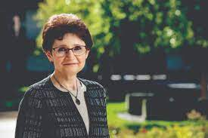
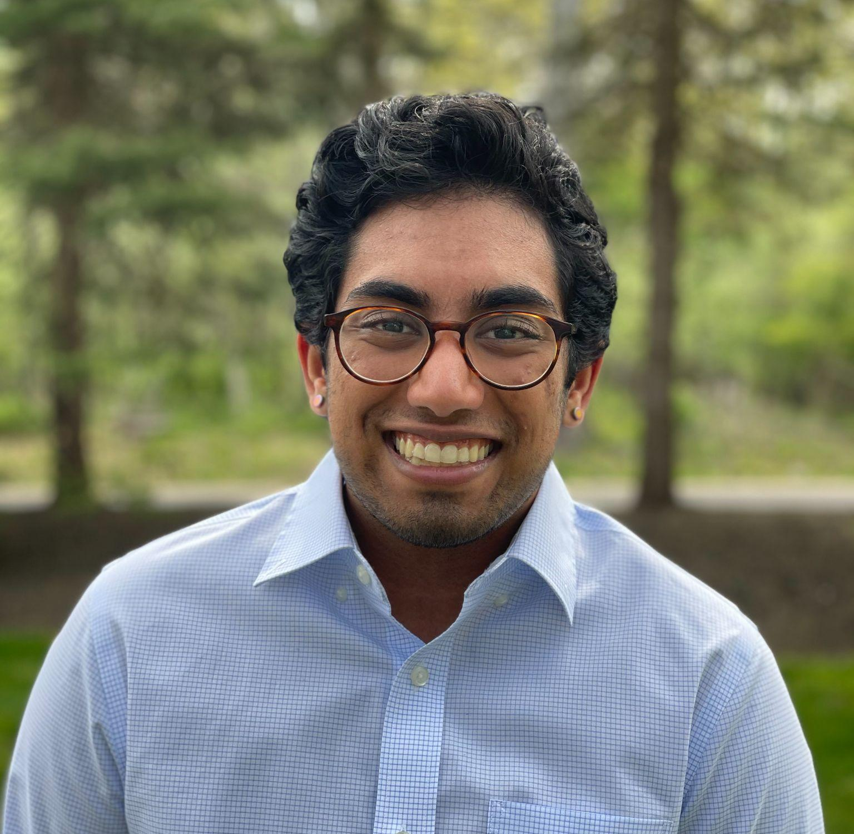


Stanford University Adult Endocrinology Clinic
Division of Endocrinology, Gerontology, and Metabolism
Multidisciplinary Team Members
16 Attending Physicians
5 Endocrinology Fellows
3 Nurse Practitioners (2 PNP-BC/CDCES, 1ANP-BC
5 Certified Diabetes Educators
1 Nutritionist
1 Psychologist
Clinic Contacts
Site PI: Marina Basina, MD
Current Site Coordinator: Deene Mohandas, BA
Previous Site Coordinator: Jacob Less, BS
Dr. Basina
Volume
1600-1700 established T1D patients
35-45 new/newly diagnosed T1D patients per year
Deene
Jacob

Slide 3
Problem Statement
T1DM has psychosocial implications and higher prevalence among individuals with T1D.
Prior to 2021, the Stanford Adult Endocrine clinic had no established system for routine mental health screening of T1DM patients.
In Winter 2021, Stanford Health Care set out a measurable and time specific aim to start regular mental health screening, and develop appropriate communication of resources and referrals.

Slide 4
Aim Statement
Increase regular mental health screening, for depression and anxiety of adult T1DM patients seen by Stanford Adult Endocrine Clinic at Stanford Health Care, using the PHQ-2 to 8 and GAD-7, from 0% to 50% for a single provider in 6 months (Dec. 2021 to June 2022) and other interested providers in the clinic in 12 months (Dec. 2021 to Dec. 1, 2022).

Slide 5
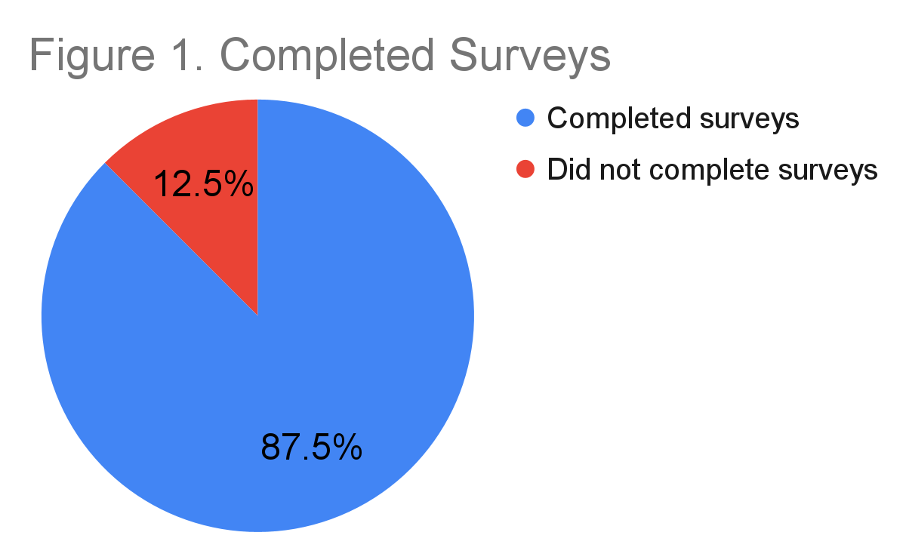
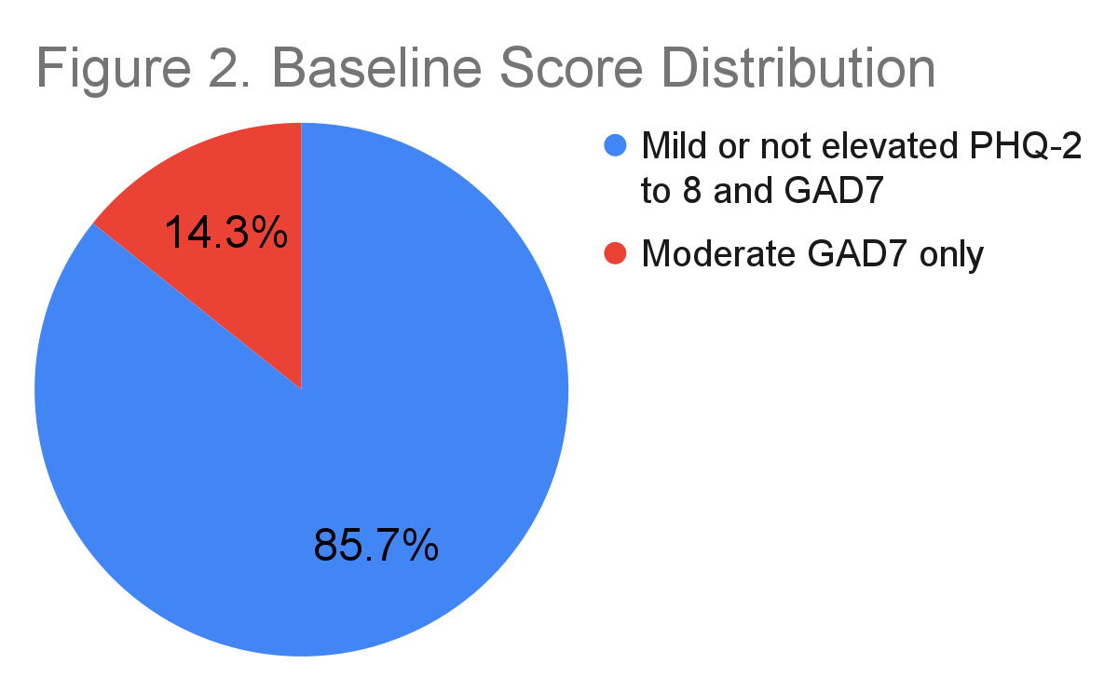
Baseline Screening
(N = 16) [12/1/21 - 12/17/21]
34.5%
65.5%
62%
38%
Figure 1: 14/16 (87.5%) of patients completed the assigned surveys during this period. Surveys were assigned 1 week prior to the scheduled visit.
Figure 2: 2/14 (14.3%) of patients had moderately elevated GAD7. 12/14 (85.7%) of patients did not have elevated scores.
14 patients completed assigned surveys: 12 did not have elevated scores for either PHQ-2 to 8 or GAD7. 2 patients had moderately elevated GAD7 (moderate range: 10-14) and no elevated PHQ-2 to 8.
2 patients did not complete assigned surveys.

Slide 6

Fishbone: Cause and Effect Diagram
Product/Materials – EPIC, PHQ-2 to 8, GAD-7, DDS-2
- EPIC includes capabilities to assign patients questionnaires on specific dates with scheduled visits
- (PHQ-8): a multipurpose instrument for screening, diagnosing, monitoring, and measuring the severity of depression (#9 screens for the presence and duration of suicide ideation)
- (GAD-7): seven-item, self-report anxiety questionnaire designed to assess the patient’s health status during the previous 2 weeks
- (DDS-2): The T1-DDS is a self-report survey that has 28 items. The T1-DDS is in English and in Spanish. The scale asks you to rate each of the 28 items from 1 to 6, from “not a problem” to “a very serious problem.”
Policies & Procedures
- Management indicated that depression and anxiety screening may fall under primary care (no official policy)
- No procedure for mental health screening in Adult Endo clinic
- No procedure for diabetes care team for routine mental health screening
- No procedure for depression and anxiety follow-up care in Endo. Clinic, including resources and appropriate wording for suicidal ideation
T1DM has psychosocial implications and higher prevalence among individuals with T1D. But no routine screening is done for many T1DM patients in Stanford Adult Endo Clinic.
Place
- My Health Messages are the only places for patient communication
- Team communication will be conducted via email, staff messages, and clinic specific blue sticky note
Process
- QI Coordinator reviews the schedule bi-weekly, Friday AM and Wednesday PM for T1DM patients on medical provider’s Schedule
- For patients who have not had the screening done in the last year, QI coordinator assigns PHQ-2 to 8, DDS-2, and GAD7 Questionnaires
People
Planning & Pilot Team:
- Medical provider
- DM Psychologist (has limited schedule, 2 half days per week)
- QI Coordinator
Patients: T1DM with no screening done in last year or with moderate to severe symptoms within one year
Providers: hope to expand to all T1DM in Adult Endo Clinic
Support staff: will hope to include in MA work flow eventually
- CDE/APP/RDs can put in referrals and share resources as well
- Cannot get LCSW effort at this time, only SW is in ED and supporting 20+ specialty clinics
Psychiatry:
- Strict referral policy, backed up for several months, only takes specific insurances identified on intake

Slide 7
Change Idea: Proposed Workflow
If surveys are still incomplete at the time of the visit
Re-assign for next scheduled visit and make note on blue sticky/ follow-up appt. note
1 week
prior to visit
QI Coordinator Assigns Surveys:
PHQ-2 to 8 and GAD-7
Re-check 2-3 days
before visit
Send reminder message and re-assign surveys. Re-check for completion 1-2 days prior to visit.
Did patient fill out surveys?
NO
YES
PHQ 2-8 < 10
AND
GAD-7 <10
PHQ 2-8 ≥ 15
AND
GAD-7 ≥ 15
PHQ 2-8 ≥ 10
AND/OR
GAD-7 ≥ 10
Offer direct referral for one-time evaluation/visit with DM psychologist. Provide other options and psychiatry info in message.
Smartphrase acknowledging completion
1. Just one elevated → offer MGV
2. Both elevated → add other options and psychiatry info
3. Also offer direct referral for one-time evaluation/visit with DM psychologist.
Follow up in 2 weeks
Send follow up message asking if patient was able to access any of the resources and offering additional support with accessing resources.

Slide 8
Run-Chart: PHQ-2 to PHQ-8 and GAD7
PDSA 6: Adjust workflow to better assist positively scoring patients (4 this cycle)
PDSA 4: Compare assigning surveys 1 vs 2 weeks pre-visit
PDSA 9&10: Send reminders to patients who read MHM but do not fill out surveys. Focus on patient F/U (i.e. did they use/pursue resources)
PDSA 2: Assign surveys 1 week before visit & 3 Week F/U
PDSA 5: Return to assigning surveys 1 week prior
PDSA 3: Increased our screening by 1.5x
- Positive screen discussed during visit
PDSA 11&12:
- Discussed moving database and survey distribution to REDCap (will see question length in intro email)
PDSA 7&8: Share PDF summary for MyHealth Message (in addition to smartphrases)
Notes:
PDSA 3: ⅕ of patients missed/cancelled/rescheduled their appointment this week
PDSA 7&8: Focus on the reminders to increase the response rate, look in to automated invitations with reminders

Slide 9
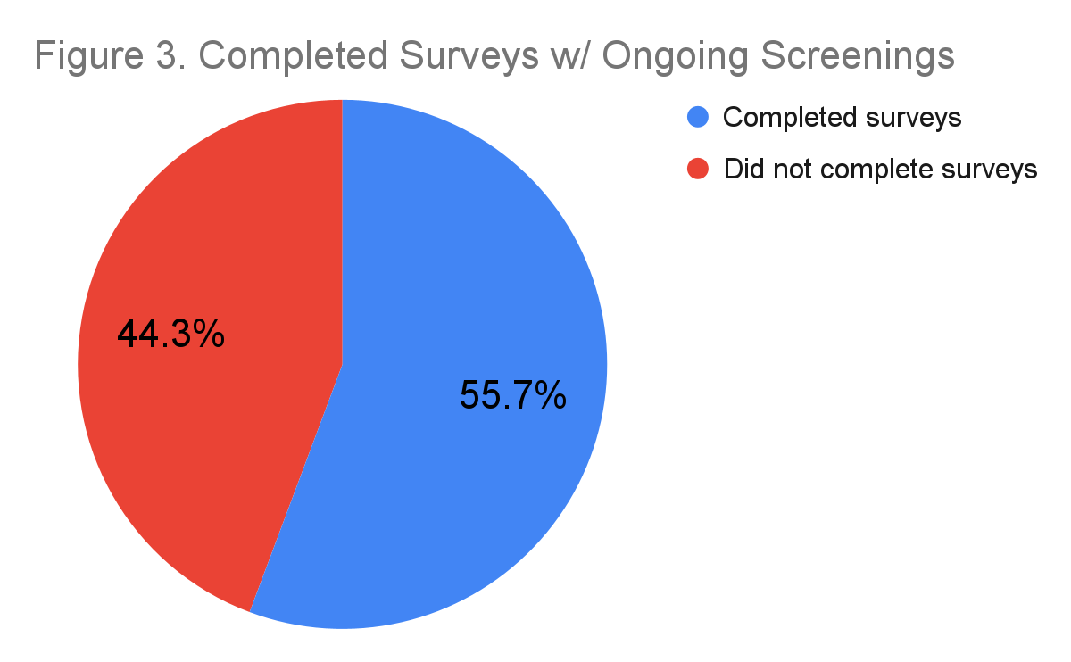
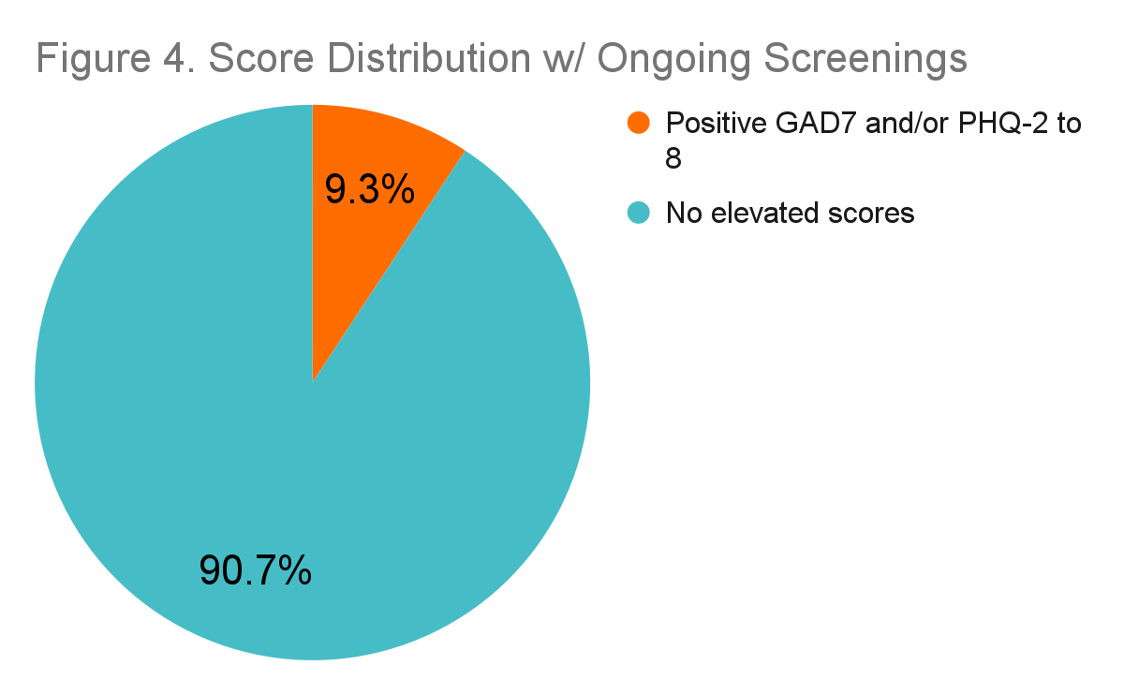
Summary of All Data
Current response rate is 55.7% (205 completed surveys/368 assigned surveys)
19 patients have had a positive screen for GAD7 and/or PHQ-2 to 8.
Response rate increased from 0%, for a single provider, compared to December 2021, prior to start of QI project.
During this time, one provider had 458 unique T1D patient visits where 368 patients were assigned surveys.

Slide 10
Next Steps
Reach out to the other providers in the Adult Endocrine Clinic to gauge interest in starting mental health screening for their patient lists
Further develop the workflow and referral system to connect patients with elevated scores in a timely and effective manner
Look into automated invitations/reminders/ways to more efficiently route positive screens.
Reach out to patients who were not screened and identify barriers to accessing/filling out survey
Notes:
Lessons Learned:
- Establishing new workflows takes a lot of time before start up and constant effort throughout the entire process
- It’s essential to get multidisciplinary buy-in for projects to succeed (e.g. psychiatry/psychology, social work, management, providers, and support staff)
- For high patient volume, automated invitations and utilizing the resources of the EHR can improve efficiency and reduce administrative burden
- Patient feedback can be key in identifying ways to improve workflow and making sure resources are accessible.

Slide 11
Improvement in Screening for Depression in Adolescents with Diabetes
Angel Nip, MD; Barbara Liepman, RN MS CDCES; Jennifer Olson, MD FAAP; Eda Cengiz, MD MHS; Ayesha Abdut-Tawwaab, LCSW; Genesis Ibarra, LCSW; Amy Warner, LCSW; Annapurna Vishnubhotla, RN MSN; Jenise Wong, MD PhD

Slide 12
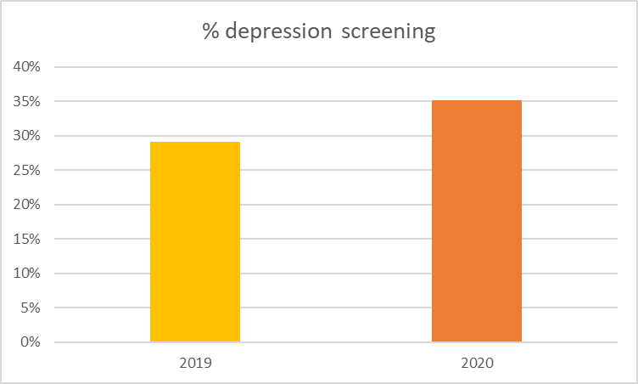
Background
Depression is common among adolescents, but rates increase significantly with chronic health conditions such as diabetes
Associated with suboptimal diabetes outcomes (higher hemoglobin A1c, increased rates of diabetes-related hospitalizations)
Standards of care recommend routine psychosocial screening
Mental health evaluations were not routinely completed in all patients or with the use of a validated screening tool in our clinics
% Depression screening at BCH (West + East Bay clinics)
Notes:
Documented rates of depression screening in adolescents aged 13-17 with Type 1 and Type 2 diabetes seen at BCH are below USNWR goal
Depression screening rates of adolescents 13-17 years old with Type 1 (T1D) and Type 2 (T2D) diabetes were 29% and 35% in 2019 and 2020 respectively at the two primary (East and West Bay) diabetes clinics at Benioff Children’s Hospital (BCH)

Slide 13
Fishbone Diagram: Why does this Problem Exist?
Cause
Effect
Resource Limitations
Ongoing f/u needed for high risk patients
SW ”own” the resources for follow up of positive screens
Workflow Challenges /
No Documentation
No SW at EB Satellites
Providers do not have the time to devote to screening
WB has 1 SW for Madison Clinic
Time
Main Campus vs Satellites
SW are the point of screening
Follow up plan for mild/mod risk is unclear
Legal Concerns if screen not addressed
APEX build requires time/$
CCS vs Public Ins vs Private
PHQ9 Documentation tool only
Adolescents with Diabetes are not systematically screened for depression
Staffing/Billing
No standard or searchable APEX documentation
Inpatient needs may trump outpatient
Documentation varies by SW
SW get pulled to other depts
Patient may be screened by ED/Inpatient SW
Potential compromise to confidentiality
Location of Visit – Satellite vs Main Campus
Safety planning
Limited In-Person SW Exposure
Telehalth Limitations
COVID19
Different SW leadership
Suicide Screen vs Depression Screen
Location of Visit – Satellite vs Main Campus
Insurance type
Social Factors
East Bay uses a combination of:
SW visit, ASQ, Columbia, PHQ-9
No standard Cross-Bay measure
Differences in MyChart utilization
Language Barrier
Literacy barriers
Patient Accessibility to Screen/SW
WB uses PHQ-9
No clear definition of “depression screen”
Different Screening Approaches
11
Improvement in Screening for Depression in Adolescents with Diabetes
Notes:
This was already compiled at previous meeting with SW.
West Bay:
Inpatient and Outpatient are in two physically different spaces (1 Marta in 2 different places)
Marta’s role includes seeing patients at satellite and Mission Bay locations. Satellite patients are supposed to come to Madison once yearly and that is where Marta is supposed to see them
Telehealth has allowed Marta to see Santa Rosa patients. Patients identified in pre-clinic huddle.
Primary care at Mt Zion uses PHQ9 and has been for years. Front desk provides, patient completes, provider scores and SW f/u if indicated
East Bay
PCPs administer PHQ9, primary care SW follows up for mod-severe.
Preferences:
Try to aim for standardization for a screening program
Documentation
Open a note > tab: screening tools (Searchable) → PHQ9 and GAD7 --> screen done on paper with patient, input answer to each question into flowsheet → score computed.
There is a .phrase: .phq if you want to pull it into the note.
Marta has another personal dotphrase .mca (table that pulls in all the measures/notes)

Slide 14
Goals
Project aim:
  To achieve ≥ 50% depression screening for adolescents at all diabetes encounters for at least 9 of 12 months in fiscal year 2022
Global aim:
  To adequately address the needs of patients with positive depression screens which will improve patient engagement with diabetes care, quality of life and reduce diabetes-related complications

Slide 15
Interventions
A multidisciplinary Task Force was formed to develop guidelines and clinic workflow
  Providers
  Social workers
  Transition coordinators
  Office assistants
  Diabetes educators
  Practice administrators
Key driver diagram

Slide 16
Key Drive Diagram
Primary Drivers
Interventions
Use a validated screening tool and algorithm for referral:
PHQ-9
Consistent screening method and referral criteria
Use of electronic medical record for:
Consistent documentation
SMART Aim
Increase screening for depression and appropriate referral to social work for eligible population
Integration of screening into clinic workflow
Involvement of clinic staff, patients and providers in process design and spread
Integration into visit planning and other patient reported intake form
Global Aim:
Adequately address the psychosocial needs of patients with positive depression screens at BCH
Adequate social work referral
Increase in referrals from screening used as justification for staffing of additional SW
Improvement in Screening for Depression in Adolescents with Diabetes

Slide 17
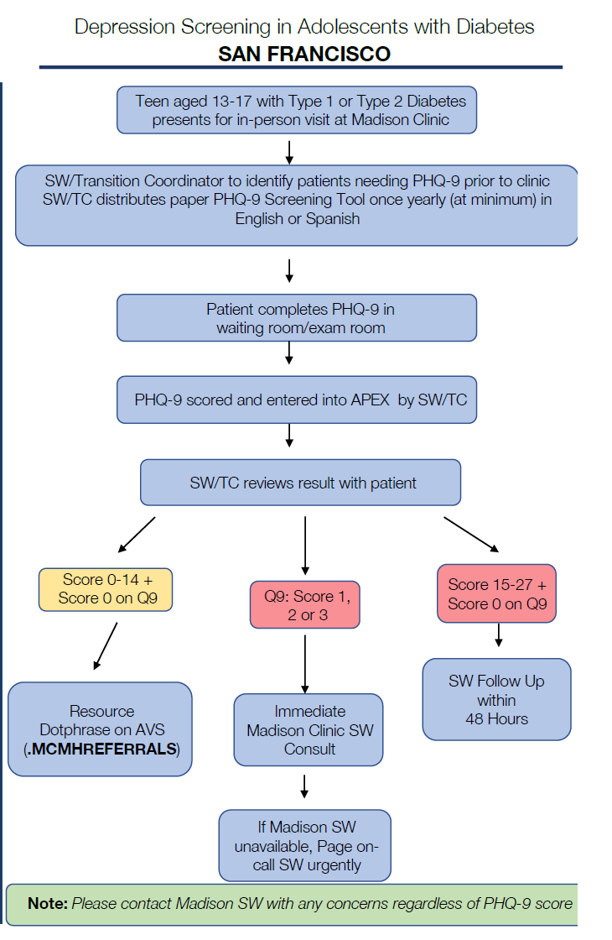
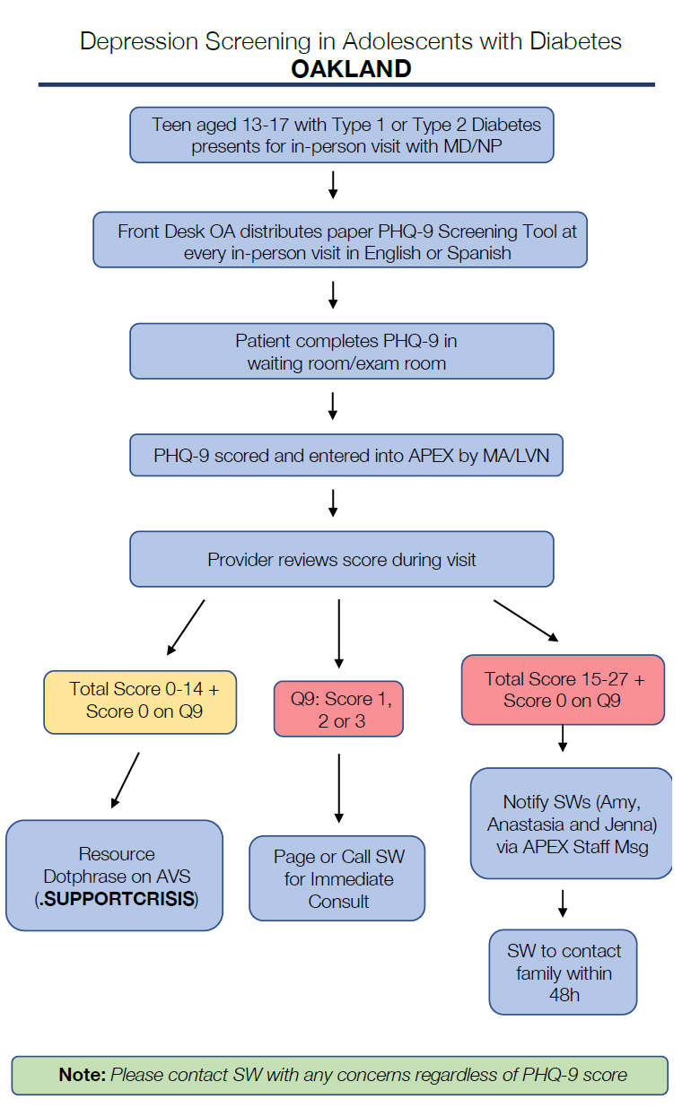
Clinics workflow
Patients aged 13-17 with T1D or T2D for in-person visits are identified for PHQ-9 screening
SW/Transition coordinator/front desk staff distribute the paper screening in English or Spanish
Patients complete the screening in the waiting/exam room
Medical assistants help input the scores into ApeX for providers/SW to review
Depending on the scores +/- suicidality, SW will be consulted
All patients provided with mental health resources on AVS
Notes:
Inclusion criteria (T1D and T2D, age 13-17, in-person visits)
Exclude telehealth visit due to concerns for confidentiality and lack of social work
TC/SW to huddle daily to identify patients who need PHQ-9 screening
Patients to be screened annually at minimum, and additionally as needed if prior PHQ-9 score was 14 or higher or any concerns arise

Slide 18
1st PDSA cycle was commenced in March 2021
Data review every 1-2 weeks after the implementing the project
2021
Feb 8 - 26
March 1
March - July
July
Finalize Screening Process
Implement
Process
Data Review
Q 1-2 weeks
Adjust Process
Formalize Initiative
Improvement in Screening for Depression in Adolescents with Diabetes

Slide 19
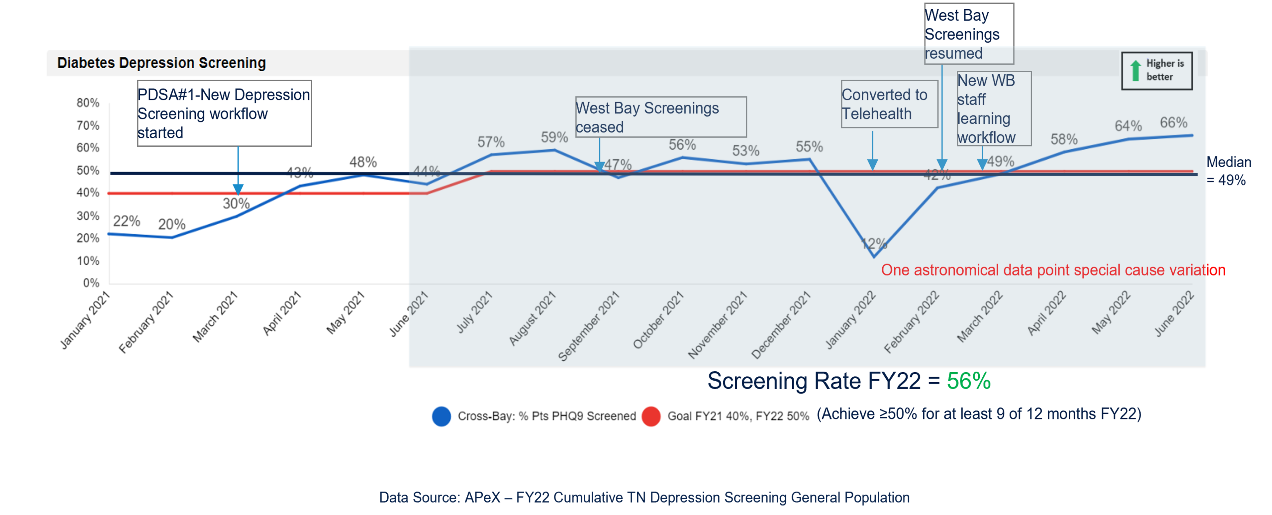
Run chart
Baseline screening rates: 29% in FY19 and 35% in FY20

Slide 20
Results
Depression screening rates were achieved ≥ 50% in 8 of 12 months in FY22
The cumulative screening rates was 56% and the rates were improved by 27% over the baseline

Slide 21
Conclusions
Adolescents with diabetes are routinely screened at least annually at in-person clinic visits at two primary BCH clinics with a standardized workflow and screening tool
Patients are referred to clinic social worker based on the screening results criteria

Slide 22
Limitations
In-person interventions were impacted by increased use of telehealth visits due to the COVID-19 pandemic
Staffing changes and resources limitations
We are considering
  Increasing screening population to all patients ≥ 13 years
  Screening via telehealth visits
  Expanding depression screening workflows to satellite clinics with social work support
  Administering screens electronically so that results can be directly populated into the EHR
Notes:
Screening at satellites and via telehealth has the potential to improve equitable care
Include more team member roles in anticipation of staffing changes
Patients who appeared clinically “well” when screened for depression were actually suffering emotionally and needed professional evaluation and intervention

Slide 23
Acknowledgement
Quality Improvement team
  Angel Nip, MD, East Bay Director
  Barbara Liepman, RN MS CDCES, Nurse Quality Coordinator
  Jenise Wong, MD PhD, West Bay Director
Depression Screening Task Force (continued)
  Anastasia Gomes, LCSW
  Annapuma Vishnubhlota, RN MSN
  Ayesha Abdut-Tawwaab, LCSW
  Eda Cengiz, MD MHS
  Elizabeth Scott, RN CDCES
  Genesis Ibarra, LCSW
  Jennifer Olson, MD
  Kathy Love, RD CDCES
  Mackenzie Allen, RD
  Sonali Belapurkar, MD

Slide 24
Increasing Patient Engagement
Through the Use of Online Diabetes Questionnaire:
Cook Children’s Endocrinology Clinic
Mouhammad Alwazeer MD, Susan Hsieh MD, Christin Morell RN, BSN, Stephanie Ogburn RN, BSN, CDCES, Candice Williams NP, CDCES

Slide 25
Cook Children’s
T1D Exchange Collaborative
Key Driver Diagram
Change Ideas
Primary Drivers
Engage patients/parents in QI projects
Identify and utilize stakeholders within clinic (providers, clinical staff, SW, therapists)
Engage team members & QI leaders via calls, learning sessions
Patient-centered Learning Collaborative
Involvement in QI continued education through IHI school
Utilize Life QI platform
Aim
Automate reporting capabilities to T1D Exchange
Map data to T1D Exchange’s QI Platform
Organizational QI Preparedness
Among People with T1D (duration > 1 yr, aged 12-26)
at Learning Collaborative sites, decrease % population with 2 A1cs > 9% by 10%
and
increase % with ≥0.5% A1c interval improvement by at least 10% over 3 years.
Use of Data System
Insulin monitoring interactions and active problem solving
Increase diabetes technology awareness for patients and staff
Assess provider prescribing patterns and increase understanding in diabetes technology
Improve Insulin Therapy
Provide resources for BG analysis
Shared decision making, goal setting, action planning, problem solving
Coach patients (not on CGM therapy) on completing >4 checks/day
Increase CGM access and use among families
Offer CGM support & problem solving skills
Improve
Glucose Monitoring
Encourage data review b/t visits with guidance from CDE
Provide active problem-solving education for families
Transition current education/policies to digital platform
Effective Self-management
Be Patient-centered
Assess patient needs/concerns at visits
Increase access to staff through clinic portal
Establish family support network, with family members on team
Ensure Access to care and regular follow-up
Use staff and automated systems to ensure patients are scheduled regularly
Follow up with high risk patients who have not been seen in clinic in >6 months.
Utilize SW to assess barriers to accessing appointments
Improve Psychosocial Support
Screen all patients for depression, eating disorders and social needs
Formulate plan of care based on patient reported outcome measures (PROM)
Ensure patients who need support receive and complete referrals
Updated March 2022

Slide 26
Background
Online health questionnaires engage patients in care and increase efficiency for clinicians.
Utilization of the online diabetes questionnaire (ODQ) by patients with type 1 diabetes (T1D) prior to their clinic appointment is approximately 37% for our entire clinic.
Objective
To improve utilization of the ODQ, with the aim to increase from baseline by 10%, at one Cook Children’s Endocrinology satellite clinic.

Slide 27
Methods
Patients with upcoming visit have access electronic portal to pre-fill health online diabetes questionnaire (ODQ) with regards to insulin dosing, carb counting, goals and questions.
Assessment of Barriers Related To Survey Completion (Barriers Survey)
  37.5% of patients know the ODQ exists online
  25% of patients forget to complete it prior to the visit
PDSA 1
MyChart Message
One week prior to visit
PDSA 2
Late MyChart Message
4 days prior
PDSA 3
Medical Receptionist Reminder
While in patient room
PDSA 4
Exam Room Reminder
While in exam room

Slide 28
PDSA Cycle 1
Aim: Improve Patients’ knowledge about the ODQ by 20%
Intervention:
  MyChart message
  Sent one week prior to visit
  8 week duration
Results:
  Total encounters: 11
  Improved participation
  Possible Notification fatigue?
  - 70% didn’t read MyChart Msg
  Small population size
Notes:
Participation in the ODQ improved. However, due to the small sample size, we couldn’t assess the objectives
Challenges:
Due to weather challenges:
Cancellations and no shows resulted in small number of patients to complete the barriers survey
Notification fatigue: Time of notification?
Other notifications?

Slide 29
PDSA Cycle 2
Intervention:
  Late MyChart message
  Sent 4 days prior to visit
  - Included specific education and reminder of benefit
Results:
  Total encounters: 18
  Decreased participation
  Increased awareness of ODQ noted through Barriers Survey
  Further notification fatigue
  Cancellations and no shows related to weather challenges
PDSA 2
37.2%
Notes:
Further notification fatigue - ~ 70% of patients read their MyChart message
Intervention not fully sustainable for longer period

Slide 30
PDSA Cycle 3
Intervention:
  Medical Receptionist reminder
  Use human interaction to reduce notification fatigue
  Expand the patient population to include two additional providers
Results:
  Total encounters: 66
  Increased participation
  Notification fatigue reduced
  New barrier: 36% reported they did not have time to do the ODQ
PDSA 3
45%

Slide 31
PDSA Cycle 4
Intervention:
  Medical assistant reminder
  Given more time to complete while waiting for the provider
  Results:
  Total encounters: 52
  Improved participation, with project aim met!
  Reduced barrier of time for completion; efficient use of wait time
PDSA 4
58%

Slide 32
Conclusions
Completing the ODQ prior to appointments improves visit quality
Online reminders are less effective than human interaction; likely leads to notification fatigue
Most effective method to increase participation was on-site reminders and effective use of visit wait time
Future Considerations
Expansion to all endocrine clinics at Cook Children’s (~ 1400 patients with T1D)
Application of SDOH criteria to improve participation (access to technology, language barriers, education)
Promote benefit of ODQ participation to patient; Patient-first approach
Notes:
Analyze data based on socioeconomic status, education, race/ethnicity to help better understand and improve the participation rate
Expand to Cook’s other locations

Slide 33
References
Kouri, A., Yamada, J., Sale, J., Straus, S. E., & Gupta, S. (2020). Primary Care Pre-Visit Electronic Patient Questionnaire for Asthma: Uptake Analysis and Predictor Modeling. Journal of medical Internet research, 22(9), e19358. https://doi.org/10.2196/19358
Cook Children’s Endocrinology & Diabetes
OUR TEAM
Doctors: 14 (12 FTE)
Nurse Practitioners: 3 (2 are CDEs)
Diabetes RN/CDEs: 10 (9.2 FTE)
Clinical Therapists: 3
Social Worker: 1
Child Life Specialist: 2 (inpatient and outpatient)
POPULATION (BASED ON 2021 DATA)
Total Patient <18yo with T1D : 1400 (~2000 total)
  2 or more visits per year
Newly diagnosed annually: ~300
Payor Mix: 37% Medicaid

Slide 34
“TechQuity” and Peer Support to Reduce Disparities in Glycemic Outcomes in Children with Type 1 Diabetes
Department of Pediatrics
Division of Endocrinology
UCSF Benioff
Children’s Hospitals
Jenise C. Wong, MD PhD
Barbara Liepman, RN MS CDCES
Katie Craft BS CCLS
Diana Arellano RN BSN CDCES
Mackenzie Allen RD
Kathy Love, RD CDCES
Annapurna Vishnubhotla, RN MSN
Angel Nip, MD

Slide 35

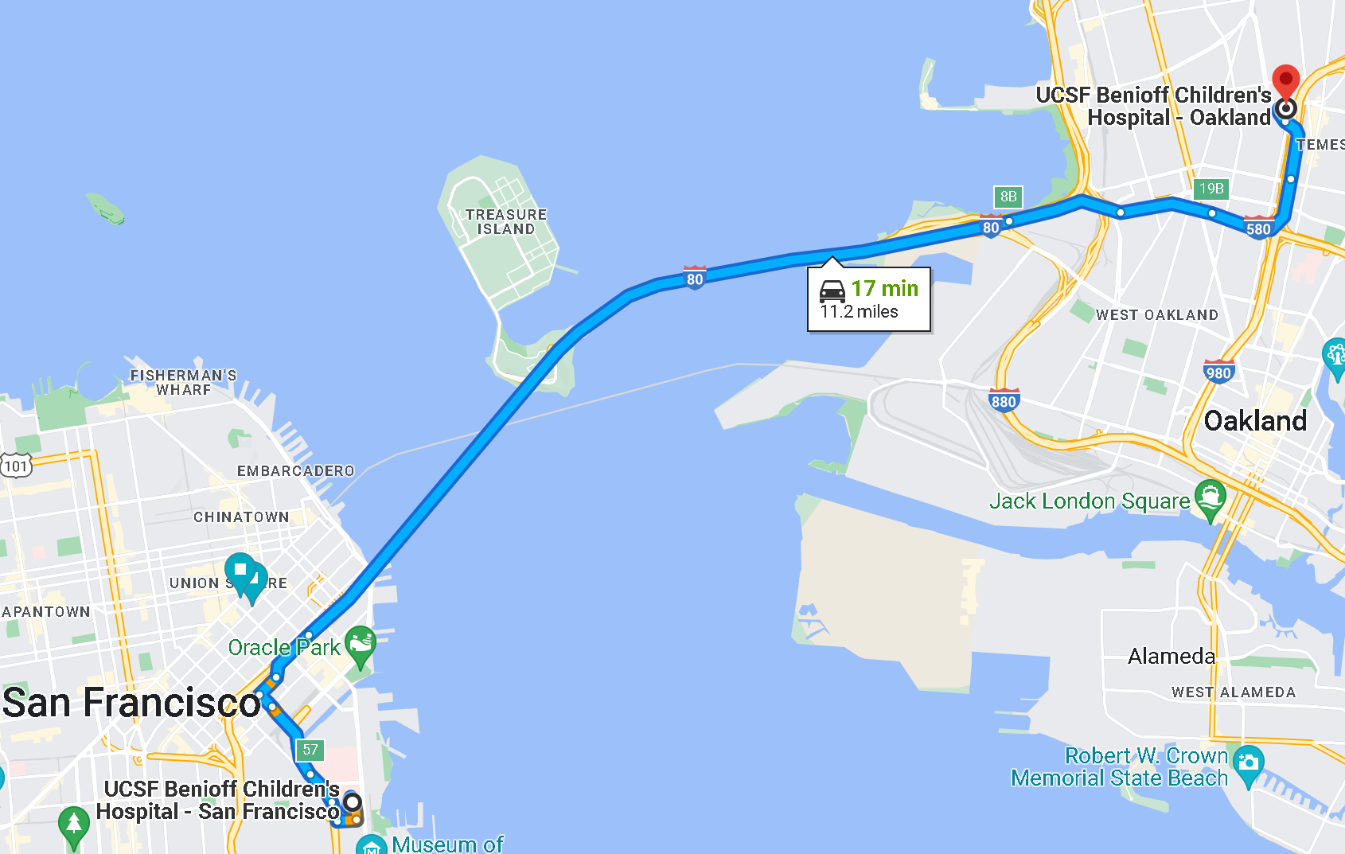
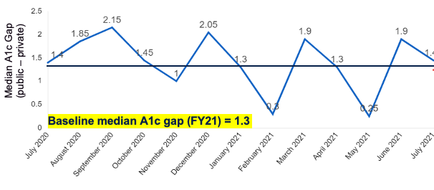
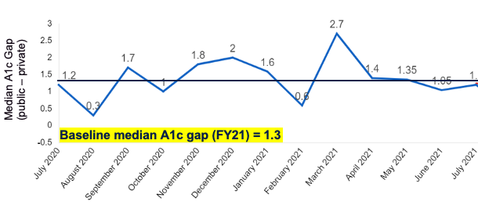
Background
A
45
A.East Bay
B.West Bay
B
2
Disparities in glycemic outcomes exist between publicly and privately insured children with type 1 diabetes (T1D).

Slide 36
Objectives
Project goal
  Reduce the monthly median A1c gap to ≤1.24% (5% reduction) between publicly and privately insured children with T1D by end of December 2021, and further reduce to ≤1.17% (10% reduction) in April-June 2022 without either population’s median A1c increasing above baseline (1.3%).
Global aim
  Achieve health equity for children with diabetes seen at Benioff Children’s Hospitals (BCH).

Slide 37
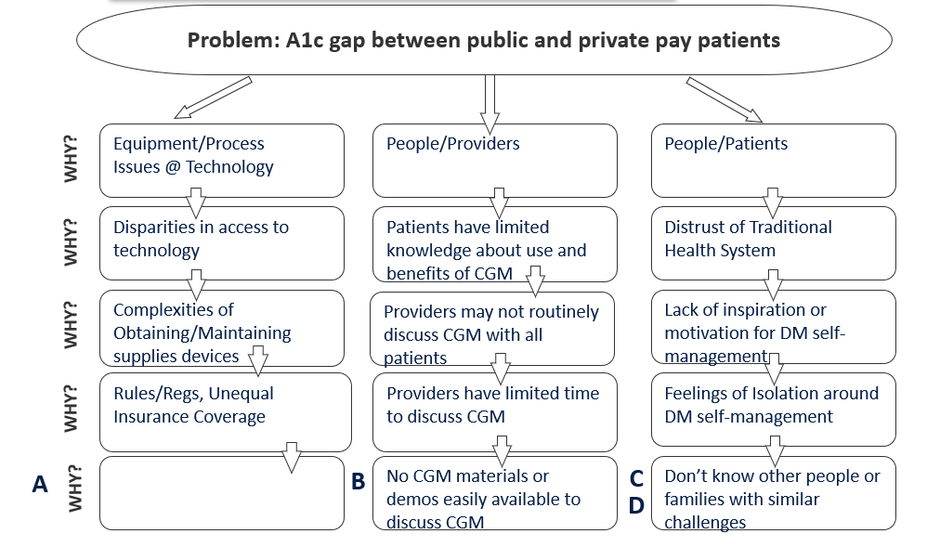
Methods: 5 Whys

Slide 38
Selected Key Drivers FY22
Primary Drivers
Secondary Drivers
Interventions
Families feel supported by peers, not isolated
Shared appointments and/or group classes
Families/patients feel supported in culturally sensitive, age-appropriate ways
SMARTIE* Goal
Establish buddy/mentor program
Reduce the gap in median A1c between privately and publicly insured patients with T1D by 10% in FY22
Parents feel supported by providers
Establish workflow to routinely tell patients about CGM/HCL
Diabetes technology is available and used effectively by all.**
Offer devices to all patients
Distribute CGM “starters” in an ethical manner
*SMARTIE GOAL
S - Specific
M - Measurable
A - Achievable
R - Realistic
T - Timebound
I - Inclusive
E - Equitable
Technology is acceptable and normalized to patients
Patient education handout posted and/or distributed in exam rooms
Global Aim:
Achieve health equity for children with diabetes seen at BCH
**Focus on “TechQuity”: the strategic development and deployment of technology to advance health equity

Slide 39
PDSA #1: CGM Educational Handout
Plan
  Created handout/electronic SmartPhrase (for video visits, AVS)
Cycle 1: 9/13/21-9/26/21
  Handout available in exam rooms as a discussion tool for patients with type 1 diabetes who were not using CGM
  Piloted with Task Force members (n=6)
Cycle 2: 9/27/21-10/11/21
Adopt
  Expanded to all diabetes team members, new patient packet
  Handout translated into Spanish

Slide 40

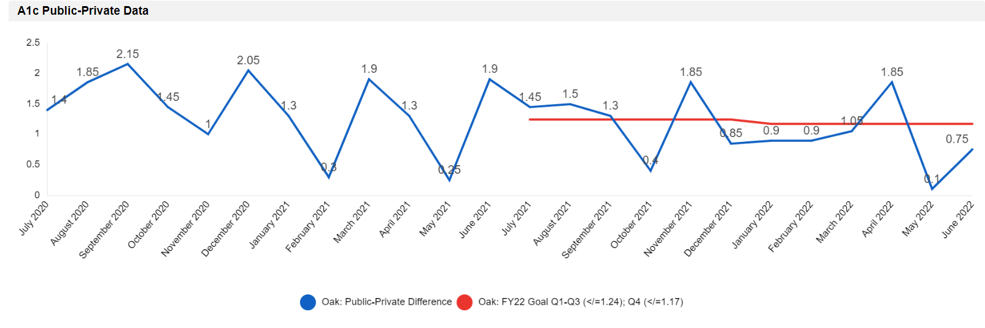
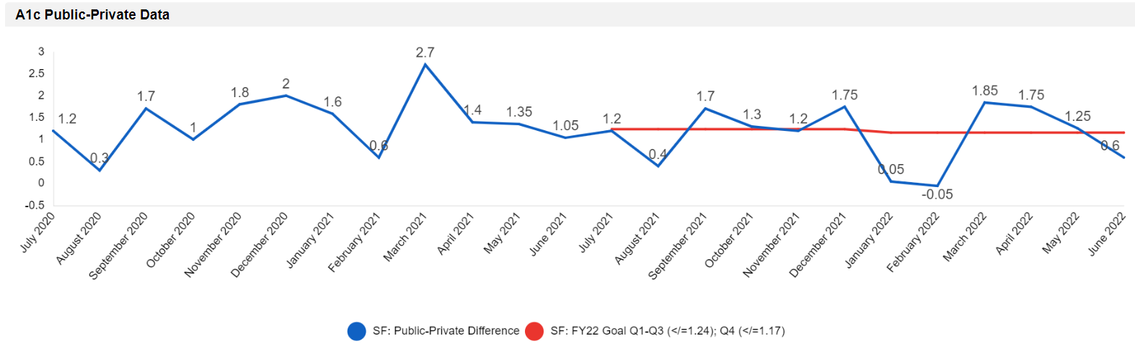
East Bay
Project start
PDSA #1
CGM Ed. Handout Cycle 1
PDSA #1
CGM Ed. Handout Cycle 2
CGM becomes Medi-Cal pharmacy benefit
PDSA #2
Buddy Program Cycle 1
PDSA #2
Buddy Program Cycle 2
Commenced A1c Task Force
Median A1c Gap
(public – private)
Run chart median = 1.3
Baseline median A1c gap (FY21) = 1.3
West Bay
Project start
CGM becomes Medi-Cal pharmacy benefit
PDSA #1
CGM handout Cycle 1
PDSA #1
CGM handout Cycle 2
PDSA #1
Buddy Program Cycle 1
PDSA #2
Buddy Program Cycle 2
FY22 Goal: A1c Gap ≤1.17 (10% reduction from FY21 baseline of 1.3) in April, May and June 2022 without either population’s median A1c increasing above baseline.
Commenced A1c Task Force
Median A1c Gap
(public – private)
Run chart median = 1.3
Baseline median A1c gap (FY21) = 1.3
FY22 Goal: A1c Gap ≤1.17 (10% reduction from FY21 baseline of 1.3) in April, May and June 2022 without either population’s median A1c increasing above baseline.

Slide 41
Next PDSA? Capture Patient Voice
Implemented survey of small number of patients
Given choices of interventions, asked patients to select those that they feel would help them
50% interested in having a diabetes buddy or shared appointments

Slide 42


PDSA #2: Buddy/mentor program
Plan
  Teamed with Diabetes Youth Families (501(c)(3) diabetes organization) to facilitate the Insulliance buddy/mentor program
  Flyers created and translated into Spanish
  Establish referral system (online registration)

Slide 43
PDSA #2: Buddy/mentor program
Cycle 1: 1/25/22-2/7/22
  Flyers and electronic SmartPhrase distributed
  Patients with type 1 diabetes encouraged to register online
  Piloted with Task Force members (n=3, transition coordinator, social work, CDCES)
Cycle 2: 2/8/22
  Expanded to all diabetes team members
Adapt
  Proactively guide patients to register

Slide 44
East Bay
Project start
PDSA #1
CGM Ed. Handout Cycle 1
PDSA #1
CGM Ed. Handout Cycle 2
CGM becomes Medi-Cal pharmacy benefit
PDSA #2
Buddy Program Cycle 1
PDSA #2
Buddy Program Cycle 2
Commenced A1c Task Force
Median A1c Gap
(public – private)
Run chart median = 1.3
Baseline median A1c gap (FY21) = 1.3
West Bay
Project start
CGM becomes Medi-Cal pharmacy benefit
PDSA #1
CGM handout Cycle 1
PDSA #1
CGM handout Cycle 2
PDSA #1
Buddy Program Cycle 1
PDSA #2
Buddy Program Cycle 2
FY22 Goal: A1c Gap ≤1.17 (10% reduction from FY21 baseline of 1.3) in April, May and June 2022 without either population’s median A1c increasing above baseline.
Commenced A1c Task Force
Median A1c Gap
(public – private)
Run chart median = 1.3
Baseline median A1c gap (FY21) = 1.3
FY22 Goal: A1c Gap ≤1.17 (10% reduction from FY21 baseline of 1.3) in April, May and June 2022 without either population’s median A1c increasing above baseline.

Slide 45
East Bay
Project start
PDSA #1
CGM Ed. Handout Cycle 1
PDSA #1
CGM Ed. Handout Cycle 2
CGM becomes Medi-Cal pharmacy benefit
PDSA #2
Buddy Program Cycle 1
PDSA #2
Buddy Program Cycle 2
Commenced A1c Task Force
Median A1c Gap
(public – private)
Run chart median = 1.3
Baseline median A1c gap (FY21) = 1.3
Project median A1c gap (FY22) = 0.9
West Bay
Project start
CGM becomes Medi-Cal pharmacy benefit
PDSA #1
CGM handout Cycle 1
PDSA #1
CGM handout Cycle 2
PDSA #1
Buddy Program Cycle 1
PDSA #2
Buddy Program Cycle 2
Commenced A1c Task Force
Median A1c Gap
(public – private)
Run chart median = 1.3
Baseline median A1c gap (FY21) = 1.3
Project median A1c gap (FY22) = 1.1
FY22 Goal: A1c Gap ≤1.17 (10% reduction from FY21 baseline of 1.3) in April, May and June 2022 without either population’s median A1c increasing above baseline.

Slide 46
Conclusions
Task force, CGM education and awareness, connecting with peer support associated with reduction in A1c disparities
Limitations
  Focused on high impact, lower effort interventions due to limited staffing and resources
  In person interventions impacted by increased telehealth due to COVID-19
Future interventions
  Continue to focus on increasing CGM use
  Outreach specifically to patients with A1c levels above goal

Slide 47


Division of Endocrinology
Quality Improvement team
  Angel Nip, MD, East Bay Director
  Barbara Liepman, RN MS CDCES, Nurse Quality Coordinator
  Jenise Wong, MD PhD, West Bay Director
A1c Health Equity Task Force
  Alison Reed, MD
  Amelia Baker, RD, CDCES
  Anastasia Gomes, LCSW
  Annapurna Vishnubhlota, RN MSN
  Anita Markoff, NP CDCES
  Diana Arellano, RN BSN CDCES
A1c Health Equity Task Force (continued)
  Elizabeth Scott, RN CDCES
  Hannah Chesser, MD
  Jennifer Olson, MD
  Kathy Love, RD CDCES
  Katie Craft, CCLS, Transition Coordinator
  Mackenzie Allen, RD
  Marta Rebelo, MSW
  Maureen McGrath, MS NP BC-ADM
  Nicole Rotter, NP
  Rosibel Jones, RD CDCES
  Sonali Belapurkar, MD

