Slide 1
T1D Exchange Overview
Nov 2022 Learning Sessions

Slide 2

The QIC Learning Session has grown
Nov 2019

Slide 3
Overview
Organization overview
Registry
Custom Research
Online Community

Slide 4

T1D Exchange Overview
HQ in Boston
32 people
Dynamic mix
  2 w/ MD
  8 w/ PhD
  8 w/ MPH
  8 w/ T1D
  32 who care about our mission
= T1D Employee

Slide 5
T1D Exchange: Key focus areas
Quality Improvement Collaborative
  52 US diabetes centers (almost 80,000 T1D patients) working collaboratively to improve care
  Collaborate with centers, providing coaching, benchmarking, joint publication development
  Specific EMR data provided by centers to T1D Exchange via Data Use Agreements
Online Patient Registry
  Patients are screened, consented and join a longitudinal study
  Nearly 16,400 have completed baseline questionnaire (14,000+ CGM and 11,800+ pump users)
  1,200 have linked CGM data and another 2,000 are targeted to do so by Q1 2023
Custom Research
  Sponsored projects include surveys, focus groups, interviews and data analysis
  Work with pump, CGM, smart pen, glucagon, SGLT-2, cell therapy and immune disruptor partners as well as some advocacy / nonprofit partners
Online Community (formerly called “Glu”)
  29,000+ total subscribers (14,000+ active users)
  Individuals sign up via email (3/4 are living with T1D and 1/4 are caregivers/other)
Study Promotion & Recruitment
  Recruiting assistance for research studies conducted by others
  Range from simple online research surveys to in-person clinical studies

Slide 6

Funding Overview 2020-2023
T1DX has become more productive given output in key program areas like the Quality Improvement Collaborative
$MM

Slide 7
Registry, Research & Recruitment

Slide 8
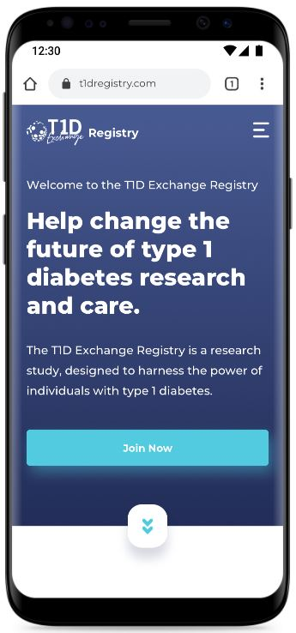
Registry Overview
Longitudinal study that seeks to create a well-characterized cohort of people living with type 1 diabetes in the US
Participants can sign up for other studies on various topics related to T1D
Goals:
  Create a well-characterized cohort of T1D patients, including underrepresented populations in research
  Improve awareness of and facilitate enrollment into T1D research studies and clinical trials
  Gather longitudinal data on disease, health status, and self-reported outcomes
  Generate evidence to support policy/insurance coverage changes that help the T1D community

Slide 9
Primary Data Collected in Registry (Patient-Reported)
Baseline Questionnaire*
Demographic
Socioeconomic
Clinical
  Age and date diagnosis
  A1C
  Care team
  Family history T1D, T2D
  Other comorbidities
Diabetes management
  Insulin brand
  Insulin delivery method & brand
  BGM/CGM use and brand
Diabetes distress
Annual Questionnaire*
Longitudinal data collection
  Selected demographic
  Selected socioeconomic
  General health information
  A1Cs
  Diabetes management
Self-reported outcomes
  DKA
  Hyperglycemic events
  Hypoglycemic events
Glucagon prescribing
Diabetes distress
* COVID-19 questions added May 2020; Diabetes distress questions added Sep 2022

Slide 10
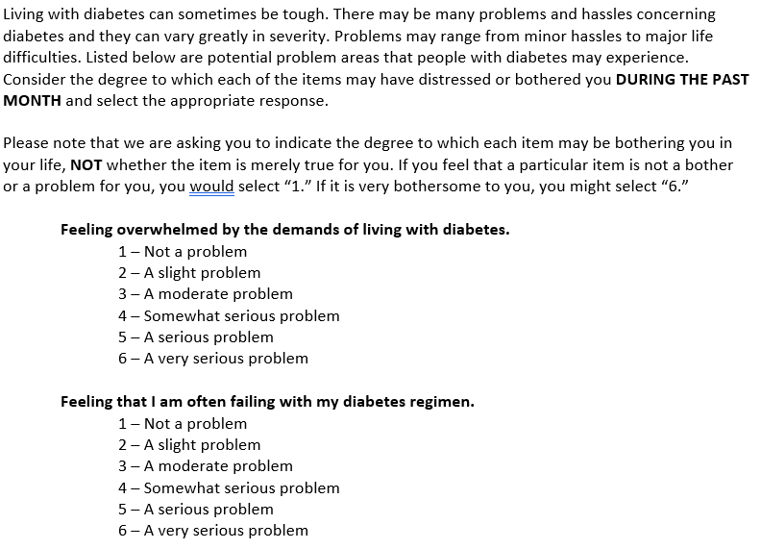
Diabetes Distress questions now in Registry questionnaires
Notes:
Outlined – will fix on Tuesday.

Slide 11
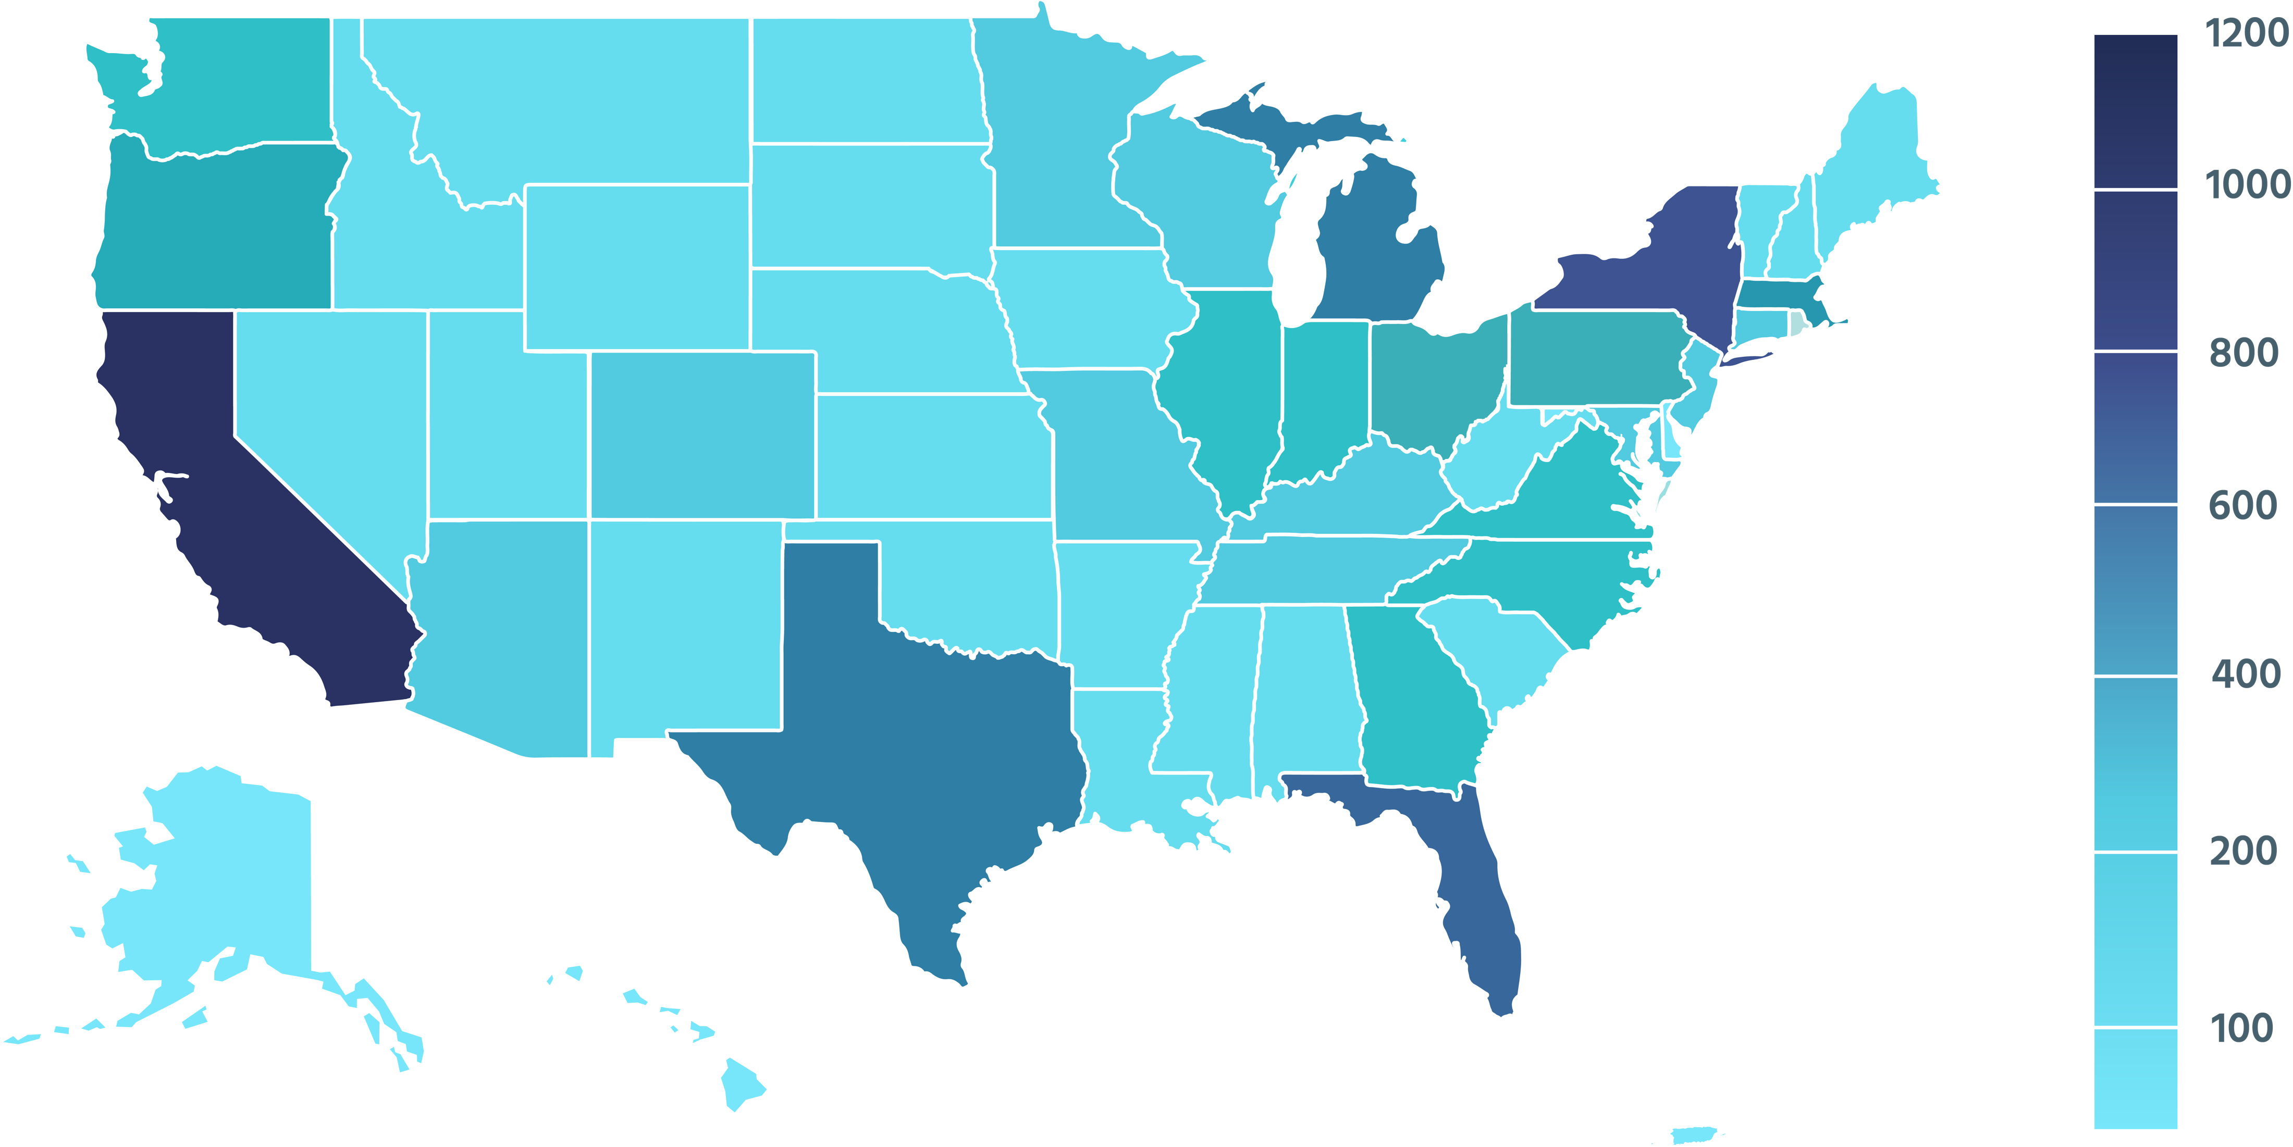
Registry Cohort Spans all 50 States and Puerto Rico

Slide 12
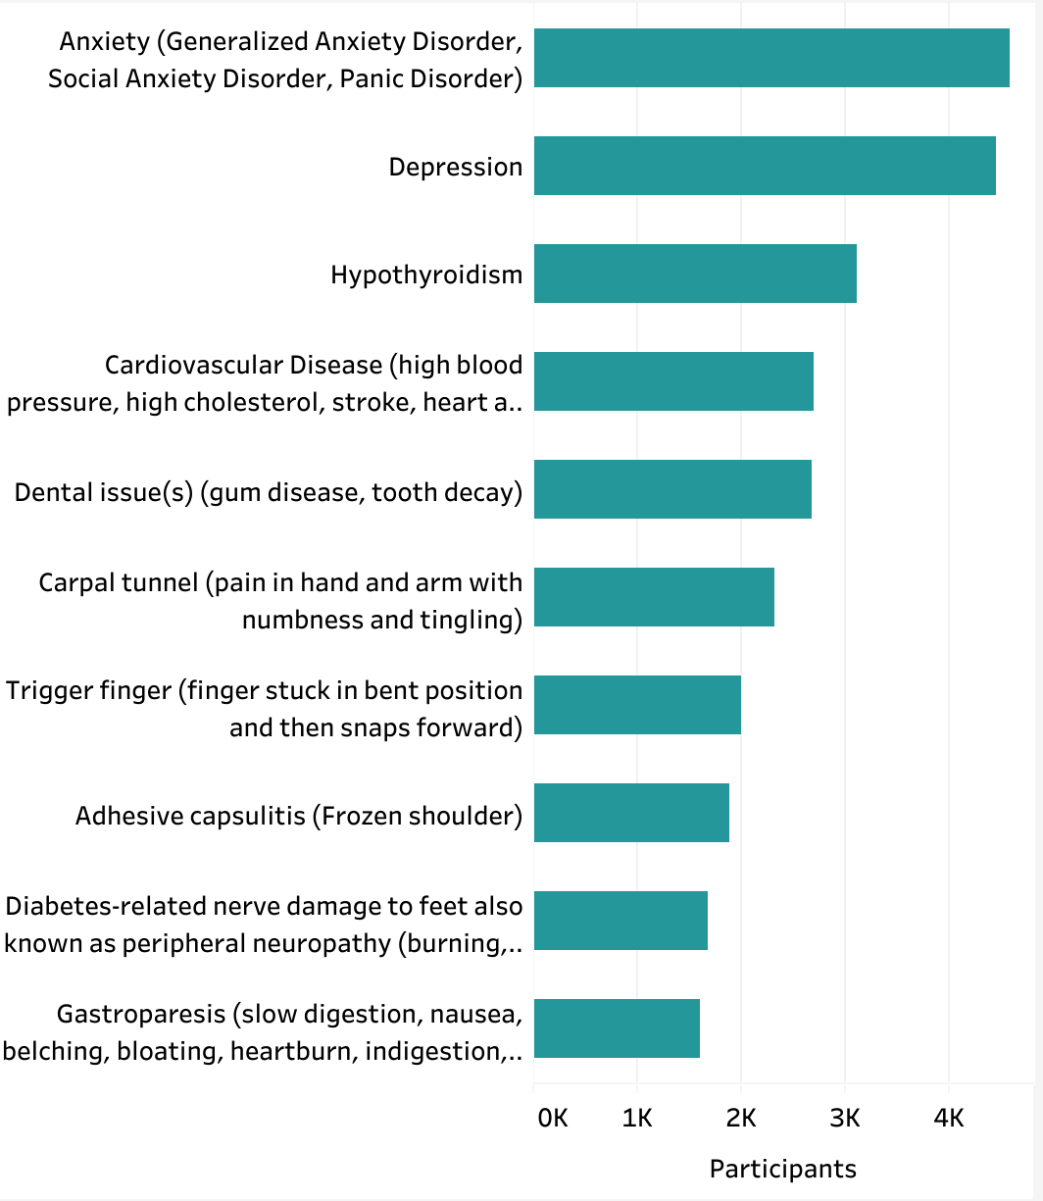
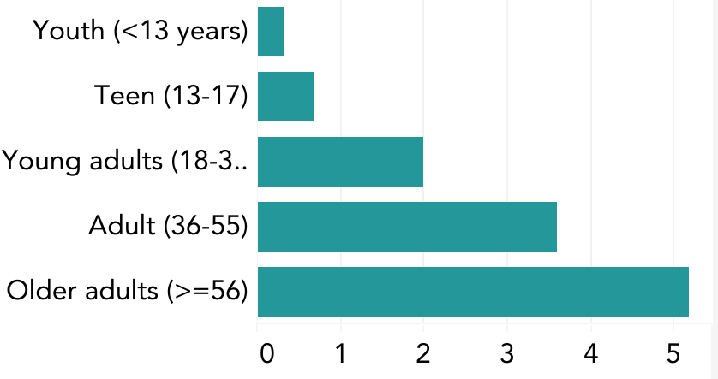
Comorbidities
Top 5 (%)
28%
27%
19%
17%
17%
Average Number of Comorbidities

Slide 13
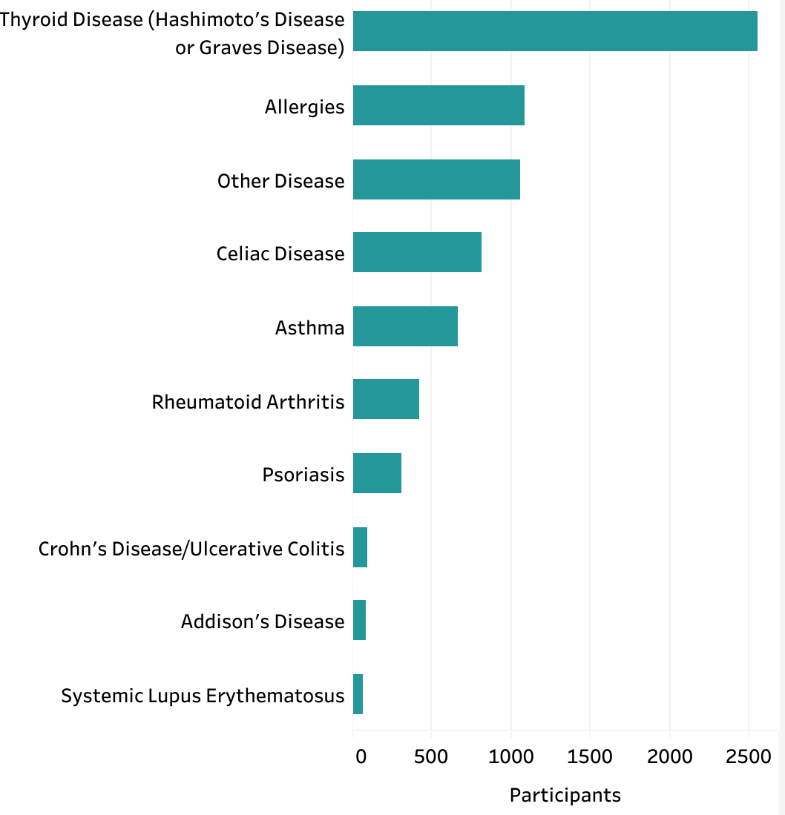
Autoimmune Comorbidities
Top 5 (%)
16%
7%
7%
5%
4%

Slide 14
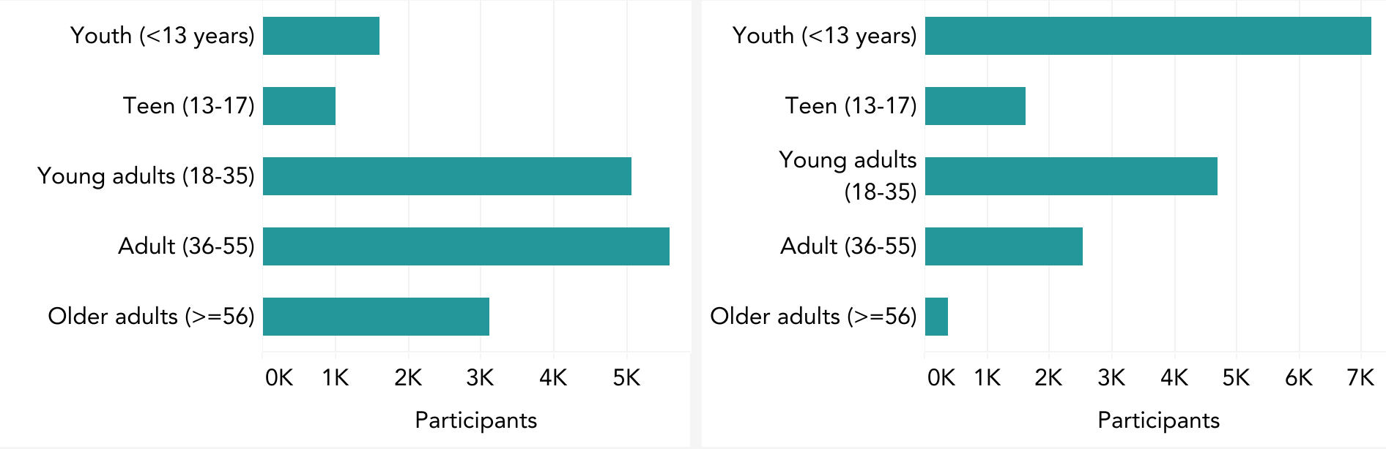
Age Breakdown
Age
Age at Diagnosis
84% are 18 or older
46% diagnosed at 18 or older

Slide 15
Custom Research
Expertise:
Interviews
Focus groups
Cross-sectional surveys
Longitudinal surveys
Mixed method design
Patient reported outcomes
CGM trace analysis linked to survey responses
Quantitative and qualitative data analyses
Abstract/publication development & presentations

Slide 16
Select Custom Sponsored Research 2022
Psychosocial experiences with severe hypoglycemia and nasal glucagon in young adults and caregivers
Development of Fear of Hypoglycemia (FOH) screener
Awareness, experience and attitudes of ”Screening” market research in T1Ds, family members and providers
Follow-on study of severe hypoglycemia and impaired hypoglycemia awareness survey and CGM analysis
Market research on glucagon use in adults
Assessment of CGM adhesives with custom survey & site photo upload

Slide 17
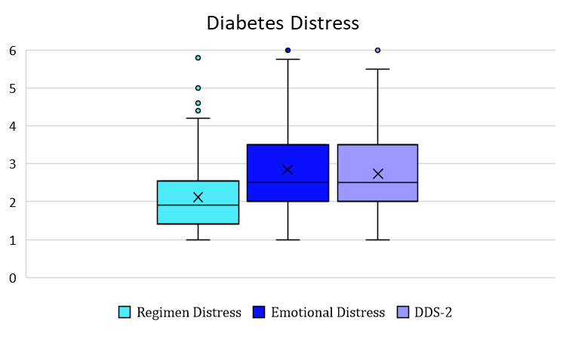
Internal Project Example: Diabetes Distress & CGM
Goal: Pilot a 2-item measure of diabetes distress in adults using CGM
  244 adults completed survey measures (fewer for CGM data capture)
Results
  Adults who use CGM still experience diabetes distress
    Average distress was ‘moderate’
    About half of individuals reported moderate or higher distress
  Brief diabetes distress scale – 2 item screener was strongly related to the longer subscales
    Indicates it is an appropriate brief measure to gauge diabetes distress
Notes:
Outlined – will fix on Tuesday.

Slide 18
Internal Project: Diabetes Distress
Impact and Next Steps
Impact
  Initial findings were presented at ADCES and generated a lot of positive interest
    Including interview and article published online with Healio
  Provided evidence to use 2-item screener in the CQ and AQ for all adult registry participants
    Increasing psychosocial data capture for adults
    Similar question was modified for Caregiver surveys (though not validated)
Next steps
  Planning for a publication
  Publication will explore:
    Benefits of the 2-item screener
    Differences in CGM metrics in people who have lower vs. higher distress
Notes:
Outlined – will fix on Tuesday.

Slide 19
Sponsored Project Summary
Primary Objectives
Among the T1D Exchange community:
To estimate the proportion of adults with T1D who have impaired hypoglycemic awareness
To estimate the proportion of adults with T1D who have experienced severe hypoglycemic events (SHEs)
To characterize glycemic outcomes as measured by HbA1c and continuous glucose monitoring (CGM) metrics

Slide 20
Key Results – Self Reported Severe Hypoglycemia
“In the past 12 months, how many times did you experience severe low blood sugars that you were unable to treat yourself and needed help from others?”

Slide 21
Key Results – CGM Derived Hypoglycemia
Level-2 hypoglycemia events:
  BG < 54 mg/dl for >=15 minutes
  Prolonged: BG < 54 mg/dl for >=120 minutes
  Annualized rate: Estimated total events per year
HCLS: Hybrid closed-loop, “insulin adjusted based on both high and low blood sugar thresholds, mealtime input needed”
Notes:
n 293 470 764 162 926

Slide 22
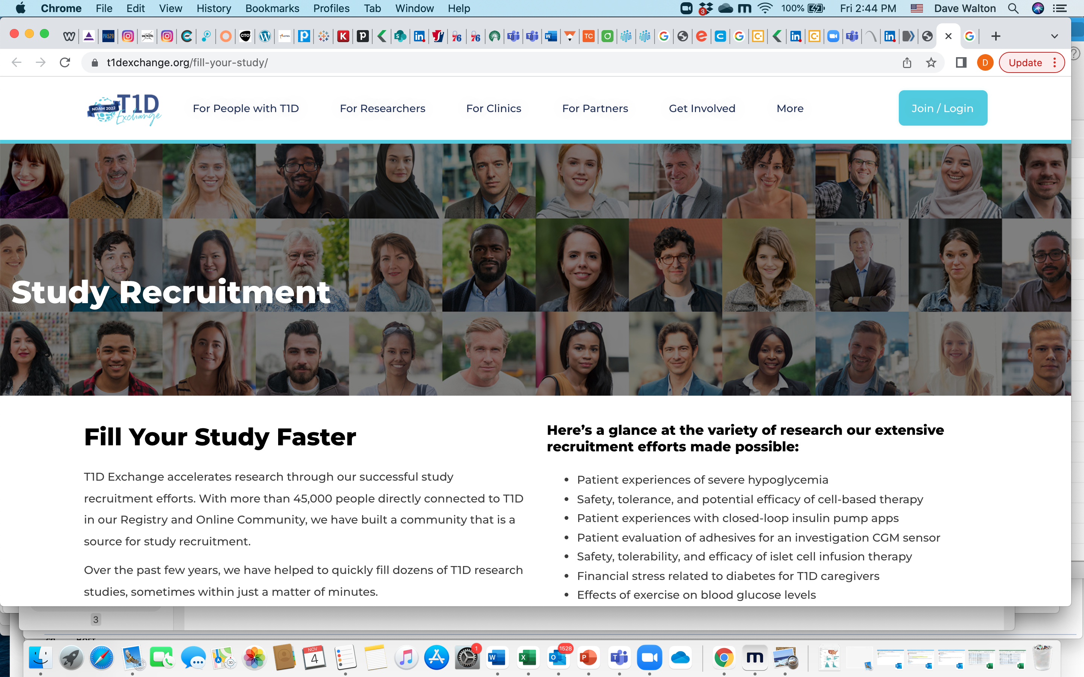
Study Recruitment Assistance
Examples:
Clinical trial of a novel biologic for newly diagnosed
Clinical trial of a cell therapy replacement for those with impaired hypoglycemia awareness
At-home CGM adhesive studies for new longer-lasting CGM sensor
At-home CGM and exercise study
Virtual participation in a global study of a closed loop system
Focus groups to understand CGM user experience

Slide 23
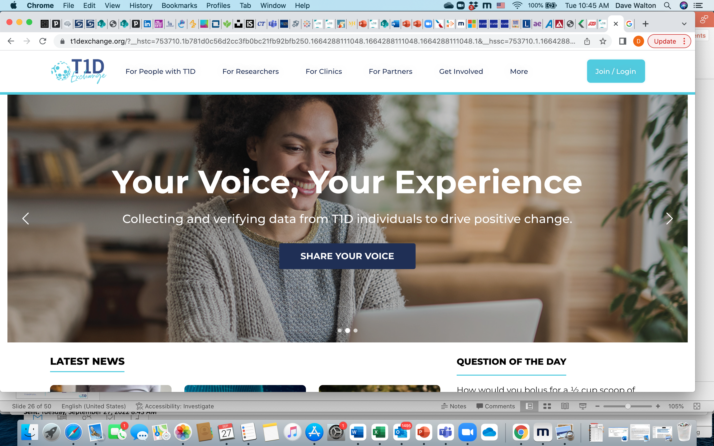
Online Community & Resources
Nearly 30,000 email addresses (75%+ are T1Ds)
More than 30,000 social media followers
Post Question of the Day
Send featured articles (for industry sponsors)
Send other articles of interest to community (product or technology overviews, reimbursement topics, etc.)
Provide resources on website (e.g., Automated Insulin Delivery review)

Slide 24
Sample QOTDs on AID use
If you use an insulin pump, is it an “automated insulin delivery” system? (August 2022)
Yes: 63% (n=296)
No: 20% (n=95)
I do not use an insulin pump 16% (n=73)
If you use both an insulin pump and CGM, do you currently use any of the following automated insulin delivery (also known as “predictive low glucose suspend” or “hybrid closed loop”) algorithms to help keep your glucose in-range? (March 2022)
Medtronic SmartGuard (Suspend): 2% (n=9)
Medtronic SmartGuard Auto Mode: 9% (n=47)
Omnipod 5 SmartAdjust : 0% (n=2)
Tandem Basal-IQ: 2% (n=12)
Tandem Control-IQ: 41% (n=207)
Loop / OpenAPS / AndroidAPS (not FDA-approved but available to build with certain combinations of insulin pumps and CGMs): 4% (n=21)
I use an insulin pump and CGM but I do not use an algorithm: 24% (n=121)
I do not use both an insulin pump and CGM: 17% (n=83)

Slide 25
2022 - Areas of Growth
Expanded data integration (CGM, lab, claims, EMR, other device)
Custom Registry modules (screening, product-specific, etc.)
Health economic analysis and policy / reimbursement support
Study promotion & recruitment
Expanded market research / marketing services
Health equity work
Operational assessments / real world evaluations of usage
Virtual / at-home studies and real-world data collection
T2D pilot expansion

Slide 26
Recently signed JDRF Collaboration - Screening
Develop the framework for a companion registry of individuals screened for T1D in addition to the existing T1D Exchange Registry of individuals with Stage 3 diabetes
The goal of the screening registry is to track individuals screened for T1D and to follow and collect data on those with Stage 1 and Stage 2 diabetes
We envision the registry to be a useful tool for
  Monitoring the progression to stage 3 and individual experiences through the collection of quantitative and qualitative data
  Assessing progression to Stage 3 disease
  Evaluating use of potential treatments in real-world
  Communicating monitoring guidelines
  Referral to clinics for monitoring
  Facilitating referrals to clinical trials.

Slide 27
Recently signed JDRF Collaboration - Screening (Oct)
QI Collaborative Preliminary Project
Test consensus evidence for autoantibody screening and monitoring recommendations in a real-world setting using QI
Focus on innovative operational strategies to scale center-based and remote screening approaches
Conduct pilot in two centers over 18 months to develop and test these new workflows, utilizing T1DX QIC coaching
Create a T1DX screening change package summarizing findings and tools for use in the clinical setting

Slide 28
Thank you to our partners and collaborators!
Funding Partners/ Collaborators
Industry Members / Collaborators
The Leona M. and Harry B. Helmsley Charitable Trust
JDRF
American Association of Diabetes Care & Education Specialists
American Diabetes Association
Children with Diabetes
College Diabetes Network
Abbott Diabetes Care
Abvance Therapeutics
Admetsys
Bigfoot Biomedical
Dexcom
Glooko
Intuity Medical
Janssen
Lilly
Lifescan
Mannkind Corporation
Medtronic Diabetes
Vertex
Xeris
Zealand

Slide 29
Thank you QIC Members!!!!!

