Slide 1




INTERVENTIONS TO IMPROVE TECHNOLOGY EQUITY IN YOUNG ADULTS WITH TYPE 1 DIABETES
Priyanka Mathias, MD and Shivani Agarwal, MD, MPH
Albert Einstein College of Medicine, Montefiore Medical Center, Bronx, NY

Slide 2
Background
Young adults (YA) are the fastest growing population with T1D
Compared to other age groups with T1D
  Higher HbA1c
  Higher hospitalization rates
  Psychiatric comorbidity
  Increased Mortality
Lowest users of diabetes technology despite known benefits
Disparities in technology use exist despite adjusting for differences in SES and insurance
Agarwal et al. Racial-Ethnic Inequity in Young Adults, J Clin Endocrinol Metab. 2020 Aug

Slide 3
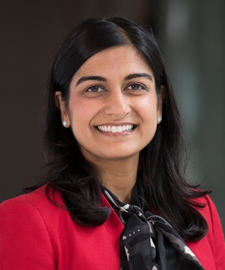
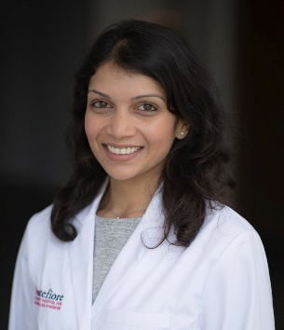
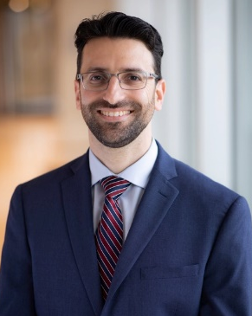
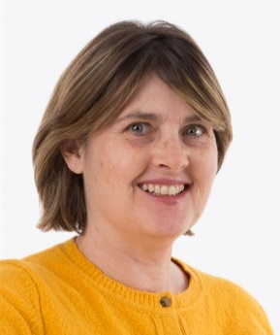
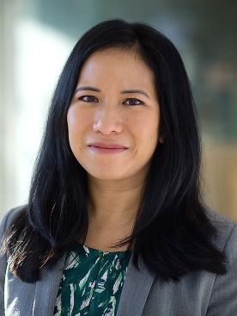
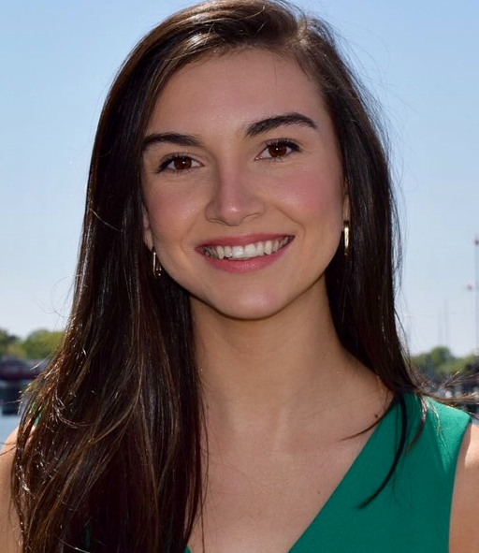
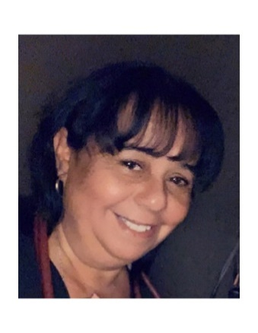
SEAD Program
Background
Developed in 2019 in an underserved medical center in New York
Comprehensive program dedicated to caring for YA with T1D
Age: 18-35 years
Transition from pediatric diabetes care
Multidisciplinary team
Technology forward care, social needs support, nutrition education, and psychological support
Shivani Agarwal
MD, MPH
Priyanka Mathias
MD
Michael Greenberg
NP
Sharon Movsas, Dietician
Stephanie Leung
Psychologist
Molly Finnan
Program
Manager
Lourdes Lebron
Social Needs Coordinator

Slide 4
SEAD: Model of Care
Continuing Education
Orientation to Adult Care
Behavioral Support
SEAD goals
Talk to patients
Equity focus
Manage expectations
Build people up, emphasize positives
Manage negatives
Avoid doomsday talk
SEAD Program Model
Care Coordination
Engagement in Care
Pediatric Partnership
Agarwal et al. Diabetes Educator 2016
Notes:
The program care model

Slide 5
Evolution of SEAD
2018
2019
2020
2022- present
2021
Established SEAD at Albert Einstein-Montefiore
Md and NP
Addition of RD and Psychology
Endocrine Trainees
Additional MD
Social Needs Coordinator
Device trials
Expansion of diabetes tech program
Joined T1D Exchange QIC
Patient advisors
Initiation of a CHW care model

Slide 6
Objectives
As part of the T1Dx QI collaborative Health Equity project, we retrospectively examined CGM and Insulin Pump (IP) prescription rates for young adults with T1D, 18-35 years
Study period: January 2019-December 2021
Examined whether a specialty young adult T1D clinic impacted technology prescriptions over time

Slide 7
Methods
Inclusion criteria
  Type 1 Diabetes (defined by ICD-10 codes)
  Age 18-35 years
  At least one visit (in-person/telemedicine) with Endocrine in the past 12 months
Monthly CGM/IP prescription data from EMR
  Numerator: number of people prescribed CGM/IP in the reporting month
  Denominator: number of total T1D patients seen by endocrine in the same month
Joined the T1D Exchange QI collaborative in 2021
Mid stage evaluation of our clinical interventions over the past two years
Collaborated with IT for data mapping

Slide 8
Results
Participant Characteristics: January 2019-December 2021
Overall | N=253 YA
Age | 23 years
Female (%) | 53%
Race/Ethnicity % (n) Hispanic Non-Hispanic Black White Other/Unknown | 55% (139) 22% (56) 10% (25) 13% (33)

Slide 9
Overall | 31% → 69%, p<0.001
Hispanic | 12.5 → 71%
NHB | 33 → 55%
White | 33→ 75%
Notes:
Overall, CGM prescription rates increased from 31% to 69% (p<0.001)
Equal improvements in Hispanic (12.5 to 71%) and NHB (33 to 55%), compared with White (33 to 75%)
Disclaimer: White date, numbers few so data initially not shown

Slide 11
Overall | 6.3% (Feb 2019) → 31%
Hispanic | 0 → 39%
NHB | 0 → 37%
White | 0→ 17%
Notes:
Equal Improvements seen in Hispanic (0 to 39%), NGB (0-37%) compared to White (0 to 17%)

Slide 13
Conclusions
Tailored programs for YA with T1D that address equity can improve technology uptake
Future studies are needed to examine the long-term impact on care engagement measures and patient-reported outcomes
As a participating site in the T1DX-QIC
  Continue working on interventions to maintain technology prescriptions
  Focus on translation to actual patient use
  Shared learnings with collaborative

Slide 14
THANK YOU
T1Dx QI collaborative and Helmsley Charitable Trust
Dr. Shivani Agarwal
Dr. Jill Crandall
Fleischer institute for Diabetes and Metabolism and our diabetes providers
SEAD program
Nursing staff
Patient advisors

Slide 15

Increasing accessibility to CGM in an equitable fashion
Blake Adams, BSN; Jayme Wasson, BSN; Kathryn Sumpter, MD; Grace Nelson, MD;
University of Tennessee Health Science Center and LeBonheur Children’s Hospital

Slide 16
Introduction
Our mission at Le Bonheur Diabetes Clinic is to partner with families to aid them in finding the best ways to manage their Diabetes.
Technology has shown to improve overall outcomes, specifically continuous glucose monitoring (CGM).Unfortunately, the process in still limited by insurance qualifications and a lengthy authorization process.
Our AIM is to reduce the Inequities in CGM use between NH White and NH Black T1D Patients by increasing CGM use in NH-Black patients from 35% to at least 45% by June 2022 and by decreasing the use difference by 10% in that same timeframe

Slide 17
Methods
A CGM champion was identified and created a streamline process for initiating CGM to prevent extra work on staff and delays for patients receiving the device.
Relationships were formed with DME company and a patient education folders with up-to-date information for our families were created.
We worked with staff to increase knowledge of CGM and utilized smartext to make sure all orders were entered and trackable documentation.
Staff attended bias training.
Future changes include changing the new onset education process to be sure all patient have equal access to CGM and working to change insurance requirements

Slide 18
Equity Project KDD (CGM)
Change Ideas
Equity/unconscious bias training Present clinic date to staff to show disparity
Aim
Primary Drivers
LBCH will increase use of CGM in Black T1D Patients from 35% to 45% by June 2022.
LBCH will reduce the difference in CGM use between NHW and NHB patients by 10%.
LBCH will increase use of CGM in the clinic by 10% by June 2022.
Have SW work with Black and NHB patients to address SDOH
Utilize community outreach staff to help families with some of the more difficult steps
Equity/SDOH
Create CGM education folder and keep updates
Partner with Dexcom to provide families with virtual training
Have staff attend Dexcom training session
Education/Training
Policies/Insurance
Tracking insurance forms/refills/initial starts
Create process for CGM start based on insurance type
CGM champion create workflow for CGM initiation
Provide contact information for device reps/patient support
Write letter to Insurance company to advocate for better coverage of CGM
Create CGM message pool and new CGM order
Access
Require patients to provide logs at initiation if insurance requires
FAQ, clinic and rep contact , troubleshooting, alarm guide education sheets provided
“CGM champion” to help follow up with family
Create process for Inpatient CGM start for patients <5yo.
Train staff on how to apply Dexcom while in clinic
Communication/
Shared decision
Provide contact info to families at initiation
My Diabetes Journey
Standardized documentation n EMR

Slide 20
Results
Baseline data (Jan2021) showed that ~35% of our NH black patients used CGM regularly as of July 2022 we now have ~55% of NH-black patients using CGM.
Our overall clinic CGM use has increased from ~50% to ~70% in this same timeframe

Slide 22
Conclusion
Overall, we have seen improvement in our percentage of Non-Hispanic Black patients and overall patient population that are utilizing the CGM. We haven’t reached our goal of reducing the use differences between black and white populations but continue to improve our processes and work towards our goal.
The most useful change was creating a CGM champion that is able to track all patients to be sure of success

Slide 23
References
Mathias P, Mahali LP, Agarwal S. Targeting Technology in Underserved Adults With Type 1 Diabetes: Effect of Diabetes Practice Transformations on Improving Equity in CGM Prescribing Behaviors. Diabetes Care. 2022 Oct 1;45(10):2231-2237. doi: 10.2337/dc22-0555. PMID: 36054022.
Bailey R, Donthi S, Markt S, Drummond C, Cullen J. Evaluating Factors Associated With Continuous Glucose Monitoring Utilization With the Type 1 Diabetes Exchange Registry. J Diabetes Sci Technol. 2022 May 3:19322968221091299. doi: 10.1177/19322968221091299. Epub ahead of print. PMID: 35506181
References :
Mathias P, Mahali LP, Agarwal S. Targeting Technology in Underserved Adults With Type 1 Diabetes: Effect of Diabetes Practice Transformations on Improving Equity in CGM Prescribing Behaviors. Diabetes Care. 2022 Oct 1;45(10):2231-2237. doi: 10.2337/dc22-0555. PMID: 36054022.
Bailey R, Donthi S, Markt S, Drummond C, Cullen J. Evaluating Factors Associated With Continuous Glucose Monitoring Utilization With the Type 1 Diabetes Exchange Registry. J Diabetes Sci Technol. 2022 May 3:19322968221091299. doi: 10.1177/19322968221091299. Epub ahead of print. PMID: 35506181.

Slide 24
Questions?
Thank you!

Slide 25
Continuing improvement of health equity: use of continuous glucose monitoring technology among youth with type 1 diabetes
Kajal Gandhi, DO, MPH; Kathryn Obrynba, MD;
Justin Indyk, MD, PhD
Site Principal Investigator: Manmohan Kamboj, MD
QI Coordinator: Don Buckingham, MBOE; CPHQ
T1D Exchange Collaborative Learning Session
November 2022
The Center for Clinical Excellence

Slide 26

Project Intention
“Leading the Journey to Best Outcomes for Children Everywhere” summarizes Nationwide Children’s Hospital strategic plan
One major outcome of this strategy includes robust quality and safety initiatives achieved through our Center of Clinical Excellence (CCE)
This improvement project works to improve clinical outcomes and improve patient equity for CGM and pump technology access/utilization among our diabetes patient population

Slide 27
Project Background
The use of continuous glucose monitors (CGM) has been shown to have improved glycemic control in children and adolescents, and improve diabetes related distress and quality of life
Disparities exist in access to diabetes technology, in which racial/ethnic minorities have consistently lower CGM utilization, which may affect diabetes outcomes
Laffel, et al, JAMA 2020
Sinisterra et al 2021
Franceschi, et al 2021
Foster et al, 2019
Lipman, et al 2021
Lai, et al 2021

Slide 28
KEY QUALITY INITIATIVE:
Increase insulin pump and CGM equity ratio between T1D black/white patient populations (1:1) from 0.44 to 1 (Pump) and from 0.7 to 1 (CGM) by 12/31/2022 and sustain through 2023

Slide 29

Project Methods
Patient clinic census (among patients with T1D for ≥ 12 months) was evaluated for 22 months
  NEW CGM Uptake
  Continued CGM Utilization
“CGM Uptake Ratio” was calculated, defined as:

Slide 30
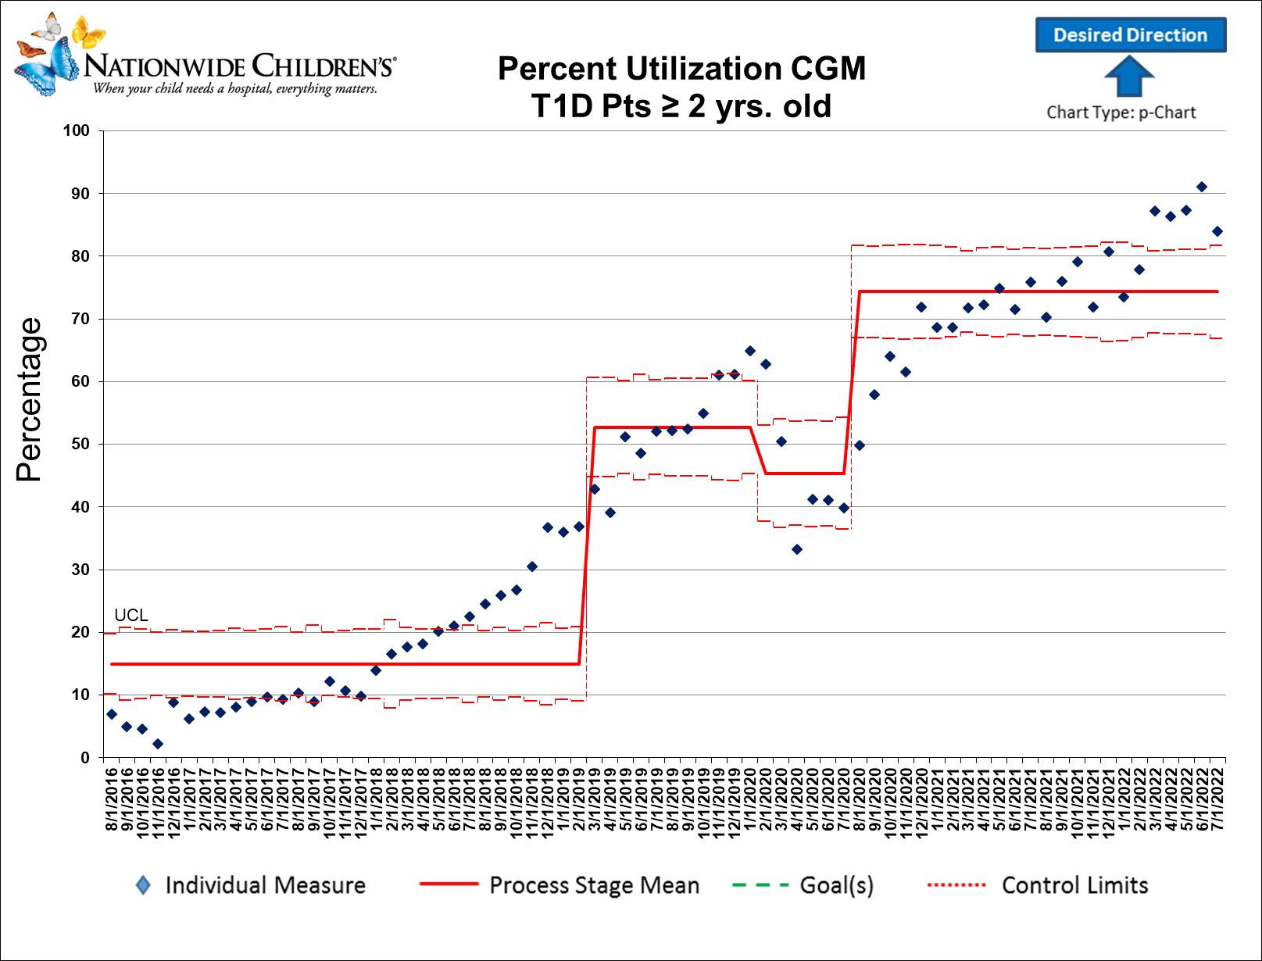

Slide 31
CGM Disparity
# People out of 100 having CGM in general population | # People in Groups having CGM per 100 | # People Difference, out of 100, Compared to Population who received CGM
61.82 | 66.22 | 4.40
61.82 | 42.74 | -19.07
61.82 | 52.78 | -9.04
61.82 | 75.00 | 13.18
61.82 | 62.87 | 1.06
61.82 | 42.86 | -18.96
Normalized the aggregate 9-month clinic population (not unique patient count)
Green = more than average
Red = fewer than average = opportunity!
CGM Use | 9 | 39 | 57 | 105 | 268 | 1876
Population | 21 | 52 | 108 | 167 | 627 | 2833
Revised 8.12.2021

Slide 32
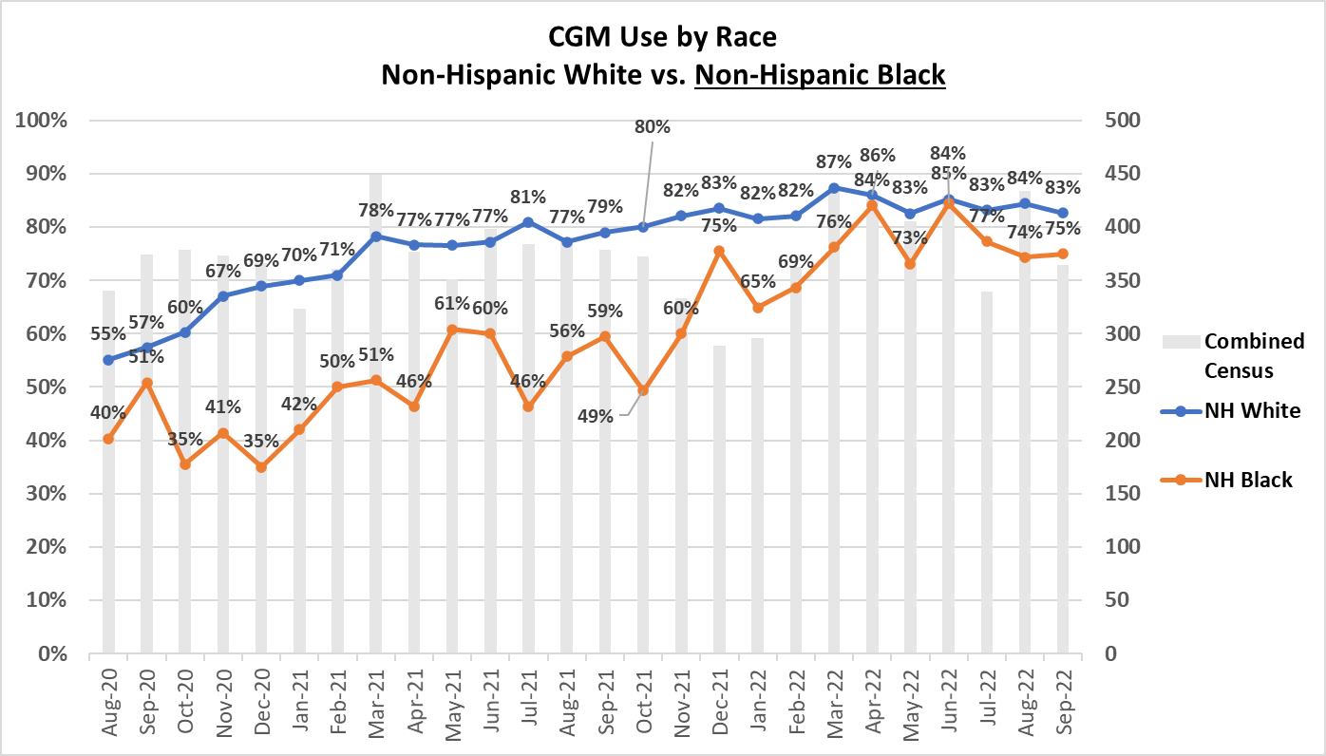

Slide 33
Improving T1D Healthcare Equity
Kajal Gandhi, DO, MPH; Ming Chan Hong, MSW, LSW; Manmohan Kamboj, MD
QI Coordinator: Don Buckingham, MBOE; CPHQ
Interventions
-- Standardize criteria and educational documents for CGM and pump initiation for providers and patients
-- Possible Best Practice Alert reminder
-- Ongoing pump and CGM patient education
What stands in the way, is the way!
Aim
Key Drivers
Increase insulin pump and CGM equity ratio between T1D black/white patient populations (1:1) from 0.44 to 1 (Pump) and from 0.7 to 1 (CGM) by 12/31/2022 and sustain through 2023
Provider Assessment
of Patient Capabilities
-- Verbal translation services available in clinic and during telehealth visits
-- Clear understanding and implementation of attendant social determinants of health (both +/-)
Verbal and Written Language Comprehension
-- Translation of written education curriculum and after-visit instructions
-- Translation of pump supplier instructions
Variation in:
1) Appointment Schedule;
2) Staff Availability; and
3) Clinic Uptake Process
1) Measure and assess improvement opportunities in clinic flow when needing translation services
2) Measure and assess staff availability & allocation to CGM and Pump education, for feedback to management
3) Standardize appointment process for CGM/Pump initiation
4) Standardize clinic uptake process and eliminate “8 wastes” in procedures
Global Goal:
Improve healthcare equity
among T1D patients
Full Closed Loop Technology Availability/Access to Technology
-- Improved time in range / A1c disparity advocacy
--Early access to CGM at T1D diagnosis through sample program
Key:
Complete
In Process
Pending

Slide 34
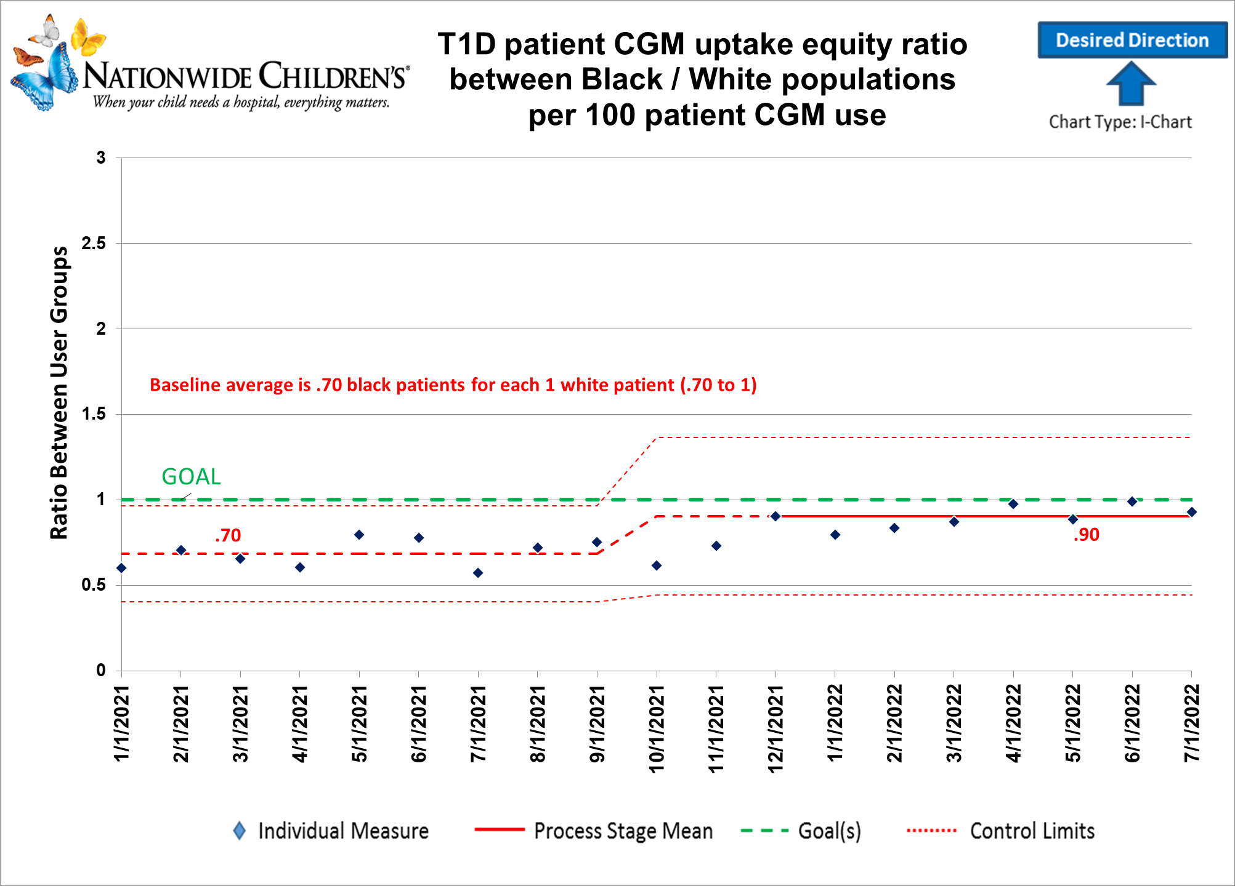

Slide 35
Thank you
Questions/Discussion

Slide 36
2021 T1D Exchange QI Clinic Practice Survey: Clinic Staffing and Structure for Adult and Pediatric Diabetes Clinics
November 2022

Slide 37
Abstract Authors
Mary Pat Gallagher¹, Emma Ospelt², Nicole Rioles², Ruth Weinstock³, Devin Steenkamp⁴, Grazia Aleppo⁵, Elizabeth Mann⁶, Sonya Haw⁷, Jennice Wong⁸, Osagie Ebekozien²
Affiliations: 1) Hassenfeld Children’s Hospital at NYU Pediatrics; 2) T1D Exchange; 3) SUNY Upstate Medical Center; 4) Boston Medical Center; 5) Northwestern University; 6) University of Wisconsin; 7) Grady Memorial Hospital; 8) University of California San Francisco Pediatrics

Slide 38
Background
Data collected in 2015 by the T1D Exchange reported significant disparities in staffing between adult and pediatric diabetes centers, including that social workers and psychologists were available at only 42% of adult diabetes clinics compared to 87% of pediatric sites.
Staff | Pediatric |  | Adult |  | p-values
 | Mean Ratio | SD | Mean Ratio | SD
Physician | 1:171 | 1:93 | 1:218 | 1:116 | 0.63
Nurse Practitioner | 1:347 | 1:93 | 1:647 | 1:192 | <0.001
Certified Diabetes Educator | 1:58 | 1:19 | 1:161 | 1:57 | <0.001
Registered Dietician | 1:379 | 1:177 | 1:797 | 1:133 | <0.001
T1D staff FTE to patient ratios of pediatric vs. adult
diabetes clinics in the T1D Exchange in 2015
Agarwal S., et al. (2018). Comparison of Adult and Pediatric Resources for Type 1 Diabetes Care among T1D Exchange Centers. Diabetes 67(Supplement_1).

Slide 39
Update on staffing in adult and pediatric diabetes clinics
Goals
  Reassess the status of staffing at diabetes clinics across the country
  Compare adult versus pediatric staffing in different disciplines in T1DX-QI diabetes clinics

Slide 40
Methods
Surveys collected from October 5th to November 19th, 2021
34 T1DX-QI sites (25 pediatric, 9 adult)
Full-time equivalents (FTEs) of different disciplines reported
Data were cleaned and analyzed in R studio
FTEs of diabetes team members (per 1000 patients) were compared in adult vs. pediatric sites using T-tests
Differences in support staff, weekend, and evening staff between pediatric and adult sites were also evaluated

Slide 41
Total FTE of Diabetes Team Members among Pediatric and Adult Clinics in the T1DX-QI
Total FTE of Diabetes Team Members | Total Average FTE N=34 | Pediatric Clinic Average N=25 | Adult Clinic Average N=9 | Per 1000 Pediatric Diabetes Patients Average [SD] | Per 1000 Adult Diabetes Patients Average [SD] | p-value^ Ped vs Adult (per 1000 patients)
MD/DO | 7.87 | 8.0 | 7.6 | 3.6 [2.4] | 1.6 [1.5] | 0.001
NP/PA | 3.31 | 3.4 | 3.1 | 1.5 [0.8] | 0.7 [0.6] | 0.003
Social Worker | 1.63 | 2.0 | 0.5 | 0.9 [0.6] | 0.09 [0.2] | <0.001
RN | 4.59 | 5.3 | 2.7 | 2.3 [1.7] | 0.5 [0.8] | <0.001
CDCES | 6.32 | 7.3 | 3.8 | 3.3 [1.7] | 0.8 [1.1] | <0.001
Psychology | 0.7 | 0.8 | 0.3 | 0.4 [0.4] | 0.06 [0.2] | 0.003
^T-test

Slide 42
Support Staff among Pediatric and Adult Clinics in the T1DX-QI
Additional support/support personnel in place | Total (N=33 clinics) | Percent (%) | Peds N [%] N= 25 | Adult N [%] N= 9 | p-value^ (Pediatric % vs Adult %)
Community health workers/collaborators [Yes] | 6 | 18.2 | 4 [16] | 2 [22] | 0.6
Patient navigators [Yes] | 9 | 27.3 | 7 [28] | 2 [22] | 1.0
Parent partners [Yes] | 9 | 27.3 | 9 [36] | 0 | N/A
Inpatient diabetes education [Yes] | 25 | 75.8 | 18 [72] | 7 [78] | 1.0
Pharmacy [Yes] | 17 | 51.5 | 12 [48] | 5 [56] | 1.0
Diabetes-specific Medical Assistants [Yes] | 14 | 42.4 | 10 [40] | 4 [44] | 1.0
Child Life [Yes] | 18 | 54.5 | 17 [68] | 1 [11] | 0.005
^Fisher test

Slide 43
Weekend coverage among Pediatric and Adult Clinics in the T1DX-QI
Roles managing diabetes patients on weekends/evenings | Total Adult and Pediatrics N [%] | Pediatrics N [%] | Adult N [%] | p-value ^ Pediatric % vs Adult %
Fellows with Attending support [Yes] | 30 [90.9] | 22 [88] | 8 [89] | 1.0
On-Call provider [Yes] | 17 [51.5] | 15 [60] | 2 [22] | 0.12
NP/PA [Yes] | 3 [9.09] | 4 [16] | 0 | N/A
^Fisher test

Slide 44
Disparities: T1D Exchange 2015 vs T1DX-QI 2021
2015 Staffing | Pediatric Mean Ratio | Adult Mean Ratio | Disparity Factor
Physician | 1:171 | 1:218 | 0.78
Nurse Practitioner | 1:347 | 1:647 | 0.54
CDCES | 1:58 | 1:161 | 0.36
2021 Staffing | Pediatric Mean Ratio | Adult Mean Ratio | Disparity Factor
Physician | 1:278 | 1:628 | 0.44
Nurse Practitioner | 1:667 | 1:1478 | 0.45
CDCES | 1:303 | 1:1250 | 0.24

Slide 45
Conclusions
New data from T1DX-QI are consistent with those collected by T1D Exchange in 2015.
Persistent staffing disparities exist between adult and pediatric clinics.
Inequities are particularly notable in behavioral health support.
Further study is warranted to see if this affects outcomes including any impact on successful transition of young adults into adult diabetes clinic settings.
There were no statistically significant differences between the type of covering weekend diabetes coverage between the pediatric and adult clinics with the majority reported a traditional model with fellow and attending coverage.
Sixteen percent of pediatric sites (and zero adult sites) reported NP participation in evening/weekend coverage, which may reflect an increased need for fellowship applicants in pediatric endocrinology.

