Slide 1
Welcome, Logistics, & Agenda
November 7, 2022

Slide 2
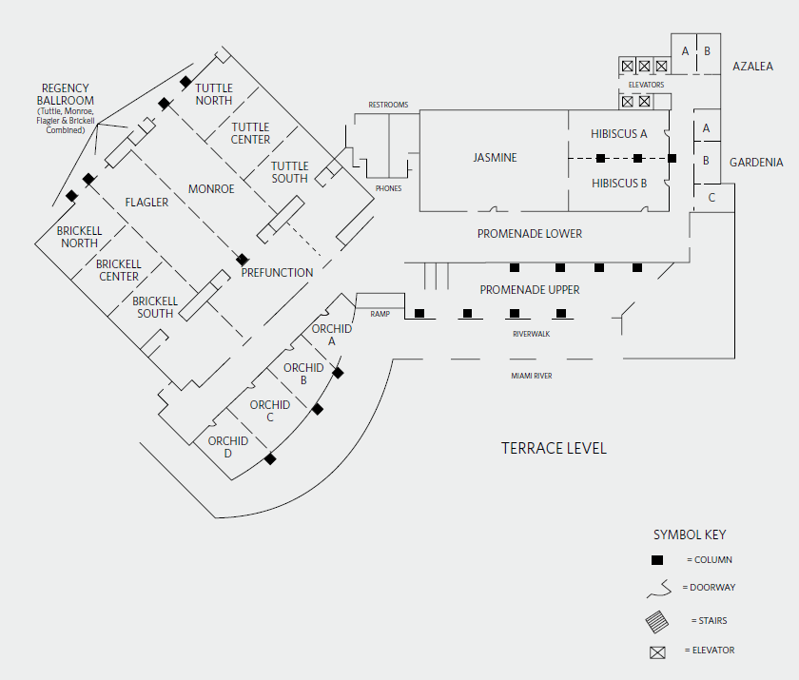
LOGISTICS
All plenary sessions are hosted in the Brickell Room, where we are sitting now. Breakout sessions will be hosted in Orchid A, B, C, and D rooms, located across the hall.

Slide 3
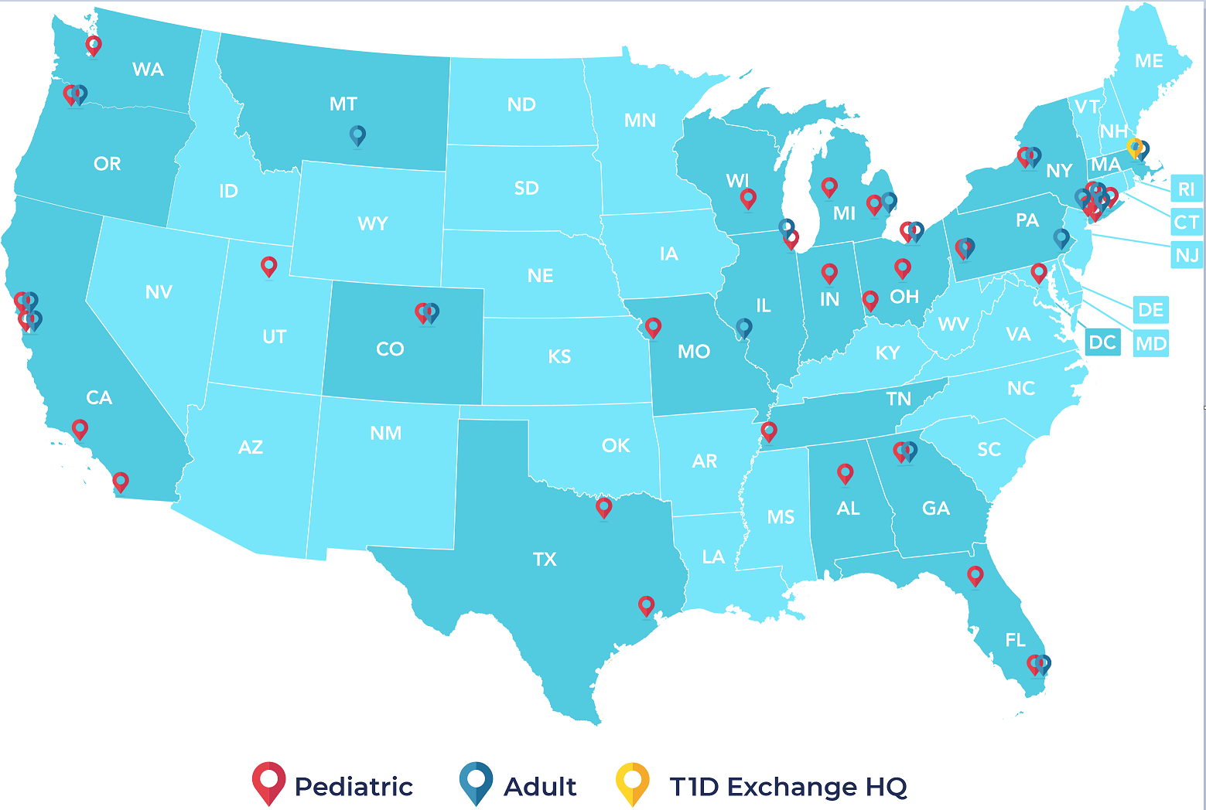
T1DX-QI network of 52 centers, caring for 80,000+ T1D patients across 21 states and Washington D.C.
Priya Prahalad, Nicole Rioles et al. T1D Exchange Quality Improvement Collaborative: Accelerating Change through Benchmarking and Improvement Science for People with Type 1 Diabetes. Journal of Diabetes. November 2021

Slide 4
































34 pediatric clinics – caring for 54,000 patients with T1D

Slide 5









20 adult clinics – caring for 28,000 patients with T1D

Slide 6
LOGISTICS
Registration Tables have been set up outside of Brickell for both Monday and Tuesday morning registration. Everyone is being asked to register separately on both days using a QR code- it just takes a minute.
Visit T1DX-QI Learning Session 2022 website to find agenda, presentations, links for CME, abstracts, FAQ. A paper copy of the agenda is also available on tables.
This learning session offers continuing education credits. CME details can be found on our website.
We encourage you to review the agenda carefully so that you can plan your breakout choices and be ready to transition to that space.
T1D Exchange staff are here to help your get the most out of these two days together. If you have any questions, please feel free to ask a member of the team.
Food Lunch is at 12:10-1:10 PM Dinner is at 6:30 PM at Marabu If you have any food allergies, restrictions, or preferences that you have not communicated yet, please contact Nudrat nnoor@t1dexchange.org.
Notes:
https://t1dexchange.org/t1dx-qi-learning-session-2022/?_hsmi=231953627&_hsenc=p2ANqtz-_USgwztn4yxkB7F_kMOMbnMJAntRfD1safrF0EjhLSd4L0yW0ZOeUCeFAp3XIGNgwh-CZcv7nu8XjyDQjgLptwCGgC1w#1633987882451-a7fee4ef-c98c%231633987882451-a7fee4ef-c98c
https://t1dexchange.org/t1dx-qi-learning-session-2022-cme-info/
https://onlinelibrary.wiley.com/journal/17530407?utm_medium=event&utm_source=exhibition&utm_campaign=JDB2&utm_content=T1DX_Conference_Banner

Slide 7
LOGISTICS: Afternoon clinic site visits
We will take three buses to tour the pediatric and adult clinics at the University of Miami Starting at 3:15 pm, we will walk outside to the buses, which will depart the hotel by 3:30 pm.
Dr. Sanchez’s team will lead the pediatrics clinic tour: 1601 NW 12th Ave, Miami, FL 33136 Dr. Vendrame’s team will lead the adult clinic tour and the Diabetes Research Institute: 1450 NW 10thAve, Miami, FL 33136
Tours will commence at 4:00 pm and end by 4:50 pm Buses will depart the medical campus (1150 NW 14th St, Miami, FL 33136) and return to the Hyatt
Collaborative Dinner and Award Ceremony at Marabu, 701 S. Miami Ave, Brickell City Center, 4th Floor, Miami, FL 33131, Monday evening 6:30-8:30PM Restaurant is within walking distance of the hotel (<15 min walk) Please contact Holly hhardison@t1dexchange.org if you would like to sign up for a non-walking travel option

Slide 8
ZOOM LOGISTICS
1. Mute yourself when you're not talking. Everyone defaults as muted.
2. We’d love to see you! When appropriate, keep your camera on. If you need to drop off, stop video and mute before leaving, but keep Zoom on.
3. Presenters can display and advance their own slides. Today’s presentations are on the website.
4. Please introduce yourself by name and affiliation, using the chat feature.
5. We encourage questions, comments, reflections throughout the conference using chat.
6. Please change you name in Zoom to display your first name, last name + affiliation by clicking the 3 dots to the right of your camera.

Slide 9
ZOOM LOGISTICS
Time is set aside for personal breaks. You can also stay in Zoom and chat with colleagues.
8. A T1D Exchange Zoom facilitator will communicate chat comments and questions to the in-person session discussions.
9. Everyone must select a breakout when the breakout rooms are displayed. If you step away from your computer when breakout options are displayed, you will be placed in a room.
10. This learning session offers continuing education credits. CME details can be found on our website
11. Visit T1DX-QI Learning Session 2022 website to find agenda, presentations, links for CME, abstracts, FAQ
12. T1D Exchange staff can be identified as NAME_T1D and they can help with any technical difficulties.
Notes:
https://t1dexchange.org/t1dx-qi-learning-session-2022/?_hsmi=231953627&_hsenc=p2ANqtz-_USgwztn4yxkB7F_kMOMbnMJAntRfD1safrF0EjhLSd4L0yW0ZOeUCeFAp3XIGNgwh-CZcv7nu8XjyDQjgLptwCGgC1w#1633987882451-a7fee4ef-c98c%231633987882451-a7fee4ef-c98c
https://t1dexchange.org/t1dx-qi-learning-session-2022-cme-info/
https://onlinelibrary.wiley.com/journal/17530407?utm_medium=event&utm_source=exhibition&utm_campaign=JDB2&utm_content=T1DX_Conference_Banner

Slide 10
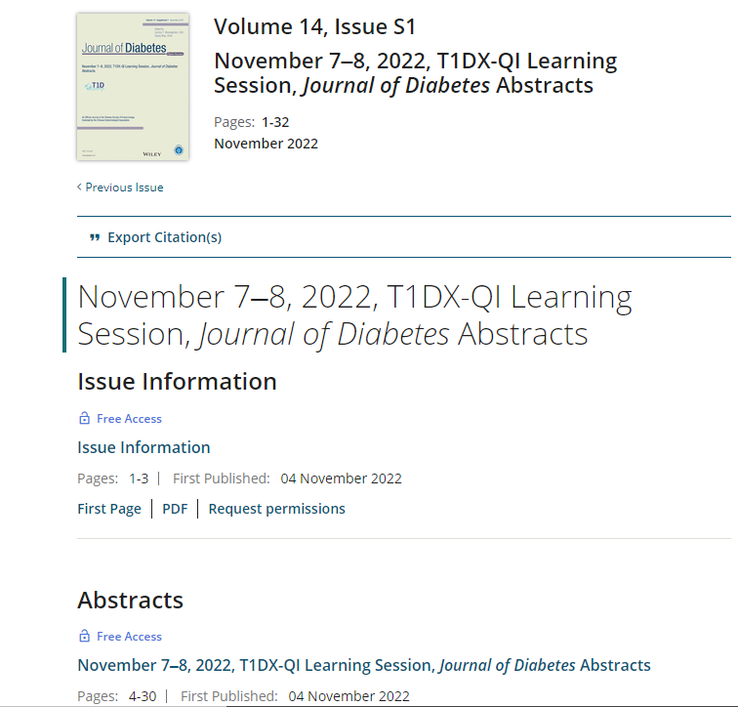
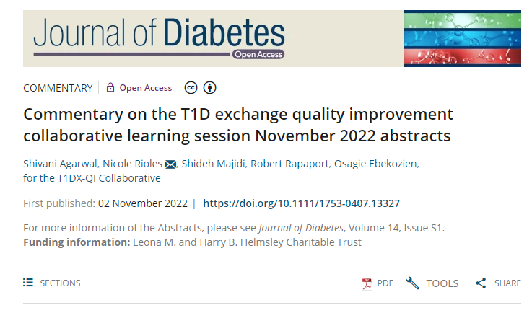
Journal of Diabetes Commentary & Supplement
https://onlinelibrary.wiley.com/toc/17530407/2022/14/S1?utm_medium=event&utm_source=exhibition&utm_campaign=JDB2&utm_content=T1DX_Conference_Banner
Notes:
https://onlinelibrary.wiley.com/toc/17530407/2022/14/S1?utm_medium=event&utm_source=exhibition&utm_campaign=JDB2&utm_content=T1DX_Conference_Banner

Slide 11
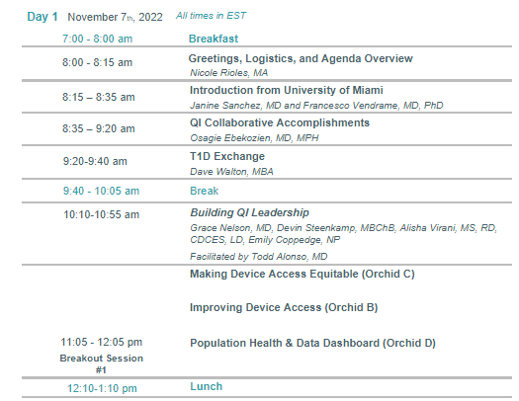
Monday November 7th Agenda, Morning

Slide 12
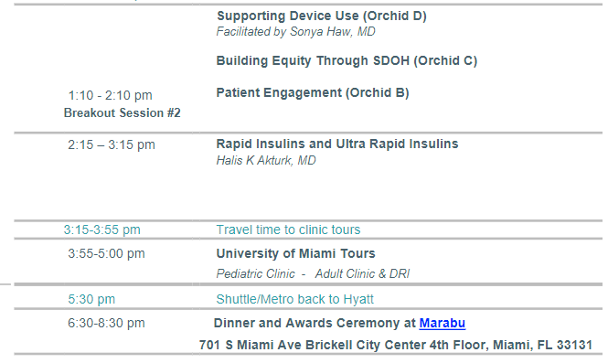
Monday November 7th Agenda, Afternoon

Slide 13
Educational Objectives
At the conclusion of this activity, learners should be able to:
1. Describe the future of novel therapies, interventions, quality improvements, and solutions to today’s diabetes care challenges.
2. Identify gaps in population health needs and state 3 ways that they can provide more equitable care over the next 2 years
3. Apply the strategies of the T1DX-QI Equity Framework which can help to improve diabetes health outcomes and increase diabetes device access for BIPOC T1D and T2D patients
4. Discuss expectations for patient care and patient engagement and describe ways to co-design care with patients and family members.

Slide 14
Continuing Education Credits

Slide 15

Course Evaluation & Certificates
Within 5 business days after the webinar, participants will receive an email to log in to the Boston University CME portal (web) to complete the course evaluation.
Within the web portal, you will be asked to attest to your hours of participation. Upon completion of the evaluation and attestation, your transcript will be updated with the appropriate accreditation hours and your certificate will be made available for download.

Slide 16
CME/NCPD credit will be awarded to those that attend the 13.5-hour program and complete the evaluation.
1. Navigate to: https://cme.bu.edu/content/t1dx-qi-learning-session-2022-1172022-1182022
2. Create a new account or log in to complete the components
3. Click the register or take course button to proceed.
4. Click on the start course button on the bottom of the page to start the evaluation.
5. Learners should claim only the credit commensurate with the extent of their participation in the activity.
6. Follow the red prompts to claim your certificate.
For questions about CME, please contact cme@bu.edu
How to Claim Education Credit

