Slide 1
Artificial Intelligence Decision Support Enhances Engagement and Integration with Home Diabetes Care
Gajanthan Muthuvel, MD^{1,3}, Siobhan Tellez, MSN, APRN-CNP¹, Katherine Bowers, PhD, MPH¹⁻³, Patrick Brady, MD, MSc³⁻⁵, Nancy Daraiseh, PhD⁵, Jane Khoury, PhD¹⁻³, Emily Smith¹, Amanda Sylvester, MSN, APRN-DNP¹, Sarah Corathers, MD^{1,3,5}
Cincinnati Children’s Hospital Medical Center, University of Cincinnati College of Medicine
Division of Endocrinology
Division of Biostatistics and Epidemiology
University of Cincinnati, Department of Pediatrics
Division of Hospital Medicine
James M. Anderson Center for Health Systems Excellence
Financial support was provided by Place Outcomes Research Award, Cincinnati Children’s Hospital
Study team acknowledges partnership with DreaMed Diabetes and T1Dx-QI Collaborative
Notes:
Pictures?

Slide 2
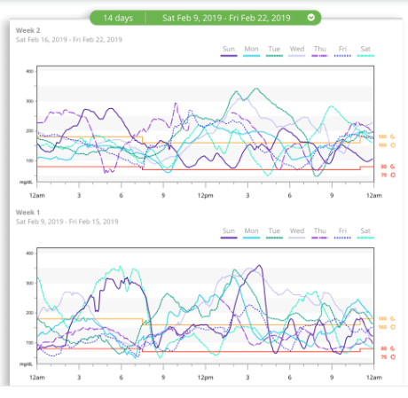
Background
>80% of youth with T1D do not meet glycemic targets¹
Cincinnati Children’s Hospital mean HbA1c 8.7%
Continuous glucose monitors (CGM) and pumps provide a wealth of knowledge largely untapped
Provider visits only every 3 months
Complex data
Months of unutilized data between visits
44/52 weeks - self interpretation and management
Artificial Intelligence can aid in aggregation and analysis of data, generation of recommendations for insulin adjustments
DreaMed Advisor Pro, FDA cleared²
Foster NC, Beck RW, Miller KM, et al. State of Type 1 Diabetes Management and Outcomes from the T1D Exchange in 2016-2018. Diabetes technology & therapeutics. 2019;21(2):66-72.
https://www.accessdata.fda.gov/scripts/cdrh/cfdocs/cfpmn/denovo.cfm?ID=DEN170043
Notes:
Data from over 16,000 participants in the Type 1 Diabetes Exchange Registry in the United States demonstrate that despite advances in pharmacology and technology, outcomes remain suboptimal, particularly in youth.
Increased technical sophistication brings additional information, as well as complexity to user experience for clinicians and PWD. Interpreting pump and CGM data can be cumbersome.
; role for AI to help.

Slide 3
Using AI to Guide Adjustments Between Visits Promoting a continuum of care between home and clinic
1
2
3
Person with Diabetes
Health Care Provider (HCP)
Pump and CGM data uploaded from home (to Glooko)
DreaMed Advisor Pro aggregates and analyzes data from past 3 weeks, generating recommendations for insulin and behavior modifications
Recommendations reviewed and modified by provider, subsequently shared with patient/family
Notes:
Our central hypothesis is that a redesigned care model that values and encourages the role of patients and families who manage diabetes 99.9% of time will improve glycemic outcomes and enhance attention to psychosocial care.
Sought to explore feasibility, acceptability, and efficacy of ECI using AI guided recommendations between visits.

Slide 4
Aims
#1: Co-design an “enhanced care intervention” (ECI) with patients/families integrating AI guided recommendations into provider visits and inter-office opportunities
#2: Implement and demonstrate the efficacy of the ECI
Primary Outcome:
Time in range (TIR)
Secondary Outcomes:
HbA1c, GMI
Time below range
#3: Examine acceptability, appropriateness, and feasibility of the ECI
Inclusion criteria | Exclusion criteria
T1D for ≥6 months | Alternative diabetes diagnosis
Ages 7-24 years | Patients on closed loop pump/CGM models
Use of insulin pump and CGM | Insufficient CGM use to utilize AI software (67% of time for 12 days in previous 21 days)
HbA1c or Glucose Management Indicator 7-13% | Use of non-insulin diabetes medications
General Principles
Enrollment period: 6 months
Rolling recruitment
Recruitment goal: 100 patients

Slide 5
Aim 1: Virtual Design Sessions
Four remote design sessions with patients/families
Thematic saturation reached:
Inter-office adjustments desired, while keeping typical in-person visits
6 month study duration
3 visits
Monthly interval uploads from home
Multiple modes of communication desired
Automated email reminders for device upload
Adjustments relayed by both push notification (via diabetes device upload platform) and electronic medical record messaging

Slide 6
Glycemic Outcomes
Outcomes measured at 3 month and 6 month visits compared to baseline
 | Baseline (n=96) | 3-month Visit (n=92) | 6-month Visit (n=85)
HbA1c (%) [mean ± std (range)] | 7.79 ± 0.87 (6.1, 10.6) [n=95] | 7.84 ± 1.05 (5.9, 11.1) [n=90] | 7.81 ± 0.90 (6.0, 10.2) [n=83]
Glucose management index (%) [mean ± std (range)] | 7.96 ± 0.74 (6.7, 10.2) [n=88] | 7.95 ± 0.82 (6.6, 10.9) [n=83] | 8.03 ± 0.71 (6.7, 10.0) [n=70]
Time in range (%) [mean ± std (range)] | 45.4 ± 14.3 (5.5, 72.1) [n=96] | 46.3 ± 15.5 (2.1, 87.6) [n=90] | 43.8 ± 13.0 (13.0, 74.6) [n=84]
Hypoglycemia (%) [mean ± std (range)] | 1.96 ± 2.24 (0, 11.4) [n=96] | 2.25 ± 2.15 (0, 14.1) [n=90] | 2.24 ± 2.22 (0, 9.7) [n=83]
Using a general linear mixed model, no differences were seen over time for HbA1c (p=0.94), glucose management index (p=0.76), time in range (p=0.51), and hypoglycemia (p=0.60).
Notes:
Using a general linear mixed model, no differences were seen over time for HbA1c (p=0.94), time in range (p=0.49), and hypoglycemia (p=0.09). Hypoglycemic episodes were log transformed for analysis.

Slide 7
Patient/Family Feedback
Better glycemic management
Improved communication
Technology challenges
“I really like getting the monthly adjustments because I've really noticed a positive shift in my blood sugar readings and A1c.”
“We have really liked the communication from this study.”
“Couldn’t upload PDM”
“Nice not having the pressure/anxiety of adjusting on your own or feeling like a bother by calling. Convenient.”
“[Challenges] to get the data to Glooko…back and forth the with companies”
Notes:
37 doing interval pattern reviews through 6 months
In context of ~11 months of various syncing issues (Dexcom no longer syncing in Glooko, clock-shift issue, DASH cloud no longer syncing in Glooko, DASH cloud account sending old settings to AdvisorPro)
Were the recommendations helpful - >90% of those who responded said yes. But total N lower
Total N=53 at 3 mo
Total N=43 at 6 mo

Slide 8
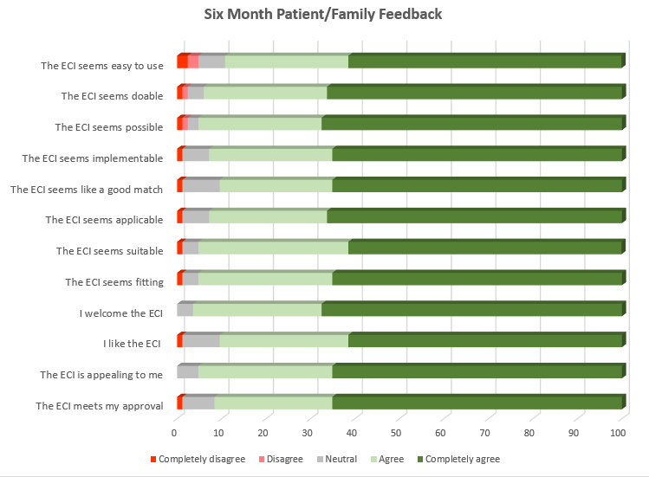
ECI = Enhanced care intervention
Weiner, BJ., et al. Psychometric assessment of three newly developed implementation outcome measures. Implement Sci.2017;12(1):108
Notes:
89% retention rate
10 withdrawals
4 unable to be seen within agreed upon study window
2 switched to Omnipod 5
2 withdrew due to frustration with lack of recommendations during tech issues
2 withdrew due to being too busy
In context of ~11 months of various syncing issues (Dexcom no longer syncing in Glooko, clock-shift issue, DASH cloud no longer syncing in Glooko, DASH cloud account sending old settings to AdvisorPro)

Slide 9
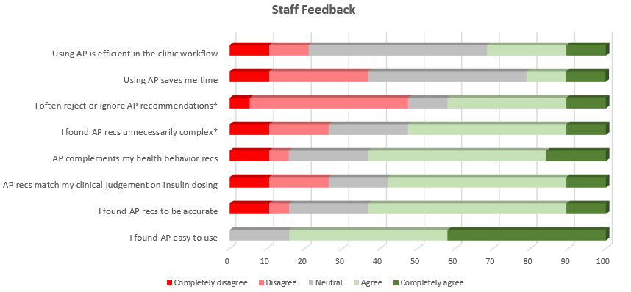
*Agree/disagree responses inverted
AP = Advisor Pro
Notes:
Themes
Complexity – “gives too complex adjustments:”
Disagreement with insulin recs – “does not take into account human actions”, “doesn’t take into consideration behavioral things…people reducing the amount of carbs they are putting in their pump”
Usability – “Having Advisor Pro recommendations presented with the glucose upload data to the provider instead of having to go into the program separately to look up the material would be helpful”

Slide 10
Conclusions
Families express benefit and positive feedback regarding monthly interval adjustments guided by AI decision support tool
Provider feedback was more heterogeneous, with some concerns regarding complexity and suboptimal agreement with insulin recommendations
Diabetes device uploading is a barrier to consistent pattern reviews
Glycemic outcomes are not significantly changed to date
Participant enthusiasm encourages continued acceptability of the intervention to explore further glycemic improvement with longitudinal application and improved diabetes device platform interoperability

Slide 11
Improving Patient Continuity of Care in Pediatric Endocrinology Fellowship
Jonathan Tatum, MD; Alison Murray, MD; Samantha Roberge, MD; Varsha Thomas, MD; Dave Baute, MS; Andrew Lavik, MD, PhD; Amy Grant, RN; Sarah Corathers, MD
Notes:
Jonathan Tatum, MD; Alison Murray, MD; Samantha Roberge, MD; Varsha Thomas, MD; Dave Baute, MS; Andrew Lavik, MD,PhD; Amy Grant, RN; Sarah Corathers, MD

Slide 12
Background
Patient continuity is important for medical training and optimal clinical outcomes.
Little research exists regarding how continuity can be systematically improved in pediatric graduate medical education.
Notes:
Problem we addressed in our QI study= Endocrine fellows losing continuity of care in fellow continuity clinic
Started as a perception that once we saw a patient, they would often not get scheduled with us for their next visit.
We wanted to take on a project to see, first of all, if this was true, and, second of all, if there was something we could do to make it better.
Continuity viewed as important in medical education
Allows trainee to be involved in diagnosis of a disease process and manage it through its course, seeing the twists and turns and reacting to those.
There is evidence that it improves clinical outcomes
Lower mortality rates
Lower healthcare costs
Decreased healthcare utilization
Increased patient satisfaction
Lower hemoglobin A1c

Slide 13
SMART Aim
To increase the percentage of patients seen in continuity clinic who are subsequently scheduled with the same fellow from 38% to 60% during the time period from 4/26/2022 to 8/18/2022.

Slide 14
Methods
Fellows completed Rapid Cycle improvement course
Baseline data was collected→38% continuity
Process map and assessment of barriers to continuity were completed
Notes:
Our team Consisted of…
Fellows, attendings registered nurses, medical assistants
Fellows completed Rapid Cycle improvement course to learn the basics of quality improvement methodology.
Baseline data was collected over 6 weeks prior to our intervention period→38% continuity
Process map and assessment of barriers using a Pareto chart were completed.

Slide 15
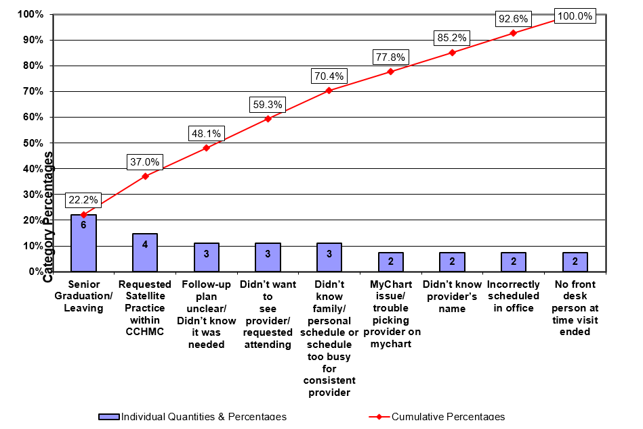
Methods
Key Driver Diagram (KDD)
Global Aim
Key Drivers
Interventions (LOR #)
Improve follow-up of patients in fellows clinic to increase provider-patient relationship and fellow education.
Clear Patient-Provider Communication
Provide feedback when patients choose to switch providers (LOR 1)
Trusting Patient-Provider Relationship
Notification from scheduling department if patient schedules with another provider (LOR 1)
SMART Aim
To increase the percentage of patients seen in fellow clinic who need follow up and are subsequently scheduled with the same fellow from 38% to 60% by 8/18/22
Informed and Educated Families
Standardize use of AVS and post-visit communication (LOR 1)
Adjust scheduling template (LOR 2)
Appropriate access to easily schedule visits
Add Fellow’s name to care team on Epic (LOR 1)
Clear communication between healthcare team
Initiate pre-clinic rounds and clear handoff
(LOR 1)
Population
Streamlined Technology
Patients seen in Fellows Clinic.
Change settings and usability of MyChart
(LOR 2)
Legend
Potential intervention
Active intervention
Adopted intervention
Abandoned intervention
Notes:
Based on our process map and our Pareto chart, we created a key driver diagram and identified 3 major pitfalls that were getting in the way of fellow continuity that we could target for intervention. These key drivers were…
Clear patient-provider communication
Informed and educated families
Clear communication with healthcare team

Slide 16
Interventions
Completed several Plan-Do-Study Act cycles (each over 2-6 weeks)
Fill out previously under-used follow up tab in Epic
Reminder signs for fellows placed
Reminder sign placed for family on clinic exit doors
Huddles with MAs (signs placed for reminders)
Reminder signs in exam rooms for families
Notes:
Fill out previously under-used follow up tab in Epic
Reminder signs for fellows placed
This tab can be seen by the scheduling center and nurses that can be used to help clarify when a follow up appointment needs to be scheduled.
Reminder sign placed for family on clinic exit doors to make an appointment with front desk before they leave
Huddles with MAs (signs placed for reminders)
Reminder signs in exam rooms for families to call to make an appointment while they are waiting.

Slide 17
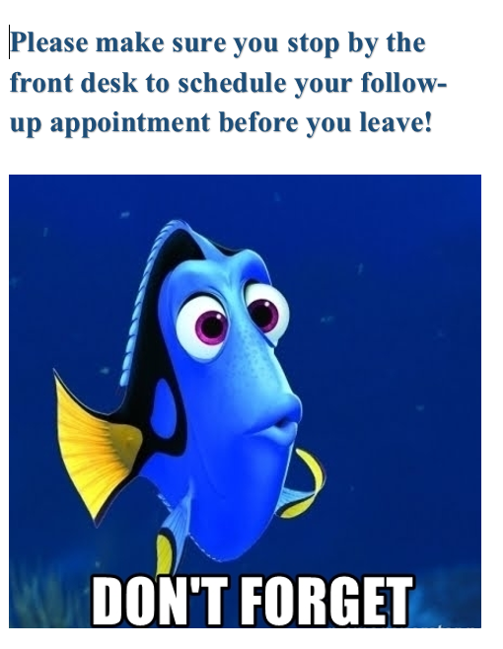

Slide 18
Results
Notes:
Able to improve continuity from 38% to 69% over 4 months.

Slide 19
Conclusions
Exceeded our stated goal of improvement.
3 of 5 patients seen by a fellow were scheduled with that same fellow in the future as compared to the previous 2 of 5 visits.
Notes:
Conclusions
Exceeded our stated goal of improvement
3 of 5 patients seen by a fellow were scheduled with that same fellow in the future as compared to the previous 2 of 5 visits.
Limitations
The length of time our interventions were fairly short, so we cannot assess the sustainability of these interventions
Interventions were not done in isolation so we cannot isolate if one intervention as having the desired effect of improving continuity. It is possible two of these interventions together were needed to improve continuity when one intervention may not have been sufficient.
Variability
I must point out that there was a fair amount of variability in our study as you can see on our run chart. We attributed this variability to:
Small sample sizes
on average, only about 13 patients required follow up per week so
Inconsistency in fellows implementing our interventions over time.
For example, we had more buy in from first-year fellows due to it being a first-year fellow project.
Initially first year fellows filled out the follow-up tab almost 100% of the time whereas other classes was essentially a coin flip on if they filled it our.

Slide 20
Future Directions
Changing scheduling template
Systematic pre-rounds huddle
Reminders of ongoing attempts to improve continuity
Notes:
We are excited to continue working to improve continuity in order to enhance our education and improve clinical care. We have a few next steps we are planning to make:
1) One our the logistical issues we’ve had in scheduling patient’s as fellows is that we have few follow up slots. We will be Increasing the number of follow up slots for fellows during the second half of our first year of fellowship. This would provide more opportunity to schedule patients for future appointments with the same fellow and allow more time for the fellow to establish a rapport with the patient. This will be implemented in the new calendar year.
2) While we implemented a pre-rounds huddle, we did not explicitly lay out what that should include. Including a script for how that should be done will help us study the effect of that more precisely.
Lastly, In an attempt to lessen the variability in our data in the future, we hope to have ongoing reminders in fellows’ meetings and email to help improve adherence to our measures. Fellows buy in seemed to lessen over the second half of our intervention period

Slide 21
November 8, 2022
The Diabetes, Data & Devices (D³) Education Program: Motivating Patient-Driven Review of Diabetes Data
and Insulin Dose Changes
Ashley Garrity, MPH, Inas Thomas, MD, Jacqueline Fisher, MD, Emily Hirschfeld, BA, & Joyce M. Lee, MD, MPH

Slide 22
U-M Pediatric Diabetes
C.S. Mott Children’s Hospital, University of Michigan
Multidisciplinary Team (FTEs*) | Patient Volume & Demographics | Contacts
4.8 endocrinologists 1.5 fellows 1.6 dietitians w/CDCES 4.6 RNs (2.6 w/CDCES) 1.0 social workers 1.0 psychologist *Devoted to T1D patient care | Main clinic at academic medical center + 2 satellite clinics 100-150 new onsets annually ~1350 established T1D patients 30% publicly insured | Site PI Joyce Lee, MD, MPH joyclee@med.umich.edu Site Coordinator Ashley Garrity, MPH ashleyna@med.umich.edu

Slide 23
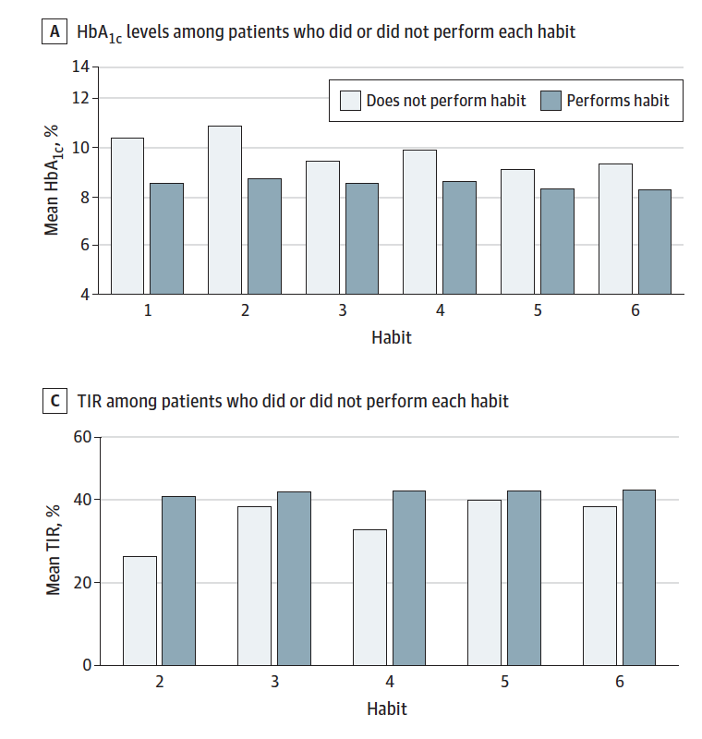
Background
Diabetes technology use (CGMs and insulin pumps) is increasing, but patient-driven data review and insulin dose adjustments are rare.
However, retrospective data review and insulin dose adjustments are associated with better glycemic outcomes.
This project aimed to provide patients and families with training in how to interpret and act on their diabetes data.
Figures from: Lee JM, Rusnak A, Garrity A, et al. Feasibility of electronic health record assessment of 6 pediatric type 1 diabetes self-management habits and their association with glycemic outcomes. JAMA Netw Open. 2021;4(10):e2131278.

Slide 24
Methods
An interdisciplinary team (pediatric endocrinologist, Certified Diabetes Care and Education Specialist, QI specialist, and graphic designer) developed the D³ curriculum.
Conducted a literature review and qualitative interviews (individual and group) with diabetes providers.
The D³ curriculum teaches patient and families to:
Understand key glycemic metrics
Identify patterns of hypoglycemia and hyperglycemia in their diabetes data
Make changes to behavior and/or insulin dosing to address patterns
Pre- and post-attendance glycemic outcomes, diabetes management self-efficacy, and diabetes data literacy were evaluated.

Slide 28
Results
Through August 2022, 155 pediatric diabetes patients and their families attended a D³ class.
For our pre-post analysis, we excluded new onset patients (i.e., attended class within 3 months of their diagnosis; n=20).
We compared pre- and post-attendance hemoglobin A1c (HbA1c; minimum 365 days post-class attendance; n=101). Post-participation:
Average reduction in HbA1c of 0.42% with greater reduction among patients whose pre-class HbA1c was ≥9% (-1.07%).
Variation by age with greater reduction among youngest patients (0-5 years, -0.97%).
We also compared pre-post (minimum 180 days post-class attendance) self-efficacy and data literacy scores.
Total self-efficacy score increased by 1.4 points, and total diabetes data literacy score increased by 0.2 points.
Notes:
PSESDM 0-40
Data literacy 0-24

Slide 29
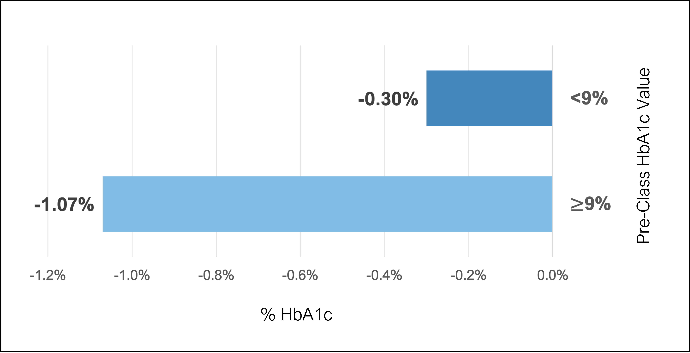
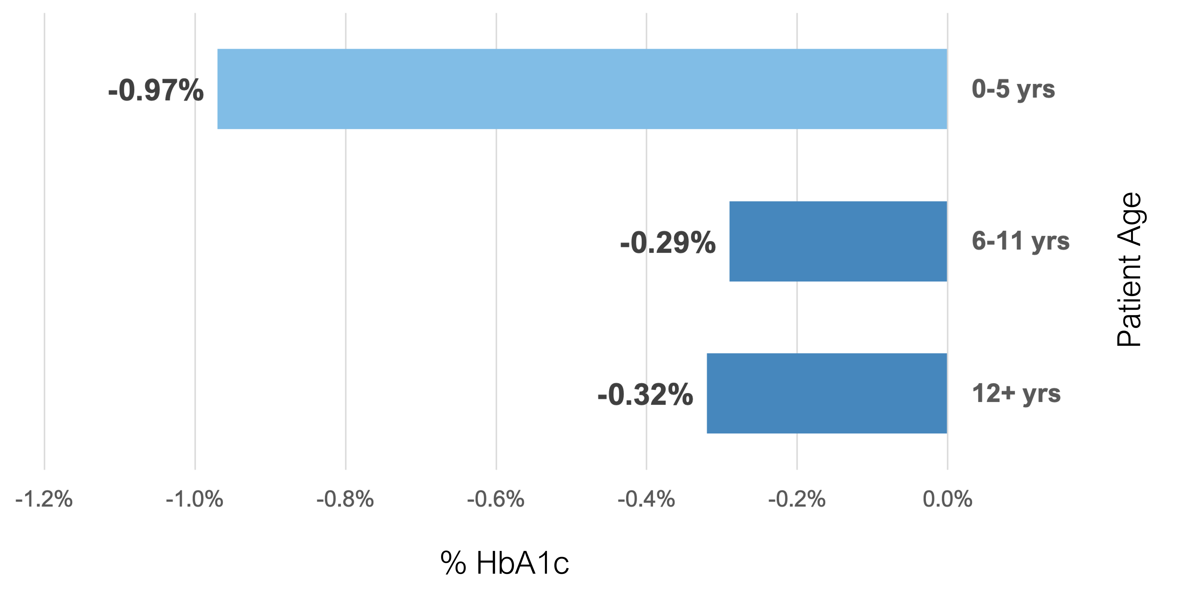
Figure 1. Average Post-Class HbA1c Change (min. 365 days post attendance) by Pre-Class HbA1c
Figure 2. Average Post-Class HbA1c Change (min. 365 days post attendance) by Age Group

Slide 30
Conclusions
The D³ program educates and empowers patients to review and act upon their personal diabetes data leading to increased knowledge and confidence as well as improvements in glycemia.
Acknowledgements
This work was supported by the Michigan Health Endowment Fund (G-1711-142124) and The Leona M. and Harry B. Helmsley Charitable Trust.

Slide 31
Increasing Frequency of Clinic Visits among Medicaid Insured Children and Adolescents with Type 1 Diabetes Carla Demeterco-Berggren^{1,2}, MD, PhD; Giana Reuter¹, CPNP, BSN, MSN; Kim McNamara¹, RN, BSN, CDCES; Jodi Peterson¹, RN, BSN; Yashia Saenz¹, PCC; Drisana Moss¹, BSN, RN; Karen Anaya¹, RN, BS, CHTP; Rhonda Sparr-Perkins¹, BSN, MBA; Keri Carstairs^{1,2}, MD, MBA, FACEP, FAAP; Michael Gottschalk^{1,2}, MD, PhD Rady Children’s Hospital, San Diego¹, University of California, San Diego², California, USA
T1D Exchange QI Learning Session
November 8th , 2022

Slide 32
Background
The relationship between more frequent clinic visits and improved HbA1c levels in people with type 1 diabetes (T1D) has been reported.
The ADA recommends quarterly follow up for routine diabetes care, but this is not always attained.

Slide 33
Aim Statement
To increase the percentage of Medicaid insured children with type 1 diabetes who attended 4 or more clinic visits per year from May 2021 baseline of 53% to 75% by May 2022.

Slide 34
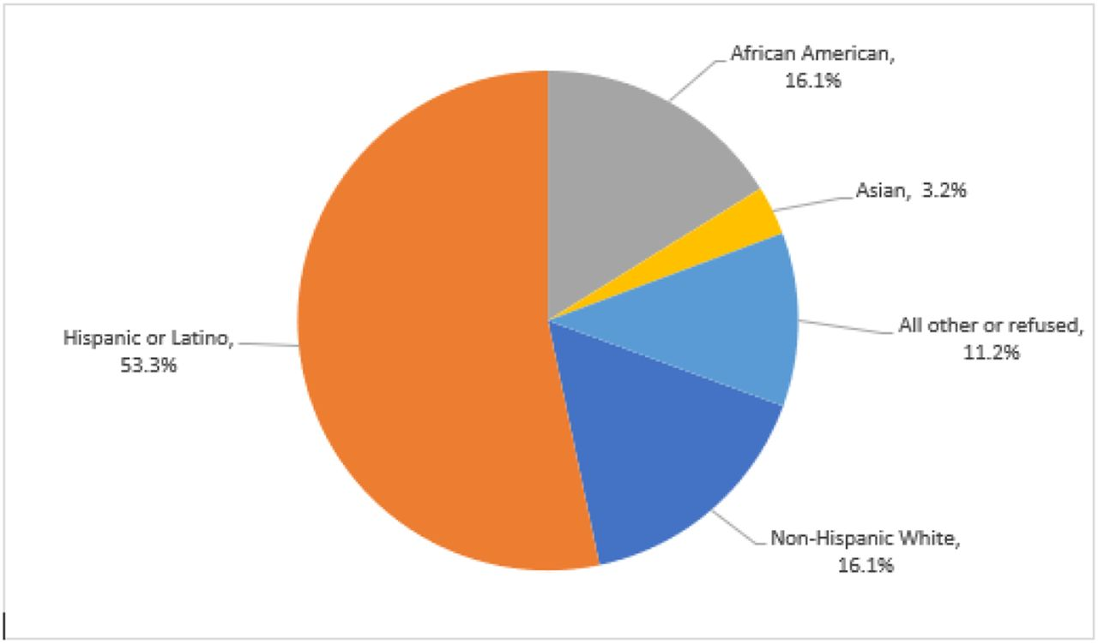
Race/Ethnicity
A Diabetes Clinic Dashboard within our electronic health record (EHR) system allowed our team to identify children and adolescents with T1D from a subset of Medicaid insured cohort (n=100) due to a clinic visit without a future appointment scheduled
A multidisciplinary team identified key change concepts. These were tested in series of PDSA cycles.

Slide 35
Key Driver Diagram
To increase the percentage of Medicaid insured children with T1D who attended 4 or more clinic visits per year from May 2021 baseline of 53% to 75% by May 2022
Ensure Access to care Promote Health Equity
Care Navigator outreach
Workflows
Health Maintenance created in the EHR
Improve Glucose Monitoring
Diabetes RN champion outreach call
EHR
Provider engagement
Rescue visits slots added to NP schedule
Monthly diabetes dashboard reviews
Diabetes RN champion outreach call
Diabetes RN call to provide education, goal setting, action planning
Improve glycemic levels in children and adolescents with TID

Slide 36
Interventions
Monthly diabetes dashboard review
Care navigator outreach
Rescue visits slots added to NP schedule
Care navigator appointment reminder call
Health Maintenance created in the EHR
Diabetes RN champion outreach call
Provider engagement

Slide 37
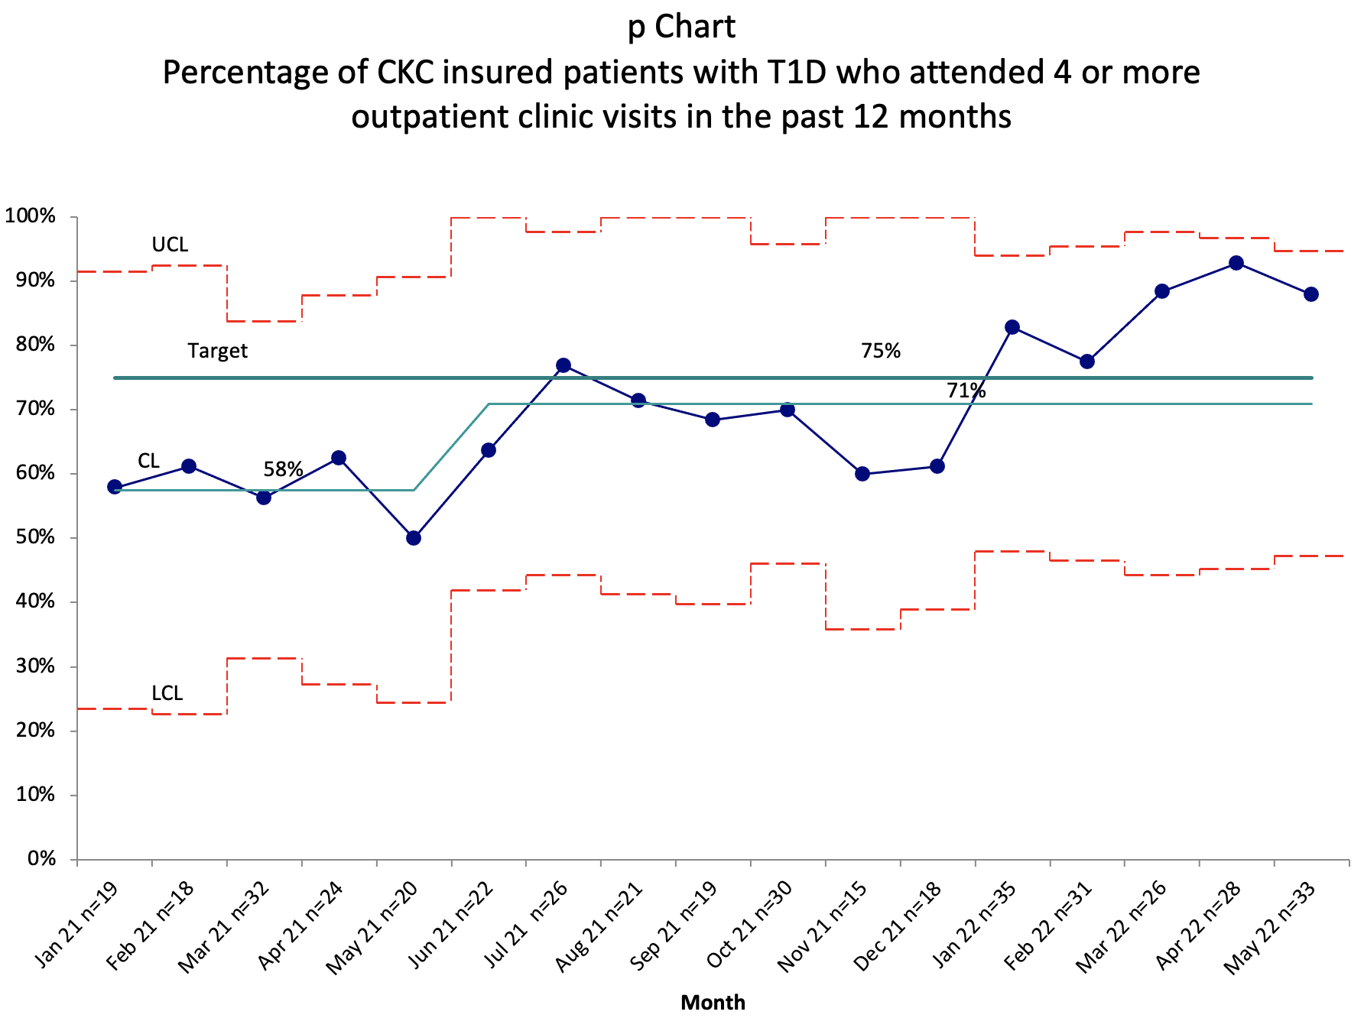
88%
Desired
Direction
3
4
5
2
6
7
Interventions:
1. Monthly diabetes dashboard review
2. Care navigator outreach
3. Provider engagement
4. Rescue visits slots added to NP schedule
5. Care navigator appointment reminder call
6. Health Maintenance created in the EHR
7. Diabetes RN champion outreach call to review blood sugars/insulin adjustment.
53%
1

Slide 38
Conclusions
Continued follow-up of this population will help identify barriers to clinic attendance and the interventions with the most impact.
New strategies to address inequities and improve visit frequency in T1D are needed.
Next Steps
We have created a Workflow to include all children and adolescents with T1D who are due for a clinic visit without a future appointment scheduled

Slide 39
Care Navigator and Diabetes Teams
It takes a village…
BSN, RN
RN, BS, CHTP
PCC
CPNP, BSN, MSN
RN, BSN, CDCES
CCLS
BSN, MBA
MSN, RN, FNP-C
MSN, RN, CPN, CNS
RN, BSN, CDCES
Thank you!
cdemeterco@rchsd.org

