Slide 1
Data Governance Committee Meeting
November 2022 Learning Session

Slide 2
Purpose
To expand research focus through academic and industry support for projects:
To have a better understanding of and improvement in patient care
Reduction in health care disparities
Improvements in understanding impact of treatments
Provide opportunities for QI team members:
To serve as PI or Co-Investigators at their sites
Provide patient opportunities to engage in QI research

Slide 3
Current Members
Carol Levy – Mt Sinai (Adult co-chair)
Daniel DeSalvo- TCH (Peds co-chair)
Brittany Caswell- OHSU
Christy Mendoza- Rady
Kathryn Fantasia – BMC
Akankasha Goyal – NYU adult
Grace Nelson – Le Bonheur
Todd Alonso – BDC peds
Ilona Lorincz – UPenn
Janine Sanchez- UM peds
Joyce Lee- Michigan
Kathryn Obrynba- Nationwide
Marina Basina- Stanford Adult
Nicole Sheanon- Cincinnati Children’s
Priya Prahalad – Stanford Peds
Ryan McDonough – Children’s Mercy
Sonya Haw- Grady
Ruth Weinstock – SUNY adult

Slide 4
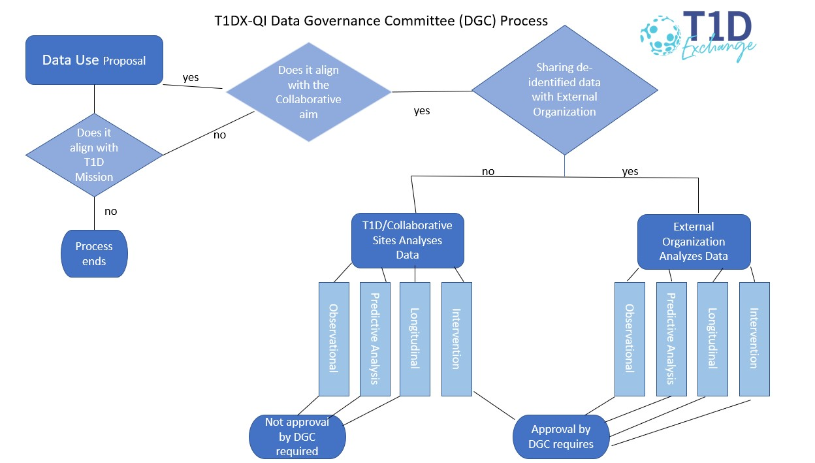
Data Governance Process Map

Slide 5
T1DX-QI Project Updates

Slide 6
T1D Antibody Screening Qualitative Assessment
Sponsor: (blinded study)
Objective: Determine provider attitudes toward T1D antibody screening among siblings of patients identified with T1D through focus groups. Submit at least two abstracts from the results of the survey and focus groups.
Participating Centers: Phase 1: Children’s Mercy Hospital, Cincinnati Children’s Le Bonheur, Childrens Hospital of Atlanta, WashU, University of Miami (P and A), NYU (A), Mt. Sinai (A), Indiana University, Cornell, Albert Einstein
Project Status: ✓On Track
New Updates: Completed Phase 1 focus groups (mixture of peds and adults); T1DX will reach out to all 50 centers for Phase 2
Notes:
I think for adults a bigger question as well is diagnostic screening

Slide 7
Ultra Rapid Insulin CME
Sponsor: MannKind
Objective: Develop a learning resource to increase awareness of the most current therapeutic modalities and medication regimens related to rapid and inhalable insulins for mealtime and correction boluses to effectively increase patients’ Time-In-Range and decrease post-prandial hyperglycemia and time in hyperglycemia. The outcomes will be measured by an analysis of numerical data obtained through participant evaluation of the stated learning outcomes.
Participating Centers: N/A; Facilitator identified from BDC (A)
Project Status: ✓On Track
New Updates: In-person course delivered earlier today!

Slide 8
Smart Pen Equity
Sponsor: Eli Lilly
Objective:
Increase connected pen dosing data availability by 10% from baseline in 9 months
Increase shared decision-making documentation using the Diabetes Technology Assessment tool for eligible patients on MDI from 0% to 25% in 9 months
Increase % of patients on a smart/connected pen by 5% from baseline
Decrease % of patients on smart/connected pen with HbA1c >9% by 5% from baseline
Reduce % racial inequities between NHW vs NHB & Hispanic patients in the availability of connected pen data reporting for clinical management
Participating Centers: Stanford (A + P), Northwestern (A), Montefiore (A), NYU (A) Mount Sinai (A), Washington University (A), Le Bonheur (P), Children’s Healthcare of Los Angeles (P); 8 total
Project Status: ✓On Track
New Updates: Pre-planning, kick-off, and PDSA planning completed. Centers are actively implementing PDSAs and tracking outcomes.
Notes:
Moving along with PDSAs, should have data early next year

Slide 9
CGM Analysis
Sponsor: Dexcom
Objectives:
Examine patient profiles of rtCGM users vs. SMBG users (using additional data from newly mapped sites).
Examine patient attributes and clinical outcomes among CGM initiators compared to a propensity score-matched comparison group.
Describe patient profiles for people currently using Dexcom CGM with Tandem X2 pump and control-IQ software.
Participating Centers: N/A; analyzing data from mapped centers
Project Status: ✓On Track
New Updates: Q3 deliverables completed; Q4 deliverables in progress
Notes:
Wrapping up analysis by end of the year

Slide 10
Diabetes Device Equity
Sponsor: Medtronic
Objectives:
Evaluate the effectiveness of provider unconscious bias training and other clinician health inequities as an intervention to address systemic inequities in T1D care management.
Implement the 'T1Dx Equity Framework' and PDSA cycles to test changes in participating clinics with an aim to reduce inequities by at least 10% from baseline in CGM prescription practices for underserved communities with a focus on racial/ethnic differences.
Implement the 'T1Dx Equity Framework' and PDSA cycles to test changes in participating clinics with an aim to use to reduce inequities by at least 10% from baseline in insulin pump prescription practices for underserved communities with a focus on racial/ethnic differences.
Participating Centers:
Cohort 1: Nationwide (P), Cincinnati (P), Children’s of Alabama (P), Children’s Healthcare of Atlanta (P), Montefiore (A)
Cohort 2: To be finalized – 5 A and 3 P
Project Status: ✓On Track
New Updates: Cohort 1 project has been extended to continue collecting data demonstrating the equity impact; Cohort 2 will initiate in the next few months

Slide 11
Project Satisfaction
For past projects, T1DX-QI surveyed:
Centers involved in project
Funders
Investigators
Project coordinators
Other staff
Notes:
Dan

Slide 12
Future Directions
Consider other areas to expand for additional funding

