Slide 1
Building QI Leadership Panel
Moderated by G. Todd Alonso, MD, November 7, 2022

Slide 2
Disclosure statement
Dr. Alonso has no disclosures

Slide 3
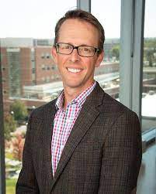
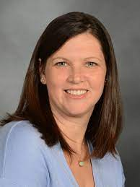
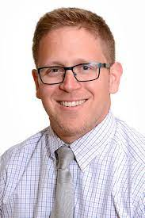
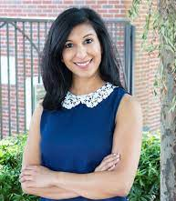
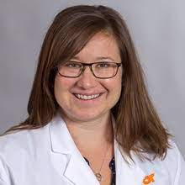
Building QI Leadership
Moderator
G. Todd Alonso, MD
Emily Coppedge, NP, Patient/Parent Advisory Committee Member
Pediatric PI
Grace Nelson, MD
Clinical Leadership Co-Chair & Adult PI
Devin Steenkamp, MBChB
QI Champion
Alisha Virani, MS, RD, CDCES, LD

Slide 4
Quality improvement in diabetes clinic is hard!
Funding – Who has time dedicated to this?
Expertise – Who has been trained in QI methods? How thorough was the training?
Data access – How agile, how quick can we access data?
Priorities – What projects will leadership support?
But it’s worth it!
Current diabetes outcomes are unsatisfactory.
We owe it to our patients to improve.

Slide 5
Panel Questions
Briefly describe your team’s structure and evolution.
Where do you find funding for QI?
How do you rope your colleagues into being a part of QI?
What clinic data can you access and how easily?
Avoiding pitfalls
“Bandaging” a process with a quick fix
Spending more time on operational demands than actual QI
What are your team’s current challenges (not already mentioned) and how are you addressing them?

Slide 6
Questions

