Slide 1
QI Publications Committee
October 2022

Slide 2
Agenda
Introductions
Publications updates
Upcoming Conferences
Learning Session 2022
ISPAD 2022
ATTD 2023
ADA 2023

Slide 3
Q3 2022 Manuscript Scorecard – October 2022
Phase 1 (New Idea): 14
Phase 2 (Internal group) 2
Phase 3 (Publication committee review) 3
Phase 4 (Journal Review ): 5
Phase 5 (Manuscript Accepted/Published): 17

Slide 4
Clinic Representation in Q3 Manuscripts
Pediatrics
Cincinatti Children's Health Medical Center, OH (4)
Children's National (3)
Lurie Children's (3)
Nationwide Children's Hospital (3)
University of Alabama (3)
Barbara Davis Center (2)
Children's Hospital Los Angeles (2)
Childrens' Mercy (2)
Le Bonheur (2)
Rady Children's Hospital (2)
Seattle Children's Hospital (2)
University of Miami (2)
University of Florida (2)
Upstate University Medical Center (2)
University of Wisconsin (2)
Cohen (1)
Cook Children's Hospital (1)
Helen DeVos (1)
Indiana (1)
Michigan (1)
Mt Sinai (1)
NYU (1)
NYU Long Island (1)
Stanford Children's Health Lucile Packard , CA (1)
Texas Children's Hospital, TX (2)
University of California San Francisco (1)

Slide 5
Clinic Representation in Q3 Manuscripts
Adults
Barbara Davis Center (3)
Albert Einstein (2)
Upstate University Medical Center (2)
Stanford (2)
BMC (1)
Grady (1)
Mt Sinai (1)
Northwestern (1)
University of Miami (1)

Slide 6
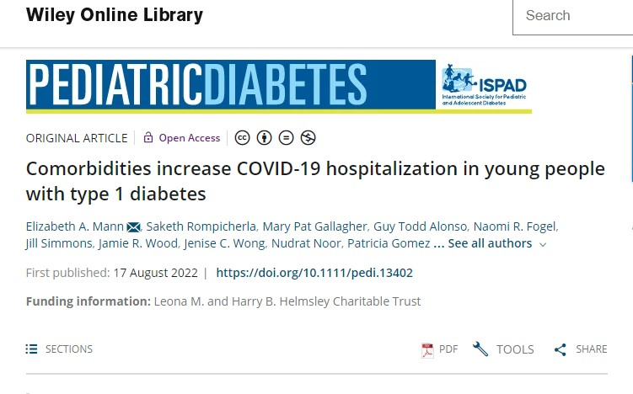
Phase 5 published Manuscript Q3 2022

Slide 7
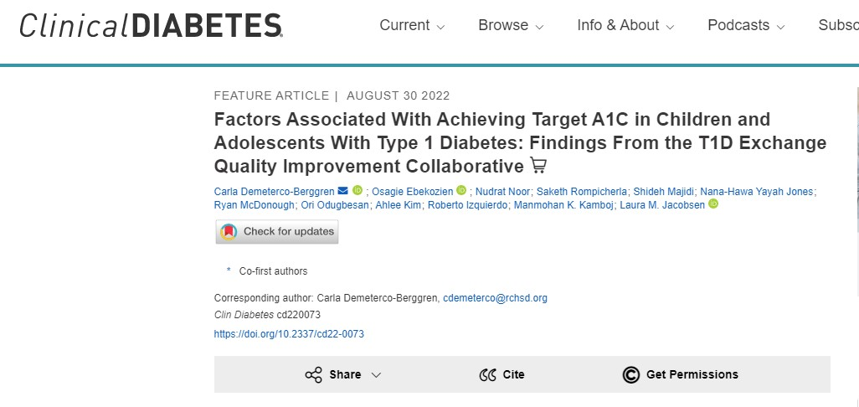
Phase 5 published Manuscript Q3 2022

Slide 8
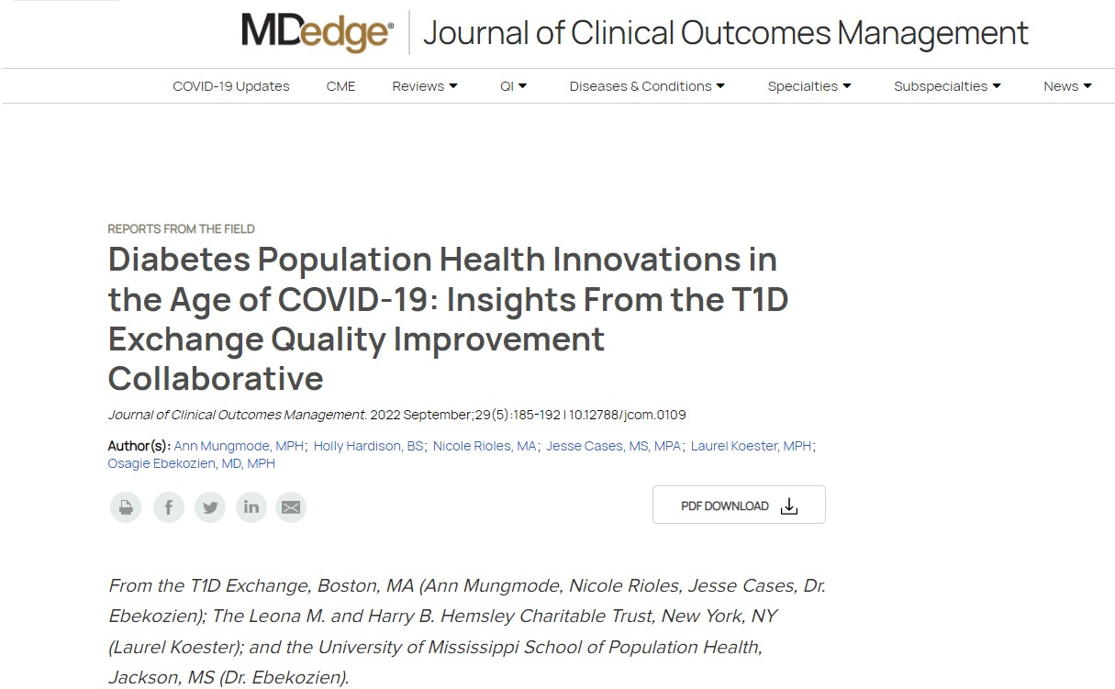
Phase 5 published Manuscript Q3 2022

Slide 9
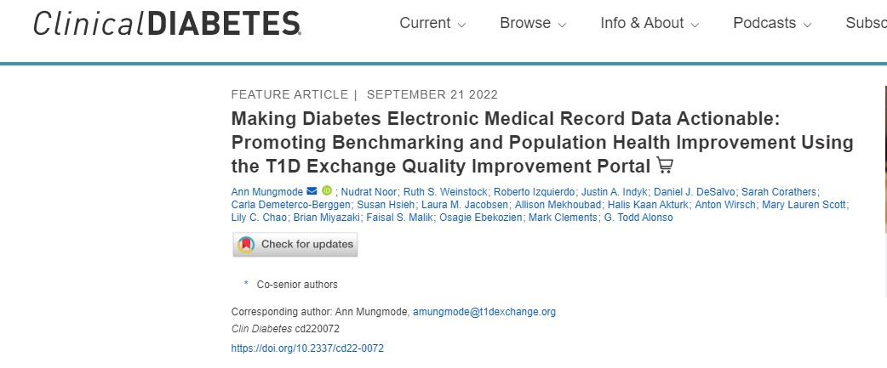
Phase 5 published Manuscript Q3 2022

Slide 10
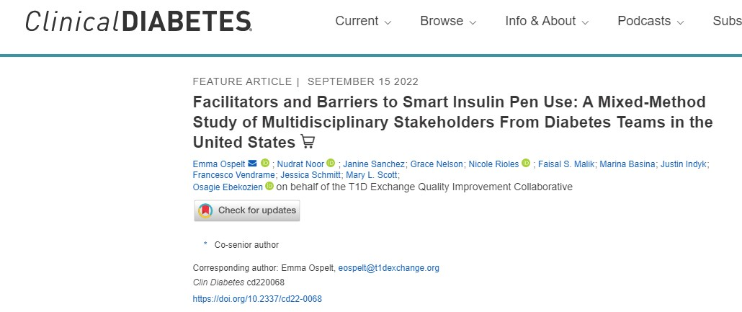
Phase 5 published Manuscript Q3 2022

Slide 11
Phase 5 published Manuscript Q3

Slide 12
Phase 4: Manuscripts Under Journal Review
Short Title: Benchmarking GCM and Pump use for Adults
First Author: Sullivan
Senior Author: Steenkamp
Status: review/resubmit
Target Journal: Journal of Diabetes Science and Technology
Short Title: Impact of diabetes status and related other factors on COVID-19-associated related hospitalization
First Author: Talon
Senior Author: Clements
Status: submitted
Target Journal: Diabetes Research and Clinical Practice

Slide 13
Phase 4: Manuscripts Under Journal Review
Short Title: Diabetes status and other factors as correlates of risk for thrombotic and thromboembolic events:
First Author: Gallagher and Tallon
Senior Author: Clements
Status: submitted
Target Journal: Diabetes Care
Short Title: Insulin Pump trends and HbA1c Association
First Author: Gandhi
Senior Author: Kamboj
Status: review/resubmit
Target Journal: JOD

Slide 14
Phase 4: Manuscripts Under Journal Review
Short Title: Psychosocial Screening
First Authors: Corathers
Senior Author: Munoz
Status: In review
Target Journal: Current Diabetes Report

Slide 15
Phase 3: Publication Committee Review
Short Title: Benchmarking CGM and Pump use for Peds
First author: Prahalad
Senior Author: Ebekozien
Status: In Review
Target Journal: Pediatric Diabetes

Slide 16
Phase 3: Publication Committee Review
Short Title: Association between health insurance type
First author: Miyazaki
Senior author: Dickinson
Status: In review
Target Journal: Journal of Diabetes care and it’s complications
Short Title: Depression Rates in Youth with Type 1 Diabetes During the COVID-19 Pandemic
First Authors: Roberts
Senior Author: Malik
Status: In review
Target Journal: Pediatric Diabetes

Slide 17
Phase 2: Internal Author Review
Short Title: One Year Telemedicine follow up
First Author: Lee and
Senior Author: Vendrame
Status: In progress
Target Journal: DTT
Short Title: HbA1c and Equity 2016-2021
First Authors: Mungmode
Senior Author: Ebekozien
Status: In progress
Target Journal: The Lancet

Slide 18
Learning Session Schedule, Nov 7-8
Hotel: Hyatt Regency Miami (400 S, SE 2nd Ave, Miami, FL 33131)
Check in Sunday November 6th. Check out Tuesday November 8th.
University of Miami Clinic Tours
Adult Practice and DRI (1450 NW 10th Ave, Miami, FL 33136)
Pediatric Practice (1601 NW 12th Ave, Miami, FL 33136)
Monday November 7th (3:55-5 pm)
Monday Session @Hyatt:
Breakfast (7-8 am)
Presentations and breakouts (8-12:05 pm)
Lunch (12:05-1:05 pm)
Presentations and breakouts (1:10-3:15 pm)
Clinic tours @University of Miami (3:55-5 pm)
Dinner at Marabu (6:30-8:30 pm)

Slide 19
Learning Session Schedule (continued)
Tuesday Session @Hyatt
Breakfast (7-8am)
Presentations and breakouts (8-12 pm)
Lunch (12-1 pm)
Panel and team discussions (1-3 m)
Wrap up (3-3:15 pm)

Slide 20
Monday November 7th from 11:05 am-12:05 pm
Topic Areas | Clinic Presentations | Facilitators
 | Albert Einstein: Tech equity with young adults Le Bonheur Children’s: Equitable CGM access Nationwide Children’s: CGM Continuing Improvement Equity NYU/T1DX: Staffing FTE | Alexis McKee, MD
Improving device access | U of Wisconsin: Decreasing barriers to CGM Rady Children’s: Increasing CGM access, decreasing inequities Grady Memorial: CGM access in safety net hospital Seattle Children’s: CGM use, insurance, race equity | Donna Eng, MD
Population health & data dashboards | CMH: Dashboard of Self-Man Habits CMH: Data dock: continuous improvement Stanford Children’s: 4T program CDE perspectives T1D Registry: SES and A1c | Brian Miyazaki, MD
Making device access equitable

Slide 21
Monday November 7th from 1:10-2:10 pm
Topic Areas | Clinic Presentations | Facilitators
Building equity through SDOH screening | CMH: SDOD/ Race/ethnicity CCHMC: Equity, care transformation, SDH spread Cook: Implementing SHH screener NYU: SDOH Screening | Andrea Mucci, MD
Supporting device use | BDC: Tech support: pump failure TCH: Standardizing Pump therapy CCHMC: Remote pump upload UMiami: Tech use: Hispanic patient perspective | Sonya Haw, MD
Patient engagement: supporting through education, wellness programs and mental health services | Stanford: Mental health, Adult UCSF: Depression screening peds Cook: Engagement questionnaire UCSF: Techquity and peer support | Jeff Hitchcock, Parent Advisor

Slide 22
Tuesday November 8th from 8:50-9:50 am
Topic Areas | Clinic Presentations | Facilitators
Developing Collaborative Infrastructure | T1DX Publications T1DX Building QI capacity T1DX Data mapping errors T1DX Value: mapped vs unmapped | Vandana Rama, MD
Decision support & care continuity | CCHMC: Using AI decision support engagement CCHMC: Continuity of care fellowship University of Michigan: D3 Patient driven review, data, insulin changes Rady: Access and Continuity for Medicaid pts | Alissa Guarneri, MD
Identifying, Delaying, and Reducing DKA, Admissions & Supporting High-Risk Populations | CMH: Reduced delayed DKA f/u SUNY: Admissions CMH: CGM dashboard for at risk pop NYU: Wellness for high risk, >9% | Andrew Ahmann, MD

Slide 23
ISPAD 2022 Presentations
Impact of the COVID-19 pandemic on disengagement from advanced diabetes technologies among racial/ethnic groups in the U.S. T1D Exchange Quality Improvement Collaborative
Shelby Carrothers, Brent Lockee, David Williams, Emily DeWit, Ryan McDonough, Nudrat Noor, Todd Alonso, Halis K Akturk, Daniel J DeSalvo, Manmohan Kamboj, Laura Jacobsen, Mary L Scott, Ann Mungmode, Osagie Ebekozien, Mark Clements
Disengagement from advanced diabetes technologies during the Covid-19 pandemic associates with worse short-term outcomes in the U.S T1D Exchange Quality Improvement Collaborative
Craig Vandervelden, Mitchell Barnes, Emily DeWit, David Williams, Ryan McDonough, Nudrat Noor, Roberto Izquierdo, Margaret Greenfield, Carla Demeterco-Berggren, Alissa Roberts, Holly Hardison, Osagie Ebekozien, Mark Clements
Barrier in Insulin Pump Uptake Among Hispanics and Black Patients with Type 1 Diabetes: T1D Exchange Multicenter Mixed-Method Study
Mary L Scott, Grace Nelson, Kristina Cossen, Ori Odugbesan, Ann Mungmode, Osagie Ebekozien, Holly Hardison, Don Buckingham, Manmohan K Kamboj

Slide 24
ATTD 2023
Patient reported Diabetic Ketoacidosis among Hybrid Close Loop System (HCLS) users: Real world evidence form a multi-center study for people with Type 1 Diabetes
Osagie Ebekozien, Carla Demeterco-Berggren, Mark Clements, Shideh Majidi, Faisal Malik, Susan Hsieh, Sonya Haw, Manmohan Kamboj, Nudrat Noor
Hemoglobin A1c levels among people with Type 1 Diabetes switching from self-monitoring of blood glucose to real-time CGM use: A retrospective longitudinal study
Nudrat Noor, Elizabeth Mann, Daniel J DeSalvo, Janine Sanchez, Carol Levy, Halis K Akturk, Todd Alonso, Osagie Ebekozien
Distribution of Continuous Glucose Monitoring (CGM) derived glycemic outcomes among real-time CGM vs. isCGM users in a large multi-center EMR database for people with T1D
Nudrat Noor, Osagie Ebekozien, Francesco Vendrame, Laura Jacobsen, Ruth S. Weinstock, Mary Pat Gallagher, Sarah Corathers, Siham Accacha, Priya Prahalad, Robert Rapaport
Patient reported Severe Hypoglycemia among Hybrid Closed Loop System (HCLS) users: Real world evidence from a multi-center study for people with Type 1 Diabetes
Osagie Ebekozien, Nudrat Noor, Joyce Lee, Roberto Izquierdo, Lauren Golden, Brian Miyazaki, Meredith Wilkes, Mary L Scott, Allison Mekhoubad, Janine Sanchez

Slide 25
Clinical Diabetes June Special
BMI Trends for Pediatrics and Adult 2016-2021 (Nelson)
Depression Screening QI (Dei Tutu, Odugbesan)
Lessons learned from QI Health Equity Project (Odugbesan)
Establishment of the T2D Collaborate (Tsai, Rioles)
SDOH QI Screening (Jones)
2020-2022 Metrics Analysis (Mungmode)

Slide 26
First/Senior author writs and submits draft to Coordinating Center
QI Publication Process
Aim: Manuscript writing process is completed in less than 120 days
Coordinating Center and First author selects co- author based on data, clinical interest, publication history
First/Senior Author submits proposal to Coordinating Center
Coordinating Center analyst discuss with First/Senior author analysis plan
Coordinating Center reviews request
Coordinating Center shares data package with First/Senior author
Journal accepts edits from authors
Coordinating Center returns to co-authors for revisions
Journal Accepts Manuscript
yes
First/Senior authors reviews, address feedback returns to coordinating center
no
First and Senior author reviews and edits journal comments
Coordinating Center or Frist/Senior author submits to journal
First/Senior author address feedback from Publication Committee
Coordinating Center selects 3 main reviewers from Publications Committee
Journal reviews manuscript
Last revised 7/11/22

Slide 27
T1DX-QI Publication Policy

