Slide 1
T1DX-QI Strategy Session – Pediatric Practice
Clinical Leadership Session
5/16/22

Slide 2
Aim Statement and Progress
Among people with T1D,* increase proportion of patients achieving glycemic targets from baseline in 2 years by:
Aim Statement | Aim Progress
a) At least 25% with A1c <7 | a) A1c <7% = 17%
b) Increase proportion of patients <7% by 5% | b) Increase by 1%
c) Increase TIR among CGM users by 5% | c) Pediatric TIR = 33%

Slide 3
Pediatric T1D Glycemic Targets KDD
Change Ideas
Primary Drivers
Aim
Patient Education on diet, exercise, transition, device use and self management habits
Education to reduce DKA events/admission, 4X glucose check education
Set small patient- and provider-selected goals with clear action step
Working with families as well as providers
Among people with T1D,* increase proportion of patients achieving glycemic targets:
At least 25% with A1c <7%, OR
Increase proportion of patients A1c <7% by 5%, OR
Increase TIR among CGM users by 5%
from baseline in 2 years.
Health Literacy/Education and Support
Referral to nutrition therapy/guidance
Physical activity coaching
Peer support groups
New onset classes
Accessibility to translated materials
Use of Data
Use data registries to support population health
Use EMR templates
Incorporate QI measures or flow sheets
Insulin therapy
Culturally Competent Care
Catalogue of community resources
Train staff about SDOH
Documenting barriers to care (housing, transportation, food, etc.)
Social Determinant of Health
Insulin / monitoring /nutrition interactions
Coach >4 checks/day (for non CGM patients)
Test new workflows to improve device use
Use workflows to improve device documentation
Advertise CGM in waiting rooms, etc.
Device data reviews and interpretation, staff troubleshoot device
Provide contact information for device reps/patient support
Glucose monitoring
Transition
READDY questionnaire
Partner with adult clinic for hand-off
Follow up with LTFU patients (not seen for > 180 days); regular follow up (phone/email/text/televisit)
Improve scheduling process
Make appointments longer/have a multidisciplinary team (seeing a CDE/SW/RD)
Access to in-person and virtual care
*Duration > 1 year, ages 1-25, with at least one in-person or telemedicine visit in the last year
Conduct mental health screening and referrals (i.e., depression, FOH, diabetes distress)
Improve psychosocial support/train providers
MyChart message for questionnaires, PROs, high-risk patients
Create workflow for positive patients who needs referral
Screen for QOL (compare control of people using CGM vs no CGM)
Psychosocial Support

Slide 4
Pediatric T1D Glycemic Targets KDD
Primary Drivers
Use of Data
25/29 clinics (86%)
Health Literacy/Education and Support
27/29 clinics (93%)
Glucose monitoring
12/29 clinics (41%)
Psychosocial Support
10/29 clinics (34%)
Insulin therapy
8/29 clinics (28%)
Transition
7/29 clinics (24%)
Access to in-person and virtual care
6/29 clinics (20%)
Social Determinant of Health
5/29clinics (17%)

Slide 5
50% Improvement Across Measures
Peds Improvement Score Card
Sites | A1c<7% | A1c<7% | CGM Use | Pump Use | Depression screening | DKA Events | TIR |  | Documented Transition | SDOH Screening
T1DX-QI Goals | <7% |  | 70% | 65% | 80% | <6.3% | >50% |  | >10% | >10%
QIC Status | 17% |  | 73% | 50% | 53% | 2.6% | 36% |  | 29% | 59%
Lurie | 22% |  | 68% | 43% | 11% | 0.6% | 12%
NYU Peds | 36% |  | 86% | 80% | 55%(↑45%) | 1.5% | 50% | 56%(↑50%) | 56%%(↑50%) | 67%(↑68%)
Cornell | 16% |  | 66% | 69%(↑4%) | 39%(↑27%) | 1.9% | 16.7% | 39% | 39% | 18%
Michigan | 15% |  | 76% | 68% | 52% | 0.4%
Florida | 21% |  | 77% | 44% | 65% | 1.6% | 22%
BDC Peds | 15% |  | 78%(↑7%) | 69% |  | 0.7% | 50%
Legend |  |  |  | Favorable |  | Below Goal

Slide 6
50% Improvement Across Measures
Peds Improvement Score Card
Sites | A1c<7% | A1c<7% | CGM Use | Pump Use | Depression screening | DKA Events | TIR | Documented Transition | SDOH Screening
T1DX-QI Goals | <7% |  | 70% | 65% | 80% | <6.3% | >50% | >10% | >10%
T1DX-QI Status | 17% |  | 73% | 50% | 53% | 2.6% | 36% | 29% | 59%
Texas | 18% |  | 63%(↑8%) | 50% | 81% | 1.6% |  |  | 61%
Cook | 18% |  | 65% | 36% | QA | 2.9%
Cohen | 20% |  | 31% | QA | QA | 0.6% | 31% | QA | 17%
Mineola | 21% |  | 82% | 78% | 25% | 0.2% | 38% | QA | QA
CMH | 18% |  | 79% | 71%(↑6%) | 55% | QA | 35% | 25%
Helen D | 13%(↑7%) |  | 55%(↑10%) | 63% | 81% |  |  | 25%(↑19%)
NCH | 19% |  | 76% | 43% | QA | QA | QA
Legend |  |  |  | Favorable |  | Below Goal
QA: Not shown for Quality Assurance
Notes:
QA: Not shown for Quality assurance

Slide 7
50% Improvement Across Measures
Peds Improvement Score Card
Sites | A1c<7% | CGM Use | Pump Use | Depression screening | Documented Transition
T1DX-QI Goals | <7% | >70% | >65% | >80% | >10%
T1DX-QI Status | 17% | 73% | 50% | 53% | 29%
Rady | 23% | 80%(↑9%) | 43% | QA | QA
Miami Peds |  |  |  | 50%
Alabama | 13% | 54%(↑17% | 31%
Seattle | 16% | 79% | 61% | QA
Atlanta | 16%(↑2%) | 80%(↑10%) | 41%
Tennessee | 12% | 55% | 23% | 96%
Indiana | 16% | 41%(↑12%) | 42%(↑9%)
Legend |  |  | Favorable
QA: Not shown for Quality Assurance

Slide 8
50% Improvement Across Measures
Peds Improvement Score Card
Sites | A1c<7% | CGM Use | Pump Use | Depression screening | DKA | SDOH
T1DX-QI Goals | <7% | 70% | 65% | 80% | <6.3% | >10%
T1DX-QI Status | 17% | 73% | 50% | 53%
Stanford | 24% | QA | 52%
CHLA | 22% | 59% | 47% | 45%(↑35%)
SUNY | QA | 78%(↑22%) | 46% | 64% | QA | 56%
C National | 17% | 53% | 31%(↑12%)
Wisconsin | 15% | 72% | 55% | 48%
Mt Sinai |  |  |  | 69%(↑13%)
Legend |  |  | Favorable
QA: Not shown for Quality Assurance

Slide 9
T1DX-QI 2020-2022
Pediatrics Measures Summary

Slide 10
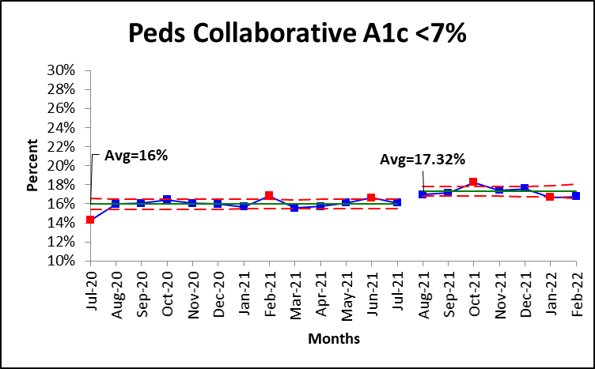
Peds Clinics - HbA1c < 7% (1% Increase)
Increase by 1%
Run chart favorable direction
Notes:
16.3% to 16.7%

Slide 11
Peds Clinics - HbA1c < 7% Summary
QI Collaborative Goal: 25%
QI Collaborative Average: 17.32%
Sites that meet goal: 1/25
Top performers:
NYU Ped: 36.5%;
Rady: 23%
Lurie: 22.6%
CHLA: 22%
NYU Mineola: 21.2%
Range: 12%-36.5%
Available data | Available data | Incomplete/No data
Texas | CMH | U of Miami
Michigan | Children National | UCSF
Cornell | SUNY | Mt Sinai
Alabama | Cohen
CHLA | Seattle
Tennessee | U of Wisconsin
Rady | Cook
BDC Peds | NCH
Indiana | Atlanta
Lurie | NYU Peds
Helen Devos | U Florida
Stanford | CCHMC
Mineola

Slide 12
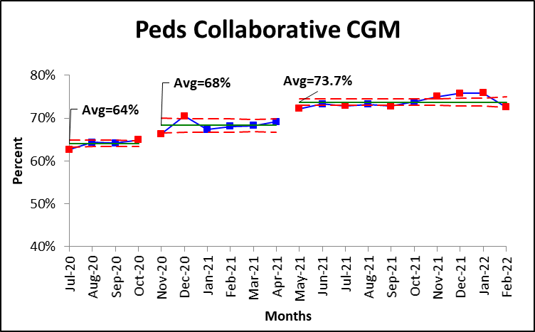
Peds Clinics - CGM Use 10% increase in CGM Use
Run chart favorable direction
Notes:
Increased by 5% from last quarter

Slide 13
Peds Clinics – CGM Use
Available data | Available data | Incomplete/No data
Texas | CMH | U of Miami
Michigan | Children National | UCSF
Cornell | SUNY | Mt Sinai
Alabama | Cohen
CHLA | Seattle
Tennessee | U of Wisconsin
Rady | Cook
BDC Peds | NCH
Indiana | Atlanta
Lurie | NYU Peds
Helen Devos | U Florida
Stanford | CCHMC
Mineola
QI Collaborative Goal: 70%
QI Collaborative Average: 74%
Sites that meet goal: 14/25
Top performers:
NYU Peds: 86%;
NYU Mineola: 83%
UF: 79%
Seattle: 79%
CMH: 79%
Range: 31%-85%

Slide 14
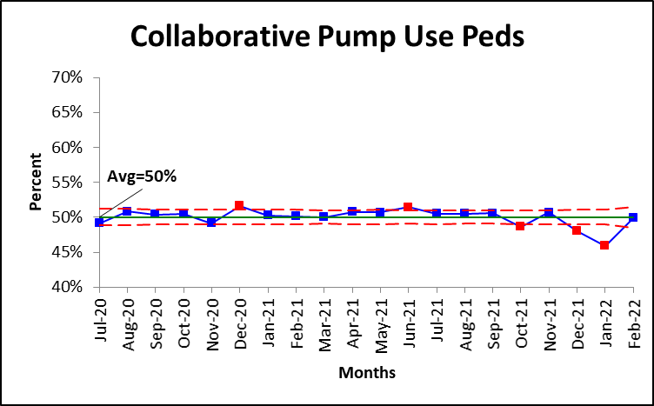
Peds Clinics - Pump Use
Run chart favorable direction
Notes:
48% to 50%

Slide 15
Peds Clinics - Pump Use
Available data | Available data | Incomplete/No data
Texas | CMH | U of Miami
Michigan | Children National | UCSF
Cornell | SUNY | MT Sinai
Alabama | Cohen
CHLA | Seattle
Tennessee | U of Wisconsin
Rady | Cook
BDC Peds | NCH
Indiana | Atlanta
Lurie | NYU Peds
Helen Devos | U Florida
Stanford | CCHMC
Mineola
QI Collaborative Goal: 65%
QI Collaborative Average:50%
Sites that meet goal: 7/25
Top performers:
NYU Langone: 79.5%
NYU Mineola: 78%
CMH: 71%
Cornell, BDC Peds: 69%
Michigan:67%
Range: 23%-79.5%

Slide 16
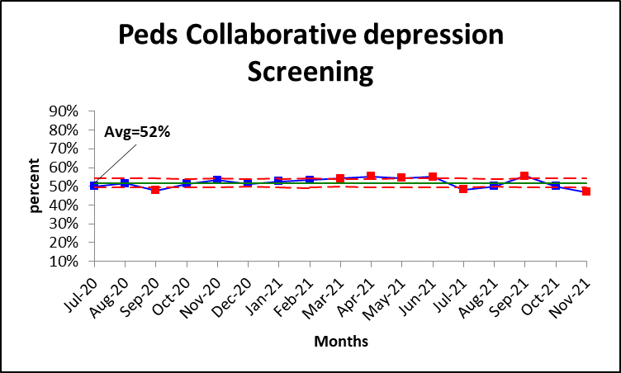
Peds Clinics – Depression Screening
Run chart favorable direction

Slide 17
Peds Clinics – Depression Screening
Available data | Available data
Texas | Mineola
NYU Peds | Mt Sinai
Cornell | Michigan
Florida
CHLA
Tennessee
Rady
Lurie
Helen Devos
Cook
BDC Peds
Wisconsin
CMH
SUNY
U. Miami
Seattle
QI Collaborative Goal: 80%
QI Collaborative Average: 52.6%
Sites that meet goal: 3/16
Top performers:
Tennessee: 96%;
Texas: 79%
Helen Devos: 81%
Range: 10%-96%

Slide 18
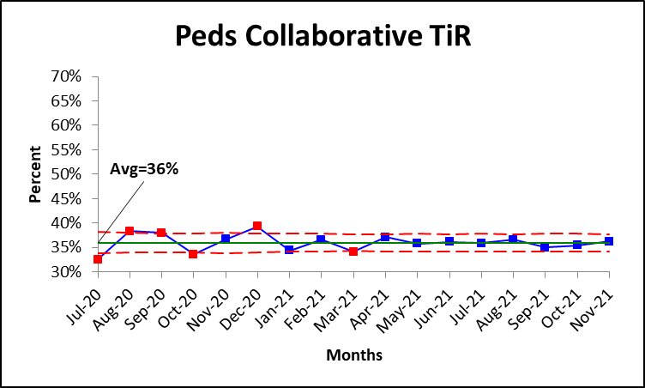
Peds Clinics – Time in Range
Run chart favorable direction
Notes:
29% to 36%

Slide 19
Peds Clinics – Time in Range
QI Collaborative Goal: 50%
QI Collaborative Average: 33%
Sites meeting goal:
Top performers:
NYU Peds: 50%;
BDC Peds: 50%
Range: 5%-50%
Available data
Lurie
NYU Peds
CMH
Florida
BDC Peds
NCH
Cornell
Mineola
Cohen

Slide 20
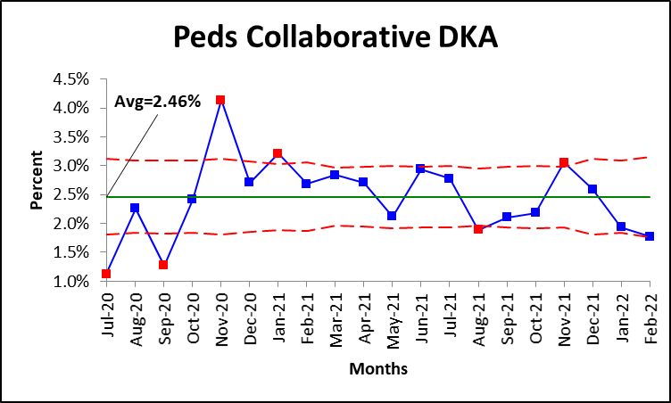
Peds Clinics – DKA Events
Run chart favorable direction

Slide 21
Peds Clinics – DKA Events
Available data
Lurie
NYU Peds
Cornell
Florida
BDC Peds
Texas
Cook
Cohen
NYU Mineola
CMH
Michigan
Cohen
SUNY
QI Collaborative Goal: 6.3%
QI Collaborative Average: 2.5 %
Sites that meet goal: 12/12
Top performers:
NYU Mineola: 0.2%;
Lurie: 0.6%
Cohen: 0.6%
BDC Peds: 0.7%
Range: 0.2-2.9%

Slide 22
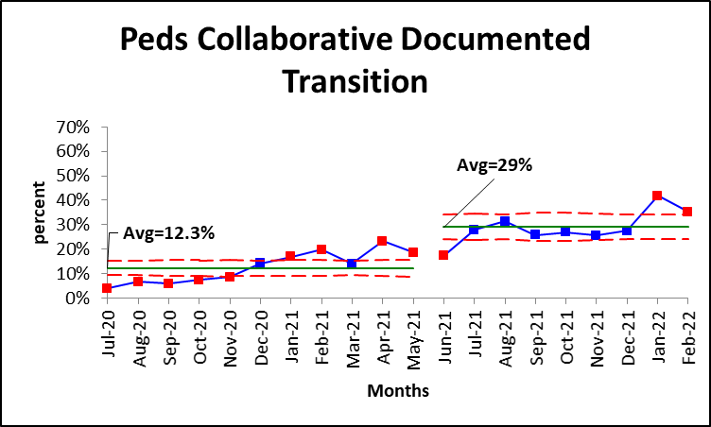
Peds Clinics – Documented Transition
Increase by 17%
Run chart favorable direction

Slide 23
Peds Clinics – Documented Transition
QI Collaborative Goal: 10%
QI Collaborative Average:29%
Top performers:
NYU Peds: 61%
Cornell: 36%
CMH: 28%
Range: 9%-61%
Available data
CMH
NYU Peds
Helen Devos
Cornell
Mineola
Rady
Cohen

Slide 24
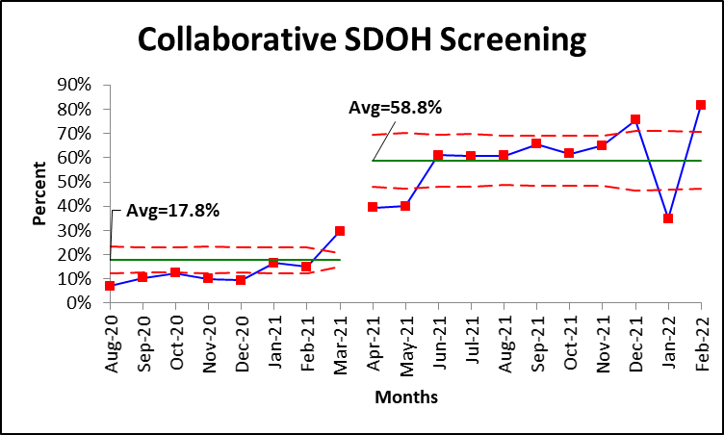
Peds Clinics – SDOH Screening Increase by 40%
Run chart favorable direction

Slide 25
Peds Clinics – SDOH Screening
QI Collaborative Goal: 10%
QI Collaborative Average:59%
Sites meeting goal: All
Sites that meet goal: 5/5
Top performers:
NYU Peds: 67%;
Texas: 61%
Range: 17%-50%
Available data
Cohen
NYU Peds
Cornell
Texas
SUNY
Mineola

Slide 26
Phase 1 Measures
1 | The number of patients in (Denominator - A) with HbA1c <7(Most recent A1C)
2 | Median A1c of all patients from (A): of the unique type 1 diabetes patients ages 1-85, what was the median of the most recent hemoglobin A1c value from all patients in this reported month
3 | The number of patients in (A) who reported using a sensor/CGM during the month being reported on
4 | Number of patients in (A), excluding CGM users, who check their FSBG > or = to 4x/day
5 | The number of patients in (A) who are active pump users
6 | Number of patients in (A), ages 12 and older, who met eligibility criteria* for depression screening for reporting month
7 | Number of patients in (6a) that were screened

Slide 27
Phase 2 Measures
1 | The number of patients in (A) who reported using a CGM during the month reported with Time in Range (70-180) > 50%
2 | The number of patients in (7a) with Time in Range (70-180) > 70%.
3 | The number of patients in (6) who bolus at least 3 times per day based on a pump download from their visit during the reporting month
4 | The number of DKA events that occurred during the reporting month among all patients in (A)
5 | The number of patients in (A) who meet eligibility criteria with a documented transition plan from peds to adults (pediatric measure.) Eligible patients are those who because of age criteria, is expected to transition the practice to adult care within the next 12-18 months.
6 | Number of patients in 13a who have a documented transition plan
7 | The number of patients in (A) who have SDOH documented in their chart (related to food security, transportation needs, education, housing security, or employment status.)

Slide 28
QI Measures – Phase 1 Proposed Changes
Metric | Definition | Proposed Change
1) HbA1c 7% | Number of patients in (A) with HbA1c <8% that had a telemedicine or in-person visit (seen) in the reporting month | N/A
2) Median A1c | Median of the most recent HbA1c value from all unique patients seen in this reporting month | N/A
3) CGM use | Number of patients in (A) who reporting using a CGM in the reporting month | N/A
X) BG check 4x | Number of patients in (A), excluding CGM users (3), who check their FSBG > or = 4x/day seen in the reporting month | Remove
4) Pump use | Number of patients in (A) who are active pump users seen in the reporting month | N/A
6) Hybrid Closed Loop | Number of patients in (A) who reporting using a HCL system in the reporting month | New metric
7) Smart Pen | Number of patients in (A) who reporting using a smart pen in the reporting month | New metric

Slide 29
QI Measures – Phase 1 Proposed Changes, cont.
Metric | Definition | Proposed Change
5a) Depression screening eligibility | Number of patients in (A) who meet eligibility criteria for depression screening for reporting month | N/A
5b) Depression screening | Number of patients in (5a) who received depression screening in reporting month | N/A
5c) Positive depression screen | Number of patients in (5b) who screened positive for depression | New Metric, informed by HEDIS and NQF
5d) Depression screening follow-up | Number of patients in (5c) who have a documented follow-up plan | New Metric, informed by HEDIS and NQF

Slide 30
QI Measures – Phase 2 Proposed Changes, cont.
Metric | Definition | Proposed Changes
10a) SDOH screening | Number of patients in (A) seen in the reporting month who have SDOH documented in their chart | N/A
10b) SDOH Screening | Number of patients in 10a who screened positive | New metric
Notes:
Between now and end of year, if no reporting, will not keep for 2023-2025

Slide 31
Core QI Measures – Peds clinics
July 2020 – June 2022
Measures reported as of Aug 2021 | Measure | # of Pediatrics clinics reporting
Outcome Measures | HbA1c >7% | 25 clinics(96%)
 | Median A1c | 25 clinics(96%)
Process Measures | CGM use | 25 clinics (96%)
 | Pump use | 25 clinics(96%)
 | Depression screening | 16 clinics(64%)
 | DKA events | 12 clinics(46%)
Other Measures | Time in Range | 8 clinics(30%)
 | Documented Transition | 4 clinics(15%)
 | Social Determinants of Health screening | 5 clinics(25%)
Notes:
7 more sites are reporting on phase 1 measures and 5 more sites are reporting on phase 2 measures.

