Slide 1
Data Governance Committee Meeting
August 22, 2022

Slide 2
Data Governance Meeting Agenda
Introductions- Dan DeSalvo and Carol Levy
Mission and Vision – Dan and Carol
Current Projects – Ann
Vertex Proposal – Osagie

Slide 3
Current Members
Daniel DeSalvo- TCH (Peds co-chair)
Carol Levy – Mt Sinai (Adult co-chair)
Brittany Caswell- OHSU
Christy Mendoza- Rady
Kathryn Fantasia – BMC
Akankasha Goyal – NYU adult
Grace Nelson – Le Bonheur
Todd Alonso – BDC peds
Ilona Lorincz – UPenn
Janine Sanchez- UM peds
Joyce Lee- Michigan
Kathryn Obrynba- Nationwide
Marina Basina- Stanford Adult
Nicole Sheanon- Cincinnati Children’s
Priya Prahalad – Stanford Peds
Ryan McDonough – Children’s Mercy
Sonya Haw- Grady
Ruth Weinstock – SUNY adult

Slide 4
Purpose of DGC
Review proposals for collaborative QI data use
Advise on sharing of data
Review/Discuss Special Projects with data requirement need/access
Review and advise on potential conflicts with data use
Each center can nominate a representative to the DGC
Committee meets quarterly

Slide 5
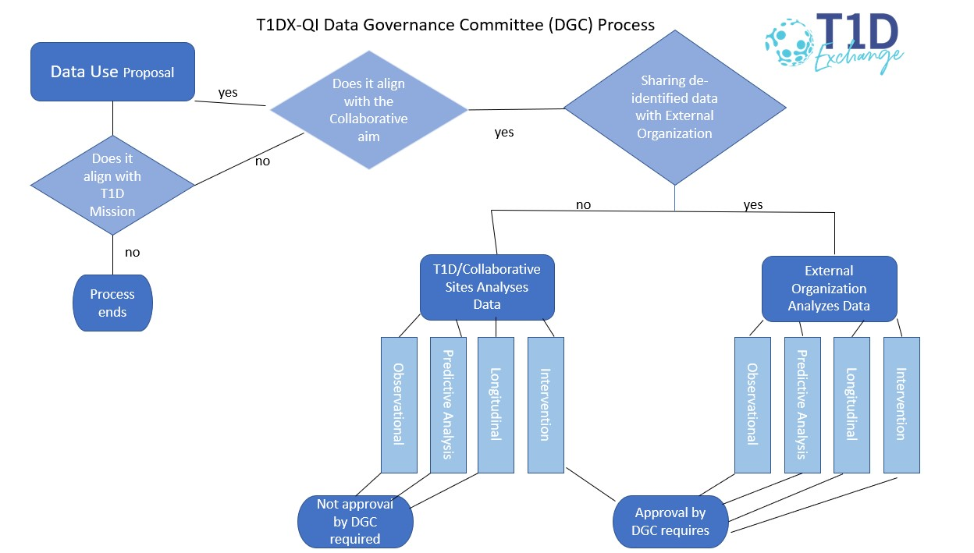
Data Governance Process Map

Slide 6
T1DX-QI Project Updates

Slide 7
T1D Antibody Screening Qualitative Assessment
Sponsor: (blinded study)
Objective: Determine provider attitudes toward T1D antibody screening among siblings of patients identified with T1D through focus groups. Submit at least two abstracts from the results of the survey and focus groups.
Participating Centers: TBD
Project Status/Results: ✓On Track

Slide 8
Ultra Rapid Insulin CME
Sponsor: MannKind
Objective: Develop a learning resource to increase awareness of the most current therapeutic modalities and medication regimens related to rapid and inhalable insulins for mealtime and correction boluses to effectively increase patients’ Time-In-Range and decrease post-prandial hyperglycemia and time in hyperglycemia. The outcomes will be measured by an analysis of numerical data obtained through participant evaluation of the stated learning outcomes.
Participating Centers: N/A; Facilitator identified from BDC (A)
Project Status/Results: ✓On Track

Slide 9
Smart Pen Equity
Sponsor: Eli Lilly
Objective:
Increase connected pen dosing data availability by 10% from baseline in 9 months
Increase shared decision-making documentation using the Diabetes Technology Assessment tool for eligible patients on MDI from 0% to 25% in 9 months
Increase % of patients on a smart/connected pen by 5% from baseline
Decrease % of patients on smart/connected pen with HbA1c >9% by 5% from baseline
Reduce % racial inequities between NHW vs NHB & Hispanic patients in the availability of connected pen data reporting for clinical management
Participating Centers: Stanford (A + P), Northwestern (A), Montefiore (A), NYU (A) Mount Sinai (A), Washington University (A), Le Bonheur (P), Children’s Healthcare of Los Angeles (P); 8 total
Project Status/Results: ✓On Track; pre-planning and kick-off completed; sites are gathering baseline data and completing QI planning through completion of process maps and Fishbone diagrams

Slide 10
CGM Analysis
Sponsor: Dexcom
Objectives:
Examine patient profiles of rtCGM users vs. SMBG users (using additional data from newly mapped sites).
Examine patient attributes and clinical outcomes among CGM initiators compared to a propensity score-matched comparison group.
Describe patient profiles for people currently using Dexcom CGM with Tandem X2 pump and control-IQ software.
Participating Centers: N/A; analyzing data from mapped centers
Project Status/Results: ✓On Track; T1DX has successfully delivered on Q1 and Q2 deliverables; on track to deliver Q3

Slide 11
Diabetes Device Equity
Sponsor: Medtronic
Objectives:
Evaluate the effectiveness of provider unconscious bias training and other clinician health inequities as an intervention to address systemic inequities in T1D care management.
Implement the 'T1Dx Equity Framework' and PDSA cycles to test changes in participating clinics with an aim to reduce inequities by at least 10% from baseline in CGM prescription rate for minoritized patients with T1D as compared with NH Whites in 10 months.
Implement the 'T1Dx Equity Framework' and PDSA cycles to test changes in participating clinics with an aim to use to reduce inequities by at least 10% from baseline in Insulin pump prescription rate for minoritized patients with T1D compared to NH Whites in 10 months.
Participating Centers:
Cohort 1: Nationwide (P), Cincinnati (P), Children’s of Alabama (P), Children’s Healthcare of Atlanta (P), Montefiore (A)
Cohort 2: To be finalized – 5 A and 3 P
Project Status/Results: ✓On Track; Cohort 1 project has been extended to continue collecting data demonstrating the equity impact; Cohort 2 will initiate this project in the Fall 2022.

Slide 12
Fear of Hypoglycemia
Sponsor: Eli Lilly
Objectives:
To understand the clinical processes, barriers, and resources needed for clinics and healthcare providers to implement the fear of hypoglycemia (FOH) screener in their daily practice
To estimate the prevalence of FOH among adults with T1D in the T1DX-QI
To further evaluate the reliability and validity of the FOH screener among diverse demographic groups within T1DX-QI
Participating Centers:
Project Status/Results: ✓On Track; project is complete; identifying opportunities for publishing findings (including recent ADCE 2022 conference)

Slide 13
Project Satisfaction

