Slide 1
T1Dx CGM Equity
Cincinnati Children’s Hospital
May 10, 2022

Slide 2
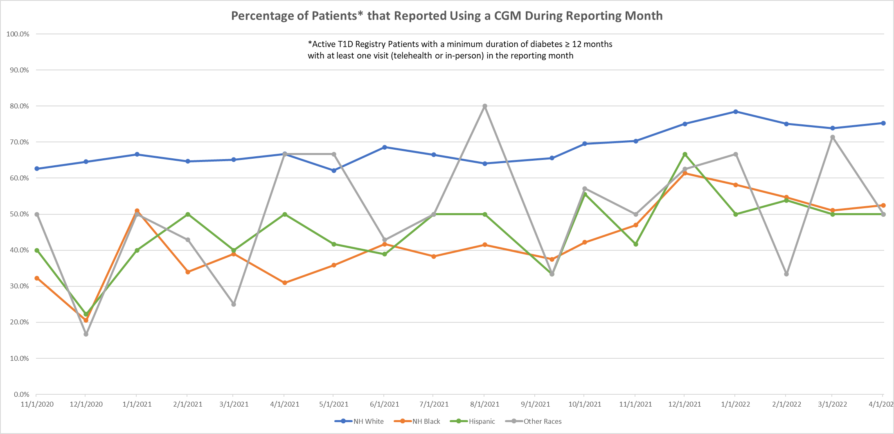

Slide 3
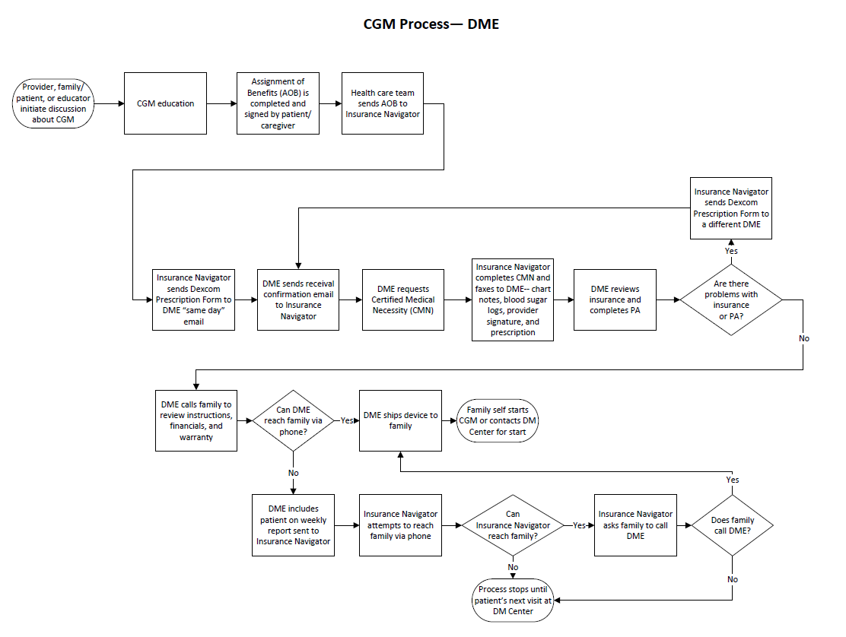

Slide 4
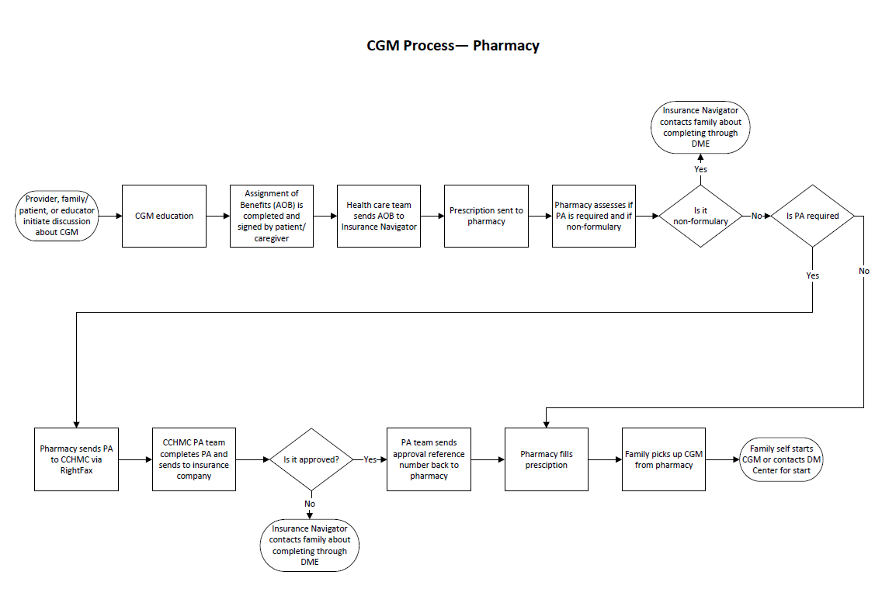

Slide 5
T1Dx CGM Equity Project (Pharmacy Process)-- Simplified Failure Mode Effects Analysis (sFMEA©)
Equity Lens: -Make list of pts without CGM– include race and insurance type -Translate flyers/ education -Standardized handouts about CGM and uptake process (including CGM start)– include info about cost of CGM and appts or how to look up cost -Role play provider exercise -Flyers about CGM or on waiting room/clinic room tv - CGM trial program -Insurance Navigator attend CGM classes
-Technology Barriers added to Epic flowsheet
Equity Lens: SDH Screening and resources for positive screens -Provider print off insurance info from EPIC -Staff help fill out form while pt in clinic
Equity Lens: -Curating pt’s pharmacies is esp important for families that often move -System that can identify closest pharmacy for families based on address and insurance type
-CCHMC pharm carries CGM supplies -In clinic ask family preferred pharmacy
-Nurses routinely clean up list of current pharmacies -Add “confirm pharmacy preferences” to visit checklist/comm. tool
Equity Lens: -Insurance Navigator or Endo staff call to investigate insurance coverage -Have a list of benefits by payer -Ask family on “CGM Readiness Screen” if they know insurance info/benefits -Shared Decision-Making tool/education about insurance options-- Pharm or DME, reviewed by SW CDE, or clinic staff
-Insurance 101/ Check-in at Beyond The Basics class for new onset pts– printed or video education deliverable
Equity Lens: -Create report for S3/M3 (or other subset) patients and check if they need follow-up related to pending CGM prescriptions -Process step for family or staff to call pharmacy to verify coverage/PA need -Revise and recirculate steps sheet for PA process– for providers and staff -Interactive Checklist for managing PA process
Equity Lens:
-SW assist with getting a hold of family or use cellphone to text them
-Educator help family make pharm call when they come back to clinic -CCHMC pharm carries CGM supplies
Equity Lens: -Utilize Dexcom start video w/ families -Phone call with Tech Team -CGM included in Day Hospital new onset bundle -Provider follow-up with family to understand why they don’t want it-- identify barriers & misconceptions -Increase communication that we are here to help with start
INTERVENTIONS
Provider- or patient-initiated discussion about CGM
Assignment of Benefits completed
Prescription sent to Pharmacy
Pharmacy assesses benefits and sends back to DM center if PA needed
DM Center completes PA and sends to insurance company. DM Center contacts pharmacy with approval reference number
Pharmacy fills prescription
Family self starts or contacts DM Center for start
CURRENT
PROCESS
-Provider/pt fails to initiate discussion - Provider has thoughts/bias that are barriers to bringing up CGM -Pt lack of awareness of CGM/Provider doesn’t know pt lacks awareness -Pt/family has thoughts/feelings about CGM that are barriers to uptake -Lack of standardization
-Family feels pressured Inequities: -Provider implicit bias -Health literacy -Technology literacy -Language barriers
-AOB not completed -Family doesn’t know insurance information -Provider unaware AOB needed -Time barrier -Paper AOB not available -Provider lack of awareness of online AOB/internal process Inequities: - Health literacy -Literacy- write/read -Language barriers
-Prescription not sent to pharmacy -Missing prescription (when switching from DME to pharmacy) -Sent to wrong pharmacy -Provider/nurse unaware how -Not in Epic preference list -Time barriers Inequities: -Not available for all patients d/t insurance
-Provider/pt and family not aware of coverage - Insurance company changes benefits -Lack of standardization -Process and criteria too complex -Takes too much time
-CGM denied -DM Center not notified of denial Inequities: -Insurance barriers -Healthcare navigation literacy -Cost
-DM Center doesn’t receive PA request -Refusal to attempt to complete PA -Doesn’t communicate to family if need to fill with DME -Time barrier -Lack of consistent staff to complete -Staff unsure of process -PA denied - PA delayed - Process too complex Inequities: -Insurance barriers
-Family not aware CGM ready and it’s put back -Pharmacy can’t reach family Inequities: -Cost/Can’t afford -Transportation issues -Neighborhood/ Delivery—Stolen, shipped to wrong parent, family has PO box, family homeless, delivered to wrong apt in building -Family doesn’t have reliable phone
-Family doesn’t start using CGM because they didn’t actually want it, felt forced -Busyness of life -Not comfortable to start on own, but don’t call for appt -Family doesn’t know that they can contact DM Center for help Inequities: -Cost of appt
- Health literacy -Literacy- write/read -Language barriers -Variability of caregivers - Home environment
FAILURE MODES
2017 © Cincinnati Children's Hospital Medical Center. All rights reserved. This work is licensed under the Creative Commons Attribution-NonCommercial-ShareAlike 4.0 International License. To view a copy of this license, visit http://creativecommons.org/licenses/by-nc-sa/4.0/ or send a letter to Creative Commons, PO Box 1866, Mountain View, CA 94042, USA. If you have any comments, questions or feedback regarding this tool, please email your feedback to AC4U@cchmc.org. Template created and maintained by The James M. Anderson Center for Health Systems Excellence at Cincinnati Children's Hospital Medical Center.

Slide 6
T1Dx CGM Equity Project (DME Process)-- Simplified Failure Mode Effects Analysis (sFMEA©)
Equity Lens: -Make list of pts without CGM– include race and insurance type -Translate flyers/ education -Standardized handouts about CGM and uptake process (including CGM start)– include info about cost of CGM and appts or how to look up cost -Role play provider exercise -Flyers about CGM or on waiting room/clinic room tv - CGM trial program -Insurance Navigator attend CGM classes
-Technology Barriers added to Epic flowsheet
Equity Lens: SDH Screening and resources for positive screens -Provider print off insurance info from EPIC -Staff help fill out form while pt in clinic -Standardize clinic staff giving AOB to Insurance Navigator -Change AOB to Epic form instead of paper -Create Epic in-basket pool for insurance process
Equity Lens: -Insurance Navigator or Endo staff call to investigate insurance coverage -Have a list of benefits by payer -Ask family on “CGM Readiness Screen” if they know insurance info/benefits -Shared Decision-Making tool/education about insurance options-- Pharm or DME, reviewed by SW, CDE, or clinic staff
-Insurance 101/ Check-in at Beyond The Basics class for new onset pts– printed or video education deliverable
- DME identified in EHR
- DM Center receives electronic notification (received)
- Pharmacy=DME
DME=Pharmacy (one and the same rec’g ctr!)
-CMN automatically generated with script -Electronic form in Epic -CMN not needed
Equity Lens:
-SW assist with getting a hold of family or use cellphone to text them -Educator help family make pharm call when they come back to clinic -CCHMC pharm carries CGM supplies
Equity Lens: -Utilize Dexcom start video w/ families -Phone call with Tech Team -CGM included in Day Hospital new onset bundle -Provider follow-up with family to understand why they don’t want it-- identify barriers & misconceptions -Increase communication that we are here to help with start
INTERVENTIONS
Provider- or patient-initiated discussion about CGM
Assignment of Benefits is completed
Dexcom prescription form sent to DME
DME sends Certification of Medical Necessity to DM Center
DM Center completes CMN and sends back to DME
DME contacts family and ships product
Family self starts CGM or contacts DM Center for start
CURRENT
PROCESS
-Provider/pt fails to initiate discussion - Provider has thoughts/bias that are barriers to bringing up CGM -Pt lack of awareness of CGM/Provider doesn’t know pt lacks awareness -Pt/family has thoughts/feelings about CGM that are barriers to uptake -Lack of standardization
-Family feels pressured Inequities: -Provider implicit bias -Health literacy -Technology literacy -Language barriers
Inequities:
-AOB not completed -Family doesn’t know insurance information -Provider unaware AOB needed -Time barrier -Paper AOB not available -Provider lack of awareness of online AOB/internal process -AOB lost in process– not sent to Insurance Navigator Inequities: - Health literacy -Literacy- write/read -Language barriers
-Prescription not sent to DME -Sent to wrong DME -Provider/nurse unaware how -Time barriers
-Provider/pt and family not aware of coverage - Insurance company changes benefits
-CGM denied -DM Center not notified of denial Inequities: -Not available for all patients d/t insurance
- DME never receives request
-DM Center never receives request -Sent but never received -Multiple sends
- Wrong DME - Inadequate staffing to move quickly
-DM Center doesn’t receive CMN -Time barrier -Lack of consistent staff to complete -Staff unsure of process - Process too complex -Provider not able to complete Inequities: -Insurance barriers
- DME can’t reach family Inequities: -Cost/Can’t afford -Neighborhood/ Delivery—Stolen, shipped to wrong parent, family has PO box, family homeless, delivered to wrong apt in building -Family doesn’t have reliable phone
-Family doesn’t start using CGM because they didn’t actually want it, felt forced -Busyness of life -Not comfortable to start on own, but don’t call for appt -Family doesn’t know that they can contact DM Center for help Inequities: -Cost of appt
- Health literacy -Literacy- write/read -Language barriers -Variability of caregivers - Home environment
FAILURE MODES
2017 © Cincinnati Children's Hospital Medical Center. All rights reserved. This work is licensed under the Creative Commons Attribution-NonCommercial-ShareAlike 4.0 International License. To view a copy of this license, visit http://creativecommons.org/licenses/by-nc-sa/4.0/ or send a letter to Creative Commons, PO Box 1866, Mountain View, CA 94042, USA. If you have any comments, questions or feedback regarding this tool, please email your feedback to AC4U@cchmc.org. Template created and maintained by The James M. Anderson Center for Health Systems Excellence at Cincinnati Children's Hospital Medical Center.
Notes:
Blue text are ideas from T1Dx
Yellow highlighting are things we have already started

Slide 7
T1Dx CGM Equity— Key Driver Diagram (KDD)
Project Leader: Nana-Hawa Yayah Jones, MD
Revision Date: 4/1/22 (v1)
Global Aim
Key Drivers
Interventions (LOR #)
Reduce equity gaps in the care of pediatric patients with Type 1 Diabetes
Accurate understanding of CGMs for patients/families
Provide education/training about CGMs (LOR 1)
Share patient experiences with other patients considering CGM (LOR 2)
Comprehensive understanding of CGMs for staff/providers
Implement handout for patients when offering CGM (LOR 1)
Shared decision making between staff/providers and families/patients
SMART Aim
Utilize coordinator roles for the CGM process: Financial counselor, insurance navigator, communication coordinator (LOR 2)
Increase the % of Black patients on CGM* from 38% to 70% by December 31, 2022. Increase the % of Hispanic patients on CGM* from 41% to 70% by December 31, 2022. *Patients who reported using CGM at clinic visit during reporting month
Effective and continuous communication about CGM process
Assessment of barriers and social determinants of health (SDH) (LOR 2)
Affordable technology access across the continuum of care
Offering patients products to help with CGM ongoing use (LOR 2)
Streamlined and patient-centered process for CGM uptake
Obtain licensure for CCHMC to be a DME Supplier (LOR 2)
Innovative healthcare delivery system
Standardize offering CGM at diagnosis (LOR 2)
Population
Effective and equitable health care policy and access throughout the spectrum of healthcare
Advocacy & building community partners (LOR 1)
Patients with Type 1 Diabetes seen at CCHMC DM Center
Expand CGM trial program (LOR 2)
Consistent and equitable provider offering of CGMs
Make list of patients not on CGM (LOR 2)
Legend
This work is licensed under the Creative Commons Attribution-NonCommercial-ShareAlike 4.0 International License. To view a copy of this license, visit http://creativecommons.org/licenses/by-nc-sa/4.0/ or send a letter to Creative Commons, PO Box 1866, Mountain View, CA 94042, USA. If you have any comments, questions or feedback regarding this tool, please email your feedback to AC4U@cchmc.org. Template created and maintained by The James M. Anderson Center for Health Systems Excellence at Cincinnati Children's Hospital Medical Center.
Potential intervention
Active intervention
Adopted intervention
Abandoned intervention
Note: LOR # = Level of Reliability Number, e.g., LOR 1

Slide 8
CGM Process: Problems and Ideas
CGM trial program would have been helpful
For interpreted forms, make sure Spanish-speaking familes check that it is phrased correctly
Introduce CGM when first diagnosed, it shouldn‘t be optional
Give tips for how to keep CGM on.
Call/message patient to check-in days/weeks after starting CGM
A video or handout about others‘ experiences and struggles would be helpful
Don‘t let patients go through all the struggles I did before starting CGM
CCHMC translators help families when they call DME (from home)
Let patients know upfront what to expect– there will be issues... call for help
Provider- or patient-initiated discussion about CGM
Assignment of Benefits is completed
Prescription sent to DME
DM Center facilitates paperwork
DME Contacts family and ships product
Family self starts CGM or contacts DM Center for start
At times, translators don’t understand what provider is saying so guess at translation
I left appt not feeling fully aware of CGM
The sensor looked scary. I was afraid of having something on me
Families don’t know the process, it’s very hard– a HEADACHE
Sometimes insurance company or DME asks for things I don’t understand (mom)– no translator
I didn’t ask for help because I didn’t want to complain
When first started— It felt weird, tight. Painful for about a day
I was afraid of having loud/ obnoxious alarms

Slide 9
Project Title: | T1Dx CGM Equity
Intervention Name: |  | No CGM List
What key driver does this test impact? |  |  |  | Accurate understanding of CCGMs for patient/families; Consistent and equitable provider offering of CGM
Test Cycle #: | 3 |  | Test Cycle Start Date: | 4/4/22 | Test Cycle Completion Date: | 4/15/22
An automated weekly report will be emailed to a CDCES that will indicate which Black and Hispanic patients do not have CGM. CDCES will review list and identify patients are coming to clinic the upcoming week. She will schedule CDCES visits with those patients during their clinic visits, she and other CDEs will meet with the patient during their visit. The intent is to discuss patients’ current barriers for starting CGM, provide education/troubleshooting as needed, and encourage patients to start CGM, if appropriate.
CDCES received the automated report and thought it was easier to use than previous report. No problems with the report, and she was able to make appointments for the Black and Hispanic patients not on CGM. Most patients were able to be seen by CDCES during their clinic visit.
During their clinic visits, CDCES team will be able to see all Black and Hispanic patients not on CGM. The conversation will enable team to identify patient barriers for CGM. Patients will have more information about CGM. % of patients on CGM will increase. Measures: Qualitative feedback from CDCES; % of Black patients on CGM run chart; Epic Technology Barriers flowsheet
Appts have felt very beneficial and provided great communication with patients. There were some opportunities for CGM education/troubleshooting and problem solving for financial barriers Barriers identified when CDCES not available – contact dermatitis with Dexcom, follow up with getting Dexcom supplies, lack of trust in device, and adhesion difficulty. The % of patients on CGM did not increase yet, but this intervention will have delayed results on the measure. CDCES noticed that HealthVine (Medicaid) patients were also on the report, and thought the CDCES team would have the bandwidth to meet with them also.
The CDCES team will be able to see the majority of patients when they are at clinic. They will discuss patients’ barriers and document in Epic. We might not see an increased % of patients on CGM immediately, but with continued use of this intervention we should.
Data team will create automated list. CDCES (Amanda) will review the list weekly and schedule CDE visits for patients in clinic this week.
CDEs will discuss barriers for CGM with patients/families and document in Epic Technology Barriers Flowsheet.
x
Spread intervention to HealthVine patients, for 2 weeks (until next meeting)

Slide 11
