Slide 1
IHI Improvement Model
AIM
What are we trying to accomplish?
Measures
How will we know that a change is an improvement?
Key Drivers &
Interventions
What changes can we make that will result in improvement?
Small Tests of Change
Act
Plan
This is where we will
Introduce the RAIL:
Rolling Action Item List
Study
Do

Slide 2
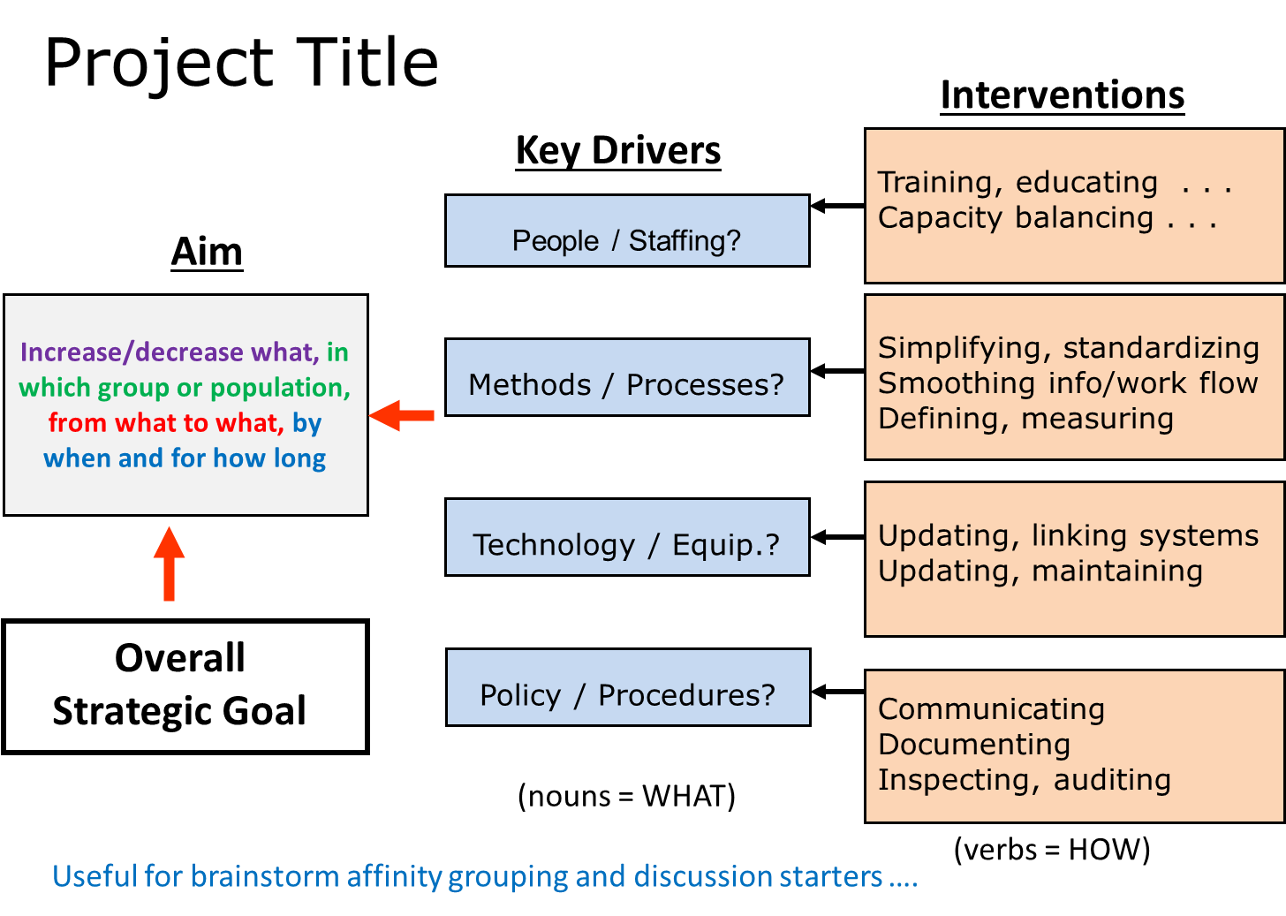
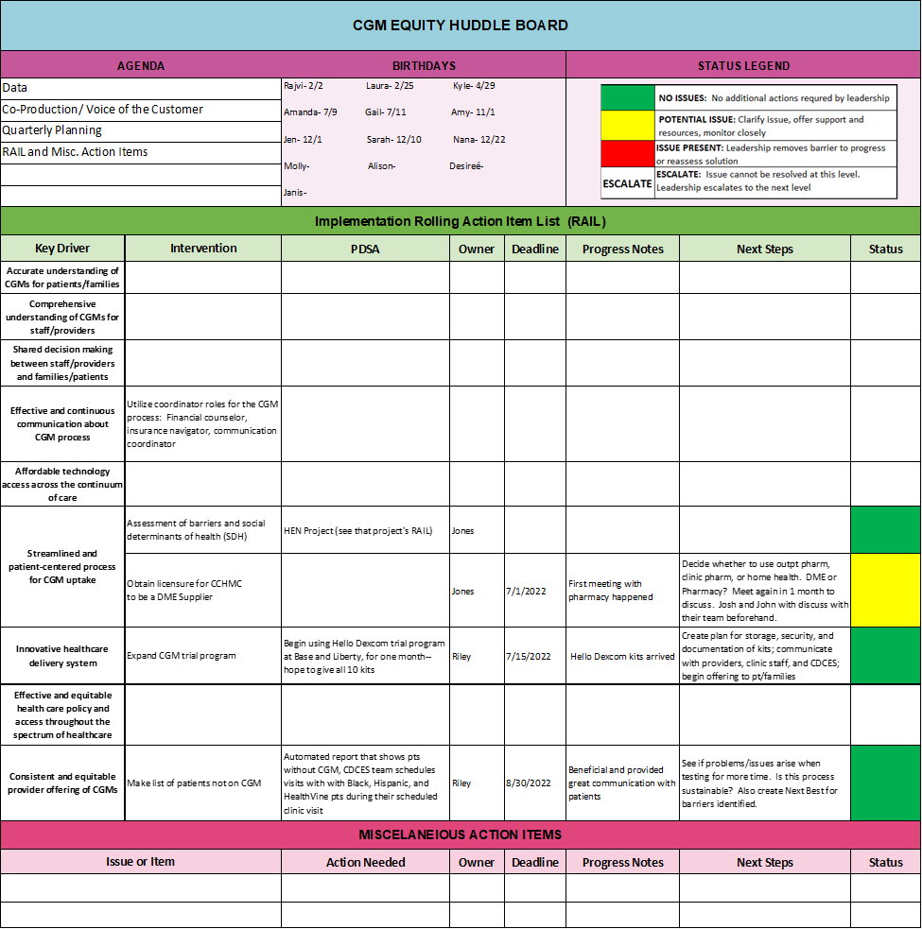
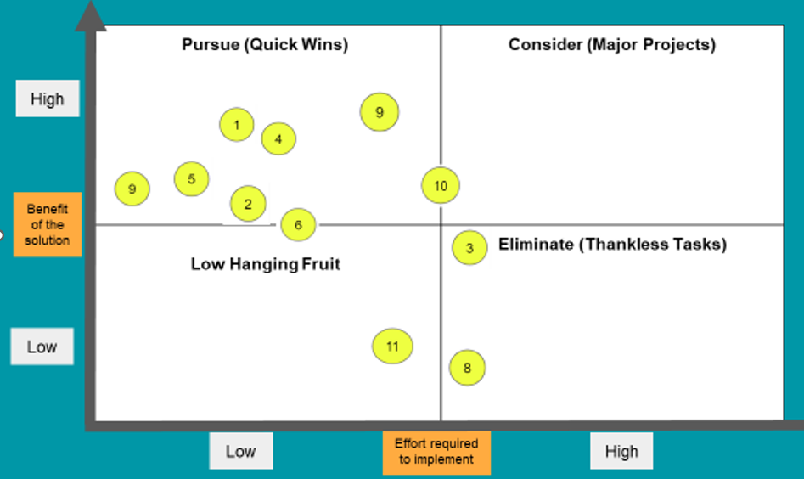
Key Driver Diagram
To Remove Barriers
[Effort/Impact]
[Barriers]
PLAN
DO
STUDY
ADJUST
Rolling Action
Item List [RAIL]
❶❷❸ ❹ ❺ ❻ ❼ ❽ ❾ ❿
Effort/Impact Matrix
To Prioritize Interventions

