Slide 1
QI Champion’s meeting
May 2022

Slide 2
Agenda
Background
Overview: Health Equity Project
High-level Project Update

Slide 3
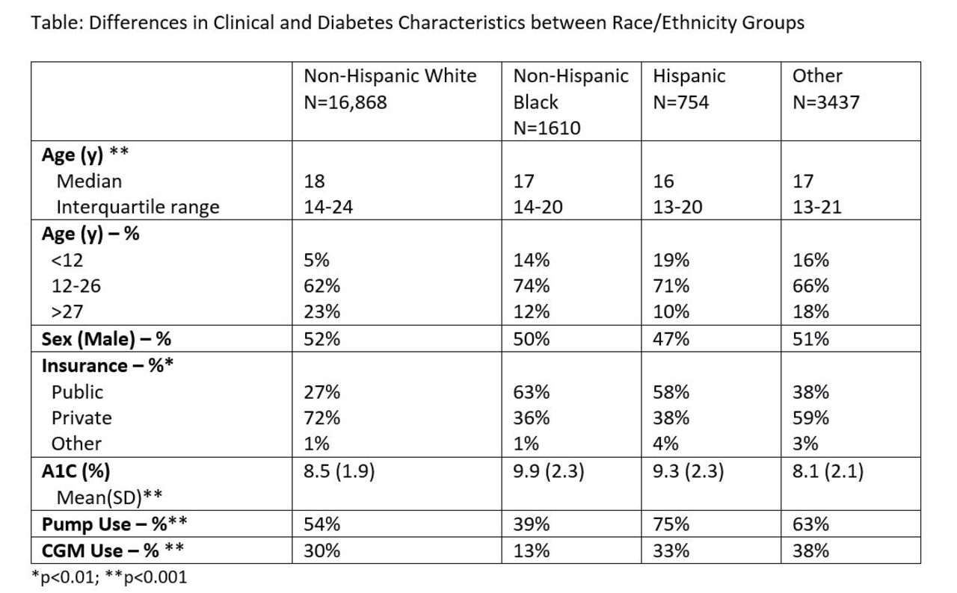
Rationale
https://diabetes.diabetesjournals.org/content/69/Supplement_1/1220-P

Slide 4
CGM and Pump Inequities Quality Improvement Project
Participating Sites (Five Pediatrics and Two Adults)
*T1D Exchange sponsored site

Slide 5
Project Milestones
Phase 1 completed (April 2021 – July 2021)
Identify Sites and Kick off
Implicit Bias Training
Data reporting
Equity focused Aim
Improvement Team with patient advisory
Phase 2 - Ongoing (August 2021 – Present)
10 Step Improvement Process
Monthly data reporting
Monthly check-in
Process maps
Key Driver Diagrams
Plan-Do-Study-Act cycles

Slide 6
Aims
Evaluate the effectiveness of provider unconscious bias training and other clinician health inequities as an intervention to address systemic inequities in T1D care management
Participating Centers will collaboratively reduce the Inequities in Pump Use between Non-Hispanic White and Hispanic T1D Patients from 19% to 10% and between Non-Hispanic White and Non-Hispanic Black T1D Patients from 28% to 14% by June 2022
Participating Centers will collaboratively reduce the Inequities in CGM Use between Non-Hispanic White and Hispanic T1D Patients from 16% to 5% and between Non-Hispanic White and Non-Hispanic Black T1D Patients from 15% to 5% by June 2022

Slide 7
Phase 1: Over 200 clinic team members participated in a virtual Health Equity/Implicit Bias Training and ongoing access to on-demand classes

Slide 8
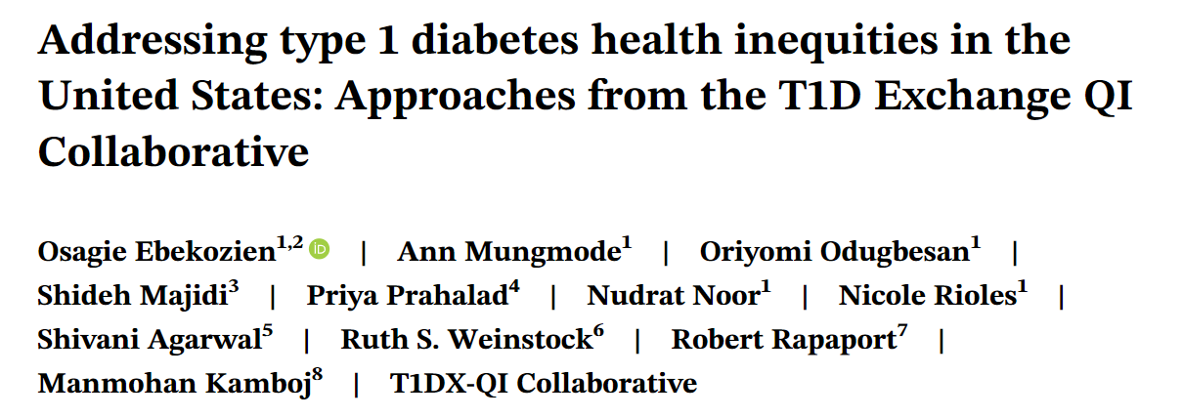
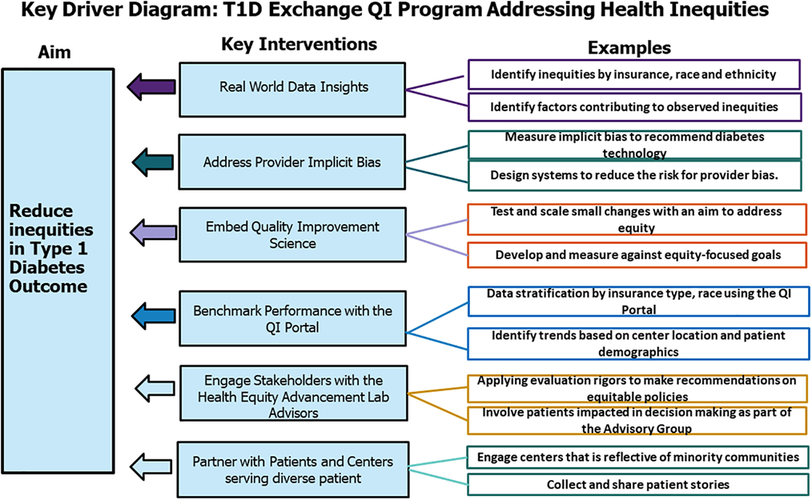
Phase 1 Dissemination: Manuscripts
New manuscript published in Journal of Diabetes December 2021
Ebekozien O Diabetes Addressing type 1 diabetes health inequities in the United States: Approaches from the T1D Exchange QI Collaborative; Journal of Diabetes 2021:
https://doi.org/10.1111/1753-0407.13235

Slide 9
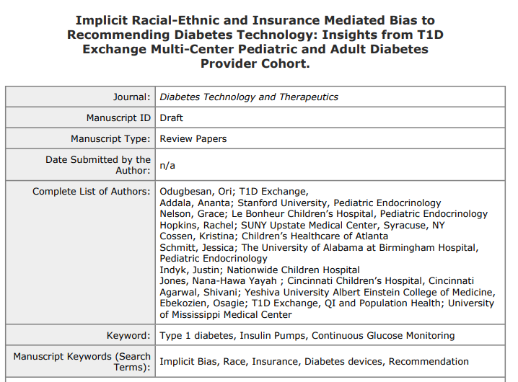
Submitted manuscripts undergoing peer review

Slide 10
Phase 1 Dissemination: Accepted Conference Abstracts
Ranking Of Important Factors In Recommending Diabetes Technology By Pediatric And Adult Endocrinologists: Data From The T1d Exchange (Oral Presentation)
Race-Ethnicity Mediated Bias In Recommending Diabetes Technology: Does Implicit Bias Training Make A Difference (Poster Presentation)
Inequities In Diabetes Device Use: T1d Exchange Baseline Trend Analysis (Oral Presentation)
Diabetes Provider Bias to Recommending Diabetes Technology for Patients on Public Insurance in the United States(Oral Presentation)

Slide 11
T1D Exchange Equity Framework: Site Interventions
Ebekozien OA, Ori Odugbesan et al Equitable Post COVID-19 Care: A Practical Framework to integrate Health Equity in Diabetes Management. Journal of Clinical Outcomes and Management Nov 2020 https://doi:10.12788/jcom.0025

Slide 12
Equity Project KDD (CGM)
Change Ideas
Equity/unconscious bias training
Aim
Primary Drivers
Accessibility to translated materials
Have CDE/SW work with Black and NHB patients to address SDOH
Utilize community outreach staff to help families with some of the more difficult steps
Disparity Advocacy
Translator available in clinic
Live interpreters for CGM starts and follow ups
A. Participating Centers will collaboratively reduce the Inequities in CGM Use between Non-Hispanic White and Hispanic T1D Patients from 10% to 5% by June 2022 B. Participating Centers will collaboratively reduce the Inequities in CGM Use between Non-Hispanic White and Non-Hispanic Black T1D Patients from 10% to 5% by June 2022
Provider & Team Bias
Equity/SDOH
Handouts from companies in other languages
Device data reviews and interpretation, staff troubleshoot device for patients who need it
Create CGM peer support groups for Blacks and NHB patients
SDOH screening at every visit
Education/Training
Discuss CGM regularly at appointments
Provide education on basic criteria for insurance (Medicaid vs Private)
Have CGM education visible in waiting rooms
Utilize Patient advocates to help talk with technology hesitant families
Force function/automatization
Provider training
Technology
Tracking insurance forms/refills/initial starts
Create process for CGM start based on insurance type
Improve/standardize workflow for insurance coverage
Provide contact information for device reps/patient support
Lessen insurance requirements that make it so hard to get technology
Standardize criteria for prescription
Force function/automatization
Policies/Insurance
Access
Require patients to provide logs at initiation
Standardize communication for staff and device companies
FAQ education sheet
Use EPIC flow sheet identify barriers
“CGM champion” to help follow up with family
Nurse training/outreach
Communication/
Shared decision
Provide alternative contact options for families to call clinic: Email, iConnect message
Best practice alert reminder
Barrier assessment survey
More time with CDE and make introduction to technology a bigger part of initial education
Equity Framework
Utilize PDSA cycles to test small changes and scale up

Slide 13
Equity Project KDD (Insulin Pumps)
Change Ideas
Equity/unconscious bias training
Aim
Primary Drivers
Add additional pump classes to give families more options
Accessibility to translated materials
Have CDE/SW work with Black and NHB patients to address SDOH
Utilize community outreach staff to help families with some of the more difficult steps
Disparity Advocacy
Translator available in clinic
Live interpreters for pump starts and follow ups
A. Participating Centers will collaboratively reduce the Inequities in Pump Use between Non-Hispanic White and Hispanic T1D Patients from 19% to 10% by June 2022 B. Participating Centers will collaboratively reduce the Inequities in Pump Use between Non-Hispanic White and Non-Hispanic Black T1D Patients from 28% to 14% by June 2022
Provider & Team Bias
Equity/SDOH
Handouts from companies in other languages
Device data reviews and interpretation, staff troubleshoot device for patients who need it
Create Insulin pumps peer support groups for Blacks and NHB patients
Education/Training
Provide log-books in clinic when refer to pre-pump and have patient bring the completed logs to pre-pump class
Provide education on basic criteria for insurance (Medicaid vs Private)
Track pump training
TRACK the content of what educators are providing to families
Utilize Patient advocates to help talk with technology hesitant families
Technology
Use EMR to tracking interest, discussions, and issues with pumps in the past
Tracking insurance forms/refills/initial starts
Make discussing pump a part of CDE care at the 6 months and 1 year from diagnosis
Improve/standardize workflow for insurance coverage
Provide contact information for device reps/patient support
Lessen insurance requirements that make it so hard to get technology
Standardize criteria for prescription
Policies/Insurance
Access
"block" 1 "pre-pump" slot per week to hold as a "schedule-in-clinic" slot
Scheduling Pump class at time of appointment
Team reaches out to pump company to order the pump for on English families
Skills assessment
Change Rigid Clinical guidelines for pump committee
“pump champion” to help follow up with family
Communication/
Shared decision
Provide alternative contact options for families to call clinic: Email, iConnect message
My diabetes journey shared decision tool
Best practice alert reminder
Barrier assessment survey
More time with CDE and make introduction to technology a bigger part of initial education
Equity Framework
Utilize PDSA cycles to test small changes and scale up
Notes:
Clean up to reflect reality as of today

Slide 14
Preliminary Results
Beginning to see early improvement.
CGM use has increased across all racial/ethnic groups. Median Use;
71% amongst NHW patients( 12%)
52% among NHB patients ( 8%)
58% in Hispanic patients ( 15%)
The disparity gap between NHW and NHB shows a stable trend
The disparity gap between NHW and Hispanic shows a positive decrease by 3%

Slide 15
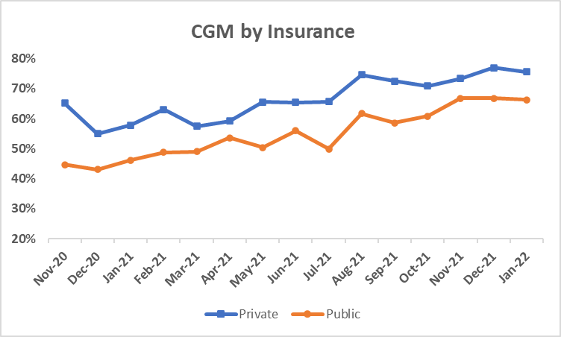
CGM By Insurance
Increase CGM use in both public and Private insurance groups has increased across;

Slide 16
Next Steps
Continue testing and scaling interventions at clinical sites
Monthly data reporting/review
Harvesting successful Ideas for scale/spread
Health Equity Change Package

