Slide 1
QI Publications Committee
July 2022

Slide 2
Agenda
Introductions (Shideh)
Publications updates (Shivani)
Upcoming Conferences (Shideh)
November 2022 Learning Session
ATTD 2023
ADA 2023
Review Current Process/Publication Policy
JOD Abstract Submission for November Learning Session (Shivani)

Slide 3
Q1 2022 Manuscript Scorecard – July 2022
Phase 1 (New Idea): 13
Phase 2 (Internal group) 3
Phase 3 (Publication committee review) 2
Phase 4 (Journal Review ): 11
Phase 5 (Manuscript Accepted/Published): 8

Slide 4
Clinic Representation in 3 published Q2 Manuscripts
Pediatrics
Cincinatti Children's Health Medical Center, OH (1)
Children's Healthcare of Atlanta, GA (1)
Children's National, D.C (1)
Children's Mercy, MO (1)
Barbara Davis Center, CO (1)
Le Bonheur Children’s Hospital (1)
Nationwide Children's, OH (2)
Rady Children's Hospital, CA (1)
Stanford Children's Health Lucile Packard , CA (2)
Texas Children's Hospital, TX (2)
University of Florida Health, FL (1)

Slide 5
Clinic Representation in 3 published Q2 Manuscripts
Adults
Albert Einstein College of Medince, NY (1)
Barbara Davis Center, CO (1)
University of Alabama Birminghmam, AL (1)
Upstate University Hopsital, NY (1)

Slide 6
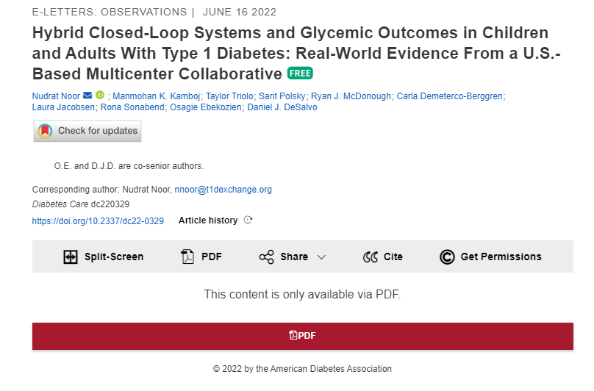
Phase 5 published Manuscript Q2 2022

Slide 7
Phase 5 published Manuscript Q2 2022

Slide 8
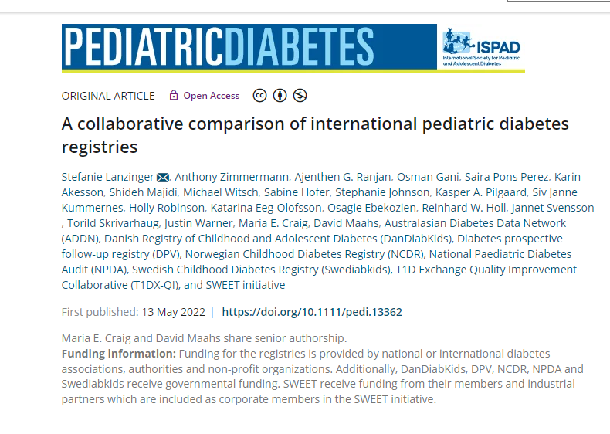
Phase 5 published Manuscript Q2 2022

Slide 9
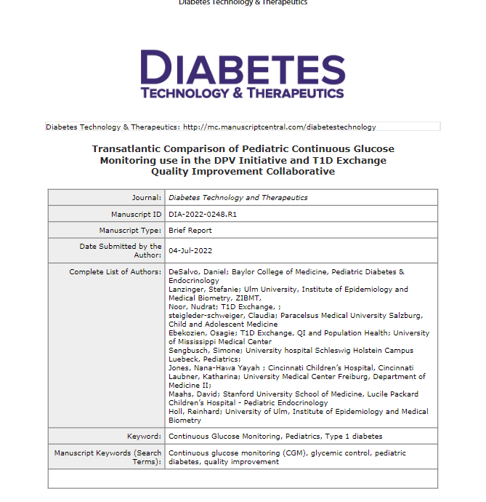
Phase 5 accepted Manuscript Q3 early progress

Slide 10
Clinical Diabetes Fall 2022 Special Issue Submission * manuscripts expected to be published in September/October Issue
Baseline QI Capacity Assessment for 34 Centers (Marks)
QI Portal and Data Mapping Process (Mungmode)
Pediatrics Glycemic Outcomes (Demeterco)
Adult Glycemic Control (Akturk)
Smart Pen Drivers and Barriers (Ospelt)
Commentary on Clinical Diabetes Publications (Majidi)
Notes:
Add all Clinical Diabetes titles and first authors

Slide 11
Phase 4- Manuscripts Under Journal Review
Short Title: Pediatrics Glycemic Outcomes
First author: Demeterco
Senior author: Jacobsen
Status: Submitted
Target Journal: Clinical Diabetes
Short Title: Adult Glycemic Outcomes
First Author: Akturk
Senior Author: Polsky
Status: Submitted
Target Journal: Clinical Diabetes

Slide 12
Phase 4: Manuscripts Under Journal Review
Short Title: Smart Pen Drivers and Barriers
First Author: Ospelt
Senior Author: Scott and Schmitt
Status: Submitted
Target Journal: Clinical Diabetes
Short Title: Commentary on Clinical Diabetes Publications
First Author: Majidi
Senior Author: Ebekozien
Status: submitted
Target Journal: Clinical Diabetes

Slide 13
Phase 4: Manuscripts Under Journal Review
Short Title: QI Portal and Data Mapping Process
First Author: Mungmode
Senior Author: Clements and Alonso
Status: Submitted
Target Journal: Clinical Diabetes
Short Title: Baseline QI Capacity Assessment for 34 Center
First Author: Marks
Senior Author: Ebekozien
Status: Submitted
Target Journal: Clinical Diabetes

Slide 14
Phase 4: Manuscripts Under Journal Review
Short Title: Benchmarking GCM and Pump use for Adults
First Author: Sullivan
Senior Author: Steenkamp
Status: submitted
Target Journal: JOD
Short Title: Impact of diabetes status and related other factors on COVID-19-associated related hospitalization
First Author: Talon
Senior Author: Clements
Status: submitted
Target Journal: Diabetes Research and Clinical Practice

Slide 15
Phase 4: Manuscripts Under Journal Review
Short Title: Diabetes status and other factors as correlates of risk for thrombotic and thromboembolic events:
First Author: Gallagher and Tallon
Senior Author: Clements
Status: submitted
Target Journal: Diabetes Care
Short Title: Comorbidities with T1D and COVID-19
First author: Mann
Senior author: Ebekozien
Status: review
Journal: Pediatric Diabetes

Slide 16
Phase 4: Manuscripts Under Journal Review
Short Title: Insulin Pump Trends and HbA1c Association
First Author: Gandhi
Senior Author: Kamboj
Status: submitted
Target Journal: JOD

Slide 17
Phase 3: Publication Committee Review
Short Title: Benchmarking GCM and Pump use for Peds
First author: Prahalad
Senior Author: Ebekozien
Status: In progress
Target Journal: Journal of Diabetes
Short Title: Psychosocial Screening
First Authors: Corathers
Senior Author: Munoz
Status: In review
Target Journal: Current Diabetes Report

Slide 18
Phase 2: Internal Author Review
Short Title: One Year Telemedicine follow up
First Author: Lee and
Senior Author: Vendrame
Status: In progress
Target Journal: DTT
Short Title: HbA1c and Equity trend 2016-2021
First Author: Mungmode
Senior Author: Ebekozien
Status: In progress
Target Journal: The Lancet

Slide 19
Phase 2: Internal Author Review
Short Title: Depression Screening QI
First Author: Dei Tutu
Senior Author: Odugbesan
Status: In progress
Target Journal: BMJ Quality
Short Title: COVID Impacts on Depression Screening
First Author: Roberts
Senior Author: Ebekozien
Status: In progress
Target Journal: JAMA

Slide 20
Phase 2: Internal Author Review
Short Title: FTE and Outcomes
First Author: Gallagher
Senior Author: Rapaport
Status: In progress
Target Journal: JCEM

Slide 21
Upcoming Conference Dates
November Learning Session: November 7-8 2022 Miami, FL
Friday July 29th abstracts need to be sent
ATTD: February 22-25 2023, Berlin Germany
Ideas due by on or before August 30th 2022
ADA: June 23-27 2023, San Diego California
Ideas due by on or before September 30th 2022

Slide 22
First/Senior author writs and submits draft to Coordinating Center
QI Publication Process
Aim: Manuscript writing process is completed in less than 120 days
Coordinating Center and First author selects co- author based on data, clinical interest, publication history
First/Senior Author submits proposal to Coordinating Center
Coordinating Center analyst discuss with First/Senior author analysis plan
Coordinating Center reviews request
Coordinating Center shares data package with First/Senior author
Journal accepts edits from authors
Coordinating Center returns to co-authors for revisions
Journal Accepts Manuscript
yes
First/Senior authors reviews, address feedback returns to coordinating center
no
First and Senior author reviews and edits journal comments
Coordinating Center or Frist/Senior author submits to journal
First/Senior author address feedback from Publication Committee
Coordinating Center selects 3 main reviewers from Publications Committee
Journal reviews manuscript
Last revised 7/11/22

Slide 23
JOD November Learning Session Discussion

Slide 24
T1DX-QI Publication Policy

