Slide 1
QI Collaborative Call, Adults
7/26/22

Slide 2
Welcome & introductions

Slide 3
Agenda
Collaborative updates
New clinics joining the Collaborative
New T1DX-QI Team member
New measures for the 2023-2025 period
Annual survey
RSVP for the November Learning Session
Collaborative member website
August Newsletter
Portal updates
Publications Updates
July Collaborative member presentations
Dr. Basina, Stanford
Alisha Virani, RD, CDCES, Grady Memorial
Notes:
Add Phase 1 measures

Slide 4
T1D Exchange Updates

Slide 5
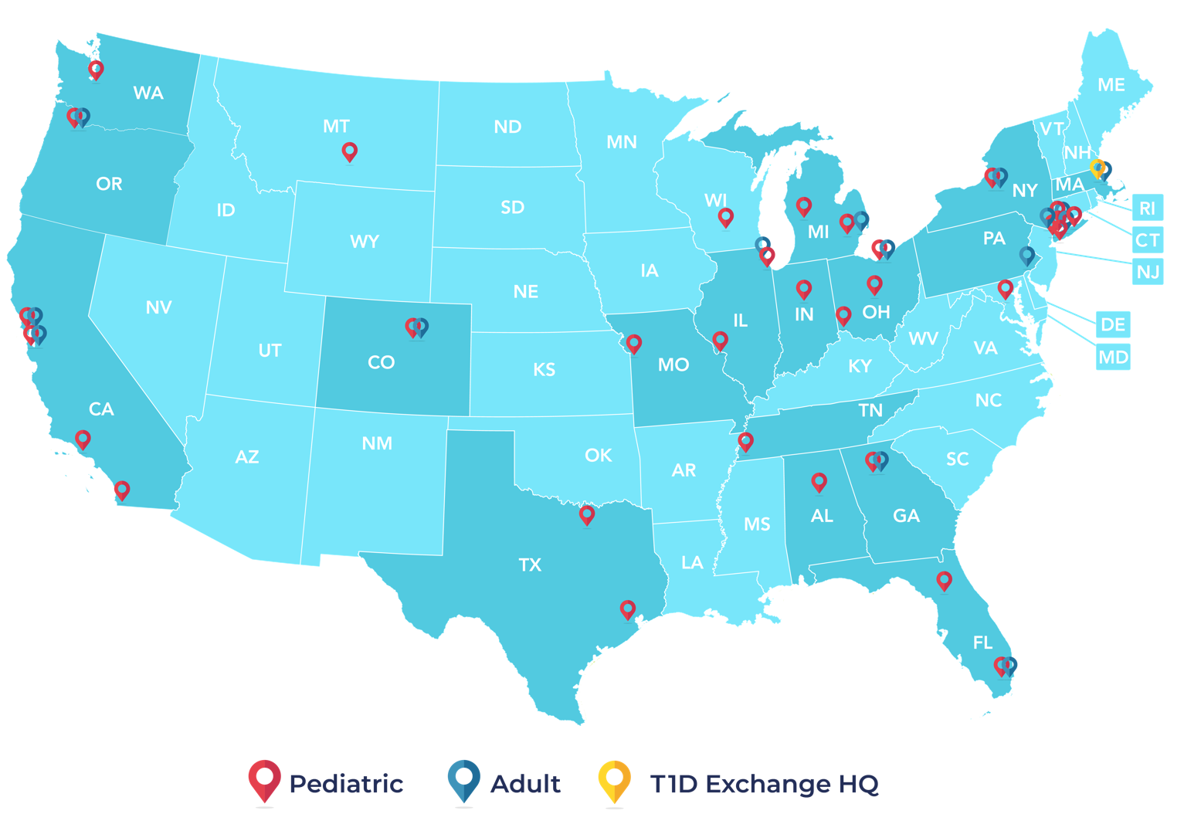
T1DX-QI network of 49 centers, caring for 72,000+ T1D patients across 19 states and Washington D.C.
Priya Prahalad, Nicole Rioles et al. T1D Exchange Quality Improvement Collaborative: Accelerating Change through Benchmarking and Improvement Science for People with Type 1 Diabetes. Journal of Diabetes. November 2021

Slide 6
31 pediatric clinics – caring for 46,000+ patients with T1D
Notes:
Include Trello link to the updated contact list for 41 Centers

Slide 7
18 adult clinics – caring for 26,000+ patients with T1D
Notes:
Include Trello link to the updated contact list for 41 Centers

Slide 8
49 Participating Clinics, 31 Pediatric & 18 Adult
Pediatric Clinics | Lurie Children’s Naomi Fogel MD | Adult Clinics Albert Einstein Shivani Agarwal MD MPH | Pediatric and Adult Clinics
Children’s Mercy Hospital Mark Clements MD PhD | Mott Children’s Joyce Lee MD | Billings Clinic Haleigh James MD | Cleveland Clinic, Pratibha PR Rao MD MPH & Andrea Mucci MD MASc
Children’s Hospital Los Angeles Brian Miyazaki, MD | Nationwide Children’s Manu Kamboj MD | Boston Medical Center Devin Steenkamp MD | Mount Sinai Carol Levy MD & Robert Rapaport MD
Cincinnati Children’s Hospital Sarah Corathers MD | Rady Children’s, Carla Demeterco Berggren MD PhD | Grady Memorial Hospital Sonya Haw MD | NYU Langone: Lauren Golden MD & Siham Accacha MD. Hassenfeld Children’s Hospital at NYU Mary Pat Gallagher MD
CHOA Kristina Cossen MD | Seattle Children’s Hospital, Faisal Malik MD, MSHS and Alissa Roberts MD | Northwestern Medicine Grazia Aleppo MD | Oregon Health & Science University Andrew Ahmann and Ines Guttmann-Bauman MD
Cohen Children’s Medical Center, Northwell Health, Jennifer Sarhis MD & Allison Mekhoubad MD | Texas Children’s, Daniel DeSalvo MD | Penn Medicine Ilona Lorincz MD | Stanford University Marina Basina MD & Priya Prahalad MD
Cook Children’s Paul Thornton MD & Susan Hsieh | University of Florida Laura Jacobsen, MD | Washington University Alexis McKee MD | SUNY, Pediatrics and Adult Ruth Weinstock MD PhD Roberto Izquierdo MD
Helen Devos Children’s Donna Eng MD | University of Alabama Mary Lauren Scott MD | Wayne State University, Berhane Seyoum MD & Elizabeth Morrison MD | UCSF, Pediatrics and Adult, Umesh Masharani MD & Jenise Wong MD
Indiana University Health Anna Neyman MD | University of Wisconsin, Madison Liz Man MD | Pediatric and Adult Clinics | University of Miami, Francesco Vendrame, MD PhD & Janine Sanchez MD
Le Bonheur Children's, U TN Grace Bazan MD | Weill Cornell Alexis Feuer MD | Barbara Davis Center Halis Akturk MD & Todd Alonso MD | University of Pittsburgh Medical Center, Jason Ng, MD & Alissa Guarneri MD

Slide 9
Washington University in St. Louis Division of Endocrinology, Metabolism & Lipid Research
Multidisciplinary Team Members | Patient Demographics | Contact Names
13 attending faculty 2 attending inpatient only faculty 8 fellows 3 NPs 5 CDCES 1 Foot RN | ~ 8-10 newly dx T1DM patients per month ~ 1500 established patients with T1DM 60% commercial insurance 40% Medicare/Medicaid | Site PI Alexis M.McKee, MD, CDCES ammckee@wustl.edu Site Coordinator Becky Sidberry, NP rebeccas@wustl.edu

Slide 10
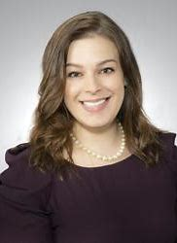
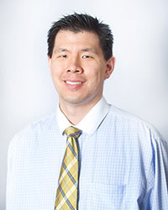
Welcome two new University of Pittsburgh Medical Center clinics!
Pediatric PI: Alissa Guarneri, MD,
UPMC
Adult PI: Jason Ng, MD
UPMC

Slide 11
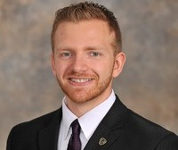
T1DX-QI welcomes a new team member!
Data Integration Manager
Jesse Cases-Villablanca, MS, MPA

Slide 12
Growth and promotions in the Collaborative!
Dr. Nana-Hawa Yaya Jones is now Associate Professor at Cincinnati Children’s!

Slide 13
New measures for the Collaborative
New measures will be circulated in early August
Separate measures and definitions for Adult and Pediatric centers
Google link will be share for a 30-day comment period
After your feedback is collected and definitions are finalized, final measures will be distributed in October so that your analysts have 90 days to review and update/create new reports for the measures
New measures go live Jan 1, 2023 and will remain in use until Dec 31, 2025

Slide 14
T1DX-QI Annual Survey
A new survey link will be shared on Qualtrics for the T1DX-QI Annual Survey
Survey link will be live 8/15-9/15
Each clinic is being asked to complete 1 survey
Ideally you will review with your internal team members to have knowledge/consensus for your responses
A PDF of the survey will be shared so that you can review before answering the questions. PDF will be accessible on the T1D-QI member website

Slide 15
Friday 7/29 is deadline to RSVP for Learning Session
Last day to RSVP for the November Learning Session is Friday 7/29
Email your response to QI@t1dexchange.org so that we know who is attending in person or virtually/through Zoom
Details for the event:
2-day learning session: Monday November 7-Tuesday November 8
Activities begin by 8am on 11/7, so in person attendees are encouraged to fly in on Sunday 11/6
Activities end by 3pm on 11/8 so that you can fly home Tuesday evening
Activities will have CME/CEU credits
T1D Exchange will cover costs for:
Two team member flights and hotels for two nights (We book the hotel. You book your flight and we reimburse you for the flight.)
If you wish to bring a 3rd team member, communicate that to T1DX-QI. Those expenses will need to be covered by your institution.
Our reimbursement form/details can be found on the T1D Exchange website. Use this link to access on the website!

Slide 16
T1DX-QI August Newsletter is released on Monday, 8/1
Be sure to check out the newsletter next Monday
Resources, links, reminders, deadlines, highlights are all featured
If you have something that you would like to announce from your clinic (for example, we’d be happy to highlight it on a newsletter
For example
Notes:
https://umich.qualtrics.com/jfe/form/SV_3VmVBRx1EjpMwCO

Slide 17
T1D Exchange Website
We use the protected space to:
Share work in progress, including emerging case studies and interventions
Ask questions to the Collaborative network with the ability to view archived threads and responses

Slide 18
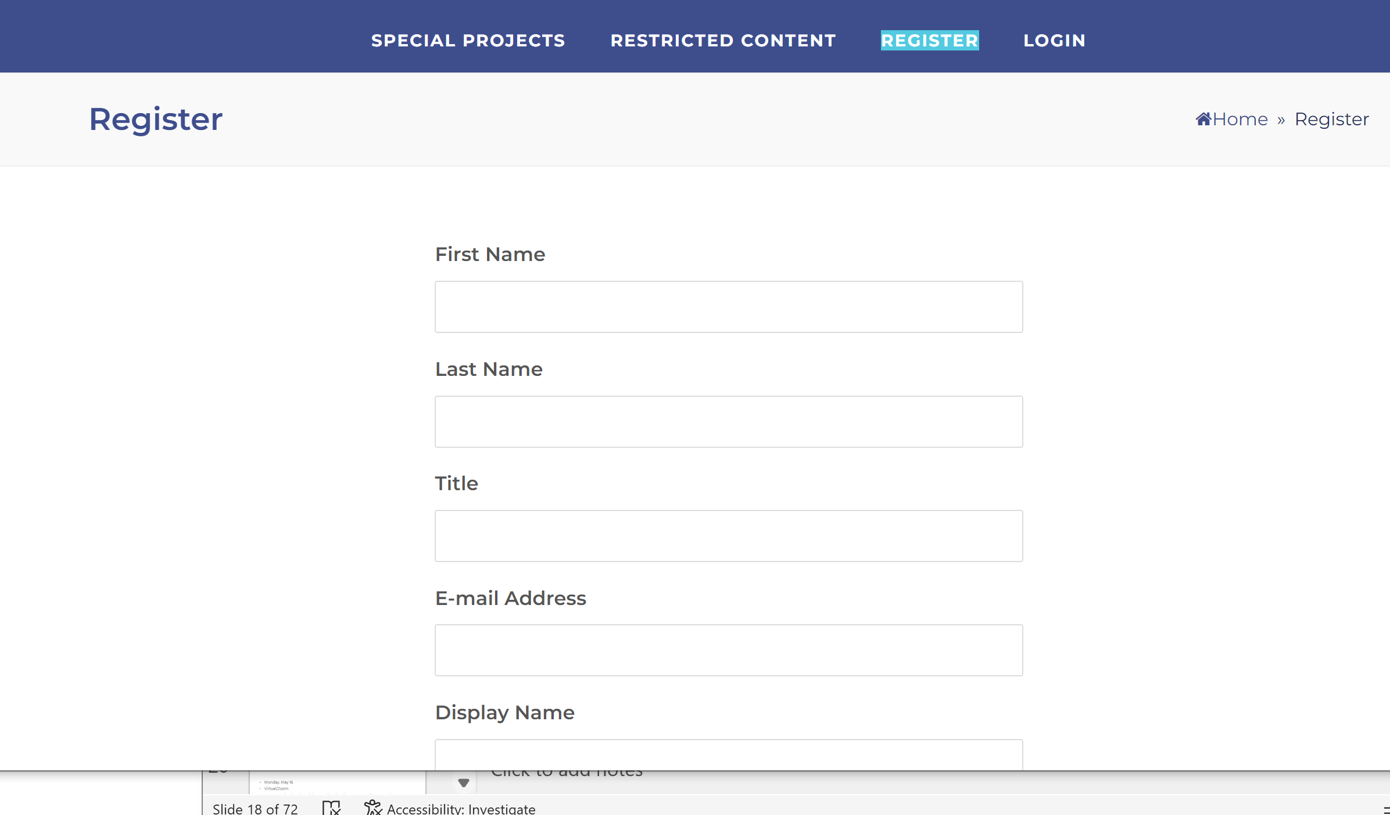
How to join website: 3 easy steps
Visit registration page: https://t1dx-qi.t1dexchange.org/register/
Register with name, title, email information. Create a password.
T1DX-QI team gets pinged to ensure that newly registered members are affiliated with the Collaborative- and you’re in!

Slide 19
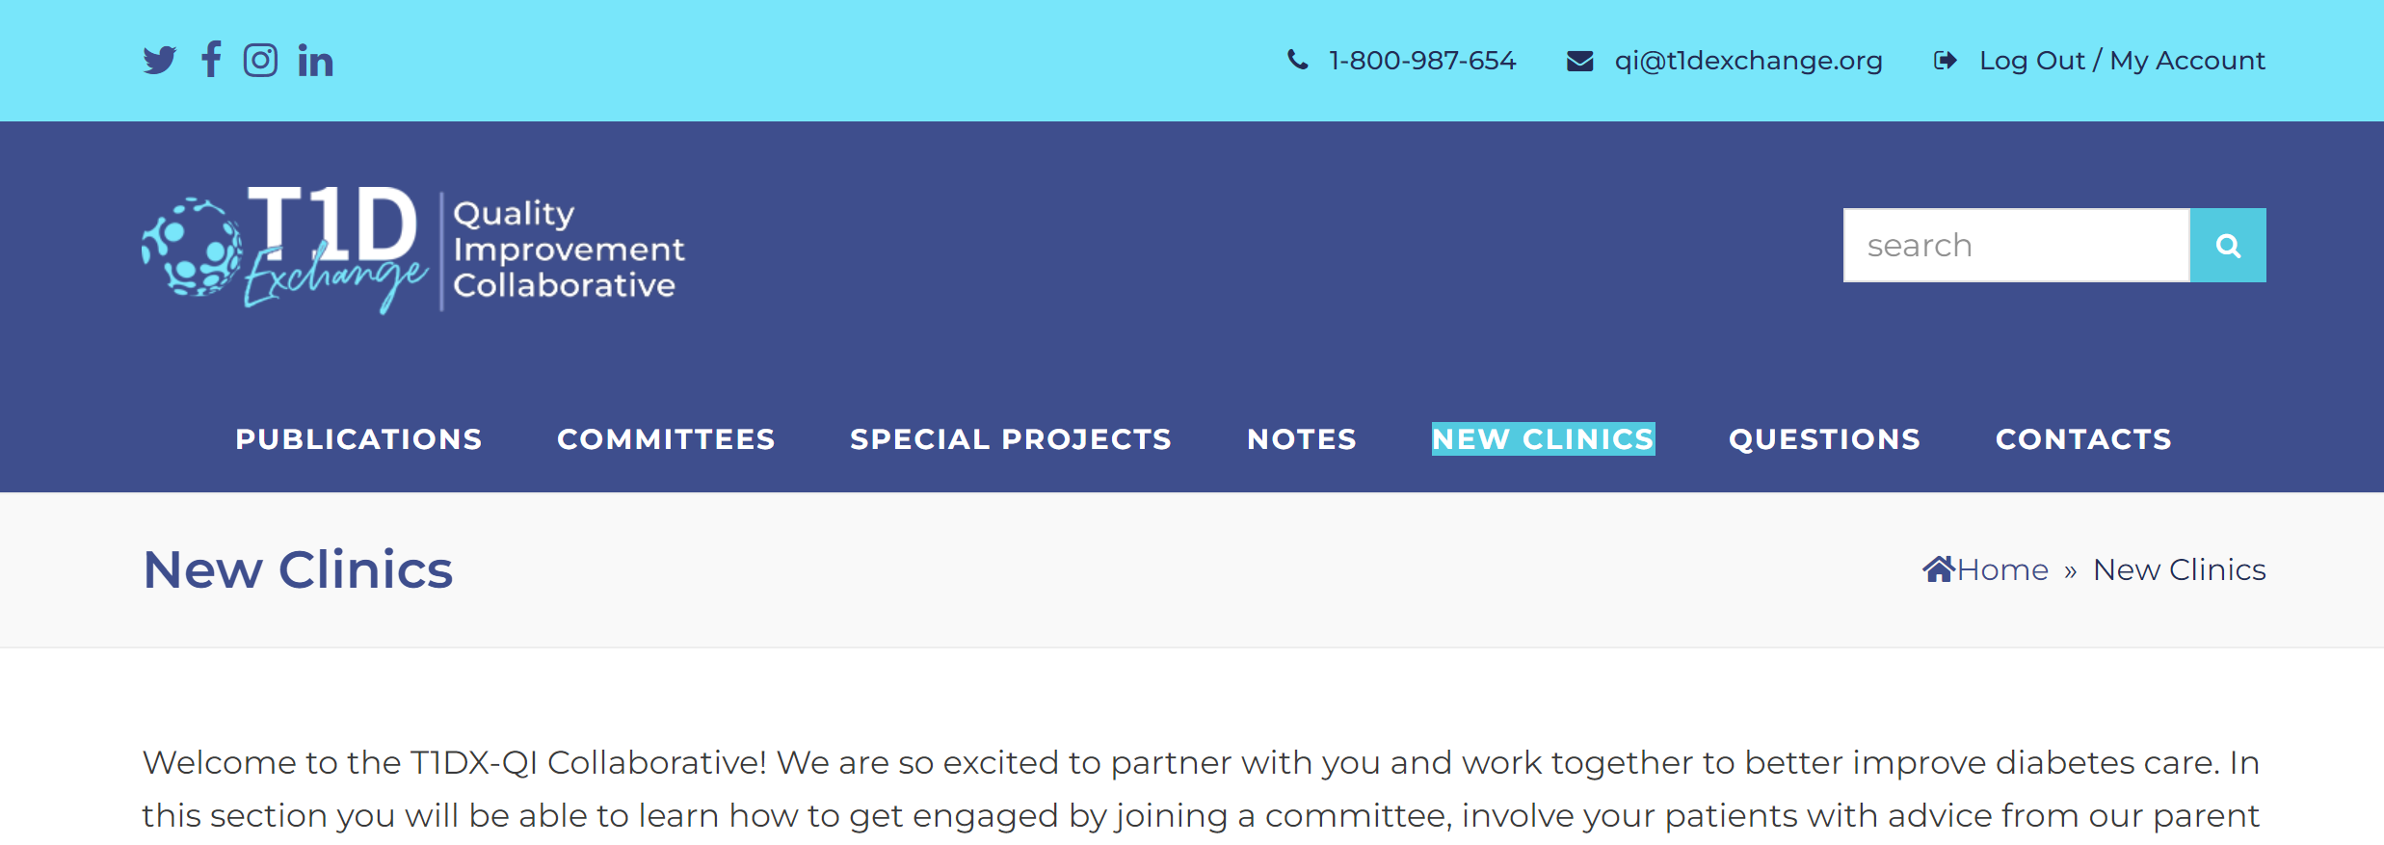
What you will find on the website

Slide 20
QI Portal Updates

Slide 21
QI Portal – April – July 2022 updates
Expanded Health Equity features!
Notes:
We now have 60 resources on the QI Portal, with new case studies from our very own Rady and COA centers, as well as ADA QI success stories. The Library is a great place to find resources either searching by category or key word,

Slide 22
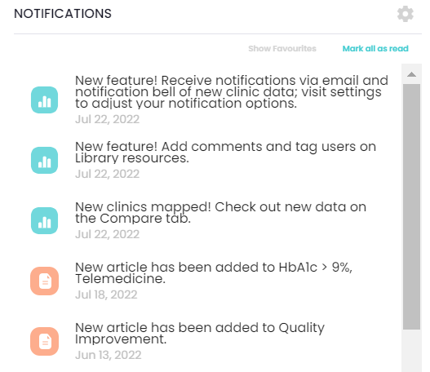
QI Portal – April – July 2022 updates
New notification bell!
Notifications for new:
QI Portal features
Clinic data
Library article
Change notification type in Settings
Notes:
We now have 60 resources on the QI Portal, with new case studies from our very own Rady and COA centers, as well as ADA QI success stories. The Library is a great place to find resources either searching by category or key word,

Slide 23
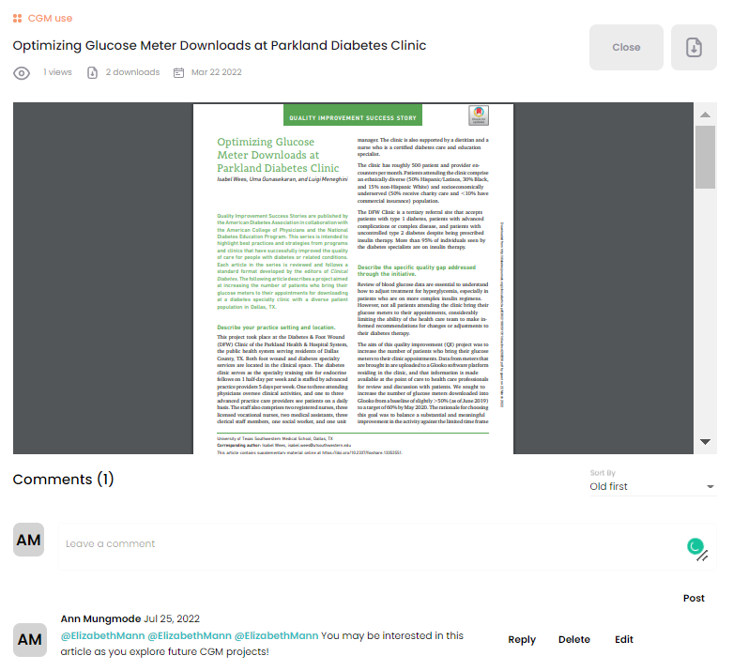
QI Portal – April – July 2022 updates
New metrics! Time in Range and Social Determinants of Health
New library comments!

Slide 24
Seize the Data! Contest – September 2022
Explore the QI Portal and win a prize!
From 9-1 through 9/30, T1DX-QI will host a Seize the Data! Contest!
Weekly awards will be given for:
Highest # of logins
Each login = one chance to win
Bonus chances to win if access all four QI Portal tabs

Slide 25
T1DX-QI Publications Updates

Slide 26
Publications Policy
Notes:
https://t1dx-qi.t1dexchange.org/publications/
https://t1dx-qi.t1dexchange.org/committees/publications/

Slide 27
First/Senior author writs and submits draft to Coordinating Center
QI Publication Process
Aim: Manuscript writing process is completed in less than 120 days
Coordinating Center and First author selects co- author based on data, clinical interest, publication history
First/Senior Author submits proposal to Coordinating Center
Coordinating Center analyst discuss with First/Senior author analysis plan
Coordinating Center reviews request
Coordinating Center shares data package with First/Senior author
Journal accepts edits from authors
Coordinating Center returns to co-authors for revisions
Journal Accepts Manuscript
yes
First/Senior authors reviews, address feedback returns to coordinating center
no
First and Senior author reviews and edits journal comments
Coordinating Center or Frist/Senior author submits to journal
First/Senior author address feedback from Publication Committee
Coordinating Center selects 3 main reviewers from Publications Committee
Journal reviews manuscript
Last revised 7/11/22

Slide 28
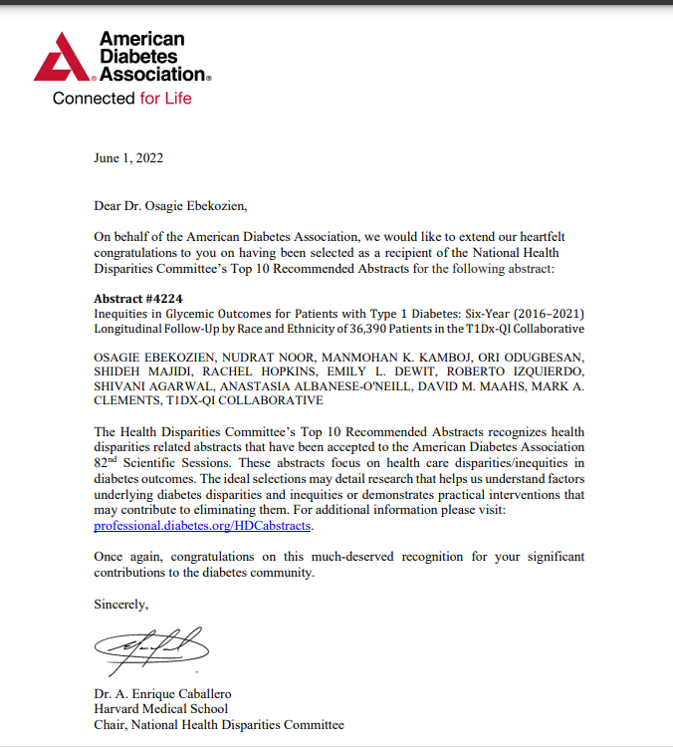
T1DX-QI HEALTH EQUITY STUDY IS ONE OF TOP TEN DISPARITIES ABSTRACT PRESENTED AT ADA 2022 SCIENTIFIC CONFERENCE

Slide 29
T1DX-QI PAPER IS THE CURRENT MOST CITED ARTICLE 2020-2022 IN THE JOURNAL OF DIABETES

Slide 30
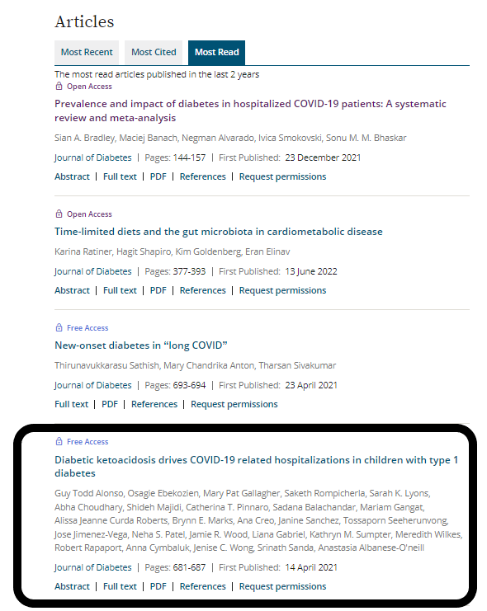
T1DX-QI PAPER IS ONE OF TOP FIVE MOST READ ARTICLE 2020-2022 IN THE JOURNAL OF DIABETES

Slide 31
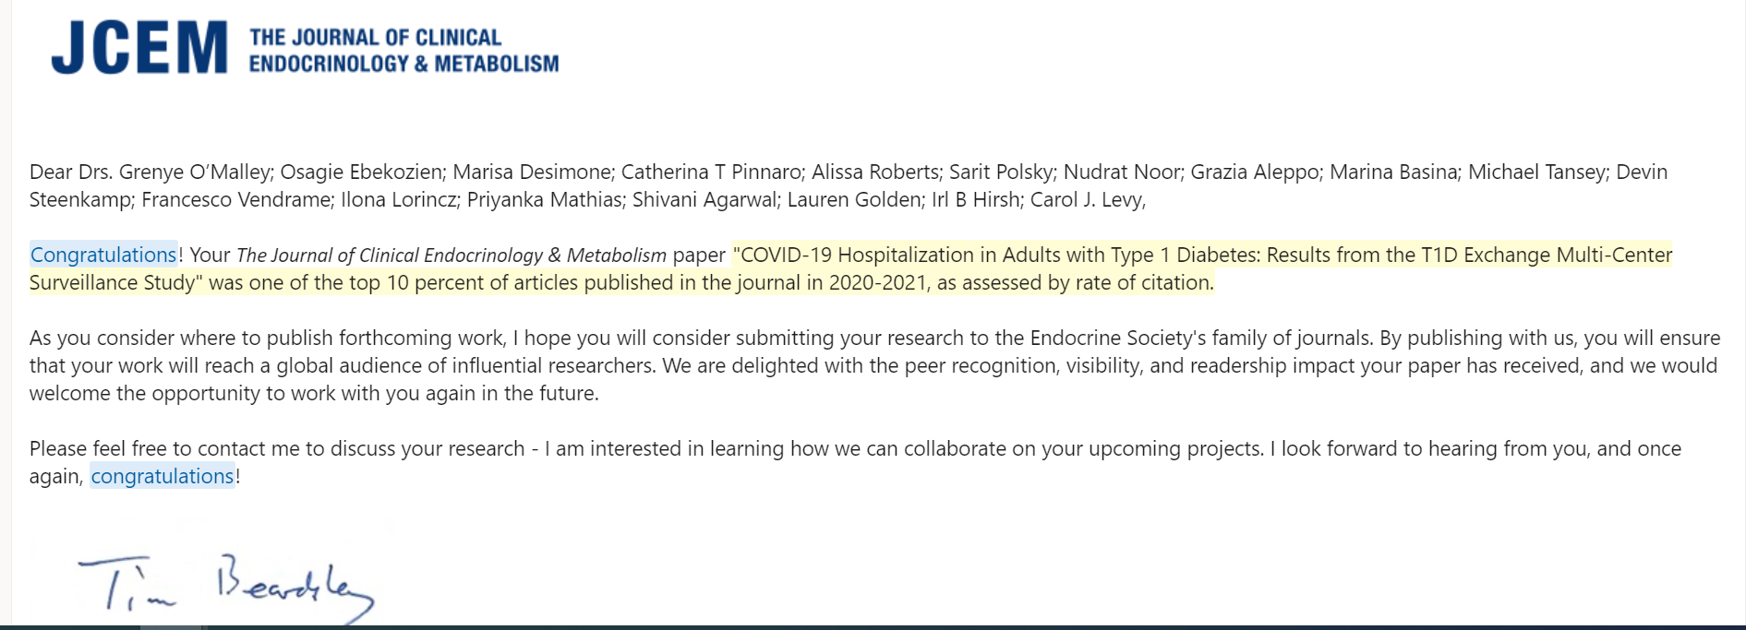
T1DX-QI PAPER WAS ONE OF THE TOP TEN PERCENT CITED ARTICLE 2020-2022 IN THE JOURNAL OF CLINICAL ENDOCRINOLOGY & METABOLISM

Slide 32
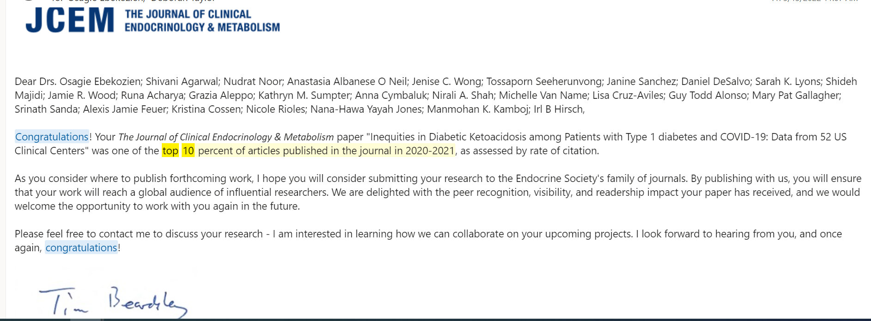
T1DX-QI PAPER WAS ONE OF THE TOP TEN PERCENT CITED ARTICLE 2020-2022 IN THE JOURNAL OF CLINICAL ENDOCRINOLOGY & METABOLISM

Slide 33
Clinical Presentation: Stanford

Slide 34
QI Projects
Marina basina, MD
Stanford university, division of endocrinology

Slide 35
Trouble shooting of insulin pump malfunction

Slide 36
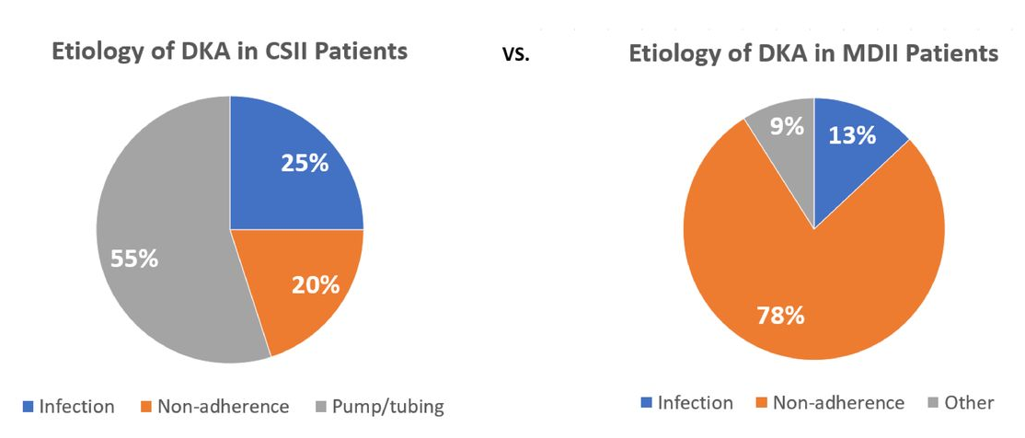
Pump malfunction is a leading cause of DKA among insulin pump users
N = 20 (46.5%)
N = 23 (53.5%)
“…most of the patients [55%] had been using insulin pumps for at least 5 years, 75% knew about their settings, and 76% recognized malfunction. These data are less suggestive of a lack of expertise but instead the problem seems to rely on the lack of knowledge regarding further actions after recognizing a pump malfunction.”
Flores M, et al. BMJ Open Diab Res Care, 2020.
Notes:
Study at Cleveland Clinic Fairview looking prospectively at 43 patients admitted with DKA of 6-month period in 2019 to determine etiology of DKA. Patients were divided into whether they were on pump or on MDI, and were split about 50/50, with around 20 in each group. While DKA etiology was attributed to non-adherence to insulin in the vast majority of patients on MDI, among those on insulin pumps, the majority of DKA episodes

Slide 37
Our clinic
Stanford Endocrine Clinic Data
Estimated total number of patients on an insulin pump using STARR cohort discovery:
At least 1,150 patients on insulin pump
Search criteria: Encounter with “Endocrine clinic” or “Hover clinic” over past 2 years, Active Rx for Aspart, Lispro, or Glulisine, Any clinical document containing keywords “Insulin pump” AND either ”Omnipod,” “Tandem,” or “Medtronic.”

Slide 38
Comfort level with guiding patients is sub-optimal
Comfort level of clinic staff with guiding patients is sub-optimal
Brief survey to endocrinology clinic nurses; n = 5 responses
All participating RNs interact with patients with DM regularly, 80% (4/5) >50% of the time
60% (3/5) felt not at all or only slightly confident in helping patients troubleshoot pumps over the phone
All reported receiving multiple calls per month regarding insulin pump malfunction, median 3-5 calls per month
Calls can take 10 to >20 min each, median 10-15 min
Estimated percent that required contacting a physician: 26±16%
Estimated percent ultimately not able to be handled over the phone: 31±25%

Slide 39
Identified challenges and goals
Older/outdated materials
No systematic approach, taking longer to search for issue or make plan over the phone
Over-reliance on patients to know what to do
Patients get frustrated on the phone
Generic advice for patients after encounter, not targeted to specific patient
Create protocol that structures approach to patients calling with concern about insulin pump malfunction in order to:
Increase confidence among nursing staff in managing pump malfunction over the phone
Limit average call time to 10 min or less
Provide patients with targeted summary/recommendations at encounter end
Better capture/track data and outcomes

Slide 40
Dot phrase: “.PUMPFAIL”PFAIL”
Encounter for insulin pump malfunction
Initial assessment (always completed, details on next slide)
Persistent hyperglycemia (Requests completion if question 3 from part A is answered, “yes.” Otherwise, auto-populates, “ – none” here.)
Pump troubleshooting: “Instructions – type “NA” if step is not applicable. Otherwise use dotphrase, “.PUMPTROUBLE” to complete.” ***
Action plan, Summary, and Recommendations: “Instructions – Use dotphrase, “.PUMPACT” to complete. Copy and paste into patient instructions for encounter” ***

Slide 41
A. Initial assessment
1. Pump/system: (Select Tandem, Medtronic, or Omnipod) – Automated? Yes/No
2. Current glucose and recent trend
Glucose *** mg/dl, checked at ***
Checked by continuous glucose monitor? yes/no
If yes --> Select type
Dexcom --> Select one from associated column on table to the right
Medtronic --> Select one from associated column on table to the right
Abbot/Libre --> Select one from associated column on table to the right
Eversense --> Select one from associated column on table to the right
Other --> Current trend is ***.
Dexcom | Medtronic | Abbot/Libre | Eversense
Rising rapidly – double up arrow (>3 mg/dl/min) | Rising rapidly – triple up arrow (>3 mg/dl/min)
Rising – single up arrow (2-3 mg/dl/min) | Rising – double up arrow (2-3 mg/dl/min) | Rising – up arrow (>2 mg/dl/min) | Rising – up arrow (>2 mg/dl/min)
Rising slowly – oblique up arrow (1-2 mg/dl/min) | Rising slowly – single up arrow (1-2 mg/dl/min) | Rising slowly – oblique up arrow (1-2 mg/dl/min) | Rising slowly – oblique up arrow (1-2 mg/dl/min)
Steady – Horizontal arrow (<1 mg/dl/min) | Steady – Horizontal arrow (<1 mg/dl/min) | Steady – Horizontal arrow (<1 mg/dl/min) | Steady – Horizontal arrow (<1 mg/dl/min)
Falling slowly – oblique down arrow (1-2 mg/dl/min) | Falling slowly – single down arrow (1-2 mg/dl/min) | Falling slowly – oblique down arrow (1-2 mg/dl/min) | Falling slowly – oblique down arrow (1-2 mg/dl/min)
Falling – single down arrow (2-3 mg/dl/min) | Falling – double down arrow (2-3 mg/dl/min) | Falling – single down arrow (>2 mg/dl/min) | Falling – single down arrow (>2 mg/dl/min)
Falling rapidly – double down arrow >3 mg/dl/min) | Falling rapidly – triple down arrow >3 mg/dl/min)
3. Has there been persistent hyperglycemia? Yes/No
Glucose >250 mg/dL >2 hours after last meal bolus
Glucose not corrected by ≥50 mg/dl one hour after last correction bolus

Slide 42
B. b. Persistent hyperglycemia: Assess symptoms and ketones
1. Symptoms and ketones assessed, as below
Minor symptoms: Patient reports [ ] Thirst, [ ] Frequent urination, [ ] Nausea (uses check boxes, not drop down multi-select)
Major symptoms: Patient reports [ ] Vomiting, [ ] Blurry vision, [ ] Confusion, [ ] Weakness, [ ] Tiredness, [ ] Labored or rapid deep breathing
Ketones were [select from single-selection drop down: “checked” OR “not checked.” Result: (If “checked” --> select “Blood” and/or “Urine”; If “not checked” --> populate “NA, not checked because ***”)
If “Blood” selected, add “ – *** mmol/L” to the right
If “Urine” selected, add “ – ***” to the right
2. Hyperglycemia managed per clinic algorithm

Slide 43
Algorithm, for reference (not included in dot phrase)
Ketones | Symptoms
Urine: Neg-Trace Blood: <0.6 mmol/L | None
Ketones | Symptoms
Urine: Small Blood: 0.6-1.5 mmol/L | Thirst, Frequent urination, Nausea
Ketones | Symptoms
Urine: Mod-Large Blood: >1.5 mmol/L | Vomiting, Blurry vision, Confusion, Labored or rapid deep breathing, Severe weakness/tiredness
1
Perform pump troubleshooting
Exchange indicated components
Use dot phrase, .PUMPTROUBLE
1
Give manual subQ injection
(with syringe/pen)
Use pump calculator for dose
1
Give manual subQ injection
(with syringe/pen)
Use pump calculator for dose
2
2
Perform complete exchange
of infusion site/pod, tubing, reservoir, and insulin
Give correction dose
using insulin pump with current BG
2
Contact MD or Refer to ER
(depending on symptom severity)
3
Document action plan
Use dot phrase, .PUMPACT
3
Document action plan
Use dot phrase, .PUMPACT
3
No improvement
No improvement
Document action plan
Use dot phrase, .PUMPACT
4
Monitor
Drink water (1-2 glasses per hour)
Recheck glucose in 2 hours
Check ketones in 2 hours (if glucose not improving)
Call back clinic if no improvement or rising ketones
4
Monitor
Drink water (1-2 glasses per hour)
Recheck glucose in 2 hours
Check ketones in 2 hours (if glucose not improving)
Call back clinic if no improvement or rising ketones
Note: When giving manual subQ injection, bolus should also be programed and given via pump while pump is disconnected so it is counted toward “insulin on board.” Advise patient to do this if not already done.

Slide 44
C. Pump troubleshooting (appears with “.PUMPTROUBLE”)
1. Verify most recent bolus delivery. Give correction bolus if missed bolus is identified.
When/how long ago was the last bolus?
How many units was the last bolus?
Was there any missed bolus?
2. Assess current infusion site/pod, replace if persistent hyperglycemia or if any of the below are present.
Does the cannula appear dislodged?
Is there ANY redness/swelling at the site?
Is there scar tissue at the site? (Skin feels thicker, more rubbery, lumpier around site)
Is there leaking at the site? (Inspect site for wetness (especially at/in adhesive) or smell of insulin)
Has there been a recent “Occlusion” (Tandem/Omnipod) or “Insulin flow blocked” (Medtronic) alarm?
Also document, approximately how old is the current infusion site?
If removed, was the cannula kinked?
3. Assess insulin in pump reservoir/pod and replace if answers to any of the following are “yes”
Was the pump reservoir/pod filled >3 days ago?
Has the pump/pod been exposed to abnormally high or low temperatures (e.g. in the sun at the beach)?
4. Replace insulin in the pump using a NEW insulin vial if answers to any of the following are “yes”
Has the vial been inconsistently refrigerated?
Was the vial dropped or damaged?
Has the vial expired? Expiration date ____
5. Assess tubing and connections (Medtronic & Tandem only), disconnect and “fill tubing” (Tandem) or “prime” tubing Medtronic if answers to any of the following are yes
Are there air bubbles/visible spaces in the tubing?
Is the reservoir or any connector loose?
**if possible, only completed entries remain in note

Slide 45
D. Action plan, summary, & recommendations (appears with “.PUMPACT” )
On our call today we, (copy & paste to patient instructions) (select from all that apply multi-select drop down)
Discussed recommendation to go to ER
Contacted MD
Gave a manual subcutaneous insulin injection: *** units
Performed targeted pump troubleshooting, which resulted in the following actions: ***
Performed a complete exchange of infusion site/pod, tubing, reservoir, and insulin
Gave a correction dose with the insulin pump: *** units
Reviewed that if blood sugar is not decreasing and you have moderate to high ketones, nausea, vomiting, difficulty breathing, or other worsening symptoms, you should go immediately to the EMERGENCY ROOM.
Please call back with any further questions: 650.721.1300
Call time: ***
Patient verbally confirmed completion of the above actions and acknowledged understanding of the above recommendations.

Slide 46
Future directions and interventions
Implement and track usage for 6 months
In 6 months
Survey nursing staff: satisfaction with protocol, confidence with pump malfunction management and troubleshooting over the phone
Review encounters: Number of calls, Call time, MD calls, ED visits, Hospitalizations, Number of call backs, Causes of malfunction, Inadequate supplies (e.g. ketone meter)
If successful, create integrated patient handout based on clinic protocol to facilitate self-management and education

Slide 47
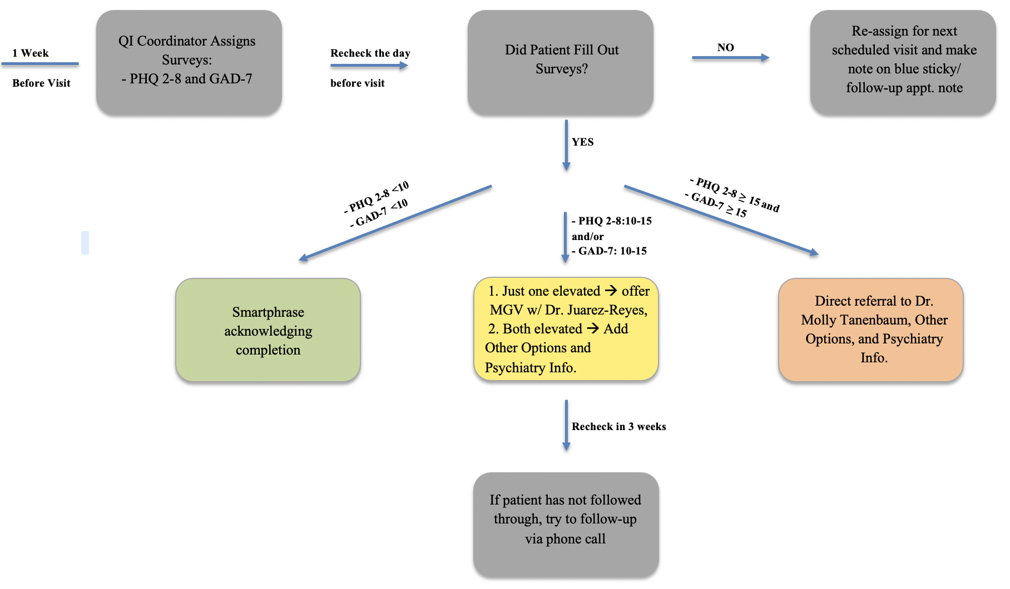
Other currently ongoing projects
Standardized note template for insulin pump/CGM/Closed loop reporting
Implementation of universe psychological screening with PHQ2-8 and GAD7 in adult Endocrinology Clinic

Slide 48
Long acting glp-1 safety and efficacy in t1d
Presented at Endo society and ada 2022 annual meetings

Slide 49
Evaluating the Efficacy and Safety of Long-Acting GLP-1 Receptor Agonist in T1DM Patients
Deene Mohandas, BA; Catherine Gao, MS; Jamie Calma, BA; Marina Basina, MD
Division of Endocrinology, Gerontology and Metabolism, Department of Medicine, Stanford University School of Medicine, Stanford, California
GLP-1 receptor agonist (RA) is a class of therapeutic agents that mimic the endogenous incretin hormone GLP-1. GLP-1 medications are not approved for T1DM patients due to concern of increased diabetic ketoacidosis (DKA) risk, but long-acting GLP-1 medications are commonly prescribed as adjunct therapies, off-label.
Only one study assessing the impact of a long-acting GLP-1 in 11 T1DM patients showed no increased risk of DKA and no significant difference in time in range (Traina et al, Can J Diabetes. 2014;38(4):269-272. doi:10.1016/j.jcjd.2013.10.006)
In our study, we aim to evaluate the safety and efficacy of long-acting GLP-1 medications in a larger cohort of T1DM patients.
retrospective chart review using an Electronic Health Record system (EPIC)

Slide 50
Methods
Search parameters: ICD-10 code E10 for Type 1 diabetes mellitus, abnormal A1c, abnormal c-peptide, Diabetes Autoimmune Profile (includes ICA-512/IA-2 AB, GAD-65 AB and insulin AB), and celiac disease screen
Inclusion criteria: adults diagnosed with T1DM, on a long-acting GLP-1 for ≥ 6 months
Exclusion criteria: pregnancy, concurrent steroid use
54 participants met the study criteria
Average of 2-year data prior to initiation of GLP-1 compared with data on GLP-1
Statistical analysis was conducted using paired t-tests on R and Excel to compare baseline and post GLP-1 values
Mean participant age: 41.54 years ± 13.89
Average time since T1DM diagnosis: 16.37 years ± 12.92
Mean duration on a long-acting GLP-1: 23.85 months ± 15.46

Slide 51
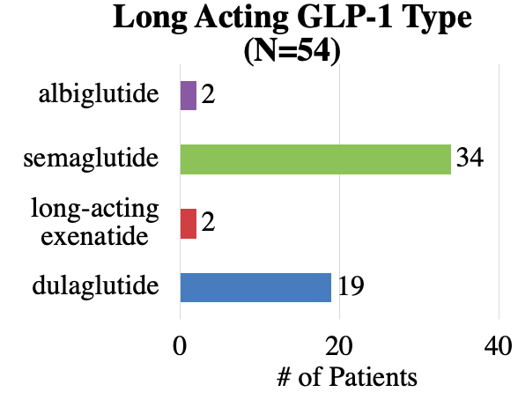
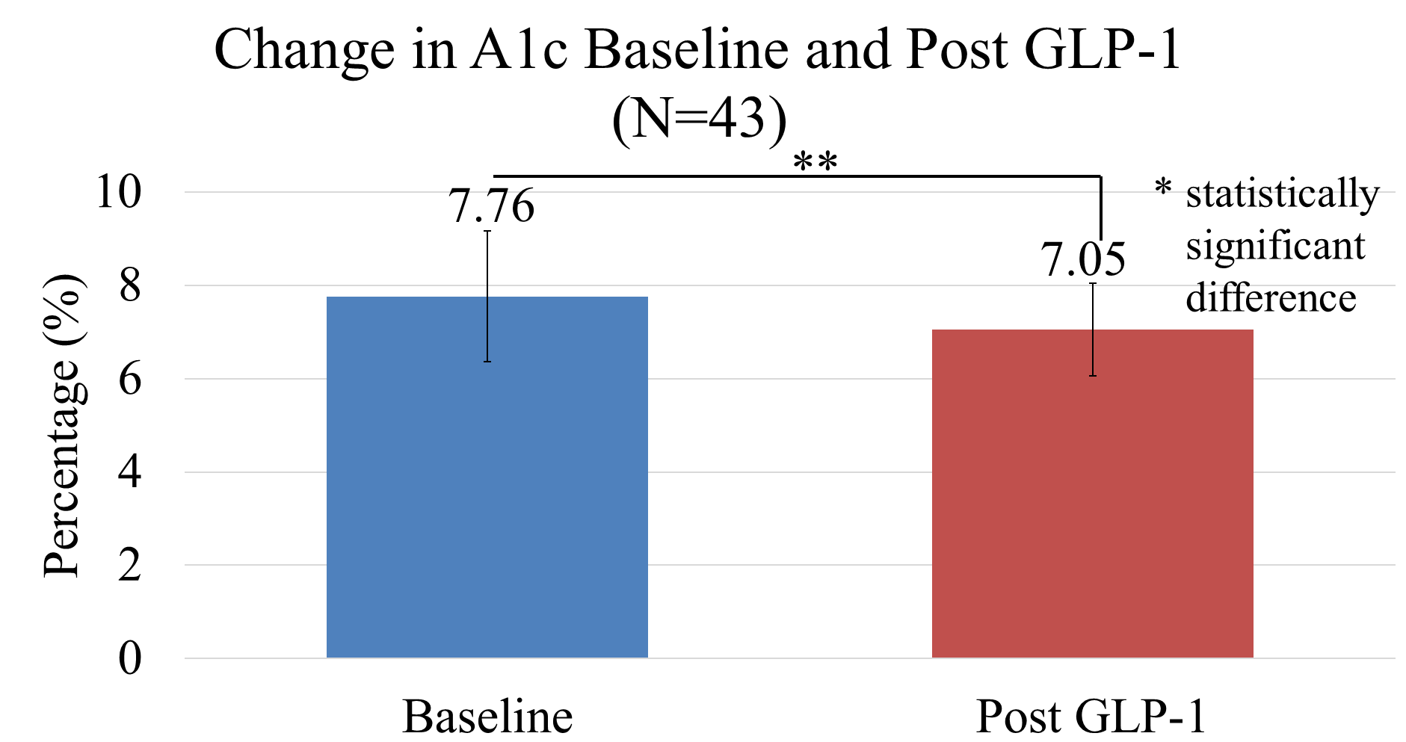
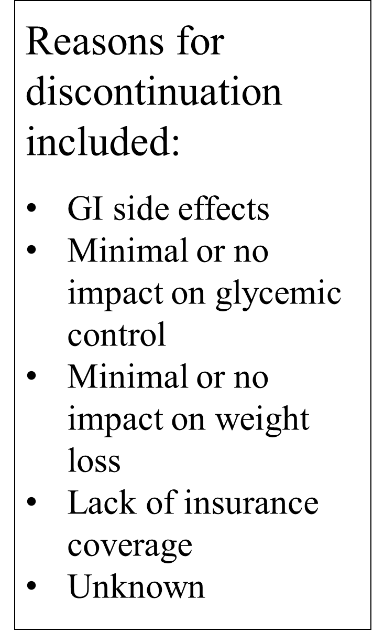
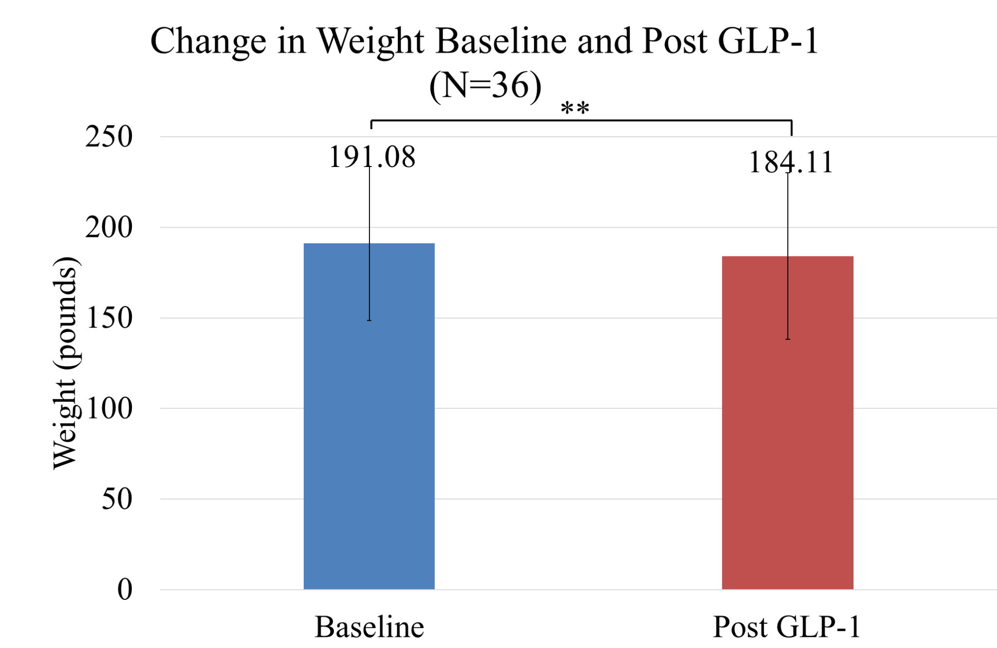
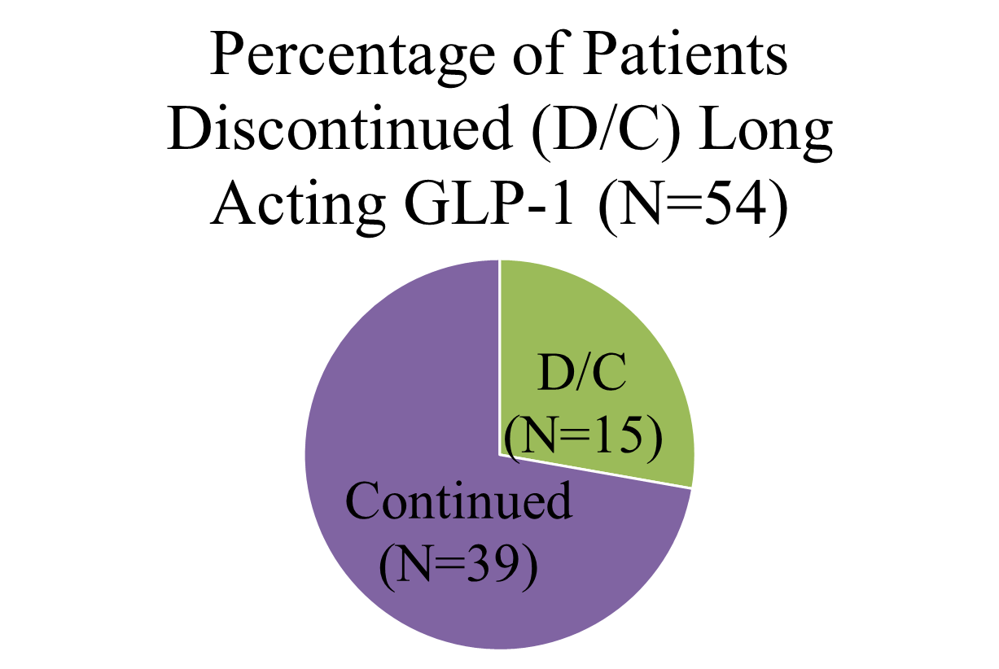
Results
P = 0.05

Slide 52
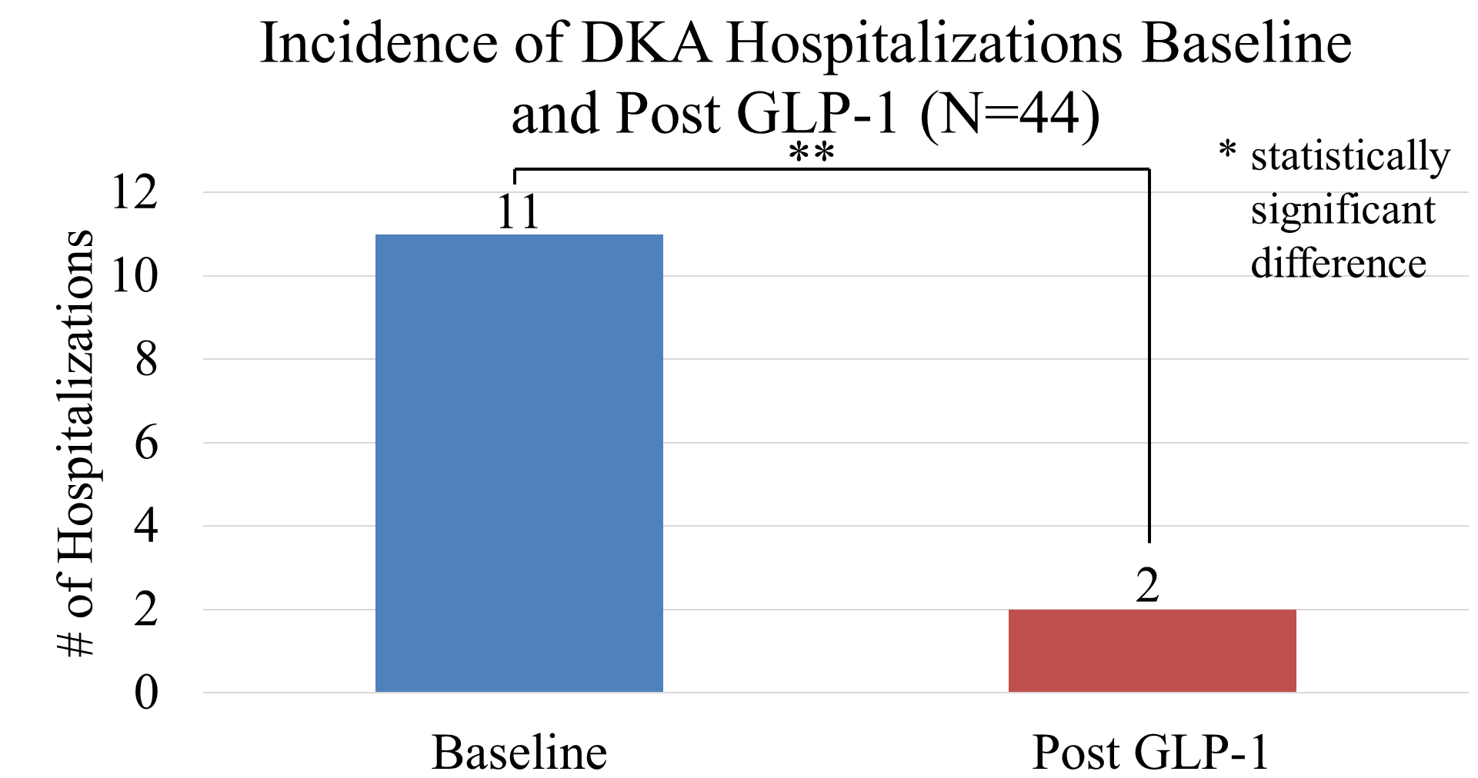
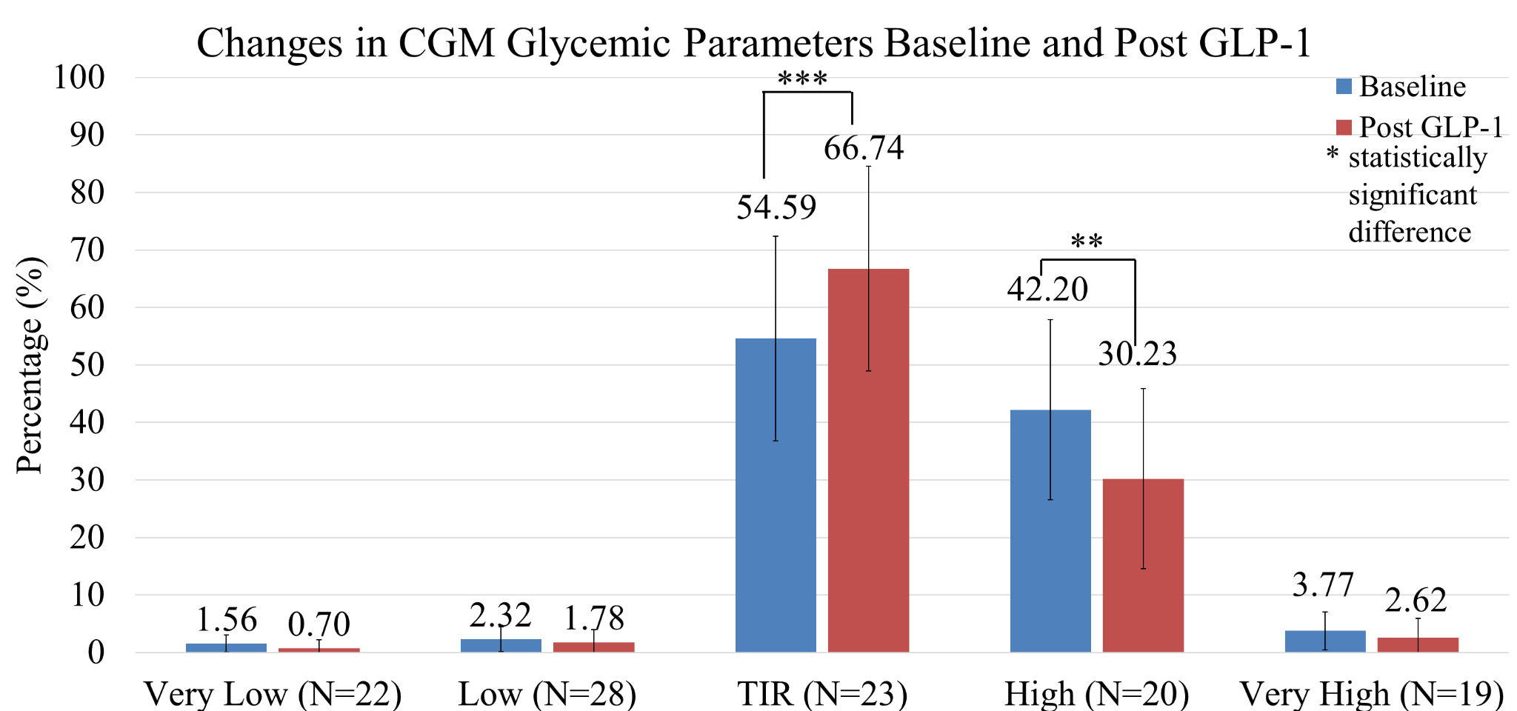
Results
Parameter | Mean Difference | p-value (ɑ = 0.05)
A1c (N=43) | -0.71% | 0.002
DKA (N=44) | -9 incidents | 0.02
CGM TIR (N=23) | +12.15% | 0.0009
CGM Highs (N=20) | -11.97% | 0.006
14-Day Average BG (N=27) | -19 mg/dL | 0.01
14-Day SD (N=17) | -8.45 mg/dL | 0.007
Weight (N=36) | -6.97 lbs | 0.007

Slide 53
Conclusion and Discussion
There is an urgent need for strategies to improve glycemic control and reduce morbidity and mortality in T1DM.
Our study is the first to demonstrate significant A1c reduction and TIR increase without increased hypoglycemia and DKA risk in 54 T1DM patients on long-acting GLP-1 receptor agonists treated for an average of almost 2 years.
In addition to improved glycemic control and reduced glycemic variability, there was a significant decrease in weight.
The study represents real-world experience.
As more data emerges on cardiovascular and renal benefits of GLP-1 receptor agonists in type 2 diabetes, this class may represent a promising adjunct therapy to insulin in individuals with type 1 diabetes

Slide 55
Clinical Presentation: Grady Memorial

Slide 56
Pre/Post learning

Slide 57
Alisha Virani, RD, CDCES
Grady Health Systems
T1Dx Project Coordinator
CGM Utilization

Slide 58
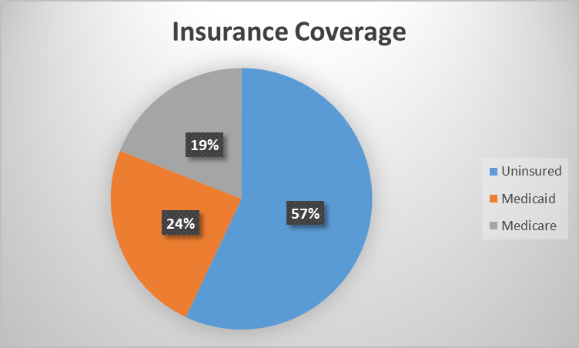
Grady Memorial Hospital, Atlanta GA
Safety Net Hospital
85% Black American
800-900 established adult patients with T1D
Notes:
Larger number of patients with touchpoints through ER and other depts. However much smaller who come back for consistent care in DC
800-900 takes into account all touch points with patients living with T1D across GMH
Those seen in DM center are much smaller

Slide 59
Grady Diabetes Center
204 T1D patients
Staffing
8 physicians
1 CDCES (RN), 2 CDCES (RD)
2 Podiatrists, 1 Wound Care RN
1 Clinical Pharmacist, CDCES
Social Worker, Behavioral Counselor
Ophthalmic technician
Medication Access Coordinator
Notes:
Short staffed: full staffing includes 4 RNs

Slide 60
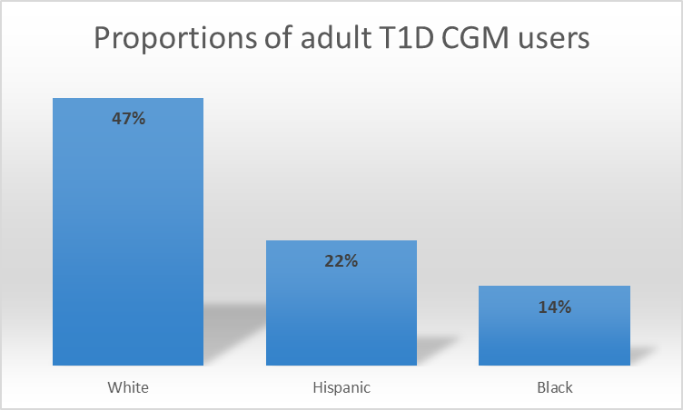
Data on Disparities in CGM Use
Wirunsawanya K: Racial differences in technology use among type 1 diabetes in a safety-net hospital. J Endocr Soc 2020;4(Suppl 1):OR30-03
Notes:
Racial/ethnic disparities in diabetes technology use observed even after adjusting for sociodemographic factors.

Slide 61
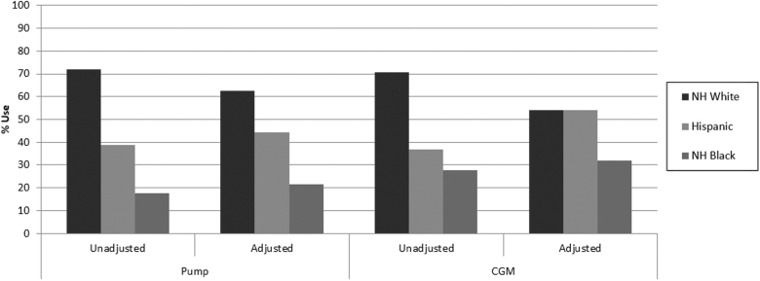
Data on Disparities in CGM Use
Percentage of YA (aged 18-28) with T1D in each racial–ethnic group using insulin pump and CGM comparing unadjusted and fully adjusted estimates. Adjustment included: demographic and clinical variables, SES, healthcare factors, and diabetes self-management. CGM, continuous glucose monitor; T1D, type 1 diabetes; YA, young adults.
Agarwal, S, et al. Racial–Ethnic Disparities in Diabetes Technology use Among Young Adults with Type 1 Diabetes. Diabetes Technol Ther. April 2021; 23(4): 306–313. Published online 2021 Mar 22.
Notes:
Similarly, data published in 2019 from the Type 1 Diabetes (T1D) Exchange registry and in a 2021 study looking at Racial Disparities in Diabetes Technology Use and Outcomes in Type 1 Diabetes in a Safety-Net Hospital showed that even after adjusting for variables we still see disparities among CGM use
Variables: age, race-ethnicity, and socioeconomic status (SES) affected glycated hemoglobin (HbA1c) levels, and that racial-ethnic inequity influenced insulin pump and continuous glucose monitoring (CGM) use across all age groups.

Slide 62
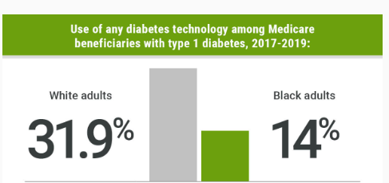
Data on Disparities in CGM Use Among Medicare Beneficiaries with T1D
Wherry K, et al. Wide Racial Gap for Diabetes Tech Use Among Medicare Patients. J Clin Endocrinol Metab. 2021

Slide 63
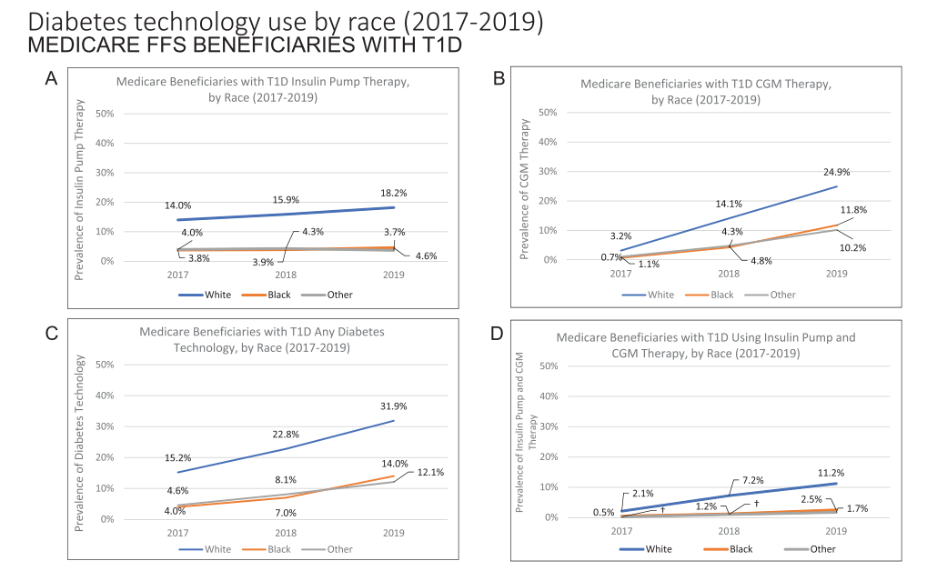
Disparities in CGM Use Among Medicare Beneficiaries with T1D
Wherry K, et al. Racial Disparities in Diabetes Technology Use and Outcomes in Type 1 Diabetes in a Safety-Net Hospital. J Clin Endocrinol Metab. 2021
Notes:
Prevalence of diabetes technology use among Medicare fee-for-service (FFS) beneficiaries with type 1 diabetes by race-ethnicity* from CY2017 to CY2019.
(A) Pump therapy alone;
(B) CGM therapy alone;
(C) any diabetes technology;
(D) pump plus CGM therapy.
This data is grouped into White (blue line), Black (orange line), and Other (Asian, Hispanic, and North American Native) populations (gray line). We continue to see that black and other races have a low CGM utilization that their white counterparts. What is more interesting is that Although there are disparities within Medicare beneficiaries, what is more notable is that overall use of diabetes tech is low among Medicare beneficiaries. We know that Medicare will cover technology and specifically CGMS for T1D, so not coverage issue. In a 2021 observational study in the Journal of Diabetes Science and Technology, Desavo, et al looked at data from eight endocrinology clinics participating in the T1DX-QI Collaborative during the years 2017-2019. It was found that patients with private insurance were more likely to use CGM (57.2%) than those with public insurance (33.3%) including Medicaid or Medicare.

Slide 64
Barries to CGM Use- What the Data Shows
Insurance eligibility criteria
Patient-provider factors
Patient preference
Implicit bias
Structural racism
Patient’s behavior and knowledge
Provider behavior
Patient–provider interactions
Organizational and institutional factors
Institutional eligibility and allocation of diabetes technologies
Clinics structure decision-making processes
Fantasia KL, Wirunsawanya K, Lee C, Rizo I. Racial Disparities in Diabetes Technology Use and Outcomes in Type 1 Diabetes in a Safety-Net Hospital. Journal of Diabetes Science and Technology. 2021 Sep;15(5):1010-1017.
Agarwal S, Schechter C, Gonzalez J, Long JA. Racial-Ethnic Disparities in Diabetes Technology use Among Young Adults with Type 1 Diabetes. Diabetes Technol Ther. 2021 Apr;23(4):306-313. doi: 10.1089/dia.2020.0338. Epub 2020 Dec 1.
Notes:
Studies published in 2021 from Fantasia and Agarwal highlight many nuances to barriers in CGM use that need to be evaluated.
Significant eligibility criteria to meet CGM medical necessity for both public and private insurers
These require a lot of time and effort and can disadvantage those of lower socioeconomic status and racial and ethnic minority patients who may be restricted by economic and social conditions at home or at work, are more likely to be publicly insured, and receive care at urban safety-net institutions (2). However, data have shown that even in those who do not perform routine self-management behaviors such as self-monitoring of blood glucose, improvements in glycemic control, and increase in self-monitoring behaviors are seen with initiation of diabetes technology (3) To this end, removing restrictive eligibility and insurance coverage criteria may enable increased access to diabetes technology, which can serve as a tool to increase self-monitoring behaviors, engage in self-care, and improve health outcomes.
Patient and provider level factors contributing to barriers in CGM use, include the role of patient preference for certain therapies over others due to perceived side effects, implicit bias, which influences clinician–patient communication, diagnosis and treatment decisions as well as negatively influence perceptions regarding shared clinical decision making, and structural racism.
Patient’s behavior and knowledge, provider behavior, patient–provider interactions, and organizational and institutional factors may also contribute to racial and ethnic disparities
Patient provider interactions- rushed medical visits can inhibit shared decision making as this takes time for patients to ask questions and for providers to be thorough with their responses. This can be an important barrier to address, especially in minority groups who have developed distrust in the medical system
Organizational and institutional factors can play a large role in access to CGM for patients that are underserved, ex having CGMs on formulary, training on implicit bias, longer appointment times, and focusing on quality of care instead of quantity

Slide 65
Barries to CGM Use- What the Our Clinic Shows
Not being able to meet the criteria for coverage
Finger sticks 3-4 times per day for a month- Medicaid
Out of pocket cost
Low level of understanding on use of device
Keep falling off (Freestyle Libre 2)
Excessive paperwork and follow up from provider level
Time needed from providers to educate patients on CGM
Notes:
How to use CGM and how to interpret- mention CGM classes

Slide 66
Possible Interventions To Address Disparity Gap in CGM Use
Remove strict eligibility of insurance coverage criteria
Provider advocate to insurance companies
Evaluate:
Clinician decision making regarding the use of diabetes technology
Role of communication regarding diabetes technology with patients
Barriers patients face after prescribing diabetes technology should be evaluated
Agarwal S, Schechter C, Gonzalez J, Long JA. Racial-Ethnic Disparities in Diabetes Technology use Among Young Adults with Type 1 Diabetes. Diabetes Technol Ther. 2021 Apr;23(4):306-313.
Notes:
Remove restrictive eligibility and insurance coverage criteria can increase access to diabetes technology, which can serve as a tool to increase self-monitoring behaviors, engage in self-care, and improve health outcomes.

Slide 67
Glycemic Optimization Clinic (GOC)
Low technology use for patients in our clinic
<5% of patient come to us on technology
Barriers with affordability
Lack of proper support for those on pumps/CGMs (ie, time, resources to obtain supplies, etc)
Development of GOC
Initiated as technology clinic, but evolved into clinic for people living with T1D
Goals:
Improve glycemic control and management for existing TID clinic patients
Patients to prioritize
Those with frequent admissions, particularly recurrent DKA, hypoglycemia
Those currently using diabetes technology (insulin pumps, continuous glucose monitors)
Those with significant social obstacles impacting adherence/care
Multidisciplinary management is key
Notes:
Because Grady Diabetes Center provides care to these T1D patients who are part of the racial and ethnic groups where CGM use is quite low, we are working towards improving quality of care in this population
Historically our clinic has not been using much technology for patients
<5% of patients come to us on technology who Usually end up having to discontinue due to not being able to afford technology
Lack of proper support for those on pumps/CGMs (ie, time, resources to obtain supplies, etc)
Development of GOC clinic by Endocrinologist, Dr. Georgia Davis
Initiated as technology clinic, but evolved into clinic for people living with T1D
Goals:
Improve glycemic control and management for existing DM clinic patients who have different issues influencing their DM management abilities. The need for more time to address these issues often significantly impacts the quick pace of DM follow up clinic. Therefore, we will offer the GOC as an option for referral
Patients to prioritize
1) those with frequent admissions, particularly recurrent DKA
2) those currently using diabetes technology (insulin pumps, continuous glucose monitors)
3) those with significant social obstacles impacting adherence/care
Multidisciplinary management is key
Asks:
GOC start date (Haw to ask Georgia)- June- August 2019?
When Abbott Samples started (Pasquel)

Slide 68
Diabetes Clinic vs GOC Appointment Flow
Diabetes Clinic
Patients seen by MD for medical visit
(30-minute appointments)
Discharged by RN to go over medication changes, medication teaching, and other relevant diabetes education
Patients assessed for other provider referrals. Usually do not see other providers on same day of their visit
Medication Access Coordinator
GOC
Patient already established in diabetes center
See MD/PharmD/RD/CDCES/Social Worker/Medication Access Coordinator- interdisciplinary approach to care
(60 to 90-minute appointments)
Follow up in GOC tailored to patient needs
Carb counting
Medication management
Insulin pump education/management
CGM education
Notes:
Diabetes Clinic
Patients seen by MD for medical visit
(30 minute appointments)
Discharged by RN to go over medication changes, medication teaching, and other relevant diabetes education
Patients assessed for referral to other disciplines for diabetes management (ie, RD, CDCES for more in-depth education, social worker)
GOC
Patient already established in diabetes center
Follow up within GOC
See MD/PharmD/RD/CDCES- interdisciplinary approach to care
(60-90 minute appointments)
Will see social worker same day if necessary
Follow up in GOC will be tailored to patient needs based on assessment at first GOC visit (ie, carb counting, medication adjustments, insulin pump education/management, CGM education, etc). Patients go through a screening process to see if eligible/able to start technology. Always initiate CGM first. With education and consistent follow up see if we can get them to point of using insulin pump (can patient carb count and make decisions based on CGM data/be able to read charts)
Medication access coordinator are for both follow up and GOC
Highlight role of social worker

Slide 69
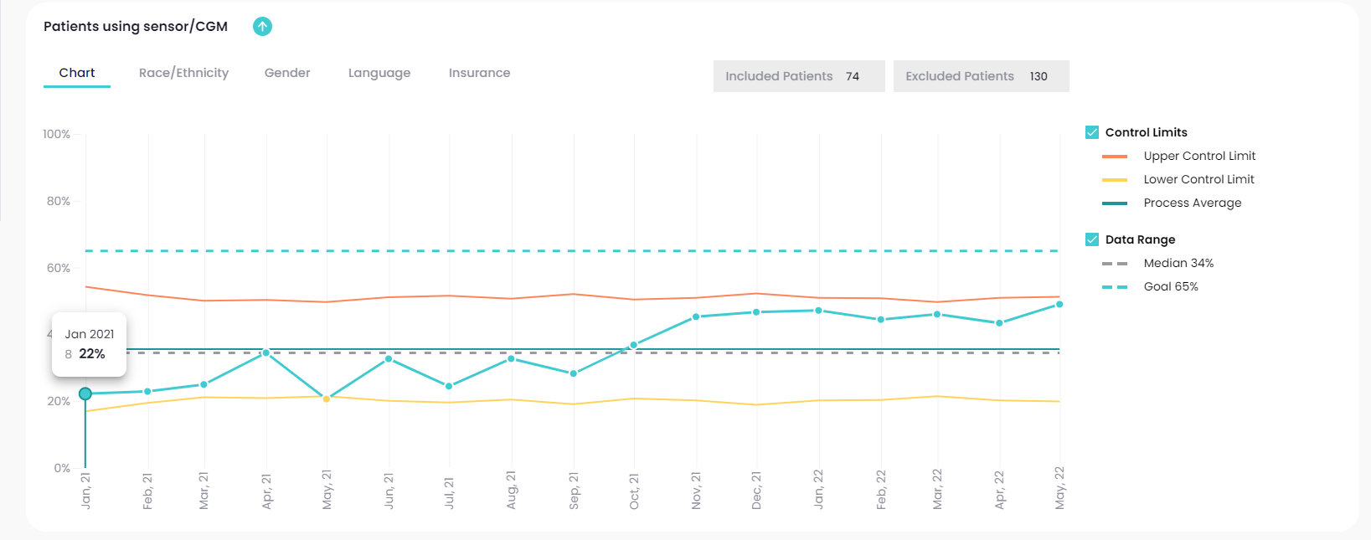
CGM Use Over One Year
Abbott Samples
Alisha/Tiara helping with CGM paperwork
Start of GOC- 2019
Began using
parachute for CGM orders
Average from July 2020 to March 2021- 27.1%
Average from Nov 2021 to April 2022- 41.4%
Average from April 2021 to October 2021- 29%
Notes:
Start of GOC- Dr. Davis, Pasquel, and Kristi managing CGM orders. Paperwork split between three providers/offices. Hard to keep track of progress for patient CGMs. No structure for tracking progress of patients getting CGMs
Alisha- began assisting with CGM orders to keep paperwork in one place. Assist doctors with completing paperwork and fax to appropriate DME companies. Hard to keep track of patient progress with getting CGMs. Started putting notes into epic when paperwork initiated and which company was used so other providers can follow up on progress as they see the patients
Parachute- keep all documents in once place with progress updates
CGM prescriptions
Breaks with shift over time.
Avg from July 2020 to March 2021 27.1%
April to October 2021 29%
Nov 2021 to April 2022 41.4%

Slide 70
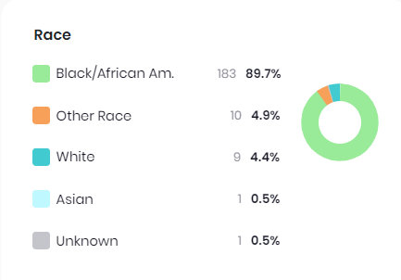
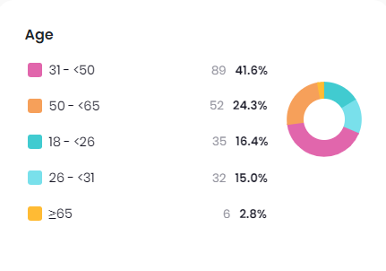
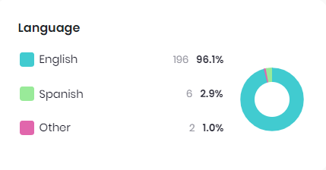
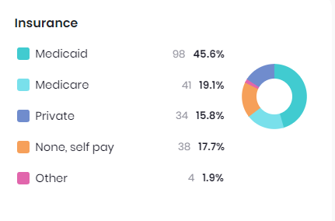
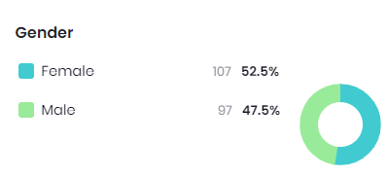
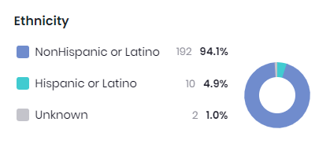
Population Analysis of Patients Using CGM
Notes:
Avg age, insurance breakdown looks a bit different from general diabetes population
Add animations for each image

Slide 71
Next Steps/Future Interventions
CGM utilization vs CGM RX
Created flowsheet
Method of implementation to capture correct data
Continue to streamline process with parachute and having point person that will correspond with the various DME and insurance companies
Continue to work towards offering CGM classes to promote continued CGM utilization with patients
Notes:
Hone in on the data more clearly because we are tracking CGm rx and not necessarily utilization
Possible Qs: Parachute, curriculum for the CGM classes

Slide 72
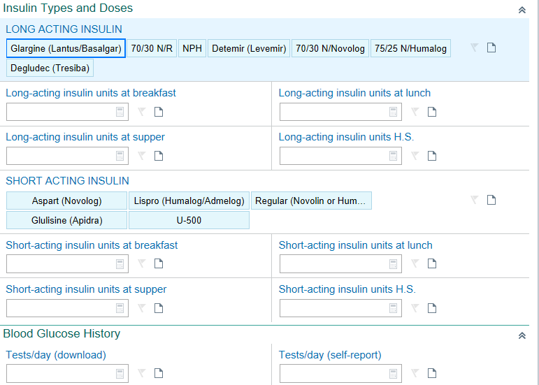
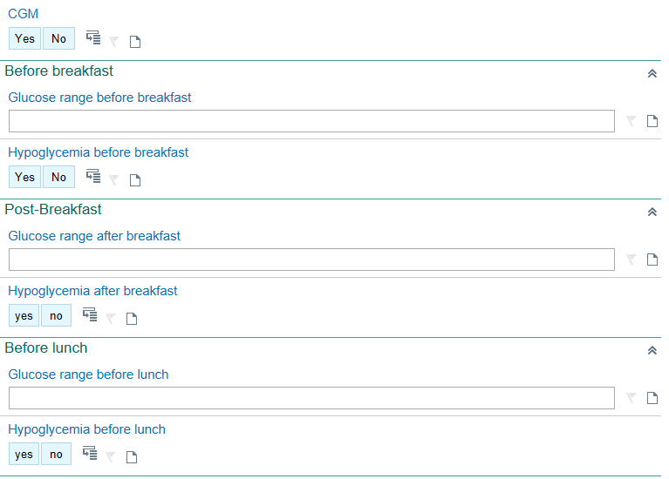

Slide 73
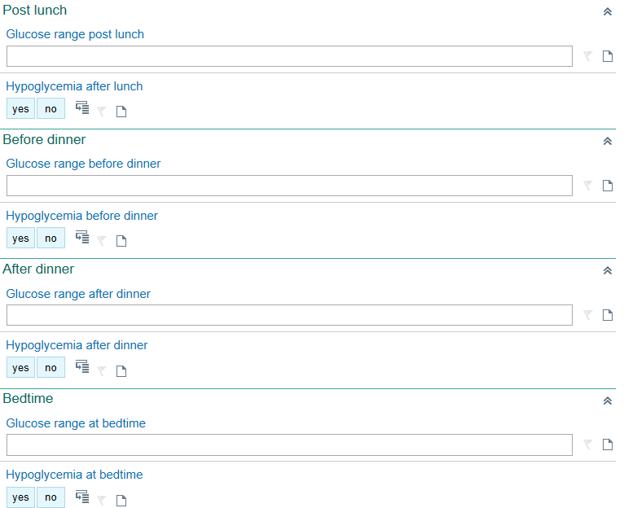
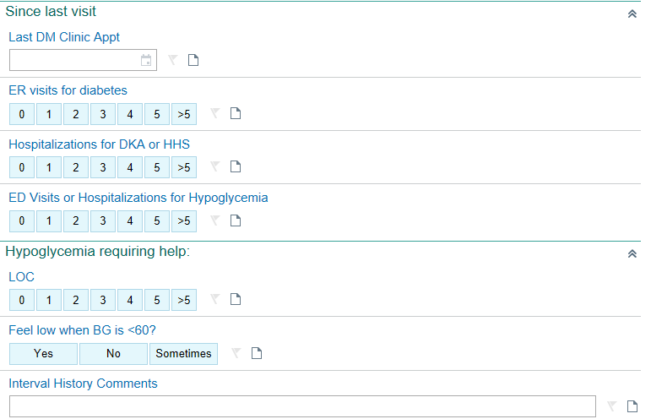

Slide 74
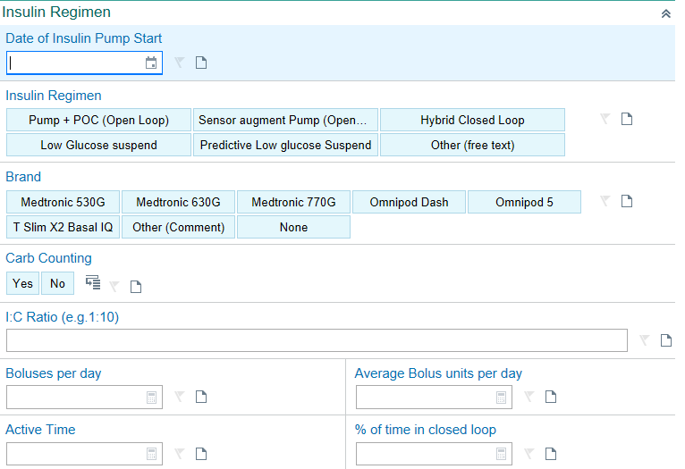
Notes:
Collaboration from Todd Alonso, MD Associate Professor of Pediatrics Barbara Davis Center for Childhood Diabetes

