Slide 1
Data Governance Committee Update

Slide 2
Agenda
Welcome and Introduction –Dan DeSalvo/ Osagie Ebekozien
Special Projects Overview- Nudrat Noor
Open for Discussion- DG Team

Slide 3
Purpose of DGC
Review proposals for collaborative QI data use
Advise on internal sharing of data
Approve external sharing of data
Approve new data governance policies and procedures
Review potential conflict and ethical considerations with data use
Each center can nominate a representative to the DGC
Committee meets quarterly

Slide 4
Current DGC Members
Todd Alonso (BDC)
Daniel Desalvo (TCH) – Co-chairperson
Joyce Lee (Michigan)
Ruth Weinstock (SUNY)
Ryan McDonough (CMH)
Priya Prahalad (Stanford)
Christine Byer-Mendosa (Rady)
Kathryn Obrynba (NCH)
Osagie Ebekozien (T1Dx) – Co-Chairperson
Nudrat Noor (T1Dx)
Nicole Rioles (T1Dx)

Slide 5
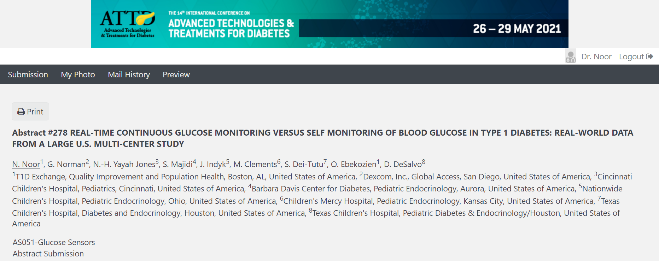
Dexcom sponsored Analysis (Oct 2019 – Dec 2020)
Pilot Project
Patient and clinical factors across CGM users
Distribution of patient demographics by type of CGM device (rt CGM vs is CGM)
Distribution of patient demographics by insulin delivery methods by CGM types
Accepted ATTD 2021 abstract

Slide 6
Special Projects

Slide 7
T1DX-QI Collaborative Data Platforms
Member clinics
(QI Collaborative) = 32
Clinic level
(Aggregate data)
EHR Mapped
(Patient level data)
Special Projects
(Other Data)
T1DX-QI Database

Slide 8
Special Projects
T1DX COVID-19 Surveillance Registry
COVID-19 and New Onsets
Telemedicine project
Medtronic Smart Pen Project

Slide 9
T1DX COVID-19 Surveillance Registry
Multi-center U.S. based surveillance registry of T1D patients with COVID-19
Study Population
Participating sites provide patient-level data based on chart reviews
Study Status
1000+ people with T1D and confirmed COVID-19
Data collection is ongoing

Slide 10
COVID-19 and New Onsets
To examine the incidence of new diagnosis T1D during the COVID19 pandemic period from January 1, 2020 – December 31, 2020 in comparison with the same period in the past year years (January 1, 2019 – December 31, 2019).
Study population
Aggregate data from survey including centers currently participating in the T1D COVID19
A total of 12 sites have provided data
Project status
Not a funded project
Data collection ongoing

Slide 11
Telemedicine project
To observe trends in the data for telemedicine versus in person clinic appointments among T1D patients during the COVID-19 pandemic
To understand barriers to telemedicine implementation for people with T1D in endocrinology clinics
Study population
Aggregate data from endocrinology centers currently participating in the T1D Exchange Quality Improvement Collaborative
A total of 13 (11 pediatric and 2 adult) clinics provided visit level data about telemedicine metrics and a total of 21 clinics (16 pediatric and 5 adult) completed the survey
Project status
Not a funded project
Manuscript under review with DTT

Slide 12
Medtronic Smart Pen Project
To identify provider perceptions, operational challenges to integrating Smart Pen use in clinical care
Study Population
Qualitative Phase-> Focus Groups including providers (T1DX-QI Collaborative)
Quantitative Phase -> Survey to be completed by providers in the T1DX-QI Collaborative
Study Status
5 focus groups completed
Project funded by Medtronic

Slide 13
Fear of Hypoglycemia Screener
T1D Exchange and Lilly

Slide 14
Fear of Hypoglycemia
Excessive fear of hypoglycemia (FoH), can become problematic and contribute to lower quality of life and interfere with optimal diabetes management.
A major predictor of FoH in adults with diabetes is past history and experiences with episodes of hypoglycemia.
Primary Objective
To develop a FoH Screener to identify adults with type 1 diabetes (T1D) who need treatment and/or additional diabetes education regarding hypoglycemia management.
To fulfill the objective, the screener must be actionable, short (less burden) and easy to implement for HCPs to utilize with patients in their normal clinical practice.
To validate the newly developed FoH screener for use in a clinical practice setting.
Notes:
https://care.diabetesjournals.org/content/early/2019/09/02/dc19-0630

Slide 15
Fear of Hypoglycemia in the Real World
Objectives
To examine the clinical implementation process of FOH screener in adult type 1 diabetes clinics
To explore clinical benefits and diabetes management outcomes of FOH screener implementation
Methods overview
12~ 18 months of screener implementation
4~ 5 adult T1D clinic sites from the T1D Exchange QIC
Monitor relevant metrics before, after, and at relevant time intervals during screener implementation
Metrics to monitor
Proportion of patients screened for FOH over time
Changes in awareness of FOH among providers and patients over time
Clinical decisions following FOH screening results
Clinical and management outcomes associated with FOH over time
E.g.: freq of hypo, patient behaviors treating/preventing hypo
(Qualitative) feedback from clinic staff and providers on success and challenges of implementation

Slide 16
Sponsored projects language in Data Agreements
Sponsorship, Information to Sponsors, and No Obligation to Refer.
Practice acknowledges that T1D EXCHANGE will receive financial and other support for the operation of the QI Data from third parties, including but not limited to medical device manufacturers (“Sponsors”). Practice consents to the provision by T1D EXCHANGE to Sponsors of information derived from information provided by Practice, to the extent the data from Practice constitutes only 10% of the dataset provided by T1D EXCHANGE to Sponsors. In addition, T1D EXCHANGE will not furnish information that identifies any individual patient or Practice or any physician affiliated with Practice. Nothing in this Agreement shall be construed to require any physician with the Practice to refer patients or order the products of a Sponsor. Physicians associated with Practice shall at all times use their own individual medical judgment in the best interests of patients of the Practice in the selection of products or services for patients. Neither Party will knowingly or intentionally conduct itself in such a manner as to violate the prohibition against fraud and abuse in connection with the Medicare and Medicaid programs (42 U.S.C. § 1320a-7b) or the physician self- referral law, commonly known as the Stark Law (42 U.S.C. § 1395nn)].

Slide 17
Discussion

Slide 18
DGC Decision Tree for ‘EMR’ Data Access

Slide 19
DGC Decision Tree for ‘Special Projects’ Data Access
Special Projects Data Use Proposal
Does it align with T1DX Mission
Yes
Does it align with Collaborative aim
Yes
Type of Data
No
No
Process Ends
Aggregate
Patient-Level
Collaborative requests
Commercial requests
Collaborative requests
Commercial requests
Review with co-chair for approval
DGC reviews for approval
Review with co-chair for approval
DGC reviews for approval

