Slide 1
Data Science Committee Meeting
September 29th , 2021

Slide 2
Data Science Committee Meeting – 09/29/21
Review of changes made to data specification version 2.6 (implemented in September 2022)
Data mapping pipeline
Discuss potential modifications to data specification for version 2.7

Slide 3
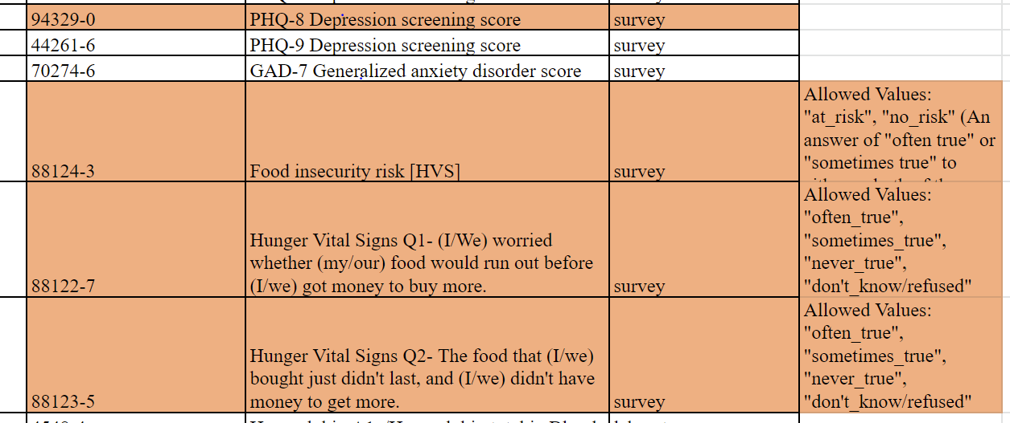
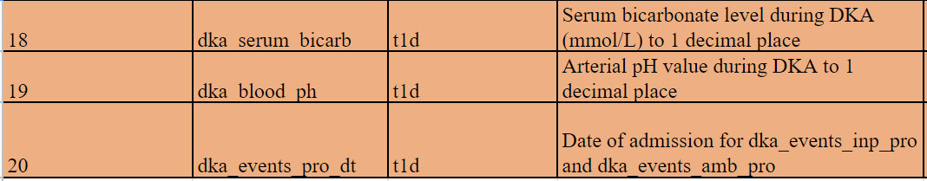
Review of changes: Data spec version 2.6
Core/Observations file- Surveys
Diabetes file- Disease

Slide 4
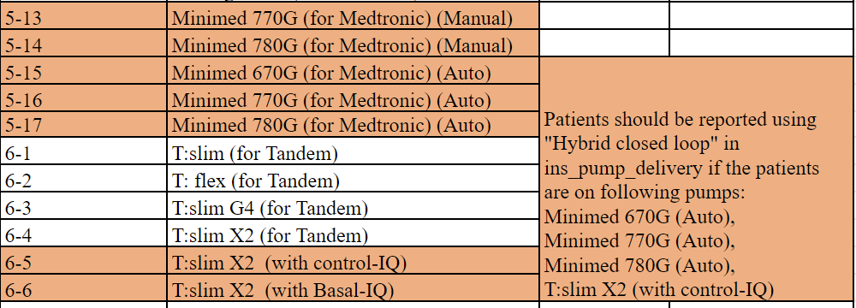
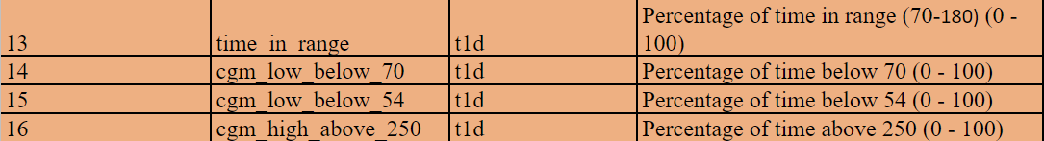
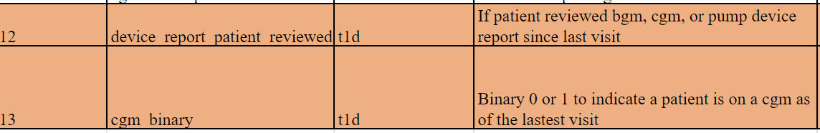
Review of changes: Data spec version 2.6
Diabetes file- Monitoring
Diabetes file- Glucose

Slide 5
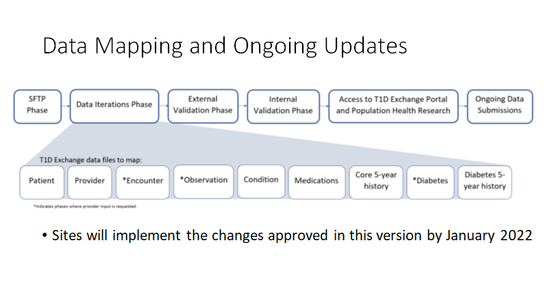
Data Mapping pipeline

Slide 6
Suggested modifications for Data Specification (version 2.7)

Slide 7
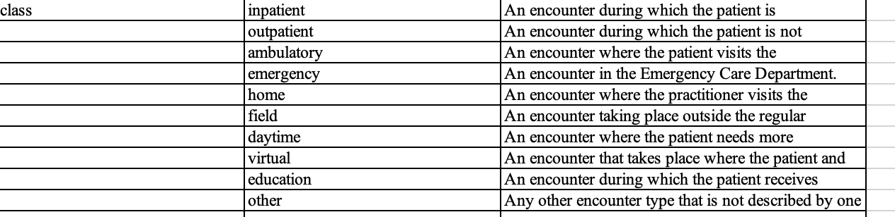
Suggested modifications for Data Specification (version 2.7)
1) Endo encounters/visits (binary indicator)
17 | Endo_visit | Binary 0 or 1 to indicate visit to endocrinology clinic
 | Allowed values
Endo_visit | 0 | Endocrinology visit
 | 1 | Non-endo visit
 | 100 | Unknown

Slide 8
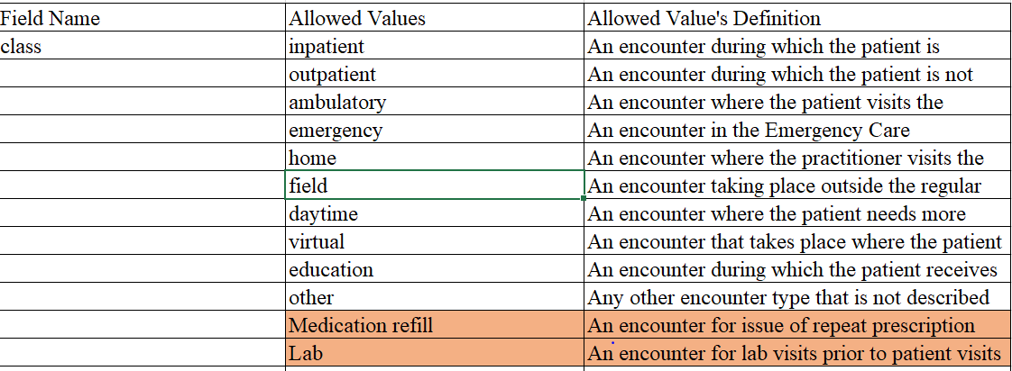
Suggested modifications for Data Specification (version 2.7)
2) Expand encounter class to include medication visits and lab visits

Slide 9
Suggested modifications for Data Specification (version 2.7)
3) Expand questions on tobacco use to current list?
Do we want to consider adding the following?
-Exposure to Tobacco smoke in home/car (Yes/No)
-Tobacco household concerns (Yes/No)

Slide 10
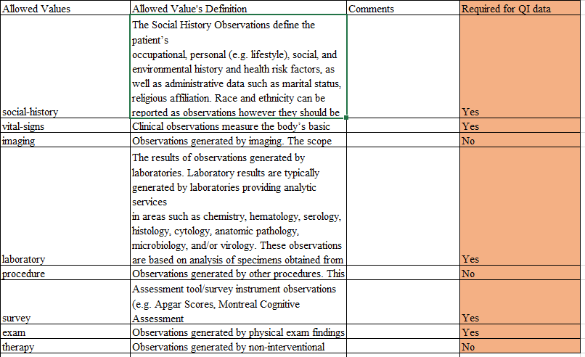
Suggested modifications for Data Specification (version 2.7)
4) Add column to indicate data required as priority for mapping

Slide 11
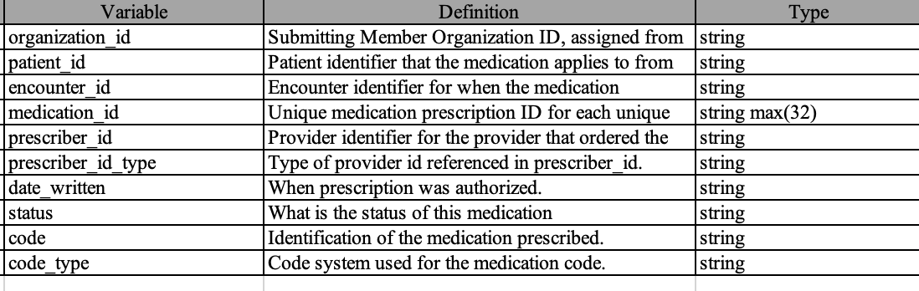
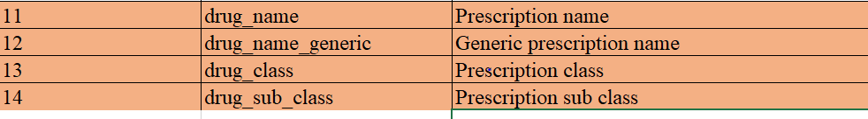
Suggested modifications for Data Specification (version 2.7)
5) Add two new columns to the medication file to capture prescription name class

