Slide 1
Data Science Committee Meeting
June 2022

Slide 2
Agenda
Introduce new Co-Chairs
Overview of QI Metrics and brief review of revisions made to data specification for version upgrade in 2021(v2.7)
Discussion with group to review adding /modifying existing data fields
Review clinic workflow (Dr. Joyce Lee)

Slide 3
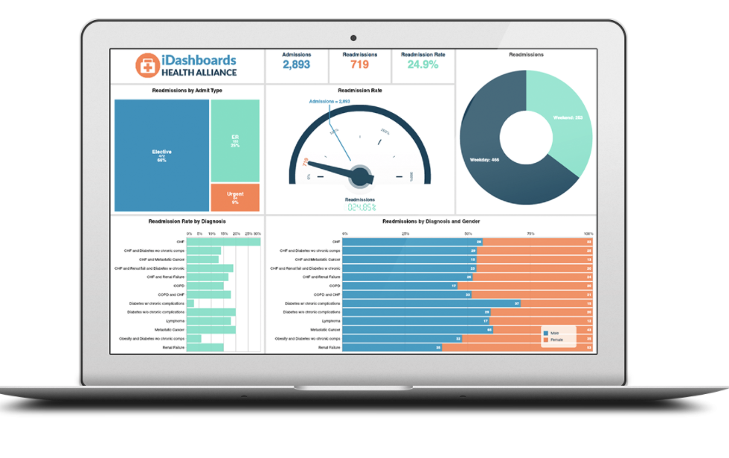
T1DX-QI
EMR
Database
Metrics on
QI Portal
(Mapped sites)
Data Mapping
T1DX-QI
Data specification
Data Spec files:
Patient
Observations
Diabetes
Encounter
Provider
Conditions
Medications
+
Population Health Research

Slide 4
Overview: Revisions in Data Spec V2.7

Slide 5
Revisions in Data Spec V2.7
Endo encounters/visits
Note: Not receiving updates from any site

Slide 6
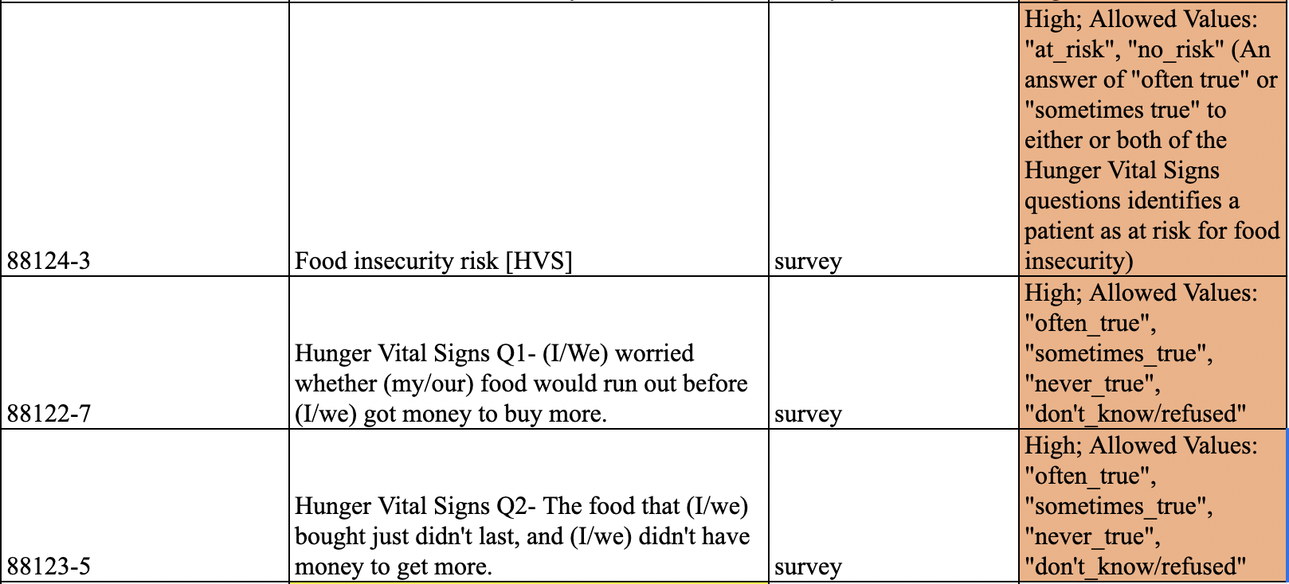
Revisions in Data Spec V2.7
3) Expand questions on SDOH
Note: Not receiving updates from most sites

Slide 7
Revisions in Data Spec V2.7
4) Add new columns to the medication file to capture prescription name, class
Note: Not receiving updates from most sites

Slide 8
Proposed updates for Data Spec V2.8

Slide 9
New fields for Data Specification V2.8
Race/Ethnicity (mixed race category)
2) Feasibility of adding Pregnancy field (Yes/No)
3) Education (Suggestions from group on best way to categorize)
4) Smart pen use (Suggest additional category to be added under ‘insulin’ in Diabetes spec)
5) Add provider specialty column (MD endo yes/ no)
6) C-peptide and auto antibodies testing/data collection process for diagnosis of T1D

Slide 10
Race/Ethnicity (mixed race category)
Include Mixed-Race option
 |  | Multiracial, Hispanic
 |  | Multiracial, Non-Hispanic
 |  | Multiracial, Unknown Ethnicity

Slide 11
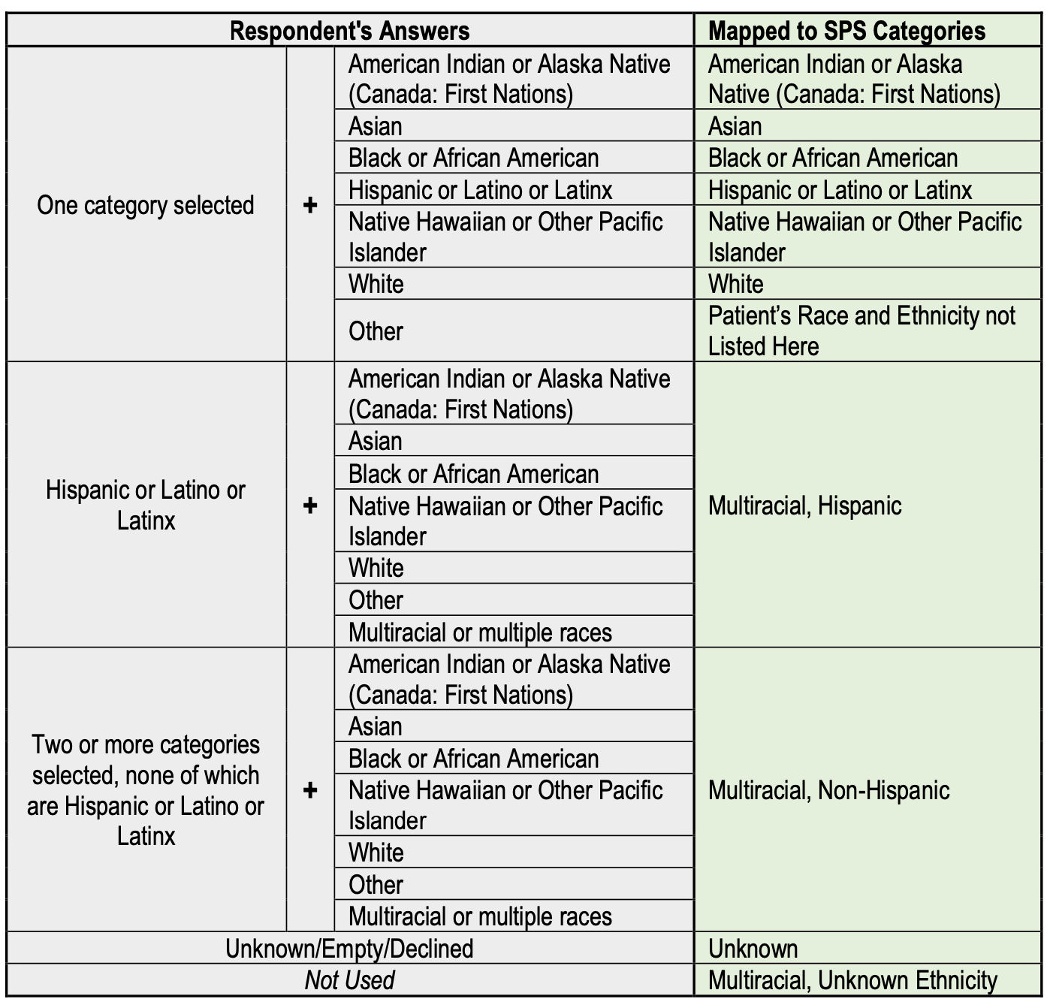
PHARE: Response recording format

Slide 12
New fields for Data Specification V2.8
2) Feasibility of adding Pregnancy field (Yes/No)
3) Education (Suggestions from group on best way to categorize)
4) Smart pen use (Suggest additional category to be added under ‘insulin’ in Diabetes spec)
5) Add provider specialty column (MD endo yes/ no)

Slide 13
Suggestions on adding C-peptide data field in addition to auto antibodies testing /
data collection process for diagnosis of T1D
Anti-IA2 Islet Cell Antibodies Anti-ICA512 |  | 31209-0 - Islet cell 512 Ab [Units/ volume] in Serum
* according to ARUP Labs at University of Utah these are all the same thing. |  | 56718-0 - Islet cell 512 Ab [Units/ volume] in Serum by Immunoassay
 |  | 32636-3 - Islet cell 512 Ab [Titer] in Serum
Insulin Autoantibodies |  | 8072-1 - Insulin Ab [Units/volume] in Serum
Zinc Transporter 8 |  | 76651-9 - Zinc transporter 8 Ab [Units/volume] in Serum or Plasma by Immunoassay
Anti-GAD | Anti-glutamic acid decarboxylase antibody | 13926-1 - Glutamate decarboxylase 65 Ab [Units/ volume] in Serum
 |  | 56540-8 - Glutamate decarboxylase 65 Ab [Units/ volume] in Serum by Immunoassay

Slide 14
Workflow Review

