Slide 1
Data Science Committee Meeting
February 2022

Slide 2
Agenda
Co-Chair roles
Overview of QI Metrics for Web Portal and Data Spec
Revisions made to data specification for version upgrade in 2021(v2.7)
Discussion with group to review adding /modifying existing data fields
Review technical suggestions to improve mapping

Slide 3
T1Dx Quality Improvement Metrics
Adults
A1c < 8%
Median A1c
CGM use
BG Check X4
Pump use (Elective measure)
6a) Depression Screening Eligibility
6b) Depression Screening
7a) CGM use at minimum 14 days in reporting month
7b) Time in Range
7c) Time in Hypoglycemia
7d) Time in Severe Hypoglycemia
8) ACE-I/ARBS prescription
9) DKA events
10) Statins prescription
11) SDOH screening, using an appropriate tool, including Hunger Vital Sign
12) Provide consistent access to routine care
13) Automated Insulin Delivery Use
14) Eye exam
15) Foot exam
Peds
A1c < 7%
Median A1c
CGM use
BG Check X4
Pump use (Elective measure)
6a) Depression Screening Eligibility
6b) Depression Screening
7a) CGM use at minimum 14 days in reporting month
7b) Time in Range
8) Bolus 3X among pump
9 ) DKA events
10a) Peds to Adults Transition Plan Eligibility
10b) Peds to Adults Transition Plan
11) SDOH screening, using an appropriate tool, including Hunger Vital Sign
12)Provide consistent access to routine care
13)Bolus 3X among MDI
14) Bolus composite
15) Review data patterns between visits
16) Adjust insulin does at least once since the last clinic visit (initiated by family or clinic)
17) Timing of insulin bolus (response of “At least several minutes before the meal” or “Immediately before the meal”)
18) Automated Insulin Delivery Use

Slide 4
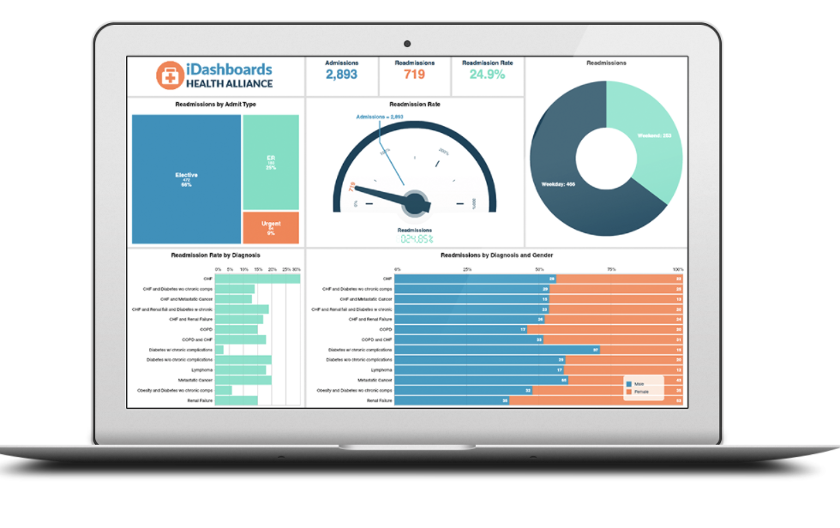
T1DX-QI
EMR
Database
Metrics on
QI Portal
(Mapped sites)
Data Mapping
T1DX-QI
Data specification
Data Spec files:
Patient
Observations
Diabetes
Encounter
Provider
Conditions
Medications
+
Population Health Research

Slide 5
Overview: Revisions in Data Spec V2.7

Slide 6
Revisions in Data Spec V2.7
Endo encounters/visits
Note: Not receiving updates from any site

Slide 7
Revisions in Data Spec V2.7
2) Expand encounter class to include medication visits and lab visits
Note: Not receiving updates from most sites

Slide 8
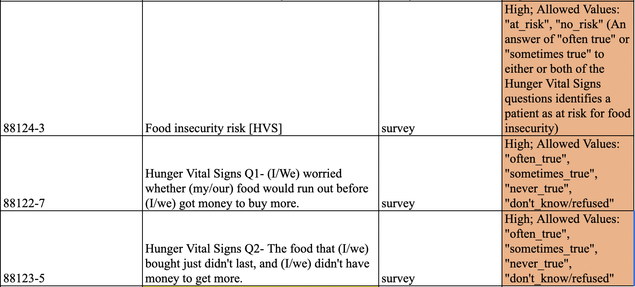
Revisions in Data Spec V2.7
3) Expand questions on SDOH
Note: Not receiving updates from most sites

Slide 9
Revisions in Data Spec V2.7
4) Add new columns to the medication file to capture prescription name, class
Note: Not receiving updates from most sites

Slide 10
Proposed updates for Data Spec V2.8

Slide 11
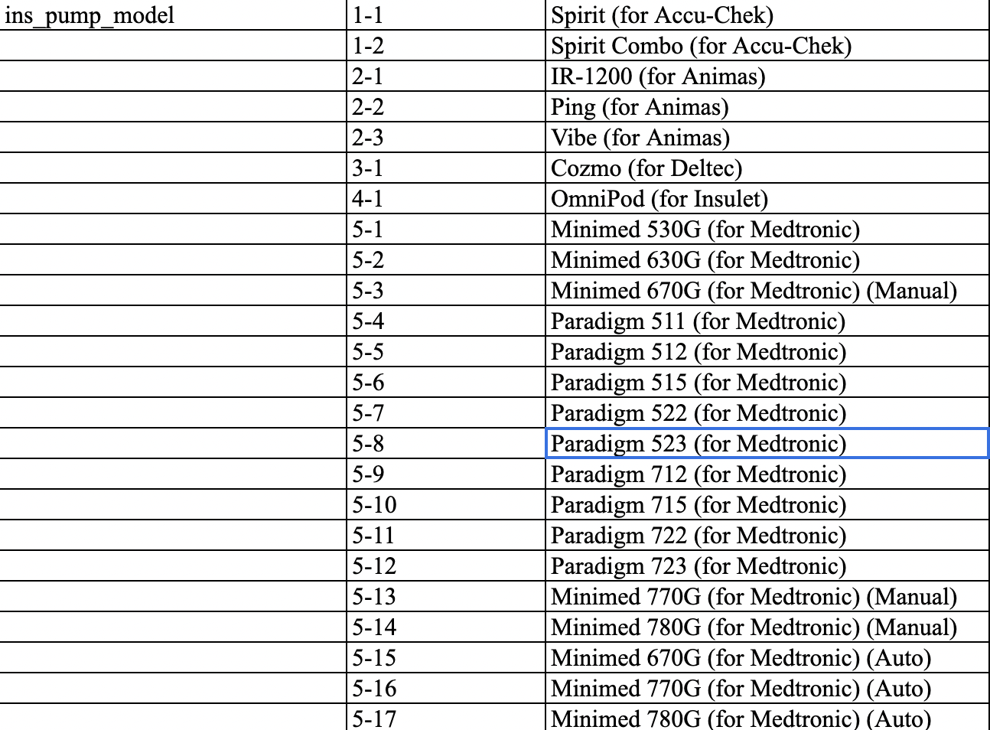
Updates for Version 2.8
Add Omnipod 5 to insulin pump
models

Slide 12
Updates for Version 2.8
SDOH – expand fields
Transportation
In the past 12 months, has lack of transportation kept you from medical appointments or from getting medications?
In the past 12 months, has lack of transportation kept you from meetings, work, or from getting things needed for daily living?
Has lack of transportation kept you from medical appointments, meetings, work, or from getting things needed for daily living? (LOINC code available: 93030-5)
Housing
In the last 12 months, was there a time when you were not able to pay the mortgage or rent on time?

Slide 13
Updates for Version 2.8
Race->Mixed-race option
Gender-> Transgender male, Transgender female, Non-binary

Slide 14
Updates for Version 2.8
Peds to Adults Transition Plan -> Are pediatric patients receiving documented care plan 12-18m prior to expected transition?

Slide 15
Technical Improvements
Mapping against data models like PCORnet and OMOP
Time to complete data mapping increases when sites submit PCORnet (Cincinnati, Michigan) and OMOP (Montefiore/Albert Einstein) files. Some of this is because Data Integration team needs to build scripts to automatically review these files the way we review files received according to our data specs.

Slide 16
Review fields for clarification
Encounter date (Enc file) versus effective date (Obs file)
What is the difference between encounter date in the encounter file and effective date in the observation file?
Now that encounter file has laboratory class, which encounter ID goes in the Obs file (for example, if patient completes A1c labs a week early, is it the encounter ID for the lab class encounter, or the ambulatory visit with a provider?)

