Slide 1
Icahn School of Medicine at Mount Sinai
T1D exchange

Slide 2
Clinic Profile
Mount Sinai East Adult Diabetes Center | Staffing | Volume | Contact Names
Main campus: 100th and Madison Avenue, NYC | 10 Endocrinologists with a diabetes focus (total division 16 providers) 4 NPs (2 CDCES) 2 RNs (1 CDCES) 2 RDs (1 CDCES) 1 Project lead 1 RC 1 Endo fellow 1 Endocrine Research fellow | 1100 ± 20 per year T1D visits New onset T1D : ⁓15 per year (+ patients misdiagnosed as T2D) | Site PI: Carol Levy Other team members: -David Lam, MD -Grenye O’Malley, MD -Nirali Shah, MD Site project manager: Selassie Ogyaadu, MD, MPH
Other Healthcare system NYC sites: Sinai West, East and Morningside

Slide 3
Active Projects
From 2020
Revision of DKA Protocol – In progress
Inpatient hyperglycemia for COVID patients protocol – In progress
New 2021
Pre-conception counseling for women with diabetes (PREPP’D) – In progress

Slide 4
DKA Protocol Revision
DKA (Diabetic Ketoacidosis) Protocol Revision
COVID-19 specific DKA Protocol created (Emergency Department, Endocrine, Hospital Medicine, Institute of Critical Care medicine)
Decreased IVF
Early introduction of basal insulin to decrease IV insulin gtt
Subcutaneous protocol for mild DKA

Slide 5
Diabetes in Pregnancy
Pregnant women with diabetes require tight glycemic targets to reduce adverse health risks (fetal and maternal complications)¹⁻³
Fetal Complications
Macrosomia Large babies Higher incidences of cesarean section Shoulder dystocia Maternal increased risk of preeclampsia Fetal death
Risks can be minimized by getting glucose levels to target before getting pregnant
Beck RW, et al. Lancet. 2019; 394: 1265-1273,
Voormolen DN, et al. Diabetes Obes Metab. 2018; 20:1894-1902;
Feig DS, et al. Lancet. 2017;390:2349-2359.

Slide 6
Patient Wait Time - Hospital Based Endocrine/Diabetes Clinic
COVID-19 social distancing and cleaning procedures have altered patient flow in clinic
Pre-COVID
Dedicated rooms for vitals, phlebotomy, POC testing allowed for intake of multiple patients before appointment
Waiting area used for patients after check-in, post-intake, and post-visit
Average wait time after check-in
Jan-Feb 2020, Mean 11 minutes, Median 7 minutes (Std. Dev. 14 minutes)
Jul-Aug 2020, Mean 24 minutes, Median 13 minutes (Std. Dev. 19 minutes)

Slide 7
Patient Wait Time - Hospital Based Endocrine/Diabetes Clinic
Issues Identified
Time spent by each patient in exam room due to phlebotomy
POCT HbA1C Testing – Limited staff that can perform task
Provider-RN-MA communication of patient rooming status
Shared space with multiple clinics (starting 9/2020) with decreased number of exam rooms and shared support staff

Slide 8
Patient Wait Time - Hospital Based Endocrine/Diabetes Clinic
Issues Identified
Time spent by each patient in exam room due to phlebotomy
Providers will contact patient 2 weeks ahead of time to arrange for pre-visit blood work
Limited appointment day lab work, routine labs ordered for patients to use 1st floor lab
Provider-RN-MA communication of patient rooming status
Unified communication protocols (dot system)
Same Day Huddle update
Changing assigned provider in response to long wait times **
Shared space with multiple clinics (starting 9/2020) with decreased number of rooms
Promotion of telehealth visits but now returning to more in person visits (9/2021)

Slide 9
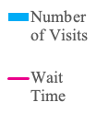

Slide 11
Pregnancy in Women with T1D is Associated with Even Higher Fetal Sequelae:
Severe complications 1 in 13
Congenital malformations
Stillbirth or neonatal death about 4 - 7 X’s that of women without diabetes
Preterm birth
Pre-eclampsia
LGA rates 40 – 70%
NICU admissions and Neonatal hypoglycemia 1 in 4
Complications
Costly emotionally and financially
Potentially preventable by improving glycemic control

Slide 12
Background
Unplanned pregnancy is a major public health issue*.
Diabetes affects ~10% of pregnancies.
Each HbA1c point above 7 in women with diabetes incrementally increase the risk of adverse pregnancy outcomes.
Pregnancy without preparation in women with diabetes is associated with:
High public cost (2010 estimated to be $21 billion per year)².
At times delays in initiating prenatal care.
Maternal complications.
Fetal complications
At Mount Sinai Health System, since 2009 there have been over 6,000 pregnancies affected by diabetes with approximately 8,000 deliveries per year.
* Finer LB, Zolna MR. Declines in Unintended Pregnancy in the United States, 2008-2011. N Engl J Med. 2016 Mar 3;374(9):843-52. doi: 10.1056/NEJMsa1506575. PMID: 26962904; PMCID: PMC4861155.
Notes:
Unplanned pregnancy is a major public health issue. According a study that is published in New England Journal of Medicine in 2016, the rate of unintended pregnancy in the United States is higher than many other industrialized countries. And as of 2011, the current rate is 45%.
Unintended pregnancies are associated with many negative health and economic consequences.
It can lead to high public cost. The public cost of births resulting from unintended pregnancies in 2010 was estimated at $21 billion per year (this figure includes costs for prenatal care, labor and delivery, post-partum care, and 1 year of infant care).
It also delays in initiating prenatal care, poor maternal mental health and birth defects.
Now lets look closer into pregnancies affected by diabetes.

Slide 13
At Mount Sinai
To date on chart reviews of eligible patients (~430 patients) with diabetes:
Historically, on random chart review, less than 50% of patients’ notes contain documentation of a discussion of the importance of pregnancy planning and the risks of unplanned pregnancies to the mother and offspring.
On average, one out of three pregnant women present with HbA1c great than 7.5% in the prenatal clinic per month (goal A1c should be less than 7.0% prior to pregnancy) and some are using meds that are teratogenic.
Notes:
Sometimes women will stop meds when they find out they are pregnant without discussing with their MD

Slide 14
QI Project Aims
To improve patient’s knowledge diabetes and pregnancy and increase use of contraception and number of scheduled gynecology visits.
To increase providers’ implementation of preconception counseling through the establishment of a uniform clinic protocol.
To implement protocols using smart phrases and educational handouts in diabetes clinic at FPA and 17 E 102nd.
To improve rates of pre-pregnancy counseling with a longer term goal to impact rate of unplanned pregnancies.
Notes:
Our pilot quality improvement project aims to
First: assess whether preconception intervention can improve patient’s knowledge on diabetes and pregnancy.
Second To improve providers’ awareness of the importance of preconception counseling
And lastly To set protocol in diabetes clinic to ensure PREPP’D can be incorporated into regular office visits.

Slide 15
PPREP’D Design/Methodology
Eligible Patients
Women between the age of 18-40
Previous diagnosis of either type I or type II diabetes
Seen at 5 E 98 th street FPA practice and17 E 102nd street diabetes clinic*
Eligible patients: 189 patients at 17 E 102nd diabetes clinic and 250 patients at 5 E 98th FPA practice (n=439).
Patients and their providers will receive surveys to assess baseline knowledge and awareness of preconception counseling and diabetes*.
At initial visit, we are collect data including demographics, diabetes treatment, use of contraception and most recent hemoglobin A1C.
Providers will be given education (smartphrases) to incorporate into their visit note.
Patients are provided educational guidance (smartphrases) upon visit completion in their visit summary.
Survey questions will be derived from validated surveys specifically: “MDRTC diabetes knowledge test”, “RHAB”, and “Health Belief Model” and will include questions such as current contraception use and current diabetes knowledge.
At 3-6 months, we will conduct post-intervention surveys over the phone or via redcap and we will chart check for number of scheduled GYN visits.
Notes:
Follow up surveys will be sent by email or via phone depending on scheduling email access. Surveys will include approximately 15 questions for patients, and 10 for clinicians
Eligible patients: 189 patients at 17 E 102nd diabetes clinic and 250 patients at 5 E 98th FPA practice (n=439)
2 weeks prior to scheduled clinic visits, both patients and their providers will receive RedCap surveys via email to assess baseline knowledge and awareness of preconception counseling and diabetes. Surveys will be both in english and spanish.
Since this is a pilot study, there is no pre-existing validated survey specifically for this project but we will be derive questions from other validated surveys specifically
We have reviewed other validated suveys including:
“MDRTC diabetes knowledge test” which include 23 questions that assess diabetes and knowledge and asks things like definition of hemoglobin A1C, testing blood glucose, affect of certain food on glucose, exercise and glucose,
RHAB reproductive health attitudes and behavior that examines preconception planning of young women with diabetes that included 48 behavioral questions such as health belief, attitude, intention, barriers to health care
And Health belief model which evaluates for Perceived susceptibility of the woman's assessment of her own and her unborn child's vulnerability to complications of pregnancy, Perceived severity as the woman's assessment of the serious- ness of those complications to herself and her unborn child (two items). Perceived benefits were measured as the woman's belief that adherence to the recommendations comprising pre-conception and pre- natal counseling would help prevent un- toward complications for her and her unborn child (seven items). Perceived barriers were measured as the woman's perceived difficulties associated with implementing the recommendations for care, such as limited time, insufficient re- sources, or required lifestyle changes (10 items).
At initial visit : we will chart review for age, marital status, employment, health, insurance, ethnicity, level of education, diabetes treatment , most recent hemoglobin A1C
Providers will be given smartphrases to incorporate into their visit note.
Patients will be provided educational guidance (smartphrases) upon visit completion in their visit summary.

Slide 16
Methodology
Data
Source: EPIC
Data: HbA1C, demographics, current diabetes treatment, use of contraception
Metrics that we will be evaluating:
Patient knowledge: the scores on pre-intervention and post-intervention questionnaires for patients.
Contraception Use: the number of gynecologist visits and the percent change of contraception use before and after intervention.
Provider awareness: the scores on pre-intervention and post-intervention questionnaires for providers and the percent change of documentation in regards to pregnancy planning.
Longer term follow up: HbA1c results at first antenatal diabetes visit compared to baseline HbA1c.

Slide 17
PREPP’D (Pregnancy Reproductive Education Program for People with Diabetes)
Ally Wang MD (PGY5, Endocrine fellow), Madeleine Rouviere RD CDE, Camilla Levister NP CDCES, Grenye O’Malley MD, Selassie Ogyaadu MD MPH, Carol Levy MD CDCES
Education initiative to patients and providers focusing on pre-conception counseling on diabetes goals in pregnancy
Surveys distributed to patients and assessment of provider counseling (captured in smart phrase)
To date : 29 patients completed survey
Expansion to Mount Sinai Downtown Union Square, Mount Sinai Morningside/West in process

Slide 18
Quality Improvement Initiative: Hyperglycemia Treatment Algorithms for COVID-19 Patients on Glucocorticoids
Alexander Karol MS4
Natalia Viera MD PGY3
Danielle Brooks MD (Graduated 2021)
Carol Levy MD
David Lam MD
Amanda Leiter MD
Grenye O’Malley MD
Selassie Ogyaadu MD, MPH
Nirali Shah MD

Slide 19
Background
Corticosteroids (dexamethasone, methylprednisolone, prednisone) have become an essential component of care in patients hospitalized with COVID-19 who require oxygen supplementation.
Hyperglycemia, regardless of diabetes history, is associated with increased mortality in COVID-19 patients.
Glucocorticoids increase the risk of hyperglycemia, yet there are no clear guidelines on optimal management.
RECOVERY Collaborative Group, Horby P, Lim WS, et al. Dexamethasone in Hospitalized Patients with Covid-19. N Engl J Med. 2021;384(8):693-704.
Bode, Bruce et al. “Glycemic Characteristics and Clinical Outcomes of COVID-19 Patients Hospitalized in the United States.” Journal of diabetes science and technology vol. 14,4 (2020): 813-821.

Slide 20
Methods
Created treatment algorithm for glucose management specifically for patients with COVID-19 treated with steroids
Based on standard of care for hospitalized patients with hyperglycemia
Adjustments made considering added hyperglycemic effect of steroids
Engaged with primary stakeholders to inform providers and distribute algorithm
Made treatment algorithm available through EPIC
Reached out to primary services via EPIC chat and e-mail
Notes:
Framing: Protocol not designed for ICU/exclusion critera…excluded because protocol for general floors –
INCLUSION: PROTOCOL CLINICALLY APPROPIATE FOR..
PROTOCOL NOT DESIGNED FOR PATIENTS (EXCLUSION)
Exclusion group—not designed to meet their needs

Slide 21
Algorithm Access

Slide 22
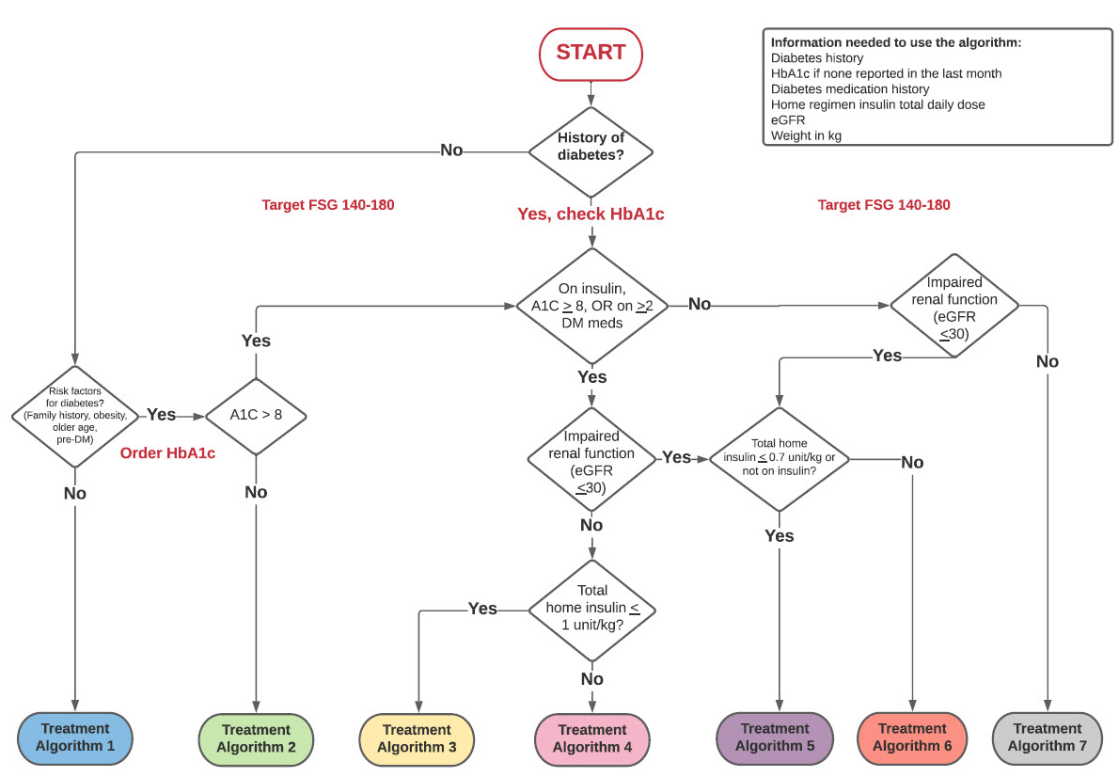
Notes:
Glucose targets were based on available outcome data in the literature.

Slide 23
Timeline/Methods:
Fall/Winter 2020
Drafted guidance algorithms
Algorithm first piloted on DM consult service. After refinement expanded to a teaching medicine team.
Jan-Feb
2021
February 2021
March 2021
Worked with IT to incorporate algorithms in Epic.
Presented to Hospital QI committee.
Began outreach to medicine teams.
April 2021
June- Aug 2021
Chart review and data analysis
Sept 2021
Notes:
Treatment guidance documents developed by Division of Endocrinology diabetologists in conjunction with Hospital Medicine, Geriatrics
Treatment guidance is based on existing ADA standard of care for hospitalized patients with diabetes/hyperglycemia as well as expert opinion on insulin dosing in the setting of steroids

Slide 24
Timeline/Methods:
November 2021
Obtained IRB approval
Chart review:
HbA1c, glucose values, insulin regimens
Demographics, weight, creatinine, comorbidities
Steroid dosing, other COVID treatments, length of stay
Metrics:
% glucose <180 mg/dL
% glucose >250 mg/dL
Hypoglycemic events (<70 mg/dL)
LOS, mortality
Historical controls data received from DWH.
Matching process → 1:1 matching on age (+/- 3 years), sex, weight (+/- 10%)
December 2021
Complete data acquisition and intergroup statistical analysis.
Manuscript completion.
January 2022
Revision of algorithm based on results.
Expanding protocol use for other inpatients requiring prolonged steroid treatment
Next steps
Notes:
Treatment guidance documents developed by Division of Endocrinology diabetologists in conjunction with Hospital Medicine, Geriatrics
Treatment guidance is based on existing ADA standard of care for hospitalized patients with diabetes/hyperglycemia as well as expert opinion on insulin dosing in the setting of steroids

Slide 25
Table 1 | Variable | Pre-Protocol | Post-Protocol
 | Number | 53 | 65
 | Patient admission dates | 04/2020-03/2021 | 04/2021-12/2021
Demographics | Median age (IQR) | 73 (57-80) | 70 (57-79)
 | Male sex (%) | 28 (52.3) | 35 (53.8)
 | Median BMI (IQR) | 27.18 (24.5-32.3) | 29.3 (24.1-32.6)
 | Hx of Diabetes (%) | 43 (81.1) | 54 (83)
 | Median A1c % (IQR) | 7.8 (6.6-9.3) | 7.4 (6.3-8.9)
 | Insulin users (%) | 17 (32.1) | 15 (23)
 | Median weight (IQR) | 77.6 (66.2-92.9) | 78.4 (66.6-94.8)
 | Median admission Creatinine | 1.2 (0.7-1.9) | 0.9 (0.7-1.2)
 | Steroids administered (%) | 53 (100) | 65 (100)
Insurance | Medicaid (%) | 11 (20.8) | 10 (15.4)
 | Medicare (%) | 25 (47.2) | 36 (55.4)
 | Commercial (%) | 12 (22.6) | 16 (24.6)
 | Unknown (%) | 5 (9.4) | 3 (4.6)
Race | African American (%) | 10 (18.9) | 26 (40)
 | White (%) | 17 (32.1) | 10 (15.4)
 | Hispanic (%) | 17 (32.1) | 20 (30.8)
 | Other (%) | 9 (17) | 9 (13.8)
Pre protocol patient data analysis still ongoing

Slide 26
Clinical Metrics
Table 2 | Pre Protocol | Post Protocol
Overall Median POC Glucose per group (mg/dl) (IQR) | 215.9 (181-250.7) | 212.7 (169.1-255.9)
Overall Mean POC Glucose Euglycemic <=180 mg/dl (%) | 12 (22.6) | 25 (38.5)
Overall Mean POC Glucose >180 mg/dl and <= 250 mg/dl (%) | 27 (50.9) | 22 (33.8)
Overall Mean POC Glucose Hyperglycemic>250 mg/dl (%) | 14 (26.4) | 18 (27.7)
Total number of hypoglycemic (<70mg/dl) events | 15.0 | 7.0
Patients with Hypoglycemic Events <70mg/dl (%) | 7 (13.2) | 7 (10.8)
Median LOS (IQR) | 12 (5-24) | 10.5 (6-17.5)
Mortality (%) | 14 (26.4) | 11 (16.9)

Slide 27
Timeline/Methods:
November 2021
Obtained IRB approval
Chart review:
HbA1c, glucose values, insulin regimens
Demographics, weight, creatinine, comorbidities
Steroid dosing, other COVID treatments, length of stay
Metrics:
% glucose <180 mg/dL
% glucose >250 mg/dL
Hypoglycemic events (<70 mg/dL)
LOS, mortality
Historical pre protocol patient data received from DWH.
Matching process → 1:1 matching on age (+/- 3 years), sex, weight (+/- 10%)
December 2021
Complete data acquisition and intergroup statistical analysis.
Manuscript completion.
January 2022
Consider revision of algorithm based on results.
Expanding protocol use for other inpatients requiring prolonged steroid treatment
Next steps
Notes:
Treatment guidance documents developed by Division of Endocrinology diabetologists in conjunction with Hospital Medicine, Geriatrics
Treatment guidance is based on existing ADA standard of care for hospitalized patients with diabetes/hyperglycemia as well as expert opinion on insulin dosing in the setting of steroids

