Slide 1



A Program to Decrease DKA Admissions:
Diabetes Wellness Program (DWP)
Pediatric Diabetes Program
SUNY Upstate Medical University
Syracuse, NY
Margaret Greenfield, MS, CHES David Hansen, MD, MPH Emilie Hess, MS
Karen Kemmis, RN, DPT, CDCES Danielle Stegman-Barber, RD, CDCES Amanda Zuccaro, BSN, RN
Cassie Bunker, CPNP Janine Robbins, BSN, RN Ann Marie Sanders, MSN, RN
Hollie Cartini, LMSW Maria Winkworth, RD Renee Pierce, LCSW
Casey Mohrien, MS IV Christopher P. Morley, PhD Roberto Izquierdo, MD

Slide 2

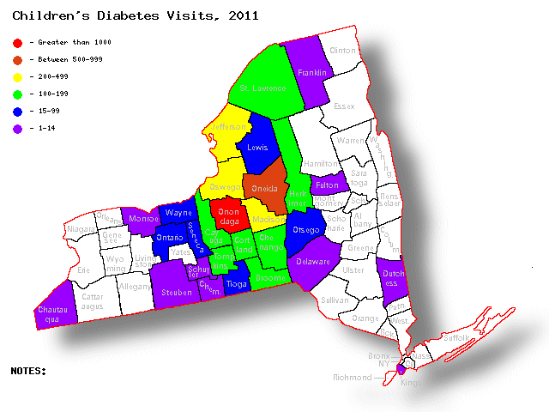
Joslin Diabetes Center at SUNY Upstate Medical University
We serve more than 25 counties in Central New York
Our patient panel over past two years:
  1262 with type 1
  620 with type 2
We see 100-142 patients with newly diagnosed diabetes each year, mostly with type 1 diabetes
Age range: 6 weeks to 21 years of age

Slide 3
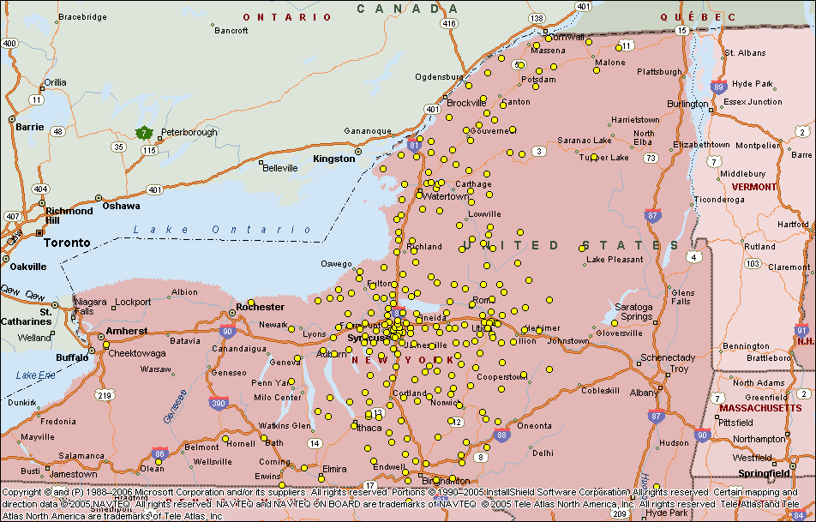
Joslin Pediatric Diabetes Home Locations

Slide 4
Increase in newly diagnosed type 1 diabetes among pediatric and adolescent patients during the COVID-19 Pandemic in the US*
Retrospective study that included patients from 7 large US clinical centers
that were member sites
 | 2019 | 2020 | p value
Newly diagnosed patients with T1D^{2,3} | 1277 | 1399 | 0.007
Presented in DKA¹ | 38.6% | 42.8% | <0.001
¹ Higher proportion presented in severe DKA (pH<7.1, bicarb<5) |  |  | 0.01
² Less likely to have private insurance |  |  | 0.001
³ Fewer females and fewer NH White youth |  |  | <0.001
*Wolf et al. ISPAD 2021

Slide 5
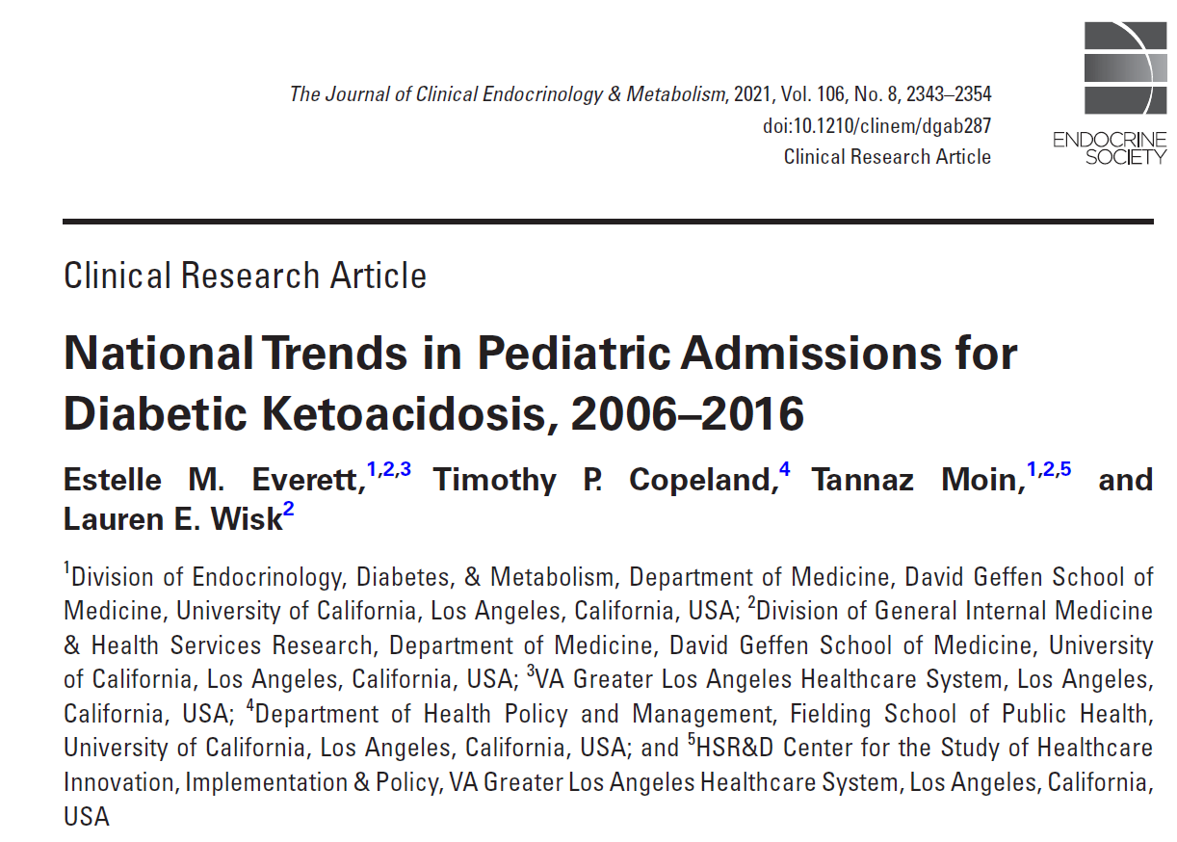

Slide 6
Methods
Used the 2006, 2009, 2012, and 2016 Kids’ Inpatient Database to identify pediatric DKA admissions per 10,000 admissions and per 10000 population, length of stay (LOS), and trends over time among all hospitalizations and by demographic subgroups
Regression models were used to evaluate differences in DKA rates within subgroups overtime.

Slide 7
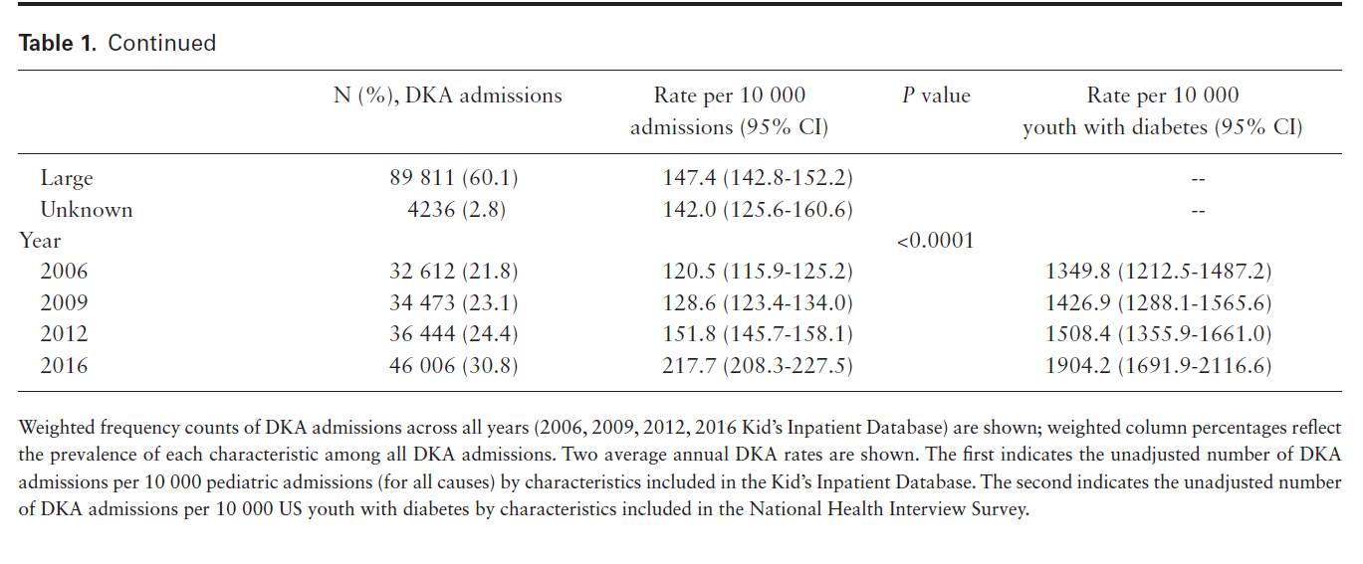
Rising Rate of DKA Admission
Pediatric DKA admissions have risen by 40% in the US and vulnerable subgroups remain at highest risks

Slide 8
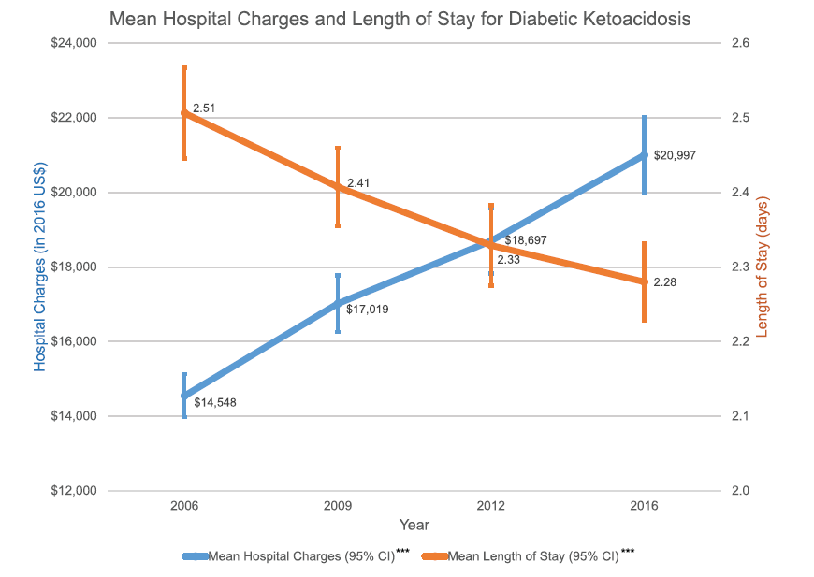
DKA admissions
are costly

Slide 9
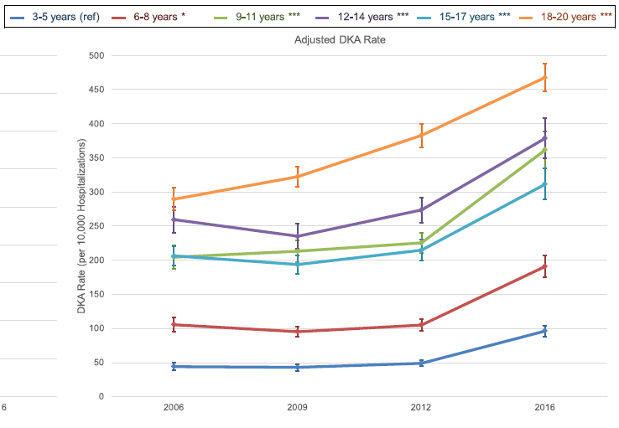
Highest risk group:
18-20 yr old
12-14 yr old

Slide 10
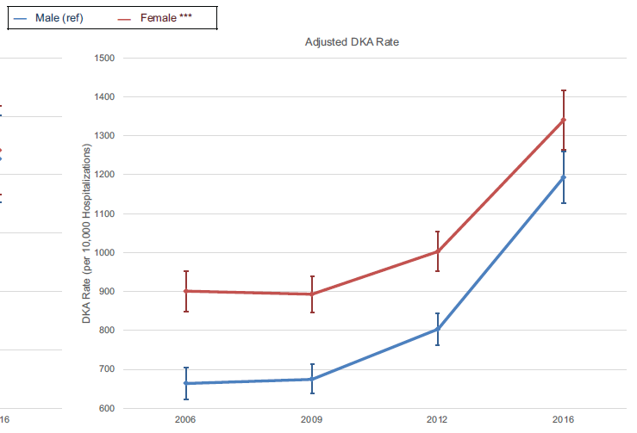
DKA risk:
Female > Male

Slide 11
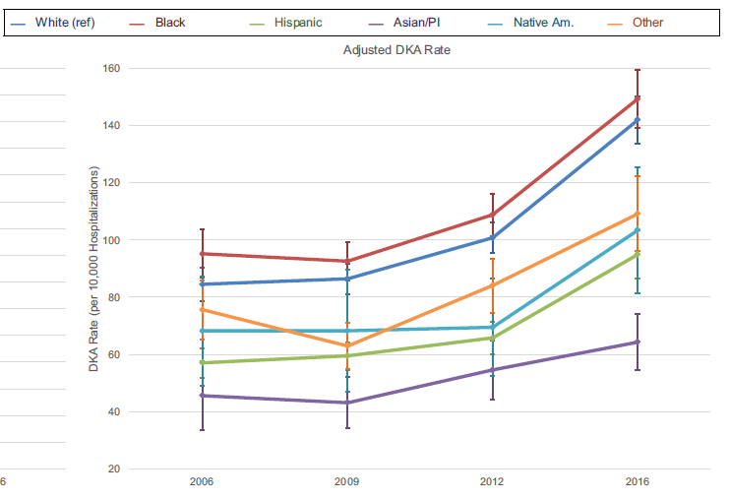
Highest risk group:
Black

Slide 12
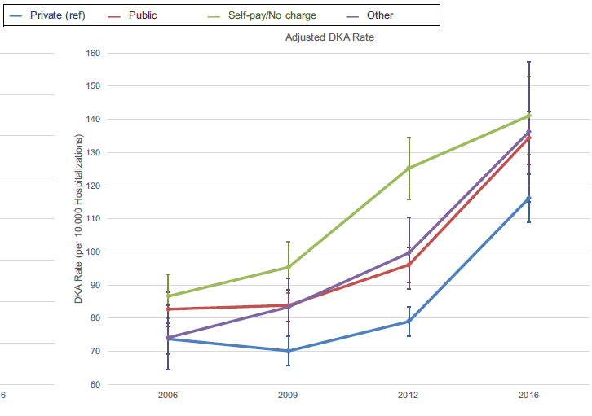
Highest risk group:
Self-pay/Public > Private

Slide 13
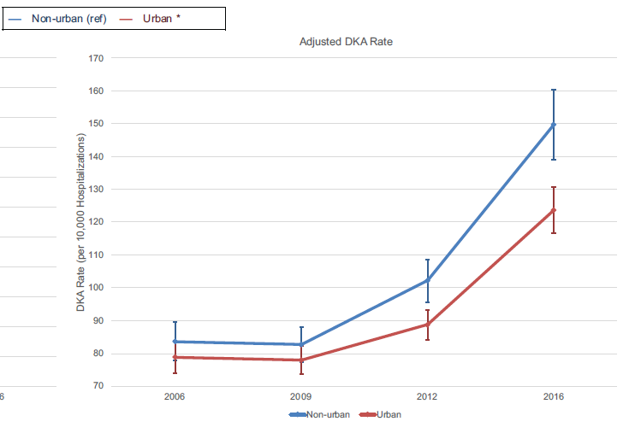
Highest risk group:
Non-urban > Urban

Slide 14
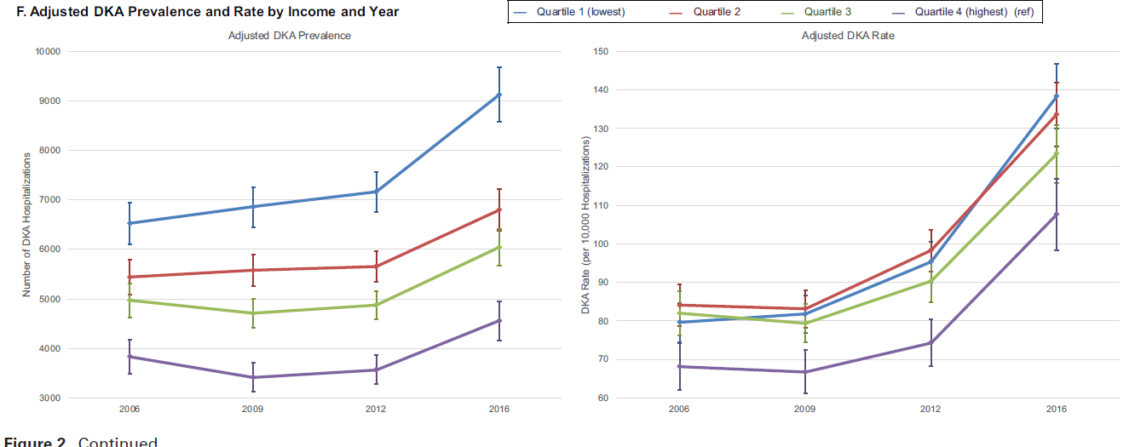
Highest risk group: those in the lowest quartile for income

Slide 15
Conclusion
Pediatric DKA admissions have risen by 40% in the US and vulnerable subgroups remain at highest risks
Further studies should characterize the challenges experienced by these groups to inform interventions to mitigate their DKA risk and to address the rising DKA rates nationally

Slide 16

Clinical Diabetes Journal 2021

Slide 17
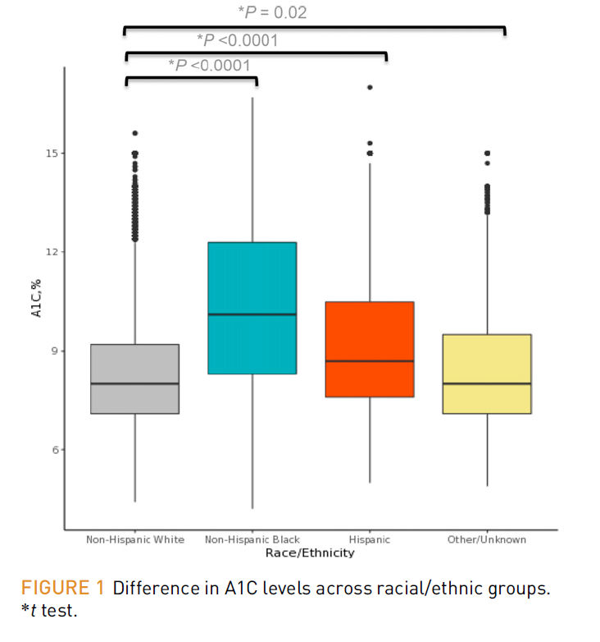

Slide 18
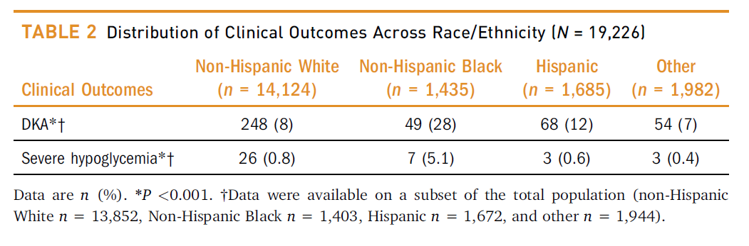

Slide 19
Conclusion
These results underscore the crucial need to study and overcome the barriers that lead to inequities in the care and outcomes of people with type 1 diabetes

Slide 20
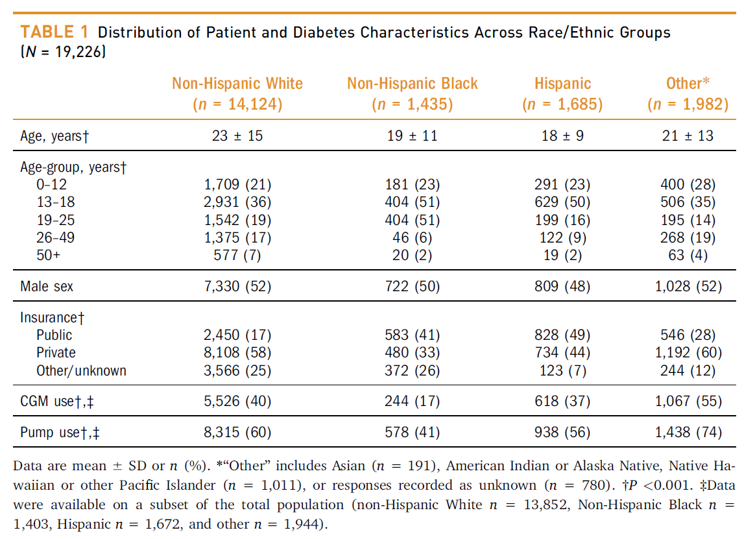

Slide 21
Needs Assessment for
Diabetes Wellness Program (DWP)
Nineteen patients had at least two or more DKA admissions from Aug 1, 2019 – Aug 1, 2020
Seventeen patients has at least two or more DKA admissions from August 2, 2020- August 2, 2021
Patients with frequent ER visits, sustained A1c >14%, or frequent outpatient calls for hyperglycemia in association with ketonuria
Two Intervention Cohorts: 16 patients each
Notes:
These numbers were prior to cohort 1, do we want updated number for prior to cohort 2 and current?

Slide 22
Enrollment Process for Cohorts 1 & 2
Identify Patient
Describe program details
Patient and Family agree to participate
Return to usual care
  Age range
  # of DKA admissions
  HbA1c values
  Provider recommendation
  Monthly:
    NP
    RD or RN for education
  SW as needed
  telemed v. in-person
  First visit is scheduled, ideally in person, if possible
    3 no shows
      For NP or education visit
    Unable to contact for follow up
Notes:
Our team met twice a month to review each patient and programmatic changes.

Slide 23
Education Curriculum for Cohorts 1 & 2
Visit 1
Weekly Calls
Visit 2
Weekly Calls
Visit 3
Weekly Calls
Visit 4
Weekly Calls
Visit 5
Weekly Calls
Visit 6
  MyChart setup and usage
  Keeping BG log and/or downloading of devices
  Setting SMART goals
  Nutrition education needs assessment
  Ketone review
  Sick day guidelines
  Hypoglycemia protocol
  Review use of Glucagon
  Review NY driving laws
  (if applicable) and importance of checking BGs
  Sports and exercise management
  Technology
  Increasing independence
  Identifying blood sugar patterns
  Making changes based on patterns
  Establishing routines
  Sports and exercise management
  Technology
  Increasing independence
  Identifying blood sugar patterns
  Making changes based on patterns
  Establishing routines
  Independent dosing changes
  Patient choice of topic
  Habits for maintenance
  “After Hours” game

Slide 24
Lessons Learned from Cohort 1
Change in scheduling process to decrease no shows and rescheduling
Nutrition assessment not always done in visit 1: learning- move to visit 2 for second cohort
Goal was to review all the material however not all patients were ready to receive it

Slide 25
Cohort 1: DKA Data prior to DWP and post DWP
Notes:
Do we want current # DKA since end of cohort 1? This would tell us whether they are headed back to pre-DWP DKA admission numbers?
Other info:
# of DKA admissions: in the last 2 years
14 have public insurance
2 have private insurance
Start of program (of participating patients): 4 on pumps, 7 on CGM, 9 on injection
These patient had high no show rates prior to enrollment

Slide 26
Pre and Post Cohort 2: HbA1C
Notes:
Average Pre: 13. 6
Standard Deviation Pre: 2.51453
Average Post: 11.7
Standard Deviation Post: 3.07432

Slide 27
Demographics
 | Completed DWP | Returned to Usual Care | Not Enrolled | Total
N | 18 | 14 | 81 | 113
Age, mean + SD | 15.2 + 2.9 | 16.8 + 2.2 | 15.4 + 4.1 | 15.5 + 3.8
Female % | 44.4 | 64.3 | 51.2 | 53.1
Race White % Black % American Indian % Mixed Race % Other % | 66.7 27.8 0 5.6 | 64.3 28.6 0 0 7.1 | 80.2 11.3 1.3 1.3 6.3 | 76.1 15.9 0.9 0.9 6.2
Insurance Public % | 88.9 | 71.4 | 64.2 | 69.0
Notes:
A greater percentage of DWP participants (77.8%) use CGM vs. those not enrolled (58.0%). However, the difference was not significant

Slide 28
Clinical Outcomes
 | Completed DWP | Returned to Usual Care | Not Enrolled | Total
A1c, mean + SD Pre Post | 12.7 + 2.0 11.3 + 2.5 | 11.8 + 2.6 12.0 + 3.6 | 9.9 + 2.3 9.5 + 2.2 | 10.5 + 2.5 10.0 + 2.4
DKA admissions, mean + SD Pre¹ Post² | 3.28 + 3.1 0.89 + 1.1 | 2.21 + 1.6 0.25 + 0.5 | 1.44 + 1.1 0.52 + 1.4 | 1.83 + 1.8 0.56 + 1.3
CGM User % | 77.8 | 64.3 | 58.0 | 61.9
¹August 2018 – August 2020
² Since the end of each cohort
Notes:
Cohort 1: there were 3 patients who were started on CGM
Cohort 2: there were 9 patients who were started on CGM

Slide 29
Change in A1c and DKA admissions
 | Completed DWP | Not Enrolled | P-value
A1c Change in mean + SD | -1.49 + 2.4 | -0.54 + 1.98 | 0.05
DKA admissions Change in mean + SD | -2.39 + 3.5 | -0.94 + 1.62 | 0.009
Notes:
Using ANOVA, DWP participants had a larger change in DKA admissions than those not enrolled (p=0.009)
Using t-test, DWP participants had a larger change in A1c compared to those not enrolled (p=0.05)

Slide 30
Type 1 Diabetes and Quality of Life (T1DAL) Measures ¹
77% of the participants who completed the program had an improvement in quality-of-life scores as shown by their pre- and post-T1DAL surveys
¹ Hilliard et al. J Pediatr Psychol 2019

Slide 31
Post Participation Survey
 | YES | NO
Did the Diabetes Wellness Program helped you learn how to prevent DKA admissions? | 100% | 0
Do you feel the program helped with your diabetes related quality of life overall ? | 100% | 0
After completing the program, do you feel more confident in independently managing your diabetes? | 100% | 0
The weekly calls were helpful? 5 = strongly agree, 3 = neither agree nor disagree, 1 = strongly disagree | 4.2 + 0.8
What were the most helpful education topics? (check all that apply) | Making changes based on blood sugar patterns Diabetes technology

Slide 32
What have we learned?
The program was effective for those who attended and completed the program
We need to make our program more accessible for patients who are already facing many barriers
Don’t need all 6 visits, decreasing the # of visits may help participation

Slide 33
Next Steps…

Slide 34
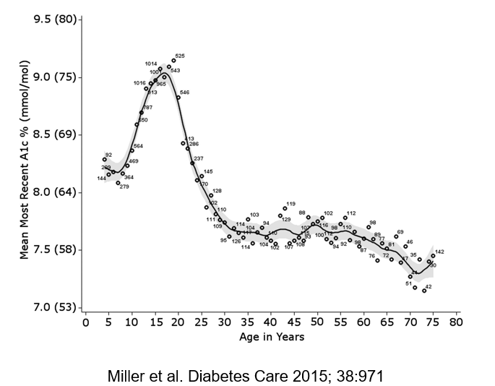
A1c at different ages
Advances in diabetes technology has improved glycemic control and quality of life in many children
Many factors influence the ability to achieve goals of therapy for type 1 diabetes
However, there is a subset of children who have been left behind
Children from low-income families and non-Hispanic Black children are not experiencing these benefits of technology
Lipman and Hawkes. Diabetes Care 2021

Slide 35
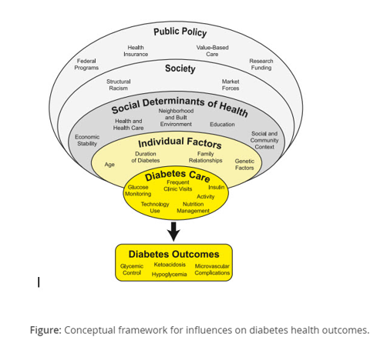
Traditionally we have focused on behavioral aspects of diabetes care such as frequency of visits with the diabetes team, frequency of blood glucose monitoring, and implementations of technologies such as insulin pump and CGMS
Our multidisciplinary diabetes teams attempt to address individual factors that influence the ability to achieve excellent diabetes outcomes, such as family relationships, age (adolescence), genetic factors (obesity, insulin resistance), and underlying mental health conditions (depression, eating disorders)
BUT we are recognizing that factors in health care and society influence patient outcomes – Social Determinants of Health (SDOH)
3
2
1
Lipman and Hawkes. Diabetes Care 2021

Slide 36
Social Determinants of Health (SDOH)
Factors in a person’s life across the lifespan that result in unequal distribution of resources:
  Socioeconomic status
  Neighborhood (rural vs urban)
  Food environment (food insecurity)
  Access to affordable and high-quality health care (lack of insurance, under insured)
  Social factors – social capital, support, cohesion (racism vs multiculturism, racial equality)
  Economic stability (homelessness)

Slide 37
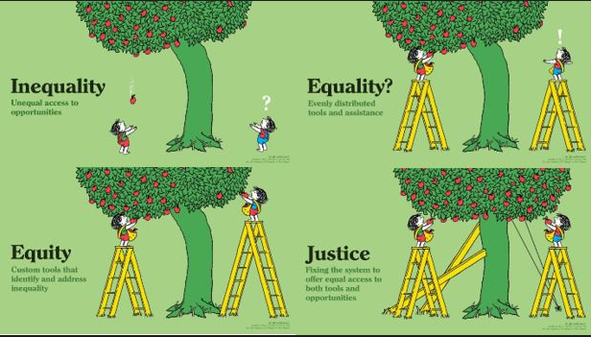
NEXT PHASE:
Identify & Address
Identify & Address
Health Disparity
SDOH
Recognition of and addressing health disparities
can lead to change in practice
Health Equity
Health Disparity: A health difference associated with social, environmental, or economic disadvantage
that typically affects people experiencing barriers or who have few resources (on the basis of
race/ethnicity, socioeconomic status, geographic location, sex, and sexual orientation and gender identify, among others)
Health Equity: An aspirational goal describing the elimination of remediable factors that adversely influence health

Slide 38
Next Steps
MAJOR AIM:
  Improve the program retention, patients’ glycemic status and quality of life by addressing the SDOH (now that we have a dedicated social worker)
  We do not need all six visits
Notes:
Most patients in this program report they don’t know a peer with diabetes. Mention first visit being with other children/families who are like them ☺ meeting someone else that has diabetes

Slide 39
Education Curriculum for Next Cohort
Introductory Call/Visit
Weekly call
Weekly call
Weekly call
Visit 3
Weekly call
Visit 1
Visit 2
Visit 4
Attend Classroom Introductory Visit in Person
Confirm first appointment date/time
Review of Program and Expectations
Hollie will be with each family individually
MyChart setup and usage
Keeping BG log and/or downloading of devices
Setting SMART goals
Nutrition education needs assessment
Ketone Testing/Sick Day Guidelines
Low Blood Sugar Management
Nutrition education needs assessment
Sport and Exercise Management
Technology
Achieving a greater independence at school
Establishing Routine
How to identify blood sugar patterns and make changes
“After Hours” game
Review the preview topic as needed
Notes:
For cohort 2022

Slide 40
DWP Return to Usual Care Criteria for Cohort 2022
Patient enrolled
Lack of 2 appointments with APP and Education
Call made to patient by Social Work
No answer or no attendance to next appointment
Return to usual care
Patient enrolled
Continues to cancel or no show and then reschedule
Review at DWP Meeting
Call made to patient by Social Worker to discuss and problem solve barriers to participation
No answer or no attendance to next appointment
Return to usual care
Patient enrolled
Patient shows for first visit
Lack of 2 appointments with APP and Education
Call made to patient by Social Work
Return to usual care
Patient enrolled
Patient cancels or no shows for Introductory Classroom
Visit
Call made to patient by Social Work
Return to usual care
Patient enrolled
Patient expresses no longer wanting education visits OR APP appointment
Call made to patient by Social Work
Return to usual care

Slide 41
Next Steps
AIM: Improve retention, patients’ glycemic status and quality of life by addressing the SDOH
  Tests of change:
    Identify and address SDOH that are barriers to care
    ↑ flexibility of appointment times
    ↑ accessibility:
      Offer/encourage telemedicine visits to improve adherence to visits
      Partner with school nurses to offer televisits at school¹
    ↑ involvement of case management and social work services
    Celebration of small victories with assistance from child life specialist
    Rolling admission
¹ Izquierdo, Weinstock et al. J Pediatric 2009. School Telemedicine Project.
Notes:
Most patients in this program report they don’t know a peer with diabetes. Mention first visit being with other children/families who are like them ☺ meeting someone else that has diabetes

Slide 42
Thank You for Your Attention

