Slide 1
Supporting Emerging Adults with Type 1 Diabetes The SEAD program
Shivani Agarwal MD, MPH
Assistant Professor of Medicine-Endocrinology
Albert Einstein College of Medicine-Montefiore Medical Center
Bronx, NY

Slide 2
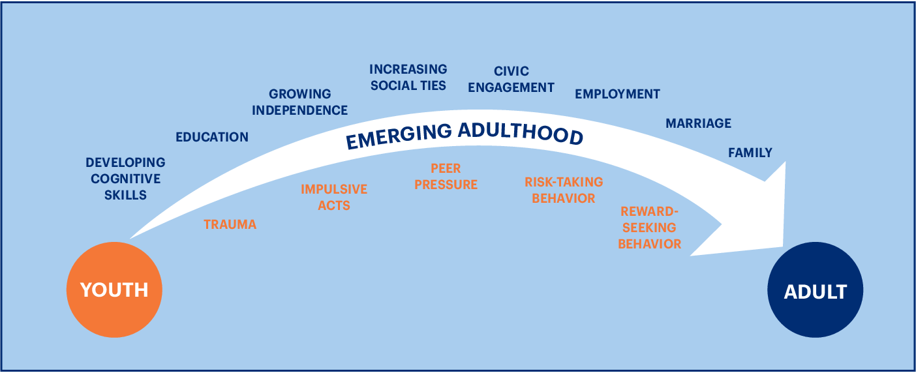
Challenge #1: Development from Child to Adult

Slide 3
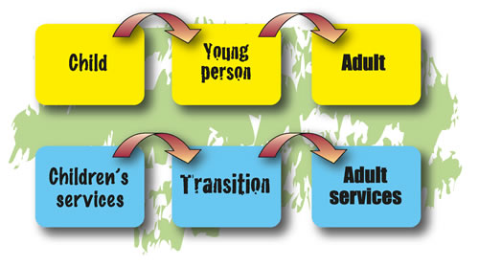
Challenge #2: Healthcare Transition
Lyons et al. JCEM 2015

Slide 4
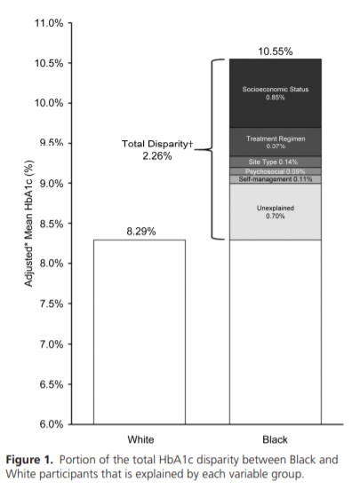
Challenge #3: Racial-Ethnic Disparities
Agarwal et. al, JCEM, 2020

Slide 5
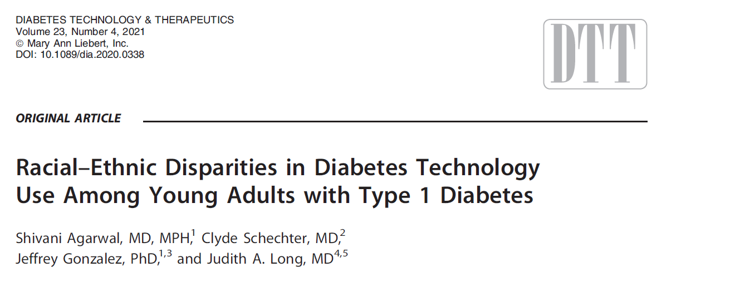
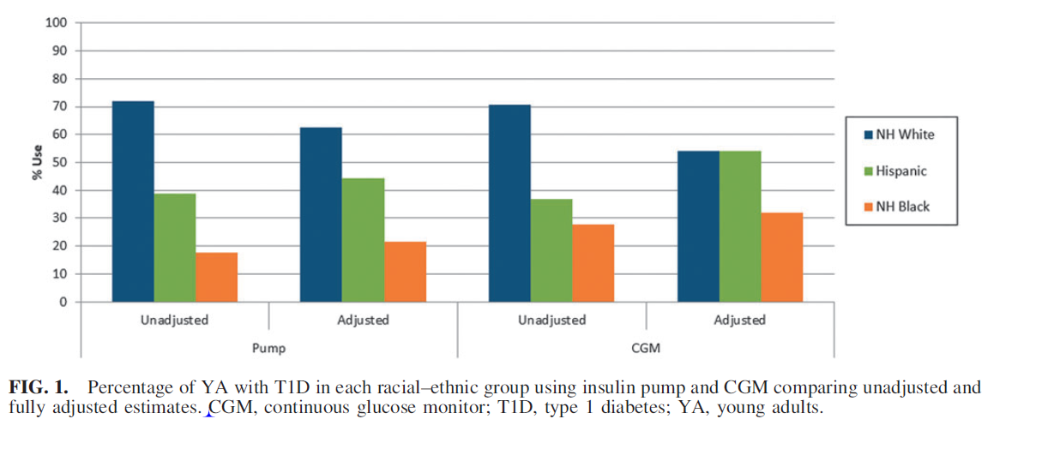
Agarwal, DTT, 2020

Slide 6
Result of Challenges:
VERY Poor Medical and Psychological Outcomes

Slide 8
The Supporting Emerging Adults with Diabetes (SEAD) Program

Slide 9
Lipman and Hawkes, Diabetes Care, 2021

Slide 10
Research
Clinical Model Innovation
Clinic

Slide 11
Research
Clinical Model Innovation
Clinic

Slide 12
Continuing Education
Orientation to Adult Care
Behavioral Support
SEAD Program Model
Care Coordination
Engagement in Care
Pediatric Partnership
Agarwal et al. Diabetes Educator 2016
Notes:
Make font bigger, citation of paper ; we moved the model from penn to Einstein because it was successful, add 2 columns

Slide 13
Evolution of SEAD
Established SEAD at UPenn
Moved SEAD to Einstein-Montefiore
1 MD
+
1 NP
+ RD
and Psychology
+ Social needs coordinator technology specialist
+ Endo fellow trainees
MDs, NP, RD, PhD, LPN, Program cdtr, Patient advisors
2016
2018
2018
2019
2019
2021

Slide 14
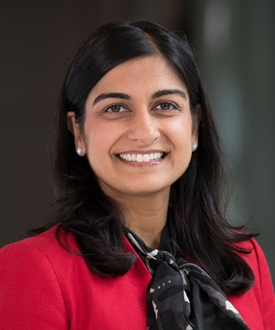
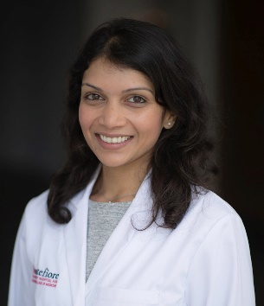
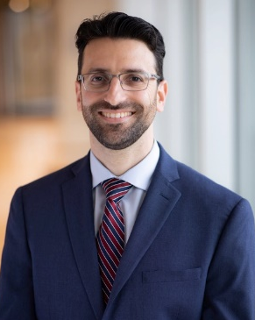
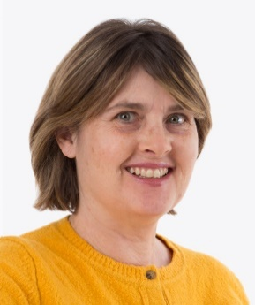
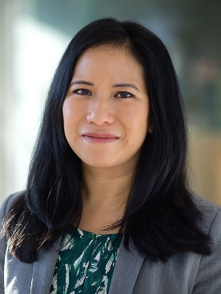
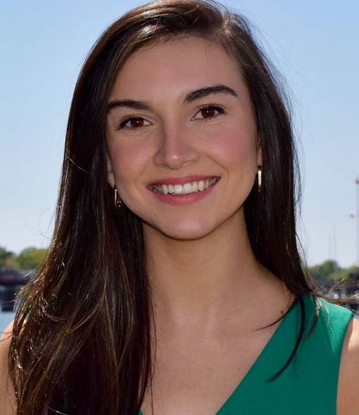
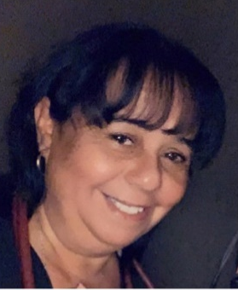
Shivani Agarwal MD, MPH
zz
Priyanka Mathias
MD
Michael Greenberg
NP
Young Adults
Trainees
Sharon Movsas, RD Dietician
Stephanie Leung, PhD
Psychologist
Molly Finnan
Program
Manager
Lourdes Lebron
Social Needs Coordinator and Tech Specialist

Slide 15
Talk to patients
Equity focus
Manage expectations
Build people up, emphasize positives
Manage negatives
Avoid doomsday talk

Slide 16
Multi-Specialty Visits
YA Programming
Weekly Complex Case Review
Patient Advisory Board
Multi-Specialty Visits

Slide 17
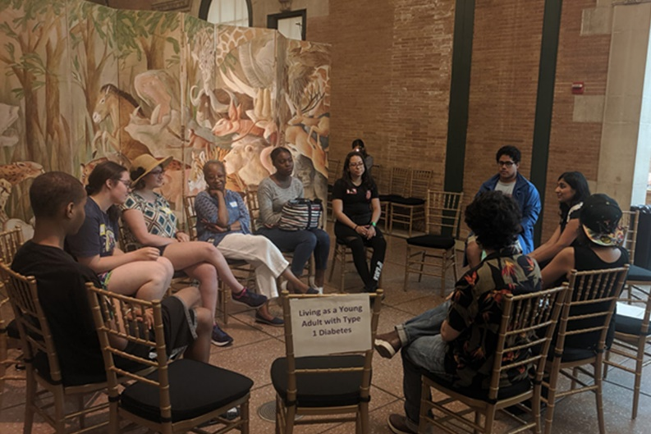
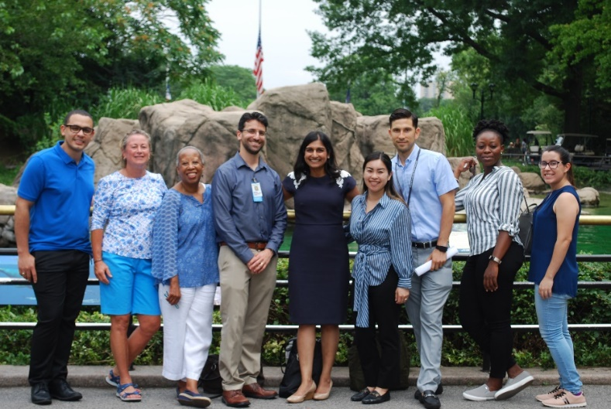
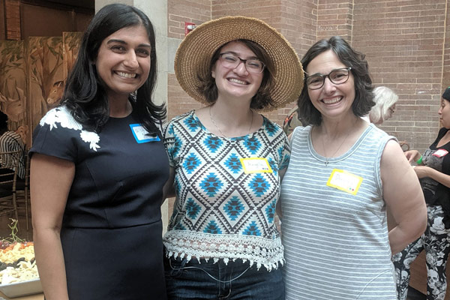
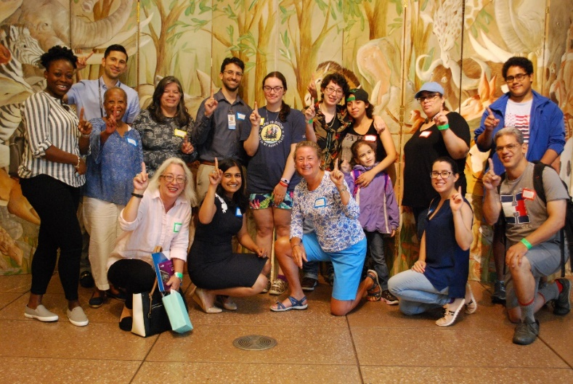

Slide 19
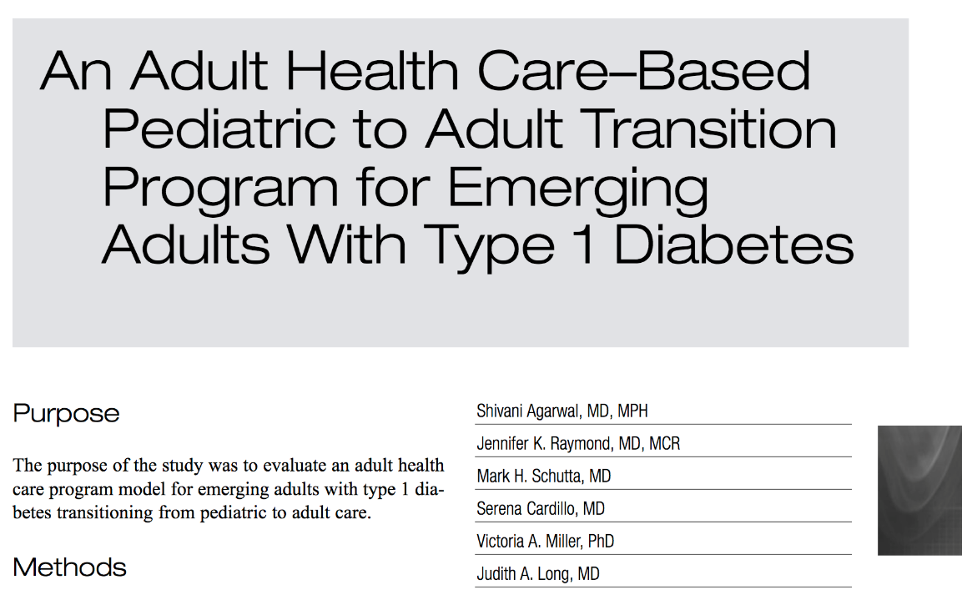
Preliminary Philly SEAD Outcomes
Agarwal et al. Diabetes Educator 2016

Slide 20
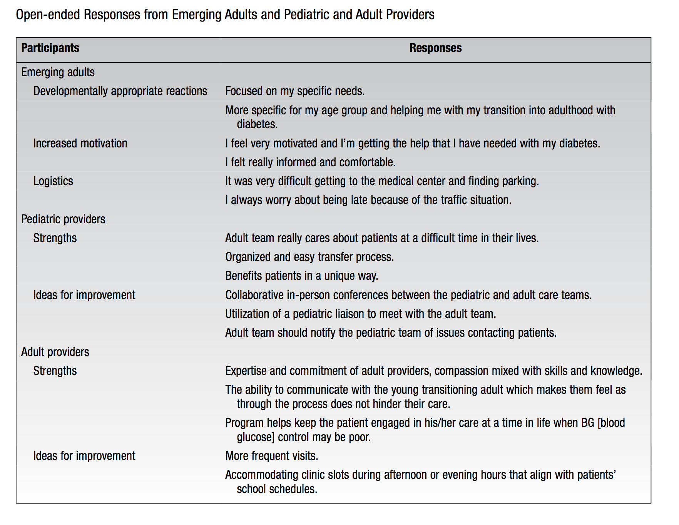

Slide 21
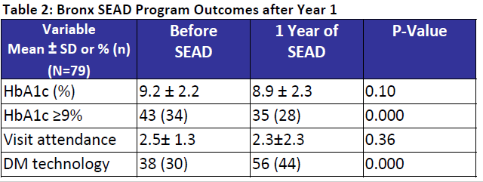
Preliminary Bronx SEAD Outcomes

Slide 22
Research
Clinical Model Innovation
Clinic

Slide 23
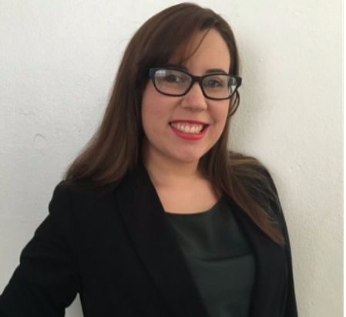
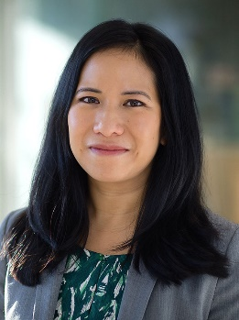
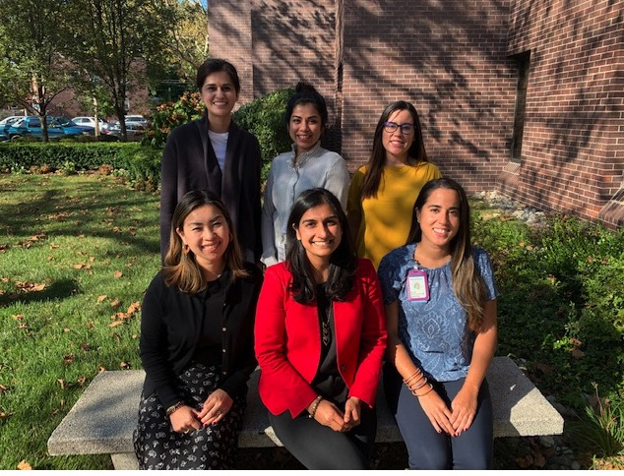
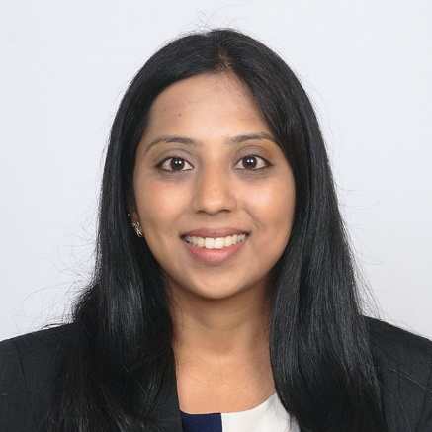
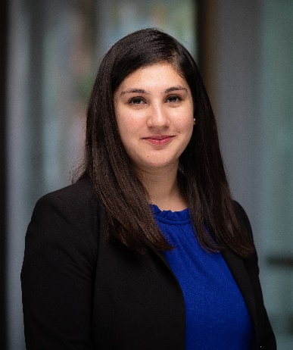
2021-2022 SEAD Research Lab
Gladys Crespo-Ramos, PhD
Stephanie Leung, PhD
Molly Finnan, BA
Priyanka Mathias, MD
Priyanka Mahali, MD
Rabail Sadiq, MD

Slide 24
Provider Factors and Young Adult T1D Outcomes
Gladys Crespo-Ramos, PhD
Racial-Ethnic Differences in Barriers to Self-Care
Molly Finnan, BA
Racial-Ethnic Differences in Diabetes Self-Care and Contributing Factors
Rabail Sadiq, MD
Young Adult Type 1 Diabetes Self-Management App
Priyanka Mahali, MD

Slide 25
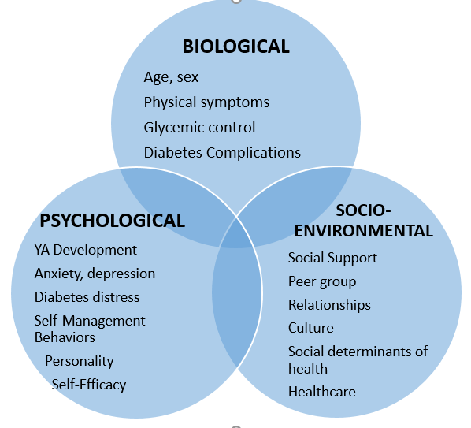
Figure 1. Biopsychosocial Model of Health in Underrepresented Young Adults with Diabetes
Finnan and Agarwal, Diabetes Spectrum 2021

Slide 26
Research
Clinical Model Innovation
Clinic

Slide 27
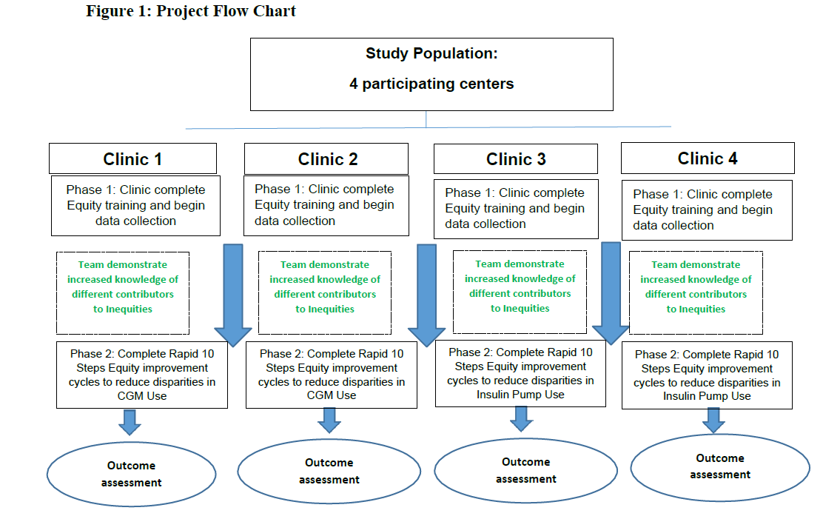
Priyanka Mathias, MD

Slide 28
Patient Characteristics
All young adults from endo (18-35 years) January 2019-November 2021
Age | 27.4 (SD 4.7)
Sex | 51% Female 49% Male
Insurance Private Public | 18% 79%

Slide 31
31%
13%

Slide 33
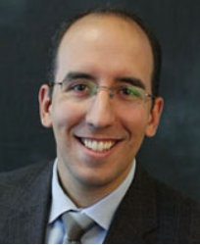
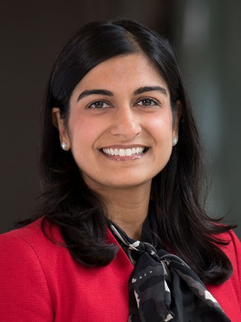
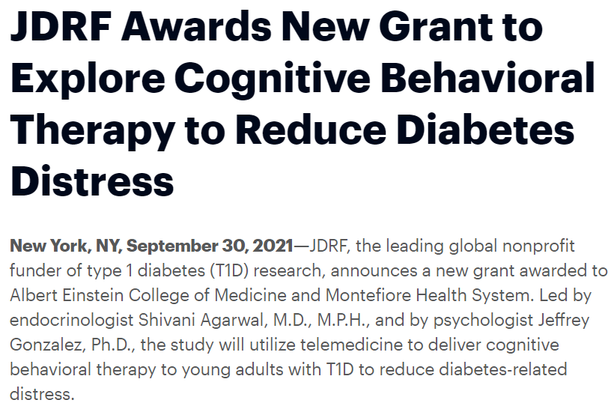
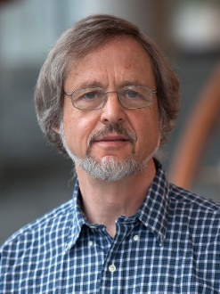
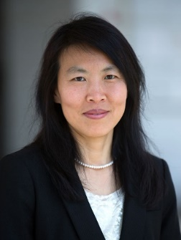
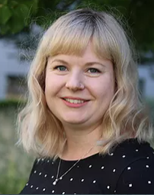
Jeffrey Gonzalez, PhD
Shivani Agarwal MD, MPH
Clyde Schechter, MD
Cuiling Wang, PhD
Gladys
Crespo-Ramos, PhD
Stephanie
Leung, PhD
Molly
Finnan, BA
Claire
Hoogendoorn, PhD

Slide 34
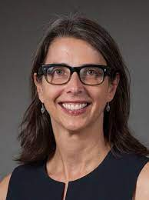
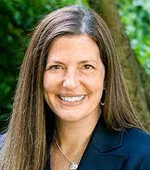
T1DTechCHW
Enhancing the Community Health Worker Model to Promote Diabetes Technology Use in Young Adults from Underrepresented Minority Groups with Type 1 Diabetes
R01DK132302
Shivani Agarwal MD, MPH
Clyde Schechter, MD
Judith Long, MD
Ashby Walker, PhD
Kevin Fiori, MD

Slide 35
Research
Clinical Model Innovation
Clinic

Slide 36
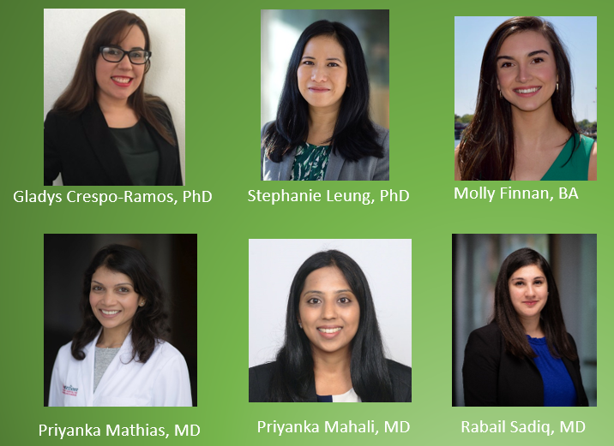
Acknowledgements
SEAD Clinical Program
Michael Greenberg, NP
Priyanka Mathias, MD
Sharon Movsas, RD
Stephanie Leung, PhD
Molly Finnan, BA
Lourdes Lebron, LPN
Practice Managers and staff
Yani Munoz
CHAM Pediatric Endo
Trainees
Patients and Families
Einstein-Montefiore
Yaron Tomer, MD PhD
Jill Crandall, MD
Jeff Gonzalez, PhD
Elizabeth Walker, PhD
Clyde Schechter, MD
Vafa Tabatabaie, MD
Penn/CHOP
Judith Long, MD
Victoria Miller, PhD
Anne Cappola, MD MSc
Susan Mandel, MD
Michael Rickels, MD
SEAD Research Program
Funding/Disclosures:
NIH-NIDDK #K23DK115896-04 (PI: Agarwal)
JDRF 4-SRA-2021-1071-M-B (mPI: Agarwal)
T1D Exchange/Helmsley Charitable Trust (Site PI: Agarwal)
NY-Regional Center for Diabetes Translational Research
#P30DK111022

