Slide 1
Cultural Humility in Working with Latinx Families
Ariana Hoet, PhD Lorena Asadi, LISW-S Gilda Begly, Payor Financial Analyst

Slide 2
A Few Definitions…
Immigrant
A person who comes from another country to live in the U.S. “Alien” is the legal word for any person who is not a citizen of the U.S.
Asylee
A person who arrives in the U.S. asking for protection because it is dangerous for them to be in their home country. Asylees apply for asylum once in the country.
Asylum
A legal status for people who came to the U.S. because they were harmed or threatened because of who they are or what they believe.

Slide 3
A Few Definitions…
Refugee
Any person forced to flee their country of nationality to escape war, violence, or persecution. Unlike asylees, refugees apply to enter the country from abroad (many times while residing in a refugee camp) and are granted entry to the U.S. after extensive vetting (the average length of the process is anywhere between 5-10 years).
Undocumented migrant
A person who enters or stays in a country without proper legal documents (i.e. visa). This refers to individuals who enter the country without going through an official port of entry or those who enter legally (with proper documentation) but overstay their visa or go “out of status” once their visa expires.

Slide 4
Diversity within the U.S. Latino Population
Source:
https://theconversation.com/the-effect-racist-rhetoric-has-on-young-latinos-and-why-all-americans-should-care-57408

Slide 5
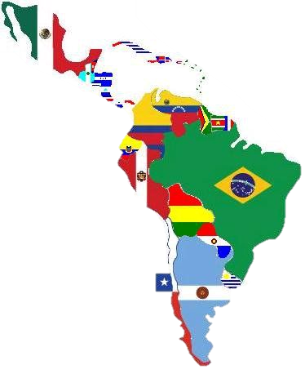
Latinos in the US
Source: https://greaterspokane.org/blog/2015/11/doing-business-in-latin-america/

Slide 6
Prevalence of Diabetes
10.2% in South Americans
13.4% in Cubans
17.7 % in Central Americans
18.0% in Dominicans and Puerto Ricans
18.3% in Mexicans
Source: https://beyondtype1.org/diabetes-disparities-hispanic-population/
Notes:
We even see differing rates of diabetes!

Slide 7
Latinos in the US
57.5 Million
Latinos living in the US as of 2017
17.8% of the US population
119 Million
Projected Latino population by 2060
28.6% of the US population
11.7 Million
Undocumented immigrants living in the US
34.2%
Are foreign-born; Majority are born in the US.
Source: Census, 2012, 2017;
Pew Research Hispanic Trends Project, 2012

Slide 8
Racial Identity
Racial Group | Latinos | Non-Latinos
White | 53% | 76.2%
Black | 2.5% | 14.6%
American Indian | 1.4% | 0.9%
Asian | 0.4% | 5.6%
Some other race | 36.7% | 0.2%
Two or more races | 6% | 2.3%
Source: Census, 2010

Slide 9
Racial Inequities
Those who classify as some other race compared to White, have lower levels of education and are:
Less likely to:
More likely to:
Speak English
Be citizens
Label themselves as “American”
Be living in poverty
Report discrimination
Report feeling marginalized
Believe discrimination is a major problem

Slide 10
Immigration
Source: https://www.youtube.com/c/theflama/videos

Slide 11
Impact of Immigration on Families
Family separation and grieving
Less social support
Remittances and commitments back home
Changes in parental and familial roles
Mothers engaging in the workforce
Children interpreting for parents
Mixed documentation families
Diane Guerrero
https://www.youtube.com/watch?v=49fN762AQWE
Source: https://www.pinterest.com/pin/775956210772997362/
Notes:
https://www.youtube.com/watch?v=49fN762AQWE

Slide 12
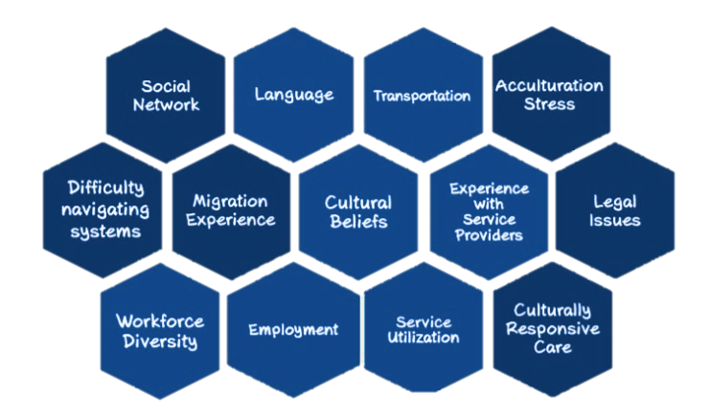
Health Inequities

Slide 13
Inequities in Diabetes
White patients use insulin pumps at higher rates than Black or Hispanic patients (Willi et al., 2015)
White children under 13 are more likely to use CGM (Wong et al., 2014)
Mixed findings on A1C levels:
Willis et al. (2015) did not find differences between Hispanic and white
Gandhi’s et al. (2016) review cited worse glycemic control for Hispanic-Americans
Agarwal et al. (2020) did find that Hispanic YA reported higher A1C levels
No differences in frequency of DKA and hospitalizations (Gandhi et al, 2016)
Notes:
Willi, S. M., Miller, K. M., DiMeglio, L. A., Klingensmith, G. J., Simmons, J. H., Tamborlane, W. V., ... & T1D Exchange Clinic Network. (2015). Racial-ethnic disparities in management and outcomes among children with type 1 diabetes. Pediatrics, 135(3), 424-434.
Wong JC, Foster NC, Maahs DM, et al.; T1D Exchange Clinic Network. Real-time continuous glucose monitoring among participants in the T1D Exchange clinic registry. Diabetes Care 2014;37:2702–2709
Abstract/FREE Full TextGoogle Scholar
Agarwal, S., Kanapka, L. G., Raymond, J. K., Walker, A., Gerard-Gonzalez, A., Kruger, D., ... & Long, J. A. (2020). Racial-ethnic inequity in young adults with type 1 diabetes. The Journal of Clinical Endocrinology & Metabolism, 105(8), e2960-e2969.
Gandhi, K. K., Baranowski, T., Anderson, B. J., Bansal, N., & Redondo, M. J. (2016). Psychosocial aspects of type 1 diabetes in Latino-and Asian-American youth. Pediatric research, 80(3), 347-355.

Slide 14
Barriers to Services
Despite the fact that new Americans are eligible for a variety of health and human services, research shows that they are often unable or unwilling to utilize them.
This is due to:
Confusion surrounding applications, eligibility, and rights
Distrust of helping professionals
Cultural beliefs and health literacy
Insufficient financial capital (insurance and time off)
DKA is more frequent in children without private health insurance (Klingensmith et al., 2013)
Language and literacy barriers
Parent reading comprehension is positively associated with adolescents’ adherence (Janisse et al., 2010)
Notes:
Hispanics have lowest health literacy of any us racial/ethnic group (Office of Disease Prevention and Health Promotion Health Communication Activities, U.S. Department of Health and Human Services. America’s Health Literacy: Why We Need Accessible Health Information, 2015. (http://health.gov/communication/literacy/issuebrief/.).)

Slide 15
Other Causes of Disparities
Food insecurity and easier access to calorie dense, high fat and carbohydrate foods
Predicts hospitalization in children (Marjerrison et al., 2011)
44% of Hispanic-Americans with T1D are overweight or obese (Lawrence et al., 2009; Liu et al., 2009)
Language obstacle to understanding nutritional information
Depression, stress, racism…
Notes:
Marjerrison S, Cummings EA, Glanville NT, Kirk SF, Ledwell M. Prevalance and associations of food insecurity in children with diabetes mellitus. J Pediatr 2011;158:607–11.

Slide 16
Putting it into Practice

Slide 17
Cultural Values & Treatment
Personalismo = Business like interaction with mental or medical professionals seems unwelcoming
Simpatia = Reluctant to share unpleasant emotions
Respeto = Agreeableness
Espiritualismo = More likely to seek assistance from religious leaders

Slide 18
Cultural Values & Treatment
Familismo = Attempt to solve problems within the family and not seek services or share personal information
Also impacts how adolescents make treatment decisions and who comes to treatment (along with respeto)
Promotes family involvement, improving T1D management (Gandhi et al., 2016)
Machismo = Help seeking is weak
Marianismo = Too busy caring for others to care for self (could feel selfish)
Notes:
Gandhi, K. K., Baranowski, T., Anderson, B. J., Bansal, N., & Redondo, M. J. (2016). Psychosocial aspects of type 1 diabetes in Latino-and Asian-American youth. Pediatric research, 80(3), 347-355.

Slide 19
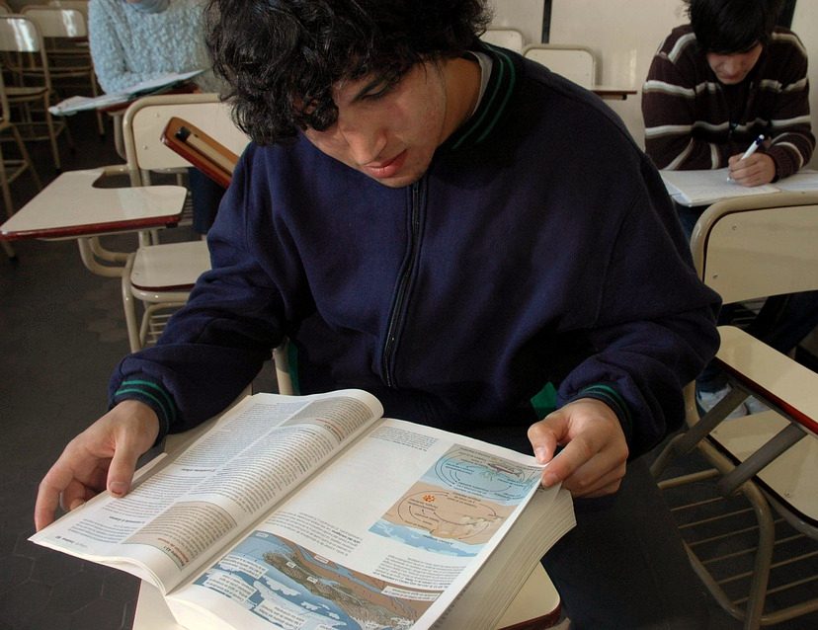
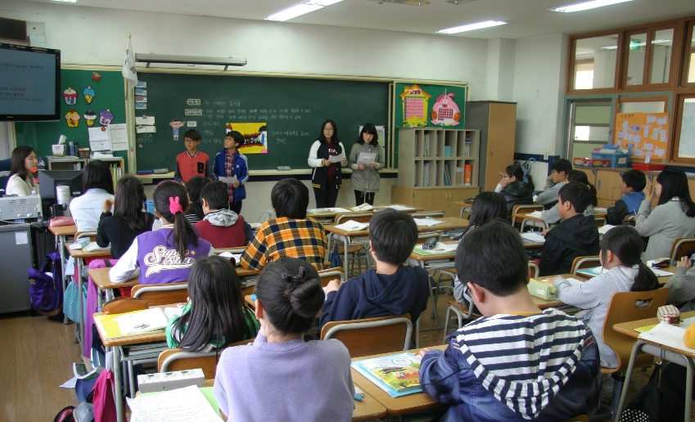
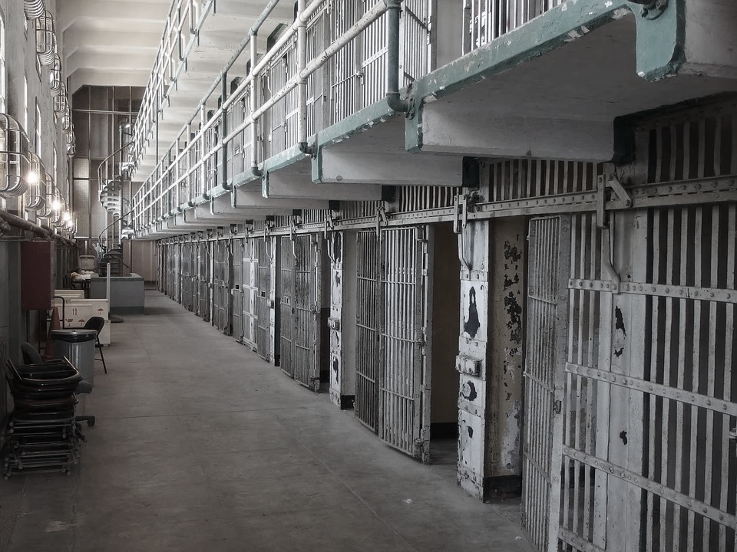
Other Considerations
Consider level of education
Immigrants have learned survival skills, which may make them appear more demanding and untrusting
Remember that many of the immigrants have fled violence, and have been abused, tortured, or imprisoned

Slide 20
Working with Interpreters
Source:
https://www.pinterest.com/pin/647533252665251615/

Slide 21
When is an Interpreter Needed?
Patients seeking treatment may not speak English or feel completely comfortable in the language
Child patient may speak English but not parents
It is important to keep parents involved!
Assessment measures are developed and meant to be used in English
Not understood or culturally inappropriate at times

Slide 22
Ethical Concerns & Other Problems
Each interpreter may have a different background and level of training
Only available interpreters may be immigrants themselves & may know the client
Confidentiality issues
Families may not be as open as they would be otherwise
Some words may not be translatable to other languages
Different dialects

Slide 23
Tips When Using an Interpreter
Talk directly to the patients when using an interpreter
When asking questions, make sure to ask one question at a time
Do not use kids under 18 to interpret

Slide 24
Tips When Using an Interpreter
Do not ask interpreters to sum up an appointment or large portions of it
Eliminate idioms
Schedule for twice the time for an appointment when working with an interpreter

Slide 25
What Can You Do?
Source: onbites.com/trump-puts-end-daca-gives-6-month-delay/

Slide 26
Next Steps
Cultural Humility!
Lifelong process, continuous
Be informed about policy changes:
Dream Act or Deferred Action (DACA)
Public Charge
H1B visas
Migrant Protection Protocols
Notes:
- Give example of my experience with my patient and public charge

Slide 27
Questions?

