Slide 1
QI Collaborative Call, Pediatrics
1/27/22

Slide 2
Welcome & introductions

Slide 3
Agenda
Welcome & introductions
Updates from the Collaborative
  New staff
  Welcome to the Cleveland Clinic
  Plans for May Leadership/PI Session
  Website updates
  Committee Chair opportunities
SUNY
Nationwide
Quarterly data results, Ori Odugbesan
Notes:
Add Phase 1 measures

Slide 4
T1D Exchange Updates

Slide 5





























29 pediatric clinics – caring for 38,500+ patients with T1D
Notes:
Include Trello link to the updated contact list for 41 Centers

Slide 6






14 adult clinics – caring for 19,500+ patients with T1D
Notes:
Include Trello link to the updated contact list for 41 Centers

Slide 7

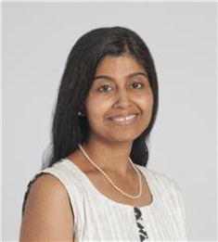
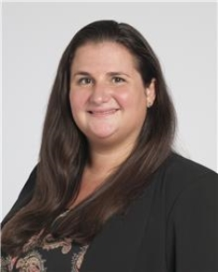
Welcome to the Cleveland Clinic!
Adult PI: Pratibha PR Rao, MD, MPH
Pediatric PI: Andrea Mucci, MD, MASc

Slide 8
Welcome!

Slide 9
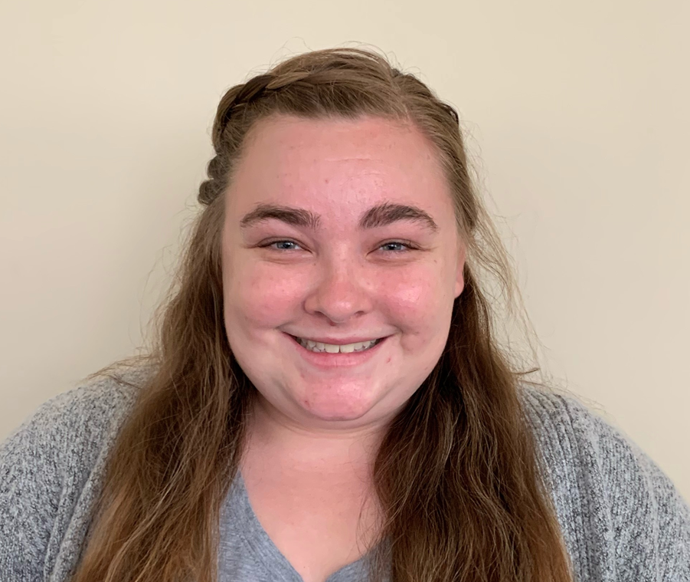

New team member at T1DX-QI!
Holly Hardison joined the Collaborative on 1/10 as our coordinator. She came from Baptist Health Research Institute in Jacksonville, FL where she held the position of Clinical Research Assistant, working on cardiology, covid and neurology research studies. Holly previously held the position of Camp Director for the American Diabetes Association in Jacksonville, FL Holly brings strong organization skills, event planning and problem-solving skills, and a lot of enthusiasm! She graduated from Jacksonville University with a BS in Biology.
Holly can be reached at hhardison@t1dexchange.org or X7210
QI Coordinator,
Holly Hardison, BS

Slide 10
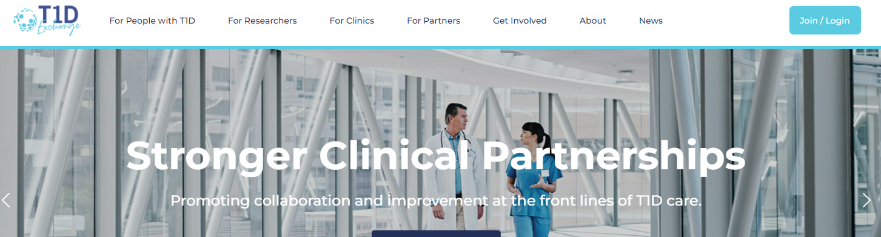
T1D Exchange Website will have a password protected space for Collaborative, beginning 3/1/22
We will use the protected space to:
Share work in progress, including emerging case studies and interventions
Ask questions to the Collaborative network with the ability to view archived threads and responses

Slide 11
T1DX-QI Committee Chair Roles

Slide 12
T1DX-QI Is looking for new committee chairs
We are looking for new Co-Chairs to help us lead the committees.
Terms last for twenty-four (24 months) and the new term will begin 6/1/2022.
Each committee has two co-chairs from a pediatric and adult clinic.
Expectations* of Committee Chairs:
Facilitate quarterly committee meetings
Create the vision for the future direction of the committee and its impact on the QI Collaborative’s future
Participate in one planning meeting with their co-chair and with the T1DX-QI coordinating center staff for 30 or 60 minutes
Facilitate or co-facilitate committee meetings
Participate in the development of content related to the committees.
*In addition to these tasks, Publications Committee Co-Chairs also review and edit abstracts and manuscripts that are written by the Collaborative.

Slide 13
T1DX-QI Is looking for new committee chairs
T1DX-QI Chair terms are ending in June 2022.
Please use this form to nominate yourself for a T1DX-QI Committee Chair position for the 2022-2024 period or share with a colleague who you think would be a good match.
If you are interested in applying for one of the committee roles, please complete the Nomination Form before Monday February 28th.
To learn more about the committees, please visit these Trello pages:
Clinical Leadership: https://trello.com/b/4F3ABcug/clinical-leadership-committee
Publications: https://trello.com/b/K5EUYxbf/updated-publications-committee
Data Science: https://trello.com/b/YmmgugBB/data-science-committee
Notes:
https://docs.google.com/forms/d/e/1FAIpQLSdHuB67dAhFwXYBmFfe23xh-86096Oys9LrAT2gN7N14nm-7A/viewform

Slide 14
Clinical Presentation: SUNY

Slide 15



A Program to Decrease DKA Admissions:
Diabetes Wellness Program (DWP)
Pediatric Diabetes Program
SUNY Upstate Medical University
Syracuse, NY
Margaret Greenfield, MS, CHES David Hansen, MD, MPH Emilie Hess, MS
Karen Kemmis, RN, DPT, CDCES Danielle Stegman-Barber, RD, CDCES Amanda Zuccaro, BSN, RN
Cassie Bunker, CPNP Janine Robbins, BSN, RN Ann Marie Sanders, MSN, RN
Hollie Cartini, LMSW Maria Winkworth, RD Renee Pierce, LCSW
Casey Mohrien, MS IV Christopher P. Morley, PhD Roberto Izquierdo, MD

Slide 16

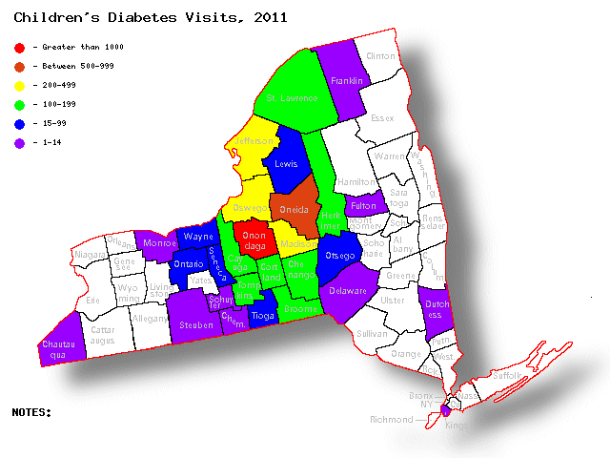
Joslin Diabetes Center at SUNY Upstate Medical University
We serve more than 25 counties in Central New York
Our patient panel over past two years:
  1262 with type 1
  620 with type 2
We see 100-142 patients with newly diagnosed diabetes each year, mostly with type 1 diabetes
Age range: 6 weeks to 21 years of age

Slide 17
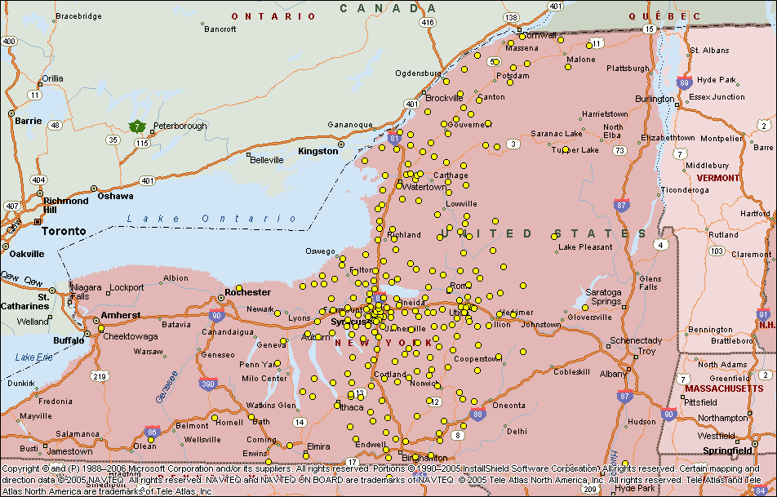
Joslin Pediatric Diabetes Home Locations

Slide 18
Increase in newly diagnosed type 1 diabetes among pediatric and adolescent patients during the COVID-19 Pandemic in the US*
Retrospective study that included patients from 7 large US clinical centers
that were member sites
 | 2019 | 2020 | p value
Newly diagnosed patients with T1D^{2,3} | 1277 | 1399 | 0.007
Presented in DKA¹ | 38.6% | 42.8% | <0.001
¹ Higher proportion presented in severe DKA (pH<7.1, bicarb<5) |  |  | 0.01
² Less likely to have private insurance |  |  | 0.001
³ Fewer females and fewer NH White youth |  |  | <0.001
*Wolf et al. ISPAD 2021

Slide 19
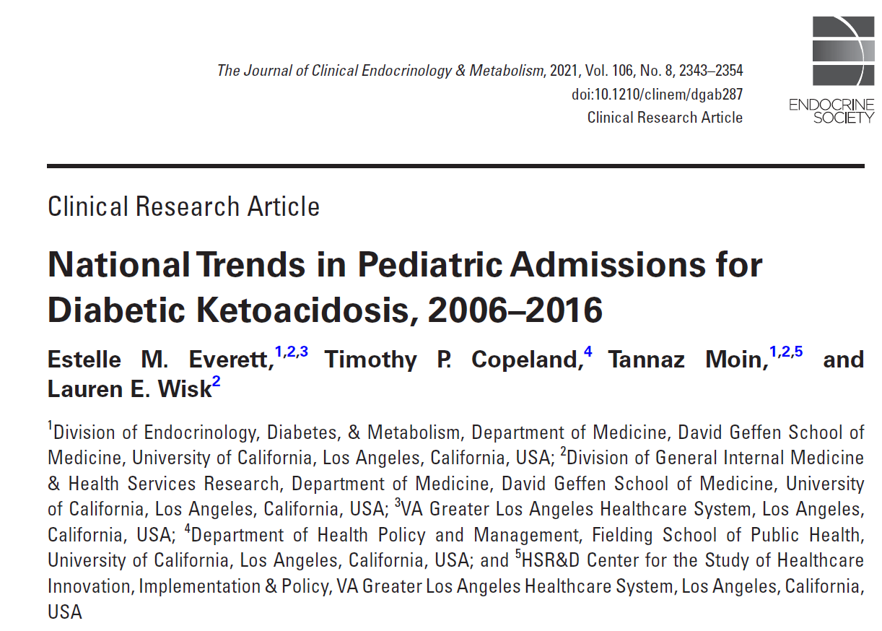

Slide 20
Methods
Used the 2006, 2009, 2012, and 2016 Kids’ Inpatient Database to identify pediatric DKA admissions per 10,000 admissions and per 10000 population, length of stay (LOS), and trends over time among all hospitalizations and by demographic subgroups
Regression models were used to evaluate differences in DKA rates within subgroups overtime.

Slide 21
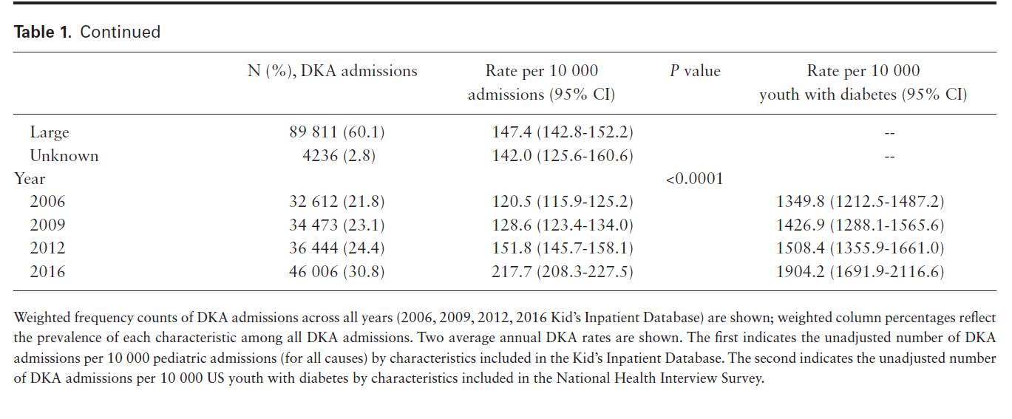
Rising Rate of DKA Admission
Pediatric DKA admissions have risen by 40% in the US and vulnerable subgroups remain at highest risks

Slide 22
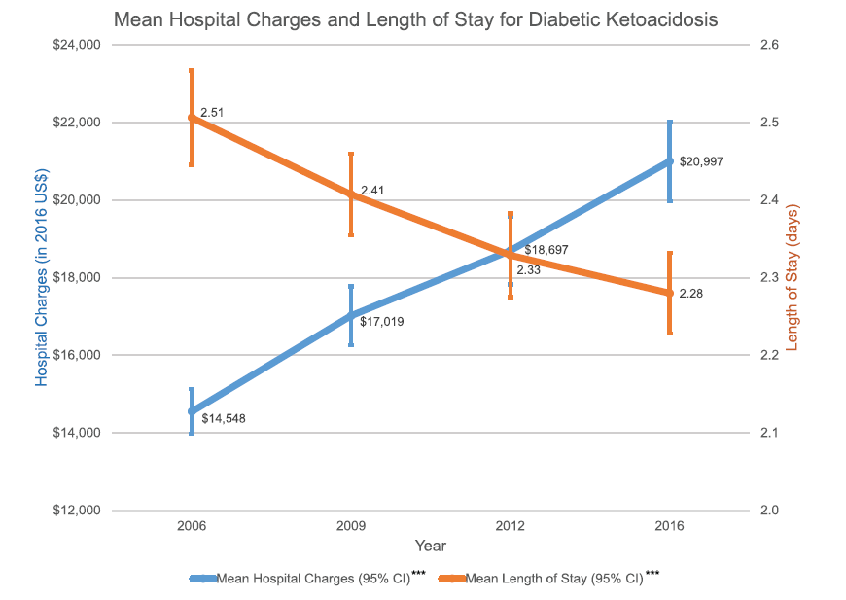
DKA admissions
are costly

Slide 23
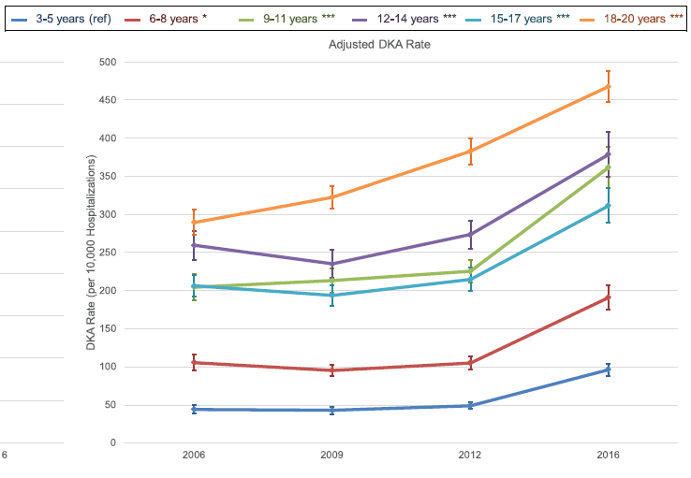
Highest risk group:
18-20 yr old
12-14 yr old

Slide 24
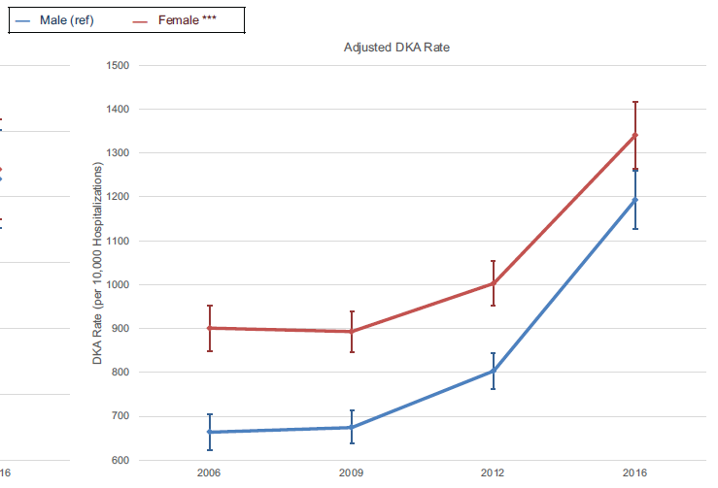
DKA risk:
Female > Male

Slide 25
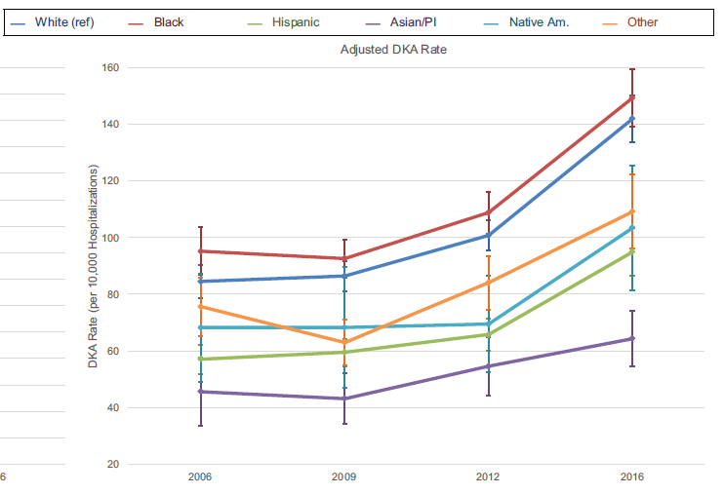
Highest risk group:
Black

Slide 26
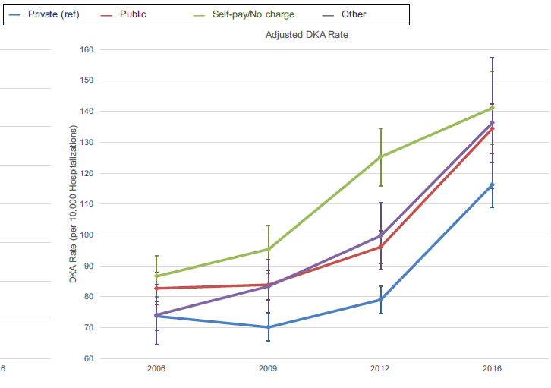
Highest risk group:
Self-pay/Public > Private

Slide 27
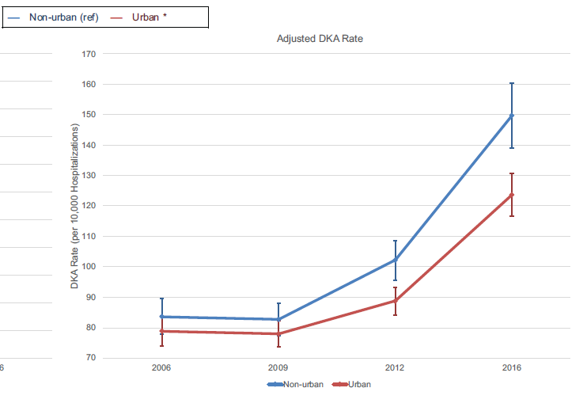
Highest risk group:
Non-urban > Urban

Slide 28
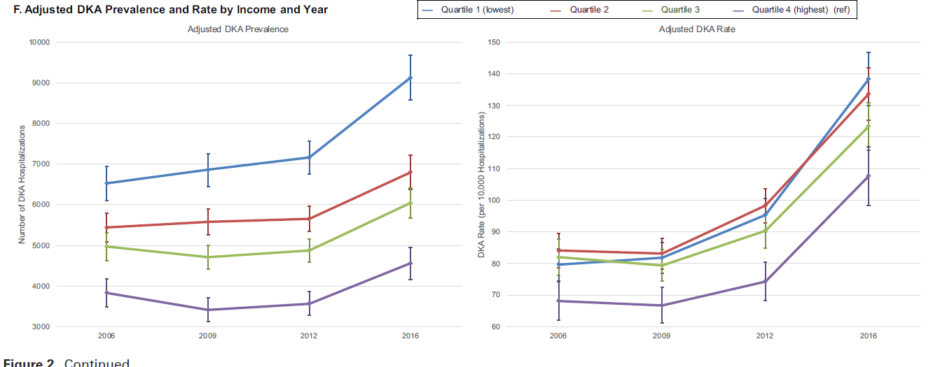
Highest risk group: those in the lowest quartile for income

Slide 29
Conclusion
Pediatric DKA admissions have risen by 40% in the US and vulnerable subgroups remain at highest risks
Further studies should characterize the challenges experienced by these groups to inform interventions to mitigate their DKA risk and to address the rising DKA rates nationally

Slide 30
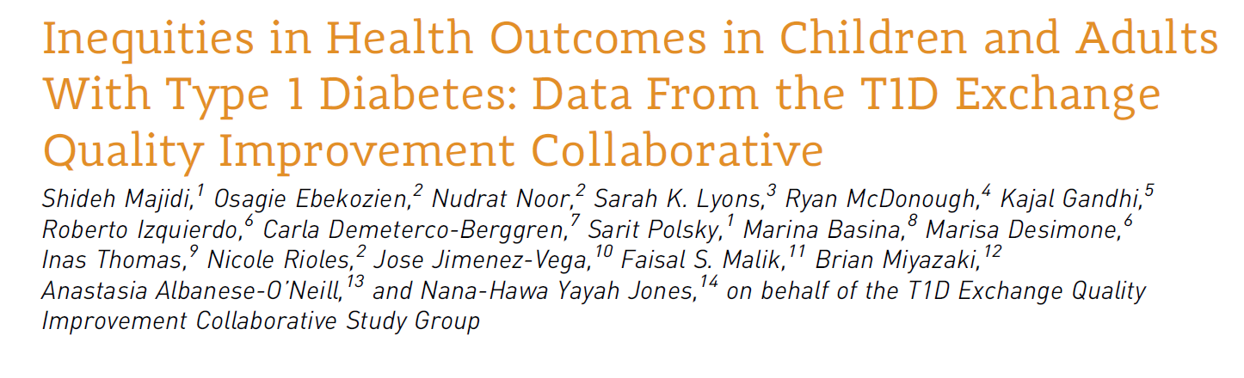
Clinical Diabetes Journal 2021

Slide 31
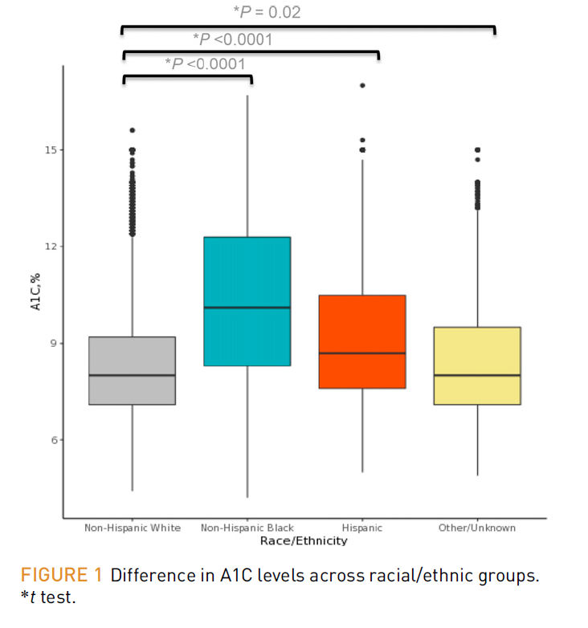

Slide 32
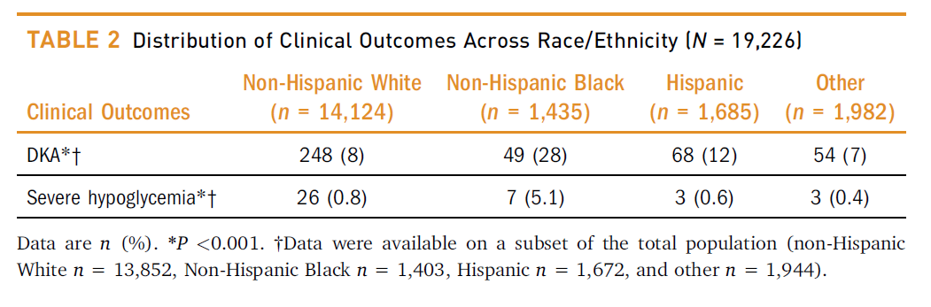

Slide 33
Conclusion
These results underscore the crucial need to study and overcome the barriers that lead to inequities in the care and outcomes of people with type 1 diabetes

Slide 34
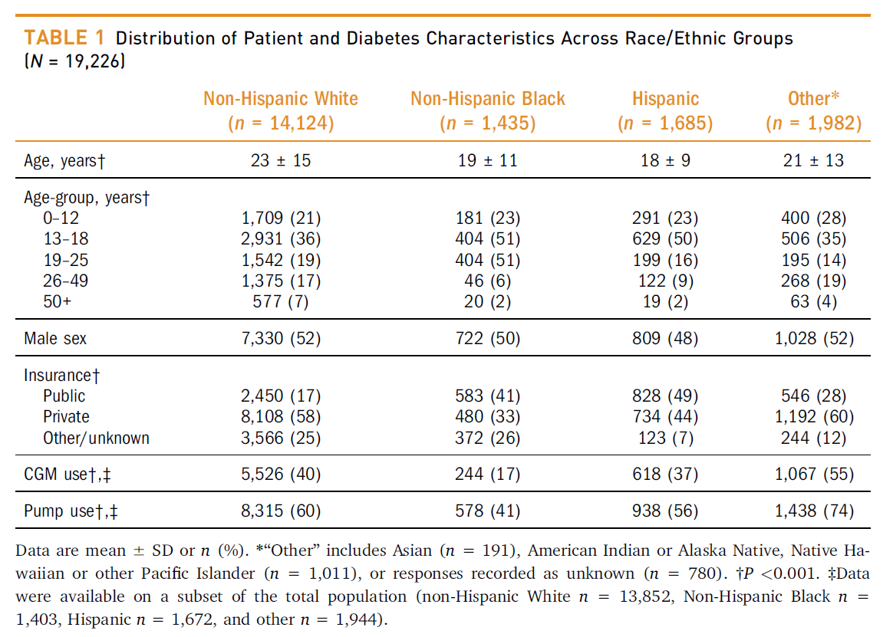

Slide 35
Needs Assessment for
Diabetes Wellness Program (DWP)
Nineteen patients had at least two or more DKA admissions from Aug 1, 2019 – Aug 1, 2020
Seventeen patients has at least two or more DKA admissions from August 2, 2020- August 2, 2021
Patients with frequent ER visits, sustained A1c >14%, or frequent outpatient calls for hyperglycemia in association with ketonuria
Two Intervention Cohorts: 16 patients each
Notes:
These numbers were prior to cohort 1, do we want updated number for prior to cohort 2 and current?

Slide 36
Enrollment Process for Cohorts 1 & 2
Identify Patient
Describe program details
Patient and Family agree to participate
Return to usual care
  Age range
  # of DKA admissions
  HbA1c values
  Provider recommendation
  Monthly:
    NP
    RD or RN for education
  SW as needed
  telemed v. in-person
  First visit is scheduled, ideally in person, if possible
    3 no shows
      For NP or education visit
    Unable to contact for follow up
Notes:
Our team met twice a month to review each patient and programmatic changes.

Slide 37
Education Curriculum for Cohorts 1 & 2
Visit 1
Weekly Calls
Visit 2
Weekly Calls
Visit 3
Weekly Calls
Visit 4
Weekly Calls
Visit 5
Weekly Calls
Visit 6
  MyChart setup and usage
  Keeping BG log and/or downloading of devices
  Setting SMART goals
  Nutrition education needs assessment
  Ketone review
  Sick day guidelines
  Hypoglycemia protocol
  Review use of Glucagon
  Review NY driving laws
  (if applicable) and importance of checking BGs
  Sports and exercise management
  Technology
  Increasing independence
  Identifying blood sugar patterns
  Making changes based on patterns
  Establishing routines
  Sports and exercise management
  Technology
  Increasing independence
  Identifying blood sugar patterns
  Making changes based on patterns
  Establishing routines
  Independent dosing changes
  Patient choice of topic
  Habits for maintenance
  “After Hours” game

Slide 38
Lessons Learned from Cohort 1
Change in scheduling process to decrease no shows and rescheduling
Nutrition assessment not always done in visit 1: learning- move to visit 2 for second cohort
Goal was to review all the material however not all patients were ready to receive it

Slide 39
Cohort 1: DKA Data prior to DWP and post DWP
Notes:
Do we want current # DKA since end of cohort 1? This would tell us whether they are headed back to pre-DWP DKA admission numbers?
Other info:
# of DKA admissions: in the last 2 years
14 have public insurance
2 have private insurance
Start of program (of participating patients): 4 on pumps, 7 on CGM, 9 on injection
These patient had high no show rates prior to enrollment

Slide 40
Pre and Post Cohort 2: HbA1C
Notes:
Average Pre: 13. 6
Standard Deviation Pre: 2.51453
Average Post: 11.7
Standard Deviation Post: 3.07432

Slide 41
Demographics
 | Completed DWP | Returned to Usual Care | Not Enrolled | Total
N | 18 | 14 | 81 | 113
Age, mean + SD | 15.2 + 2.9 | 16.8 + 2.2 | 15.4 + 4.1 | 15.5 + 3.8
Female % | 44.4 | 64.3 | 51.2 | 53.1
Race White % Black % American Indian % Mixed Race % Other % | 66.7 27.8 0 5.6 | 64.3 28.6 0 0 7.1 | 80.2 11.3 1.3 1.3 6.3 | 76.1 15.9 0.9 0.9 6.2
Insurance Public % | 88.9 | 71.4 | 64.2 | 69.0
Notes:
A greater percentage of DWP participants (77.8%) use CGM vs. those not enrolled (58.0%). However, the difference was not significant

Slide 42
Clinical Outcomes
 | Completed DWP | Returned to Usual Care | Not Enrolled | Total
A1c, mean + SD Pre Post | 12.7 + 2.0 11.3 + 2.5 | 11.8 + 2.6 12.0 + 3.6 | 9.9 + 2.3 9.5 + 2.2 | 10.5 + 2.5 10.0 + 2.4
DKA admissions, mean + SD Pre¹ Post² | 3.28 + 3.1 0.89 + 1.1 | 2.21 + 1.6 0.25 + 0.5 | 1.44 + 1.1 0.52 + 1.4 | 1.83 + 1.8 0.56 + 1.3
CGM User % | 77.8 | 64.3 | 58.0 | 61.9
¹August 2018 – August 2020
² Since the end of each cohort
Notes:
Cohort 1: there were 3 patients who were started on CGM
Cohort 2: there were 9 patients who were started on CGM

Slide 43
Change in A1c and DKA admissions
 | Completed DWP | Not Enrolled | P-value
A1c Change in mean + SD | -1.49 + 2.4 | -0.54 + 1.98 | 0.05
DKA admissions Change in mean + SD | -2.39 + 3.5 | -0.94 + 1.62 | 0.009
Notes:
Using ANOVA, DWP participants had a larger change in DKA admissions than those not enrolled (p=0.009)
Using t-test, DWP participants had a larger change in A1c compared to those not enrolled (p=0.05)

Slide 44
Type 1 Diabetes and Quality of Life (T1DAL) Measures ¹
77% of the participants who completed the program had an improvement in quality-of-life scores as shown by their pre- and post-T1DAL surveys
¹ Hilliard et al. J Pediatr Psychol 2019

Slide 45
Post Participation Survey
 | YES | NO
Did the Diabetes Wellness Program helped you learn how to prevent DKA admissions? | 100% | 0
Do you feel the program helped with your diabetes related quality of life overall ? | 100% | 0
After completing the program, do you feel more confident in independently managing your diabetes? | 100% | 0
The weekly calls were helpful? 5 = strongly agree, 3 = neither agree nor disagree, 1 = strongly disagree | 4.2 + 0.8
What were the most helpful education topics? (check all that apply) | Making changes based on blood sugar patterns Diabetes technology

Slide 46
What have we learned?
The program was effective for those who attended and completed the program
We need to make our program more accessible for patients who are already facing many barriers
Don’t need all 6 visits, decreasing the # of visits may help participation

Slide 47
Next Steps…

Slide 48
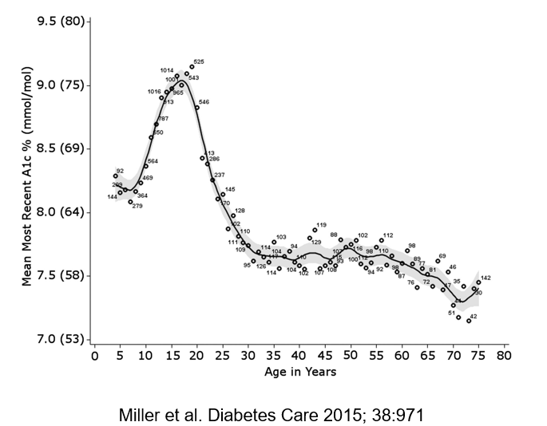
A1c at different ages
Advances in diabetes technology has improved glycemic control and quality of life in many children
Many factors influence the ability to achieve goals of therapy for type 1 diabetes
However, there is a subset of children who have been left behind
Children from low-income families and non-Hispanic Black children are not experiencing these benefits of technology
Lipman and Hawkes. Diabetes Care 2021

Slide 49
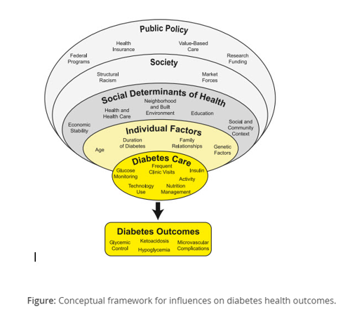
Traditionally we have focused on behavioral aspects of diabetes care such as frequency of visits with the diabetes team, frequency of blood glucose monitoring, and implementations of technologies such as insulin pump and CGMS
Our multidisciplinary diabetes teams attempt to address individual factors that influence the ability to achieve excellent diabetes outcomes, such as family relationships, age (adolescence), genetic factors (obesity, insulin resistance), and underlying mental health conditions (depression, eating disorders)
BUT we are recognizing that factors in health care and society influence patient outcomes – Social Determinants of Health (SDOH)
3
2
1
Lipman and Hawkes. Diabetes Care 2021

Slide 50
Social Determinants of Health (SDOH)
Factors in a person’s life across the lifespan that result in unequal distribution of resources:
  Socioeconomic status
  Neighborhood (rural vs urban)
  Food environment (food insecurity)
  Access to affordable and high-quality health care (lack of insurance, under insured)
  Social factors – social capital, support, cohesion (racism vs multiculturism, racial equality)
  Economic stability (homelessness)

Slide 51
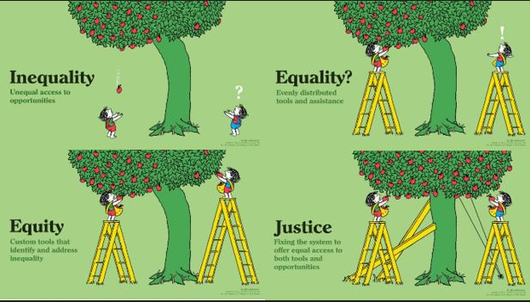
NEXT PHASE:
Identify & Address
Identify & Address
Health Disparity
SDOH
Recognition of and addressing health disparities
can lead to change in practice
Health Equity
Health Disparity: A health difference associated with social, environmental, or economic disadvantage
that typically affects people experiencing barriers or who have few resources (on the basis of
race/ethnicity, socioeconomic status, geographic location, sex, and sexual orientation and gender identify, among others)
Health Equity: An aspirational goal describing the elimination of remediable factors that adversely influence health

Slide 52
Next Steps
MAJOR AIM:
  Improve the program retention, patients’ glycemic status and quality of life by addressing the SDOH (now that we have a dedicated social worker)
  We do not need all six visits
Notes:
Most patients in this program report they don’t know a peer with diabetes. Mention first visit being with other children/families who are like them ☺ meeting someone else that has diabetes

Slide 53
Education Curriculum for Next Cohort
Introductory Call/Visit
Weekly call
Weekly call
Weekly call
Visit 3
Weekly call
Visit 1
Visit 2
Visit 4
Attend Classroom Introductory Visit in Person
Confirm first appointment date/time
Review of Program and Expectations
Hollie will be with each family individually
MyChart setup and usage
Keeping BG log and/or downloading of devices
Setting SMART goals
Nutrition education needs assessment
Ketone Testing/Sick Day Guidelines
Low Blood Sugar Management
Nutrition education needs assessment
Sport and Exercise Management
Technology
Achieving a greater independence at school
Establishing Routine
How to identify blood sugar patterns and make changes
“After Hours” game
Review the preview topic as needed
Notes:
For cohort 2022

Slide 54
DWP Return to Usual Care Criteria for Cohort 2022
Patient enrolled
Lack of 2 appointments with APP and Education
Call made to patient by Social Work
No answer or no attendance to next appointment
Return to usual care
Patient enrolled
Continues to cancel or no show and then reschedule
Review at DWP Meeting
Call made to patient by Social Worker to discuss and problem solve barriers to participation
No answer or no attendance to next appointment
Return to usual care
Patient enrolled
Patient shows for first visit
Lack of 2 appointments with APP and Education
Call made to patient by Social Work
Return to usual care
Patient enrolled
Patient cancels or no shows for Introductory Classroom
Visit
Call made to patient by Social Work
Return to usual care
Patient enrolled
Patient expresses no longer wanting education visits OR APP appointment
Call made to patient by Social Work
Return to usual care

Slide 55
Next Steps
AIM: Improve retention, patients’ glycemic status and quality of life by addressing the SDOH
  Tests of change:
    Identify and address SDOH that are barriers to care
    ↑ flexibility of appointment times
    ↑ accessibility:
      Offer/encourage telemedicine visits to improve adherence to visits
      Partner with school nurses to offer televisits at school¹
    ↑ involvement of case management and social work services
    Celebration of small victories with assistance from child life specialist
    Rolling admission
¹ Izquierdo, Weinstock et al. J Pediatric 2009. School Telemedicine Project.
Notes:
Most patients in this program report they don’t know a peer with diabetes. Mention first visit being with other children/families who are like them ☺ meeting someone else that has diabetes

Slide 56
Thank You for Your Attention

Slide 57
Clinical Presentation: Nationwide

Slide 58

Cultural Humility in Working with Latinx Families
Ariana Hoet, PhD
Lorena Asadi, LISW-S
Gilda Begly, Payor Financial Analyst

Slide 59
A Few Definitions…
Immigrant
A person who comes from another country to live in the U.S. “Alien” is the legal word for any person who is not a citizen of the U.S.
Asylee
A person who arrives in the U.S. asking for protection because it is dangerous for them to be in their home country. Asylees apply for asylum once in the country.
Asylum
  A legal status for people who came to the U.S. because they were harmed or threatened because of who they are or what they believe.

Slide 60
A Few Definitions…
Refugee
Any person forced to flee their country of nationality to escape war, violence, or persecution. Unlike asylees, refugees apply to enter the country from abroad (many times while residing in a refugee camp) and are granted entry to the U.S. after extensive vetting (the average length of the process is anywhere between 5-10 years).
Undocumented migrant
A person who enters or stays in a country without proper legal documents (i.e. visa). This refers to individuals who enter the country without going through an official port of entry or those who enter legally (with proper documentation) but overstay their visa or go “out of status” once their visa expires.

Slide 61
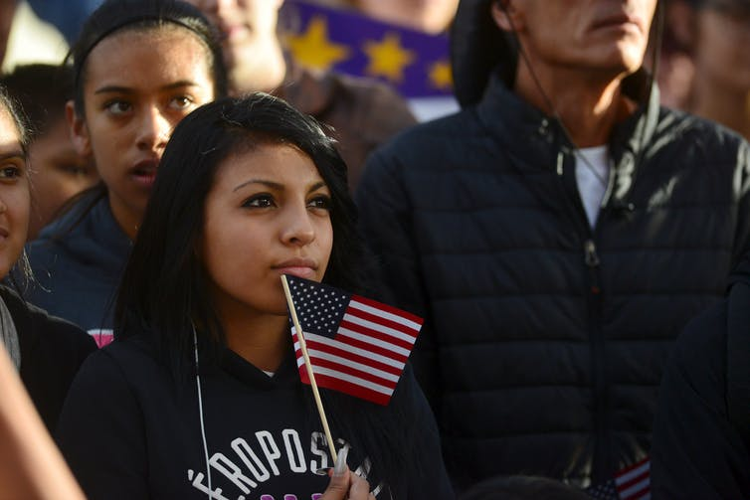
Diversity within the U.S. Latino Population
Source:
https://theconversation.com/the-effect-racist-rhetoric-has-on-young-latinos-and-why-all-americans-should-care-57408

Slide 62

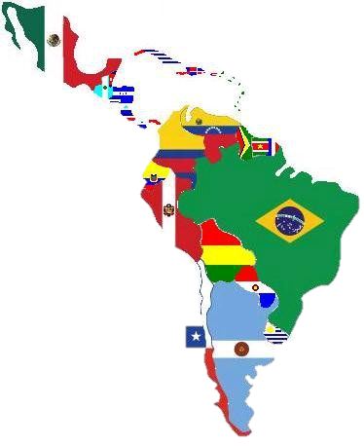
Latinos in the US
Source: https://greaterspokane.org/blog/2015/11/doing-business-in-latin-america/

Slide 63
Prevalence of Diabetes
10.2% in South Americans
13.4% in Cubans
17.7 % in Central Americans
18.0% in Dominicans and Puerto Ricans
18.3% in Mexicans
Source: https://beyondtype1.org/diabetes-disparities-hispanic-population/
Notes:
We even see differing rates of diabetes!

Slide 64
Latinos in the US
57.5 Million
Latinos living in the US as of 2017
17.8% of the US population
119 Million
Projected Latino population by 2060
28.6% of the US population
11.7 Million
Undocumented immigrants living in the US
34.2%
Are foreign-born; Majority are born in the US.
Source: Census, 2012, 2017;
Pew Research Hispanic Trends Project, 2012

Slide 65
Racial Identity
Racial Group | Latinos | Non-Latinos
White | 53% | 76.2%
Black | 2.5% | 14.6%
American Indian | 1.4% | 0.9%
Asian | 0.4% | 5.6%
Some other race | 36.7% | 0.2%
Two or more races | 6% | 2.3%
Source: Census, 2010

Slide 66
Racial Inequities
Those who classify as some other race compared to White, have lower levels of education and are:
Less likely to:
More likely to:
        Speak English
        Be citizens
        Label themselves as “American”
        Be living in poverty
        Report discrimination
        Report feeling marginalized
        Believe discrimination is a major problem

Slide 67

Immigration
Source: https://www.youtube.com/c/theflama/videos

Slide 68

Impact of Immigration on Families
Family separation and grieving
    Less social support
Remittances and commitments back home
Changes in parental and familial roles
    Mothers engaging in the workforce
    Children interpreting for parents
Mixed documentation families
Diane Guerrero
https://www.youtube.com/watch?v=49fN762AQWE
Source: https://www.pinterest.com/pin/775956210772997362/
Notes:
https://www.youtube.com/watch?v=49fN762AQWE

Slide 69

Health Inequities

Slide 70
Inequities in Diabetes
White patients use insulin pumps at higher rates than Black or Hispanic patients (Willi et al., 2015)
White children under 13 are more likely to use CGM (Wong et al., 2014)
Mixed findings on A1C levels:
Willis et al. (2015) did not find differences between Hispanic and white
Gandhi’s et al. (2016) review cited worse glycemic control for Hispanic-Americans
Agarwal et al. (2020) did find that Hispanic YA reported higher A1C levels
No differences in frequency of DKA and hospitalizations (Gandhi et al, 2016)
Notes:
Willi, S. M., Miller, K. M., DiMeglio, L. A., Klingensmith, G. J., Simmons, J. H., Tamborlane, W. V., ... & T1D Exchange Clinic Network. (2015). Racial-ethnic disparities in management and outcomes among children with type 1 diabetes. Pediatrics, 135(3), 424-434.
Wong JC, Foster NC, Maahs DM, et al.; T1D Exchange Clinic Network. Real-time continuous glucose monitoring among participants in the T1D Exchange clinic registry. Diabetes Care 2014;37:2702–2709
Abstract/FREE Full TextGoogle Scholar
Agarwal, S., Kanapka, L. G., Raymond, J. K., Walker, A., Gerard-Gonzalez, A., Kruger, D., ... & Long, J. A. (2020). Racial-ethnic inequity in young adults with type 1 diabetes. The Journal of Clinical Endocrinology & Metabolism, 105(8), e2960-e2969.
Gandhi, K. K., Baranowski, T., Anderson, B. J., Bansal, N., & Redondo, M. J. (2016). Psychosocial aspects of type 1 diabetes in Latino-and Asian-American youth. Pediatric research, 80(3), 347-355.

Slide 71
Barriers to Services
Despite the fact that new Americans are eligible for a variety of health and human services, research shows that they are often unable or unwilling to utilize them.
This is due to:
  Confusion surrounding applications, eligibility, and rights
  Distrust of helping professionals
  Cultural beliefs and health literacy
  Insufficient financial capital (insurance and time off)
      DKA is more frequent in children without private health insurance (Klingensmith et al., 2013)
  Language and literacy barriers
      Parent reading comprehension is positively associated with adolescents’ adherence (Janisse et al., 2010)
Notes:
Hispanics have lowest health literacy of any us racial/ethnic group (Office of Disease Prevention and Health Promotion Health Communication Activities, U.S. Department of Health and Human Services. America’s Health Literacy: Why We Need Accessible Health Information, 2015. (http://health.gov/communication/literacy/issuebrief/.).)

Slide 72

Other Causes of Disparities
Food insecurity and easier access to calorie dense, high fat and carbohydrate foods
Predicts hospitalization in children (Marjerrison et al., 2011)
44% of Hispanic-Americans with T1D are overweight or obese (Lawrence et al., 2009; Liu et al., 2009)
Language obstacle to understanding nutritional information
Depression, stress, racism…
Notes:
Marjerrison S, Cummings EA, Glanville NT, Kirk SF, Ledwell M. Prevalance and associations of food insecurity in children with diabetes mellitus. J Pediatr 2011;158:607–11.

Slide 73
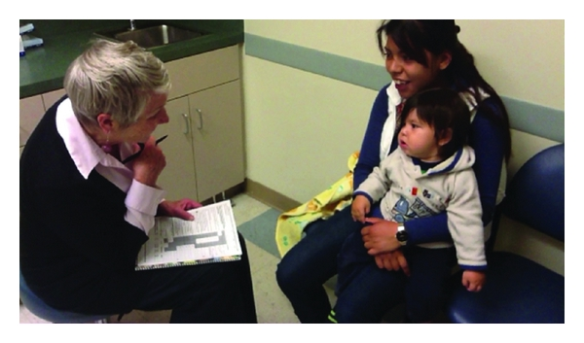
Putting it into Practice

Slide 74
Cultural Values & Treatment
  Personalismo = Business like interaction with mental or medical professionals seems unwelcoming
  Simpatia = Reluctant to share unpleasant emotions
  Respeto = Agreeableness
  Espiritualismo = More likely to seek assistance from religious leaders

Slide 75
Cultural Values & Treatment
Familismo = Attempt to solve problems within the family and not seek services or share personal information
Also impacts how adolescents make treatment decisions and who comes to treatment (along with respeto)
Promotes family involvement, improving T1D management (Gandhi et al., 2016)
Machismo = Help seeking is weak
Marianismo = Too busy caring for others to care for self (could feel selfish)
Notes:
Gandhi, K. K., Baranowski, T., Anderson, B. J., Bansal, N., & Redondo, M. J. (2016). Psychosocial aspects of type 1 diabetes in Latino-and Asian-American youth. Pediatric research, 80(3), 347-355.

Slide 76


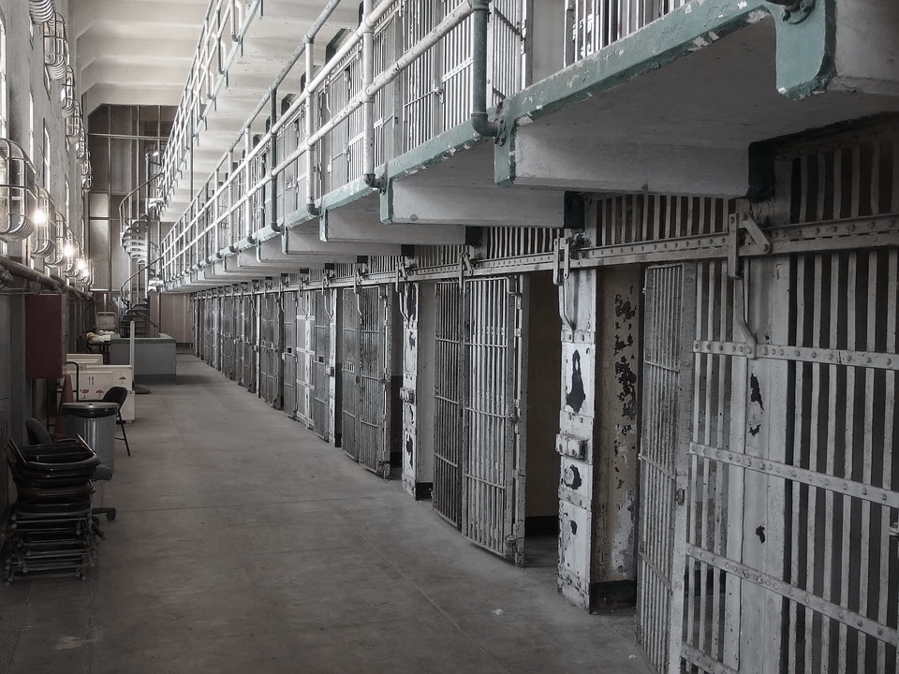
Other Considerations
Consider level of education
Immigrants have learned survival skills, which may make them appear more demanding and untrusting
Remember that many of the immigrants have fled violence, and have been abused, tortured, or imprisoned

Slide 77
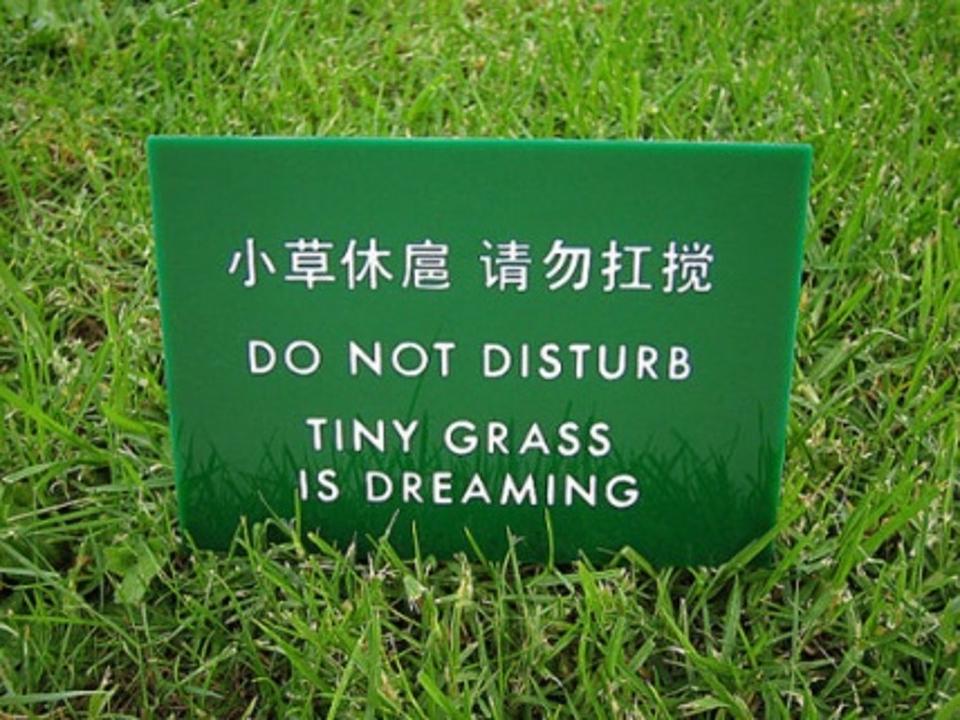
Working with Interpreters
Source:
https://www.pinterest.com/pin/647533252665251615/

Slide 78
When is an Interpreter Needed?
Patients seeking treatment may not speak English or feel completely comfortable in the language
Child patient may speak English but not parents
    It is important to keep parents involved!
Assessment measures are developed and meant to be used in English
  Not understood or culturally inappropriate at times

Slide 79
Ethical Concerns & Other Problems
Each interpreter may have a different background and level of training
Only available interpreters may be immigrants themselves & may know the client
    Confidentiality issues
    Families may not be as open as they would be otherwise
Some words may not be translatable to other languages
Different dialects

Slide 80
Tips When Using an Interpreter
Talk directly to the patients when using an interpreter
When asking questions, make sure to ask one question at a time
Do not use kids under 18 to interpret

Slide 81
Tips When Using an Interpreter
Do not ask interpreters to sum up an appointment or large portions of it
Eliminate idioms
Schedule for twice the time for an appointment when working with an interpreter

Slide 82

What Can You Do?
Source: onbites.com/trump-puts-end-daca-gives-6-month-delay/

Slide 83
Next Steps
Cultural Humility!
  Lifelong process, continuous
Be informed about policy changes:
  Dream Act or Deferred Action (DACA)
  Public Charge
  H1B visas
  Migrant Protection Protocols
Notes:
- Give example of my experience with my patient and public charge

Slide 84

Questions?

Slide 85
Data and the T1D Exchange
Data Mapping
Typically led by IT team, process to map against T1Dx data specifications resulting in access to the full QI portal and contribution to population health research.
Smartsheets
Temporary data sharing solution (prior to site completing data mapping) where site shares aggregate data to produce dashboards; allows sites the benefit of benchmarking and identifying shifts and trends over time.
Special Initiatives
Modify/use an existing data collection tool to support a temporary project (i.e. COVID-19 or telemedicine)
Notes:
There are two ways that we receive data from your sites. The main way is through the completed data mapping process. The second way is by reporting on Smartsheets. Once a site completes data mapping, you will have access to the QI Portal and we will complete the Smartsheet on your behalf. There are currently two adult sites that have completed data mapping, SUNY and BDC. All other sites are in the process of data mapping and need to report measures on Smartsheets.

Slide 86
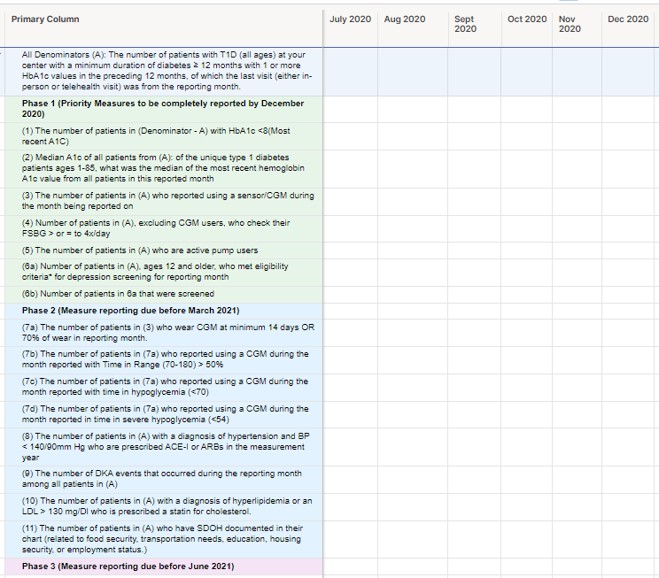
Smartsheets

Slide 88
QI Collaborative Pediatric Centers Dashboard Review
January 2022
Notes:
I will share an overview of quarterly data

Slide 89


28 pediatric clinics – caring for 36,000 patients with T1D

Slide 90
Pediatric T1D Glycemic Targets KDD
Change Ideas
Primary Drivers
Aim
Patient Education on diet, exercise, transition, device use and self management habits
Education to reduce DKA events/admission, 4X glucose check education
Set small patient- and provider-selected goals with clear action step
Working with families as well as providers
Among people with T1D,* increase proportion of patients achieving glycemic targets:
At least 25% with A1c <7%, OR
Increase proportion of patients A1c <7% by 5%, OR
Increase TIR among CGM users by 5%
from baseline in 2 years.
Health Literacy/Education and Support
Referral to nutrition therapy/guidance
Physical activity coaching
Peer support groups
New onset classes
Accessibility to translated materials
Use of Data
Use data registries to support population health
Use EMR templates
Incorporate QI measures or flow sheets
Insulin therapy
Culturally Competent Care
Catalogue of community resources
Train staff about SDOH
Documenting barriers to care (housing, transportation, food, etc.)
Social Determinant of Health
Insulin / monitoring /nutrition interactions
Coach >4 checks/day (for non CGM patients)
Test new workflows to improve device use
Use workflows to improve device documentation
Advertise CGM in waiting rooms, etc.
Device data reviews and interpretation, staff troubleshoot device
Provide contact information for device reps/patient support
Glucose monitoring
Transition
READDY questionnaire
Partner with adult clinic for hand-off
Follow up with LTFU patients (not seen for > 180 days); regular follow up (phone/email/text/televisit)
Improve scheduling process
Make appointments longer/have a multidisciplinary team (seeing a CDE/SW/RD)
Access to in-person and virtual care
*Duration > 1 year, ages 1-25, with at least one in-person or telemedicine visit in the last year
Conduct mental health screening and referrals (i.e. depression, FOH, diabetes distress)
Improve psychosocial support/train providers
MyChart message for questionnaires, PROs, high-risk patients
Create workflow for positive patients who needs referral
Screen for QOL (compare control of people using CGM vs no CGM)
Psychosocial Support

Slide 91
How we get data at T1D Exchange
Data Mapping
Typically led by IT team, process to map against T1Dx data specifications resulting in access to the QI portal and contribution to population health research.
Smartsheets
Temporary data sharing solution (prior to site completing data mapping) where site shares aggregate data to produce dashboards; allows sites the benefit of benchmarking and identifying shifts and trends over time.

Slide 92
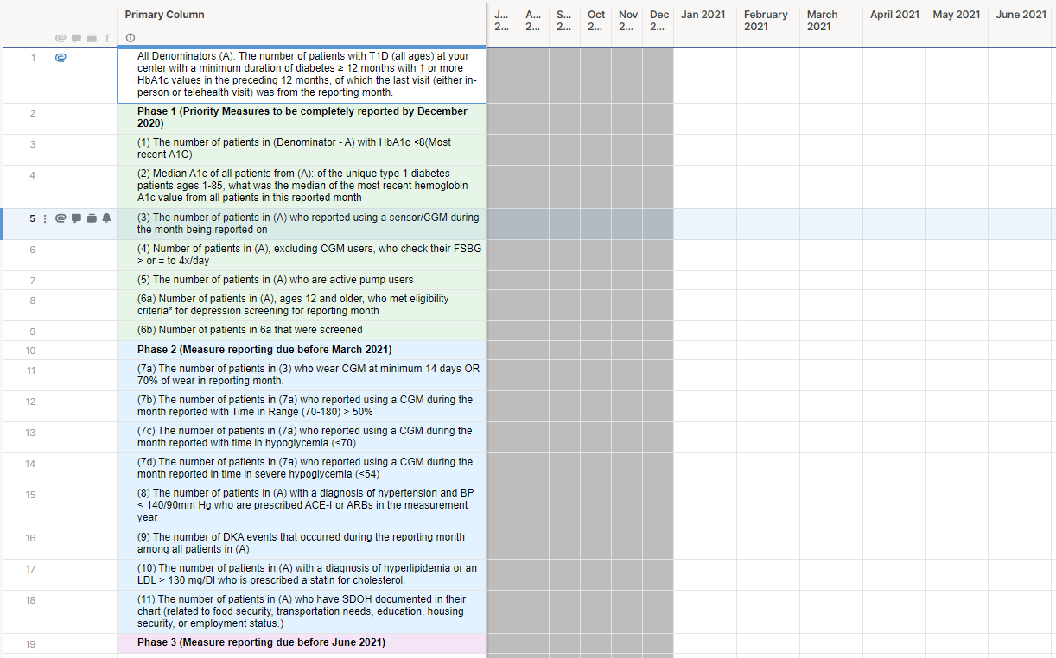
Smartsheets

Slide 93
2020-2021 Data Overview

Slide 94
Core QI Measures – Peds clinics
July 2020 – June 2022
Measures reported as of Aug 2021 | Measure | # of Pediatrics clinics reporting
Outcome Measures | HbA1c >7% | 24 clinics
 | Median A1c | 24 clinics
Process Measures | CGM use | 24 clinics
 | Pump use | 24 clinics
 | Depression screening | 16 clinics
 | DKA events | 10 clinics
Other Measures | Time in Range | 7 clinics
 | Documented Transition | 5 clinics
 | Social Determinants of Health screening | 4 clinics
Notes:
7 more sites are reporting on phase 1 measures and 5 more sites are reporting on phase 2 measures.

Slide 95
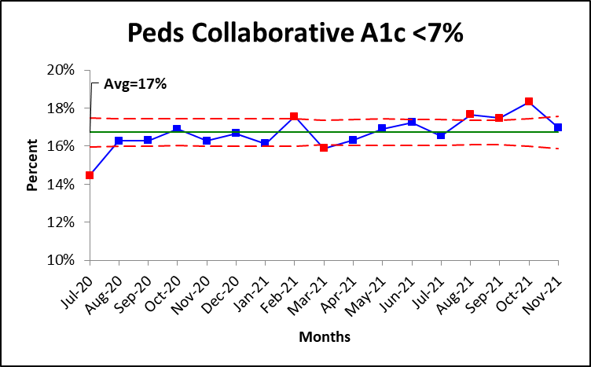
Peds Clinics - HbA1c < 7%
Run chart favorable direction
Notes:
16.3% to 16.7%

Slide 96
Peds Clinics - HbA1c < 7% Summary
Available data | Available data | Incomplete/No data
Texas | CMH | U of Miami
Michigan | Children National | UCSF
Cornell | SUNY | Mt Sanai
Alabama | Cohen
CHLA | Seattle
Tennessee | U of Wisconsin
Rady | Cook
BDC Peds | NCH
Indiana | Atlanta
Lurie | NYU Peds
Helen Devos | U Florida
Stanford | CCHMC
Mineola
QI Collaborative Goal: 25%
QI Collaborative Average: 16.8%
Sites that meet goal: 1/16
Top performers:
NYU Ped: 35.5%;
Rady: 22.4%
Lurie: 21.8%
CHLA: 21.6
NYU Mineola: 21.2
Improvement Range: 11.6%-35.5%

Slide 97
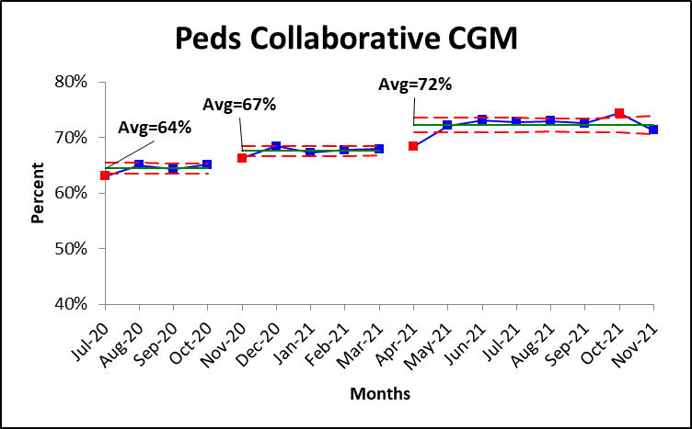
Peds Clinics - CGM Use
Increase by 8%
Run chart favorable direction
Notes:
Increased by 5% from last quarter

Slide 98
Peds Clinics – CGM Use
Available data | Available data | Incomplete/No data
Texas | CMH | U of Miami
Michigan | Children National | UCSF
Cornell | SUNY | Mt Sanai
Alabama | Cohen
CHLA | Seattle
Tennessee | U of Wisconsin
Rady | Cook
BDC Peds | NCH
Indiana | Atlanta
Lurie | NYU Peds
Helen Devos | U Florida
Stanford | CCHMC
Mineola
QI Collaborative Goal: 70%
QI Collaborative Average: 72%
Sites that meet goal: 12/24
Top performers:
NYU Peds: 85%;
NYU Mineola: 83%
UF: 79%
Seattle: 79%
CMH: 79%
Rady, BDC Peds, NCH, Michigan,
Florida, CHoA, Wisconsin
Improvement Range: 31%-85%

Slide 99
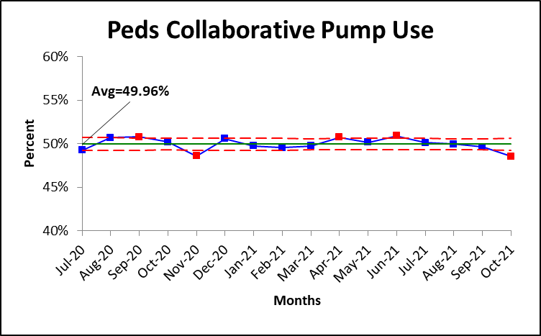
Peds Clinics - Pump Use
Run chart favorable direction
Notes:
48% to 50%

Slide 100
Peds Clinics - Pump Use
Available data | Available data | Incomplete/No data
Texas | CMH | U of Miami
Michigan | Children National | UCSF
Cornell | SUNY | Mt Sanai
Alabama | Cohen
CHLA | Seattle
Tennessee | U of Wisconsin
Rady | Cook
BDC Peds | NCH
Indiana | Atlanta
Lurie | NYU Peds
Helen Devos | U Florida
Stanford | CCHMC
Mineola
QI Collaborative Goal: 65%
QI Collaborative Average:50%
Sites that meet goal: 6/24
Top performers:
NYU: 79.5%
NYU Mineola: 78%;
CMH: 71%
Cornell, BDC Peds: 69%
Michigan:67%
Improvement Range: 15%-79.5%

Slide 101
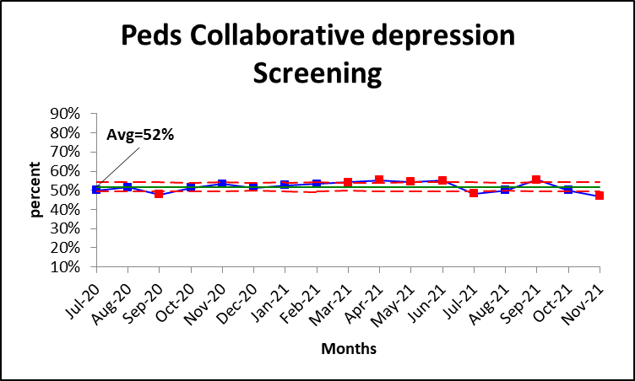
Peds Clinics – Depression Screening
Increase by 11%
Run chart favorable direction

Slide 102
Peds Clinics – Depression Screening
QI Collaborative Goal: 80%
QI Collaborative Average: 52%
Sites that meet goal: 3/16
Top performers:
Tennessee: 96%;
Texas: 82%
Helen Devos: 79%
Improvement Range: 10%-96%
Available data | Available data | No data
Texas | Indiana | Stanford
NYU Peds | Seattle | UCSF
Cornell | Cohen | NYU Mineola
Florida | NCH | CMH
CHLA |  | U of Wisconsin
Tennessee |  | Indiana
Rady |  | CCHMC
Lurie |  | Mt Sinai
Helen Devos |  | Alabama
Cook |  | BDC Peds
C. National |  | Michigan
Wisconsin
CMH
SUNY
U. Miami
Cohen

Slide 103
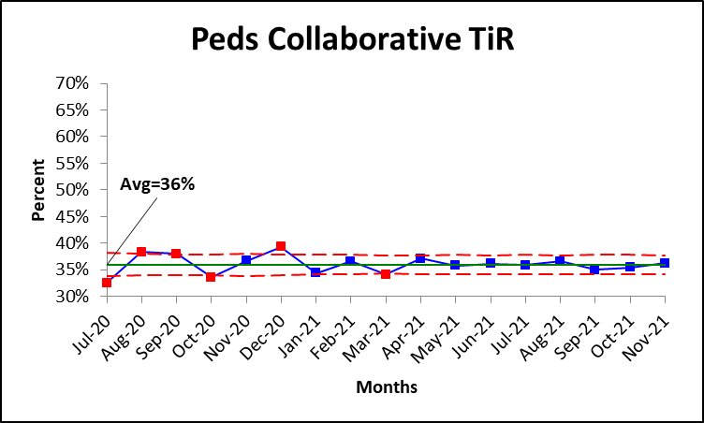
Peds Clinics – Time in Range
Run chart favorable direction
Notes:
29% to 36%

Slide 104
Peds Clinics – Time in Range
QI Collaborative Goal: 70%
QI Collaborative Average:36%
Sites meeting goal: None
Top performers:
NYU Peds: 50%;
BDC Peds: 50%
Improvement Range: 5%-50%
Available data | No data | No data
Lurie | CCHMC | U of Miami
NYU Peds | Stanford | UCSF
CMH | SUNY | NYU Mineola
Florida | Cohen | CMH
BDC Peds | Seattle | U of Wisconsin
NCH | Tennessee | Cook
Cornell | Rady | Children National
 | CHLA | Mt Sinai
 | Indiana | Atlanta
 | Texas | Michigan
 | Helen Devos | Stanford
 |  | Alabama

Slide 105
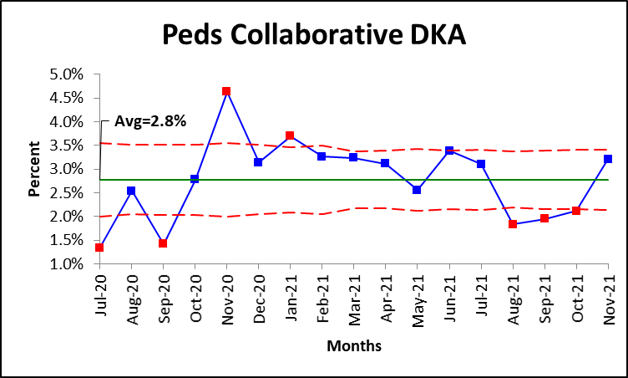
Peds Clinics – DKA Events
Run chart favorable direction

Slide 106
Peds Clinics – DKA Events
Available data | No data | No data
Lurie | CCHMC | U of Miami
NYU Peds | Stanford | UCSF
Cornell | SUNY | NYU Mineola
Florida | Cohen | CMH
BDC Peds | Seattle | U of Wisconsin
Texas | Tennessee | Cook
Cook | Rady | Children National
Cohen | CHLA | Mt Sinai
NYU Mineola | Indiana | Atlanta
CMH | Texas | Michigan
 | Helen Devos | Stanford
 | NCH | Alabama
QI Collaborative Goal: 6.3%
QI Collaborative Average: 2.8 %
Sites that meet goal: 09/10
Top performers:
NYU Mineola: 0.2%;
Lurie: 0.6%
Cohen: 0.6%
BDC Peds: 0.7%
Improvement Range: 0.2-11%

Slide 107
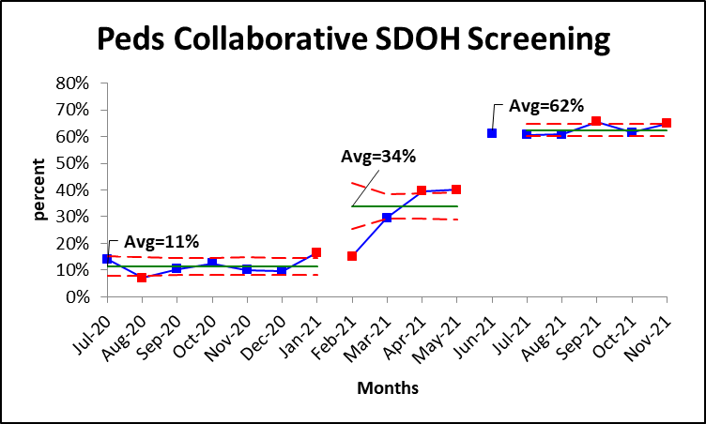
Peds Clinics – SDOH Screening
Run chart favorable direction

Slide 108
Peds Clinics – SDOH Screening
QI Collaborative Goal: 10%
QI Collaborative Average:61%
Sites meeting goal: All
Sites that meet goal: 4/4
Top performers:
NYU Peds: 67%;
Texas: 61%
Improvement Range: 5%-50%
Available data | Incomplete/No data | No data
Cornell | CCHMC | U of Miami
NYU Peds | Stanford | UCSF
Cohen | SUNY | NYU Mineola
Texas | Cohen | CMH
 | Seattle | U of Wisconsin
 | Tennessee | Cook
 | Rady | Children National
 | CHLA | Mt Sinai
 | Indiana | Atlanta
 | Texas | Michigan
 | Helen Devos | Stanford
 |  | Alabama

Slide 109
Peds Improvement Score Card
Sites | A1c<7% | A1c<7% | CGM Use | Pump Use | Depression screening | DKA Events | TIR | Documented Transition | SDOH Screening
QIC Goals | <7% |  | 70% | 60% | 80% | <6.3% | >70%
QIC Status | 17% |  | 72% | 50% | 52% | 2.8% | 36% | 28% | 62%
Lurie | 22% |  | 68% | 43% | 11% | 0.6% | 12%
NYU Peds | 36% |  | 86% | 80% | 50%(↑45%) | 1.5% | 50% | 56% | 67%
Cornell | 16% |  | 66% | 69% | 39% | 1.9% |  | 39% | 18%
Florida | 21% |  | 77% | 44% | 65% | 1.6% | 22%
BDC Peds | 15% |  | 78%(↑7%) | 69% |  | 0.7% | 50%
Texas | 18% |  | 63% | 50% | 81% | 1.6% |  |  | 61%
Cook | 18% |  | 65% | 36% |  | 2.9%
Cohen | 20% |  | 31% | 16% |  | 0.6% |  |  | 17%
Mineola | 21% |  | 82% | 78% |  | 0.2%
CMH | 18% |  | 79% | 71%(↑6%) | 55% | 11% | 35% | 25%
Helen D | 15% |  | 55%
NCH | 19% |  | 72%
Legend |  |  |  | Favorable |  | Below Goal

Slide 110
Peds Improvement Score Card
Sites | A1c<7% | CGM Use | Pump Use | Depression screening | DKA Events | TIR | Documented Transition | SDOH Screening
QIC Goals | <7% | 70% | 60% | 80% | <6.3% | >70%
QIC Status | 17% | 72% | 50% | 52% | 2.8% | 36% | 28% | 62%
Rady | 23% | 80%(↑7%) | 43%
Alabama | 13% | 54%(↑17% | 31%
Michigan | 14% | 76% | 67%
Seattle
Atlanta | 15% | 79% | 41%
Tennessee | 12% | 55% | 23% | 96%
Indiana | 16% | 41% | 42%
Stanford | 24% |  | 52%
CHLA | 22% | 59% | 48% | 49%(↑30%)
SUNY | 18% | 51% | 62% | 40%
National | 17% | 53% | 31%
Wisconsin | 15% | 72% | 55% | 48%
Legend |  |  | Favorable |  | Below Goal

Slide 111
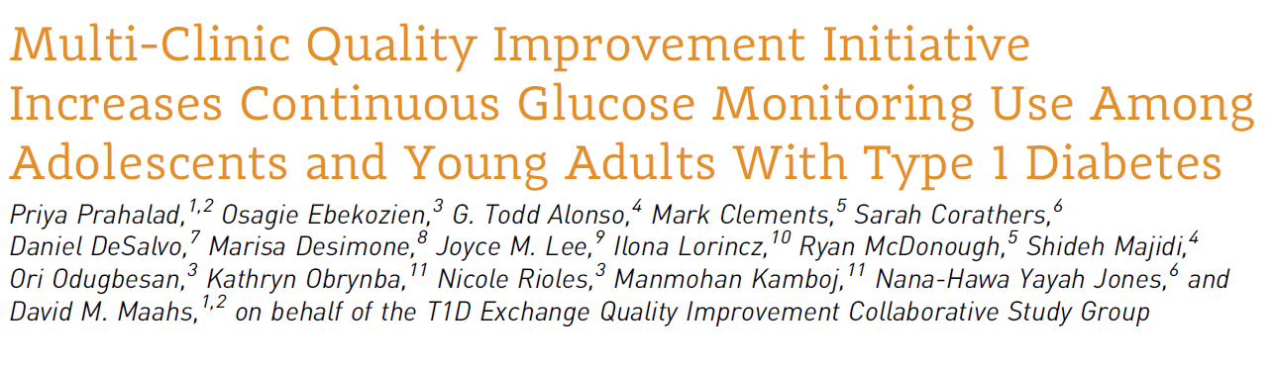
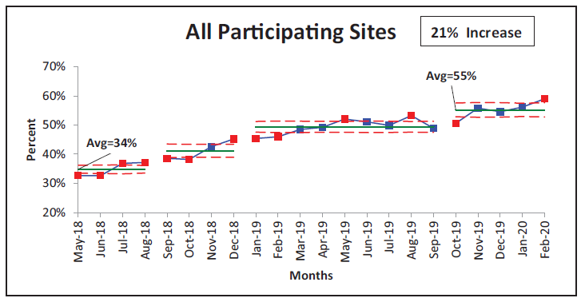
Clinical Diabetes 2021 Jul; 39(3): 264-271.https://doi.org/10.2337/cd21-0026

Slide 112
Peds Clinic Insights
Decrease High risk patients' proportion
Increase Pump use
Increase CGM Use
Depression screening
SDOH Screening
Increase device download
Increase smart pen Use
Equity Project
Notes:
Device downloads (Stanford, Miami, SUNY)

Slide 113
Next Steps
Provide Phase 1 measures
Take on new QI projects
If collecting Phase 1, begin collection on Phase 2 measures
Utilize the QI Portal for data trending, benchmarking, and creating alerts (mapped sites)
Take IHI Open School courses
Document PDSAs in LifeQI
Engage other faculty members in your improvement efforts
Consider submitting an abstract for your improvement work
Notes:
# of sites not providing any data, don’t have to provide everything on Smartsheet. Prioritize phase 1

Slide 114
Resources Available
Monthly Collaborative Calls
Check in Calls with Ori/Ann
Dashboards
IHI Open School Courses
PDSA cycle documentation in LifeQI
T1Dx QIC Trello page
QI Portal

Slide 115
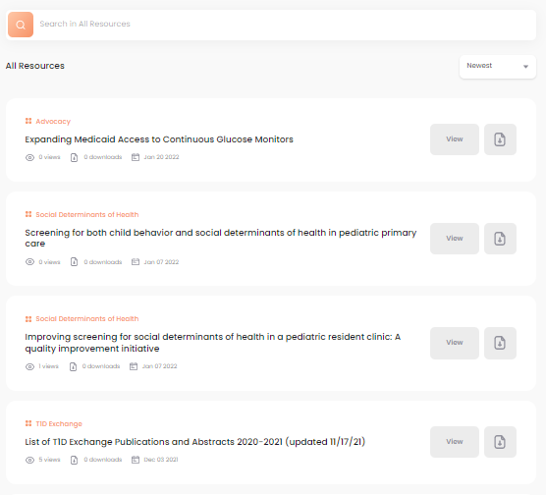
QI Portal
Available for ALL clinics
QI Portal offers benchmarking, charting, and library resources
Notes:
https://qi.t1dplatform.org/auth/login

Slide 116
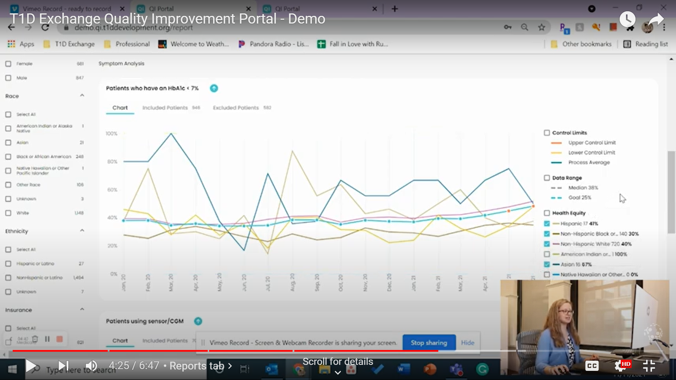
QI Portal Demo Video
Five-minute overview of all four Portal tabs. Or, select tab “chapters” for a quick refresher on a specific feature
https://www.youtube.com/watch?v=iZCe48_MtsE
Notes:
https://www.youtube.com/watch?v=iZCe48_MtsE

Slide 117
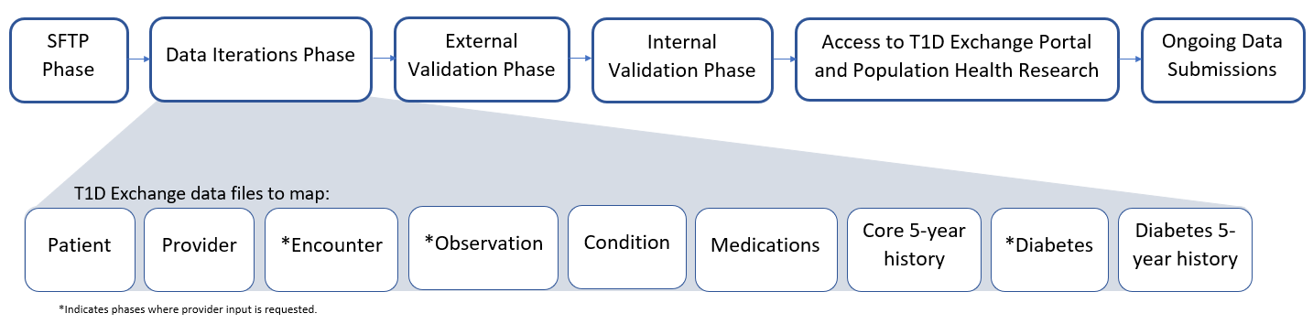
Data Mapping Process

Slide 118
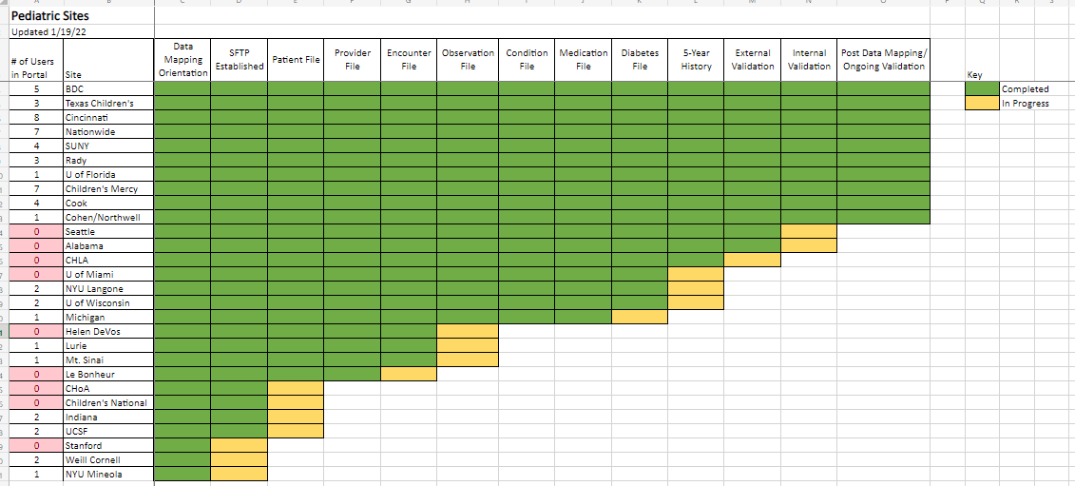
Data Mapping Progress – Peds clinics

Slide 120
Next Pediatric Collaborative Call (combo with Adults)
Thursday March 24th, 11:00-12:30 PM EST

Slide 121
Questions from the Collaborative

