Slide 1
QI Collaborative Call, Adults
1/25/22

Slide 2
Welcome & introductions

Slide 3
Agenda
Welcome & introductions
Updates from the Collaborative
New staff!
Welcome to the Cleveland Clinic!
Plans for May Leadership/PI Session
Website updates
Committee Chair opportunities
Albert Einstein Presentation, Drs. Agarwal and Mathias
Mount Sinai, Dr. Levy
Quarterly data results & QI Portal, Ann Mungmode
Notes:
Add Phase 1 measures

Slide 4
T1D Exchange Updates

Slide 5
29 pediatric clinics – caring for 38,500+ patients with T1D
Notes:
Include Trello link to the updated contact list for 41 Centers

Slide 6
14 adult clinics – caring for 19,500+ patients with T1D
Notes:
Include Trello link to the updated contact list for 41 Centers

Slide 7
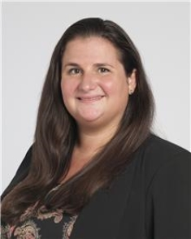
Welcome to the Cleveland Clinic!
Adult PI: Pratibha PR Rao, MD, MPH
Pediatric PI: Andrea Mucci, MD, MASc

Slide 8
Welcome!

Slide 9
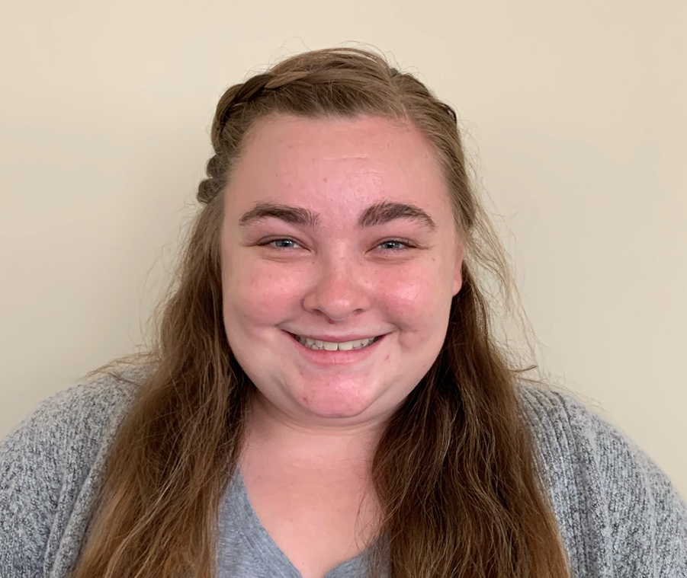
New team member at T1DX-QI!
Holly Hardison joined the Collaborative on 1/10 as our coordinator. She came from Baptist Health Research Institute in Jacksonville, FL where she held the position of Clinical Research Assistant, working on cardiology, covid and neurology research studies. Holly previously held the position of Camp Director for the American Diabetes Association in Jacksonville, FL Holly brings strong organization skills, event planning and problem-solving skills, and a lot of enthusiasm! She graduated from Jacksonville University with a BS in Biology.
Holly can be reached at hhardison@t1dexchange.org or X7210
QI Coordinator,
Holly Hardison, BS

Slide 10
PI/Clinical Leadership Planning Session May 16-17 will be virtual, 11am-4pm EST
Notes:
T1DX-QI Calendar Schedule for 2022 on Collaborative Calls | Trello

Slide 11
T1D Exchange Website will have a password protected space for Collaborative, beginning 3/1/22
We will use the protected space to:
Share work in progress, including emerging case studies and interventions
Ask questions to the Collaborative network with the ability to view archived threads and responses

Slide 12
T1DX-QI Committee Chair Roles

Slide 13
T1DX-QI Is looking for new committee chairs
We are looking for new Co-Chairs to help us lead the committees.
Terms last for twenty-four (24 months) and the new term will begin 6/1/2022.
Each committee has two co-chairs from a pediatric and adult clinic.
Expectations* of Committee Chairs:
Facilitate quarterly committee meetings
Create the vision for the future direction of the committee and its impact on the QI Collaborative’s future
Participate in one planning meeting with their co-chair and with the T1DX-QI coordinating center staff for 30 or 60 minutes
Facilitate or co-facilitate committee meetings
Participate in the development of content related to the committees.
*In addition to these tasks, Publications Committee Co-Chairs also review and edit abstracts and manuscripts that are written by the Collaborative.

Slide 14
T1DX-QI Is looking for new committee chairs
T1DX-QI Chair terms are ending in June 2022.
Please use this form to nominate yourself for a T1DX-QI Committee Chair position for the 2022-2024 period or share with a colleague who you think would be a good match.
If you are interested in applying for one of the committee roles, please complete the Nomination Form before Monday February 28th.
To learn more about the committees, please visit these Trello pages:
Clinical Leadership: https://trello.com/b/4F3ABcug/clinical-leadership-committee
Publications: https://trello.com/b/K5EUYxbf/updated-publications-committee
Data Science: https://trello.com/b/YmmgugBB/data-science-committee
Notes:
https://docs.google.com/forms/d/e/1FAIpQLSdHuB67dAhFwXYBmFfe23xh-86096Oys9LrAT2gN7N14nm-7A/viewform

Slide 15
Clinical Presentation: Albert Einstein

Slide 16
Learning Objectives
Understand the various challenges that young adults with type 1 diabetes face that interfere with diabetes self-management and attainment of glycemic goals
Learn about innovative clinical models that can address racial-ethnic disparities in outcomes among young adults with type 1 diabetes

Slide 17
Supporting Emerging Adults with Type 1 Diabetes The SEAD program
Shivani Agarwal MD, MPH
Assistant Professor of Medicine-Endocrinology
Albert Einstein College of Medicine-Montefiore Medical Center
Bronx, NY

Slide 18
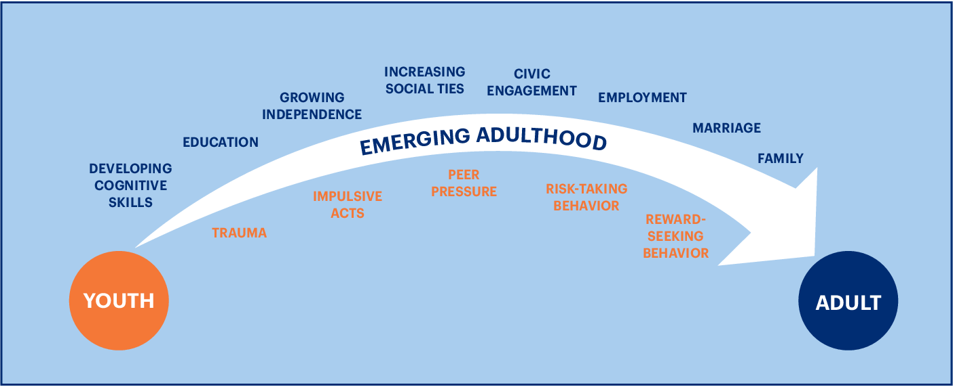
Challenge #1: Development from Child to Adult

Slide 19
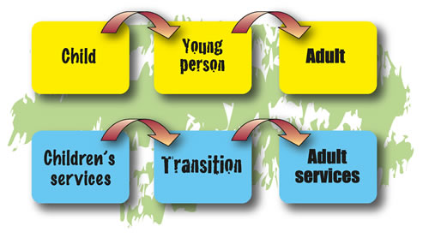
Challenge #2: Healthcare Transition
Lyons et al. JCEM 2015

Slide 20
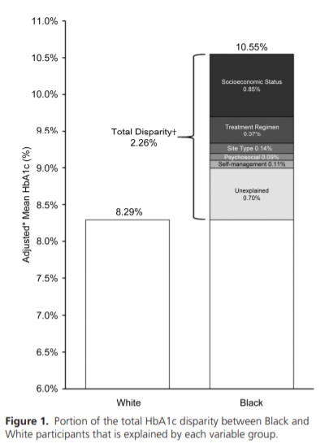
Challenge #3: Racial-Ethnic Disparities
Agarwal et. al, JCEM, 2020

Slide 21
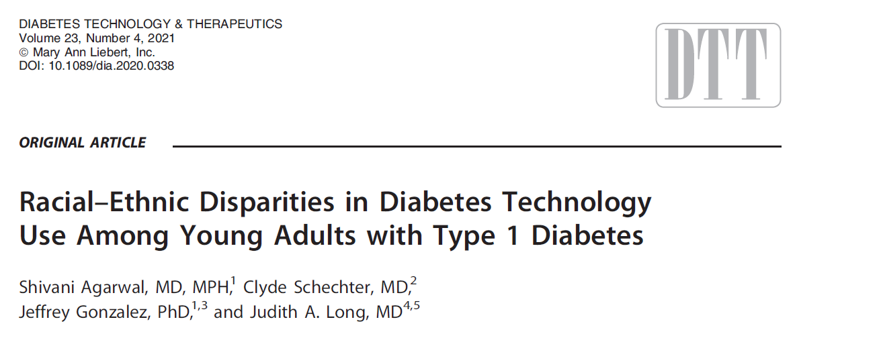
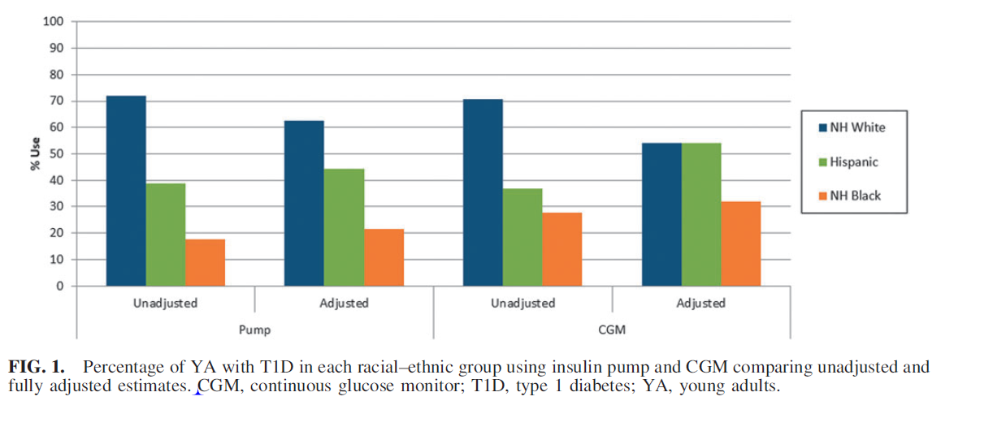
Agarwal, DTT, 2020

Slide 22
Result of Challenges:
VERY Poor Medical and Psychological Outcomes

Slide 24
The Supporting Emerging Adults with Diabetes (SEAD) Program

Slide 25
Lipman and Hawkes, Diabetes Care, 2021

Slide 26
Research
Clinical Model Innovation
Clinic

Slide 27
Research
Clinical Model Innovation
Clinic

Slide 28
Continuing Education
Orientation to Adult Care
Behavioral Support
SEAD Program Model
Care Coordination
Engagement in Care
Pediatric Partnership
Agarwal et al. Diabetes Educator 2016
Notes:
Make font bigger, citation of paper ; we moved the model from penn to Einstein because it was successful, add 2 columns

Slide 29
Evolution of SEAD
Established SEAD at UPenn
Moved SEAD to Einstein-Montefiore
1 MD
+
1 NP
+ RD
and Psychology
+ Social needs coordinator technology specialist
+ Endo fellow trainees
MDs, NP, RD, PhD, LPN, Program cdtr, Patient advisors
2016
2018
2018
2019
2019
2021

Slide 30
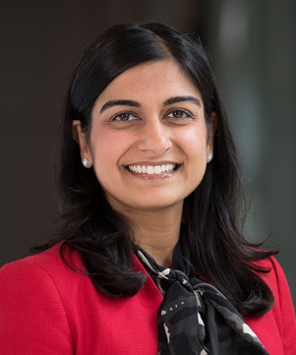
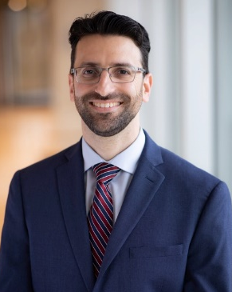
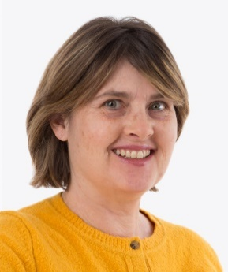
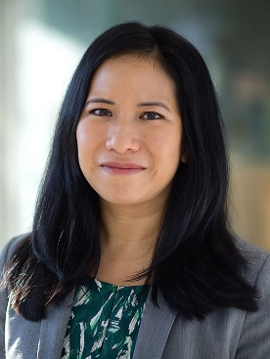
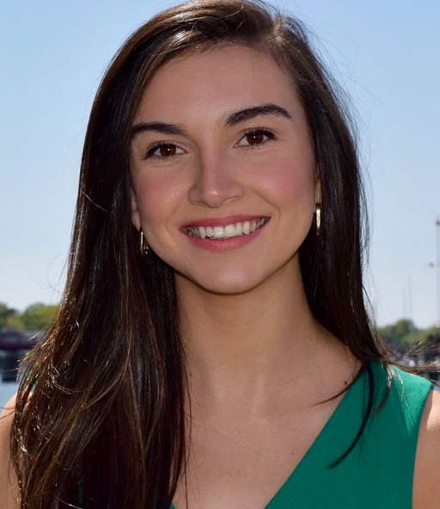
Shivani Agarwal MD, MPH
zz
Priyanka Mathias
MD
Michael Greenberg
NP
Young Adults
Trainees
Sharon Movsas, RD Dietician
Stephanie Leung, PhD
Psychologist
Molly Finnan
Program
Manager
Lourdes Lebron
Social Needs Coordinator and Tech Specialist

Slide 31
Talk to patients
Equity focus
Manage expectations
Build people up, emphasize positives
Manage negatives
Avoid doomsday talk

Slide 32
Multi-Specialty Visits
YA Programming
Weekly Complex Case Review
Patient Advisory Board
Multi-Specialty Visits

Slide 33
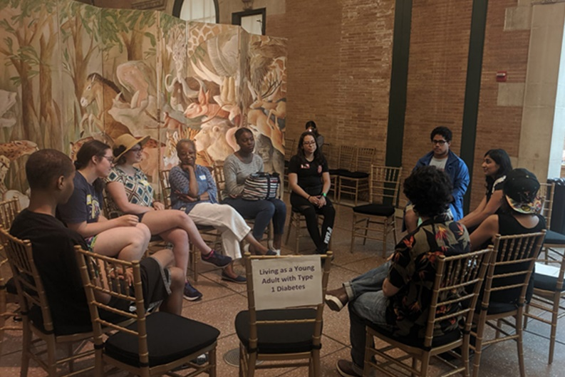
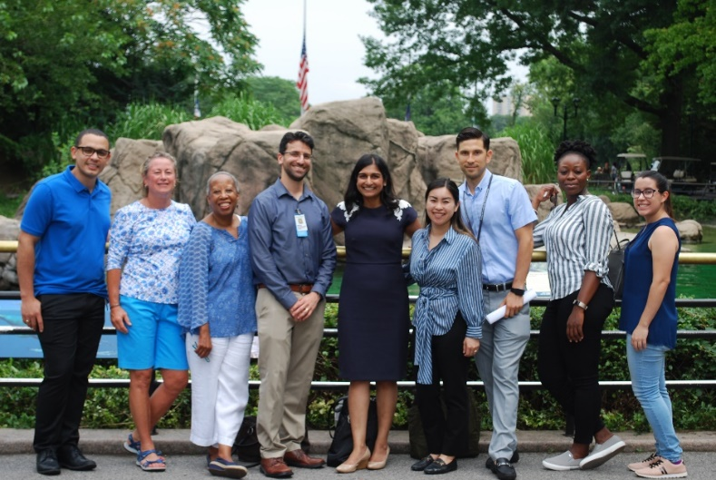
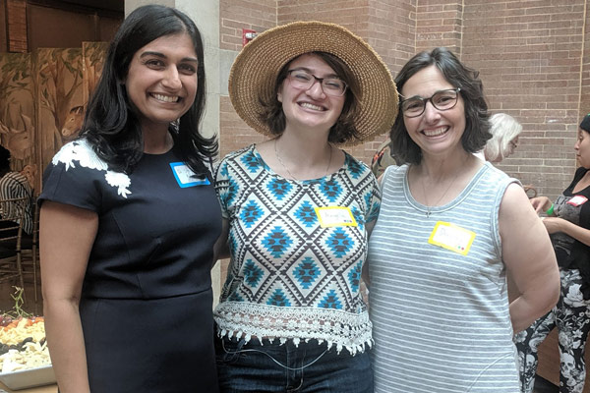
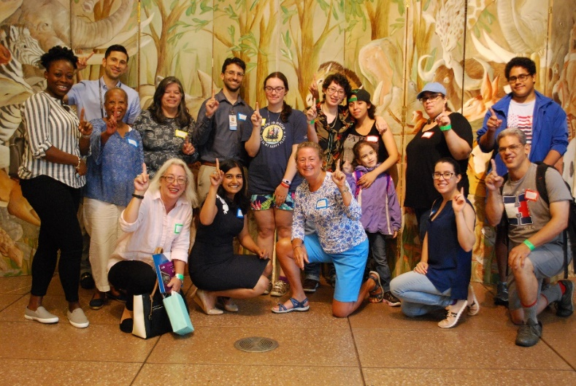

Slide 35
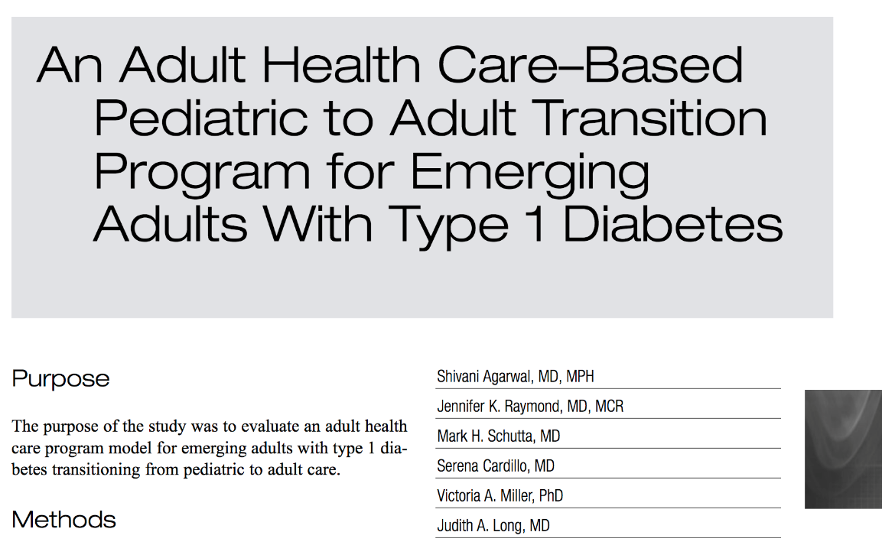
Preliminary Philly SEAD Outcomes
Agarwal et al. Diabetes Educator 2016

Slide 36
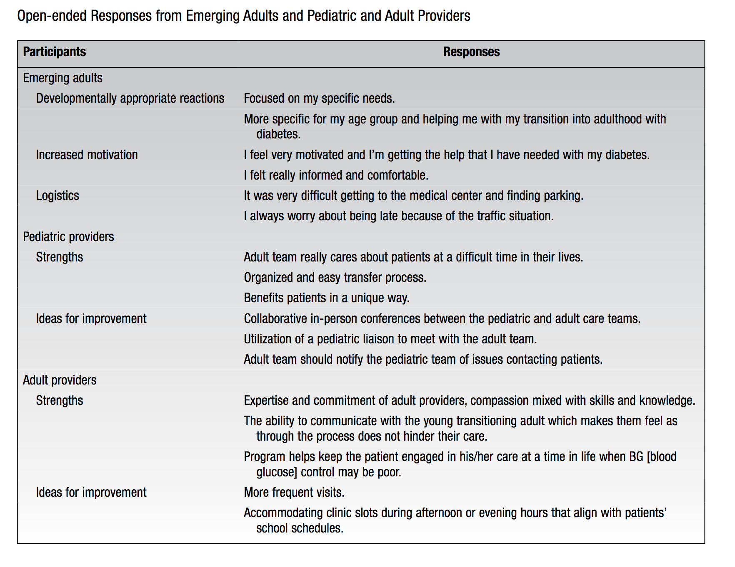

Slide 37
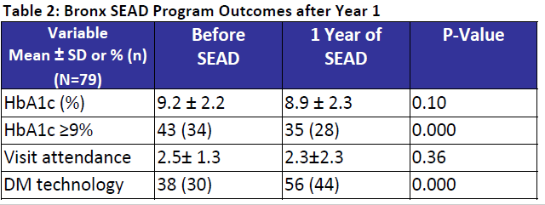
Preliminary Bronx SEAD Outcomes

Slide 38
Research
Clinical Model Innovation
Clinic

Slide 39
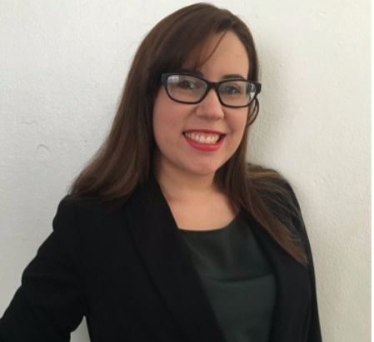
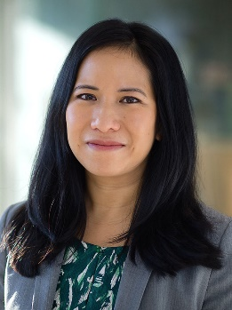
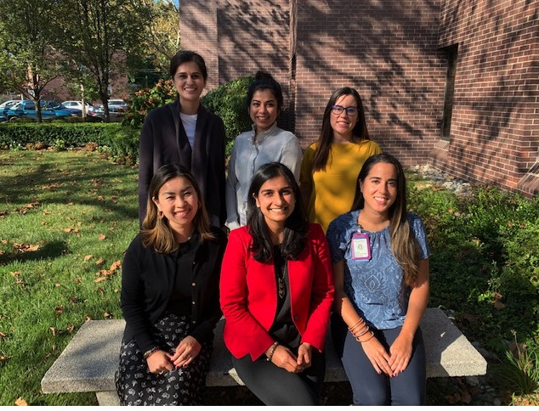
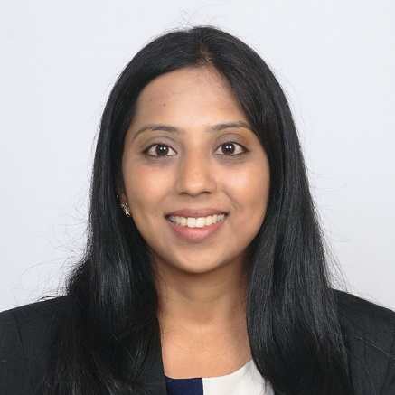
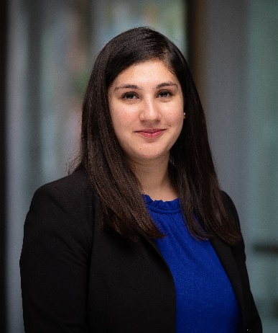
2021-2022 SEAD Research Lab
Gladys Crespo-Ramos, PhD
Stephanie Leung, PhD
Molly Finnan, BA
Priyanka Mathias, MD
Priyanka Mahali, MD
Rabail Sadiq, MD

Slide 40
Provider Factors and Young Adult T1D Outcomes
Gladys Crespo-Ramos, PhD
Racial-Ethnic Differences in Barriers to Self-Care
Molly Finnan, BA
Racial-Ethnic Differences in Diabetes Self-Care and Contributing Factors
Rabail Sadiq, MD
Young Adult Type 1 Diabetes Self-Management App
Priyanka Mahali, MD

Slide 41
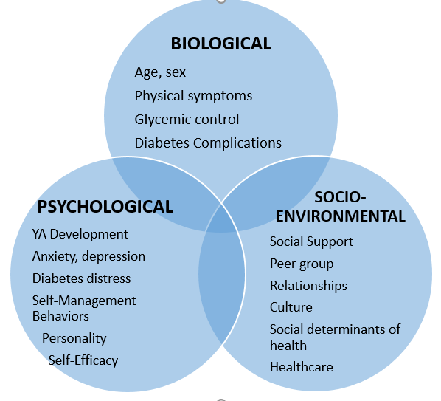
Figure 1. Biopsychosocial Model of Health in Underrepresented Young Adults with Diabetes
Finnan and Agarwal, Diabetes Spectrum 2021

Slide 42
Research
Clinical Model Innovation
Clinic

Slide 43
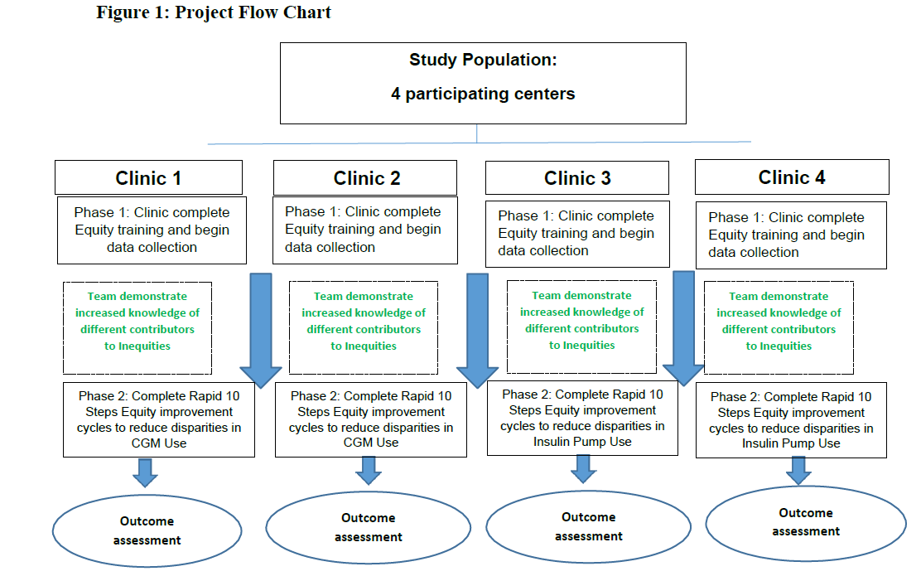
Priyanka Mathias, MD

Slide 44
Patient Characteristics
All young adults from endo (18-35 years) January 2019-November 2021
Age | 27.4 (SD 4.7)
Sex | 51% Female 49% Male
Insurance Private Public | 18% 79%

Slide 47
31%
13%

Slide 49
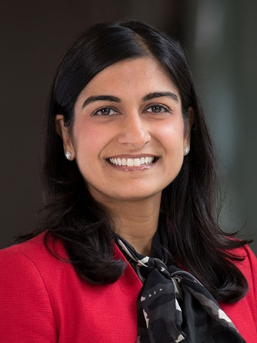
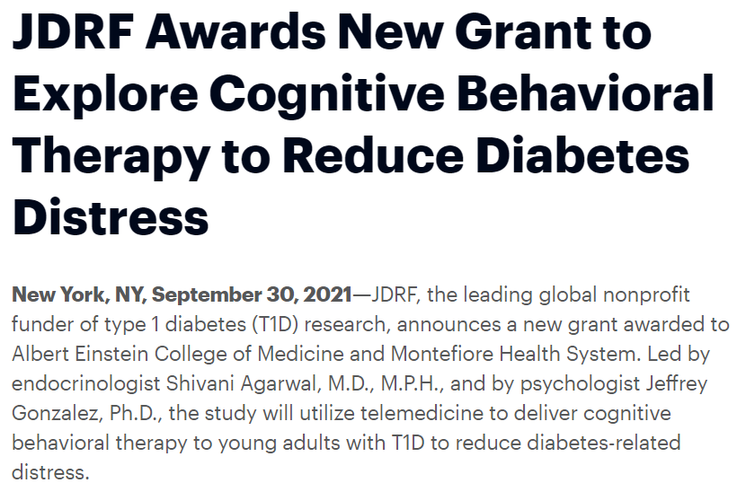
Jeffrey Gonzalez, PhD
Shivani Agarwal MD, MPH
Clyde Schechter, MD
Cuiling Wang, PhD
Gladys
Crespo-Ramos, PhD
Stephanie
Leung, PhD
Molly
Finnan, BA
Claire
Hoogendoorn, PhD

Slide 50
T1DTechCHW
Enhancing the Community Health Worker Model to Promote Diabetes Technology Use in Young Adults from Underrepresented Minority Groups with Type 1 Diabetes
R01DK132302
Shivani Agarwal MD, MPH
Clyde Schechter, MD
Judith Long, MD
Ashby Walker, PhD
Kevin Fiori, MD

Slide 51
Research
Clinical Model Innovation
Clinic

Slide 52
Acknowledgements
SEAD Clinical Program
Michael Greenberg, NP
Priyanka Mathias, MD
Sharon Movsas, RD
Stephanie Leung, PhD
Molly Finnan, BA
Lourdes Lebron, LPN
Practice Managers and staff
Yani Munoz
CHAM Pediatric Endo
Trainees
Patients and Families
Einstein-Montefiore
Yaron Tomer, MD PhD
Jill Crandall, MD
Jeff Gonzalez, PhD
Elizabeth Walker, PhD
Clyde Schechter, MD
Vafa Tabatabaie, MD
Penn/CHOP
Judith Long, MD
Victoria Miller, PhD
Anne Cappola, MD MSc
Susan Mandel, MD
Michael Rickels, MD
SEAD Research Program
Funding/Disclosures:
NIH-NIDDK #K23DK115896-04 (PI: Agarwal)
JDRF 4-SRA-2021-1071-M-B (mPI: Agarwal)
T1D Exchange/Helmsley Charitable Trust (Site PI: Agarwal)
NY-Regional Center for Diabetes Translational Research
#P30DK111022

Slide 53
Clinical Presentation: Mt Siani

Slide 54
Learning Objectives
The management of hyperglycemia for patients with COVID 19 can be challenging in the inpatient setting. The use of formalized algorithms may reduce glycemic variability.
Pregnancies in women with diabetes pose increased risks to the fetus. Implementation of preconception counseling strategies in women of child bearing age, may help to improve outcomes.

Slide 55
Icahn School of Medicine at Mount Sinai
T1D exchange

Slide 56
Clinic Profile
Mount Sinai East Adult Diabetes Center | Staffing | Volume | Contact Names
Main campus: 100th and Madison Avenue, NYC | 10 Endocrinologists with a diabetes focus (total division 16 providers) 4 NPs (2 CDCES) 2 RNs (1 CDCES) 2 RDs (1 CDCES) 1 Project lead 1 RC 1 Endo fellow 1 Endocrine Research fellow | 1100 ± 20 per year T1D visits New onset T1D : ⁓15 per year (+ patients misdiagnosed as T2D) | Site PI: Carol Levy Other team members: -David Lam, MD -Grenye O’Malley, MD -Nirali Shah, MD Site project manager: Selassie Ogyaadu, MD, MPH
Other Healthcare system NYC sites: Sinai West, East and Morningside

Slide 57
Active Projects
From 2020
Revision of DKA Protocol – In progress
Inpatient hyperglycemia for COVID patients protocol – In progress
New 2021
Pre-conception counseling for women with diabetes (PREPP’D) – In progress

Slide 58
DKA Protocol Revision
DKA (Diabetic Ketoacidosis) Protocol Revision
COVID-19 specific DKA Protocol created (Emergency Department, Endocrine, Hospital Medicine, Institute of Critical Care medicine)
Decreased IVF
Early introduction of basal insulin to decrease IV insulin gtt
Subcutaneous protocol for mild DKA

Slide 59
Diabetes in Pregnancy
Pregnant women with diabetes require tight glycemic targets to reduce adverse health risks (fetal and maternal complications)¹⁻³
Fetal Complications
Macrosomia Large babies Higher incidences of cesarean section Shoulder dystocia Maternal increased risk of preeclampsia Fetal death
Risks can be minimized by getting glucose levels to target before getting pregnant
Beck RW, et al. Lancet. 2019; 394: 1265-1273,
Voormolen DN, et al. Diabetes Obes Metab. 2018; 20:1894-1902;
Feig DS, et al. Lancet. 2017;390:2349-2359.

Slide 60
Patient Wait Time - Hospital Based Endocrine/Diabetes Clinic
COVID-19 social distancing and cleaning procedures have altered patient flow in clinic
Pre-COVID
Dedicated rooms for vitals, phlebotomy, POC testing allowed for intake of multiple patients before appointment
Waiting area used for patients after check-in, post-intake, and post-visit
Average wait time after check-in
Jan-Feb 2020, Mean 11 minutes, Median 7 minutes (Std. Dev. 14 minutes)
Jul-Aug 2020, Mean 24 minutes, Median 13 minutes (Std. Dev. 19 minutes)

Slide 61
Patient Wait Time - Hospital Based Endocrine/Diabetes Clinic
Issues Identified
Time spent by each patient in exam room due to phlebotomy
POCT HbA1C Testing – Limited staff that can perform task
Provider-RN-MA communication of patient rooming status
Shared space with multiple clinics (starting 9/2020) with decreased number of exam rooms and shared support staff

Slide 62
Patient Wait Time - Hospital Based Endocrine/Diabetes Clinic
Issues Identified
Time spent by each patient in exam room due to phlebotomy
Providers will contact patient 2 weeks ahead of time to arrange for pre-visit blood work
Limited appointment day lab work, routine labs ordered for patients to use 1st floor lab
Provider-RN-MA communication of patient rooming status
Unified communication protocols (dot system)
Same Day Huddle update
Changing assigned provider in response to long wait times **
Shared space with multiple clinics (starting 9/2020) with decreased number of rooms
Promotion of telehealth visits but now returning to more in person visits (9/2021)

Slide 63
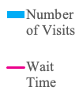

Slide 65
Pregnancy in Women with T1D is Associated with Even Higher Fetal Sequelae:
Severe complications 1 in 13
Congenital malformations
Stillbirth or neonatal death about 4 - 7 X’s that of women without diabetes
Preterm birth
Pre-eclampsia
LGA rates 40 – 70%
NICU admissions and Neonatal hypoglycemia 1 in 4
Complications
Costly emotionally and financially
Potentially preventable by improving glycemic control

Slide 66
Background
Unplanned pregnancy is a major public health issue*.
Diabetes affects ~10% of pregnancies.
Each HbA1c point above 7 in women with diabetes incrementally increase the risk of adverse pregnancy outcomes.
Pregnancy without preparation in women with diabetes is associated with:
High public cost (2010 estimated to be $21 billion per year)².
At times delays in initiating prenatal care.
Maternal complications.
Fetal complications
At Mount Sinai Health System, since 2009 there have been over 6,000 pregnancies affected by diabetes with approximately 8,000 deliveries per year.
* Finer LB, Zolna MR. Declines in Unintended Pregnancy in the United States, 2008-2011. N Engl J Med. 2016 Mar 3;374(9):843-52. doi: 10.1056/NEJMsa1506575. PMID: 26962904; PMCID: PMC4861155.
Notes:
Unplanned pregnancy is a major public health issue. According a study that is published in New England Journal of Medicine in 2016, the rate of unintended pregnancy in the United States is higher than many other industrialized countries. And as of 2011, the current rate is 45%.
Unintended pregnancies are associated with many negative health and economic consequences.
It can lead to high public cost. The public cost of births resulting from unintended pregnancies in 2010 was estimated at $21 billion per year (this figure includes costs for prenatal care, labor and delivery, post-partum care, and 1 year of infant care).
It also delays in initiating prenatal care, poor maternal mental health and birth defects.
Now lets look closer into pregnancies affected by diabetes.

Slide 67
At Mount Sinai
To date on chart reviews of eligible patients (~430 patients) with diabetes:
Historically, on random chart review, less than 50% of patients’ notes contain documentation of a discussion of the importance of pregnancy planning and the risks of unplanned pregnancies to the mother and offspring.
On average, one out of three pregnant women present with HbA1c great than 7.5% in the prenatal clinic per month (goal A1c should be less than 7.0% prior to pregnancy) and some are using meds that are teratogenic.
Notes:
Sometimes women will stop meds when they find out they are pregnant without discussing with their MD

Slide 68
QI Project Aims
To improve patient’s knowledge diabetes and pregnancy and increase use of contraception and number of scheduled gynecology visits.
To increase providers’ implementation of preconception counseling through the establishment of a uniform clinic protocol.
To implement protocols using smart phrases and educational handouts in diabetes clinic at FPA and 17 E 102nd.
To improve rates of pre-pregnancy counseling with a longer term goal to impact rate of unplanned pregnancies.
Notes:
Our pilot quality improvement project aims to
First: assess whether preconception intervention can improve patient’s knowledge on diabetes and pregnancy.
Second To improve providers’ awareness of the importance of preconception counseling
And lastly To set protocol in diabetes clinic to ensure PREPP’D can be incorporated into regular office visits.

Slide 69
PPREP’D Design/Methodology
Eligible Patients
Women between the age of 18-40
Previous diagnosis of either type I or type II diabetes
Seen at 5 E 98 th street FPA practice and17 E 102nd street diabetes clinic*
Eligible patients: 189 patients at 17 E 102nd diabetes clinic and 250 patients at 5 E 98th FPA practice (n=439).
Patients and their providers will receive surveys to assess baseline knowledge and awareness of preconception counseling and diabetes*.
At initial visit, we are collect data including demographics, diabetes treatment, use of contraception and most recent hemoglobin A1C.
Providers will be given education (smartphrases) to incorporate into their visit note.
Patients are provided educational guidance (smartphrases) upon visit completion in their visit summary.
Survey questions will be derived from validated surveys specifically: “MDRTC diabetes knowledge test”, “RHAB”, and “Health Belief Model” and will include questions such as current contraception use and current diabetes knowledge.
At 3-6 months, we will conduct post-intervention surveys over the phone or via redcap and we will chart check for number of scheduled GYN visits.
Notes:
Follow up surveys will be sent by email or via phone depending on scheduling email access. Surveys will include approximately 15 questions for patients, and 10 for clinicians
Eligible patients: 189 patients at 17 E 102nd diabetes clinic and 250 patients at 5 E 98th FPA practice (n=439)
2 weeks prior to scheduled clinic visits, both patients and their providers will receive RedCap surveys via email to assess baseline knowledge and awareness of preconception counseling and diabetes. Surveys will be both in english and spanish.
Since this is a pilot study, there is no pre-existing validated survey specifically for this project but we will be derive questions from other validated surveys specifically
We have reviewed other validated suveys including:
“MDRTC diabetes knowledge test” which include 23 questions that assess diabetes and knowledge and asks things like definition of hemoglobin A1C, testing blood glucose, affect of certain food on glucose, exercise and glucose,
RHAB reproductive health attitudes and behavior that examines preconception planning of young women with diabetes that included 48 behavioral questions such as health belief, attitude, intention, barriers to health care
And Health belief model which evaluates for Perceived susceptibility of the woman's assessment of her own and her unborn child's vulnerability to complications of pregnancy, Perceived severity as the woman's assessment of the serious- ness of those complications to herself and her unborn child (two items). Perceived benefits were measured as the woman's belief that adherence to the recommendations comprising pre-conception and pre- natal counseling would help prevent un- toward complications for her and her unborn child (seven items). Perceived barriers were measured as the woman's perceived difficulties associated with implementing the recommendations for care, such as limited time, insufficient re- sources, or required lifestyle changes (10 items).
At initial visit : we will chart review for age, marital status, employment, health, insurance, ethnicity, level of education, diabetes treatment , most recent hemoglobin A1C
Providers will be given smartphrases to incorporate into their visit note.
Patients will be provided educational guidance (smartphrases) upon visit completion in their visit summary.

Slide 70
Methodology
Data
Source: EPIC
Data: HbA1C, demographics, current diabetes treatment, use of contraception
Metrics that we will be evaluating:
Patient knowledge: the scores on pre-intervention and post-intervention questionnaires for patients.
Contraception Use: the number of gynecologist visits and the percent change of contraception use before and after intervention.
Provider awareness: the scores on pre-intervention and post-intervention questionnaires for providers and the percent change of documentation in regards to pregnancy planning.
Longer term follow up: HbA1c results at first antenatal diabetes visit compared to baseline HbA1c.

Slide 71
PREPP’D (Pregnancy Reproductive Education Program for People with Diabetes)
Ally Wang MD (PGY5, Endocrine fellow), Madeleine Rouviere RD CDE, Camilla Levister NP CDCES, Grenye O’Malley MD, Selassie Ogyaadu MD MPH, Carol Levy MD CDCES
Education initiative to patients and providers focusing on pre-conception counseling on diabetes goals in pregnancy
Surveys distributed to patients and assessment of provider counseling (captured in smart phrase)
To date : 29 patients completed survey
Expansion to Mount Sinai Downtown Union Square, Mount Sinai Morningside/West in process

Slide 72
Quality Improvement Initiative: Hyperglycemia Treatment Algorithms for COVID-19 Patients on Glucocorticoids
Alexander Karol MS4
Natalia Viera MD PGY3
Danielle Brooks MD (Graduated 2021)
Carol Levy MD
David Lam MD
Amanda Leiter MD
Grenye O’Malley MD
Selassie Ogyaadu MD, MPH
Nirali Shah MD

Slide 73
Background
Corticosteroids (dexamethasone, methylprednisolone, prednisone) have become an essential component of care in patients hospitalized with COVID-19 who require oxygen supplementation.
Hyperglycemia, regardless of diabetes history, is associated with increased mortality in COVID-19 patients.
Glucocorticoids increase the risk of hyperglycemia, yet there are no clear guidelines on optimal management.
RECOVERY Collaborative Group, Horby P, Lim WS, et al. Dexamethasone in Hospitalized Patients with Covid-19. N Engl J Med. 2021;384(8):693-704.
Bode, Bruce et al. “Glycemic Characteristics and Clinical Outcomes of COVID-19 Patients Hospitalized in the United States.” Journal of diabetes science and technology vol. 14,4 (2020): 813-821.

Slide 74
Methods
Created treatment algorithm for glucose management specifically for patients with COVID-19 treated with steroids
Based on standard of care for hospitalized patients with hyperglycemia
Adjustments made considering added hyperglycemic effect of steroids
Engaged with primary stakeholders to inform providers and distribute algorithm
Made treatment algorithm available through EPIC
Reached out to primary services via EPIC chat and e-mail
Notes:
Framing: Protocol not designed for ICU/exclusion critera…excluded because protocol for general floors –
INCLUSION: PROTOCOL CLINICALLY APPROPIATE FOR..
PROTOCOL NOT DESIGNED FOR PATIENTS (EXCLUSION)
Exclusion group—not designed to meet their needs

Slide 75
Algorithm Access

Slide 76
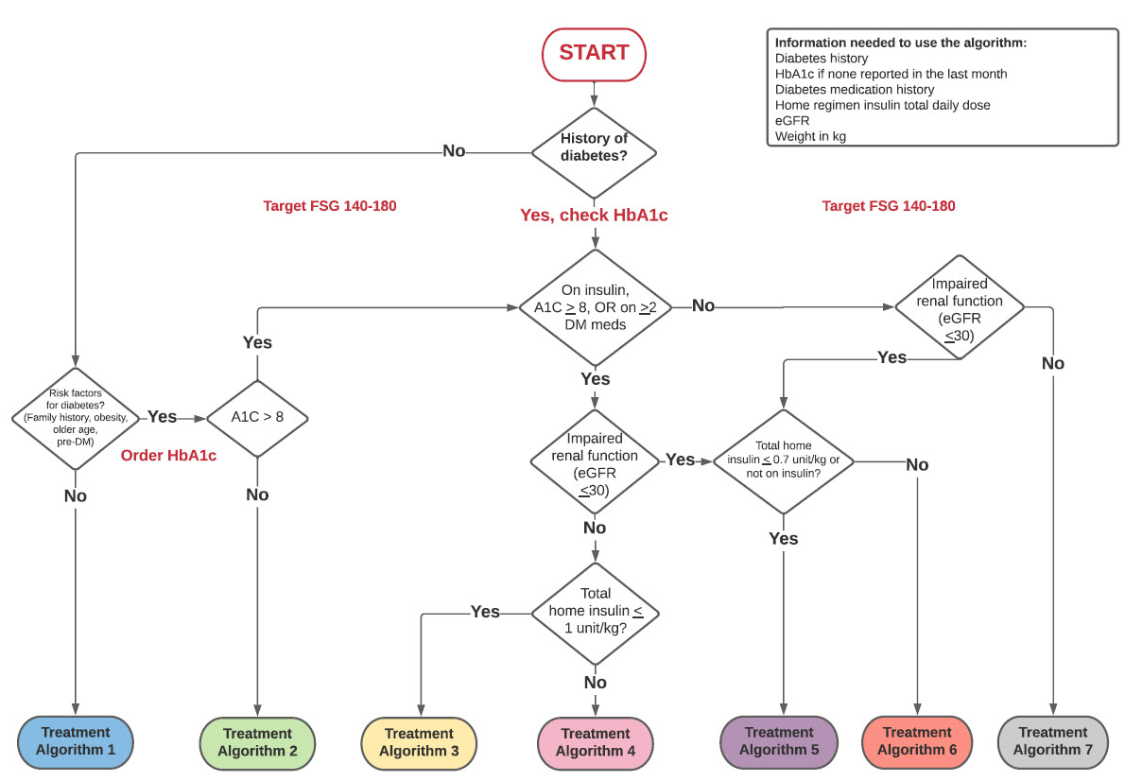
Notes:
Glucose targets were based on available outcome data in the literature.

Slide 77
Timeline/Methods:
Fall/Winter 2020
Drafted guidance algorithms
Algorithm first piloted on DM consult service. After refinement expanded to a teaching medicine team.
Jan-Feb
2021
February 2021
March 2021
Worked with IT to incorporate algorithms in Epic.
Presented to Hospital QI committee.
Began outreach to medicine teams.
April 2021
June- Aug 2021
Chart review and data analysis
Sept 2021
Notes:
Treatment guidance documents developed by Division of Endocrinology diabetologists in conjunction with Hospital Medicine, Geriatrics
Treatment guidance is based on existing ADA standard of care for hospitalized patients with diabetes/hyperglycemia as well as expert opinion on insulin dosing in the setting of steroids

Slide 78
Timeline/Methods:
November 2021
Obtained IRB approval
Chart review:
HbA1c, glucose values, insulin regimens
Demographics, weight, creatinine, comorbidities
Steroid dosing, other COVID treatments, length of stay
Metrics:
% glucose <180 mg/dL
% glucose >250 mg/dL
Hypoglycemic events (<70 mg/dL)
LOS, mortality
Historical controls data received from DWH.
Matching process → 1:1 matching on age (+/- 3 years), sex, weight (+/- 10%)
December 2021
Complete data acquisition and intergroup statistical analysis.
Manuscript completion.
January 2022
Revision of algorithm based on results.
Expanding protocol use for other inpatients requiring prolonged steroid treatment
Next steps
Notes:
Treatment guidance documents developed by Division of Endocrinology diabetologists in conjunction with Hospital Medicine, Geriatrics
Treatment guidance is based on existing ADA standard of care for hospitalized patients with diabetes/hyperglycemia as well as expert opinion on insulin dosing in the setting of steroids

Slide 79
Table 1 | Variable | Pre-Protocol | Post-Protocol
 | Number | 53 | 65
 | Patient admission dates | 04/2020-03/2021 | 04/2021-12/2021
Demographics | Median age (IQR) | 73 (57-80) | 70 (57-79)
 | Male sex (%) | 28 (52.3) | 35 (53.8)
 | Median BMI (IQR) | 27.18 (24.5-32.3) | 29.3 (24.1-32.6)
 | Hx of Diabetes (%) | 43 (81.1) | 54 (83)
 | Median A1c % (IQR) | 7.8 (6.6-9.3) | 7.4 (6.3-8.9)
 | Insulin users (%) | 17 (32.1) | 15 (23)
 | Median weight (IQR) | 77.6 (66.2-92.9) | 78.4 (66.6-94.8)
 | Median admission Creatinine | 1.2 (0.7-1.9) | 0.9 (0.7-1.2)
 | Steroids administered (%) | 53 (100) | 65 (100)
Insurance | Medicaid (%) | 11 (20.8) | 10 (15.4)
 | Medicare (%) | 25 (47.2) | 36 (55.4)
 | Commercial (%) | 12 (22.6) | 16 (24.6)
 | Unknown (%) | 5 (9.4) | 3 (4.6)
Race | African American (%) | 10 (18.9) | 26 (40)
 | White (%) | 17 (32.1) | 10 (15.4)
 | Hispanic (%) | 17 (32.1) | 20 (30.8)
 | Other (%) | 9 (17) | 9 (13.8)
Pre protocol patient data analysis still ongoing

Slide 80
Clinical Metrics
Table 2 | Pre Protocol | Post Protocol
Overall Median POC Glucose per group (mg/dl) (IQR) | 215.9 (181-250.7) | 212.7 (169.1-255.9)
Overall Mean POC Glucose Euglycemic <=180 mg/dl (%) | 12 (22.6) | 25 (38.5)
Overall Mean POC Glucose >180 mg/dl and <= 250 mg/dl (%) | 27 (50.9) | 22 (33.8)
Overall Mean POC Glucose Hyperglycemic>250 mg/dl (%) | 14 (26.4) | 18 (27.7)
Total number of hypoglycemic (<70mg/dl) events | 15.0 | 7.0
Patients with Hypoglycemic Events <70mg/dl (%) | 7 (13.2) | 7 (10.8)
Median LOS (IQR) | 12 (5-24) | 10.5 (6-17.5)
Mortality (%) | 14 (26.4) | 11 (16.9)

Slide 81
Timeline/Methods:
November 2021
Obtained IRB approval
Chart review:
HbA1c, glucose values, insulin regimens
Demographics, weight, creatinine, comorbidities
Steroid dosing, other COVID treatments, length of stay
Metrics:
% glucose <180 mg/dL
% glucose >250 mg/dL
Hypoglycemic events (<70 mg/dL)
LOS, mortality
Historical pre protocol patient data received from DWH.
Matching process → 1:1 matching on age (+/- 3 years), sex, weight (+/- 10%)
December 2021
Complete data acquisition and intergroup statistical analysis.
Manuscript completion.
January 2022
Consider revision of algorithm based on results.
Expanding protocol use for other inpatients requiring prolonged steroid treatment
Next steps
Notes:
Treatment guidance documents developed by Division of Endocrinology diabetologists in conjunction with Hospital Medicine, Geriatrics
Treatment guidance is based on existing ADA standard of care for hospitalized patients with diabetes/hyperglycemia as well as expert opinion on insulin dosing in the setting of steroids

Slide 82
QI Adult Centers Network Performance
Monthly Collaborative Call
1/25/22
Notes:
I will share an overview of quarterly data

Slide 83
14 adult clinics – caring for 19,500+ patients with T1D

Slide 84
Adult T1D Glycemia Targets KDD
Aim
Primary Drivers
Change Ideas
Health Literacy/ Education and Support
Patient Education on diet, exercise and device use
Support “emerging adults” (18-26) with continued “transition” education for disease management
Education to reduce DKA events/admission, 4X glucose check education
Set small patient- and provider-selected goals with clear action step
Peer support groups, new onset classes, technology literacy
Among people with T1D,* increase proportion of patients achieving glycemic targets:
At least 25% with A1c <8%, OR
Increase proportion of patients <8% by 5%, OR
Increase TIR among CGM users by 5%
from baseline in 2 years
Use of Data
Use data registries to support population health
Use EMR templates
Incorporate QI measures or flow sheets
Culturally Competent Care (offering education/materials in appropriate languages, etc.
Catalogue of community resources, Train staff about SDOH
Documenting barriers to care (housing, transportation, food etc.)
Social Determinant of Health
Case management, follow up for patients not reaching target goals for BG, LDL, BP
Self-management
Health education for diabetes complications
Screening for diabetes complications and comorbidities and referring to subspecialists/care as appropriate
Diabetes comorbidities and complications
Medication management and device use
Insulin monitoring/nutrition interactions
Coach >4 checks/day (for non CGM patients)
Test new workflows to improve device use/device documentation
Device data reviews, staff troubleshoot device
Advertise CGM in waiting rooms, etc.
Provide contact information for device reps/patient support
Access to care
Follow up with LTFU patients (not seen for > 180 days); regular follow up (phone/email/text/televisit)
Improve scheduling process
Preparing patients for telehealth visits (“pre-visit visit”)
Psychosocial Support
Conduct mental health screening and referrals (i.e. depression, FOH, diabetes distress)
Improve psychosocial support
MyChart message for questionnaires, PROs, high-risk patients
Create workflow for positive patients who needs referral
Screen for QOL (compare control of people using CGM vs no CGM)
*Duration > 1 year, ages 18-75, with at least one in-person or telemedicine visit in the last year
Notes:
This KDD summarizes the theoretical, of what we believed would be key primary drivers and change ideas to meet our collaborative aim. In our next call, we will share a streamlined version of the KDD that displays our collective action, showcasing the change ideas that we have implemented (a shift from theoretical to actual).

Slide 85
Data and T1D Exchange

Slide 86
Data and the T1D Exchange
Data Mapping
Typically led by IT team, process to map against T1Dx data specifications resulting in access to the full QI portal and contribution to population health research.
Smartsheets
Temporary data sharing solution (prior to site completing data mapping) where site shares aggregate data to produce dashboards; allows sites the benefit of benchmarking and identifying shifts and trends over time.
Special Initiatives
Modify/use an existing data collection tool to support a temporary project (i.e. COVID-19 or telemedicine)
Notes:
There are two ways that we receive data from your sites. The main way is through the completed data mapping process. The second way is by reporting on Smartsheets. Once a site completes data mapping, you will have access to the QI Portal and we will complete the Smartsheet on your behalf. There are currently two adult sites that have completed data mapping, SUNY and BDC. All other sites are in the process of data mapping and need to report measures on Smartsheets.

Slide 87
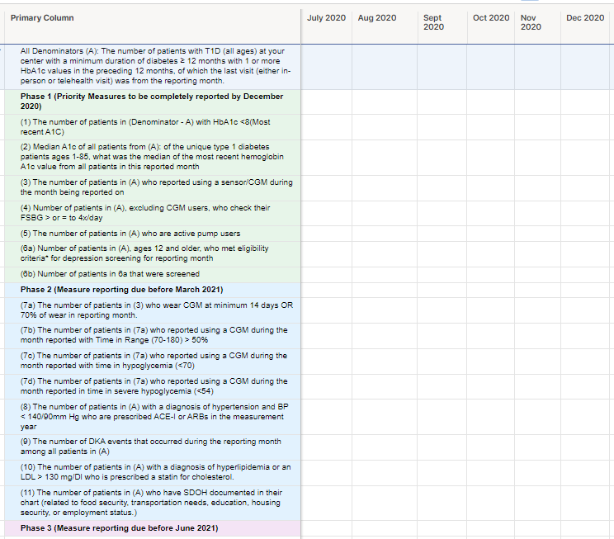
Smartsheets

Slide 88
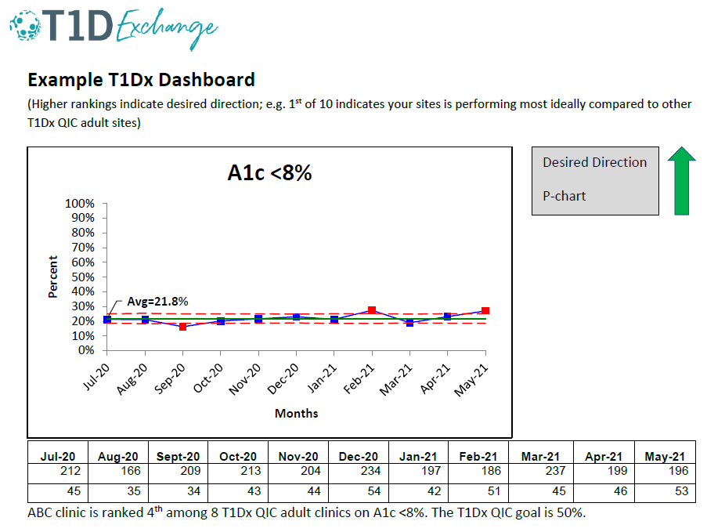
Clinic-specific Dashboards

Slide 89
Data Mapping Process

Slide 90
Data Mapping Progress – adult clinics as of 1/18/22
Notes:
While we have two sites that have completed data mapping, as they will tell you ☺ the work doesn’t end because we hold ongoing data validation as we identify opportunities for improvement or update our data specs to refine our measures

Slide 91
2020-2021 Data Overview

Slide 92
Core QI Measures – Adult clinics July 2020 – June 2022
Measures reported as of Nov 2021 | Measure | # of adult clinics reporting
Outcome Measures | HbA1c < 8% | 7 (53.8%)
 | Median A1c | 6 (46.2%)
Process Measures | CGM use | 7 (53.8%)
 | Pump use | 6 (46.2%)
 | Depression screening | 3 (23.1%)
 | DKA events | 4 (30.8%)
 | Time in Range | 1 (7.1%)
 | Social Determinants of Health screening | 3 (23.1%)
Notes:
Statin/ACE/ARB may be in information being provided but we are not able to access it currently; having conversations with SUNY to revalidate some information from medication file so we can use this information
BDC
Ask when do they think could provide TIR data

Slide 93
Notes:
We are sharing this with clinics names, rank, and percentages revealed to support in our mission as a learning network. When we share information externally, we remove clinic names (as we did, for example, in a few ADA abstracts submitted looking at benchmarking pump and CGM use).

Slide 94
Adult Clinics - HbA1c < 8%
Lahey-P chart favorable direction
 | 2020 |  |  |  |  |  | 2021
 | Jul | Aug | Sept | Oct | Nov | Dec | Jan | Feb | Mar | Apr | May | Jun | Jul | Aug | Sept | Oct | Nov
T1D Population | 899 | 834 | 815 | 892 | 730 | 721 | 577 | 582 | 580 | 703 | 712 | 688 | 723 | 681 | 637 | 602 | 527
A1c >8% | 525 | 545 | 522 | 577 | 459 | 457 | 386 | 394 | 390 | 482 | 472 | 461 | 497 | 428 | 407 | 379 | 346
Notes:
We’ve seen a slight but significant increase in the % of patients with A1c <8%.

Slide 95
Adult Clinics - HbA1c < 8% Summary
QI Collaborative Goal: 50%
QI Collaborative Average: 63%
Sites that meet goal: 2/7
Top performers:
BDC, 72%;
SUNY, 54%
Improvement Range: 23%
Available data | No data
BDC | Albert Einstein
BMC | Mt. Sinai
Grady | Northwestern
Penn | NYU
Stanford | UCSF
SUNY | U of Miami
Wayne
Notes:
We are meeting our collaborative goal, and have over half of the clinics represented.

Slide 96
Adult Clinics - Median A1c
Run chart favorable direction
 | 2020 |  |  |  |  |  | 2021
 | Jul | Aug | Sept | Oct | Nov | Dec | Jan | Feb | Mar | Apr | May | Jun | Jul | Aug | Sept | Oct | Nov
Average median A1c | 7.7 | 7.7 | 7.6 | 7.5 | 7.6 | 7.5 | 7.4 | 7.4 | 7.5 | 7.3 | 7.5 | 7.5 | 7.3 | 8.1 | 8.0 | 8.3 | 7.6

Slide 97
Adult Clinics - Median A1c Summary
QI Collaborative Goal: 8.0%
QI Collaborative Average: 7.9%
Sites that meet goal: 4/6
Top performers:
BDC, 7.2%;
Penn State, 7.5%
Available data | No data
BDC | Albert Einstein
BMC | Mt. Sinai
Grady | Northwestern
Penn | NYU
SUNY | Stanford
Wayne | UCSF
 | U of Miami

Slide 98
Adult Clinics - CGM Use
Lahey-P chart favorable direction
 | 2020 |  |  |  |  |  | 2021
 | Jul | Aug | Sept | Oct | Nov | Dec | Jan | Feb | Mar | Apr | May | Jun | Jul | Aug | Sept | Oct | Nov
T1D Population | 1012 | 935 | 925 | 1006 | 817 | 826 | 649 | 669 | 682 | 800 | 357 | 768 | 806 | 681 | 637 | 602 | 527
CGM users | 439 | 441 | 519 | 565 | 467 | 413 | 397 | 451 | 426 | 397 | 211 | 478 | 469 | 443 | 398 | 362 | 356

Slide 99
Adult Clinics – CGM Use Summary
QI Collaborative Goal: 70%
QI Collaborative Average: 61%
Sites that meet goal: 1/7
Top performers:
Penn State, 83%;
BMC, 68%;
SUNY, 67%
Improvement Range: 19%-36%
Available data | No data
BDC | Albert Einstein
BMC | Mt. Sinai
Grady | Northwestern
Penn | NYU
Stanford | UCSF
SUNY | U of Miami
Wayne

Slide 100
Adult Clinics - Pump Use
Lahey-P chart favorable direction
 | 2020 |  |  |  |  |  | 2021
 | Jul | Aug | Sept | Oct | Nov | Dec | Jan | Feb | Mar | Apr | May | Jun | Jul | Aug | Sept | Oct | Nov
T1D Population | 969 | 883 | 878 | 965 | 776 | 779 | 612 | 619 | 621 | 741 | 294 | 713 | 755 | 624 | 590 | 544 | 473
Pump users | 465 | 419 | 494 | 546 | 393 | 359 | 318 | 356 | 313 | 316 | 149 | 361 | 370 | 344 | 283 | 263 | 230

Slide 101
Adult Clinics – Pump Use Summary
QI Collaborative Goal: 65%
QI Collaborative Average: 45%
Sites that meet goal: 0/6
Top performers:
Penn State, 59%;
Wayne, 56%;
Available data | No data
BDC | Albert Einstein
BMC | Grady
Penn | Mt. Sinai
Stanford | Northwestern
SUNY | NYU
Wayne | UCSF
 | U of Miami

Slide 102
Adult Clinics – Depression Screening
Lahey-P chart favorable direction
 | 2020 |  |  |  |  |  | 2021
 | Jul | Aug | Sept | Oct | Nov | Dec | Jan | Feb | Mar | Apr | May | Jun | Jul | Aug | Sept | Oct | Nov
Eligible for screening | 111 | 117 | 83 | 99 | 71 | 48 | 48 | 43 | 35 | 30 | 37 | 34 | 30 | 111 | 117 | 83 | 99
Received screening | 52 | 66 | 48 | 62 | 39 | 26 | 26 | 24 | 15 | 13 | 14 | 20 | 15 | 52 | 66 | 48 | 62

Slide 103
Adult Clinics – Depression Screening Summary
QI Collaborative Goal: 80%
QI Collaborative Average: 69%
Sites that meet goal: 1/4
Top performers:
SUNY, 88%
Improvement Range: 19%
Available data | No data
BMC | Albert Einstein
Grady | BDC
SUNY | Mt. Sinai
 | Northwestern
 | NYU
 | Penn
 | Stanford
 | UCSF
 | U of Miami
 | Wayne

Slide 104
Adult Clinics – SDOH Screening
Lahey-P chart favorable direction
 | 2020 |  |  |  |  |  | 2021
 | Jul | Aug | Sept | Oct | Nov | Dec | Jan | Feb | Mar | Apr | May | Jun | Jul | Aug | Sept | Oct | Nov
T1D Population | 346 | 348 | 312 | 298 | 241 | 253 | 178 | 132 | 114 | 146 | 158 | 146 | 153 | 180 | 194 | 209 | 217
Received screening | 0 | 11 | 11 | 8 | 12 | 13 | 15 | 19 | 18 | 23 | 16 | 22 | 12 | 50 | 56 | 96 | 132

Slide 105
Adult Clinics – SDOH Screening Summary
QI Collaborative Goal: 10%
QI Collaborative Average: 42%
Sites that meet goal: 3/3
Top performers:
SUNY, 50%;
BMC, 36%;
Grady, 28%
Improvement Range: 50%
Available data | No data
BMC | Albert Einstein
Grady | BDC
SUNY | Mt. Sinai
 | Northwestern
 | NYU
 | Penn
 | Stanford
 | UCSF
 | U of Miami
 | Wayne

Slide 106
Utilizing Data

Slide 107
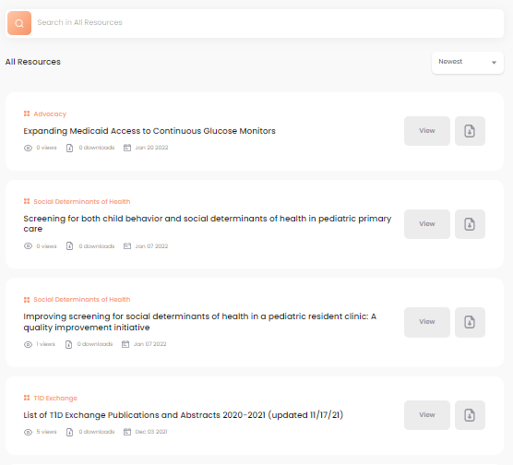
QI Portal
Available for ALL clinics
QI Portal offers benchmarking, charting, and library resources
Notes:
https://qi.t1dplatform.org/auth/login

Slide 108
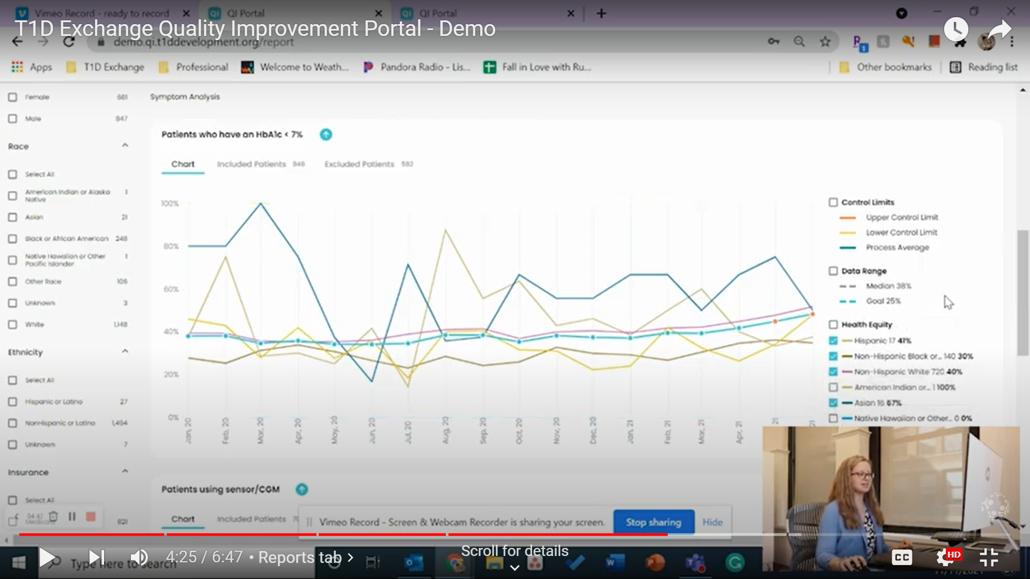
QI Portal Demo Video
Five-minute overview of all four Portal tabs. Or, select tab “chapters” for a quick refresher on a specific feature
https://www.youtube.com/watch?v=iZCe48_MtsE
Notes:
https://www.youtube.com/watch?v=iZCe48_MtsE

Slide 109
Adult Clinic Insights
Past (✔) and Current ( ) Adult QI Projects
 | BDC | SUNY | Stanford | Penn | Wayne | Miami | NYU | Grady | Albert Einstein | UCSF | BMC | Mt. Sinai | Northwestern
A1c |  | ✔ |  | ✔
CGM
Pump
Depression Screening |  |  |  | ✔
SDOH Screening |  |  |  | ✔
Health Equity in devices
Data/ Infrastructure

Slide 110
Resources Available
Monthly Collaborative Calls
Coaching Calls with Ori/Ann
QI Portal and Dashboards
IHI Open School Courses
PDSA cycle documentation in LifeQI
T1Dx QIC Trello page
Case Studies and Change Packages

Slide 111
Recommendations for next 1/2 year (through June 2022)
If not already, identify a QI project for the next 4-6 months
If not already, provide Phase 1 measures
If collecting Phase 1, begin collection on Phase 2 measures
Utilize the QI Portal for data trending, benchmarking, and creating notifications, and resources
Take IHI Open School courses
Document PDSAs in LifeQI
Engage other faculty members in your improvement efforts by discussing/sharing these insights
Consider submitting an abstract for your improvement work
Notes:
# of sites not providing any data, don’t have to provide everything on Smartsheet. Prioritize phase 1

Slide 112
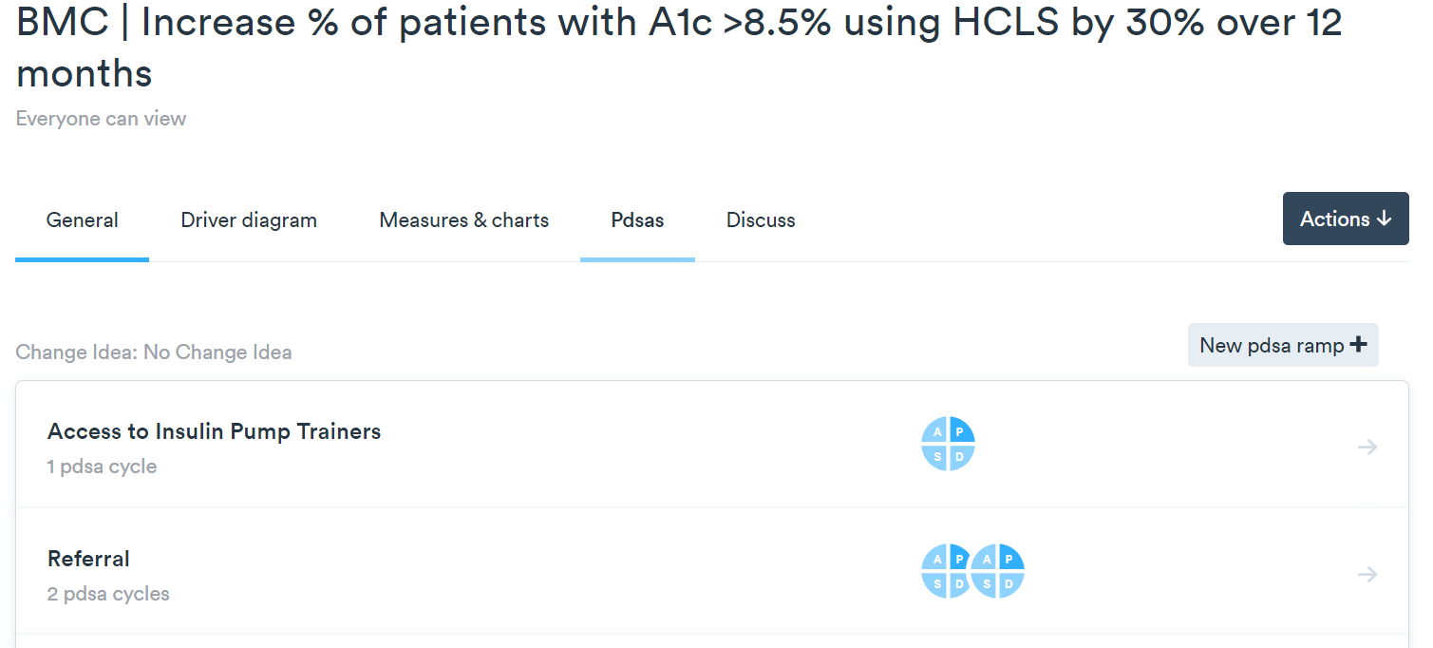

Slide 114
Next Adult Collaborative Call (combo with peds!)
Thursday March 24th, 11:00-12:30 PM EST

Slide 115
Questions from the Collaborative

