Slide 1
Data Governance Committee September 8, 2020

Slide 2
Current Members – Caring for over 30,000 patients with T1D

Slide 3
Clinical Leadership
Barbara Davis Center, Sarit Polsky MD & Todd Alonso MD | Penn Medicine, Ilona Lorincz MD
Le Bonheur Children’s, Ahlee Kim MD | Rady Children’s, Carla Demeterco Berggren MD
Children’s Mercy Hospital, Mark Clements MD, PhD | Seattle Children’s Hospital, Faisal Malik MD, MSHS
Children’s Hospital Los Angeles Brian Miyazaki, MD | Spectrum Health, Helen DeVos, Jose Jimenez Vega MD
Cincinnati Children’s Hospital Medical Center, Sarah Corathers MD | Stanford University Marina Basina MD & Priya Prahalad MD
Cook Children’s Paul Thornton, MD | SUNY, Pediatrics and Adult, Ruth Weinstock MD PhD Roberto Izquierdo MD
University of Michigan, Mott Children’s, Joyce Lee MD | Texas Children’s, Daniel DeSalvo MD
Nationwide Children’s, Manu Kamboj MD | University of Florida, Anastasia Albanese-O'Neill PhD, APRN, CDE
NYU Langone, Lauren Golden MD & Mary Pat Gallagher MD | University of Miami, Francesco Vendrame, M.D. Ph.D. & Janine Sanchez MD
 | Wayne State University, Berhane Seyoum MD

Slide 4
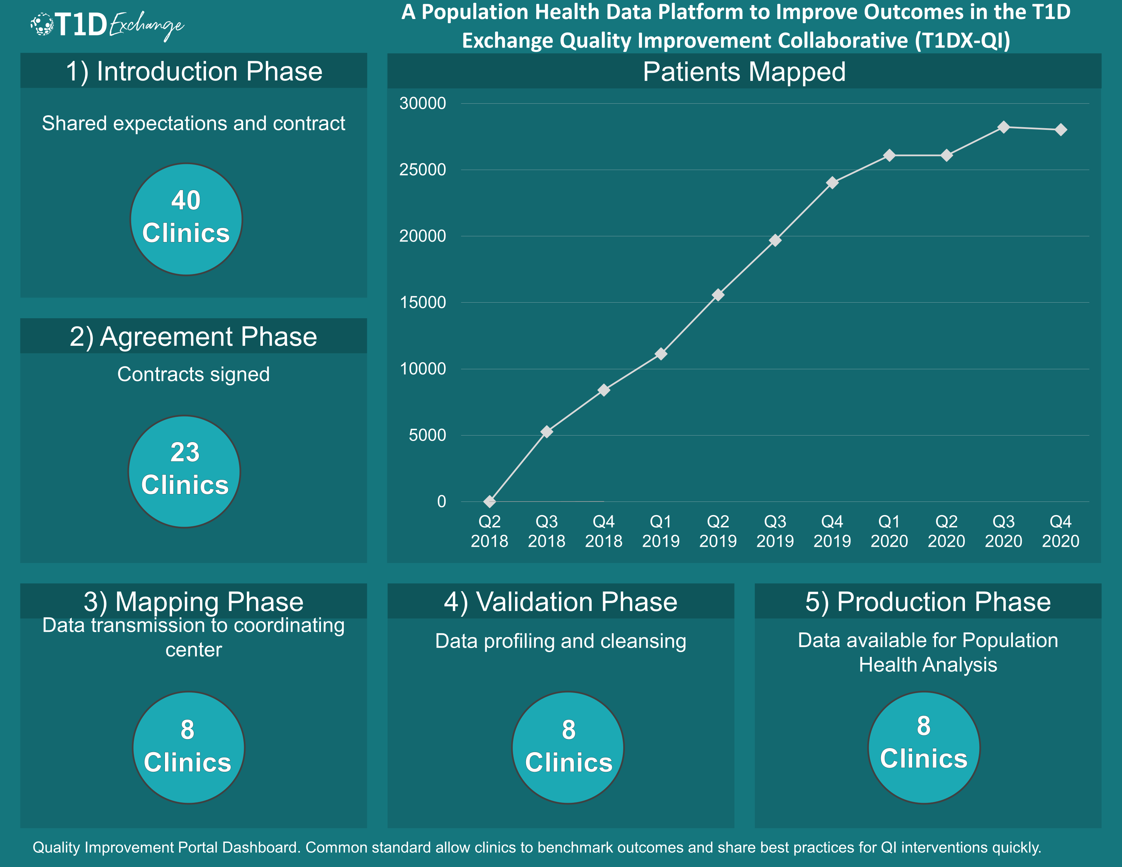

Slide 5
Data Governance Committee Purpose
The T1D Exchange QI Collaborative Data Governance Committee shall guide optimization of the use of healthcare data generated by the QI Collaborative for clinical outcome improvements.
This data asset requires oversight and coordination to insure they are managed appropriately, both in pursuit of our mission and aims and with respect to ethical and regulatory compliance in their uses.

Slide 6
Quality Improvement Process
Decision Making

Slide 7
Decision Making and documentation
Decision making is reserved to QI Collaborative members that have data mapped to the Portal (currently 8 hospitals, including: BDC, CMH, SUNY, NCH, TCH, and CCHMC). This number will increase over time.
All QI Collaborative members are invited to participate in this Committee to understand Data Governance processes and decisions.
Meetings, charters, minutes, slides, and diagrams can be accessed on Trello

Slide 8
Dexcom sponsored project

Slide 9
Rt vs Flash CGM project
Analysis supported by Dexcom

Slide 10
Project aims
Examine patient and clinical factors among CGM device users versus CGM non-users
Examine patient and clinical factors among CGM device users by insulin delivery methods
Describe clinical attributes for the rt-CGM and is-CGM cohorts before and after CGM use initiation
Is there a difference in HbA1c levels between CGM device before and after CGM use initiation in a sub-population of patients with baseline HbA1c levels >9%?
Is there a difference in pre-CGM HbA1c and post-CGM HbA1c categories for each of the two CGM device groups?

Slide 11
Summary of findings
Table 1: Patient characteristics in the T1DX-QI Cohort by CGM device users versus non CGM users (N=11,472)
 | CGM Users (N=5486) | CGM Non-Users (N=5986)
 | N (%) | N (%)
Mean Age (SD) in years* | 24 [16] | 21 [13]
Age Categories*
2-12 | 1142 (21) | 1061 (18)
13-26 | 2631 (48) | 3956 (66)
27-55 | 1339 (24) | 683 (11)
55+ | 371 (7) | 286 (5)
Gender*
Male | 2671(49) | 3138(52)
Female | 2812 (51) | 2842(48)
 | CGM Users (N=5486) | CGM Non-Users (N=5986)
 | N (%) | N (%)
Race/ethnicity*
Non-Hispanic White | 4105 (75) | 4193 (70)
Non-Hispanic Black | 123 (2) | 570 (10)
Hispanic | 420 (8) | 675 (11)
Others | 835 (15) | 548 (9)
Insurance*
Public | 1092 (20) | 2187 (37)
Private | 4215 (77) | 3154 (53)
Others/Unknown | 176 (3) | 645 (11)
Mean HbA1c [Sd] | 8.0 [1.7] | 8.8[2.1]
*P<0.0001

Slide 12
Summary of findings
Table 2: Patient characteristics in the T1DX-QI Cohort by type of CGM users (N=8,227)
 | rt-CGM (N=5278) | is-CGM (N=319) | Unknown (N=2630)
Mean Age (SD) * | 22.7 (16) | 30(19) | 21 (13)
Age* -no. (%)
2-12 | 1425 (27) | 34 (11) | 569 (22)
13-26 | 2372 (45) | 145 (46) | 1522 (58)
27-55 | 1125 (21) | 87 (27) | 465 (18)
55+ | 349 (7) | 53 (16) | 74 (2)
Gender –no. (%)
Male | 2610 (51) | 178 (56) | 1327 (51)
Female | 2668 (49) | 141 (44) | 1303 (49)
 | rt-CGM (N=5278) | is-CGM (N=319) | Unknown (N=2630)
Race/ethnicity* -no. (%)
Non-Hispanic White | 4166 (79) | 279 (87) | 1901 (73)
Non-Hispanic Black | 105 (2) | 17 (5) | 155 (6)
Hispanic | 331 (3) | 7 (2) | 246 (9)
Others | 676 (12) | 16 (5) | 328 (12)
Insurance* -no. (%)
Public | 615 (5) | 17 (6) | 765 (29)
Private | 4011 (32) | 103 (32) | 1856 (70)
Others/Unknown | 652 (62) | 199 (62) | 9 (1)
Insulin Pump Users*-no. (%) | 53 (68) | 69 (22) | 1351 (51)
MDI Users* -no. (%) | 1114 (24) | 92(62) | 988 (43)
*P<0.0001

Slide 13
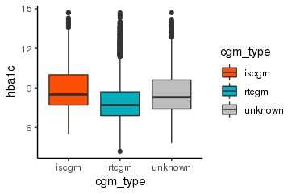
Summary of findings
Table 3: Clinical outcomes in the T1D Exchange QI Cohort by type of CGM device users
 | rt-CGM (N=5278) | is-CGM (N=319) | Unknown (N=2630)
Primary Outcome
Mean HbA1c [SD]*,% | 8.1 [1.6] | 8.9 [1.9] | 8.6 [1.8]
Median HbA1c [IQR]*,% | 7.7 [1.8] | 8.5 [2.3] | 8.3 [2.2]
SH -n(%) | 525 (10) | 59 (18) | 688 (6)
DKA -n(%) | 102 (2) | 15 (5) | 632 (6)
*p<0.001, Kruskal Wallis
-HbA1c report within a year of CGM start

Slide 14
Ongoing work: Abstract submission for ATTD
Proposal 1: Continuous Glucose Monitoring (CGM) versus Self-monitoring of blood glucose: Patient demographics and clinical profiles from a U.S. based multi-center observational study
Proposal 2: Clinical outcomes among patients with type 1 diabetes using real-time continuous glucose monitors versus intermittent scanning device: A multi-center cross-sectional study in the U.S.

Slide 15
Glycemic Control Project
Potential analysis supported by Vertex

Slide 16
Overview
The proposal involves conducting a pilot project using Type 1 Diabetes data assets→ The primary goal of this project is to estimate the proportion of Type 1 Diabetes patients that are poorly controlled on their current treatment in:
A. Patients overall
B. Patients with a continuous glucose monitor (CGM)
C. Patients with a history of a kidney transplant.

Slide 17
Questions of interest (Information available)
What proportion of adult T1D patients visit their endocrinologist 3 or more times per year?
A - Among those, what proportion either: A. have a continuous glucose monitor or B. Check their glucose at least 3 times per day?
B - HbA1c, and proportion of patients with HbA1c levels greater than or equal to 7%, 7.5%, 8% and 9%
C- Number of severe hypoglycemic events (SHEs) per year, and proportion of patients with at least 1 SHE per year
D- A-C stratified by CGM/insulin pump type
E- Patient socio-demographics (age, race/ethnicity, Region, BMI, Insurance status)

Slide 18
Questions of interest (Information unavailable)
What is the distribution of the measures below in adult T1D patients both A. overall and B. within the context of the other measures:
a. C-peptide, and proportion of patients with undetectable levels of C-peptide
b. Time spent with blood glucose <54 mg/dL and proportion of patients that spend ≥5% of time <54 mg/dL
c. Time spent in range (i.e., blood glucose 70-180 mg/dL) and proportion of patients that spend ≥70% of time in range
d. Time spent above 180 mg/dL and 250 mg/dL, and proportion of patients that spend ≥25% of time >180 mg/dL or ≥5% of time >250 mg/dL
e. Blood glucose coefficient of variation and proportion of patients with a coefficient of variation over each 33% and 36%
f. How transient are patients in (hypoglycemic) states

Slide 19
Questions

