Slide 1

Friday, March 26 2021

Slide 2
Webinar Agenda
• Welcome/Announcement – Dr. Osagie Ebekozien
• Device Use and COVID Outcomes in T1D Patients – Dr. Nudrat Noor
• Harold Hamm Diabetes Center, Oklahoma clinical experience – Dr. David Sparling (15 mins, 5 mins Q/A)
• Northwestern University, Chicago clinical experience – Dr. Grazia Aleppo (15 mins, 5 mins Q/A)

Slide 3
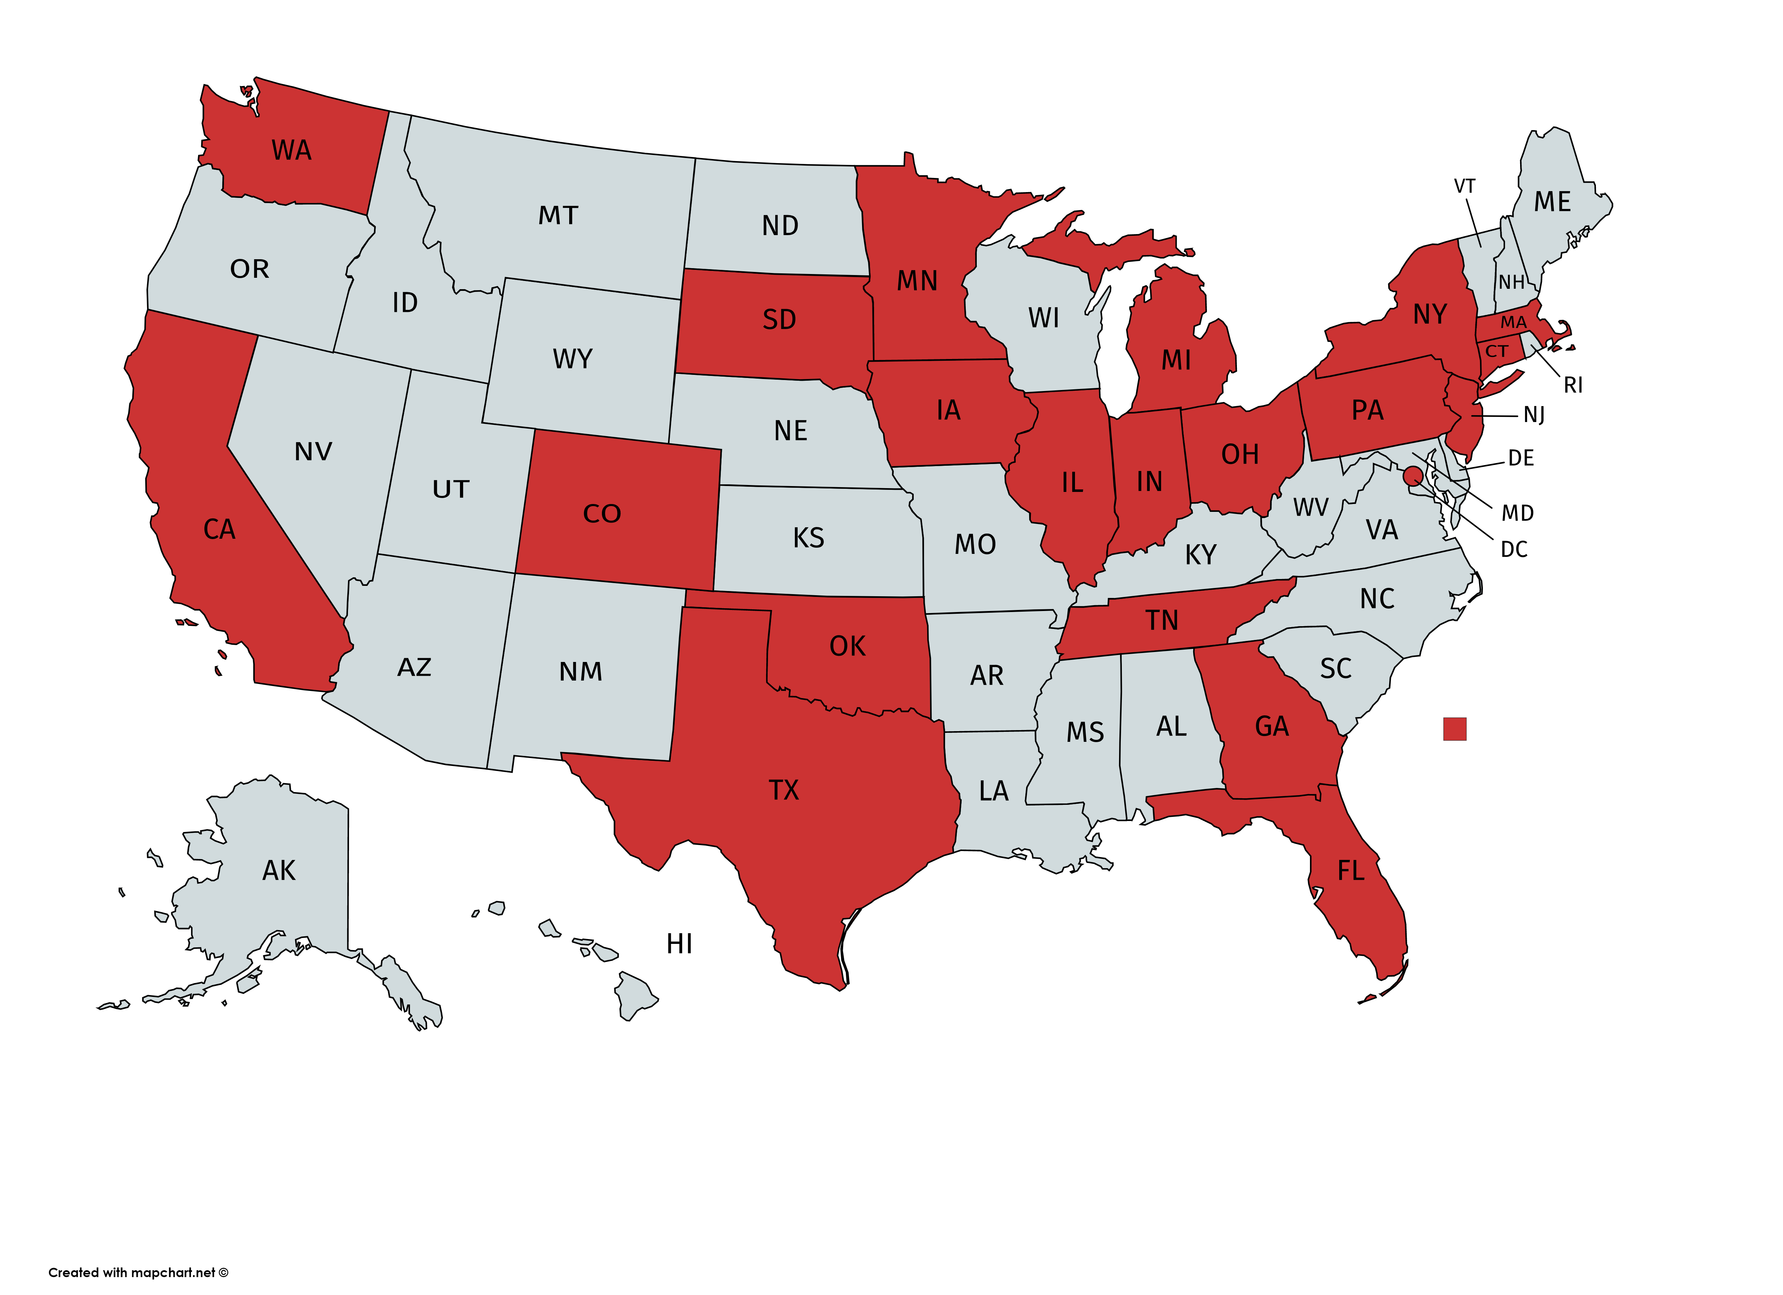
1000+ (850+ Confirmed COVID) Submitted Cases from 24 U.S States as of 3/26/2021
56 Contributing Centers
65% of confirmed cases are Pediatric patients (less than 19 years)
Notes:
Update

Slide 4
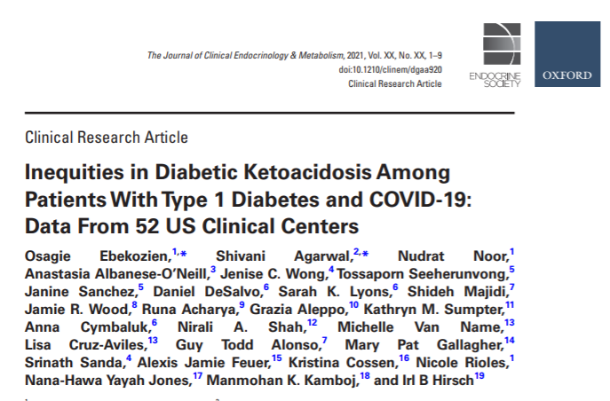

Slide 5
Coordinating Center Update
Four publications in process
        Hospitalization in Pediatric patients (Alonso et al)
        Diabetes Technology Use and COVID outcome (Noor et al)
        Early vs Late Surge (Gallagher et al)
        Age based hospitalization risk stratification (Demeterco-Berggren et al)
T1D and T2D Cerner Database Authorship work group and analysis plan
DKA and New Onset 2019 and 2020 Trend Analysis, author group interest email next week.
We will continue monthly update via emails and additional opportunities until June 2021
Questions/suggestions/comments, please email qi@t1dexchange.org

Slide 6



COVID Study Updates
Last Webinar on this project Today. The registry will remain open until June 30, 2021, so please continue to contribute relevant cases.
Notes:
Join Webinar by web
https://t1dexchange.webex.com/join/qi
Join Webinar by phone
1-240-454-0879 USA Toll
Access code: 736 275 337

Slide 7
Diabetes Technology Use for management of type 1 diabetes (T1D) is associated with fewer adverse COVID-19 outcomes
Data source: T1D Exchange COVID-19 Surveillance Registry

Slide 8
Background
People with COVID-19 and type 1 diabetes (T1D) are at high risk of diabetes-related outcomes such as diabetic ketoacidosis (DKA) and hospitalization. For people with elevated glucose levels, infections could further exacerbate the risk of acute complications.
As part of the management of T1D, the use of diabetes technology including continuous glucose monitors (CGM) and insulin pumps is recommended to improve glycemic control.
However, despite increasing evidence of the benefits of diabetes technology its uptake remains low, in part owing to systemic racism and social inequities
Aim: Examine the frequency of adverse outcomes across categories of diabetes technology use

Slide 9
Methods
This analysis included 447 people with T1D and a confirmed COVID-19 infection during March 2020-Dec 2020.
Patients were grouped into four categories of diabetes technology use;
  'No device use': patients who did not report using a CGM or insulin pump device;
  'CGM use' including all patients currently using a CGM device, regardless of insulin pump use;
  'Insulin pump use' including all patients currently using insulin pump, regardless of CGM device;
  'CGM and Insulin pump use' including patients who reported using a CGM in combination with an insulin pump.
Adverse outcomes: Hospitalization, DKA, severe hypoglycemia, or death

Slide 10
Results
Table 1: Distribution of patient factors and adverse outcomes among T1D patients tested positive for COVID-19 across diabetes device users and nonusers
 | No Device Use N=181 | CGM Use N=241 | Insulin Pump Use N=183 | CGM + Insulin Pump Use N=158
Mean age (SD), years | 24 (17) | 21 (13) | 22 (13) | 21 (13)
Insurance Status—N(%) -Private -Public | 55 (30) 126 (70) | 162 (67) 79 (33) | 135 (74) 48 (26) | 117 (74) 41 (26)
Race/ethnicity—N(%) ^{a,b,c} -NH White -NH Black -Hispanic -Other | 59 (33) 59 (33) 54 (30) 9 (4) | 162 (67) 24 (10) 39 (16) 16 (7) | 136 (74) 14 (8) 27 (15) 6 (3) | 119 (75) 9 (6) 24 (15) 6 (4)
Mean A1c (%) | 10.2 (2.8) | 8.4 (2.8) | 8.1 (2.8) | 8.0 (2.7)
Outcomes—N(%)
-Hospitalization ^{a,b,c} | 110 (59) | 34 (18) | 22 (12) | 19 (10)
-DKA ^{a,b,c} | 65 (35) | 18 (18) | 10 (10) | 7 (7)
ª Chi-square test (p<0.05) CGM use vs. No device use; ^{b} Chi-square test (p<0.05) Insulin pump use vs. No device us; ^{c} Chi-square test (p<0.05) CGM + pump use vs. No device use
Figure 1: Distribution of adverse outcomes among categories of diabetes technology use
% Adverse Outcomes

Slide 11
Results
Table 2: Adjusted Odds Ratios for adverse outcomes of COVID-19 in T1D patients using diabetes technology compared with technology non-users
 | No Device Use | CGM Use | Pump Use | CGM + Insulin Pump use
 | OR (95% CI) | OR (95% CI) | OR (95% CI) | OR (95% CI)
Hospitalization | 4.0 (2.7-5.9) | 0.2(0.1-0.4) | 0.3 (0.2-0.4) | 0.3(0.2-0.4)
DKA | 3.8 (2.3-6.4) | 0.2 (0.1-0.4) | 0.2 (0.1-0.4) | 0.2 (0.08-0.3)
* Adjusted for age, gender, insurance status and race/ethnicity
Figure 2: Distribution of DKA by race/ethnicity across categories of diabetes technology use
% DKA

Slide 12
Summary
This study provides additional evidence supporting the benefits of diabetes technology to optimize glycemic control.
Our findings demonstrate that glycemic management with technology is associated with a lower risk of adverse outcomes during COVID-19 infection
This study further confirms the known existence of racial disparities in the utilization of diabetes technology.

Slide 13

Pediatric COVID-19 and Type 1 Diabetes Experience in Oklahoma
David Sparling, M.D., Ph.D., Section of Pediatric Diabetes and Endocrinology
March 26, 2021

Slide 14
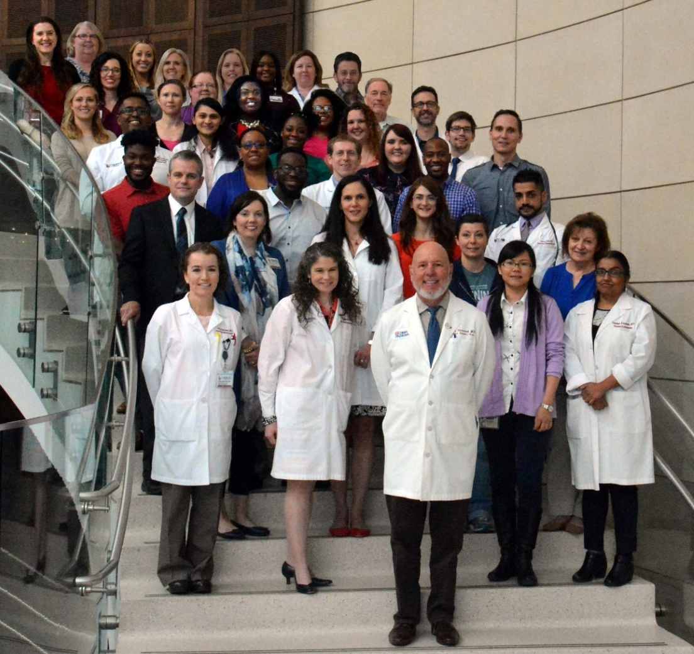
Section of Pediatric Diabetes and Endocrinology
ADA-accredited diabetes program, the diabetes team focuses on the education and care of children with diabetes, including type 1, type 2, Cystic Fibrosis-related, genetic or secondary diabetes, and those transitioning to adult diabetes care (Wavelengths).
Our clinics are located in the OU Children's Physician's Building on the OU Health Center campus, and in several satellite clinics at Mercy Hospital, the Children's Center in Bethany, and Native American clinics in Ada, Ardmore, Durant, and Talihina.
Have been very active in TrialNet, TODAY, T1DEx, along with a variety of diabetes clinical trials.

Slide 15
Section facts
Practitioners: Steven Chernausek, M.D., Section Chief
7 MD practitioners, with a variety of clinical loads
2 APRN’s, 1 fellow
Clinical Programs Director: Joni Beck, Pharm.D.
4 CDCES
2 PENS
RN Clinical Research Coordinator
Clinic Staff: RN Clinic Manager, with 9 staffers
Behavioral Health specialist
Metabolic Research Program: 3 Ph.D. researchers, 6 staffers

Slide 16
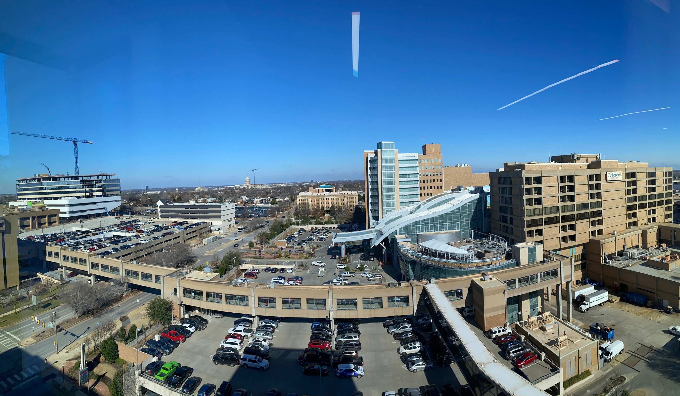
Oklahoma Children’s Hospital
Oklahoma City, OK

Slide 17
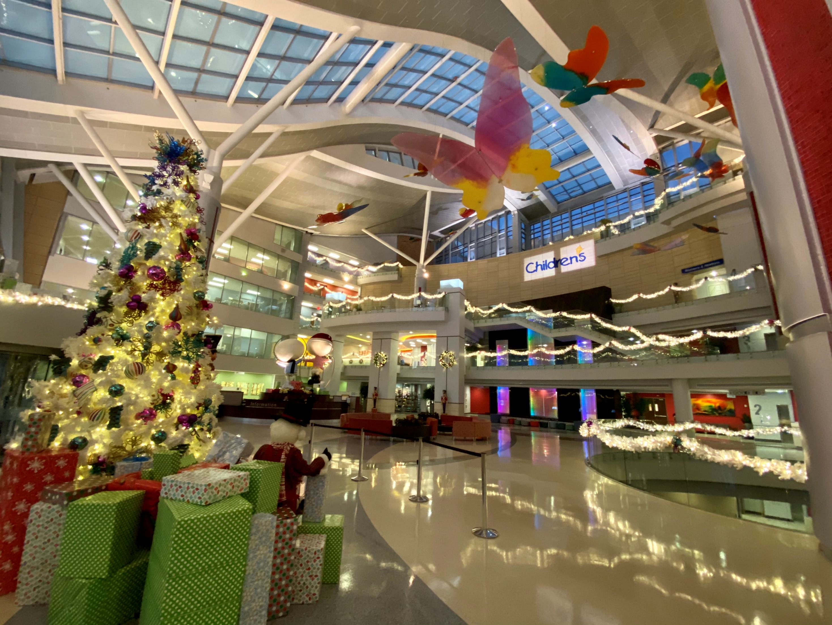
Oklahoma Children’s Hospital
Oklahoma City, OK

Slide 18
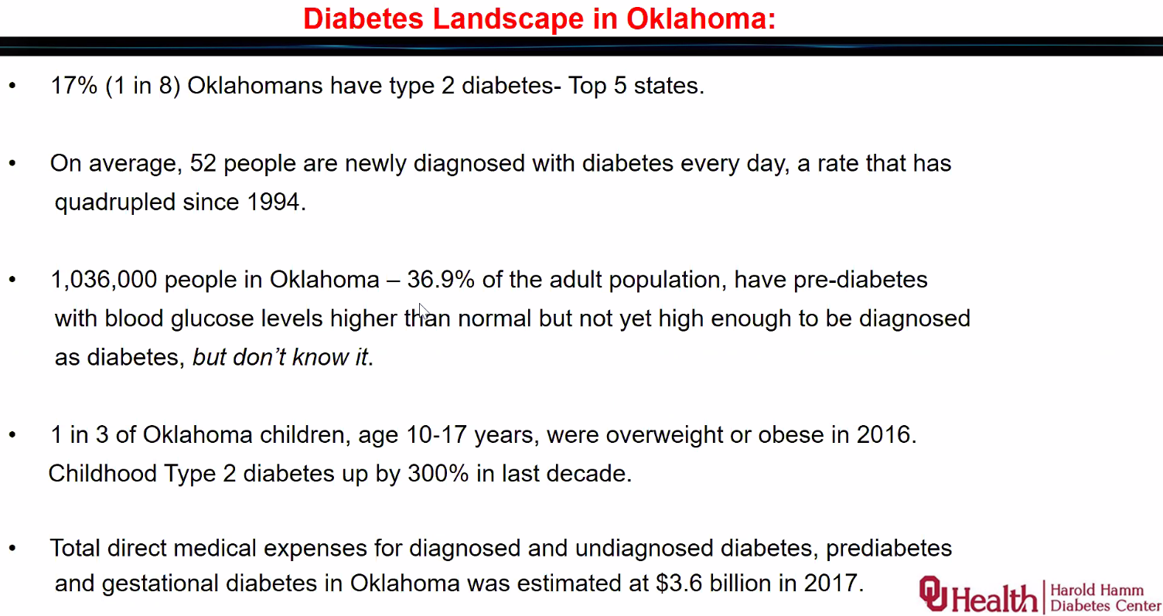

Slide 19
Pediatric diabetes care in OKC
Roughly 850 patients with direct care for T1D in our section in 2020 (Oklahoma City and associated clinics)
Slightly above 1,000 if including pediatric T2D patients, CFRD, etc
Wide patient base
675 with Soonercare (Medicaid), up to age 19.
Full access to diabetes tech
~50% of all T1D patients on pumps
~70% on CGM
Soonercare started covering Dexcom in Jan. 2020
Choctaw Nation: Libre easily available

Slide 20
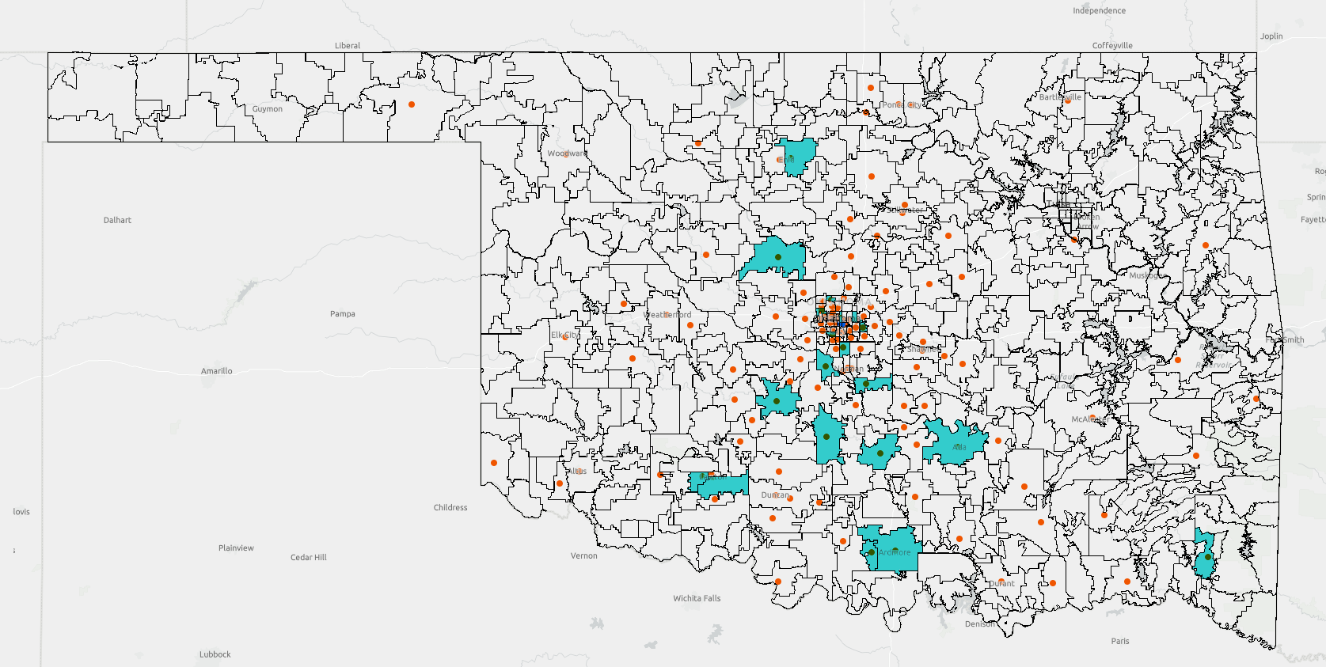
Landscape prior to COVID-19
● | Zip code with any DKA admission
■ | Zip code with a readmitted new-onset patient
● | OU Children’s Hospital
DKA admissions, 2015-2019
Courtesy of Chris Sebastian, MD

Slide 21
COVID-19
Christmas
School + fall sports + Labor Day
Thanksgiving
Phase 3 reopening statewide
Outbreak in NW Oklahoma
4th of July
Thank you healthcare workers flyover of OKC

Slide 22
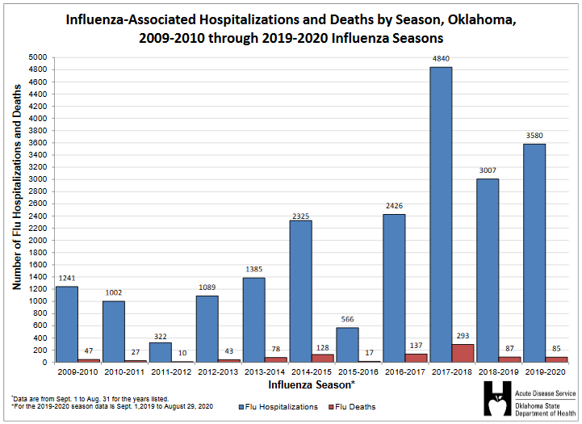
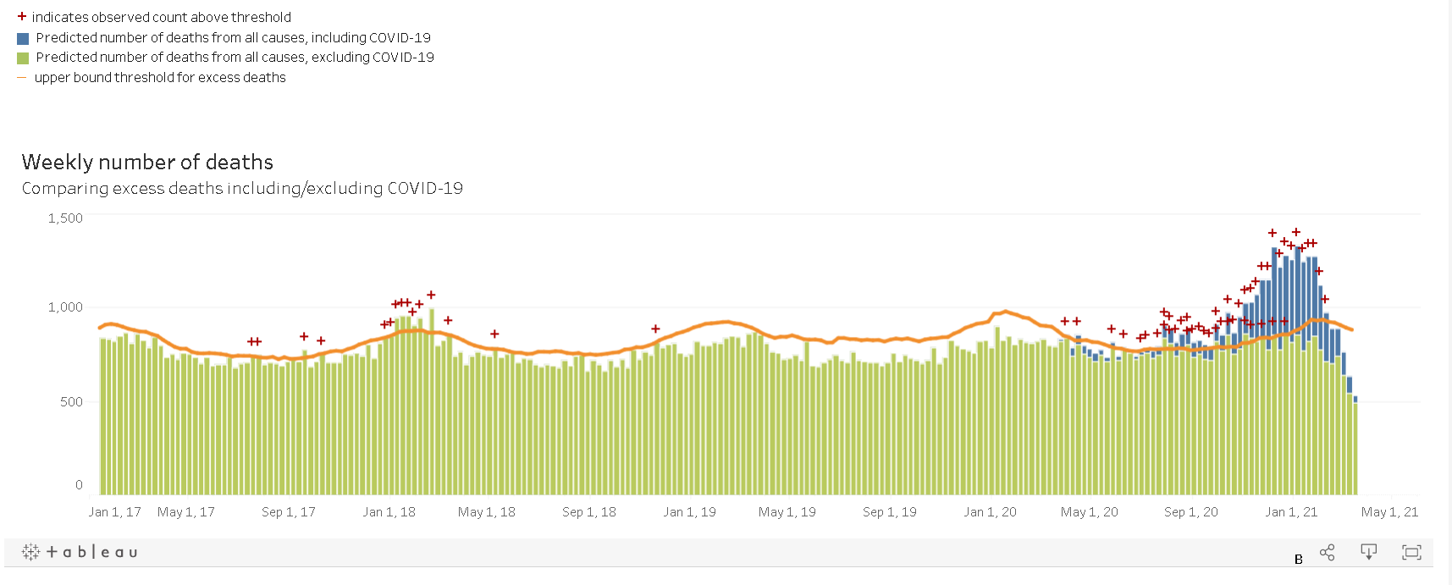
COVID-19 vs. influenza

Slide 23
“All” new to section and PICU admissions

Slide 24
Inpatient admitted with DM and COVID-19 confirmed cases
Type 1 diabetes: 7 total +COVID-19 in pediatrics, 2 new onsets
Generally normal PICU and floor courses
Teaching done via Zoom while inpatient
Type 2 diabetes: 6 total +COVID-19, including 1st pediatric patient in OK admitted with COVID-19
Significantly increased morbidity
A few “others”
1 CFRD, COVID+, sent from our clinic
1 lymphoma, MISC, steroid-induced DM

Slide 25
Outpatient clinic response
Section went fully virtual March-April 2020
Incorporated telemedicine relatively quickly: history within Native American care
Re-opened quickly
Gradually increased in-person visits, but limited providers within clinic space
Additional resources: Webcams for education team, iPads for floor, Zoom inpatient education (single and group classes)
Surge was late and intermittently reported
Team has long had protocols in place, sent home with every new onset, for sick day management. Most patients seem to have adhered to that protocol.
Native American clinics likely had several that were “missed”

Slide 26
Outpatient clinic response
Sick day management: data from “high risk” patients
123 phoned-in “sick day” aid encounters (both COVID- and non-COVID)
5 sent to ER
Admissions for DKA (any hospital in OK)
55 repeat DKA admissions from this cohort
52 had not contacted the section
17 non-DM management admissions
12 admitted for DM management but not in DKA
ER visits (any hospital)
22 related to DM, non contacted center
All interestingly are down from 2018 and 2019 data

Slide 27

Thanks! Questions?

Slide 28
One Year Of Telemedicine:
Lessons Learned In The Time Of COVID
Grazia Aleppo, MD, FACE, FACP
Professor of Medicine
Feinberg School of Medicine
Northwestern University, Chicago

Slide 29


How It All Started
March 6th, 2020 - All clinics move to Telemedicine!
NO preparation for TELEHEALTH!
NO setup for remote visits
NO setup for remote glucose monitoring
NO setup for remote insulin pump uploads
NO setup for remote CGM uploads
SO, what happened????
Grazia Aleppo’s face on 03-06-2020!

Slide 30
Moments of PANIC!
NM Endocrinology practice - Adult Endocrinology
  >20K visits/yr., ~12K Diabetes, 36% T1DM, 64% T2DM
  14 providers, 2 APPs, 4 fellows, 4 RNs, 3 MAs,1CDCES (?!?)
Software/systems available:
  Glooko clinic account
  Medtronic CareLink clinic account
  Dexcom Clarity clinic account
  LibreView clinic account
  However, NO individual username/password for providers!!

Slide 31



Slide 32
The Challenge Starts!!
TEAMWORK!!
Rapid conversion to TELE HEALTH with:
Flowsheets - Strategy Map!
  Scheduler
  Medical Assistants
  Nurses
  Providers
Material preparation
  Patients/Medical Assistants
    Instructions for uploading
  Providers
    Instructions to login on various platforms and CSII/CGM manuals
Notes:
External schedulers were given instructions to inform all patients that visits were only available via telemedicine
Internal schedulers were instructed to call patients and inform them about conversion to telemedicine, if patients declined they would be rescheduled for may 2020 or later.
Medical assistants sent pts instructions for uploads and called patients one week prior to their appointments to verify that patients had received these instructions and discuss challenges for remote uploads or obtain 2 weeks of glucose levels from patients who could not upload remotely
Nurses assisted with the letters to patients with CDC recommendations for working from home, sending letters to patients to the ones who requested work from home letters
Providers were given personal login accounts for all the platforms and instructions on how to view data from the various platforms
Instructions on how to change insulin pump settings or CGM settings remotely were given to each provider ( cheat sheets)
I took advil daily!

Slide 33
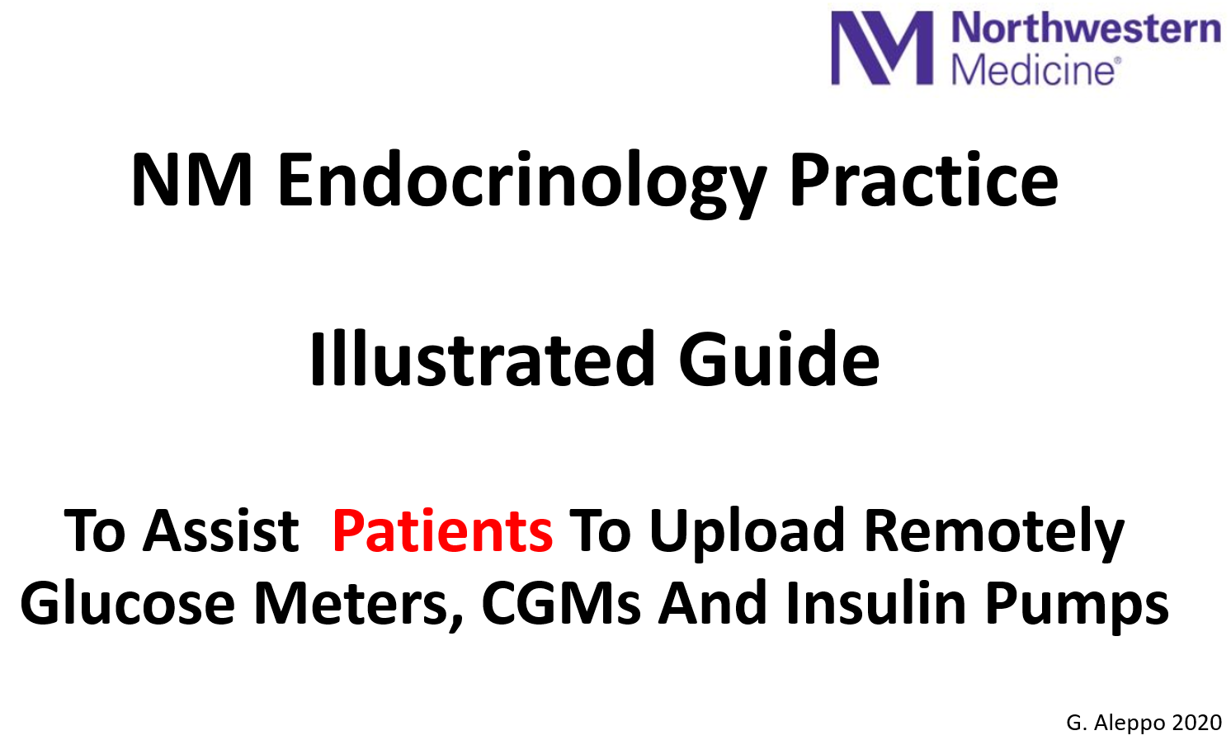
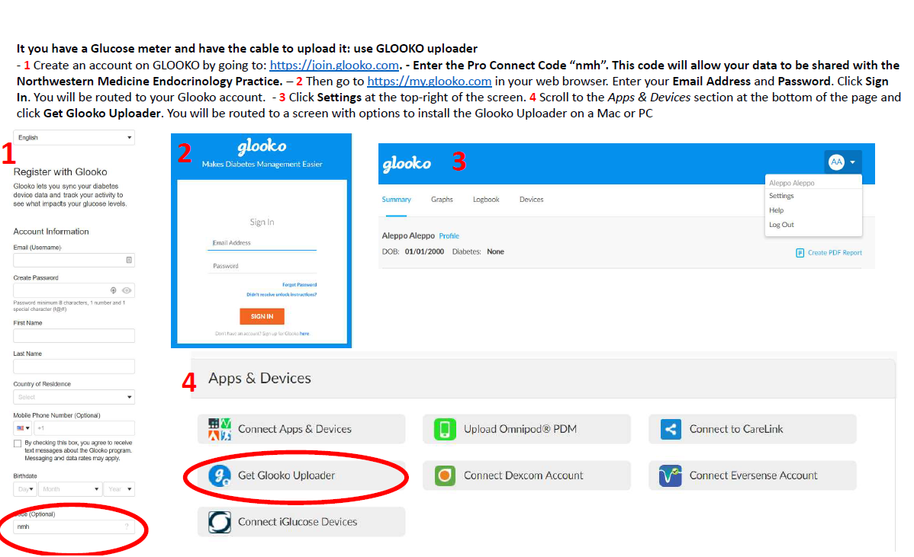
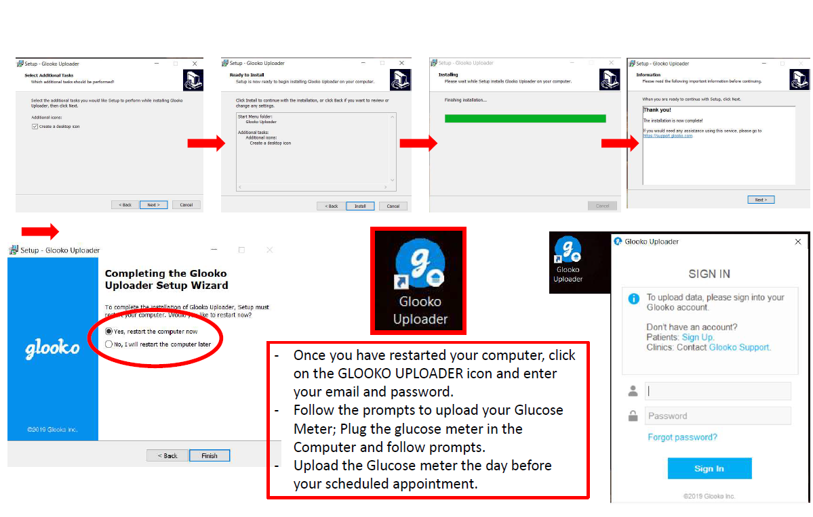
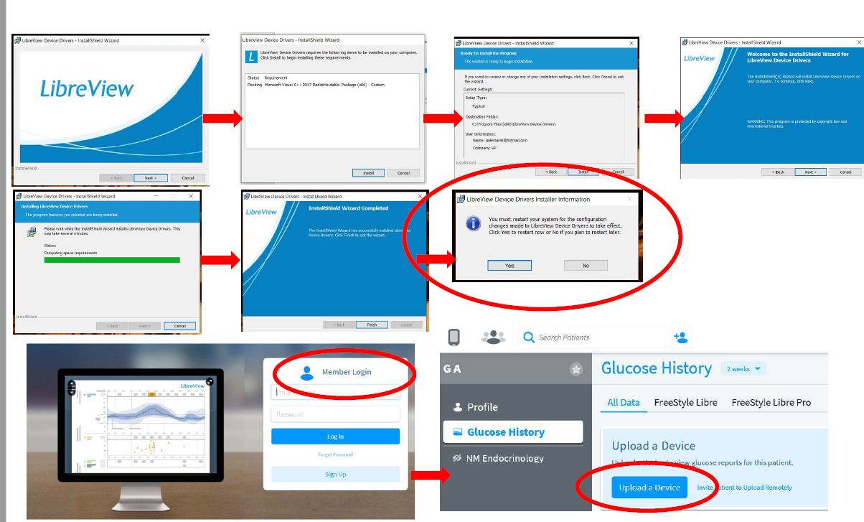
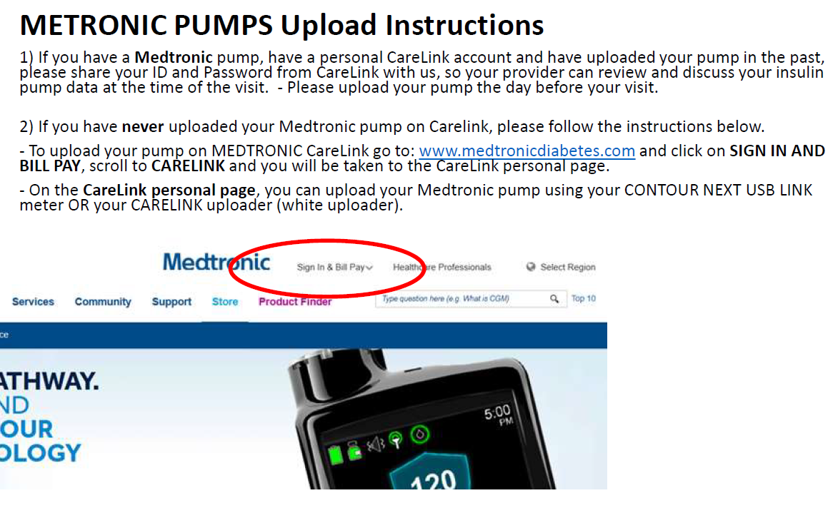
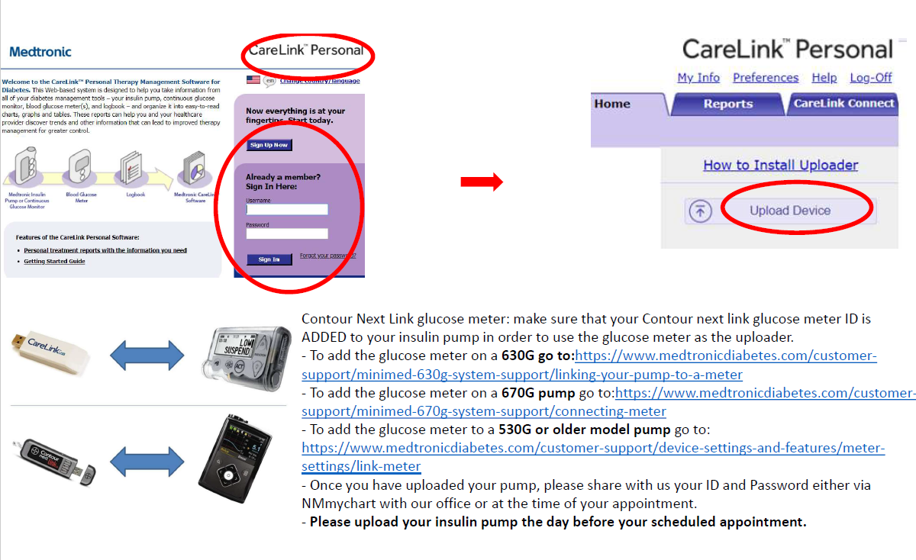
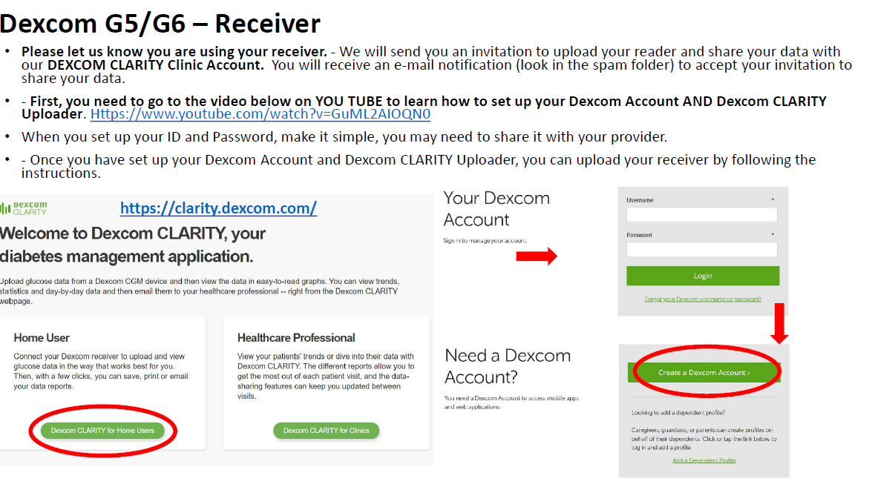
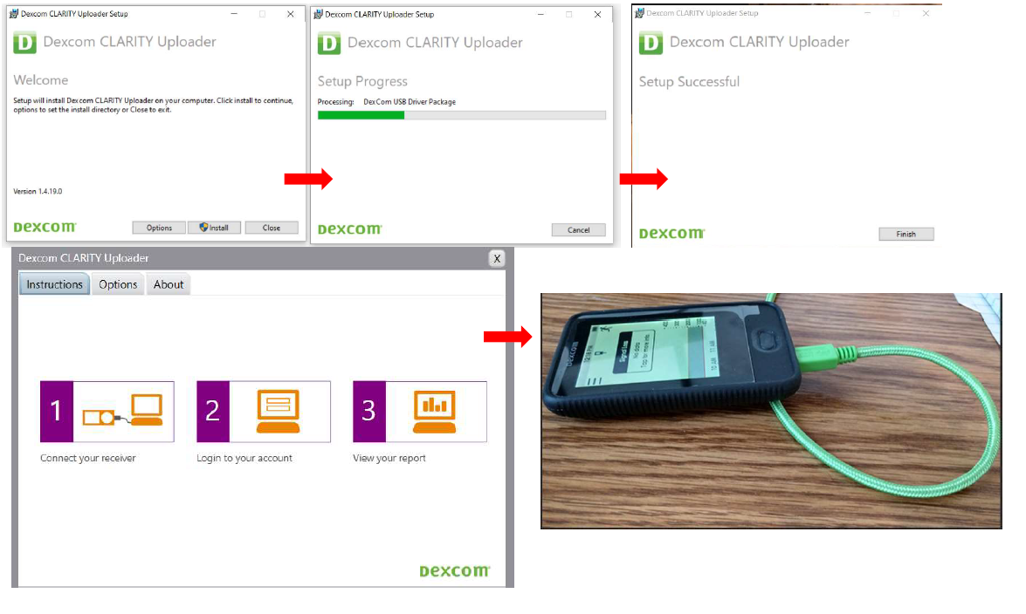
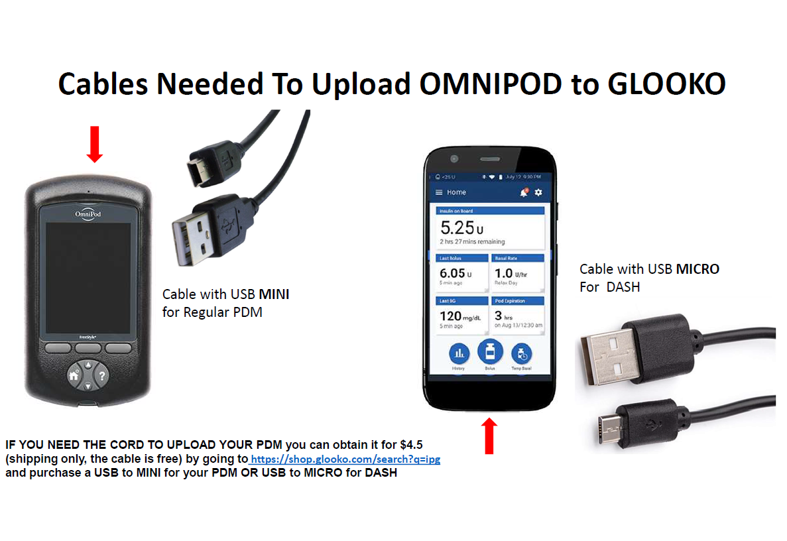
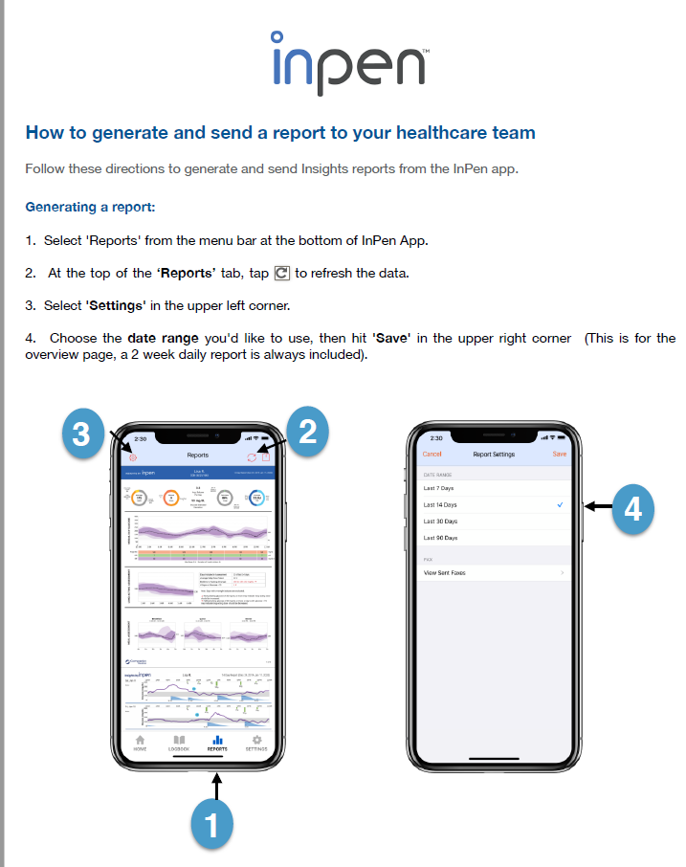
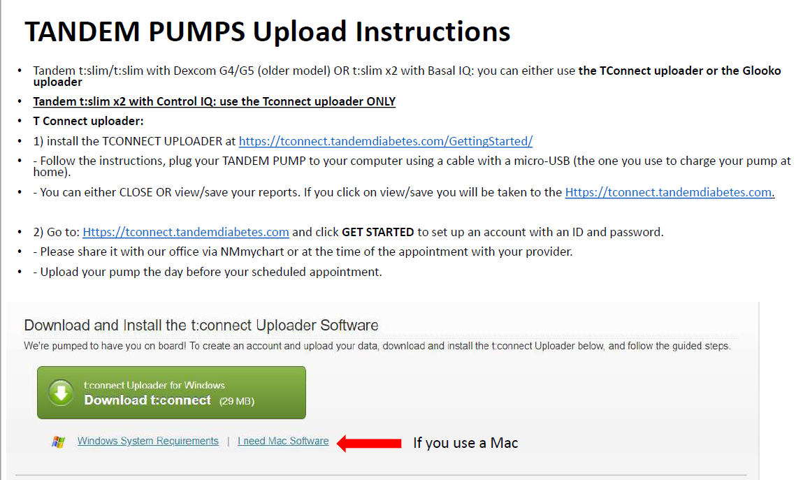
Notes:
Now we are at version 6

Slide 34
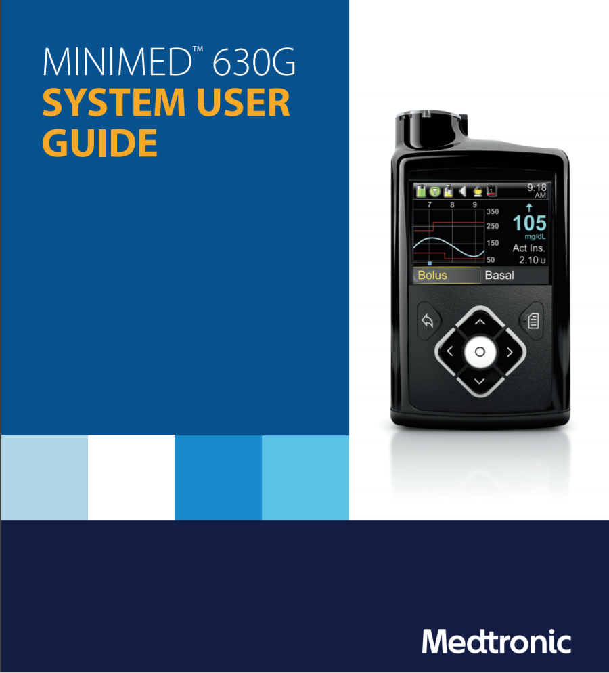
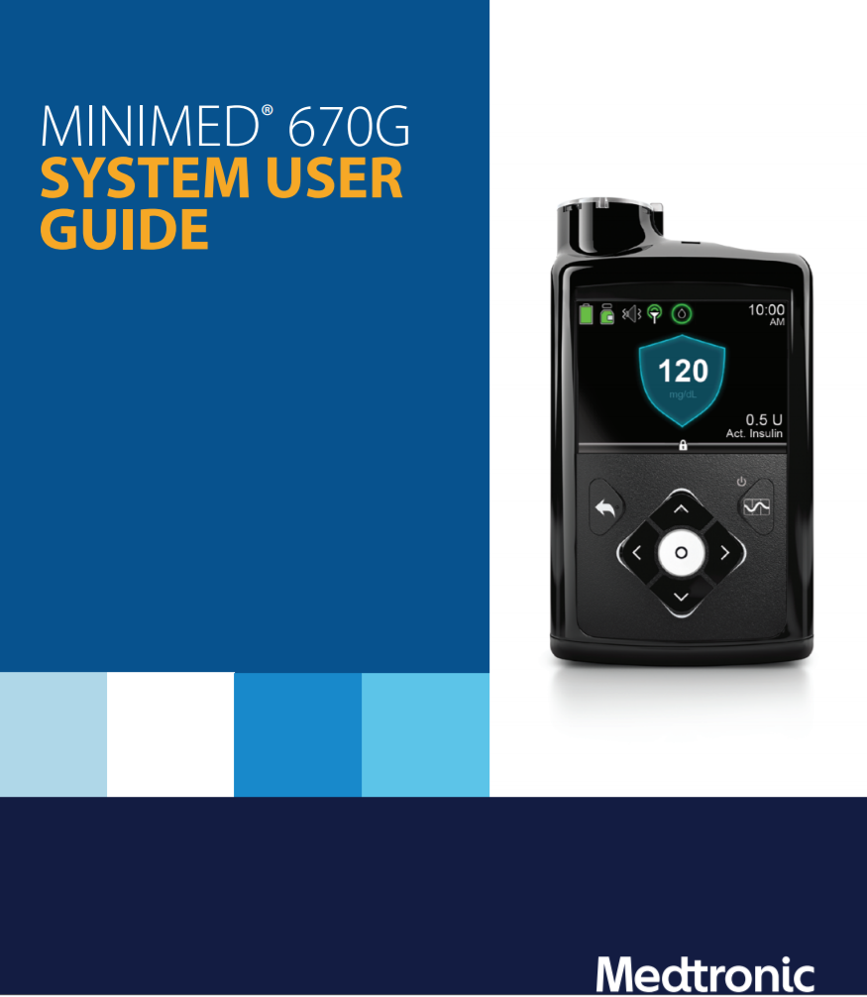
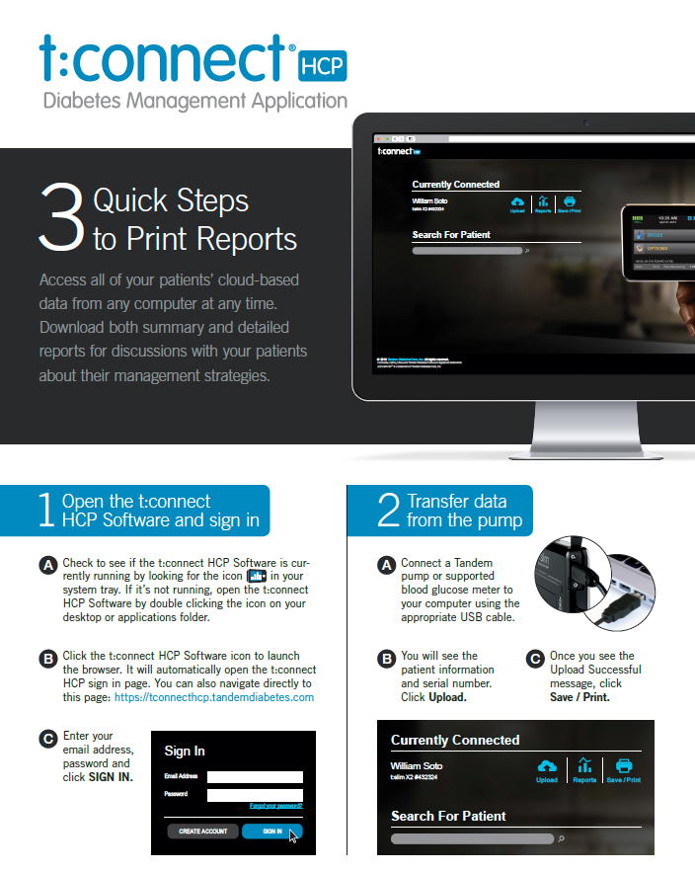
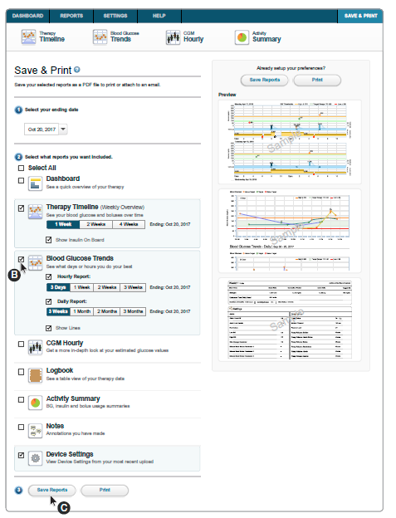
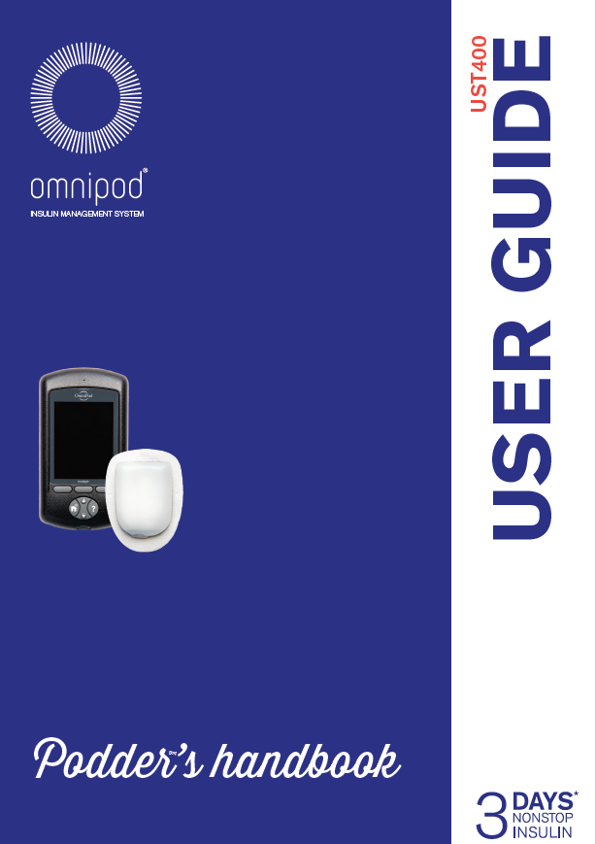
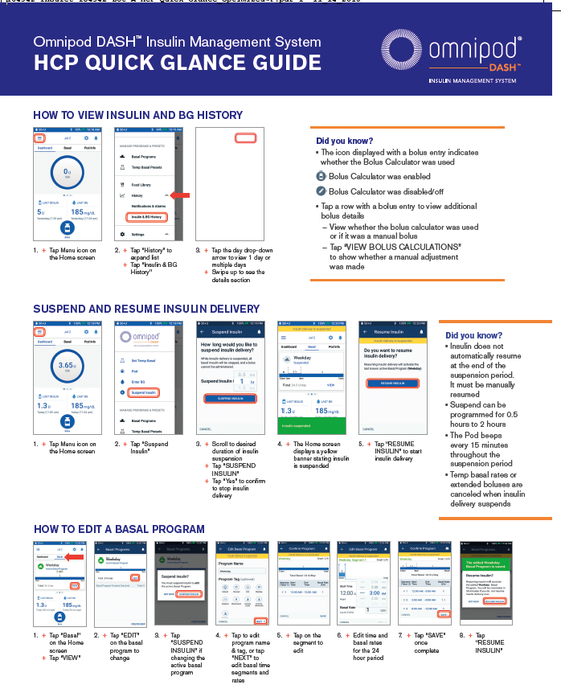


Slide 35
NM Endocrinology Practice
Software Stats
Software (T1 and T2DM) | Active Accounts | Linked Access, N (%)
Glooko | 3,495 | 75 (21%)
Medtronic CareLink | 600 | 166 (27%)
LibreView | 302 | 191(63%)
Dexcom Clarity | 897 | 781 (87%)
Tandem Tconnect (all in 2020!) | 226 | 226(100%)

Slide 36
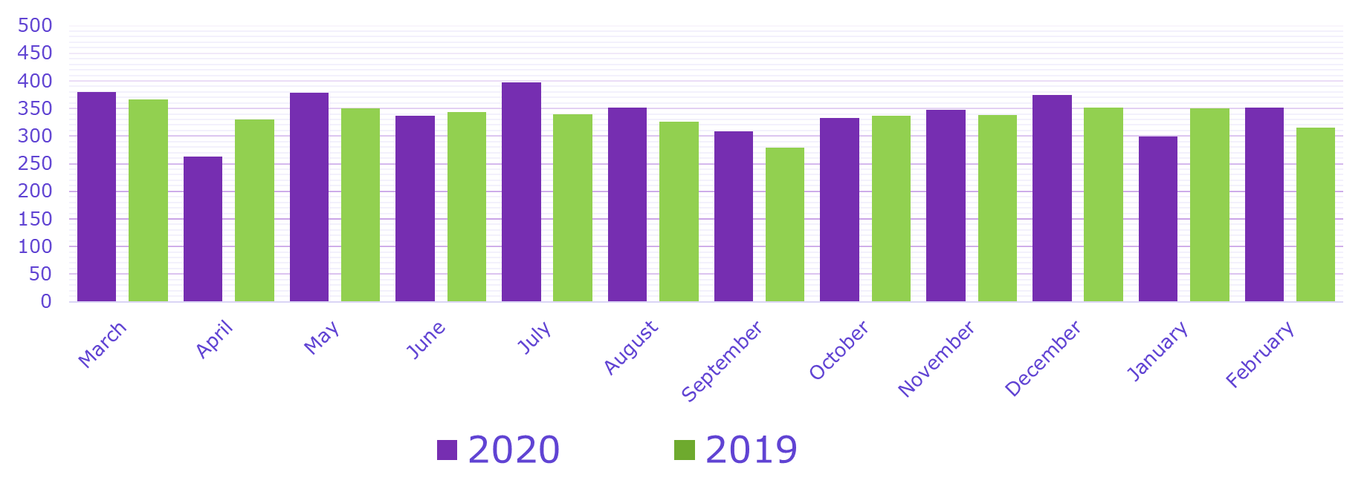
Trends in T1DM Visits Pre/During COVID
(March-Feb)
2020 N= 4120
2019 N= 4026

Slide 37
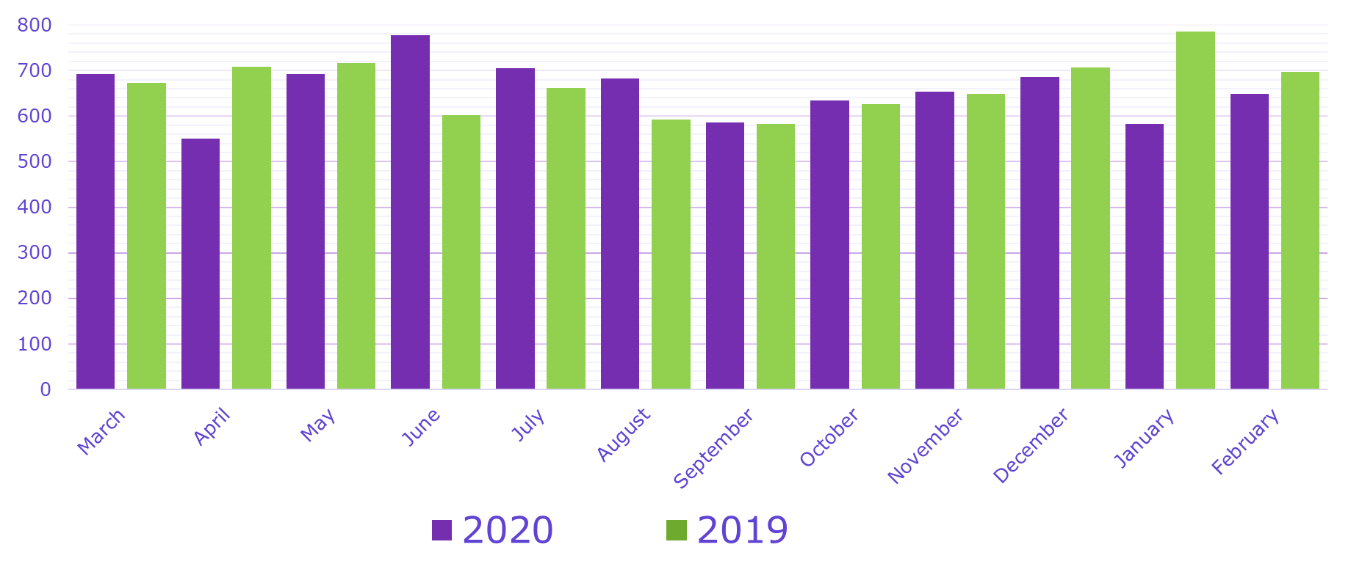
Trends in T2DM Visits Pre/During COVID
(March-Feb)
2020 N= 7891
2019 N= 7999

Slide 38
What Contributed To The Success Of Telemedicine At NM Endocrinology? 1
Type 1 DM patients training to upload from home PRIOR to COVID-19 pandemic
Patients grateful for telemedicine options/engaged in telemedicine
CGM-Phone connected users (Clarity, LibreView)
Medtronic patients with linked CareLink OR w/uploading tool OR Contour Link meter
Tconnect t:slim x2 with Control IQ (all started in 2020!)

Slide 39
What Contributed To The Success Of Telemedicine At NM Endocrinology? 2
T mobile connect app users
Omnipod – Glooko Connected users
InPen users
GMI (even for T1DM on Medicare)
Remote CGM training
Remote Pump initiation and follow up - all brands!
Remote insulin training/InPen training
Remote diabetes education

Slide 40
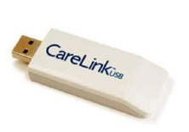
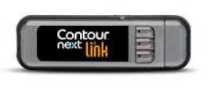
Challenges/Barriers - 1
Dexcom receiver users
  No “green cable”
  Did not prepare prior to visit
  No access to personal computer
Libre reader users
  No “yellow cable”
  Did not prepare prior to visit
  No access to personal computer
Medtronic pump users
  No uploading tools

Slide 41


Challenges/Barriers - 2
Omnipod users
  No cable to upload to Glooko (MINI USB vs. micro-USB)
  No Glooko account or ability to connect to Glooko
  Solution=TIDEPOOL!!
BG meter users
  No cable to connect to Glooko or Tidepool
  Did not prepare prior to visit
  Did not write down glucose levels
Institutional support
  No cameras for computers (used Phone March-April, then Doximity)
  Staff support (MAs re-assigned for other tasks, August 2020)

Slide 42
Challenges/Barriers - 3
Patient preparation/interest
  Did not read instructions via myChart patient portal
  Did not answer Medical Assistants calls pre-appointment
  Visit while driving
  Visit in the car
  Visit in the bedroom or bathroom (!)
Patient resources
  No smartphone
  Job loss
  Insurance loss

Slide 43
What Have We Learned?
Setting up practices for Telemedicine crucial regardless of COVID
Teamwork with staff/providers and patients
Ideally, new patient encounters should be in person
Engage with the patient multiple times to impress importance of preparation for visit success
GMI has been a great tool to substitute for HbA1c

Slide 44
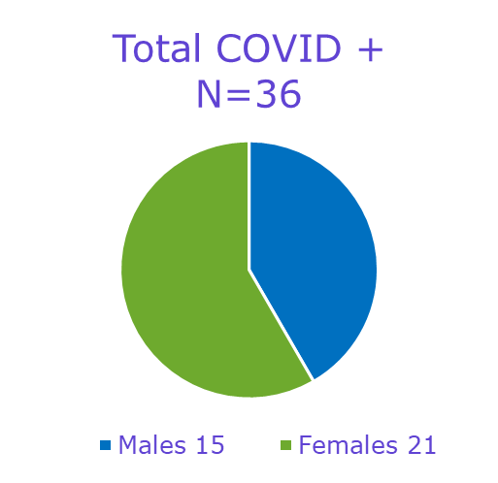
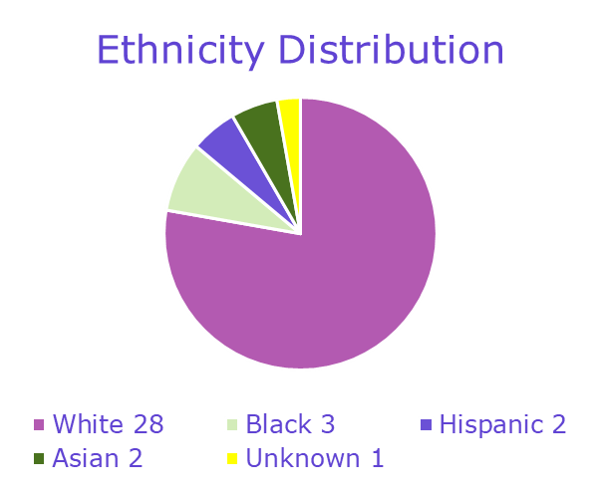
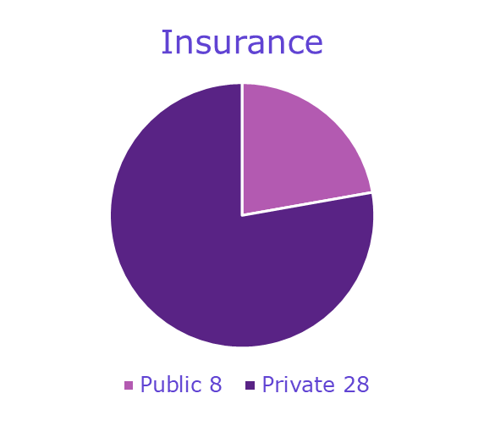
T1DM COVID+ at NU/NM
 | Mean + SD (Min-Max)
Age (years) | 43+ 13.7 (21-71)
T1D duration (years) | 25.08 + 13.08 (3-55)
HbA1c (%) | 7.64 + 1.77 (5->13.9
DKA (%) | 0

Slide 45
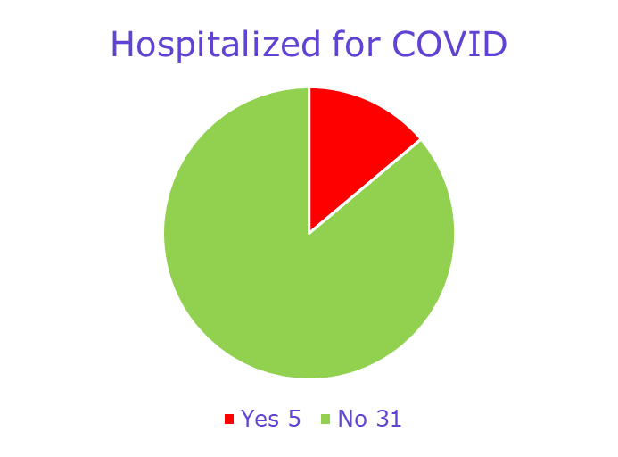
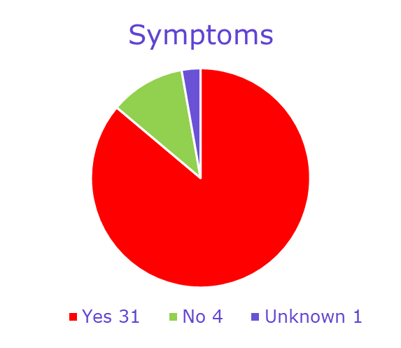
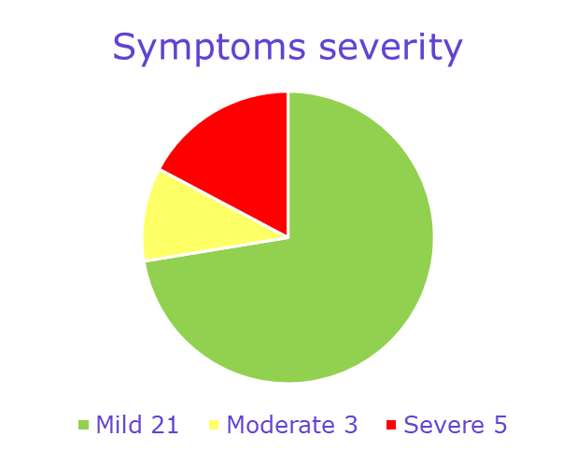
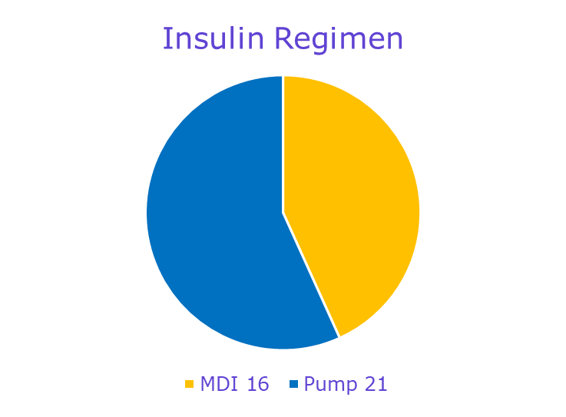

Slide 46
Conclusions
Telemedicine for type 1 DM patients is a team effort
It needs Institution support
It needs software simplification
It needs phone app connection
It needs patient engagement
It needs staff to work with patient PRIOR to visit
It needs PATIENCE!!

Slide 47
Thank You

