Slide 1
Strategy Session
May 16, 2022

Slide 2
Welcome, Agenda, and Logistics Overview
Review of Accomplishments
Nicole Rioles
Osagie Ebekozien

Slide 3
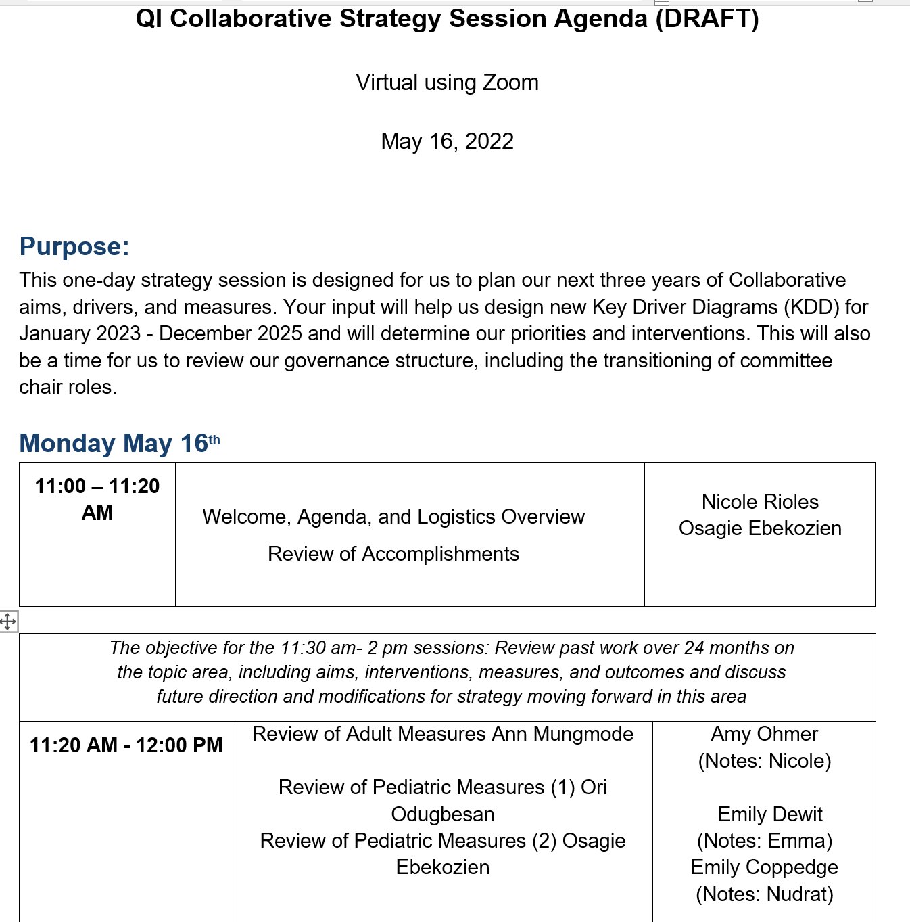
Agenda

Slide 4
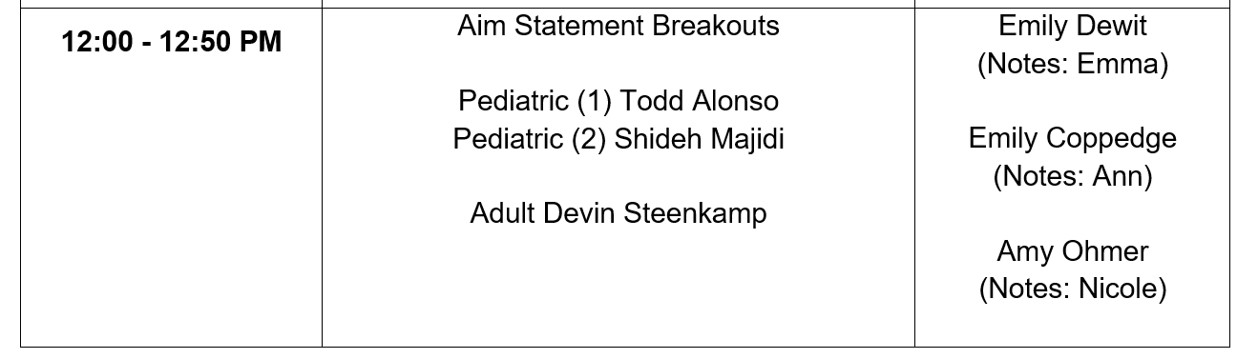
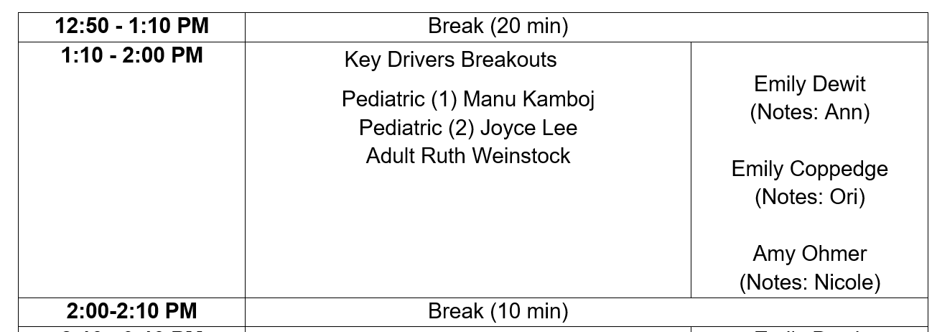
Agenda

Slide 5
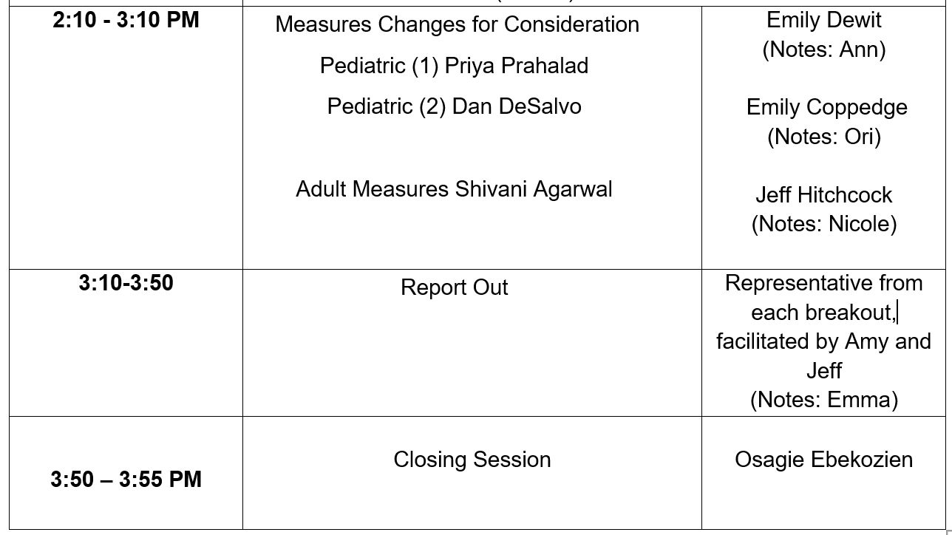
Agenda

Slide 6
Review of Measures
Adult – Ann Mungmode
Pediatric – Ori Odugbesan

Slide 7
Core QI Adult Measures / Drivers
June 2020 – May 2022
Global Outcome Measure | Process Measures
Increase proportion of patients A1c <8% (All clinics) Increase TIR among CGM users (All clinics) | CGM/Sensor Use (All clinics)
 | BG Check
 | Insulin Pump/Pod Use (Elective)
 | Depression Screening
 | Time In Range
 | DKA events
 | Statin Prescribing
 | ACE/Arb Prescribing
 | SDOH Screening
^ Patients that have not been seen in 180 days and don’t have a scheduled appointment
* CGM/Sensor Use and/or patients checking blood glucose using finger sticks at least 4 times daily
Notes:
18-75

Slide 8
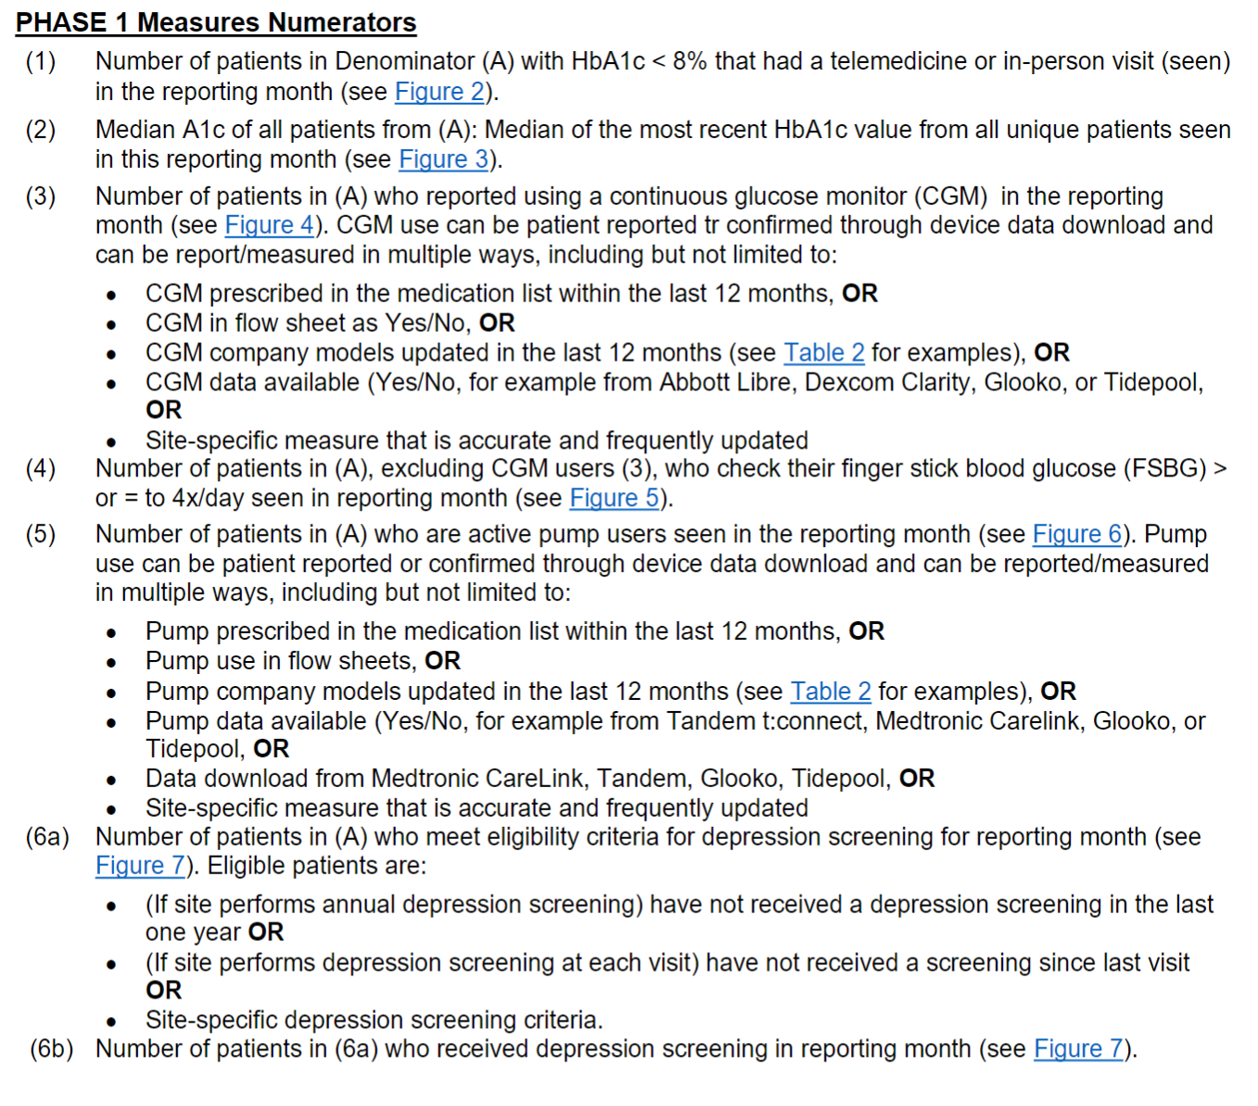

Slide 9
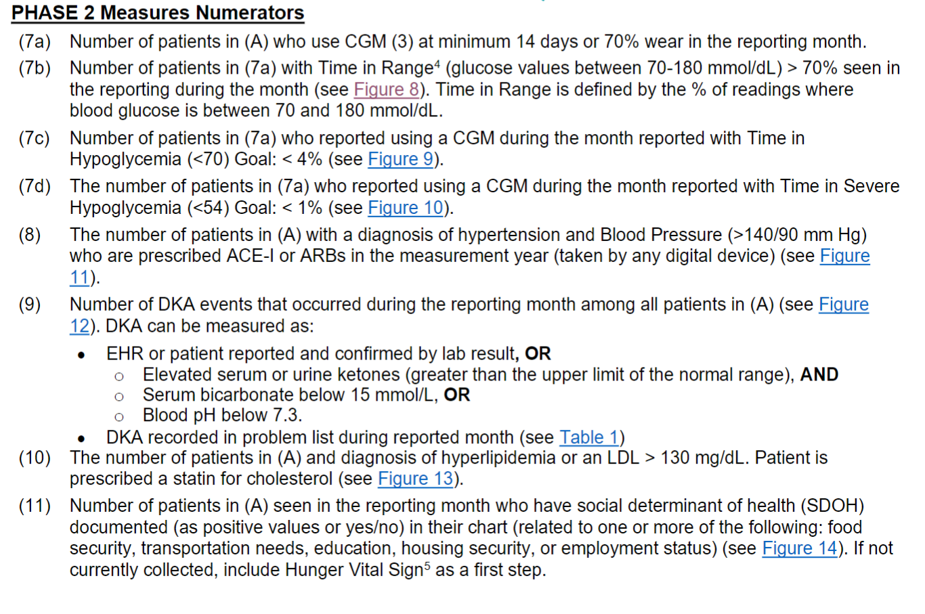

Slide 10
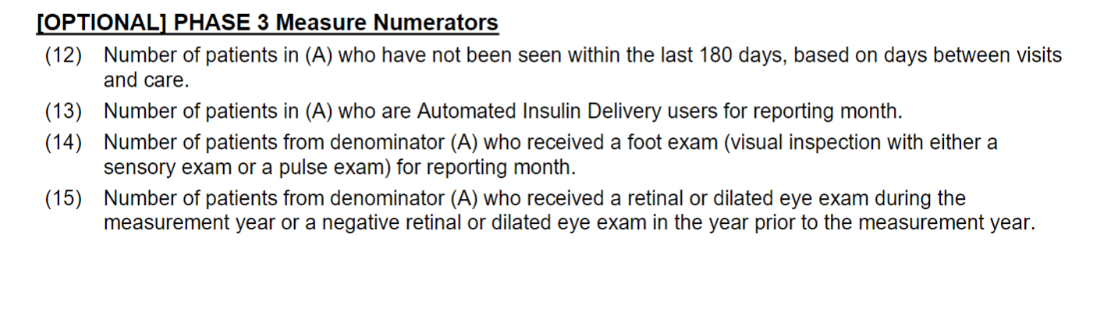

Slide 11
Core QI Pediatric Measures / Drivers
June 2020 – May 2022
Global Outcome Measure | Process Measures
Increase proportion of patients A1c <7% (All clinics) Increase TIR among CGM users (All clinics) | CGM/Sensor Use
 | BG Checks
 | Insulin Pump/Pod Use
 | Depression Screening
 | Time In Range
 | DKA events/admissions
 | Mealtime bolusing 3x
 | Documented transition plan
 | Review data patterns
 | Adjust insulin dosing
 | Timing of insulin bolus (at or before meal)
 | SDOH Screening
^ Patients that have not been seen in 180 days and don’t have a scheduled appointment
* CGM/Sensor Use and/or patients checking blood glucose using finger sticks at least 4 times daily
Notes:
0-25

Slide 12
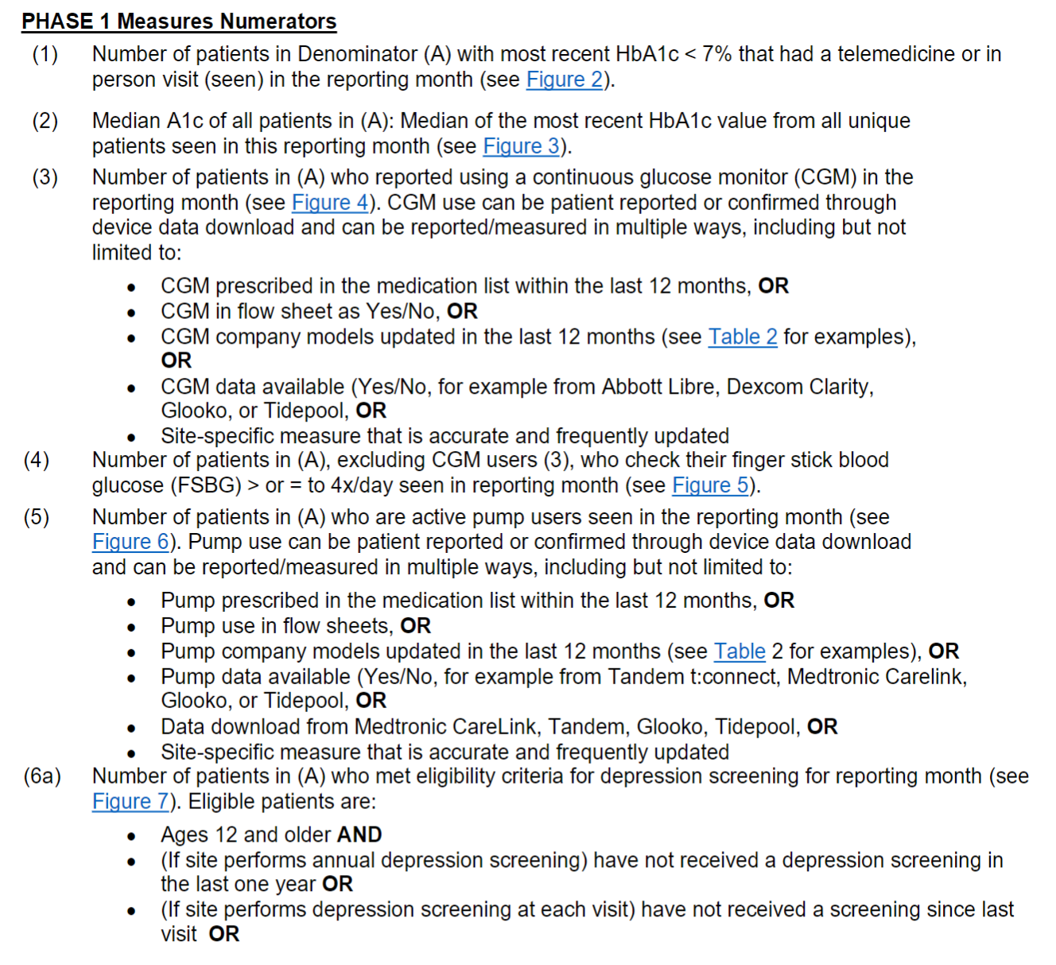

Slide 13
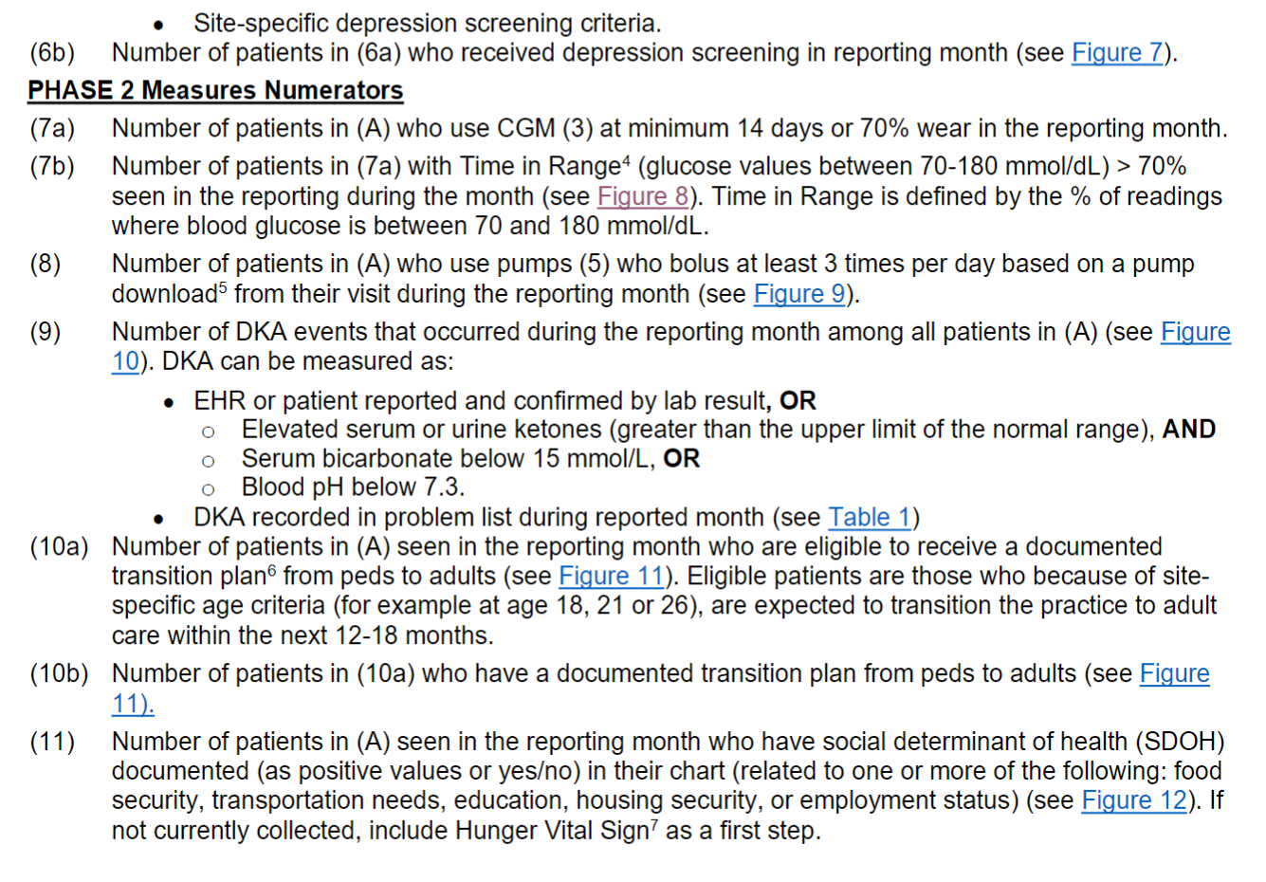

Slide 14
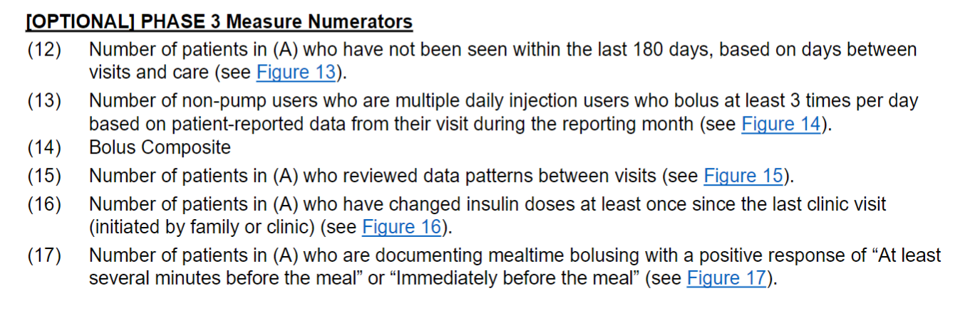

Slide 15
Global Aim Discussion
Todd Alonso- Pediatric group 1
Shideh Majidi – Pediatric group 2
Devin Steenkamp – Adult group

Slide 16
Global Aim
Current Aim: (June 2020 – May 2022)
Among People with T1D (duration > 1 yr, all ages) at QI Collaborative clinics, Among people with T1D,* increase proportion of patients achieving glycemic targets from baseline in 2 years:
At least 25% with A1c <7%, OR
Increase proportion of patients A1c <7% by 5%, OR
Increase TIR among CGM users by 5%
Previous Aim: (2018 – 2020)
Among People with T1D (duration > 1 yr, aged 12-26) at QI Collaborative sites, decrease % population with 2 A1cs > 9% by 5% over 24 months.

Slide 17
Proposed Adult Global Aim
Proposed Aim: (Jan 2023 – Jan 2025)
Increase proportion of patients (duration > 1 yr) achieving glycemic targets from baseline achieving glycemic targets from baseline in 2 years:
At least 60% with A1c <8%, OR
Increase proportion of patients A1c <8% by 10% from baseline, OR
At least 50% will achieve TIR >50% among CGM users
Current Aim: (June 2020 – May 2022)
Among People with T1D (duration > 1 yr, all ages) at QI Collaborative clinics, Among people with T1D,* increase proportion of patients achieving glycemic targets from baseline in 2 years:
At least 25% with A1c <7%, OR
Increase proportion of patients A1c <7% by 5%, OR
Increase TIR among CGM users by 5%
https://www.liebertpub.com/doi/10.1089/dia.2020.0622
https://www.liebertpub.com/doi/10.1089/dia.2020.0572
https://www.liebertpub.com/doi/10.1089/dia.2018.0310
Notes:
https://www.liebertpub.com/doi/10.1089/dia.2020.0572
Results: Mean age of the 63 participants was 17 years, median type 1 diabetes duration was 7 years, and mean baseline HbA1c was 8.1%. All 63 completed the trial. Time in range (TIR) increased by 13% with CLC versus decreasing by 1% with SAP (adjusted treatment group difference = +13% [+3.1 h/day]; 95% confidence interval [CI] 9–16, P < 0.001), which largely reflected a reduction in time >180 mg/dL (adjusted difference −12% [−2.9 h/day], P < 0.001). Time <70 mg/dL decreased by 1.6% with CLC versus 0.3% with SAP (adjusted difference −0.7% [−10 min/day], 95% CI −1.0% to −0.2%, P = 0.002). CLC use averaged 89% of the time for 6 months. The mean adjusted difference in HbA1c after 6 months was 0.30% in CLC versus SAP (95% CI −0.67 to +0.08, P = 0.13). There was one diabetic ketoacidosis episode in the CLC group.

Slide 18
Proposed Pediatric Global Aim
Current Aim: (June 2020 – May 2022)
Among People with T1D (duration > 1 yr, all ages) at QI Collaborative clinics, Among people with T1D,* increase proportion of patients achieving glycemic targets from baseline in 2 years:
At least 25% with A1c <7%, OR
Increase proportion of patients A1c <7% by 5%, OR
Increase TIR among CGM users by 5%
Proposed Aim: (2022 – 2025)
Increase proportion of patients (duration > 1 yr, ) achieving glycemic targets from baseline achieving glycemic targets from baseline in 2 years:
At least 25% with A1c 7%, OR
Increase proportion of patients A1c <7% by 10% from baseline, OR
At least 50% will achieve TIR >50% among CGM users
https://www.liebertpub.com/doi/10.1089/dia.2020.0622
https://www.liebertpub.com/doi/10.1089/dia.2020.0572
https://www.liebertpub.com/doi/10.1089/dia.2018.0310
Notes:
https://www.liebertpub.com/doi/10.1089/dia.2020.0572
Results: Mean age of the 63 participants was 17 years, median type 1 diabetes duration was 7 years, and mean baseline HbA1c was 8.1%. All 63 completed the trial. Time in range (TIR) increased by 13% with CLC versus decreasing by 1% with SAP (adjusted treatment group difference = +13% [+3.1 h/day]; 95% confidence interval [CI] 9–16, P < 0.001), which largely reflected a reduction in time >180 mg/dL (adjusted difference −12% [−2.9 h/day], P < 0.001). Time <70 mg/dL decreased by 1.6% with CLC versus 0.3% with SAP (adjusted difference −0.7% [−10 min/day], 95% CI −1.0% to −0.2%, P = 0.002). CLC use averaged 89% of the time for 6 months. The mean adjusted difference in HbA1c after 6 months was 0.30% in CLC versus SAP (95% CI −0.67 to +0.08, P = 0.13). There was one diabetic ketoacidosis episode in the CLC group.
Among People with T1D (duration > 1 yr, all ages) at QI Collaborative sites, increase % population using HCL by 15% and increase TIR among HCL users by 10% over 36 months.
Among People with T1D (duration > 1 yr, all ages) at QI Collaborative sites, increase % NW Hispanic and Black populations using CGM by 15% over 36 months.

Slide 19
Proposed Pediatric Global Aim
Current Aim: (June 2020 – May 2022)
Among People with T1D (duration > 1 yr, all ages) at QI Collaborative clinics, Among people with T1D,* increase proportion of patients achieving glycemic targets from baseline in 2 years:
At least 25% with A1c <7%, OR
Increase proportion of patients A1c <7% by 5%, OR
Increase TIR among CGM users by 5%
Proposed Aim: (2022 – 2025)
Among People with T1D (duration > 1 yr) increase % population using HCL by 15% and increase TIR among HCL users by 10% over 36 months.
Among People with T1D (duration > 1 yr) increase % NW Hispanic and Black populations using CGM by 15% over 36 months.
https://www.liebertpub.com/doi/10.1089/dia.2020.0622
https://www.liebertpub.com/doi/10.1089/dia.2020.0572
https://www.liebertpub.com/doi/10.1089/dia.2018.0310
Notes:
https://www.liebertpub.com/doi/10.1089/dia.2020.0572
Results: Mean age of the 63 participants was 17 years, median type 1 diabetes duration was 7 years, and mean baseline HbA1c was 8.1%. All 63 completed the trial. Time in range (TIR) increased by 13% with CLC versus decreasing by 1% with SAP (adjusted treatment group difference = +13% [+3.1 h/day]; 95% confidence interval [CI] 9–16, P < 0.001), which largely reflected a reduction in time >180 mg/dL (adjusted difference −12% [−2.9 h/day], P < 0.001). Time <70 mg/dL decreased by 1.6% with CLC versus 0.3% with SAP (adjusted difference −0.7% [−10 min/day], 95% CI −1.0% to −0.2%, P = 0.002). CLC use averaged 89% of the time for 6 months. The mean adjusted difference in HbA1c after 6 months was 0.30% in CLC versus SAP (95% CI −0.67 to +0.08, P = 0.13). There was one diabetic ketoacidosis episode in the CLC group.
Among People with T1D (duration > 1 yr, all ages) at QI Collaborative sites, increase % population using HCL by 15% and increase TIR among HCL users by 10% over 36 months.
Among People with T1D (duration > 1 yr, all ages) at QI Collaborative sites, increase % NW Hispanic and Black populations using CGM by 15% over 36 months.

Slide 20
Diabetes Technology & Therapeutics Vol. 23, No. 50
Closed-Loop Insulin Therapy Improves Glycemic Control in Adolescents and Young Adults: Outcomes from the International Diabetes Closed-Loop Trial
Elvira Isganaitis, Dan Raghinaru, Louise Ambler-Osborn, Jordan E. Pinsker, Bruce A. Buckingham, R. Paul Wadwa, Laya Ekhlaspour, Yogish C. Kudva, Carol J. Levy, Gregory P. Forlenza, Roy W. Beck, Craig Kollman, John W. Lum, Sue A. Brown, Lori M. Laffel, for the iDCL Trial Research Group* … See all authors
Published Online:20 Apr 2021https://doi.org/10.1089/dia.2020.0572
Results: Mean age of the 63 participants was 17 years, median type 1 diabetes duration was 7 years, and mean baseline HbA1c was 8.1%. All 63 completed the trial. Time in range (TIR) increased by 13% with CLC versus decreasing by 1% with SAP (adjusted treatment group difference = +13% [+3.1 h/day]; 95% confidence interval [CI] 9–16, P < 0.001), which largely reflected a reduction in time >180 mg/dL (adjusted difference −12% [−2.9 h/day], P < 0.001). Time <70 mg/dL decreased by 1.6% with CLC versus 0.3% with SAP (adjusted difference −0.7% [−10 min/day], 95% CI −1.0% to −0.2%, P = 0.002). CLC use averaged 89% of the time for 6 months. The mean adjusted difference in HbA1c after 6 months was 0.30% in CLC versus SAP (95% CI −0.67 to +0.08, P = 0.13). There was one diabetic ketoacidosis episode in the CLC group.
Notes:
https://www.liebertpub.com/doi/10.1089/dia.2020.0572

Slide 21
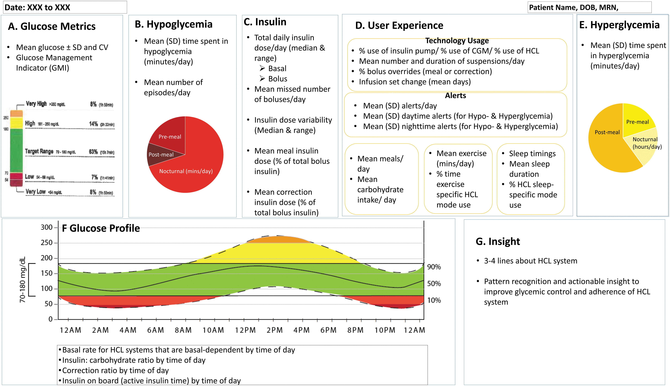
A. Glucose metrics
As presented in Figure 1, the components of glucose metrics should include four variables: (1) mean glucose, (2) standard deviation (SD) and/or coefficient of variation (CV), (3) glucose management indicator (GMI), and (4) a visual graph displaying the recommended CGM metrics, such as time-in-range (TIR) of 70–180 mg/dL, time-above-range (TAR) of >180 and >250 mg/dL, and time-below-range (TBR) of <70 mg/dL (level 1) and <54 mg/dL (level 2).
Notes:
https://www.liebertpub.com/doi/10.1089/dia.2020.0622
Shah

Slide 22
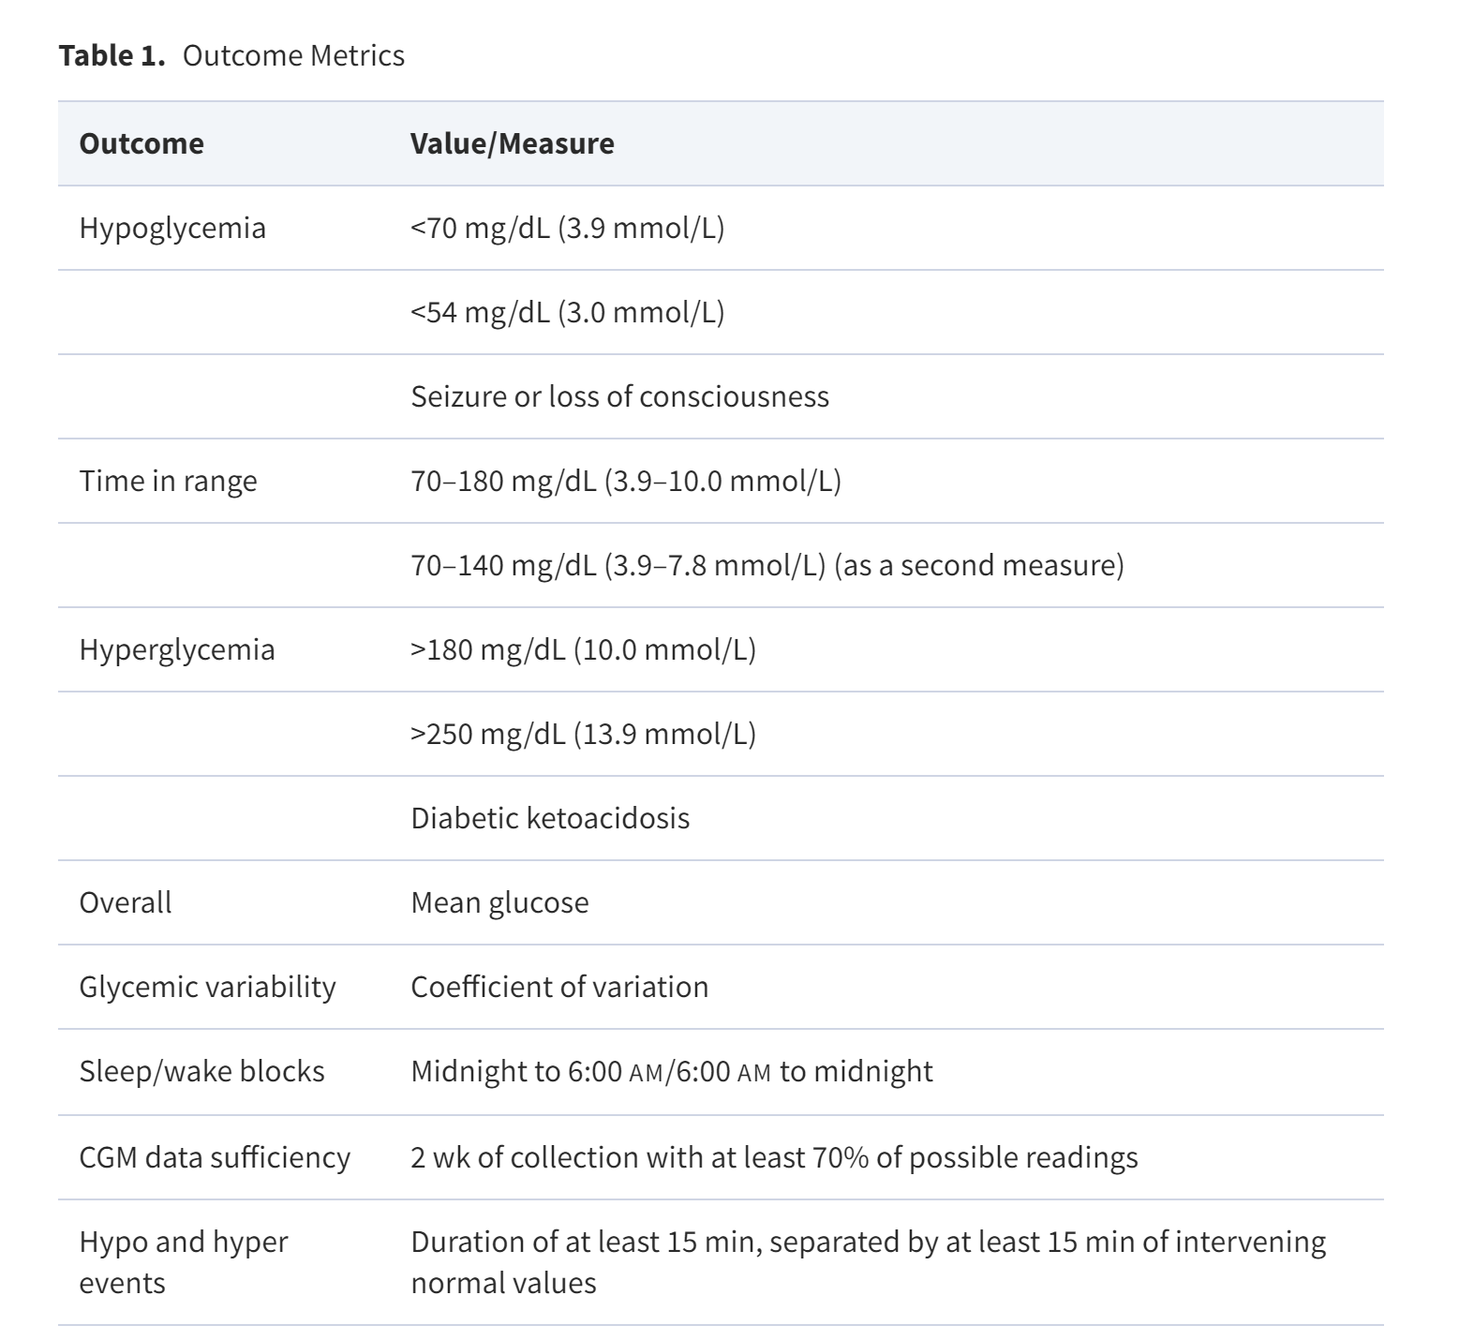
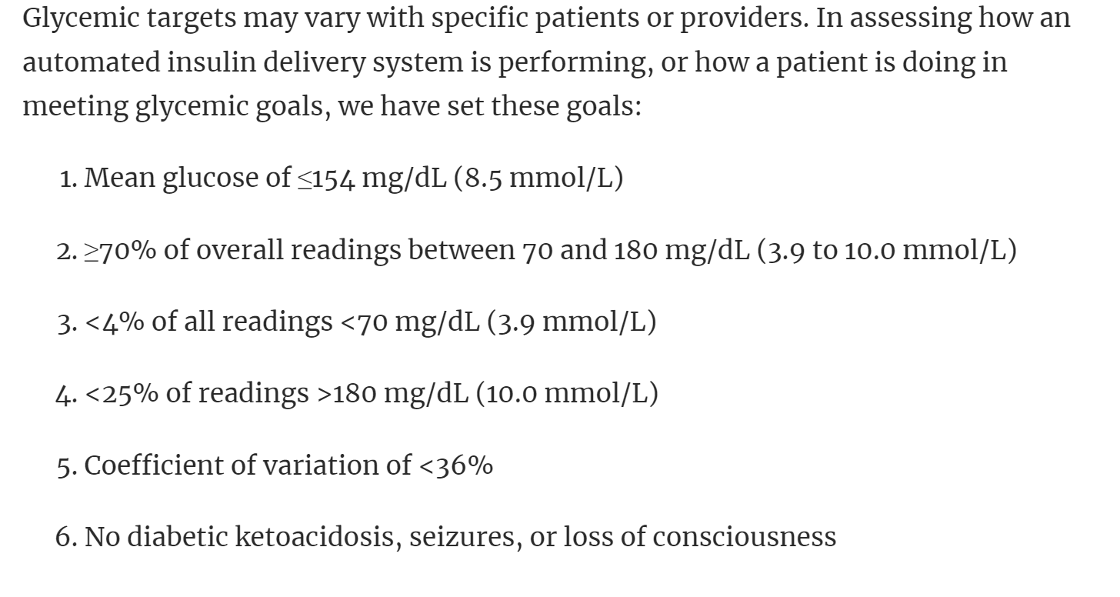
https://academic.oup.com/edrv/article/40/6/1521/5528142
Realizing a Closed-Loop (Artificial Pancreas) System for the Treatment of Type 1 Diabetes
Rayhan A Lal, Laya Ekhlaspour, Korey Hood, Bruce Buckingham Author Notes
Endocrine Reviews, Volume 40, Issue 6, December 2019, Pages 1521–1546, https://doi.org/10.1210/er.2018-00174
Published: 05 July 2019
Notes:
Rayhan

Slide 23
The Relationship of Hemoglobin A1C to Time-in-Range in Patients with Diabetes
Robert A. Vigersky
and Chantal McMahon
Published Online:1 Feb 2019https://doi.org/10.1089/dia.2018.0310
Results
All trials included in this analysis reported %TIR as 70 or 71–180 mg/dL except Van Beers et al. who report %TIR as 72–180 mg/dL (Table 1). There is a linear relationship between HbA1C and %TIR across 18 clinical trials %TIR (R = —0.84; R² = 0.71) where %TIR = −12.762*HbA1C+155.4 (CI = −2.7%; SEM slope = 1.7; SEM intercept = 13.3) (Fig. 1). When the results derived from frequent SMBG performed in the DCCT study (1) were excluded, a similar correlation (R = −0.85; R² = 0.72; %TIR = −12.42*HbA1C+153) was found (CI = −2.6%; SEM slope = 1.7; SEM intercept = 13.3). To determine the effect of short- versus longer-term days of CGM on the results, we reanalyzed the data excluding all studies of ≤7 days of CGM data (references 5, 6, 8, 17, 19, and 20). The results demonstrate that there was no difference in the HbA1C estimated from the %TIR (R = 0.84; R² = 0.71) where %TIR = −13.173x + 158.9 (CI = −3.0%; SEM slope = 2.2; SEM intercept = 16.3). A 10% change in %TIR (e.g., between 50% and 60%) when including all 18 studies is equivalent to a 0.8% (9 mmol/mol) change in HbA1C (CI = −0.35 to 1.21) (Fig. 1). Time-in-Ranges for each decile are shown in Table 2. For instance, 80%, 90%, and 100% are equivalent to an HbA1c of 5.9% (42 mmol/mol), 5.1% (32 mmol/mol), and 4.3% (23 mmol/mol), respectively.
Notes:
https://www.liebertpub.com/doi/10.1089/dia.2018.0310

Slide 24
Table 2. Hemoglobin A1c in % and mmol/mol at Each Decile of Time-in-Range per Equation in the Figure
Time-in-range | HbA1C (%) | HbA1C (mmol/mol)
0% | 12.1 | 109
10% | 11.4 | 101
20% | 10.6 | 92
30% | 9.8 | 84
40% | 9.0 | 75
50% | 8.3 | 67
60% | 7.5 | 59
70% | 6.7 | 50
80% | 5.9 | 42
90% | 5.1 | 32
100% | 4.3 | 23
Notes:
Bob V

Slide 25
1 = Dexcom SEVEN; 2 = MiniMed™ Paradigm REAL-Time Insulin Pump and Mini-Link™ REAL-Time CGM System; 3 = Abbott Freestyle Navigator; 4 = MiniMed 670G; 5 = MiniMed Paradigm Veo™ with Mini-Link REAL-Time CGM System; 6 = DexCom G4 Platinum with software 505; 7 = DexCom G4 Platinum; 8 = MiniMed™ CGMS Gold™.
B, African American; BG, blood glucose monitoring; CGM, continuous glucose monitoring; H, Hispanic; HbA1C, hemoglobin A1C; O, other or not specified; NA, not available; W, white or non-Hispanic white.
Table 1. The Demographics, Group Assignment, Duration of Continuous Glucose Monitoring, and Timing of Studies with Paired Hemoglobin A1C and Time-in-Range
Author with reference | Number of subjects | Age | Type of diabetes |  |  |  | Race (%) (W/B/H/O) | Device | Treatment group: intervention (IN) or control (C) | Baseline (B) or end-of-study (EOS) | Duration of CGM (days) | HbA1C % (mmol/mol) | Time-in-range (%)
JDRF⁵ | 66 | 29.3 ± 16.3 | 1 |  |  |  | 94/0/0/6 | 1, 2, 3 | IN | EOS | 7 | 6.4 (46) | 73.8
Battelino⁶ | 62 | 25.8 ± 14.1 | 1 |  |  |  | NA | 3 | IN | EOS | 5 | 6.7 (50) | 73.3
Bergenstal⁷ | 124 | 37.8 ± 16.5 | 1 |  |  |  | NA | 4 | IN | EOS | 14 | 6.9 (52) | 72.2
JDRF⁸ | 52 | 41.2 ± 11.2 | 1 |  |  |  | 100/0/0/0 | 1, 2, 3 | IN | EOS | 7 | 7.1 (54) | 68.4
Beck¹⁴ | 711 | 26 ± 8 | 1 |  |  |  | 96/0/0/4 | BG | C | EOS | BG | 7.3 (56) | 52.0
Van Beers⁹ | 52 | 48.6 ± 11.6 | 1 |  |  |  | NA | 5 | IN |  | 84 | 7.3 (56) | 65.0
Bergenstal⁷ | 124 | 37.8 ± 16.5 | 1 |  |  |  | NA | 4 | IN | B | 14 | 7.4 (57) | 66.7
Notes:
Bob V

Slide 26
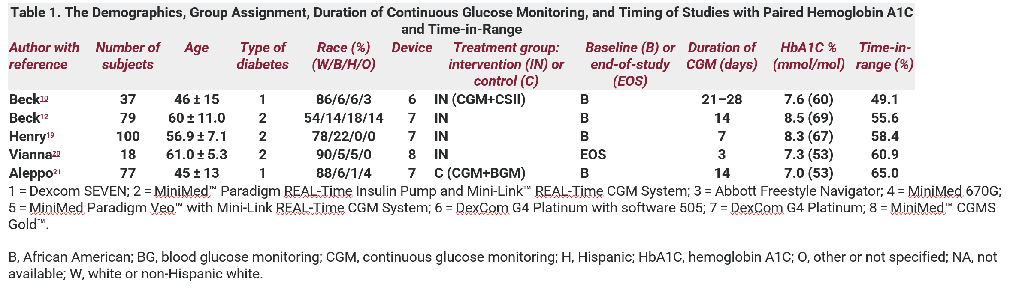
The Relationship of Hemoglobin A1C to Time-in-Range in Patients with Diabetes
Robert A. Vigersky
Highlight of the five studies where at least 5% of population is Black
Notes:
Bob V

Slide 27
Global Aim questions
Are there anything that we wish to remove?
Are there anything that we wish to modify?
Is there any content that we wish to add?

Slide 28
Break

Slide 29
Key Drivers
Manu Kamboj - Pediatric group 1
Joyce Lee– Pediatric group 2
Ruth Weinstock– Adult group

Slide 30
Current Primary Drivers, Adult
Use of Data
Medication Management & Device Use
Access to Clinical Care
Health literacy and education
Psychosocial Care
SDOH
Diabetes Co-morbidities and Complications

Slide 31
Current Primary Drivers, Pediatric
Use of Data
Glucose monitoring
Access to Clinical Care
Health literacy and education
Psychosocial Care
SDOH
Transitions
Insulin Therapy

Slide 32
Adult T1D Glycemia Targets KDD
Change Ideas
Aim
Primary Drivers
Patient Education on diet, exercise and device use
Support “emerging adults” (18-26) with continued “transition” education for disease management
Education to reduce DKA events/admission, 4X glucose check education
Set small patient- and provider-selected goals with clear action step
Peer support groups, new onset classes, technology literacy
Health Literacy/ Education and Support
Among people with T1D,* increase proportion of patients achieving glycemic targets:
At least 25% with A1c <8%, OR
Increase proportion of patients <8% by 5%, OR
Increase TIR among CGM users by 5%
from baseline in 2 years
Use data registries to support population health
Use EMR templates
Incorporate QI measures or flow sheets
Use of Data
Culturally Competent Care (offering education/materials in appropriate languages, etc.
Catalogue of community resources, Train staff about SDOH
Documenting barriers to care (housing, transportation, food etc.)
Social Determinant of Health
Case management, follow up for patients not reaching target goals for BG, LDL, BP
Self-management
Health education for diabetes complications
Screening for diabetes complications and comorbidities and referring to subspecialists/care as appropriate
Diabetes comorbidities and complications
Insulin monitoring/nutrition interactions
Coach >4 checks/day (for non CGM patients)
Test new workflows to improve device use/device documentation
Device data reviews, staff troubleshoot device
Advertise CGM in waiting rooms, etc.
Provide contact information for device reps/patient support
Medication management and device use
Follow up with LTFU patients (not seen for > 180 days); regular follow up (phone/email/text/televisit)
Improve scheduling process
Preparing patients for telehealth visits (“pre-visit visit”)
Access to care
*Duration > 1 year, ages 18-75, with at least one in-person or telemedicine visit in the last year
Conduct mental health screening and referrals (i.e. depression, FOH, diabetes distress)
Improve psychosocial support
MyChart message for questionnaires, PROs, high-risk patients
Create workflow for positive patients who needs referral
Screen for QOL (compare control of people using CGM vs no CGM)
Psychosocial Support

Slide 33
Pediatric T1D Glycemic Targets KDD
Change Ideas
Aim
Primary Drivers
Patient Education on diet, exercise, transition, device use and self management habits
Education to reduce DKA events/admission, 4X glucose check education
Set small patient- and provider-selected goals with clear action step
Working with families as well as providers
Health Literacy/Education and Support
Among people with T1D,* increase proportion of patients achieving glycemic targets:
At least 25% with A1c <7%, OR
Increase proportion of patients A1c <7% by 5%, OR
Increase TIR among CGM users by 5%
from baseline in 2 years.
Referral to nutrition therapy/guidance
Physical activity coaching
Peer support groups
New onset classes
Accessibility to translated materials
Use of Data
Use data registries to support population health
Use EMR templates
Incorporate QI measures or flow sheets
Insulin therapy
Culturally Competent Care
Catalogue of community resources
Train staff about SDOH
Documenting barriers to care (housing, transportation, food, etc.)
Social Determinant of Health
Insulin / monitoring /nutrition interactions
Coach >4 checks/day (for non CGM patients)
Test new workflows to improve device use
Use workflows to improve device documentation
Advertise CGM in waiting rooms, etc.
Device data reviews and interpretation, staff troubleshoot device
Provide contact information for device reps/patient support
Glucose monitoring
Transition
READDY questionnaire
Partner with adult clinic for hand-off
Follow up with LTFU patients (not seen for > 180 days); regular follow up (phone/email/text/televisit)
Improve scheduling process
Make appointments longer/have a multidisciplinary team (seeing a CDE/SW/RD)
Access to in-person and virtual care
*Duration > 1 year, ages 1-25, with at least one in-person or telemedicine visit in the last year
Conduct mental health screening and referrals (i.e. depression, FOH, diabetes distress)
Improve psychosocial support/train providers
MyChart message for questionnaires, PROs, high-risk patients
Create workflow for positive patients who needs referral
Screen for QOL (compare control of people using CGM vs no CGM)
Psychosocial Support
Notes:
High

Slide 34
Proposed Peds Key Drivers
Current
Use of Data
Health literacy and education
Transitions
SDOH
Access to Clinical Care
Psychosocial Care
Glucose monitoring
Insulin Therapy
Proposed
Use of Data
Health literacy and education
Transitions of care
Addressing health inequities
Access to Clinical Care
Psychosocial Care
Device use support
Hybrid closed loop use

Slide 35
Proposed Adult Key Drivers
Current
Use of Data
Medication Management & Device Use
Health literacy and education
Diabetes Co-morbidities and Complications
SDOH
Access to Clinical Care
Psychosocial Care
Proposed
Use of Data
Medication Management & Device Use
Health literacy and education
Diabetes Co-morbidities and Complications
SDOH screening
Access to Clinical Care
Psychosocial Care
Addressing health inequities
HCL use

Slide 36
Drivers questions
Are there anything that we wish to remove?
Are there anything that we wish to modify?
Is there any content that we wish to add?

Slide 37
Break

Slide 38
Adult & Pediatric Measures Changes for Consideration
Priya Prahalad- Pediatric group 1
Daniel DeSalvo– Pediatric group 2
Shivani Agarwal– Adult group

Slide 39
Measures questions
Are there anything that we wish to remove?
Are there anything that we wish to modify?
Is there any content that we wish to add?

Slide 40
Report Out
Amy Ohmer
Emily Coppedge
Emily Dewit
Jeff Hitchcock

Slide 41
Closing Session
Osagie Ebekozien

