Slide 1
AID/HCL Work Group
August 28, 2026
Carol Levy, MD and Emily Coppedge | Co-chairs

Slide 2
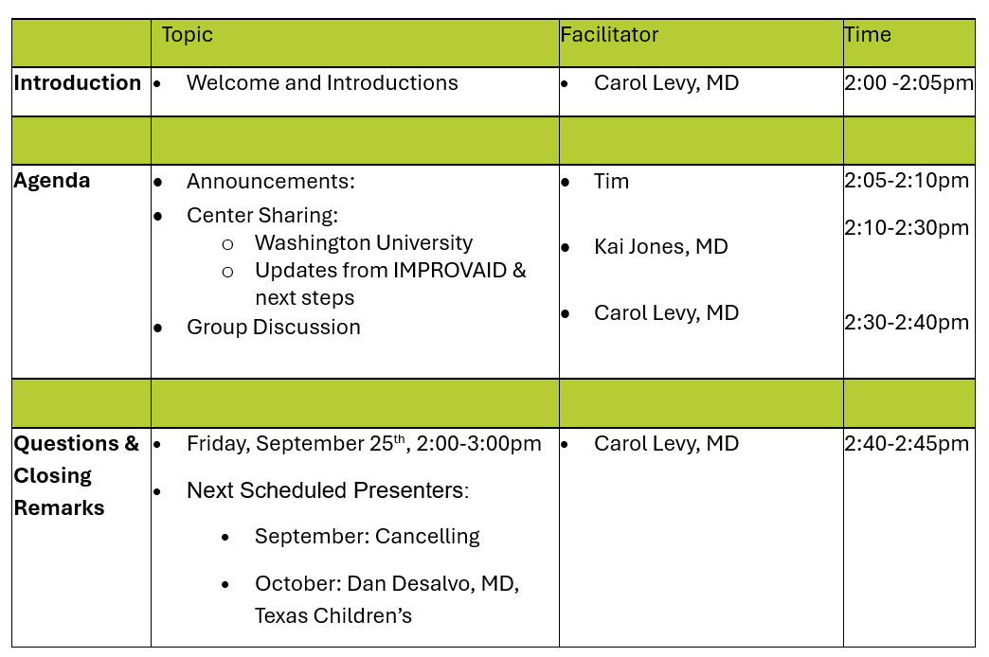
Meeting Agenda

Slide 3
Welcome and Introductions

Slide 4
Announcements
Upcoming Meetings:
  September: Cancelled
  October: 10/30/2026 2:00pm EST
  November: 2026 Learning Session
  January: 01/29/2027 – invites for 2027 went out this past month

Slide 5
Center Sharing:
Washington University
IMPROVAID updates & next steps
Kai Jones, MD

Slide 6
Closing Remarks
Next Scheduled Meeting:
  Friday, October 30th 2:00pm EST
  Scheduled Presenter:
    October: Dan DeSalvo, MD, Texas Children’s – AID use during sports, exercise, and other activities.

Slide 7
Thank you!

