Slide 1


Slide 2
Make Clinical Visits More Personal: Lead With Person-First and Strength-Based Approaches

Slide 3
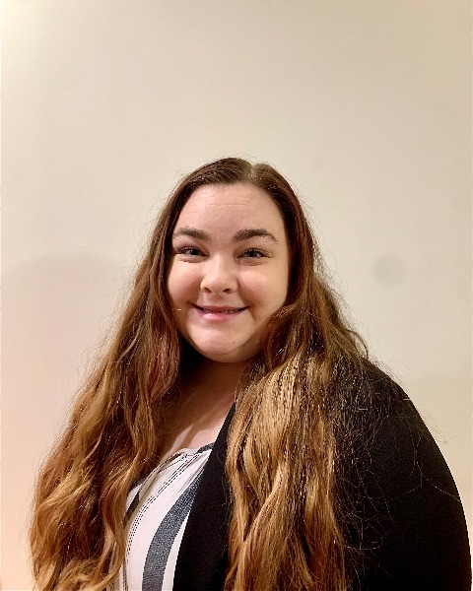
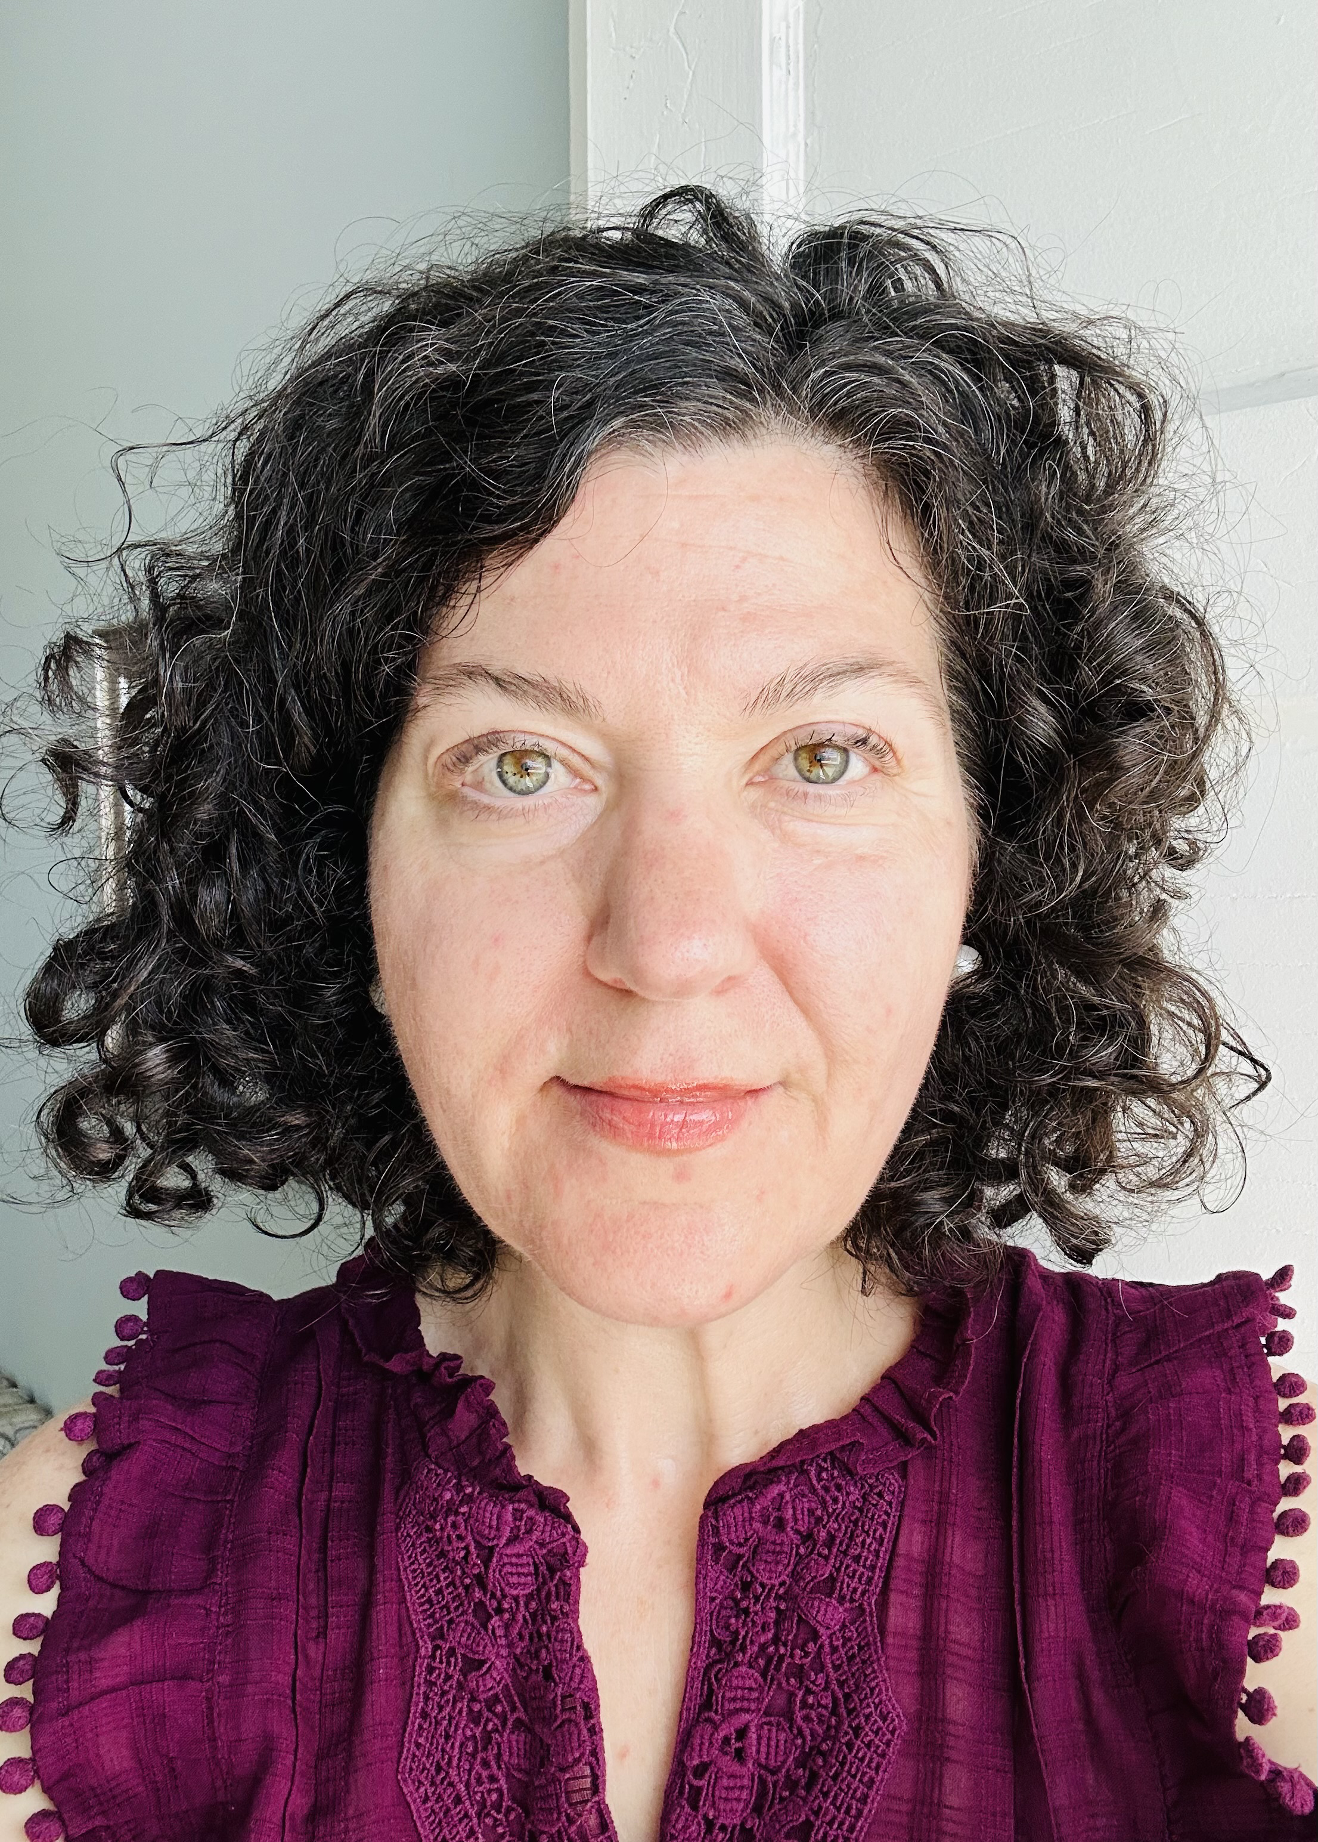
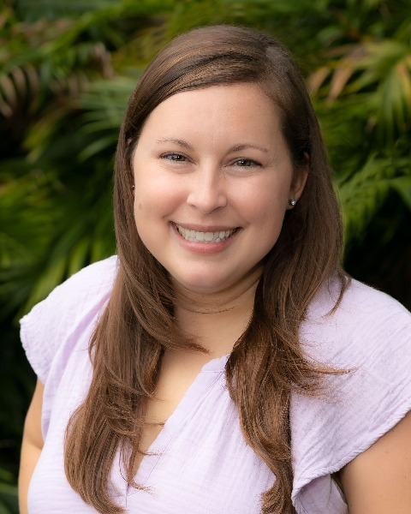
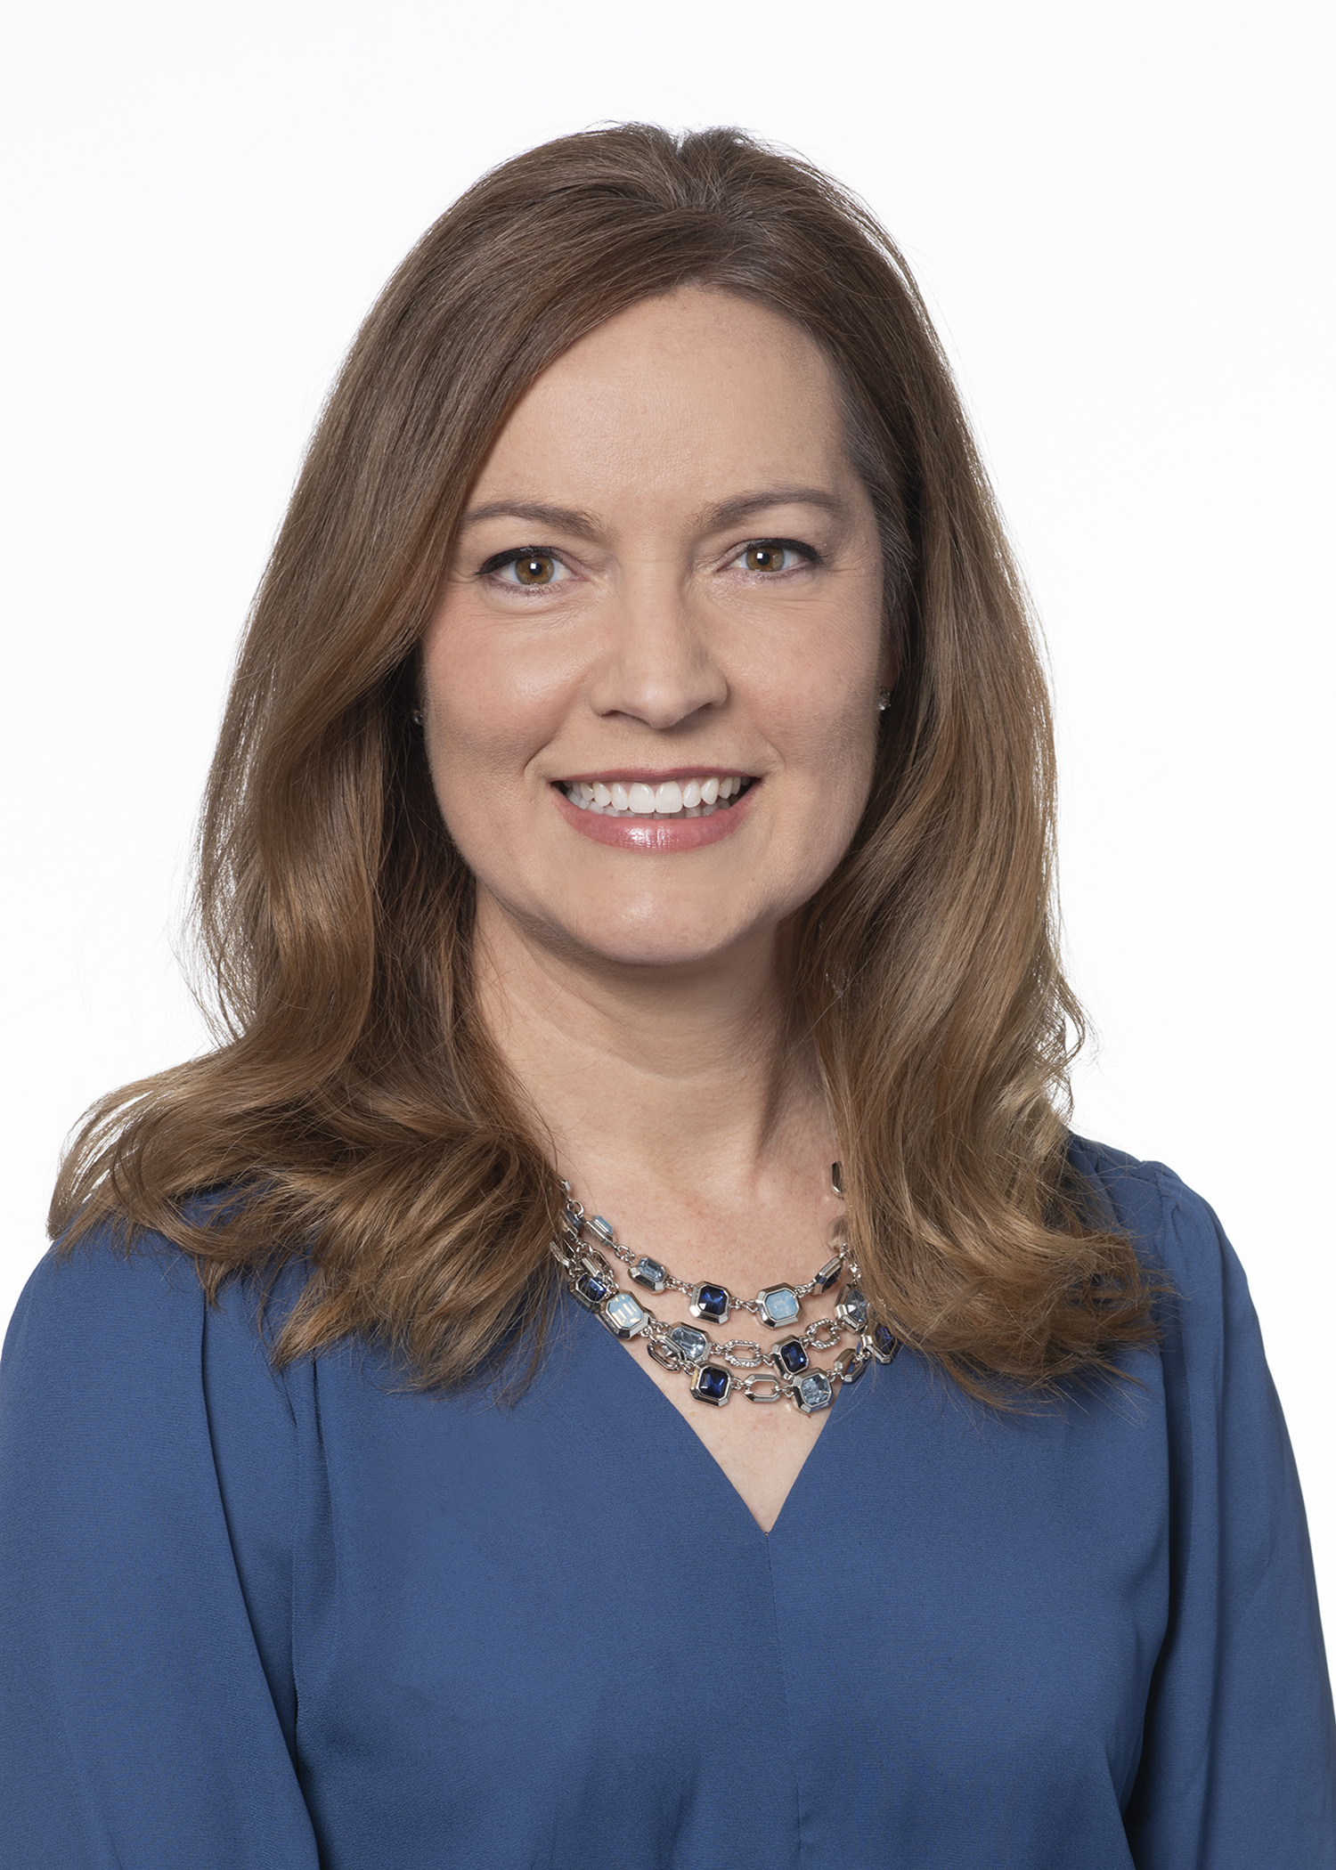
Speakers
Holly Hardison
BS
Quality Improvement Analyst
T1D Exchange
Boston, MA
Nicole Rioles
MA
Senior Director of Clinical Partnerships
T1D Exchange
Boston, MA
Marissa Town
BSN, RN, CDCES
Clinical Director
Children with Diabetes Cincinnati, OH
Emily DeWit
MASL
Project Manager, Clinical Research
Endocrinology
Children’s Mercy Research Institute , MO

Slide 4
Disclosure to Participants
Notice of Requirements For Successful Completion
  Learners must attend the full presentation and complete the evaluation in order to claim continuing education credit/hours
Financial Relationship Disclosures: In accordance with the ACCME Standards for Integrity and Independence, the Association of Diabetes Care & Education Specialists (ADCES) requires anyone in a position to affect or control continuing education content (e.g., authors, presenters, and program planners) to disclose all financial relationships with ineligible companies. It is the responsibility of ADCES to mitigate and disclose all relevant conflicts of interest. Disclosure of a relationship is not intended to suggest or condone bias in any presentation but is made to provide participants with information that might be of potential importance to their evaluation of the presentation. Relevant disclosures (or lack thereof) among this session’s speakers and/or content authors are as follows:
  Holly Hardison: no financial relationships to report
  Nicole Rioles: no financial relationships to report
  Marissa Town: no financial relationships to report
  Off-Label Use:
  Participants will be notified by speakers of any product used for a purpose other than for which it was approved by the Food and Drug Administration.

Slide 5

Diabetes and Language
Table 1: Guiding Principles for Communication with and about People Living with Diabetes
Diabetes is a complex and challenging disease involving many factors and variable
Stigma that has historically been attached to a diagnosis of diabetes can contribute to stress and feelings of shame and judgment
Every member of the health care team can serve people with diabetes more effectively through a respectful, inclusive, and person-centered approach
Person-first, strengths-based, empowering language can improve communication and enhance the motivation, health, and well-being of people with diabetes
Table 2: Key Definitions
Word/Phrase | Definition
Strengths-based language | Opposite of a deficit approach; emphasizing what people know and what they can do. Focusing on strengths that can empower people to take more control over their own health and healing. Example: Lee takes her insulin 50% of the time because of cost concerns (instead of Lee is noncompliant/nonadherent).
Person-first language | Words that indicate awareness, a sense of dignity, and positive attitudes toward people with a disability/disease. Places emphasis on the person, rather than the disability/disease. Example: Lee has diabetes (instead of Lee is a diabetic).
Table 3: Recommendations
Use language that
1. is neutral, nonjudgmental, and based on facts, actions, or physiology/biology
2. is free from stigma
3. is strengths based, respectful, inclusive, and imparts hope
4. fosters collaboration between patients and providers
5. is person centered
Dickinson JK, Guzman SJ, Maryniuk MD, O'Brian CA, Kadohiro JK, Jackson RA, et al. The Use of Language in Diabetes Care and Education. Diabetes Care. 2017;40(12):1790-9.

Slide 6
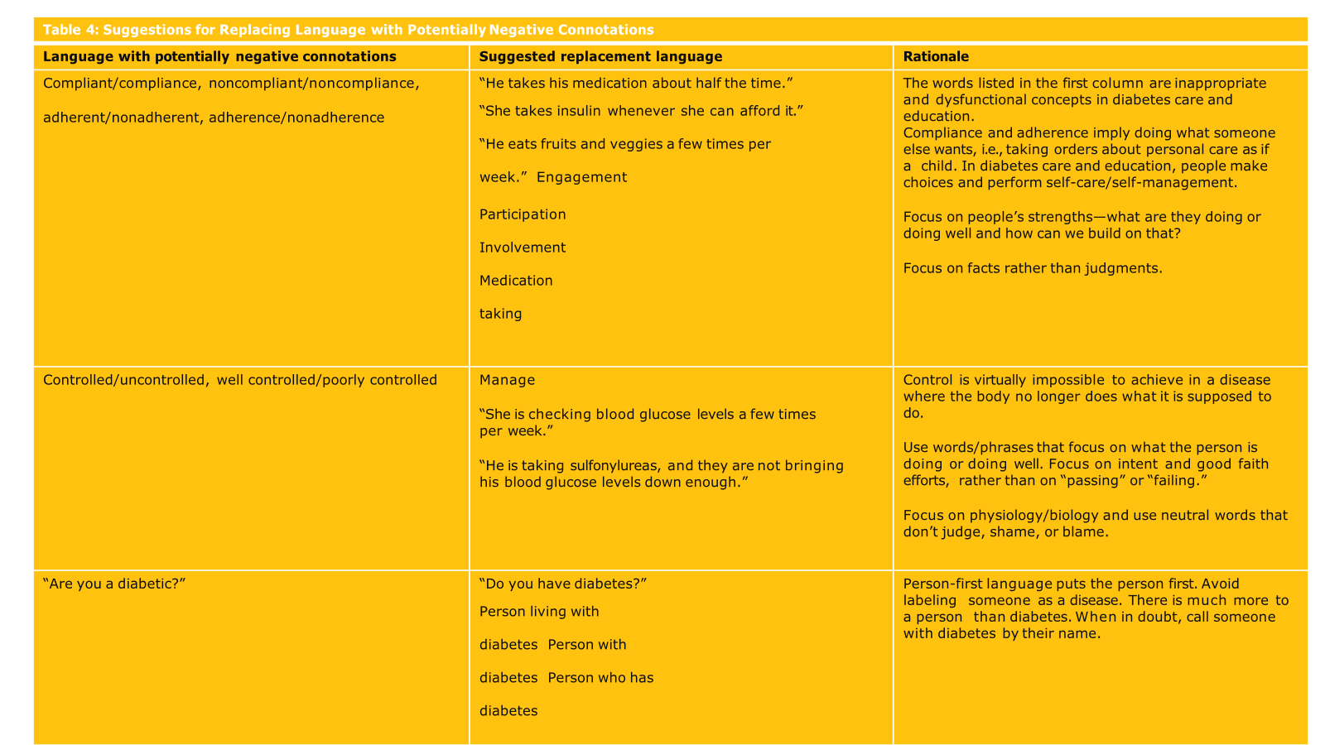

Slide 7
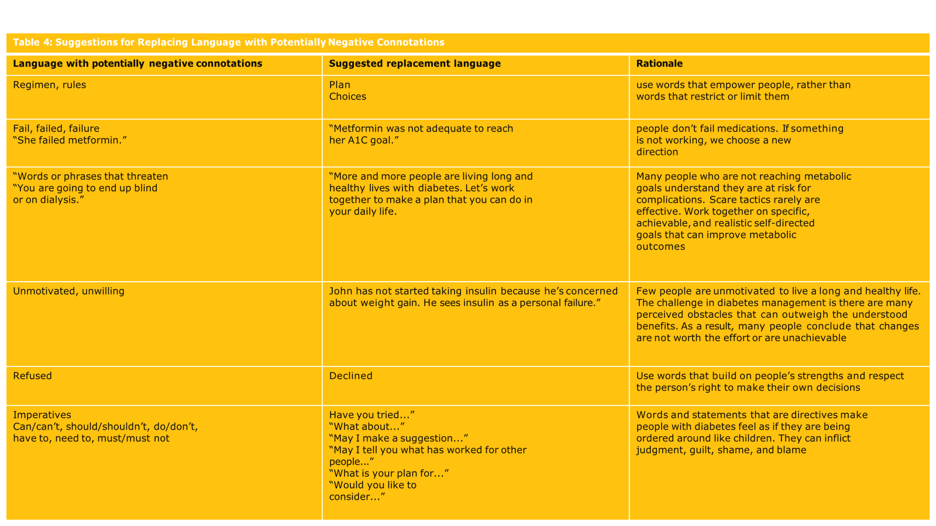

Slide 8
Session Goal
Share 3 exercises in skit format of how communication can positively and negatively impact a person with diabetes (PWD).
  Child on public insurance
  Transitions of care
  Diabetes distress

Slide 9
Child on Public Insurance of Hispanic/Latinx Background
Background: A mom and her 12-year-old son are at the pediatric endocrinology office for their first visit after a referral from the pediatrician.
They visited their pediatrician to address her son’s constant fatigue, and as part of the labs, an A1C was completed, which came back at 8.9%.
They use public insurance and are of Hispanic/Latinx background.

Slide 10

Recap
Did the care team listen to and validate the moms' concerns?
Was there an assumption of diagnosis based on history and lifestyle?
Was nonjudgmental and person-centered language used in communicating with the mom and the son?

Slide 11

Transitions of Care
Background: A teenager is transitioning from pediatric to adult care.
She is nervous about the transition and does not feel confident in her skills to manage her care independently.

Slide 12
Recap
How can we, as care team members, ensure the people with diabetes feel supported and ready to transition to adult care?
Can we provide resources to them on moving to adult care?
Can we ensure that we support them with our words and celebrate this time as a “graduation” into adult care?
Can we start the transition conversation earlier to ensure that the person with diabetes feels confident and ready to transition?

Slide 13
Diabetes Distress
Background: A 26 years old, who has type 1 diabetes for nine years, is seen. Her last two A1cs were 13.6% and 9.3%.
She uses MDI for insulin and is prescribed a CGM but doesn’t often wear it.
She has been working part time, is uninsured, and recently signed up for a Medicaid plan.
She reports that she does not like devices on her body and does not like to take insulin in public or check BG in public.
She doses basal insulin consistently, at home, and does not always bolus for meals.
She has been hospitalized twice for DKA in the last three years.
She communicated diabetes distress in her last visit.

Slide 14
Recap
In scenario 1
  Did the HCP understand the PWD’s goals?
  Did the HCP effectively share her goals for the visit?
  Did the HCP make the PWD feel comfortable or confident?
In Scenario 2
  Did the HCP understand the PWD’s goals?
  Did the HCP effectively share her goals for the visit?
  Did the HCP make the PWD feel comfortable or confident?
  What tone was set?

Slide 15
Recommendations from the PWD Advisory Committee
Ask what is important and motivating. Learn how the practice help can keep PWD motivated during the marathon that is living with diabetes.
It helps to remind providers that when someone uses the word "diabetes," they are essentially saying "you." Therefore, any adjectives around this word can ultimately place blame and cause diabetes distress.

Slide 16

THANK YOU!
Holly Hardison, BS
HHardison@t1dexchange.org
Nicole Rioles, MA
nrioles@t1dexchange.org
Marissa Town, BSN, RN, CDCES
marissatown@childrenwithdiabetes.com
Emily DeWit, MASL
eldewit@cmh.edu
T1D Exchange: https://t1dexchange.org/startsite/
Children with Diabetes: https://childrenwithdiabetes.com/

