Slide 1
QI Collaborative Clinical Leadership
Friday June 19, 2020

Slide 2
General Updates - Osagie
Contracts - Nicole
QI Portal - Emily
QI Processes - Ori
QI Data - Nudrat
Committee Role - Osagie
AGENDA

Slide 3
Purpose of Clinical Leadership Committee
Review progress against strategic goals
Advise on clinical directions and partnerships
Recommend new Co-PIs for special project
Discuss new grant ideas and sustainability plans

Slide 4
Committees
Clinical Leadership Committee
Publication/Scientific Committee
Patient Advisory Committee
Data Science/IT Committee
Data Governance

Slide 5
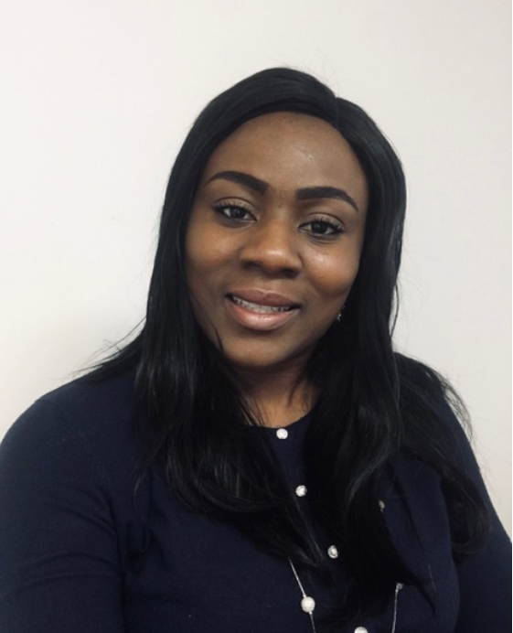

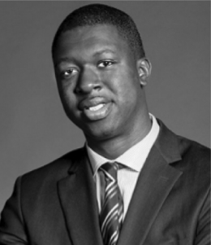

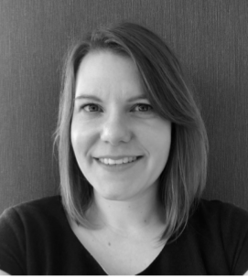
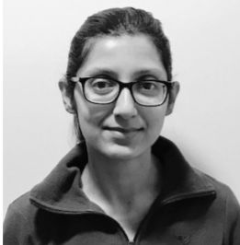
Coordinating Center QI Team
QI Projects
Ori Odugbesan, MD, MPH
Contracts, Partnerships
Nicole Rioles, MA
VP, QI and Pop Health
Osagie Ebekozien, MD, MPH
Population Health Analyst,
Saketh Rompicherla, MS
Jordan Neerhof
jneerhof@t1dexchange.org
Administrative Assistant
QI Portal, Project Manager,
Emily Carlson
Senior Data Scientist, Nudrat Noor, PhD

Slide 6
T1D QI Population Health Improvement Framework
Design and Improve Clinical Processes (QI)
Use QI Portal for Population Health Management
Analyze Data for QI/Policy Insights
Co-Design with Partners and People with Diabetes
eg: Test changes in the clinic to improve outcomes for high risk patients
eg: Identify top drivers for high risk patients
eg: Identify high risk patients for follow up

Slide 7
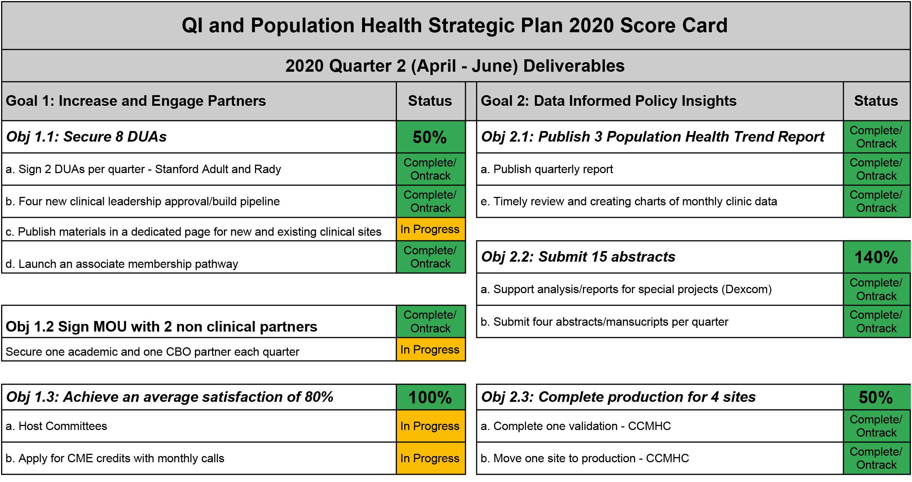
Quality Improvement and Population Health Strategic Plan Score Card

Slide 8
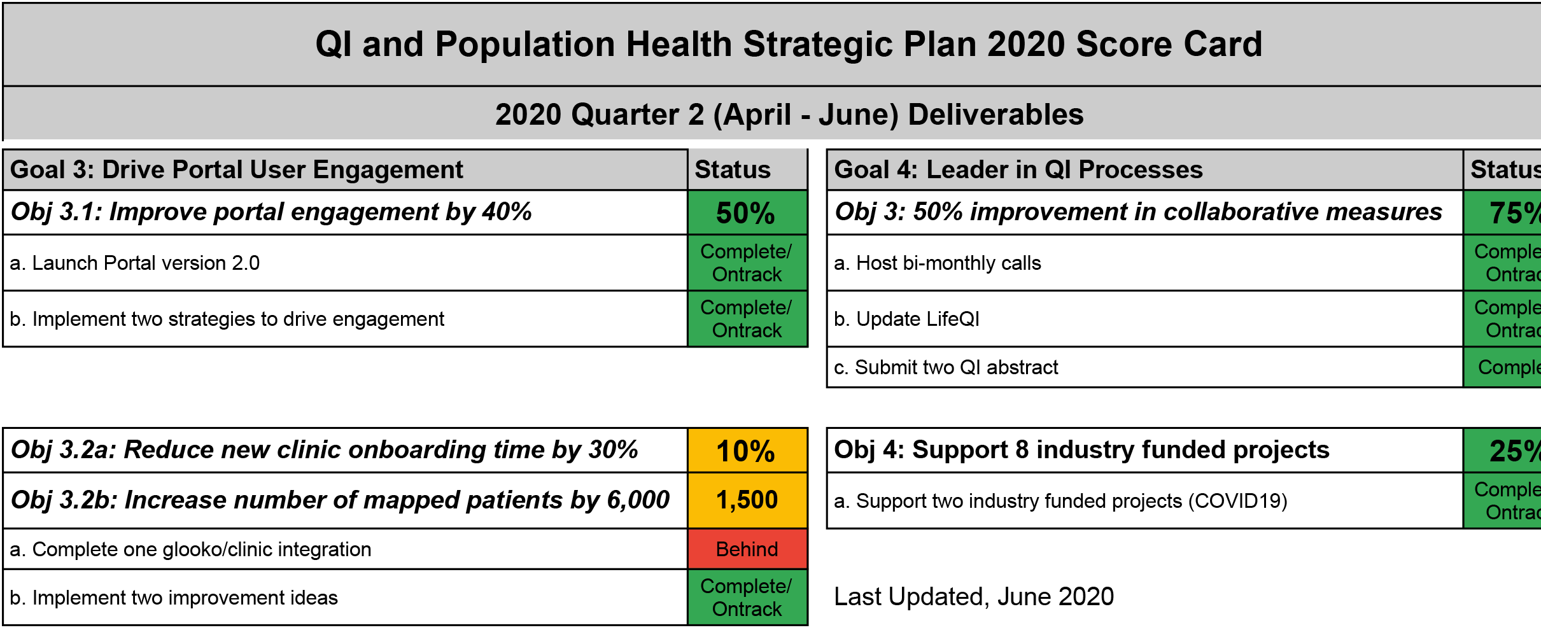
Quality Improvement and Population Health Strategic Plan Score Card

Slide 9
2020 Manuscript Status
Phase 1: New idea with first and senior authors identified
11 Manuscripts
Phase 2: Internal writing group review phase
1 Manuscript
Phase 3: Manuscript submitted for external peer review
2 Manuscripts
Phase 4: Manuscript accepted/published
3 Manuscripts

Slide 10
2020 Conference Oral Presentation/Posters
Accepted Presentation
6 ADA Oral Poster Presentations
1 ASQ (American Society Quality) Oral Presentation
1 NAHQ (National Association for Healthcare Quality) Oral Presentation
1 ISPAD Plenary Session (T1D COVID19)
2020 Pending Presentation
8 ISPAD Oral Presentations
3 IHI (Institute for Healthcare Improvement) Oral Presentation

Slide 11
Contracts and New Grant Updates
Nicole

Slide 12
Last updated 6/18/20

Slide 13
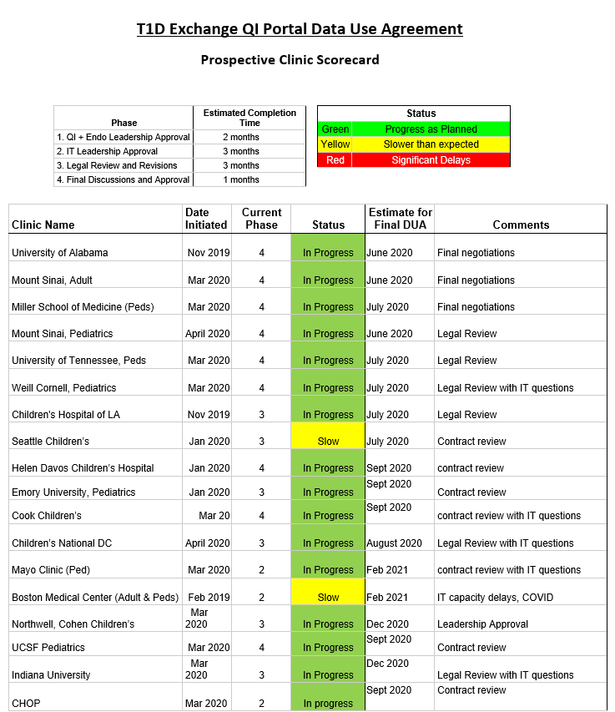
Notes:
Need help with: Seattle contract

Slide 14
New Grant Year Measures 2020-2022

Slide 15
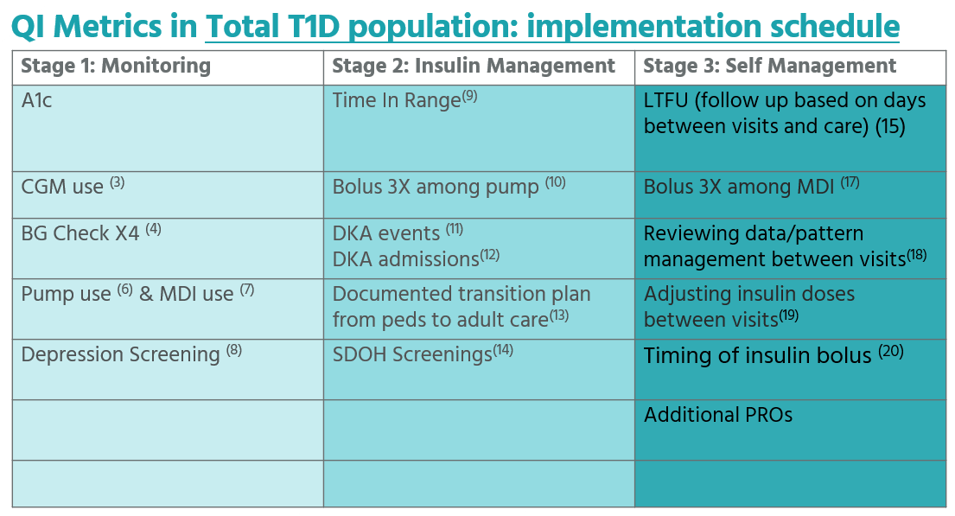
Measures July 2020-May 2022

Slide 16
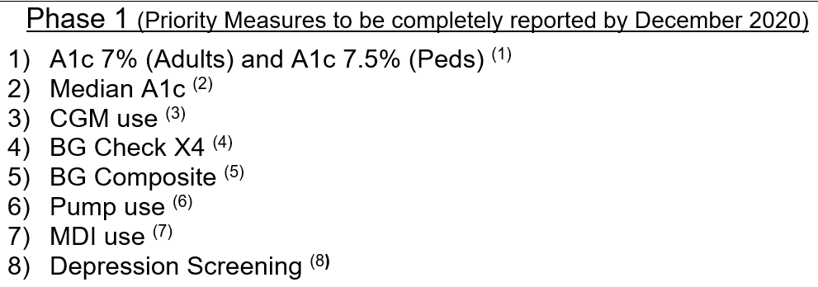
QI Metrics in Total T1D Population

Slide 17
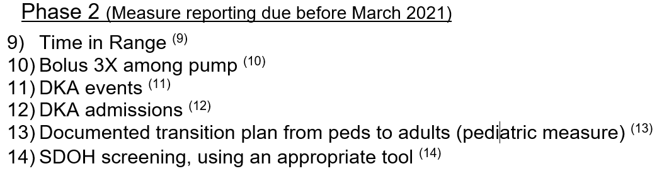
QI Metrics in Total T1D Population

Slide 18
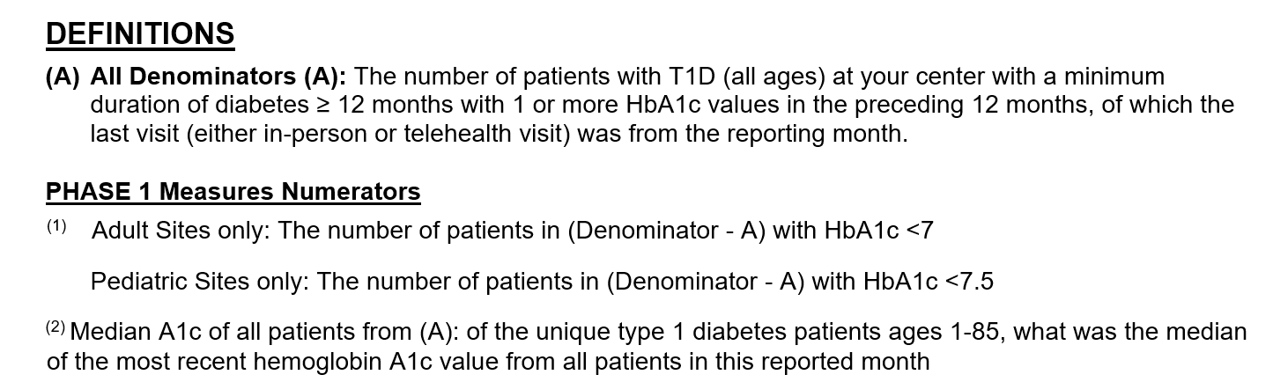
Sample Measure Definitions, for consideration
Notes:
Acknowledge ADA standards of care changes and our decision to keep 7.5
Discuss Median decision

Slide 19
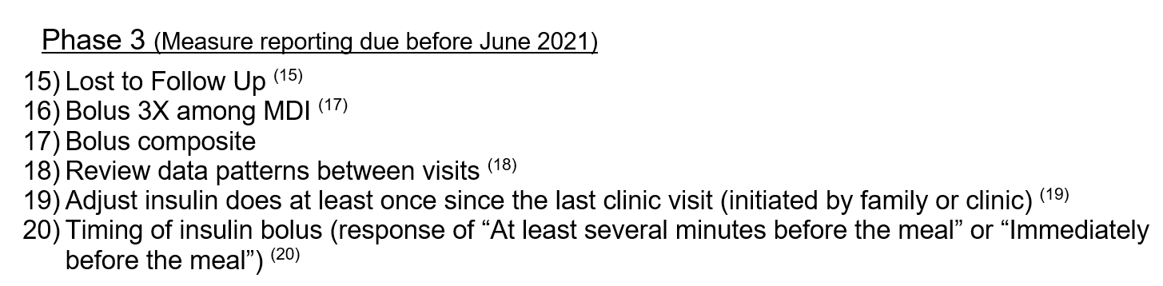
QI Metrics in Total T1D Population

Slide 20
QI Engagement Update
Ori

Slide 21
QI Resources
Bi Monthly QI Check-in Calls
QI Project
Life QI
IHI Open School
Ongoing Technical Assistance

Slide 22
Bi Monthly Calls
QI Check in with sites
Keeps T1D and Sites informed about changes
Sites share QI updates and QI Project Updates with T1D
QI Coaching
QI Project sharing/feedback
PDSA Reviews
QI Dashboard Reviews
Platform to share resources available
Platform to suggest ideas for collaborative

Slide 23
Bi Monthly Calls
Cincinnati Children’s (CCHMC)
Barbara Davis Center (BDC) Pead
Barbara Davis Center/(BDC) Adult
Children’s Mercy(CMH)
University of Michigan
Texas Children’s
Nationwide (NCH)
SUNY Upstate (Pead)
SUNY Upstate (Adult)
Stanford (Pead)
Stanford( Adult)
University of Pennsylvania(Penn)
Wayne State
Rady
University of Florida

Slide 24
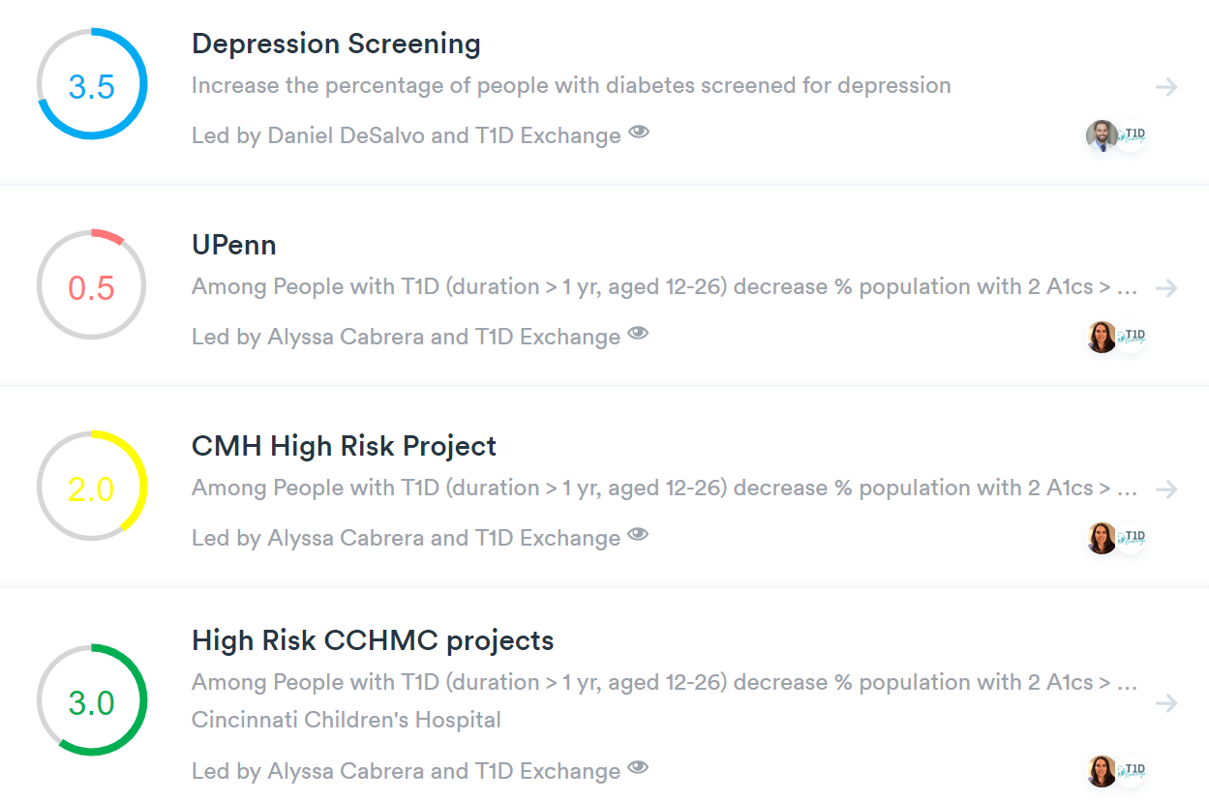
Life QI Engagement
QI Collaborative software
Designed based on the IHI Model
Document your QI Project and PDSA Cycles
Learn as a team
Learn from other sites
Provide a tour to your site

Slide 25
Life QI Engagement
Cincinnati Children’s (CCHMC)
Barbara Davis Center (BDC) Pead
Barbara Davis Center/(BDC) Adult
Children’s Mercy(CMH)
University of Michigan
Texas Children’s
Nationwide (NCH)
SUNY Upstate (Pead)
SUNY Upstate (Adult)
Stanford (Pead)
Stanford( Adult)
University of Pennsylvania(Penn)
Wayne State
Rady
University of Florida

Slide 26
IHI Open School
The IHI Open School community is an innovative, network of more than​ 800,000 learners committed to improving health and health care
Learn QI vocabulary and Methodology
Take Online QI courses and build your QI knowledge
Earn a Basic Certificate in Q​uality​ and Safety
Courses are on us
Get started

Slide 27
IHI Open School
Cincinnati Children’s (CCHMC)
Barbara Davis Center (BDC) Pead
Barbara Davis Center/(BDC) Adult
Children’s Mercy(CMH)
University of Michigan
Texas Children’s
Nationwide (NCH)
SUNY Upstate (Pead)
SUNY Upstate (Adult)
Stanford (Pead)
Stanford( Adult)
University of Pennsylvania(Penn)
Wayne State
Rady

Slide 28
IHI Open School Account creation link: https://my.ihi.org/Portal/rise/Contacts/ihi-create-account/create-account-complete.aspx
Add T1D Exchange as the affiliating organization and we will add you
Begin taking courses
    QI 101: Introduction to Health Care Improvement
    QI 102: How to Improve with the Model for Improvement
    QI 103: Testing and Measuring Changes with PDSA Cycles
    QI 104: Interpreting Data: Run Charts, Control Charts, and other Measurement Tools
    QI 105: Leading Quality Improvement

Slide 29
Data Mapping and the
QI Portal
Emily

Slide 30
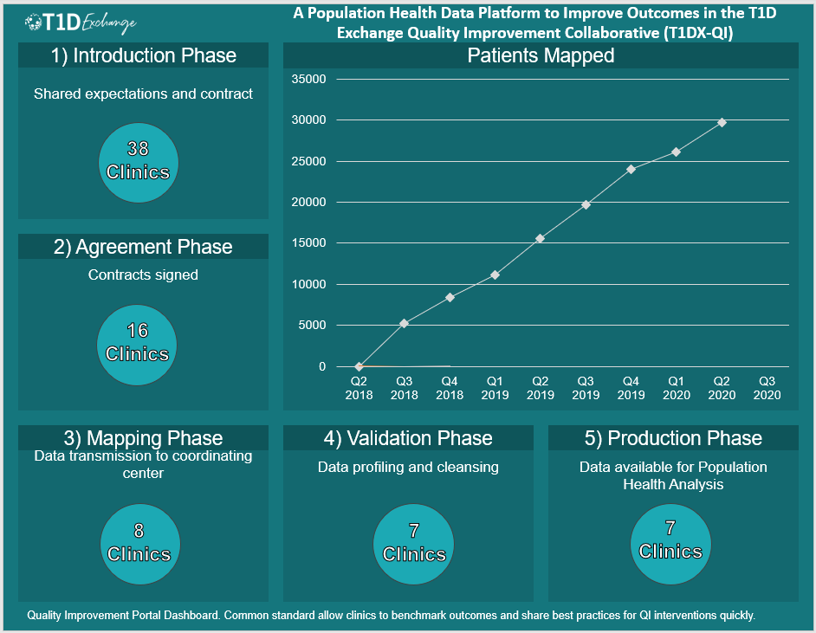
Notes:
We have just over 29K patients in the system now

Slide 31
Fully Mapped Clinics
 | 44%
Barbara Davis Center (BDC A)
Barbara Davis Center (BDC) (P)
Children’s Mercy (CMH) (P)
Cincinnati Children’s (CCHMC) (P) | Validation
Nationwide (NCH) (P)
NYU Langone Health (P)
Rady Children’s Hospital (P)
SUNY Upstate (A)
SUNY Upstate (P)
Stanford (A)
Stanford (P)
Texas Children’s (P)
University of Florida (P)
University of Michigan (P)
University of Pennsylvania (Penn) (A)
Wayne State (A)
Note: CCHMC is in Validation: the final stage of data mapping.
We expect to begin data mapping with University of Florida soon.

Slide 32
Data Completeness on the QI Portal
Clinics |  |  | HbA1C > 9% | HbA1C Improvement ≥ 0.5 | Screened for Depression | Using CGM/sensor | DKA events | FSBG 4x/day | Pump Users Bolusing 3x/day
Barbara Davis Center (BDC A) | MAY | 71%
Barbara Davis Center (BDC) (P) | MAY | 100%
Children’s Mercy (CMH) (P) | DEC | 71%
Nationwide (NCH) (P) | *APR | 71%
SUNY Upstate (A) and (P) | MAY | 71%
Texas Children’s (P) | MAY | 57%
QI Collaborative Completeness |  |  | 100% | 100% | 67% | 83% | 100% | 50% | 17%
Note: NCH provides data consistently on the 20th of the month for the month prior. We expect May’s data on 6/22 as the 20th is a Sat in June.

Slide 33
QI Portal Engagement
 | Users | Clinic Admin
Barbara Davis Center (BDC A) | 0 | N
Barbara Davis Center (BDC) (P) | 6 | Y
Children’s Mercy (CMH) (P) | 5 | Y
Nationwide (NCH) (P) | 5 | Y
SUNY Upstate (A) | 2 | Y
SUNY Upstate (P) | 0 | N
Texas Children’s (P) | 2 | N
We are thrilled to have mapped 7 sites so far, however user engagement with the QI Portal remains low.
If you have any questions, a User you would like to add, and/or a Clinic Admin you would like to designate, please email Emily (ecarlson@t1dechange.org) or Osagie (oebekozien@t1dexchange.org)

Slide 34
QI Portal Update Timeline
Today
July 17 – 24
User Testing
Aug 2020
2.0
Nov 2020
2.2
In Progress
Built: re-designed Compare Tab, Metric tiles on new Dashboard page
In Progress: Reports Tab, pre-login screens
All in backend, not available on QI Portal until launch
User Testing
Will happen over the course of a week in July
via scheduled 1:1 with Emily
2.0 build expected to be complete on July 30th. Feedback during this time will be collected for next iteration of QI Portal
2.0 Release
2.0 completed July 30th
Live for fully mapped clinics
Includes Clinic to Clinic Comparison on Compare Tab screen
2.2 Deliverables
Downloadable PDFs
New Metrics aligned with March meeting Goals
Run Chart Annotations
Feedback from 2.0 User Testing implemented
Expected before Learning Session

Slide 35
Population Health Data Measures Update
Nudrat

Slide 36
Mapped Data available for QI Portal Measures
Metric | BDC (A) | SUNY (A) | BDC (P) | SUNY (P) | CCMHC | TCH | NCH | CMH
% High Risk (HR) | Y | Y | Y | Y | Y | Y | Y | Y
% Interval Improvement HR | Y | Y | Y | Y | Y | Y | Y | Y
% CGM Use | Y | Y | Y | Y | Y | Y | Y | Y
% CGM Use HR Risk | Y | Y | Y | Y | Y | Y | Y | Y
% BG Check X4 (7 Sites) | Y | N | Y | N | Y | N | Y | Y
% BG Check X4 HR (7 Sites) | Y | N | Y | N | Y | N | Y | Y
% BGM Composite* (7 Sites) | Y | N | Y | N | Y | N | Y | Y
% Depression Screening (9 Sites) | N | Y | Y | Y | Y | Y | Y | Y
% Depression Screening HR (9 Sites) | N | Y | Y | Y | Y | Y | Y | Y
% Pump Use (10 Sites) | Y | Y | Y | Y | Y | Y | Y | N
% Pump Use HR (9 Sites) | Y | Y | Y | Y | Y | Y | Y | N
% Bolus 3X among Pump (4 Sites) | N | N | Y | N | N | N | Y | N
% Bolus among Pump Use HR (4 Sites) | N | N | Y | N | N | N | Y | N
% MDI Users (6 Sites) | N | N | Y | N | Y | Y | Y | N
% MDI Users HR (6 Sites) | N | N | Y | N | Y | Y | Y | N
% Bolus 3X among MDI Use (3 Sites) | N | N | Y | N | N | N | Y | N
% Bolus 3X among MDI Use HR (3 Sites) | N | N | Y | N | N | N | Y | N
% Bolus Composite^ (3 sites) | N | N | Y | N | N | N | Y | N
% Review data HR (2 Sites) | N | N | N | N | Y | N | N | N
DKA Event HR (10 Sites) | Y | Y | Y | Y | Y | Y | Y | N
DKA Admissions HR (10 Sites) | Y | Y | Y | Y | Y | Y | Y | N
% LTFU (5 Sites) | N | N | n | N | Y | N | Y | Y

Slide 37
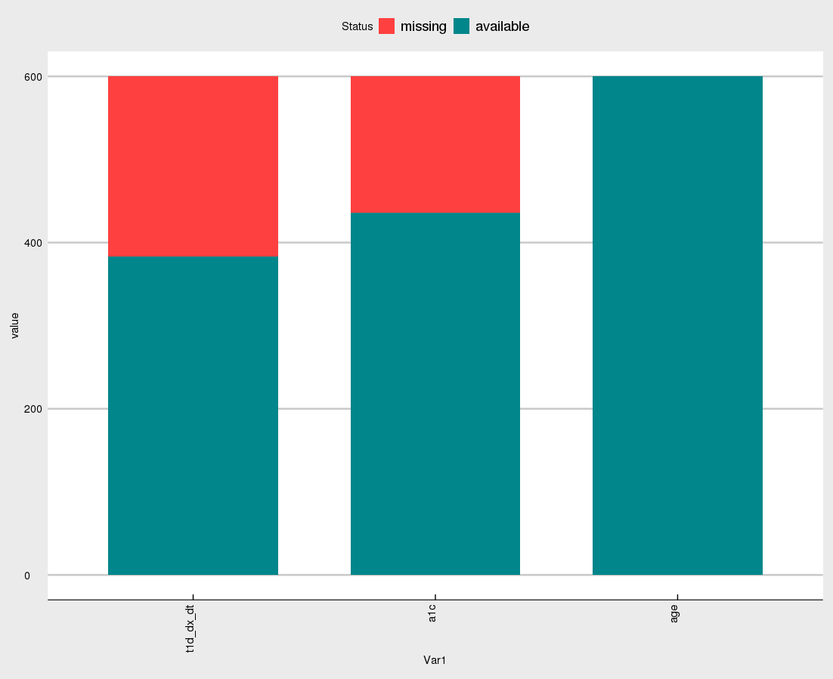
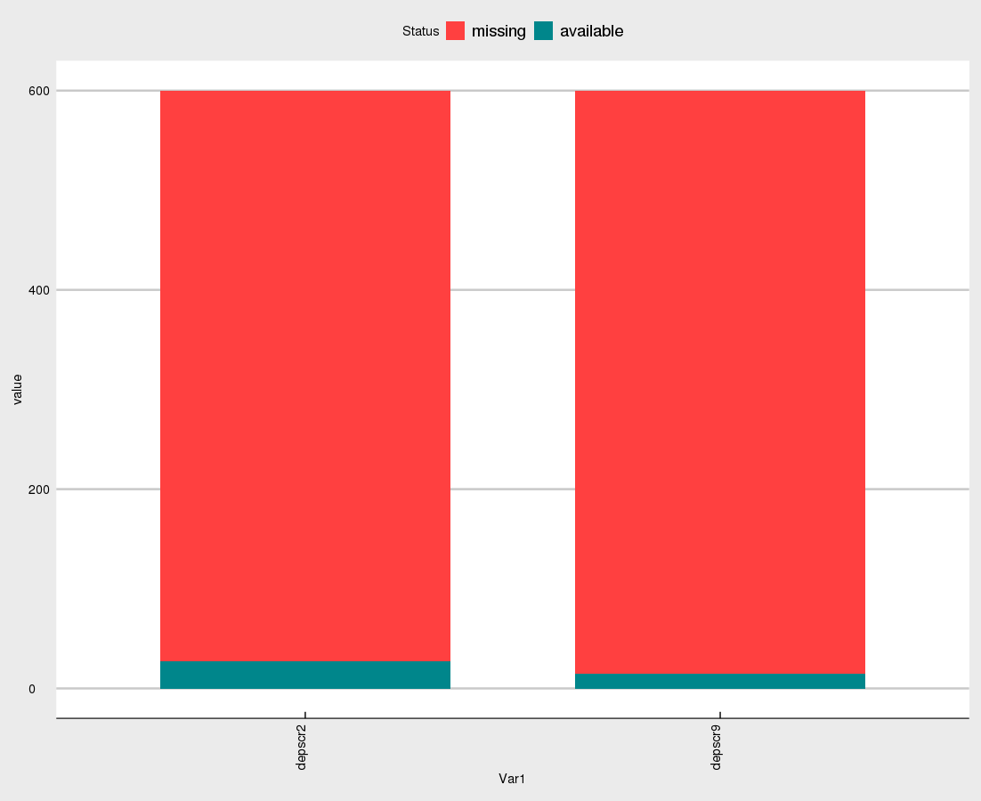
Measures via QI Portal
Measures | Information required | Information Available
High-Risk Patients Mean A1c of High-Risk Patients Interval Improvement | -Date of birth (age) -HbA1c values -Date of diagnosis
Depression screening | -PHQ-2 or PHQ-9
100
75
50
25
0
Missing
Available
% Available
T1D_dx_dt HbA1c D.o.B
100
75
50
25
0
100
75
50
25
0
% Available
PHQ2 PHQ9

Slide 38
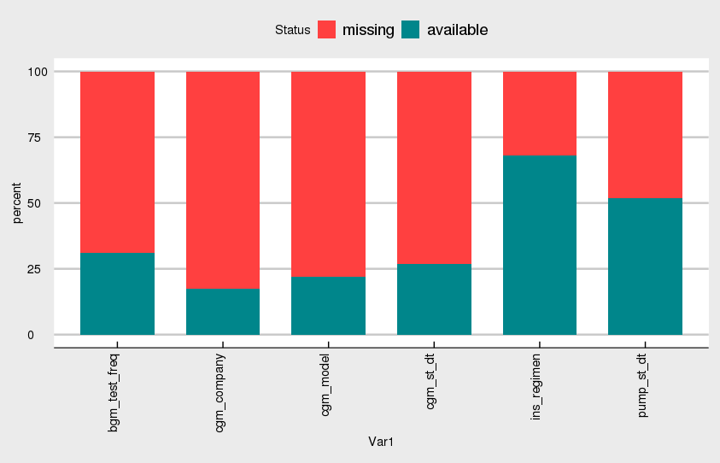
Measures via QI Portal
Measures | Information required | Information Available
CGM/sensor use | -CGM start date/model/company
Insulin Pump/pod use | -Pump start date/model/company
Glucose monitoring (FSBG >=4) | BG monitoring frequency
100
75
50
25
0
Missing
% Available
Available
FSBG CGM Pump

Slide 39
Committee Chair

